Slide 1
Geology 5690/6690
Geodynamics
9 Jan 2023
• Some important syllabus points
• Course website is at:
http://aconcagua.geol.usu.edu/~arlowry/Geodyn/index.html
• Text is Turcotte & Schubert (3rd Ed)
• 6690 differs from 5690 in expectations that grads will do a
semester project
Semester projects should begin in the next couple
of weeks; should be related to your thesis
topic; should be interesting to you!
• Always feel free to ask questions! (It helps!)
• Math, physics, geology backgrounds?
© A.R. Lowry 2023

Slide 2
Brief Overview of Geophysics:
A large discipline that includes:
Atmospheric Science (Meteorology, Climatology, Ionosphere)
Hydrology, Glaciology
Oceanography
Planetary Science
• Solid Earth Science
Solid Earth Geophysics Includes:
• Geophysical Imaging (Seismic velocity; electrical resistivity)
Geodesy
Earthquake Seismology
Mineral Physics
• Geodynamics
This course will emphasize the lattermost subdiscipline

Slide 3
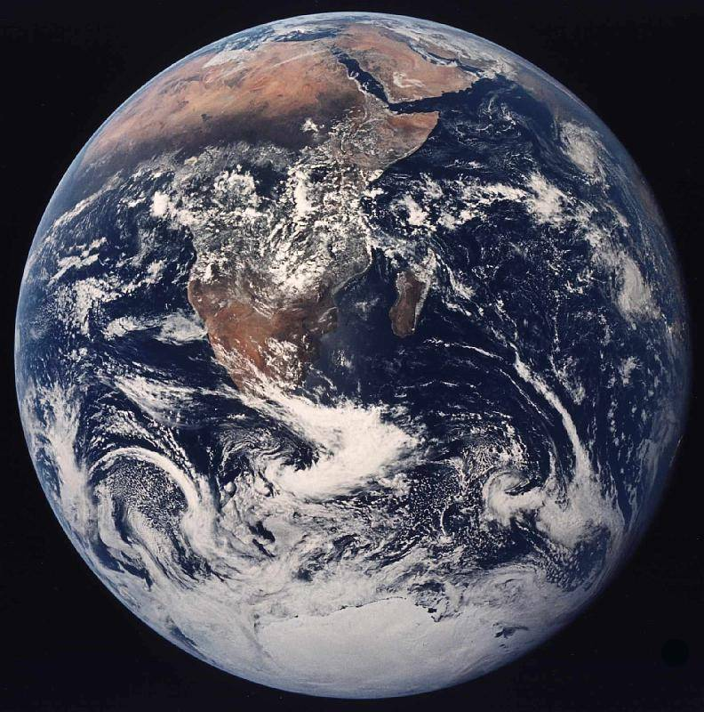
Geophysics = Geo + physics
• Highly
quantitative
• Applications-
oriented,
often with direct
societal impacts…
• Complex
problems
“Systems science”
⇒ often combines
elements of the
other physical
sciences including
physics, chemistry,
biology, …

Slide 4
Two Career Tracks in Geophysics:
Academic/Research (PhD):
• Universities
(Teaching &/or Research)
• Federal Agencies
(USGS, NOAA, NIST, NASA,
DHS, DoD)
• Government Labs
(Lawrence Livermore NL,
Los Alamos NL, Pacific NL…)
• Industry
(Petroleum/Natural Gas,
Mining, Contractors to PNGM
& Defense, e.g. SAIC)
AGU has ~130,000 members;
Industry: (MSc, PhD)
• Energy
(Petroleum, Natural Gas,
Coal, Geothermal)
• Mining
• Environmental &
Construction Contractors
• Et al…
(Problem-solving skills
from geophysical
training has benefited
many entrepreneurs…)
AAPG ~38,000 members
SEG ~14,000 members

Slide 5
Geophysics is a set of mathematical & physical tools
for measuring and modeling Earth & planetary
processes…
Geodynamics is a specific toolbox for simulation of
Earth processes involving fluxes of energy and mass,
for purposes of better understanding processes
responsible for structure, chemistry, deformation,
tectonism, earthquakes, volcanoes, mountain-building
& topography

Slide 6
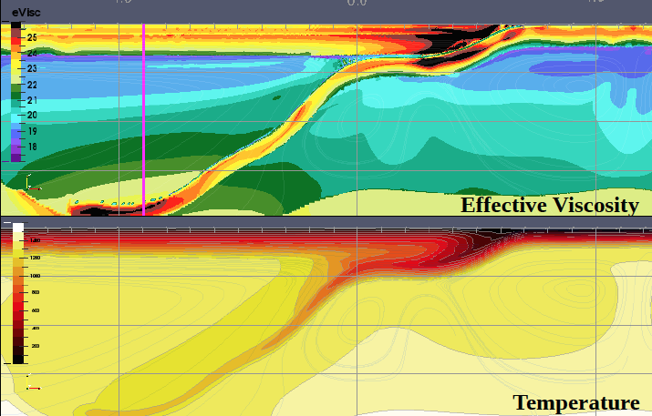
This commonly involves numerical simulation of fluid dynamics!

Slide 7
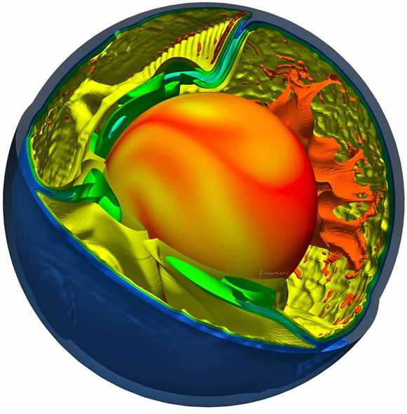

Slide 8
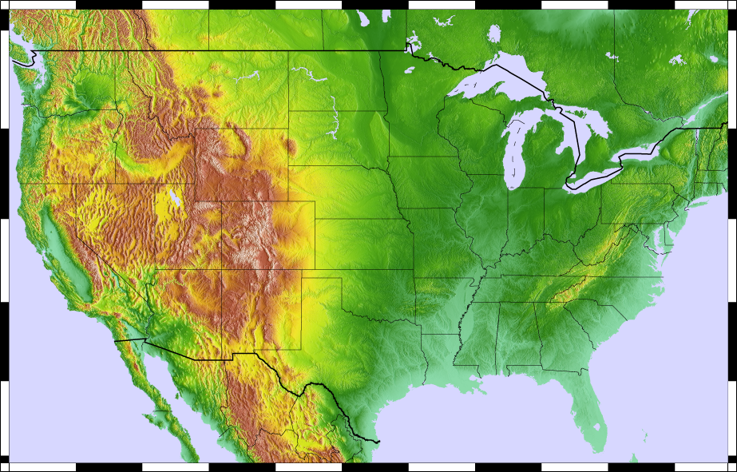
What jumps out at you here?
(There are no wrong answers!)

Slide 9
Geodynamics applies to observations at all scales
But the inclination is to start large and progress from there
(global → continental → regional → 100s km → …)

Slide 10
Δρ₁h₁
=
Δρ₂h₂
If the Earth is
an inviscid
fluid at depth,
(i.e., can’t
support any
deviatoric
stress), that
requires
uniform
pressure!
At large scales, elevation → isostasy
(“equal stasis” → standstill)
which means the vertical normal stress from
gravity ($\int{ρgdz}$, or integral of density times gravity
over the depth) is constant. This implies the
deep Earth behaves like a fluid on long timescales

