Slide 1
GEO 5/6690 Geodynamics
10 Apr 2023
Last Time: Brittle-field rheology
The “Earthquake Cycle” is understood based on:
Lab experiments
• Friction is dynamical; changes over time; can increase
(stable) or decrease (unstable) with slip velocity; depends
also on some sort of state variable
• Friction laws are empirical (but have predictive power)!
Geodesy, from strain that builds where fault patches are
coupled or “locked”, from earthquakes, and from slow slip
events that nucleate near transitional frictional state
♦ Seismology (distribution of earthquakes):
• Limited by sampling (in time and in space)
• Represents the smallest fraction of the earthquake cycle
(but the most important fraction from a hazard perspective!)
• Recent innovation: observation of tectonic tremor!
Read for Wed 12 Apr: T&S §3.1-3.16
© A.R. Lowry 2023

Slide 2
Last Times (Continued): Dynamical friction rheology
Dynamical (Dieterich-Ruina) friction laws recognize that friction
is time-variable and depends on rate and state:
but these are empirical rather than first principles! And
different emphasis in measurements lead to different
friction laws (“slowness law”, “slip law”, composites…)
Measurements of rate-state parameters are:
• Highly-variable/uncertain/“messy”
• Composition-dependent!
• May miss some physics
BUT: Models using these laws do have predictive power!

Slide 3
Next Journal Article Reading:
For Friday Apr 14: Willett et al. (1985)
A thermo-mechanical model of
continental lithosphere, Nature,
314(6011), 520-523.

Slide 4
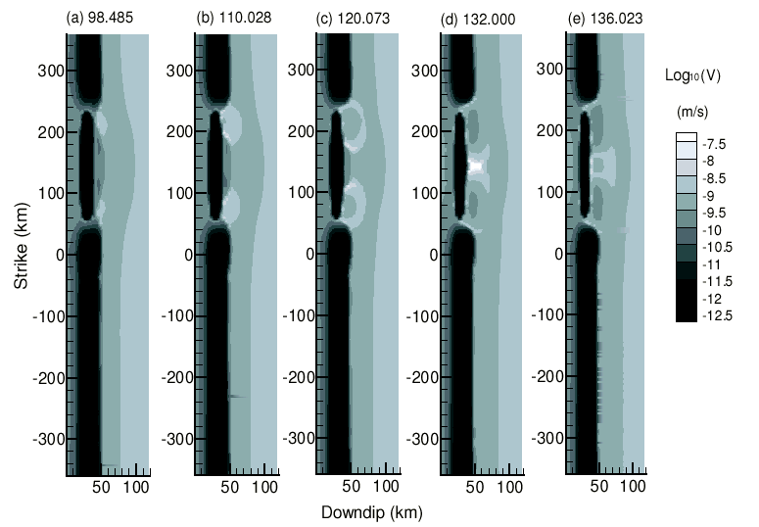
Rate & state frictional simulations of subduction zone slip…
Liu and Rice,
JGR 2006
Also predict slow slip events that focus near the frictional transition!

Slide 5
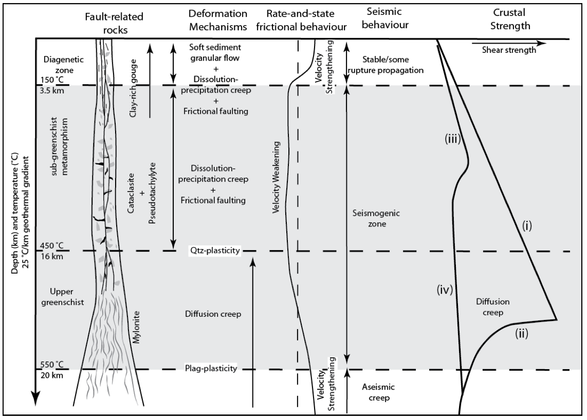
Geology plays a role in this too! And other observations…
Prante, PhD dissertation, 2013
are converging with concepts based on exhumed faults…

Slide 6
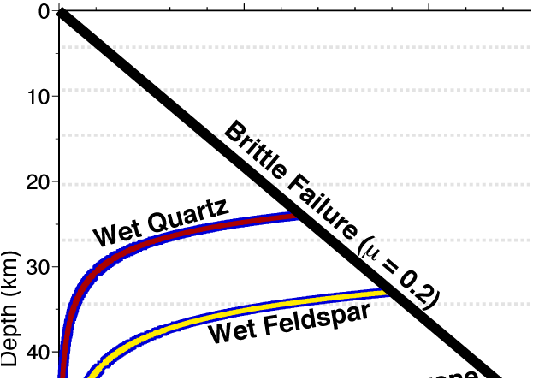
But with some minor discrepancies to think about.
RSF Stability ~325
Prante, PhD dissertation, 2013
450°C
550°C

Slide 7
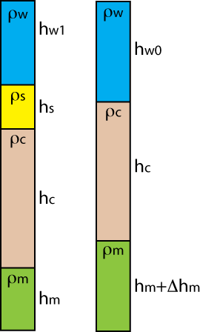
Flexural Isostasy
Recall from T&S (and maybe several
other classes you’ve taken) that
isostasy is a stress balance resulting
in uniform pressure at depth: E.g., this
balance of vertical stress:
This balance of only the vertical stress is called
“Airy isostasy” (after the Airy, 1855, paper on Himalaya)
In reality, “blocks” are not disconnected and we must account
also for horizontal stress in the lithosphere. Approximate
as flexure of a thin plate with vertical stress “loads”:

Slide 8
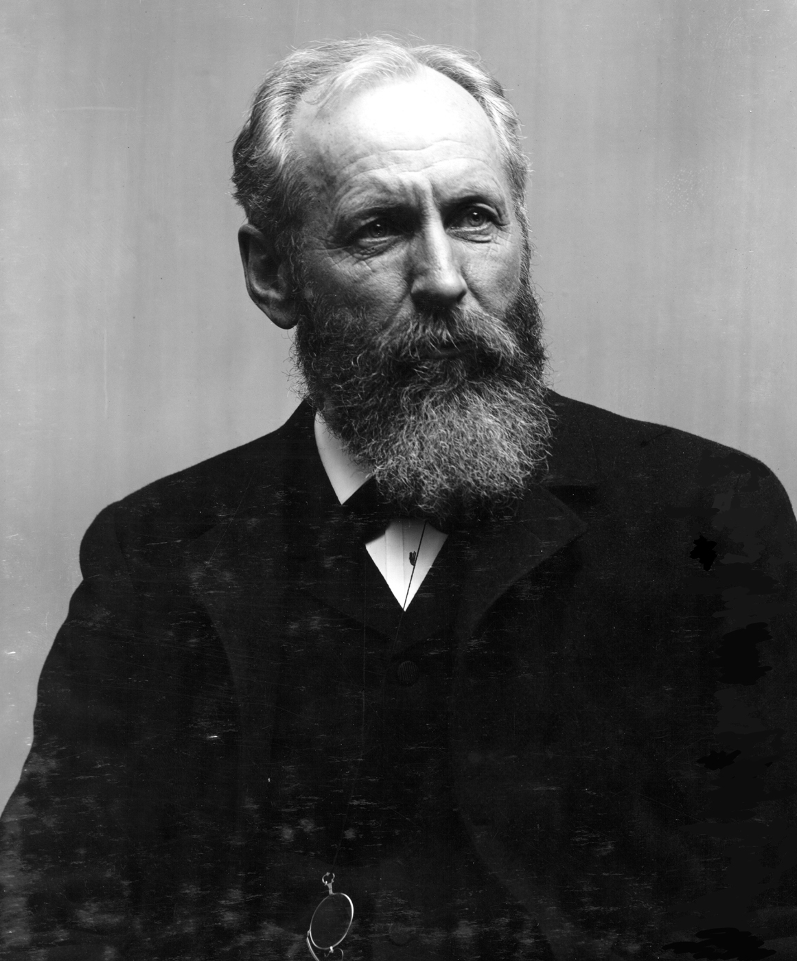
Flexural Isostasy
Modeling of the Earth’s
surface response to loads as a
thin plate over a
fluid was first
proposed by
G. K. Gilbert, to
explain heights
of Bonneville
shorelines!
Gilbert (1990)
Grove Karl Gilbert

Slide 9
The governing equation for flexural isostasy is expressed in
terms of a flexural rigidity D and vertical deflection w as
where P is a horizontal (in-plane or “tectonic”) stress,
Δρ is the difference in density at the surface and in
the asthenosphere,
g is gravitational acceleration,
and q is the vertical stress load.
Note (1): This equation assumes a “thin-plate approximation”,
in which we neglect depth-dependent compression within
the plate resulting from the vertical load stress. This is a
reasonable approximation except when wavelengths are
short relative to the plate thickness (Comer, JGRAS, 1983)
and errors introduced are small relative to those
associated with neglecting realistic rheology.

Slide 10
Note (2): This equation works for either a Cartesian or a
spherical geometry (but the eigenfunctions on a sphere
are spherical harmonics instead of sines & cosines).
Note (3): If it is a truly perfectly elastic plate over an inviscid
fluid, D relates to elastic plate thickness T_{e} as
where E is Young’s modulus,
ν is Poisson’s ratio
Note (4): If there are two elastic plates with no stress
coupling between them (the “leaf-spring”
approximation), then
D_{tot} = D₁ + D₂ or equivalently
Notes:
Too complex

Slide 11
Note (5) If D is uniform (and neglecting P), solution is simple
if the loads and flexure are sines and cosines.
Example: let (assuming Cartesian cords!)
where H_{I} is initial amplitude of height of a topographic
load (i.e., before it is reduced by flexure;
k = 2π/λ is wavenumber (& λ is wavelength);
ρ₀ is surface density
Which after evaluating derivatives turns out to be:
(after we divide by sin(kx).)
So the flexure is given by (for every 2D = (k_{x}, k_{y}) in FT domain):
The final topography after flexure is H_{T} = H_{I} + W_{T}.

Slide 12
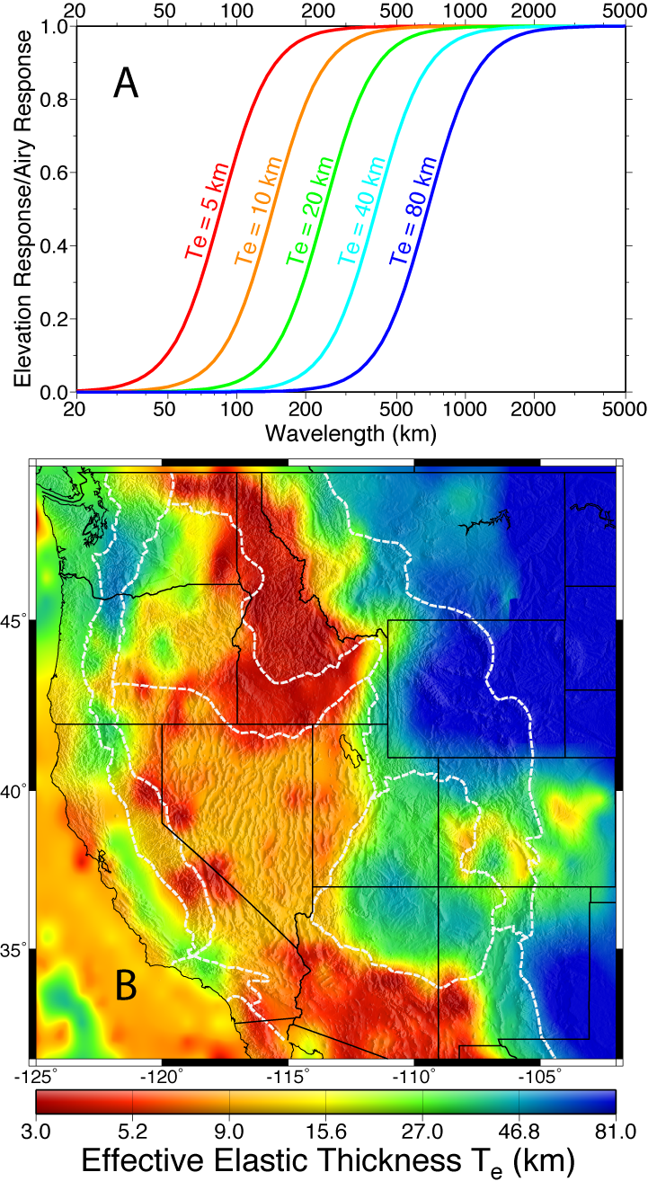
Note the implications of this!
• As k gets small (λ gets large),
flexural displacement tends
toward Airy isostasy
• ~Airy isostasy occurs at shorter
wavelengths when D is small
(hence T_{e} is small) than when
D is large. Hence flexural
rigidity represents a “resistance
to bending” by the plate.
Notes:
Too complex

