Slide 1
GEO 5/6690 Geodynamics
8 Feb 2023
Last Time: Temperature & heat flow; The adiabat
• Mechanical thinning/rifting of the lithosphere can increase the
geotherm and hence surface heat flow, but…
• Surface heat flow > 90 mW/m² requires strain rates > 3x10⁻¹⁵
s⁻¹ (highest rates in the western US are ~1x10⁻¹⁵ s⁻¹), implying
advection by mass flux of melt & volatiles must play a role!
• The adiabat approximates the geotherm in convection.
Assuming no change in heat energy (only change in
temperature due to change in pressure/lattice structure):
Read for Mon 13 Feb: T&S §6.1–6.9
© A.R. Lowry 2023

Slide 2
Next Journal Article Reading:
For Wednesday Feb 15: Kellogg et al.,
Science 283, 1881-1884 (1999).
Jacob L. will lead!

Slide 3
Convection:
Assume:
An incompressible fluid
Temperature dependence of density
Ignore momentum in the force balance;
ignore frictional (shear) heating
Define: (2D case)
u, v as flow velocity in x, z directions
η is viscosity of the fluid
z
u
flow
v
x

Slide 4
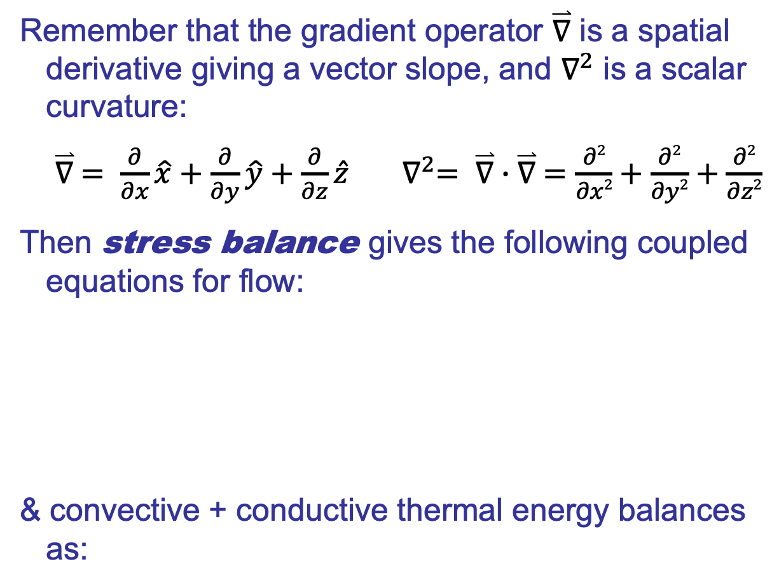
Remember that the gradient operator $\overset{⃑}{∇}$ is a spatial
derivative giving a vector slope, and $∇^{2}$ is a scalar
curvature:
$\overset{⃑}{∇} = \frac{∂}{∂x}\hat{x}+\frac{∂}{∂y}\hat{y}+\frac{∂}{∂z}\hat{z}$ $∇^{2}= \overset{⃑}{∇}∙\overset{⃑}{∇} =\frac{∂2}{∂x2}+\frac{∂2}{∂y2}+\frac{∂2}{∂z2}$
Then stress balance gives the following coupled
equations for flow:
& convective + conductive thermal energy balances
as:

Slide 5
Boundary conditions:
z = 0
b
λ → wavelength
Using these relations, we can define:
• A Rayleigh number:
• A dimensionless
wavenumber:

Slide 6
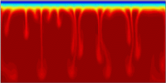
Can define stability of flow in terms of the growth
rate of disturbances: Flow is unstable when
And when flow is unstable, convection occurs…

Slide 7
The critical Rayleigh number, Ra_{cr}, is the Rayleigh number
4500
beyond which convection is the
favored mode of heat transfer
4000
3500
3000
Ra
2500
2000
Unstable
1500
Stable
1000
500
0
0
1
2
3
4
5
6
7
8
9
10

Slide 8
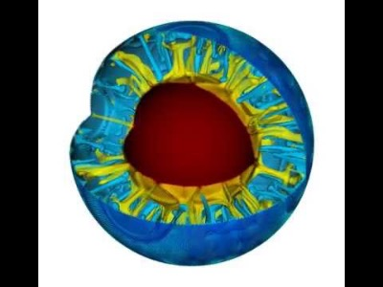

Slide 9
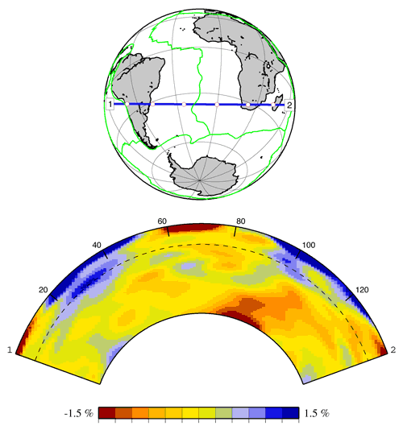
How might we measure evidence of convection in the
Earth? (What do we need to know?)

Slide 10
How might we measure evidence of convection in the
Earth? (What do we need to know?)

Slide 11
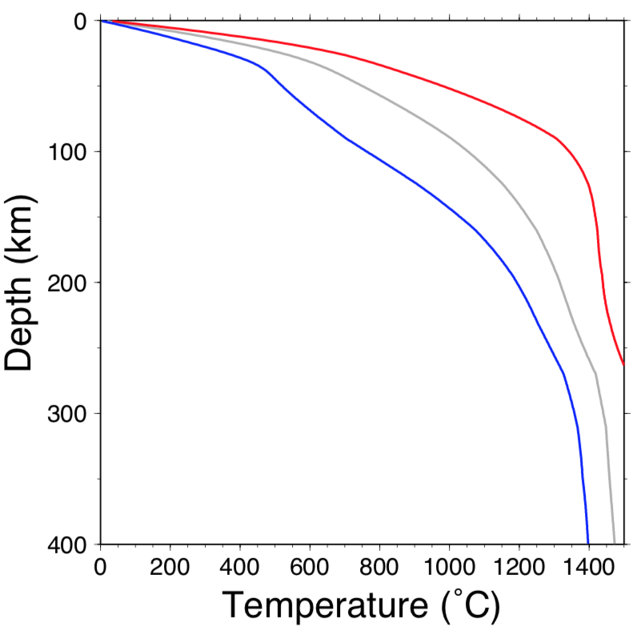
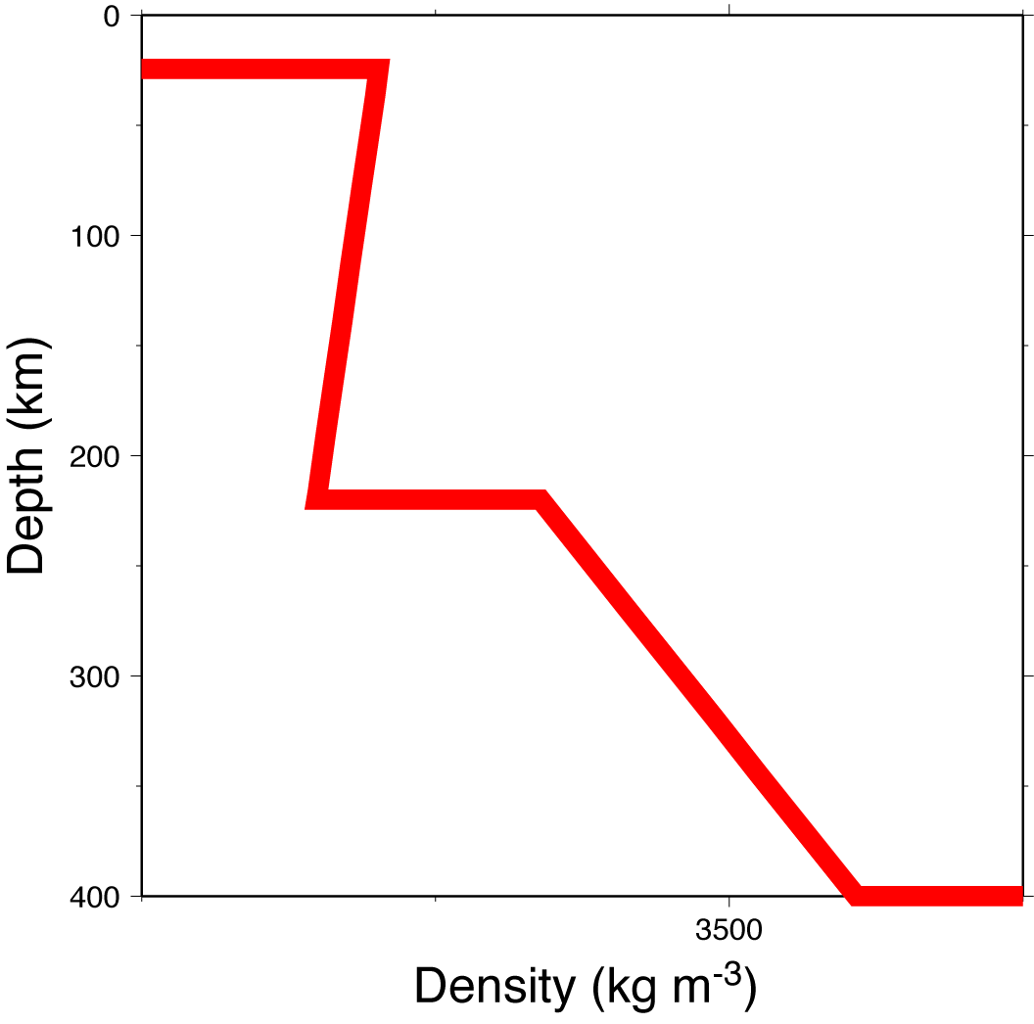
Downwelling, delamination and
Rayleigh-Taylor instabilities:
When a dense layer lies above a less dense layer in a
fluid medium, it is gravitationally unstable.
Examples:
Conductive Thermal
Boundary Layer
Decreasing shallow
density vs. depth
Continental
PREM (from
normal modes)
⇒
US geotherm
modeling

Slide 12
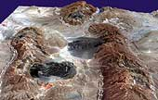
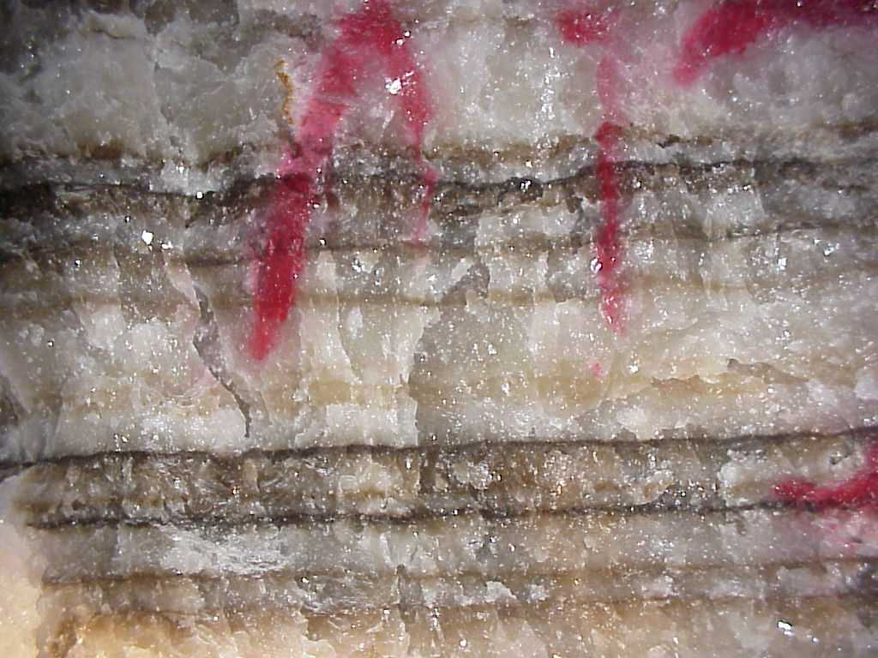
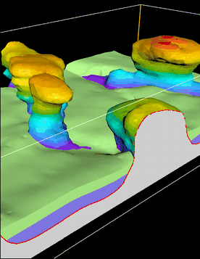
Examples:
Salt Layers (ρ = 2170 kg m⁻³)
in sediments
(ρ = 2300-2800 kg m⁻³)
⇒ Salt Diapirs

