Slide 1
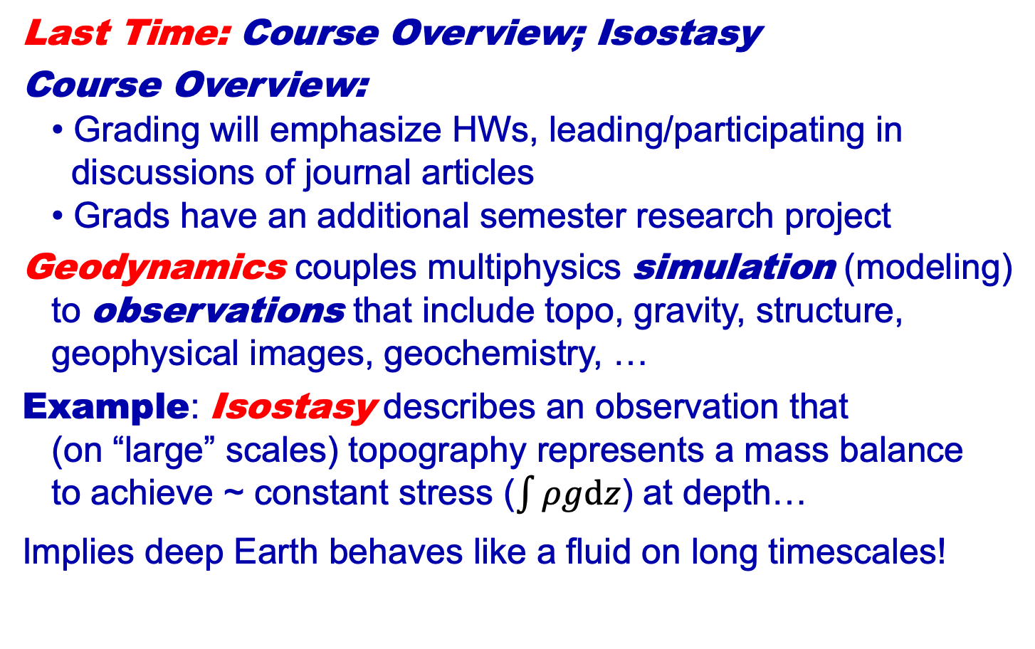
Geology 5690/6690
Geodynamics
11 Jan 2023
Last Time: Course Overview; Isostasy
Course Overview:
• Grading will emphasize HWs, leading/participating in
discussions of journal articles
• Grads have an additional semester research project
Geodynamics couples multiphysics simulation (modeling)
to observations that include topo, gravity, structure,
geophysical images, geochemistry, …
Example: Isostasy describes an observation that
(on “large” scales) topography represents a mass balance
to achieve ~ constant stress ($\int{ρgdz}$) at depth…
Implies deep Earth behaves like a fluid on long timescales!
Read for Fri 13 Jan: T&S 73-80 (§2.1-2.2)
© A.R. Lowry 2023

Slide 2
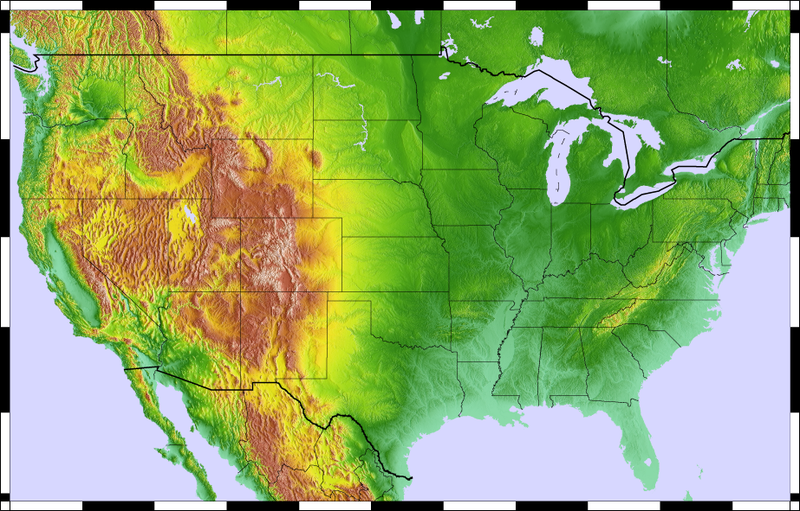

Slide 3
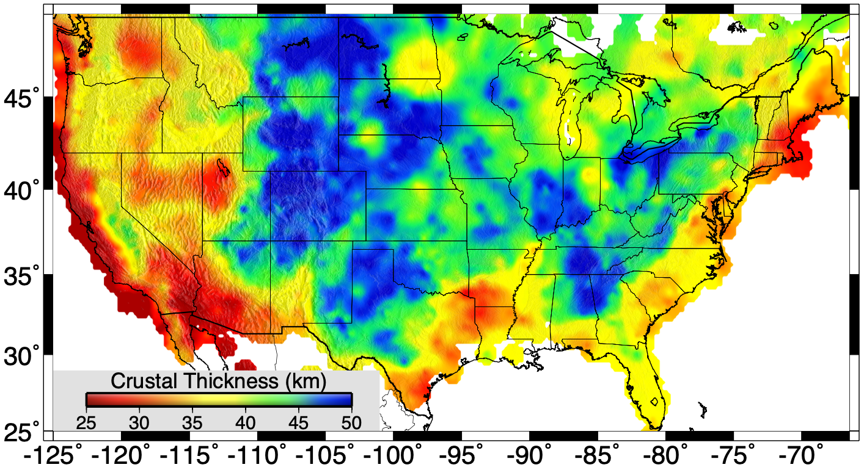
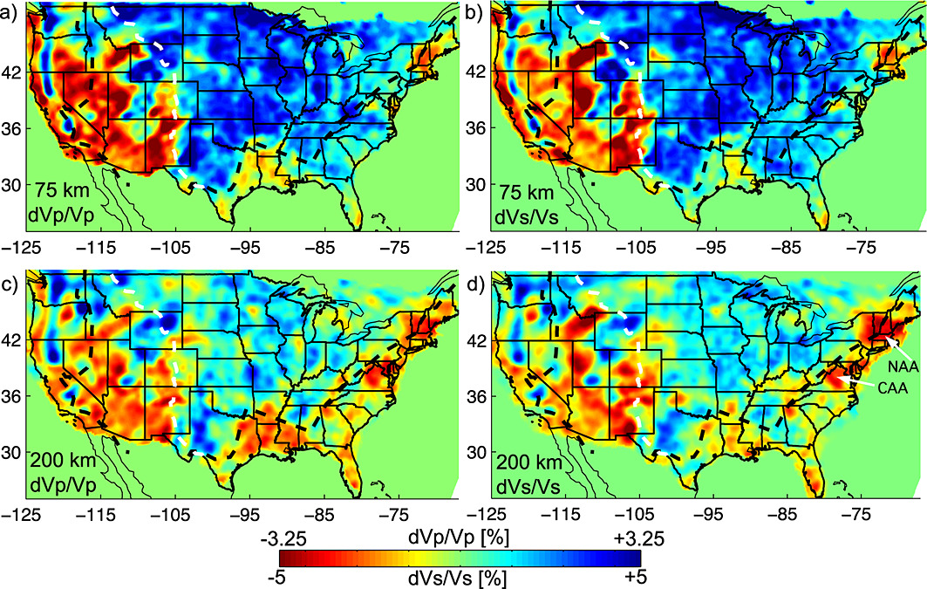
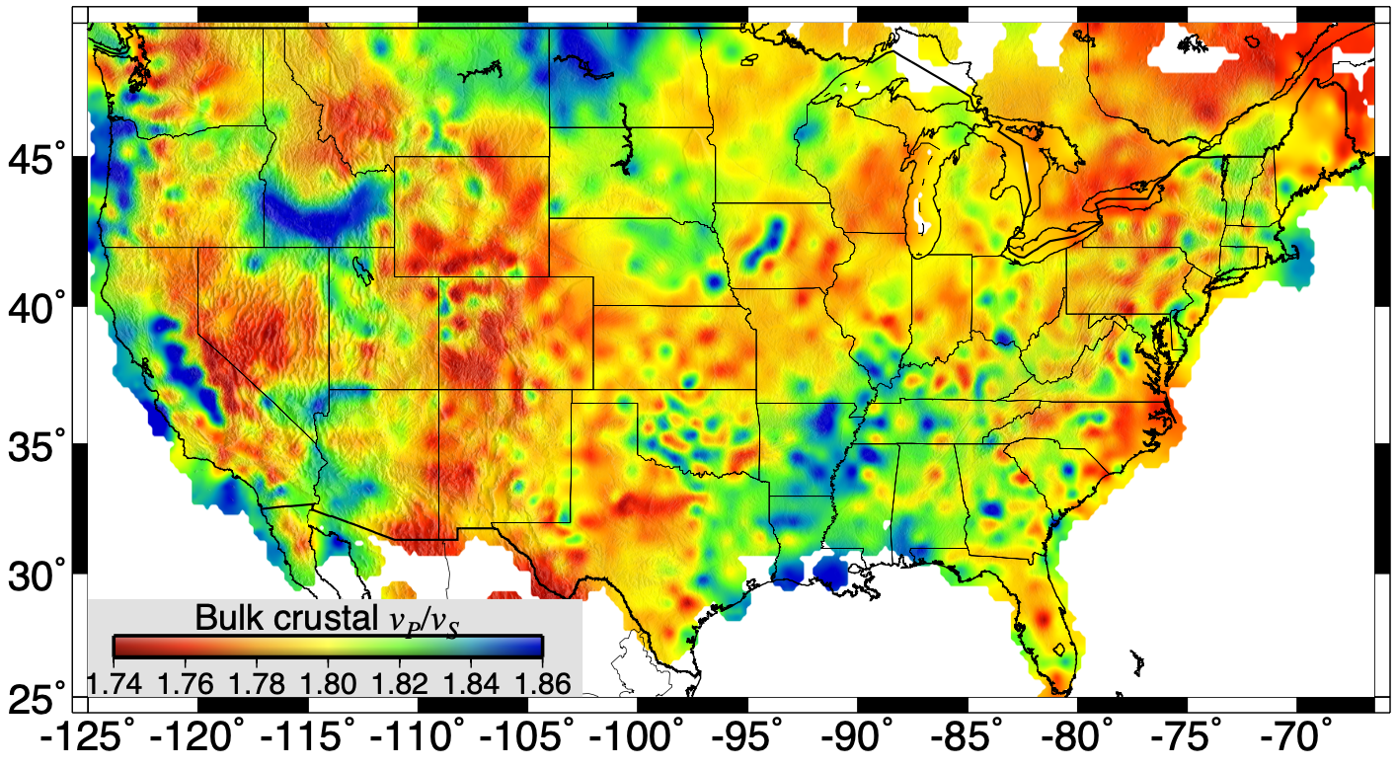
Schmandt & Lin 2014
Lowry & Pérez-Gussinyé 2011; Ma & Lowry 2017

Slide 4
So, what do you think of when someone
says lithosphere?

Slide 5
Plate Tectonics?
Rigid Plate
Velocity
Assume “no-slip”
boundary conditions
(fluid velocity at the
boundary with the
plate = plate velocity
u₀; fluid velocity at
mesosphere boundary
= 0) and constant
viscosity, then
u = u₀
z = 0
constant
viscosity
η
h
z = h
~Rigid Mesosphere
u = 0

Slide 6
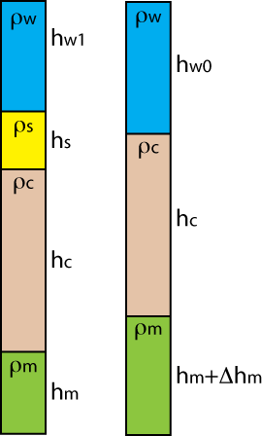
An elastic beam that bends
to isostatically balance applied
mass loads?
(G. K. Gilbert, ~1880)
(J. Barrell, ~1911)
(Probably not… But that’s the context in which the term
was introduced!)

Slide 7
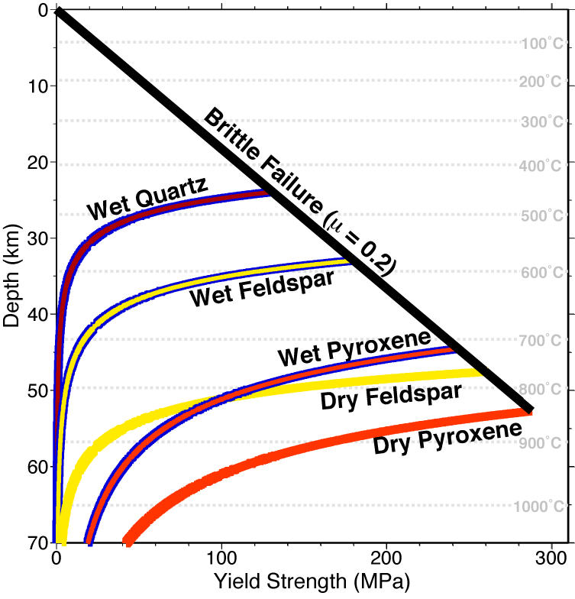
A rheologically strong layer?

Slide 8
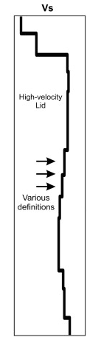
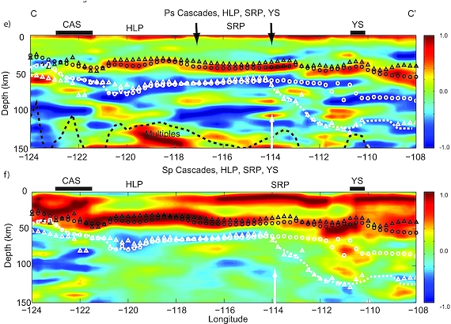
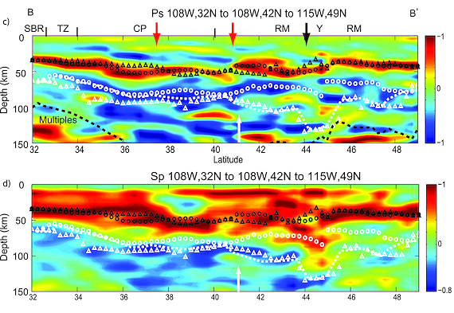
Upper Crust
Here, an increase in velocity
with depth creates a positive
(red) amplitude in a seismic
receiver function image… A
decrease in velocity creates
a negative (blue) amplitude
Lower Crust
Higher Seismic
Velocity in the
Uppermost
Mantle?
Upper
Mantle
High-
Velocity
“Lid”
(Levander & Miller, G³, 2012)

Slide 9
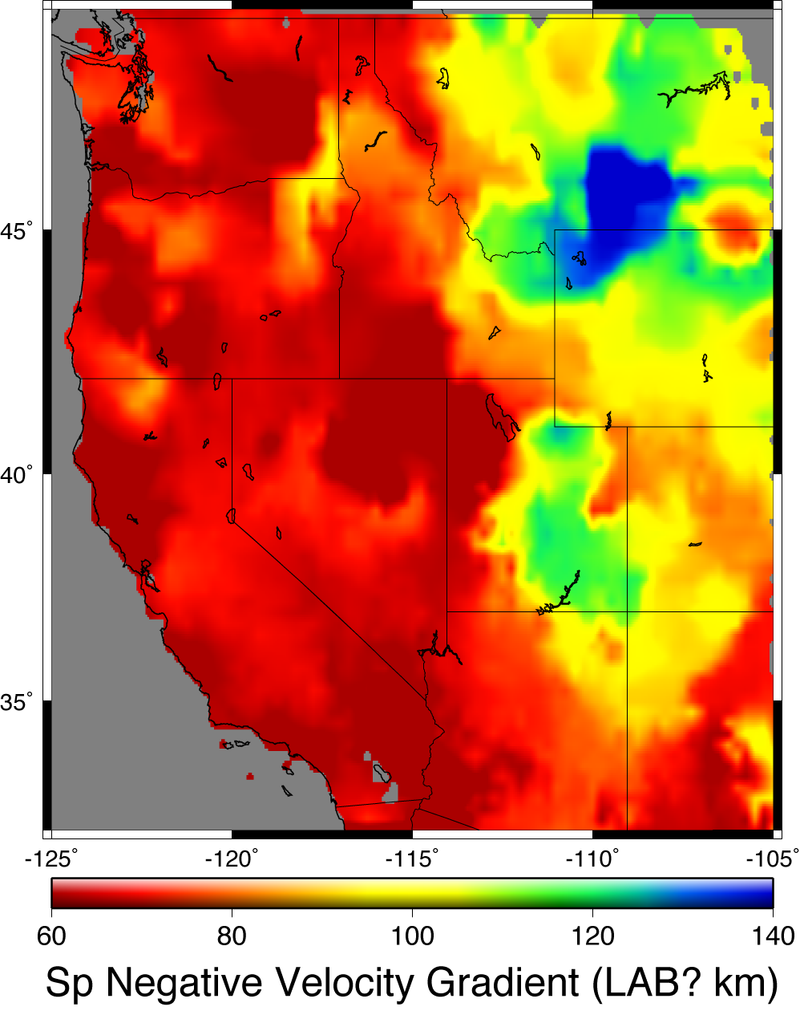
(Levander & Miller, G³ 2012)

Slide 10
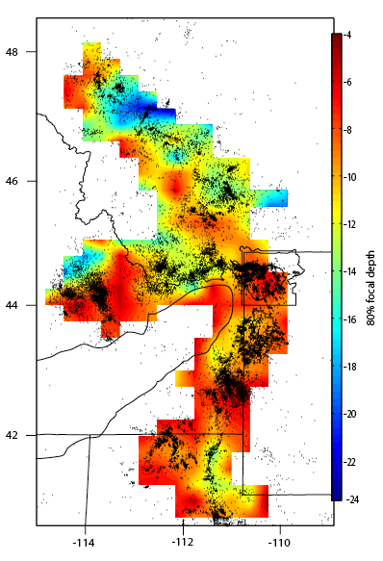
The
Seismogenic
Layer?

Slide 11
Mode of Thermal Transfer?
0
Temperature
1200-1400 ºC
0
Conductive
50-300
km
Adiabat: Temperature
increases with pressure
but energy doesn’t
change
Depth
Convective

Slide 12
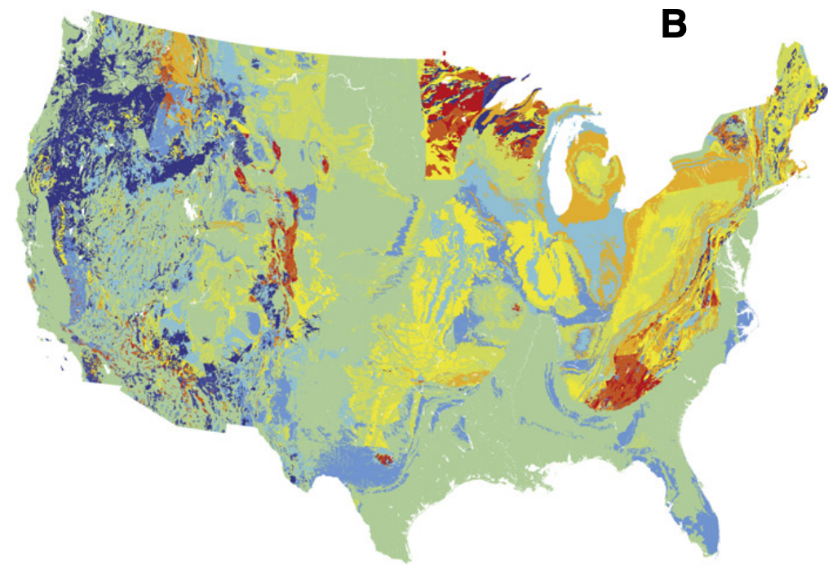
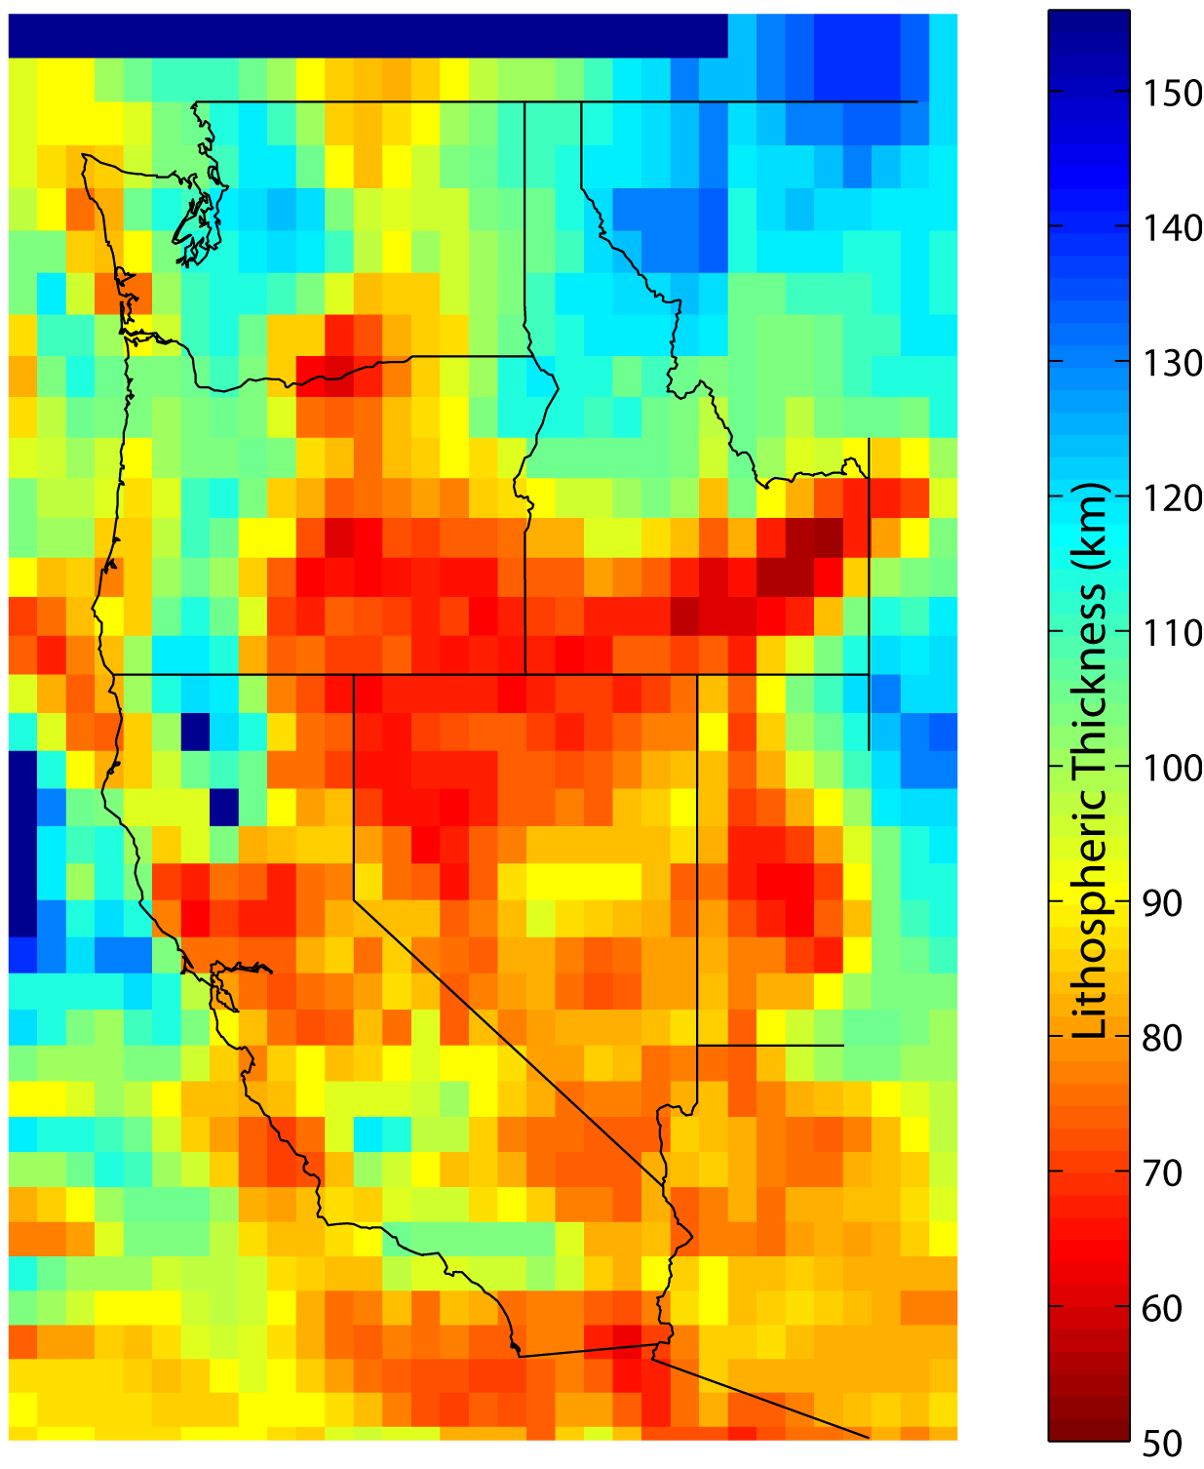
Isotopic Geochemistry?
“That can’t be
right… It should
be thinner at the
west coast!”
–J. Shervais

