Slide 1
GEO 5/6690 Geodynamics
12 Apr 2023
Last Time: Brittle-field rheology
• Geological observations of exhumed faults don’t provide
real-time in-situ constraints, but do provide important
constraints on assumptions in earthquake physics (e.g.,
deformation textures → deformation mechanisms;
thermochronology studies → energy partitioning;
how well does laboratory rheology match up?)
Read for Wed 12 Apr: T&S §3.1-3.16
© A.R. Lowry 2023

Slide 2
Last Time: Flexural Isostasy
• Isostasy is a stress balance resulting in ~consistent pressure
at “asthenospheric” depth; Airy isostasy balances vertical
stress (in columns) only.
• Flexural isostasy balances vertical + horizontal stress &
is governed by a 4th order PDE:
For a perfectly elastic plate,
and for multiple layers:
For top-loading (density ρ₀, amplitude H_{I}), the PDE has linear
solution (in amplitudes of sines/cosines) of the form:

Slide 3
Next Journal Article Reading:
For Friday Apr 14: Willett et al. (1985)
A thermo-mechanical model of
continental lithosphere, Nature,
314(6011), 520-523.
Natalie will lead!

Slide 4
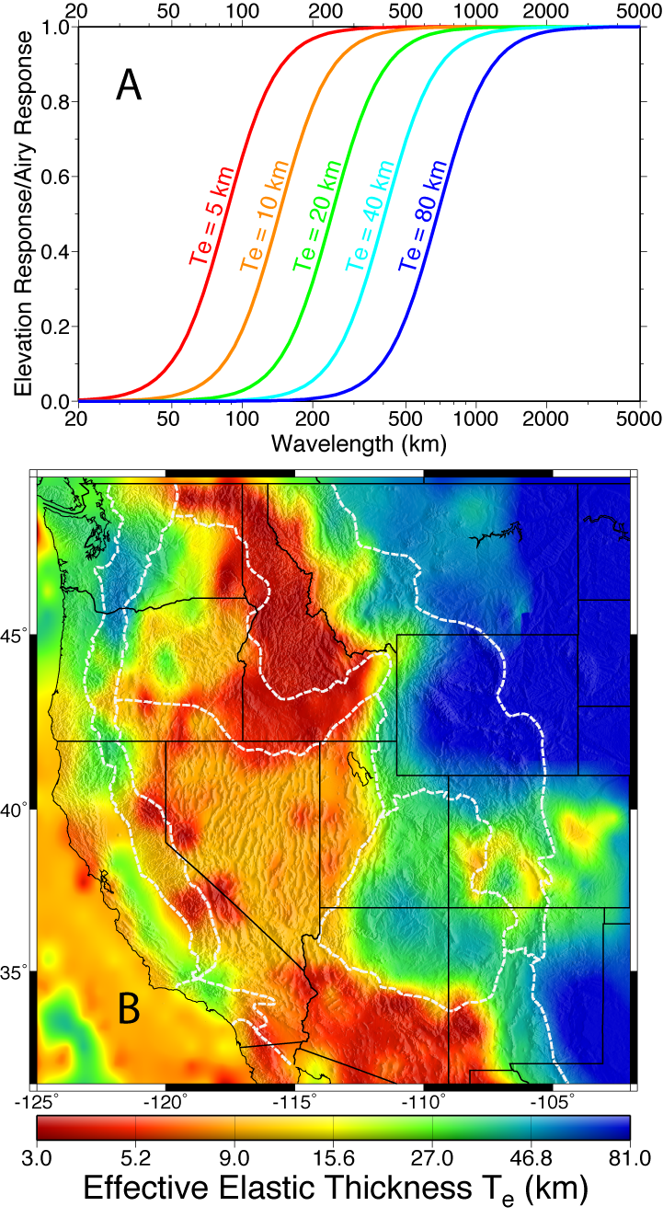
Note the implications of this!
• As k gets small (λ gets large),
flexural displacement tends
toward Airy isostasy
• ~Airy isostasy occurs at shorter
wavelengths when D is small
(hence T_{e} is small) than when
D is large. Hence flexural
rigidity represents a “resistance
to bending” by the plate.
Notes:
Too complex

Slide 5
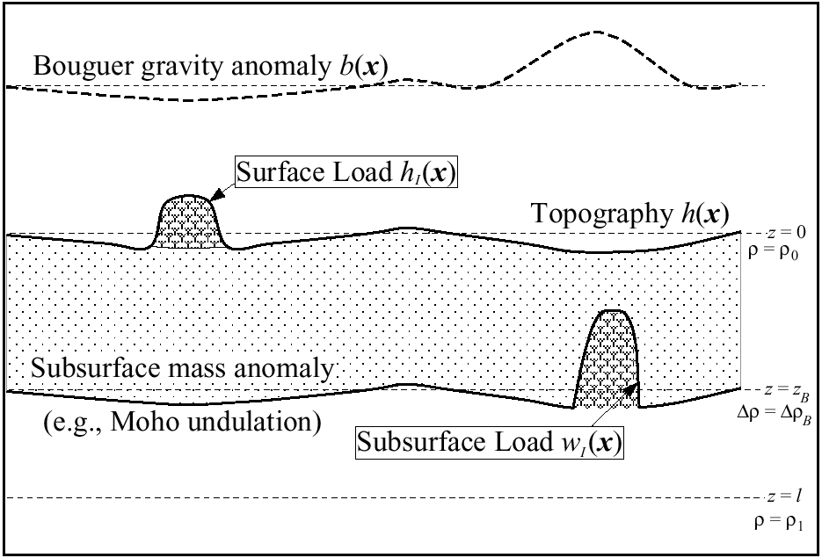
Problem: What if loads are both surface and internal?
• Total isostatic balance includes
surface (topographic) mass
plus internal mass variations
plus lithospheric stress
• Small surface loads are under-
compensated by subsurface
mass because of flexural
strength of the lithosphere
• Small internal loads are under-
compensated by surface
topographic response
If rigidity D and mean profile density of the lithosphere are known,
we can solve for two unknowns (surface and internal load mass)
from two observations (e.g., gravity and topography fields)

Slide 6
Separation of loads is useful for:
• Estimation of lithospheric strength and rheology
(parameterized by effective elastic thickness T_{e})
• Understanding processes of mass redistribution
inside the Earth or at the surface
Surface loading processes:
Internal loading processes:
• Erosion/exhumation
• Deposition
• Normal faulting
(footwall uplift)
• Reverse faulting
(hanging-wall thrust)
• Volcanic construction
• Thermal mass variations
• Compositional mass
variations
• Crustal thickening or
thinning by lower crustal
flow
• Cooled igneous intrusions

Slide 7
Implications For Mass Flux Processes:
Surface Loads
• Erosion
• Deposition
• Fault
Displacement
• Volcanic
Construction
Subsurface Loads
• Thermal
Variations
• Lithologic
Variations
• Crustal Thickness
(Lower Crustal
Flow)
Gravity & topography reflect a complicated mix of all mass
flux processes… But if we can separate the loads from their
isostatic response, it narrows the field of candidate processes.

Slide 8
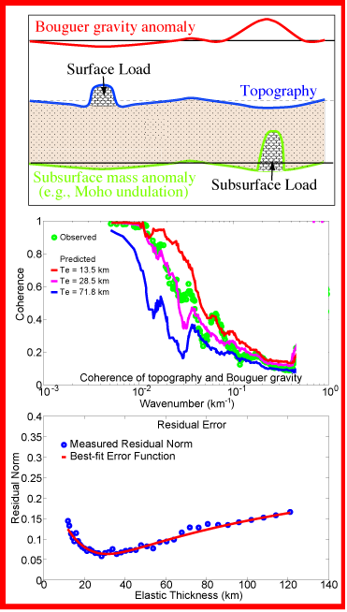
METHOD:
Using equations for observed topography
h and Bouguer gravity anomaly b plus:
gives two equations in two unknowns:
the definition of surface load
gravity due to internal mass variation
flexure of a thin elastic plate
(unknown loads) x
(flexural & gravity response) =
(observations)
(Here ξ = 1 + Dk⁴/Δρg; φ = 1 + Dk⁴/ρ₀g)
Then search for T_{e} (& perhaps other
parameters) that minimize the difference
between observed & predicted
coherence
Or equivalently, that minimize correlation
of the load fields

Slide 9
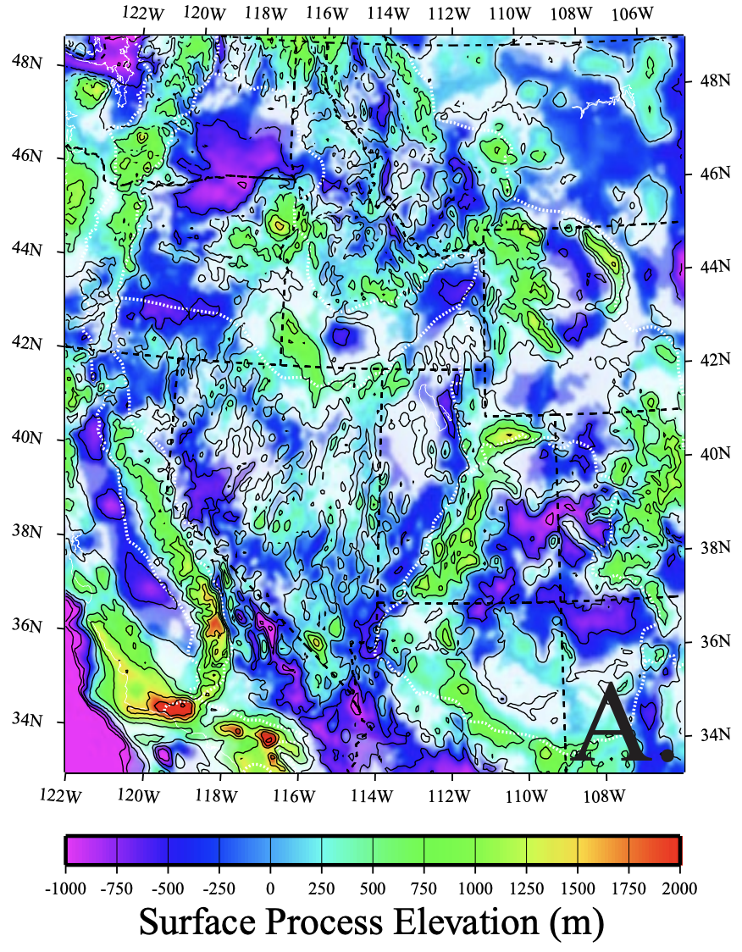
Example: Western United States:
Surface loads → topography
with no balancing mass in
gravity → Laramide ranges,
volcanoes, “rift flank uplifts”…
Stretching of the lithosphere
attempts to equilibrate the
“stress fiber” (centroid of
lithospheric strength) by pulling
down on the rift side, pulling
up adjacent stable lithosphere

Slide 10
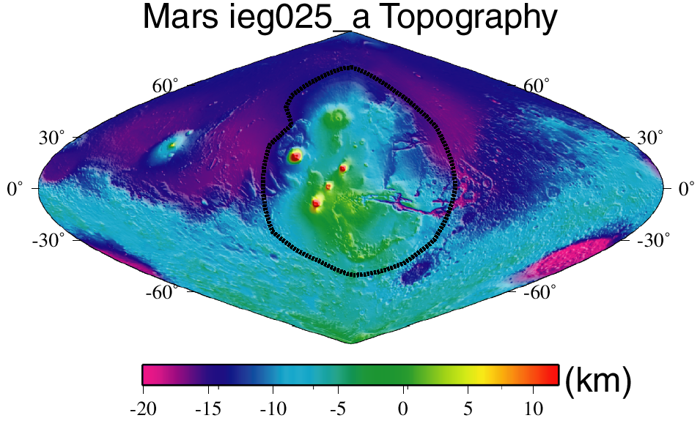
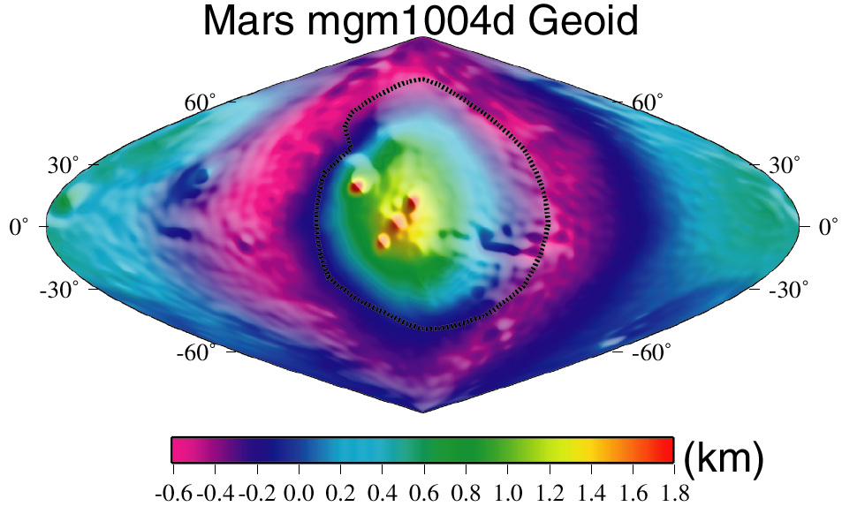
Example: Tharsis Rise, Mars:
Martian topography is dominated
by (1) a north-south hemispheric
“crustal dichotomy” and (2) the
Tharsis rise, average elevation
5000 m covering 20% of the planet
The geoid (or “areoid”) is the shape of
the gravity field. The 2000 m areoid
anomaly over Tharsis is the largest
in the solar system!
Notes:
Too complex

Slide 11

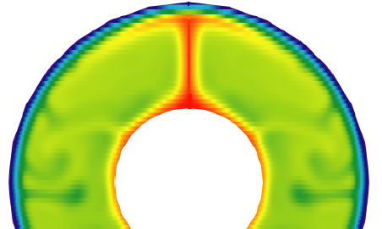
The Tharsis Rise Loading Controversy:
Surface topography
constructed by volcanism?
Thermal/chemical buoyancy
of a single mantle plume?
[e.g., Willemann & Turcotte, 1982;
Solomon & Head, 1982]
[e.g., Sleep & Phillips, 1979; Harder
& Christensen, 1996; Harder, 2000]
Probably some combination of both!

Slide 12
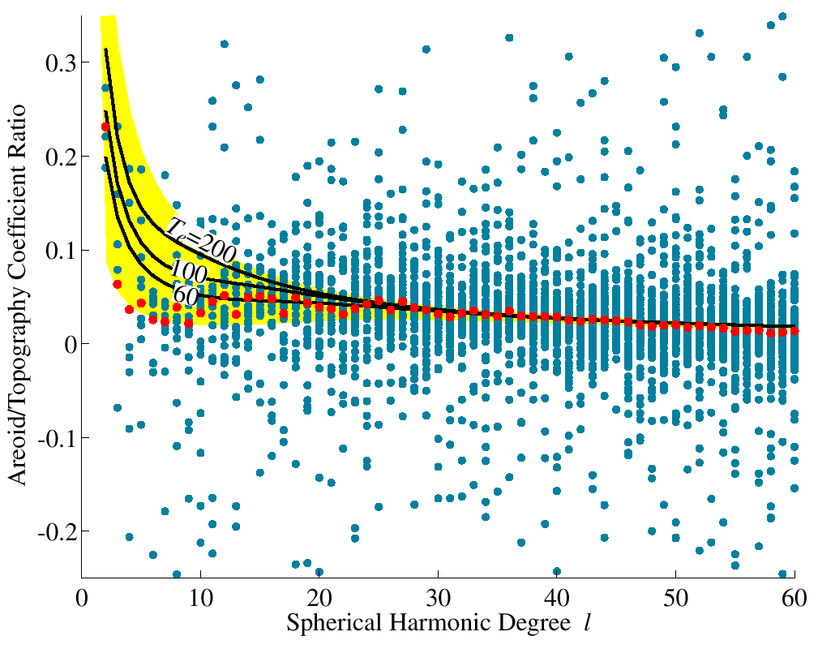
Ratios of Geoid/Topography in the Spherical Harmonic Domain:
Yellow is the range possible for surface loading…
So internal loading is an important part of the total!

Slide 13
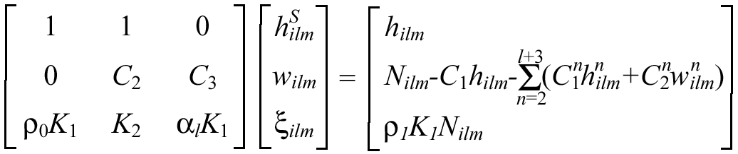
Method:
In the spherical harmonic domain,
solve for:
Using equations for observed topography
h_{ilm} and geoid N_{ilm} including:
• surface load height h^{S}_{ilm}
• lithospheric flexure w_{ilm}
• internal load mass ξ_{ilm}
• the definition of surface load
• finite amplitude geoid calculation
• flexure of a thin elastic shell over a
self-gravitating, viscous sphere
• Solve for each harmonic coefficient i,l,m
• Iterate: Set w^{n}_{ilm} = 0 on the first iteration
and update on subsequent iterations
• Relations depend on:
crustal density ρ₀ mantle density ρ₁
crustal thickness T_{c} load radius R_{I}
lithosphere thickness T_{e} asth. viscosity η

Slide 14
Important Point to Note:
Using these three equations in three unknowns, we can
devise an isostatic model that EXACTLY fits both the
gravity and the topography data using ANY choice of
reference density structure, lithospheric thickness and
internal load depth.
Hence, we must either
Explore the range of possible solutions by using all of
the possible range of density and other parameters, or
(2) Use some additional measurement or constraint to
estimate those parameters independently.

Slide 15
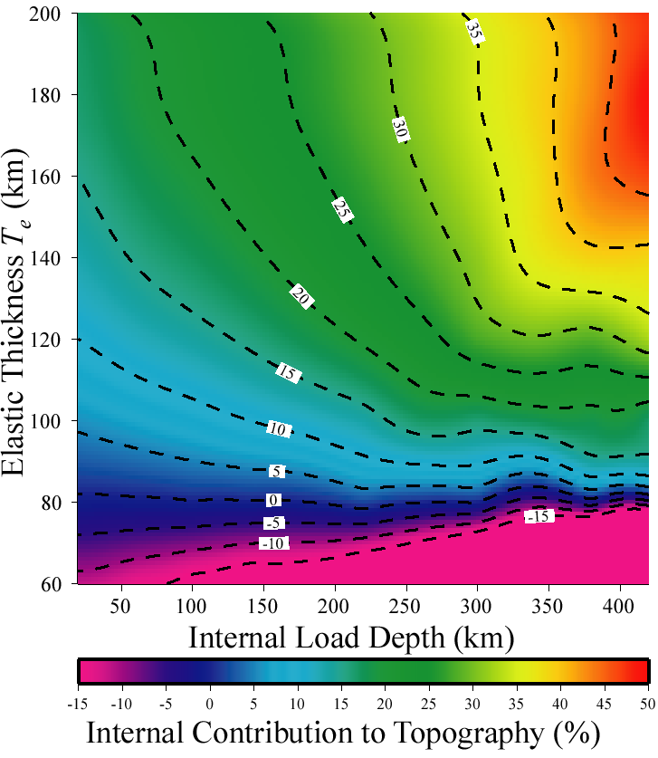
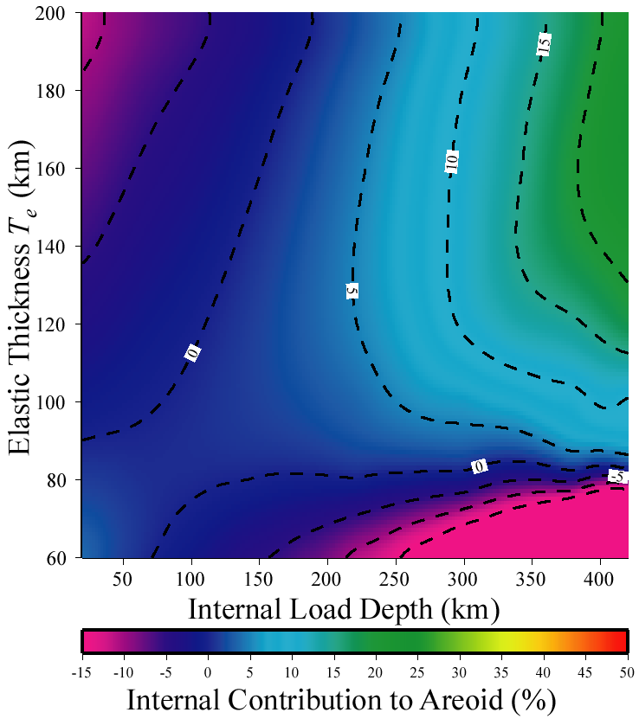
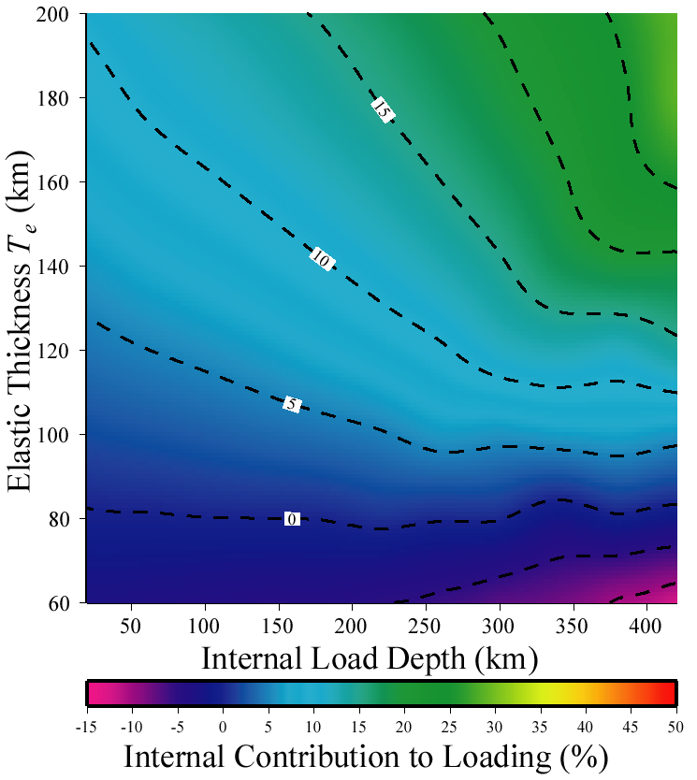
Effects of lithosphere thickness and internal load depth
on the estimate of internal load contribution

Slide 16
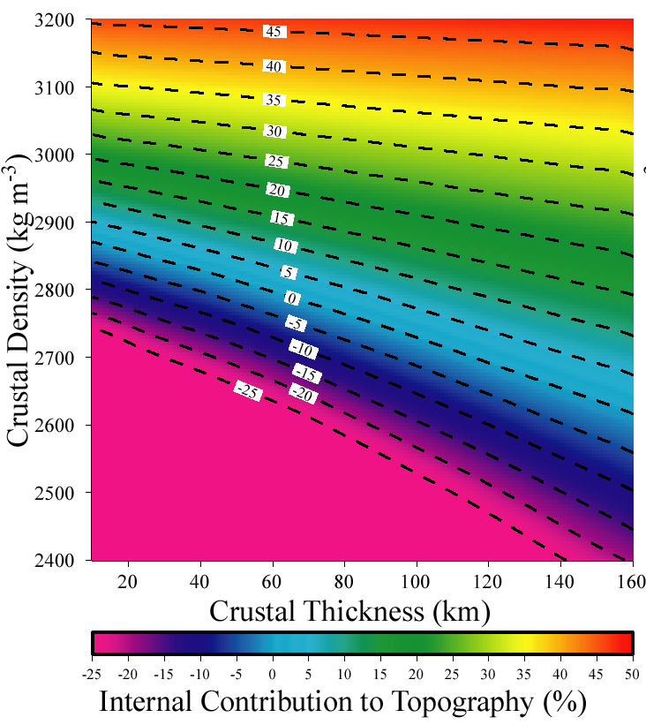
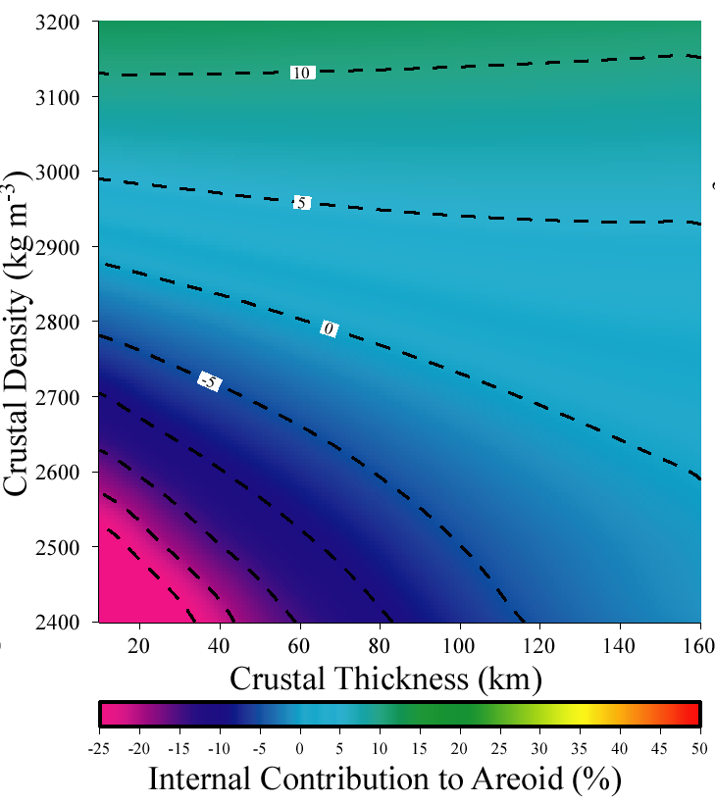
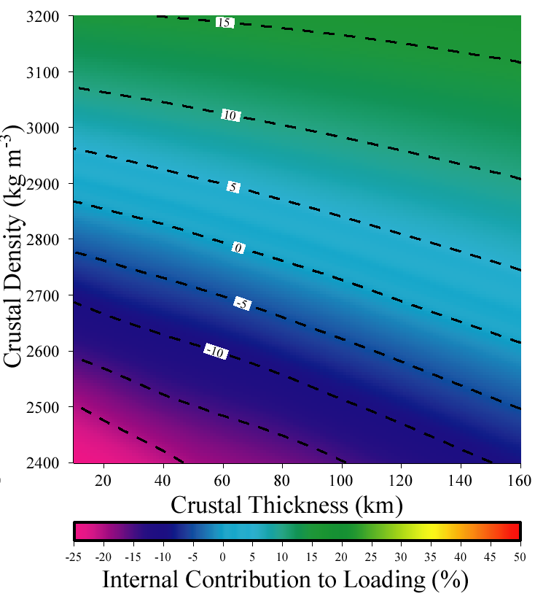
Effects of crustal density and crustal thickness
on the estimate of internal load contribution

Slide 17
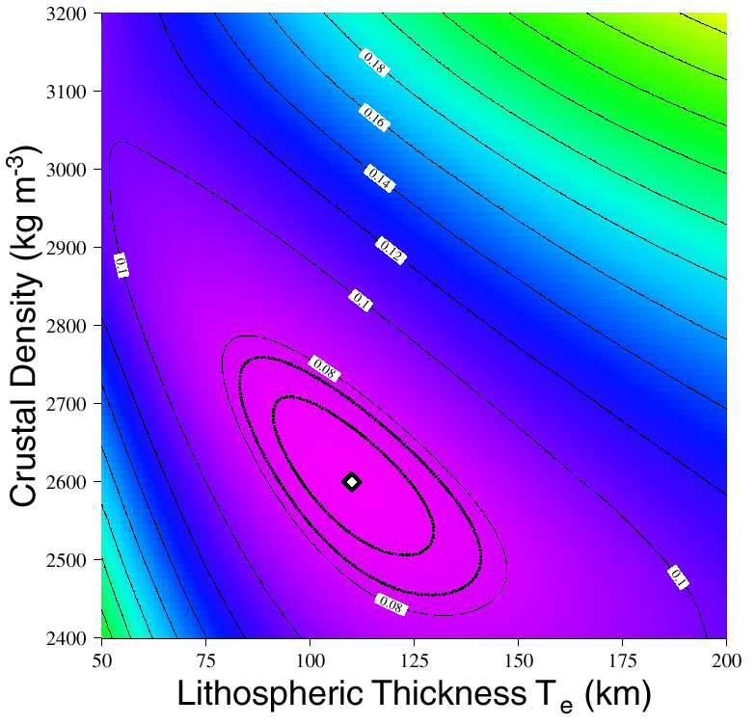
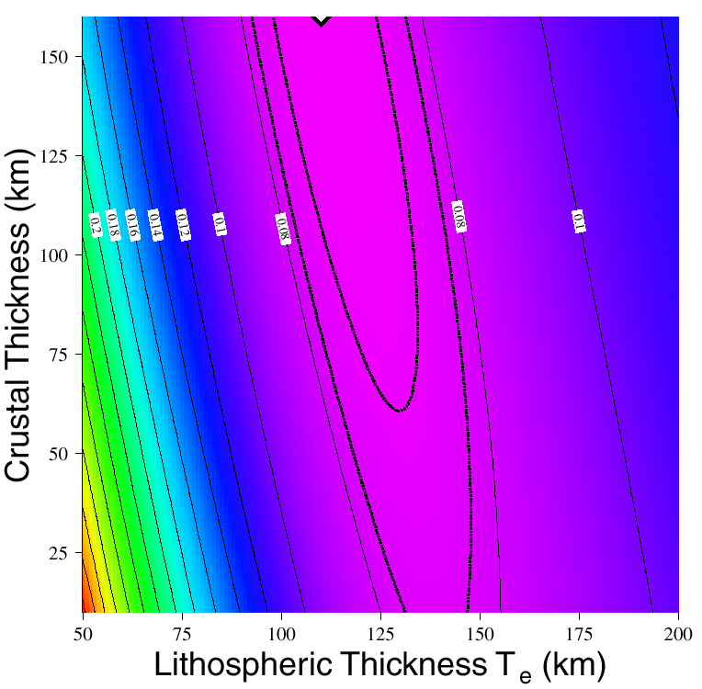
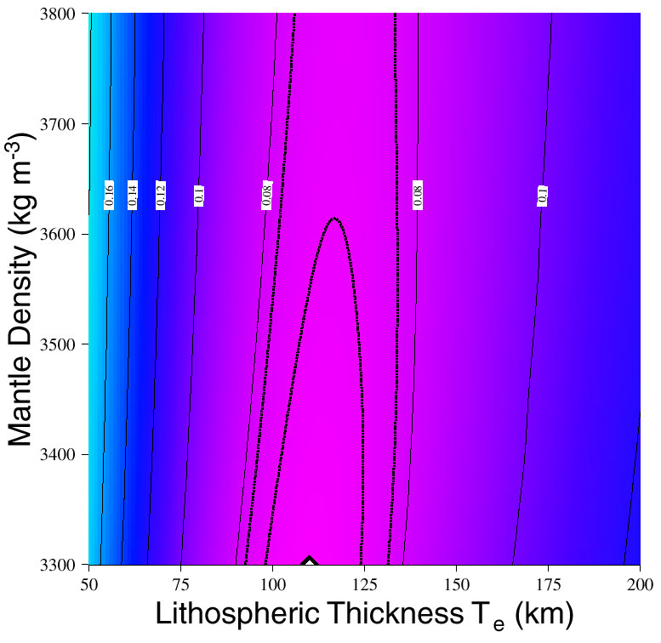
Constraining Parameter Space:
• Correlation of the load estimates is very sensitive
to parameter-induced error, because errors in
one load must be balanced by error in the other
• Hence we assume surface and internal load fields
are uncorrelated, and search for model params
that minimize the correlation of the two!

Slide 18
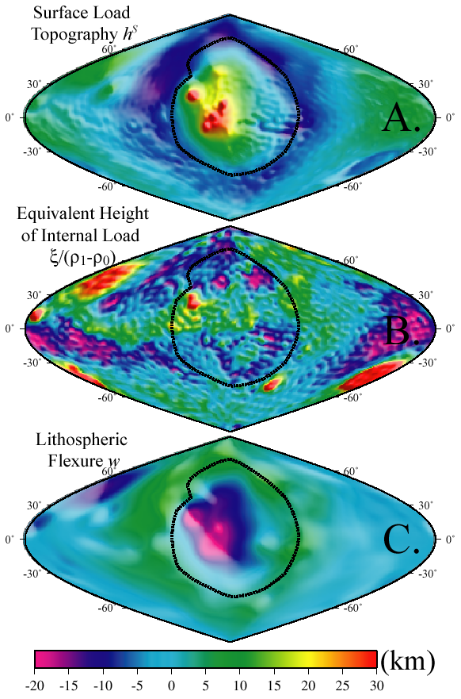
Using the model
parameterization that
minimizes load coherence,
the “best” estimate of
surface loading has an
average thickness of 17 km
within the Tharsis rise, and
average flexure is 12 km.
The averaged internal load
is buoyant but small.

