Slide 1
GEO 5/6690 Geodynamics
13 Feb 2023
Last Time: Convection
Convective vigor can be described by a
Rayleigh number stability field:
; is unstable
where α is coefficient of thermal expansion, b is thickness
of the convecting layer, η is viscosity, κ is thermal
diffusivity, and l = 2πb/λ is a dimensionless wavenumber.
© A.R. Lowry 2023

Slide 2
Next Journal Article Reading:
For Wednesday Feb 15: Kellogg et al.,
Science 283, 1881-1884 (1999).
Jacob L. will lead!

Slide 3
A little background:
Isotopic and
geochemical signatures
from ocean island
basalts versus
mid-ocean ridge basalts
suggest the mantle is
NOT well mixed…
There must be
multiple geochemical
reservoirs that do not
communicate much.
Used to argue for
top-driven, sluggish flow
(Don Anderson,
www.mantleplumes.org)

Slide 4
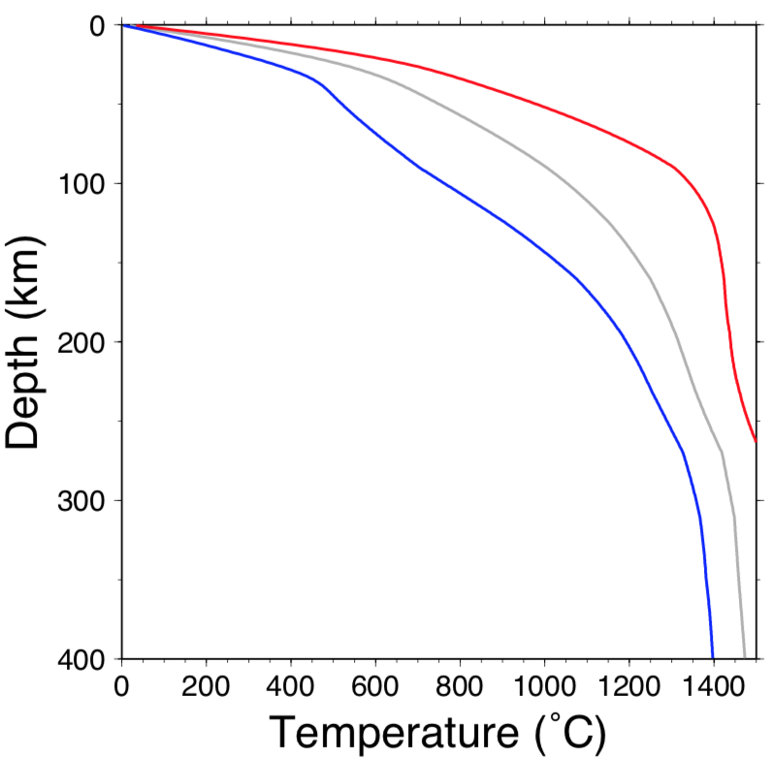
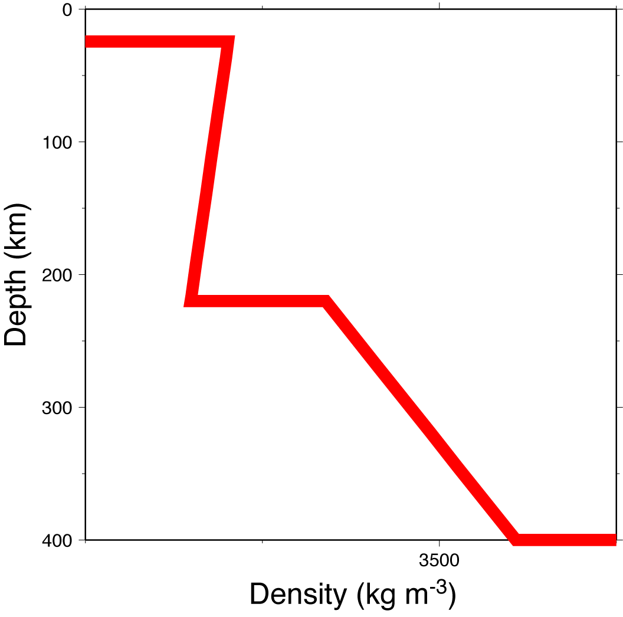
Downwelling, delamination and
Rayleigh-Taylor instabilities:
When a dense layer lies above a less dense layer in a
fluid medium, it is gravitationally unstable.
Examples:
Conductive Thermal
Boundary Layer
Decreasing shallow
density vs. depth
Continental
PREM (from
normal modes)
⇒
US geotherm
modeling

Slide 5
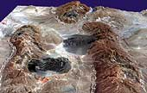
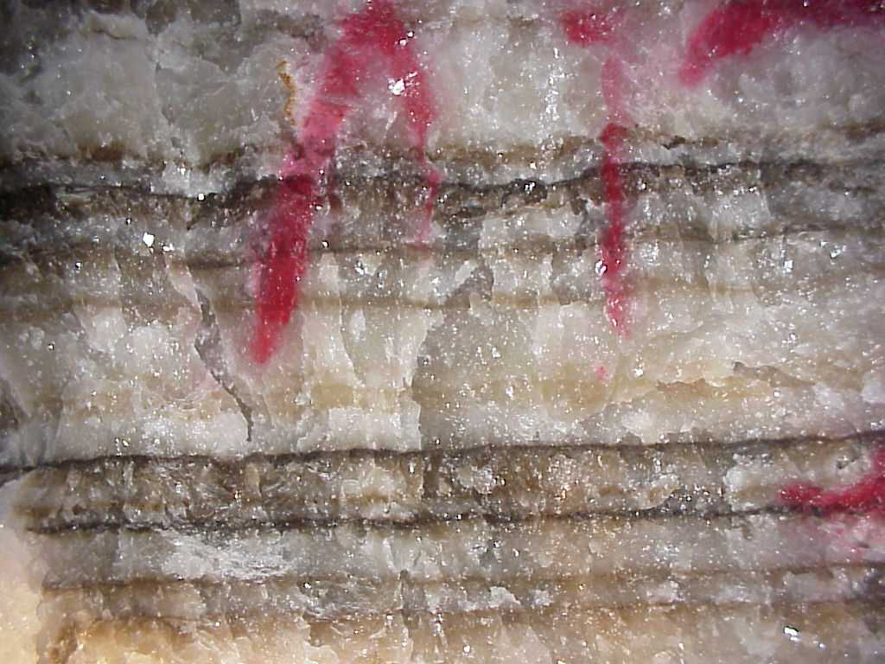
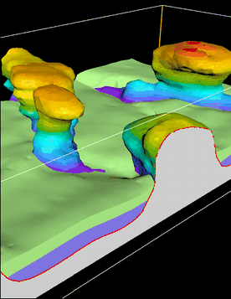
Examples:
Salt Layers (ρ = 2170 kg m⁻³)
in sediments
(ρ = 2300-2800 kg m⁻³)
⇒ Salt Diapirs

Slide 6
Note: If layers are perfectly horizontal, or fluid viscosities
are extremely high, the system is unstable but
will not change.
Growth of Rayleigh-Taylor instabilities requires a
perturbation w₀, a positive density difference Δρ = ρ₁ – ρ₂
and a sufficiently low viscosity for one or both fluids:
ρ₁, η
λ/2
w₀
2b
ρ₂, η

Slide 7
In the case of constant viscosity η, growth of the instability is
governed by:
with solution
where:

Slide 8
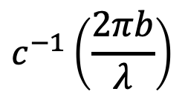

In the case of constant viscosity η, growth of the instability is
governed by:
$c\left(\frac{2πb}{λ}\right)$w
with solution
where:
$$c^{−1}\left(\frac{2πb}{λ}\right)$$

Slide 9
1000
100
Unstable
10
Stable
1
0.1
1
10
100

Slide 10
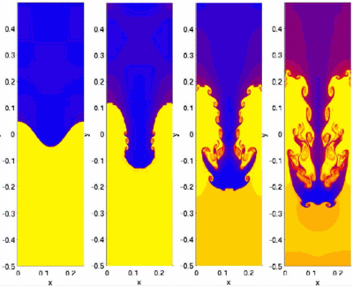
Credit:
S. Li &
H. Li,
LANL
(Two-D flow, low and differing η ⇒ turbulence)

Slide 11

(Another nifty numerical example)

Slide 12
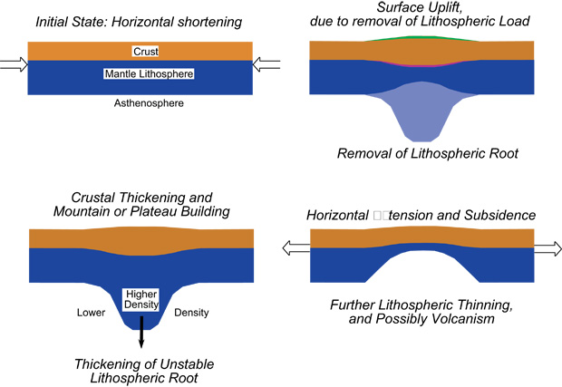
So how would these initiate in the real Earth?
ex
From: http://cires.colorado.edu/science/groups/molnar/projects/rayleightaylor/

Slide 13
Credit:
S. Li &
H. Li,
LANL
Can we observe this in the Earth’s mantle?

Slide 14
Some useful things to think about:
What should a drip “look like”?
• In gravity?
• In surface elevation?
• In resulting lithospheric stress?
• In crustal thickness?
• In surface heat flow?

