Slide 1
Geology 5690/6690
Geodynamics
13 Jan 2023
Last Time: Isostasy continued…
• Isostasy describes an observation that (on “large” scales)
topography represents a mass balance to achieve ~ constant
stress ($\int{ρgdz}$) at depth…
Implies deep Earth behaves like a fluid on long timescales!
• Isostatic mass contributions to elevation in North America
include crustal thickness, crustal composition (mafic is
more dense; granitic less), thermal boundary layer thickness
and deeper mantle temperature… Among others…
• Which mass fields dominate (and which are responsible for
uplift & subsidence over time) is a topic of active research
Read for Wed 18 Jan: T&S 132-149 (§4.1-4.12)
© A.R. Lowry 2023

Slide 2
GEO 5/6690 Geodynamics
Last Time: Concepts/Definitions of Lithosphere
→ *Generally* Includes Crust & Uppermost Mantle
• Plate tectonics: Rigid “plate” moving over fluid asthenosphere
• Thermal boundary layer (conductive over convective)
• “Elastic” upper layer that supports recoverable stress/strain
• Rheologically strong layer (“mechanical boundary layer”)
• Seismogenic layer
• Seismic “Lid” (high seismic velocity over lower velocity)
• “Tectosphere”: Basalt-depleted mantle (major elmt chem)
• Isotopic geochemistry (related to age of rock “reservoir”)…
• REE: Depleted or enriched (depending) in Large-Ion Lithophile
elements; Light Rare Earth elements; other incompatible els.
These (observation-based) concepts derive from several
different/related processes, so represent different rock volumes!

Slide 3
How to use these powerpoints:
• Review them often: Before each class, and while doing
homework exercises
• The most important points of each lecture (in my opinion)
are summarized on the first slide(s) of the next lecture
• Note the notation!
→ Arial Black, italic means Important, pay
attention…
→ Arial Black, italic, red font means
Critically important concept or terminology
that I expect you to understand well
for exercises
→ Times New Roman, italic, black font means this is an
equation or an algebraic variable
→ A red box with grey background means this is an
especially important concept or equation

Slide 4
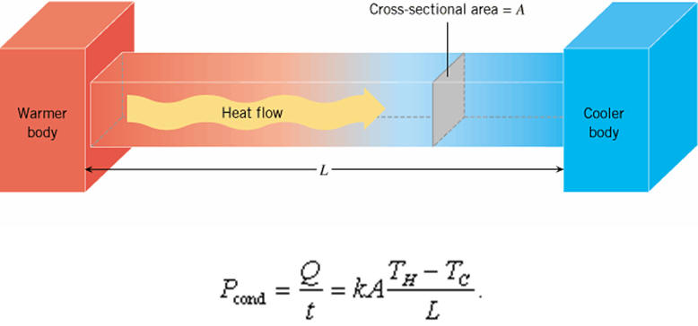
Today: The Geotherm
Four types of heat transfer are relevant in solid Earth:
I. Conduction ≡ Molecular collisions
➲ Slow & inefficient: ~100 Myr “traveltime”
for a thermal pulse to travel 100 km
➲ Dominates in Thermal Boundary Layer

Slide 5
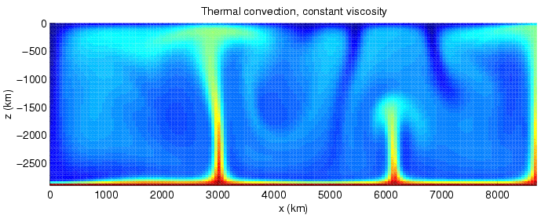
Four types of heat transfer are relevant in solid Earth:
II. Convection ≡ Thermal buoyancy-driven, active
transport of heat in a fluid
➲ Implies Rayleigh # exceeds a critical value;
has a preferred length scale ~ vertical
thickness of convecting layer (for 2D flow)
➲ General circulation ⇒ Everything is
moving… As flow driven by buoyancy
Image courtesy Harro Schmeling

Slide 6
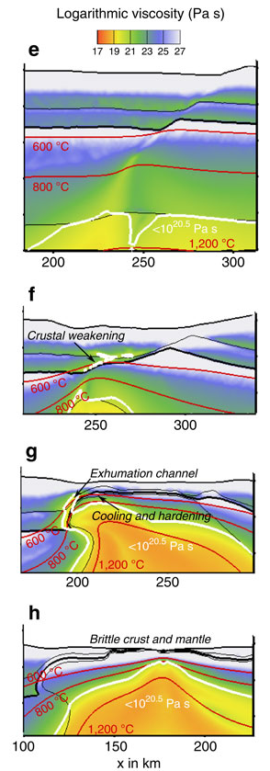
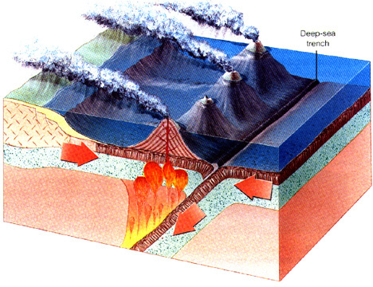
Four types of heat transfer are relevant
in the solid Earth:
III. Advection ≡ Heat carried by
flux of material by processes other
than wholesale buoyancy-driven flow
➲ Examples include magmatic
intrusion, erosion/deposition,
tectonic strain, groundwater
Brune et al., Nat. Comm., 2014

Slide 7
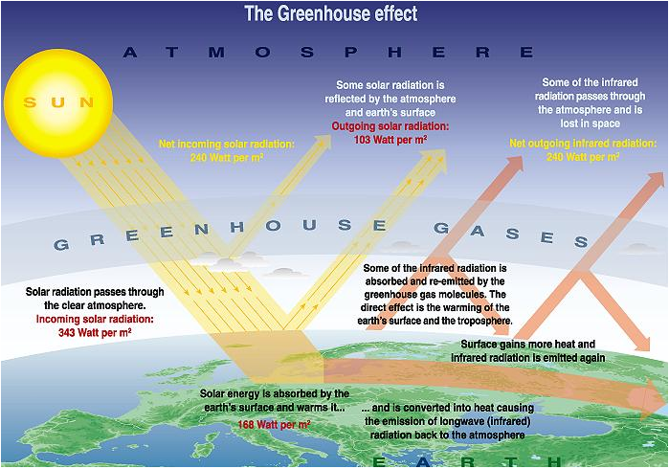
Four types of heat transfer are relevant in solid Earth:
IV. Radiation ≡ Transfer by electromagnetic
radiation (light)
➲ Not usually considered important in the
solid Earth, but some (controversial)
measurements
have suggested it could
contribute to
mantle transfer…
Certainly matters
for the upper
boundary
temperature!

Slide 8
The Geotherm:
0
Temperature
1200-1400 ºC
0
Conductive
50-300
km
Adiabat: Temperature
increases with pressure
but energy doesn’t
change
Depth
Convective

