Slide 1
GEO 5/6690 Geodynamics
13 Mar 2023
Last Time: RHEOLOGY
Flow Rheology depends on mineral-type (i.e. lithology),
temperature, pressure, & volatile state (especially hydration!)
Diffusion also depends on grain size, but only dominates for
very small (<50 μm) grain size and/or very low stress
Temperature is often inferred from surface heat flow, which
is a poor predictor of temperature at depth… More recently,
efforts have focused on using mineral physics to infer
temperature variations!
Lithology can be inferred from crustal seismic imaging
(e.g., Moho represents the boundary between feldspar/olivine)
Yield Strength Envelopes approximate deviatoric stress
supported by the lithosphere; assume a brittle field rheology
(friction coefficient, pore fluid pressure) plus strain rate
© A.R. Lowry 2023

Slide 2
Next Journal Article Reading:
For Wednesday Mar 15: Becker et al. (2015)
Western U.S. intermountain seismicity
caused by changes in upper mantle flow,
Nature, 524(7566), 458-461.
Drew will lead!

Slide 3
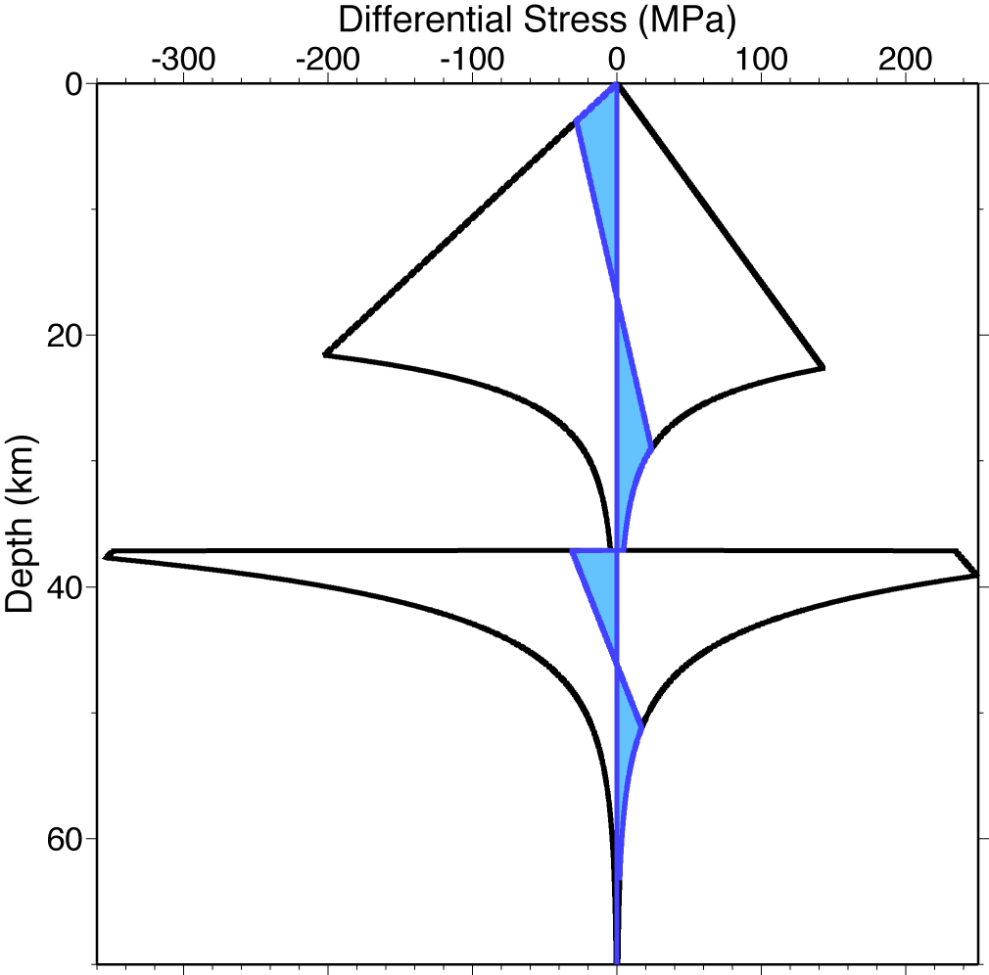
Laboratory studies of rock strain use roughly the same
equations as those derived from first principles in mineral
physics, but collapse them to observable constant params
Frictional
(Byerlee)
depends on:
• Lithology
(pyroxene > olivine > feldspar > quartz)
• Water fugacity f_{H2O}
• Temperature T
(and to a lesser extent)
• Strain rate ε
• Grain size d
• Pressure P
Ductile flow
(Dislocation Creep)
.
Ductile flow
(Dislocation Creep)
Ideally, we would like to use geophysics to determine each
in situ! But it’s not so simple.

Slide 4
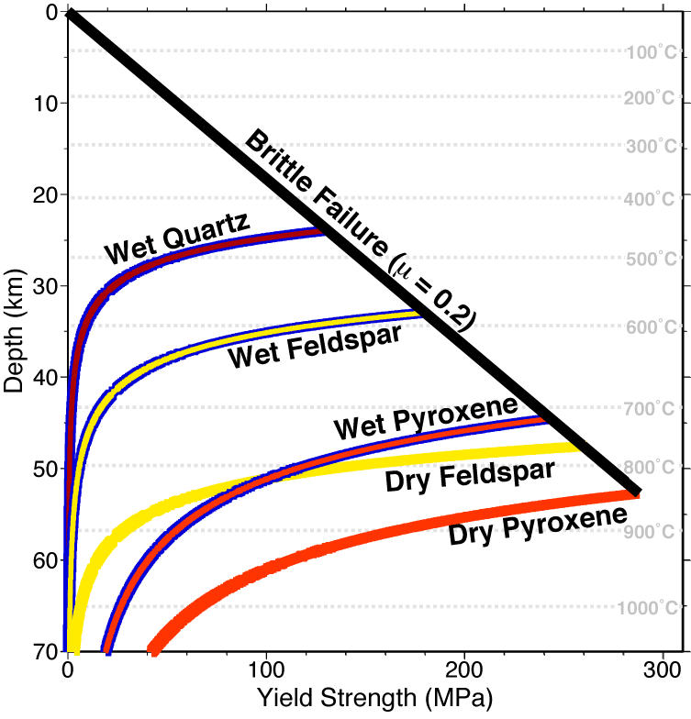
Brittle-field (Amonton’s or
Byerlee’s law) assumes
elastic-plastic
constitutive law
In Yield
Strength
Envelopes, we
often assume
steady-state
horizontal
strain (i.e.,
constant strain
rate) for
dislocation
creep laws
That assumption
is valid for long
time-scales but
not for all depths!
Ductile assumes Newtonian
or non-Newtonian viscous flow

Slide 5
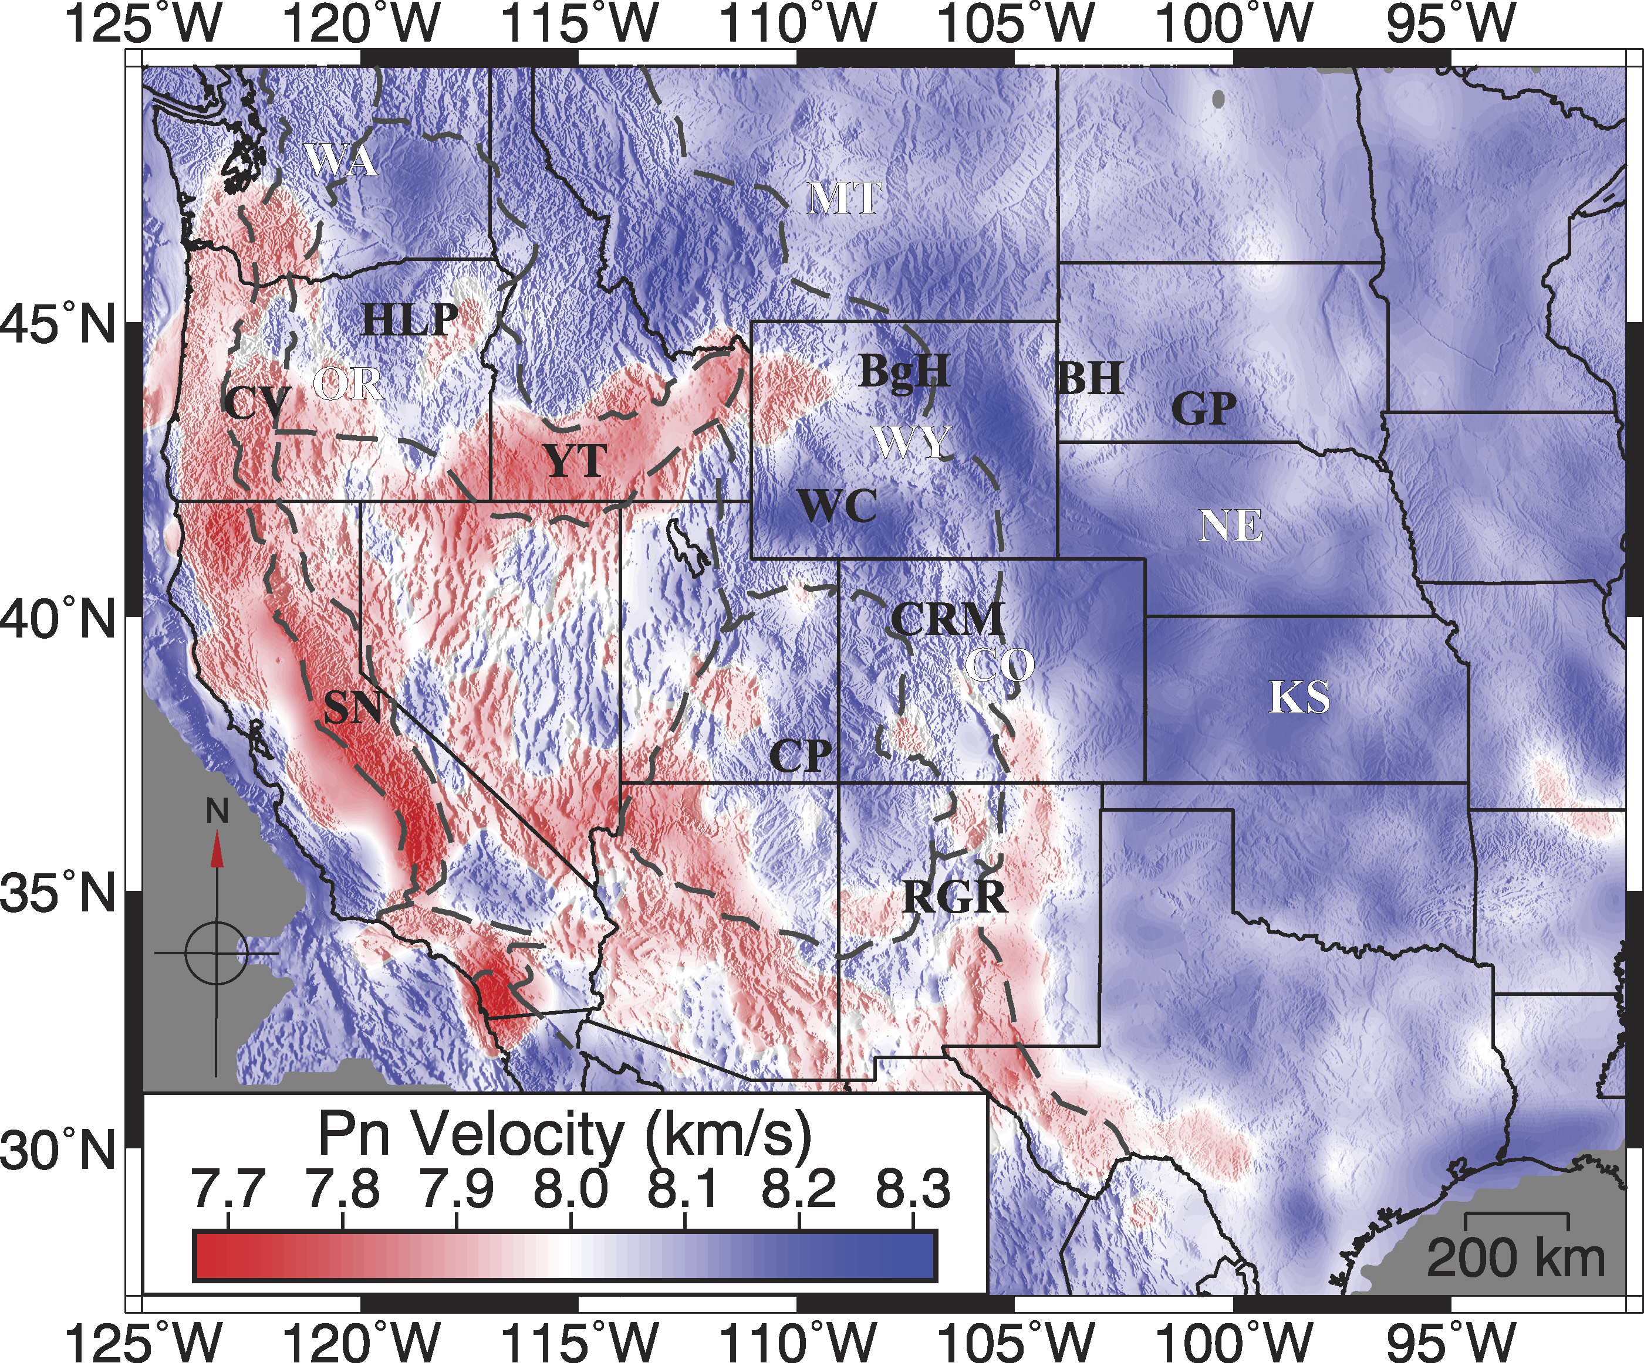
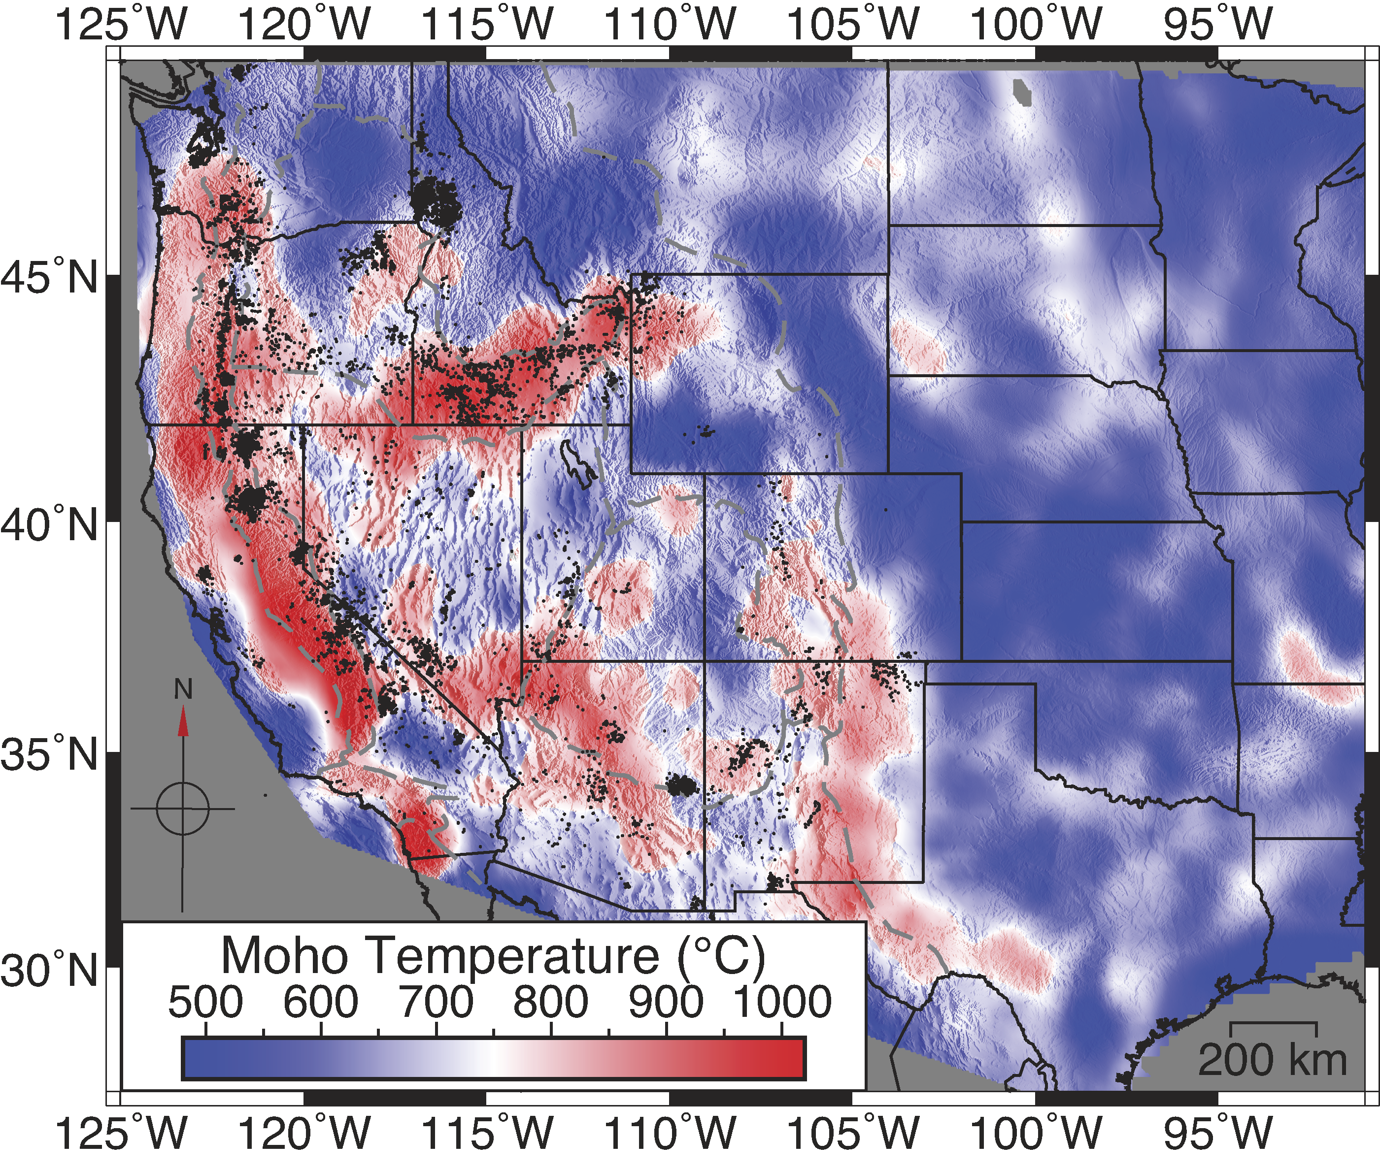
Temperature T → surface heat flow, seismic velocities
Moho temperature T_{Moho} from P_{n} phase:
P_{n} velocity variation
Moho temperature from
P_{n} & mineral physics
After Buehler & Shearer, JGR 2017
Schutt et al., Geology 2018

Slide 6
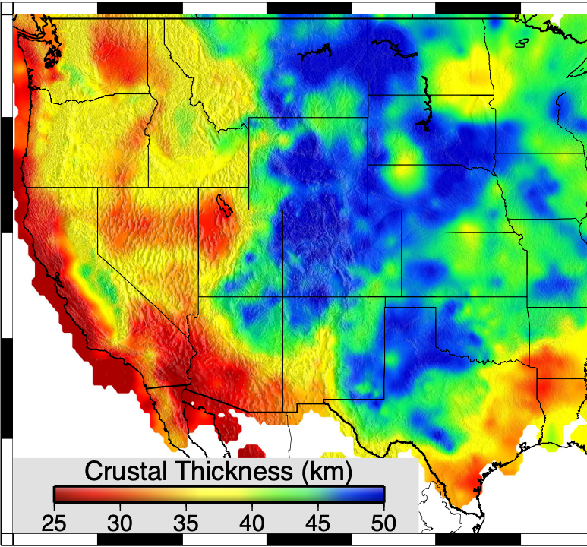
Remember that depths vary for these Ts!
Moho temperature from
P_{n} & mineral physics
(Because the Moho is deeper
in the stable part of the
continental lithosphere…)
Schutt et al., Geology 2018

Slide 7
Dry
Wet
Moho
temperatures are
sufficiently high
to produce some
lower crustal flow
for all likely
crustal lithologies,
wet or dry…
Note viscosity is
very sensitive
to lithology &
hydration state!
Pyroxene
Schutt et al., Geology 2018
Feldspar
Olivine
Quartz

Slide 8
This raises a question…
How close are we (i.e., what else would we
need to know) to perform physics-based
predictive modeling
of deformation in the Earth?

