Slide 1
A thermo-mechanical model of continental lithosphere
Sean Willet, David Chapman, Horst Neugebauer
Nature, 1985

Slide 2
Motivation
Rheology of the lithosphere
Yield-stress envelope for brittle failure and T dependent nonlinear dislocation flow
Oceanic lithosphere: elastic thickness is age dependent and related to 450C isotherm
Application of thermo-elastic model to continental lithosphere
flexural rigidity for continental lithosphere similar to oceanic
Thermal behavior of continental lithosphere simple cooling model
Effective elastic thickness does not change with time after loading
Authors suggest continental lithosphere may have more complex relationships between thermal state and mechanical behavior than oceanic lithosphere

Slide 3
Research presented
Data from observable flexural response (heat flow, AET, isotherm depth)
Steady-state thermal model of continental lithosphere
Non-linear thermally activated rheology (mechanical)
Lithospheric thickness dependent on q, geotherm = 1300 C
Apply a surface load
How do stresses/AET change with time in continental lithosphere after loading

Slide 4
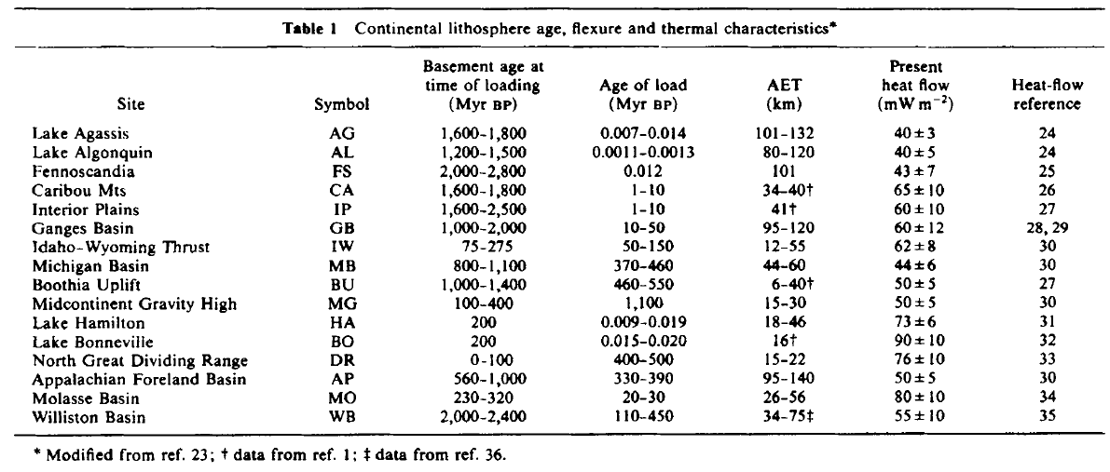
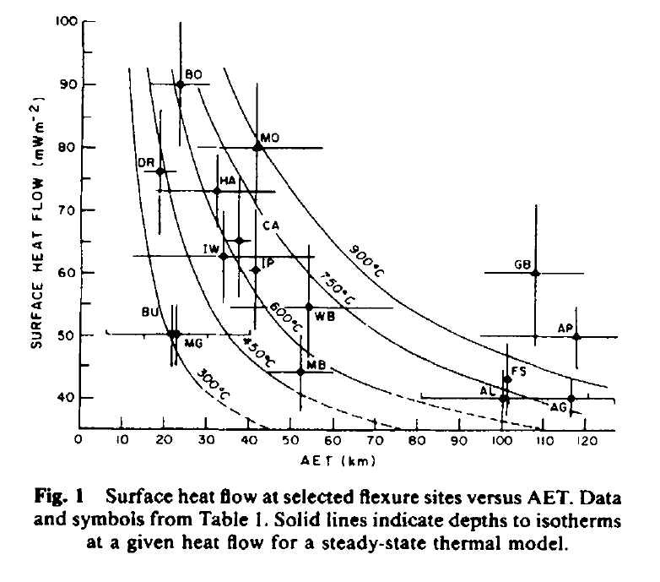

Slide 5
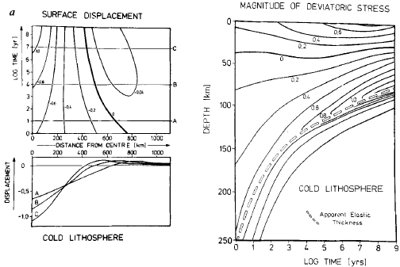
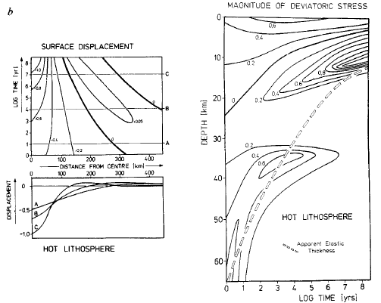

Slide 6
