Slide 1
Western US intermountain seismicity caused by changes in upper mantle flow
Drew White

Slide 2
Figure 1
a. Provinces and focal mechanisms
b. Seismicity < 50 km
c. Geodetic Shear Strain rates
d. Gravitational Potential Energy (GPE)
e. Dynamic Topography
f. Rate change of Dynamic Topography

Slide 3
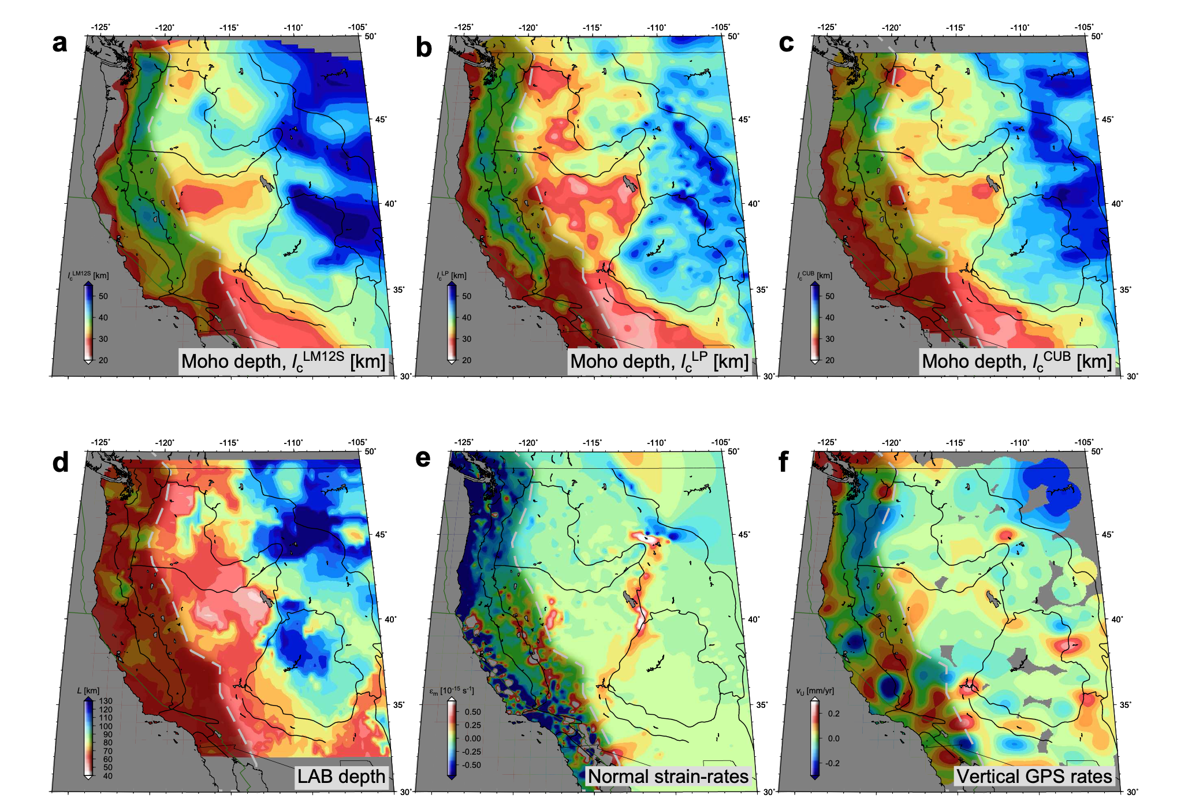
Extended data figure 1

Slide 4
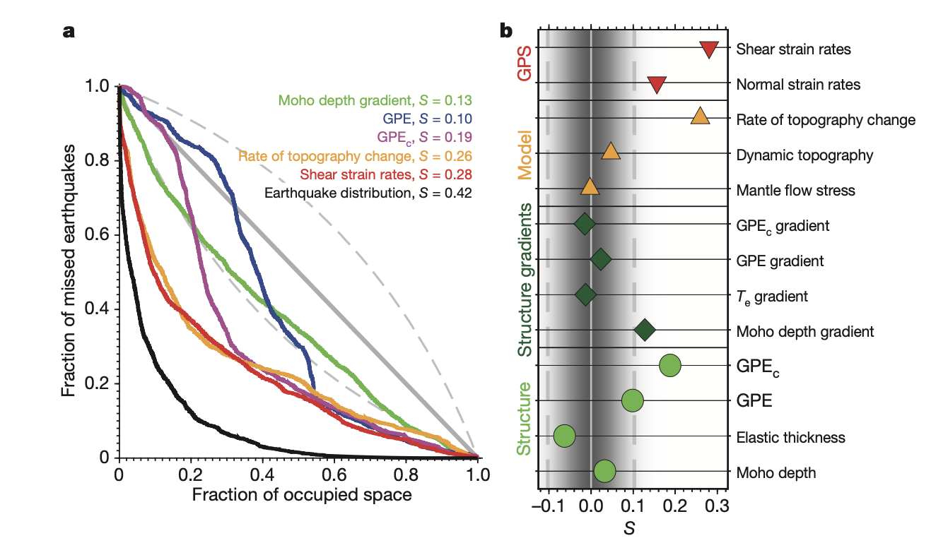
Figure 2
Molchan curves and associated skill in observations from figure 1.

Slide 5
Figure 3
Illustration of mantle flow forcing in the study region. Inferred temperature anomalies and mantle flow velocities (background) and temporal change thereof (foreground) are shown along a north–south profile. Profile location, corresponding dynamic topography, and rate change thereof are shown in Fig. 1e and f, respectively.

Slide 6
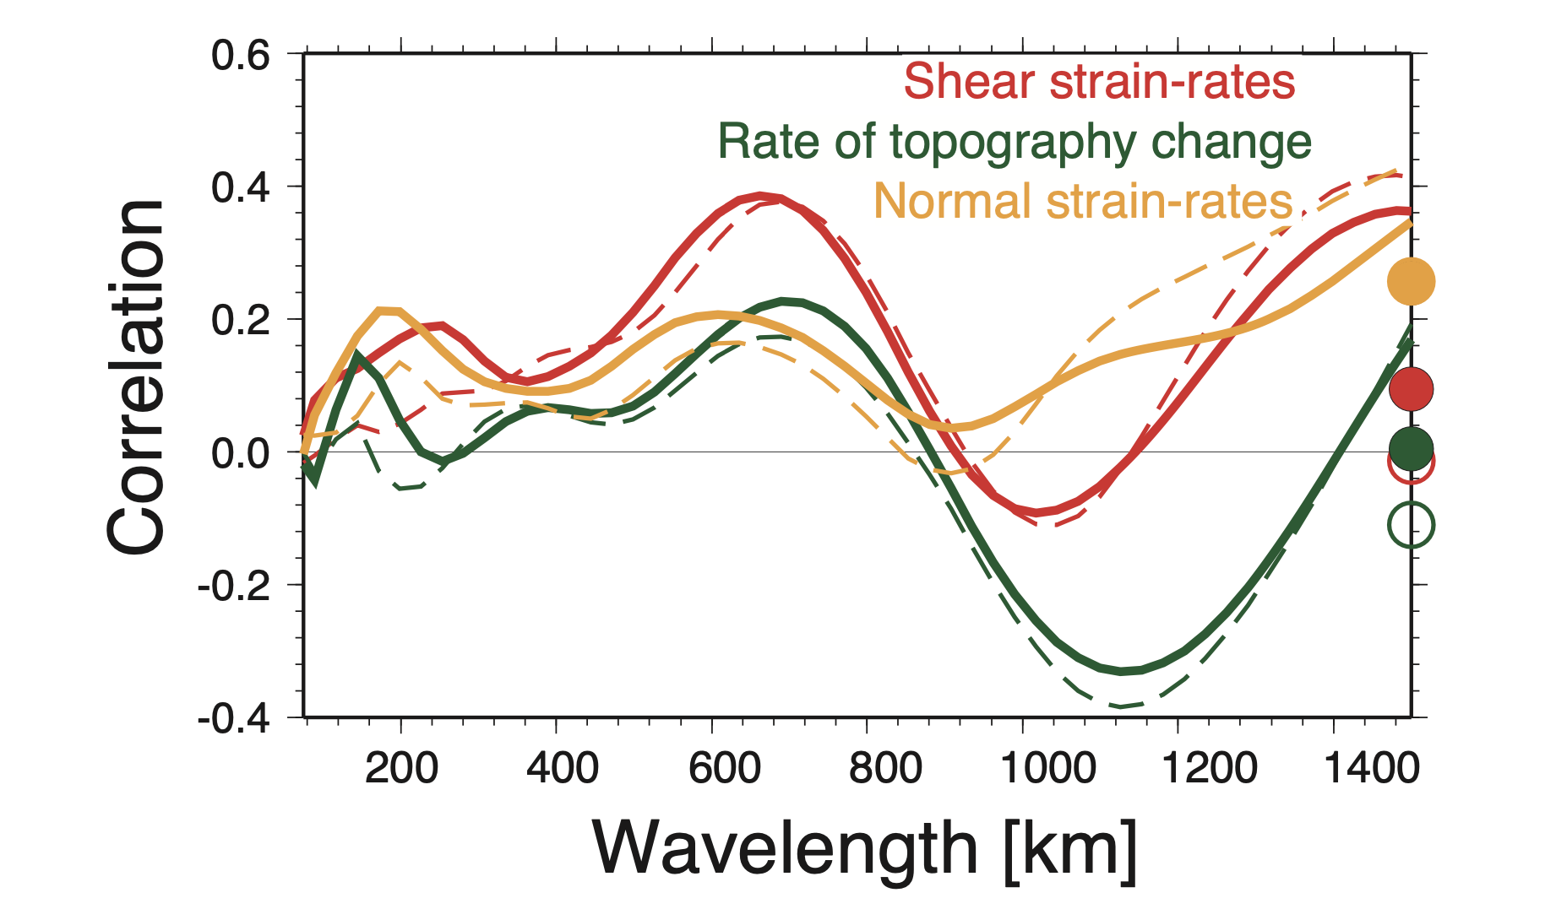
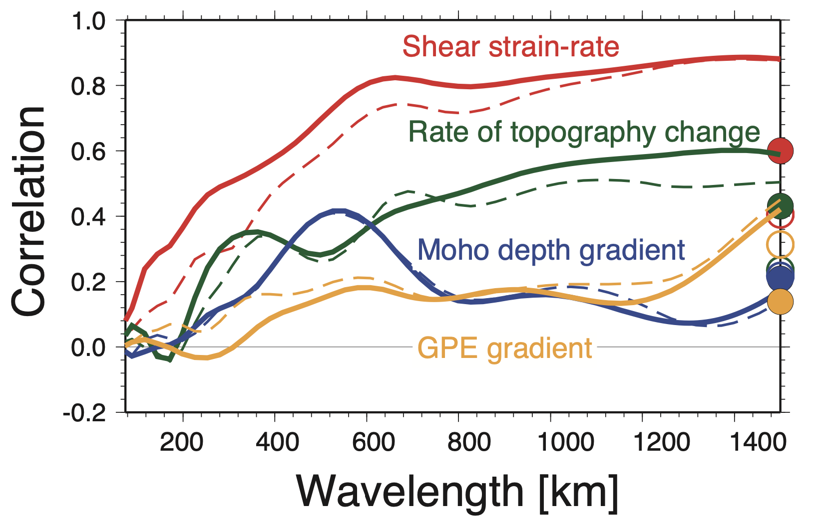
Comparison
Figure 8
Figure 4
“A preliminary analysis of geodetically determined vertical motions from Global Positioning System (GPS) data indicates that patterns of surface uplift do not correlate with our predictions of rate change of dynamic topography, except at some wavelengths (Extended Data Fig. 8). This lack of correlation partly stems from neglect of lithospheric strength by the viscous flow model, which would greatly dampen uplift on scales =200...600 km in the region”
Figure 5

