Slide 1
GEO 5/6690 Geodynamics
17 Apr 2023
Last Time: Flexural Isostasy
Generally, loading will occur both by surface mass flux
processes and internal mass flux. If D and radial density
structure are known, can solve for surface loads and
internal mass loads (useful for understanding the
processes that create topo and gravity variations!)
(unknown loads)
x (flexural & gravity response)
= (observations)
However to get D (or equivalently T_{e}) we need more
information. Forsyth’s method: assume loads are
uncorrelated & find T_{e} that predicts coherence γ² of gravity
& topography most closely matching observed coherence
© A.R. Lowry 2023

Slide 2
Last Time Continued: Flexural Load Separation
• Application of load analysis to Tharsis rise (Mars)
sought to separate surface loading due to volcanic
construction from internal buoyancy of a one-plume source
• Approach 1: Solve for loads for the entire range of possible
density, T_{e}, load depth parameters
This gives load scenarios ranging from 50% of topography
due to plume, to 0%, to negative plume buoyancy (so puts
bounds on possible loading!)
• Approach 2: Find the model parameters that minimize
correlation of the surface and internal loads
Results in ~4% of topography from plume buoyancy,
reasonable T_{e} ~ 110 km, unreasonable(?) surface density
of 2600 kg/m³, indeterminate crustal thickness & mantle
density…

Slide 3
Next Journal Article Readings:
For Wed Apr 19: Schmandt et al. (2014)
Jacob will lead!
For Mon Apr 24: Schutt & Lesher (2006)
Michael will lead!

Slide 4
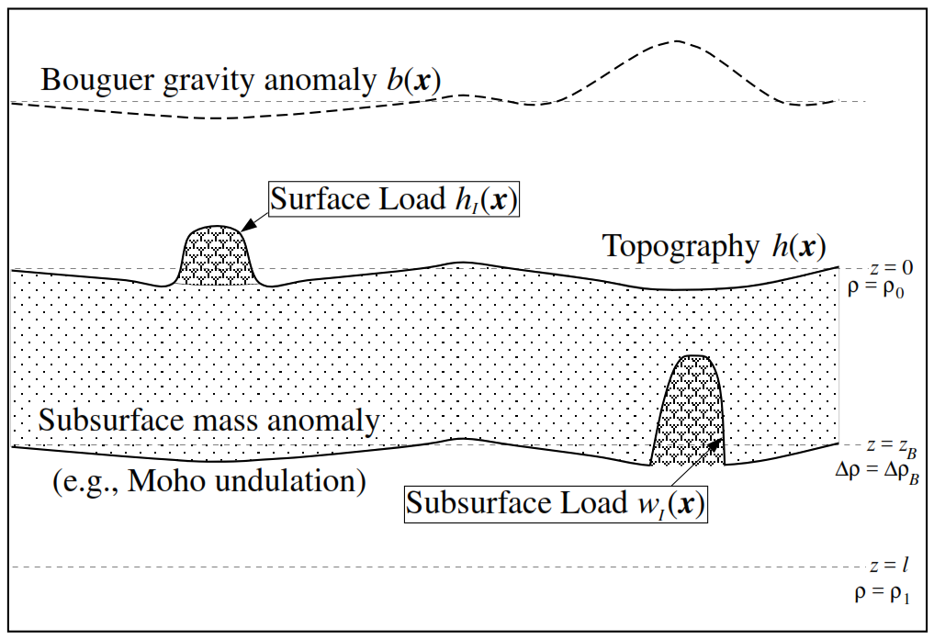
Another application of flexural isostasy:
Source of western U.S. high elevation?
Notes:
Too complex

Slide 5
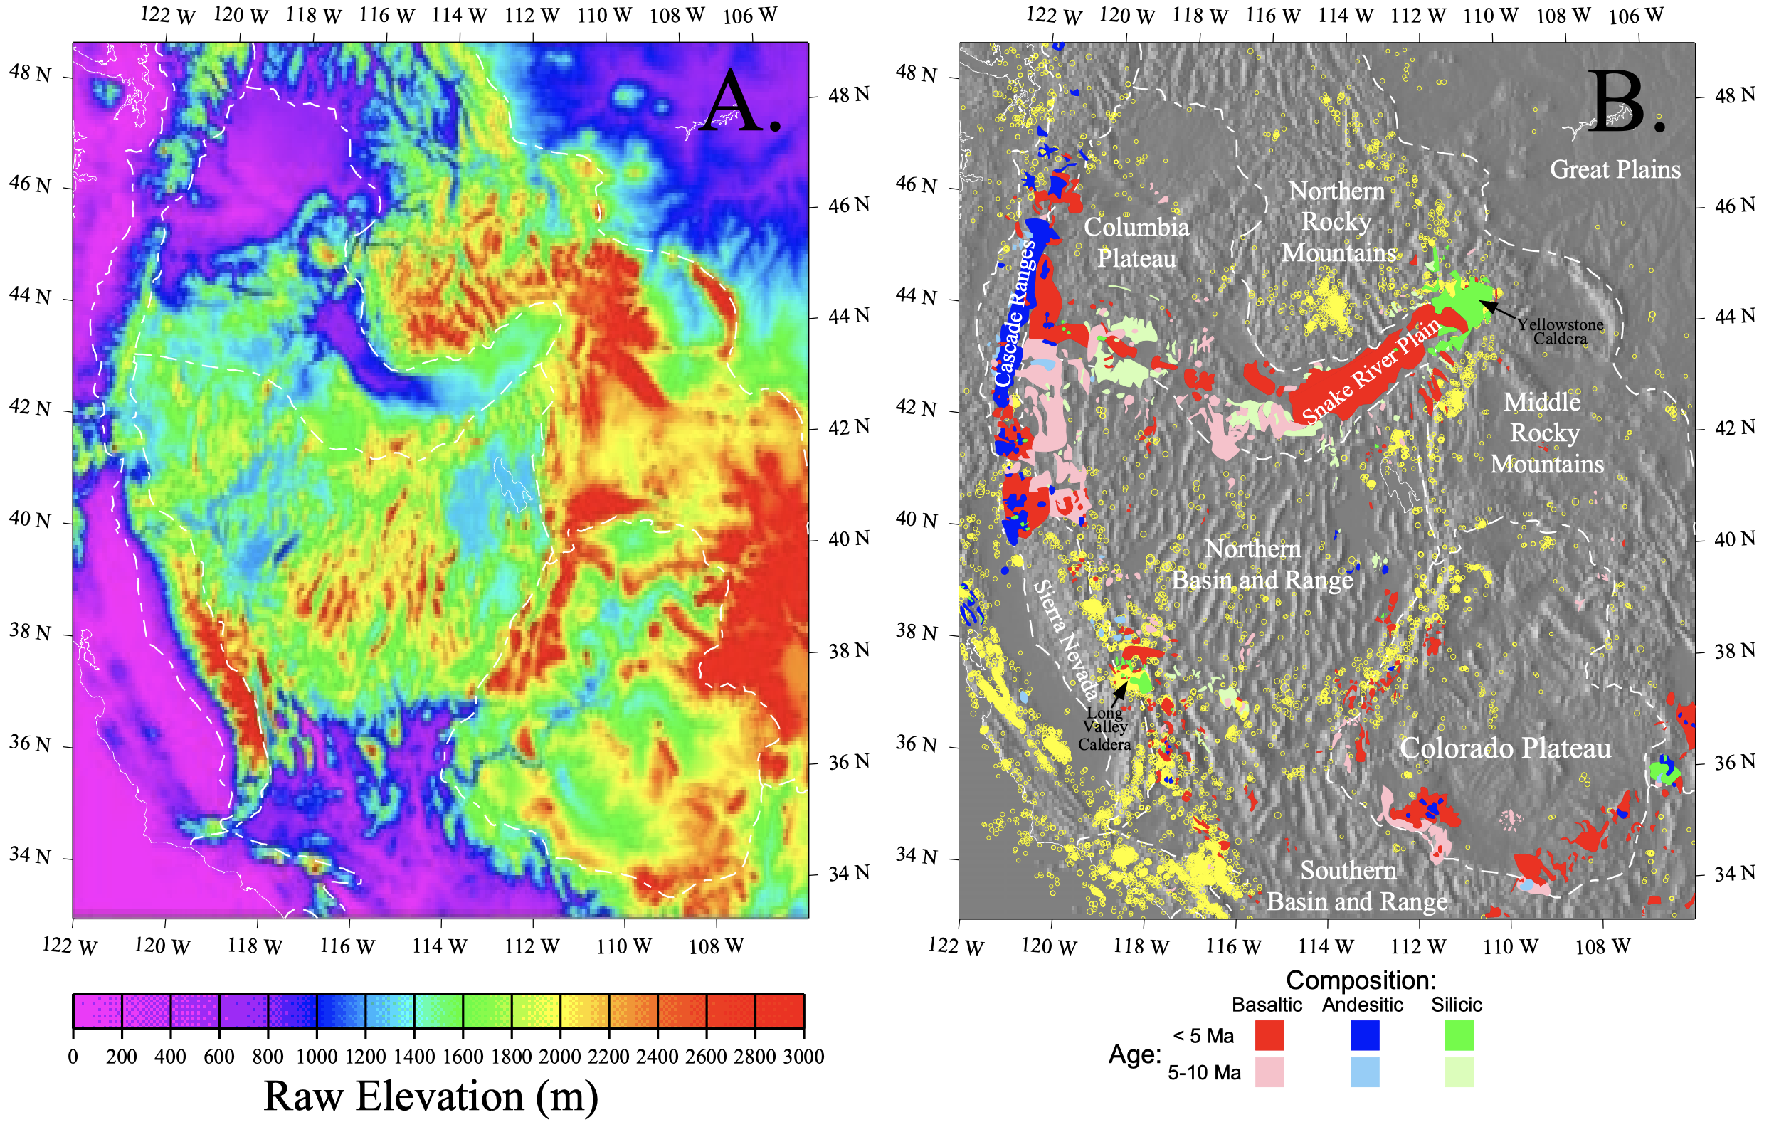
Lowry et al. (JGR 2000)

Slide 6
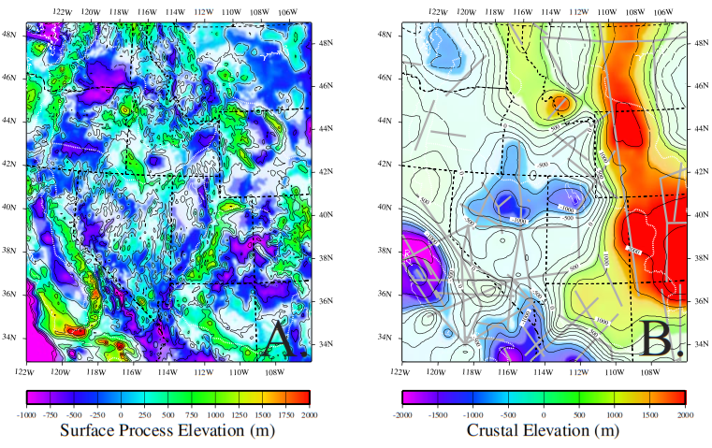
Surface loading (& flexural response) estimated from isostatic analysis
Crustal elevation estimated from Vp of crustal-scale seismic refraction lines
Lowry et al. (JGR 2000)

Slide 7
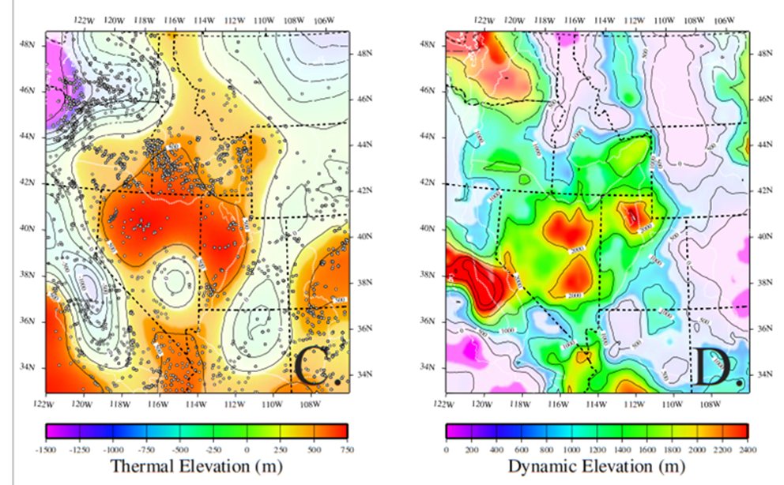
Thermal elevation estimated from geotherms modeled from surface heat flow
Residual = response to astheno-spheric buoyancy?
Lowry et al. (JGR 2000)

Slide 8
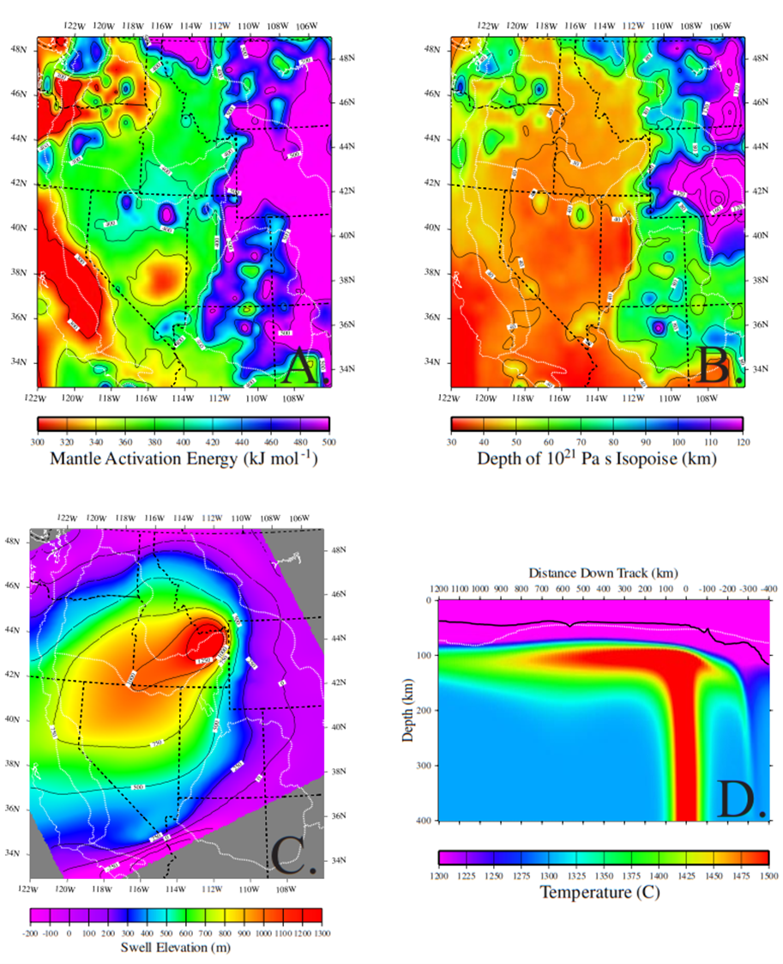
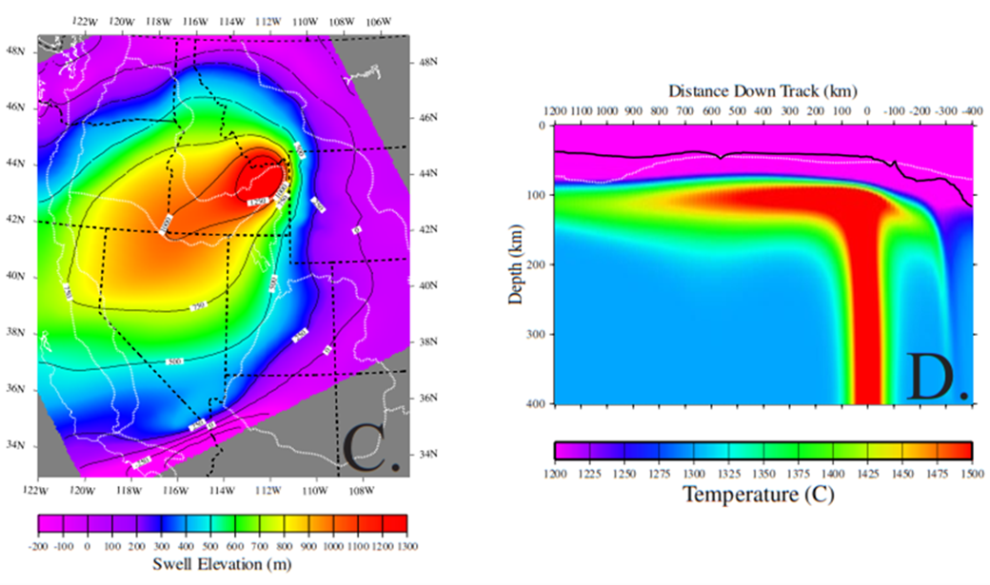
One possible explanation: Hot asthenosphere from a
Yellowstone hotspot or plume?
Lowry et al. (JGR 2000)

Slide 9
Lowry et al. (JGR 2000)

Slide 10
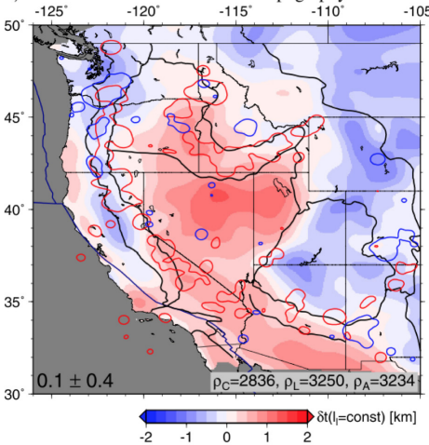
~ 10 to 15 years later we had much better data from
EarthScope’s USArray and newer seismic methods:
Crustal elevations from receiver function thickness & bulk v_{P}/v_{S}; thermal boundary layer thickness modeled from seismic lithosphere-asthenosphere boundary
Now residual
(assumed
asthenospheric)
buoyancy more
clearly follows
past subduction
back-arcs
Becker et al. (2014)
Earth Planet. Sci. Lett.
Notes:
Too complex

Slide 11
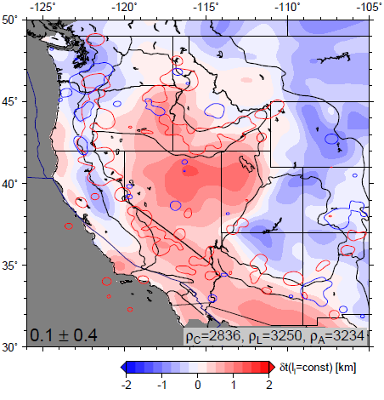
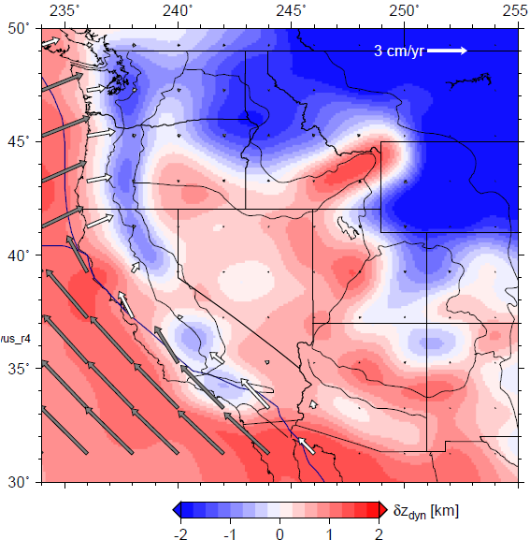
Becker et al. (2014) Earth Planet. Sci. Lett.
also estimated buoyancy and
flow from deeper seismic v_{S}
tomography...
Match between residual and
dynamic topography from
present-day mantle flow:
Correlation ~0.6

Slide 12
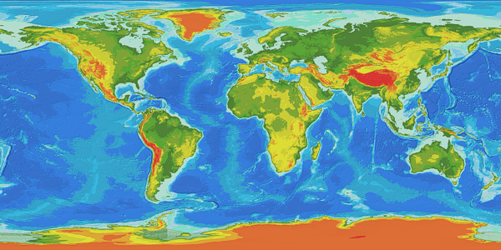
So why would asthenosphere-derived
western U.S. Cordilleran elevation
(and for that matter, in Cordilleras
all over the world) correlate so strongly
with subduction backarcs?

Slide 13
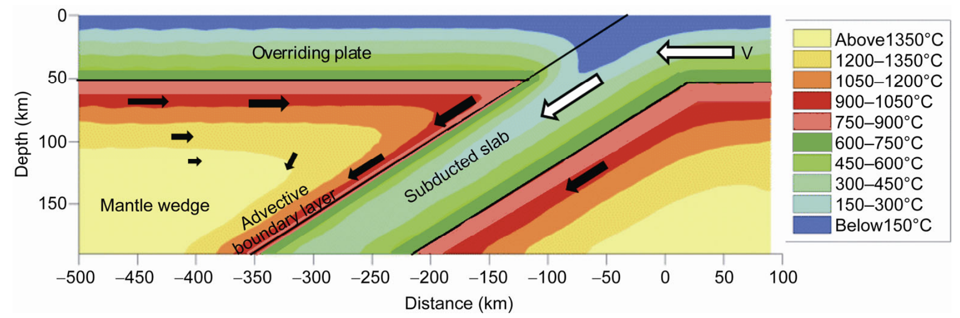
Many studies have noted low seismic velocity, high heat
flow, and high elevations in subduction backarcs (e.g.,
Currie & Hyndman, JGR 2006)
Leng & Wei,
Sci. China
Earth Sci. 2015
The problem is that warming of the slab robs heat from
the asthenospheric wedge (as does melting in arc volcanics)
Modelers get around this by assuming very hot source for
asthenospheric wedge flow (from under cratons!)
Anyone see a problem with that?

Slide 14
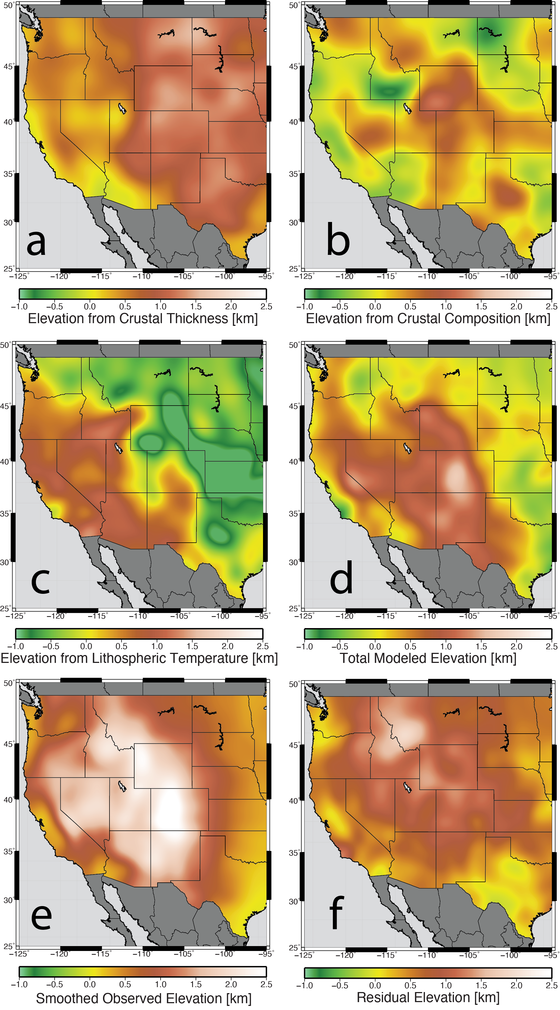
Berry et al. (2022) improved
further on elevation sourcing
(using geotherms from Pn
temperature estimates) and
showed strong correlations
of both crustal and
asthenospheric buoyancy to
thermal disequilibrium from
melting & hydration
thermodynamics!

