Slide 1
GEO 5/6690 Geodynamics
17 Feb 2023
On Monday: Mantle fluid dynamics (R-T instability)
• Anderson hypothesis: Mantle convection is not vigorous
(based on geochemical evidence for distinct reservoirs &
chemical heterogeneity); hence, no whole-mantle plumes!
• Rayleigh-Taylor instabilities may develop when a
dense layer occurs above a buoyant layer. Perturbations
w of the layer boundary grow exponentially as
with timescale τ_{a} dependent on layer thickness b,
viscosity η, gravity g, density contrast, and wavelength λ:
Read for Wed 22 Feb: T&S §7.1–7.4
© A.R. Lowry 2023

Slide 2
Last Time: Kellogg et al.
• Geochemical evidence for distinct reservoirs & chemical
heterogeneity & total heat energy flux imply mantle requires
two-layer convection…
• Instead of layering at 660, proposed a lower mantle layer
• Denser composition would have to be Fe + Si enriched in
order to match seismic observations of slightly slower V_{S}
(but only a few % difference from “normal” lower mantle)

Slide 3
First Assignment:
Will post on web this pm
Due Mar 3 at 1:30 pm
Next reading Assignment:
(Monday Feb 27)
Castellanos et al. (2020)
Science Advances 6(28)
#eabb0476

Slide 4
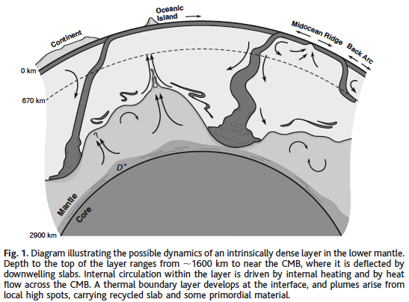
Compositional layering of mantle convection
was previously inferred from basalt compositions… But
argument/uncertainty as to where (660, or 1600 km?)
From Kellogg et al., 1999

Slide 5
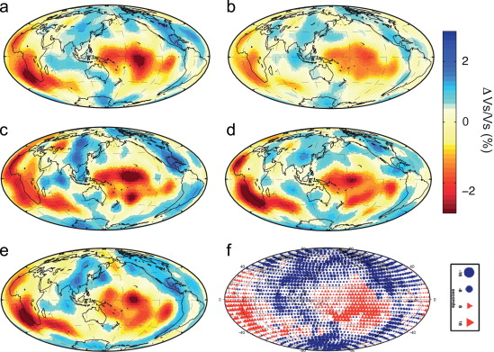
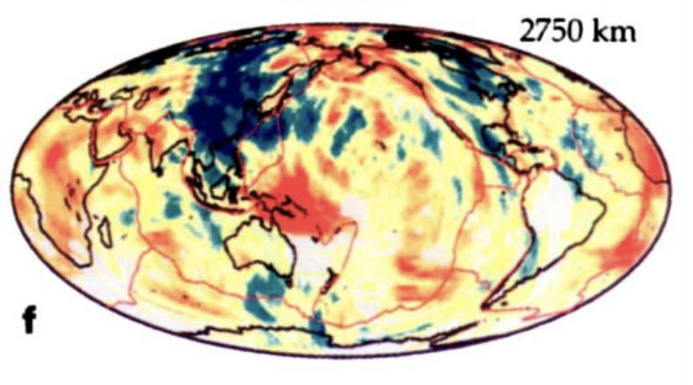
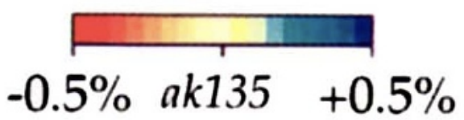
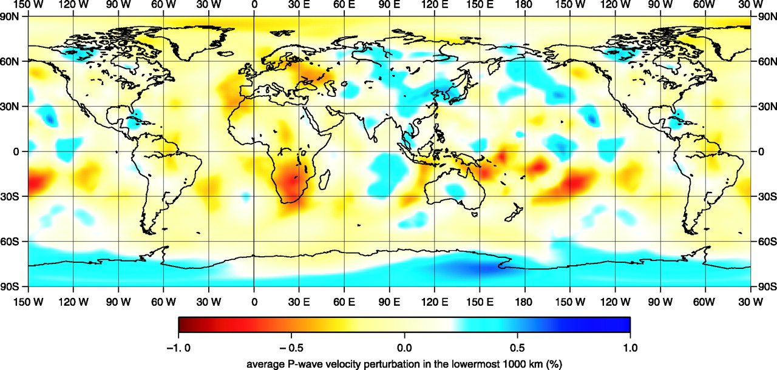
Lekic et al., EPSL 2012
5 models @ 2800 km
Van der Hilst et al., 1997
Deep mantle
tomography
has come a
long way
…
Montelli et al.,
Science 2004

Slide 6
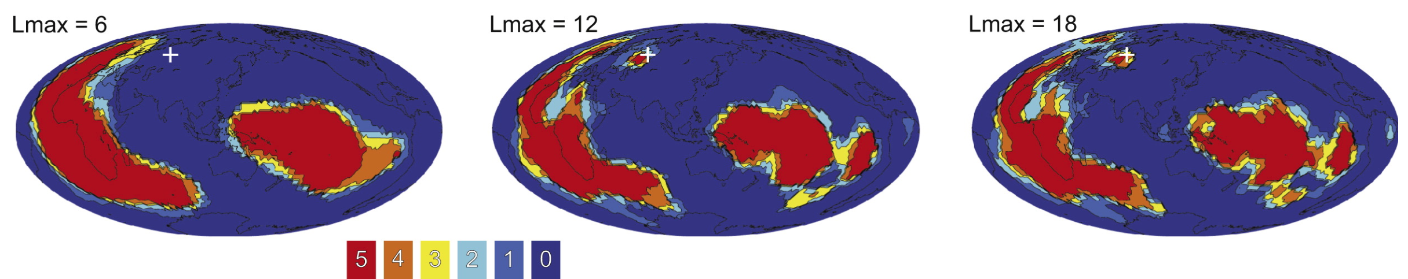
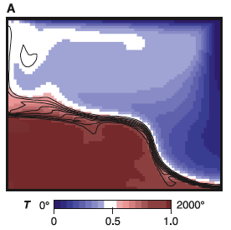
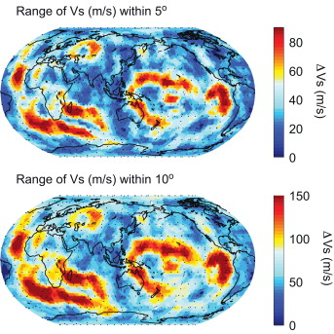
Lekic et al., EPSL 2012
Kellogg et al., Science 1999
Current models ~agree & show
sharp boundaries on anomalies!

Slide 7
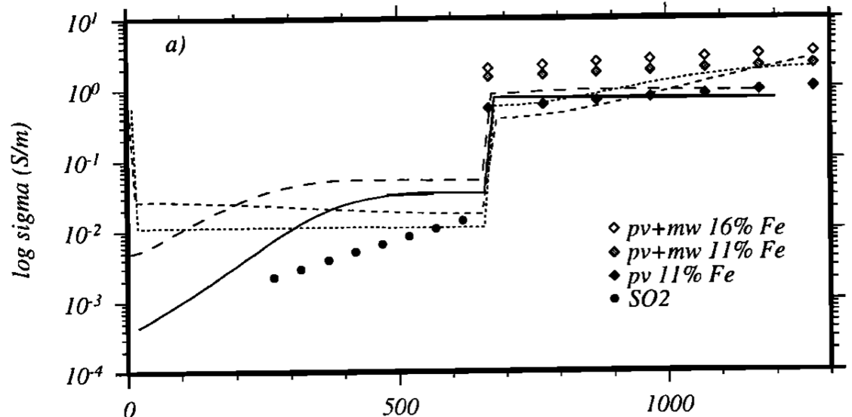
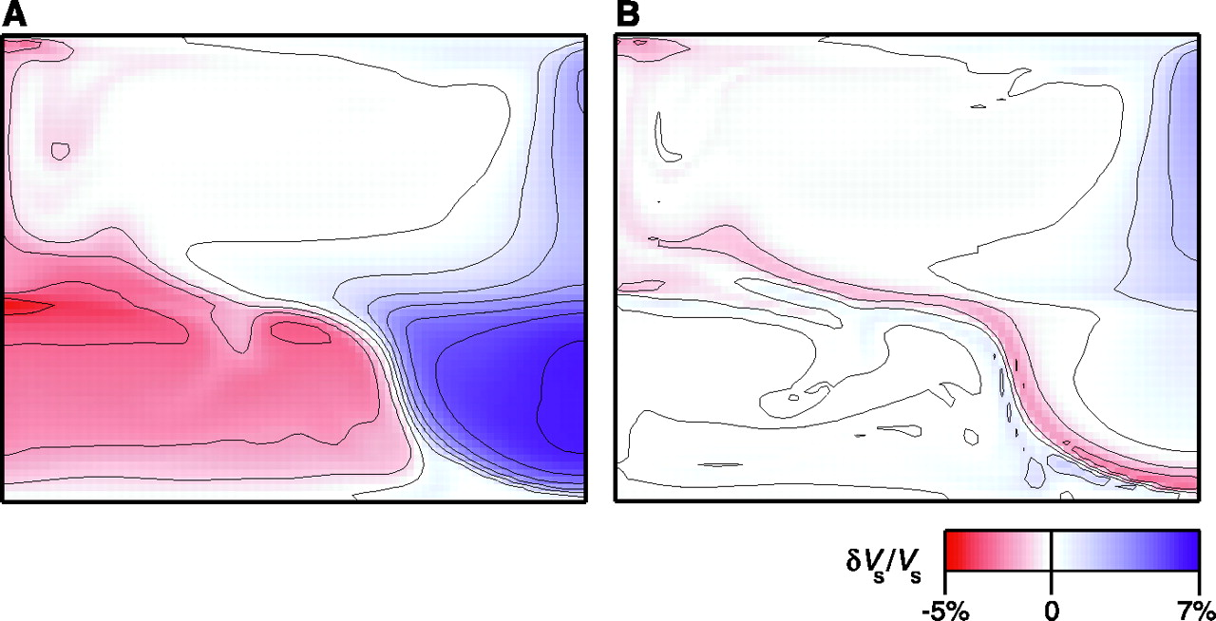
Dashed: Hawaii
Intriguingly,
lower-mantle
electrical
conductivity is
higher under
Hawaii than under
cratonic North
America; requires
a compositional
difference in iron
or water…
Iron content is the
more plausible
explanation.
Solid: Eastern Canada
Neal et al., JGR 2000
Iron
Silica
Kellogg et al., Science 1999

Slide 8
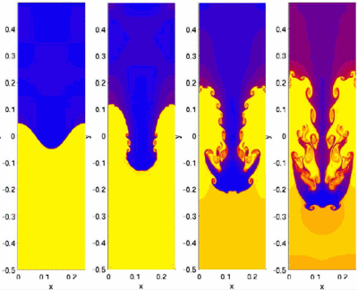
Credit:
S. Li &
H. Li,
LANL
Can we observe this in the Earth’s mantle?

Slide 9
Some useful things to think about:
What should a drip “look like”?
• In gravity?
• In surface elevation?
• In resulting lithospheric stress?
• In crustal thickness?
• In surface heat flow?

Slide 10
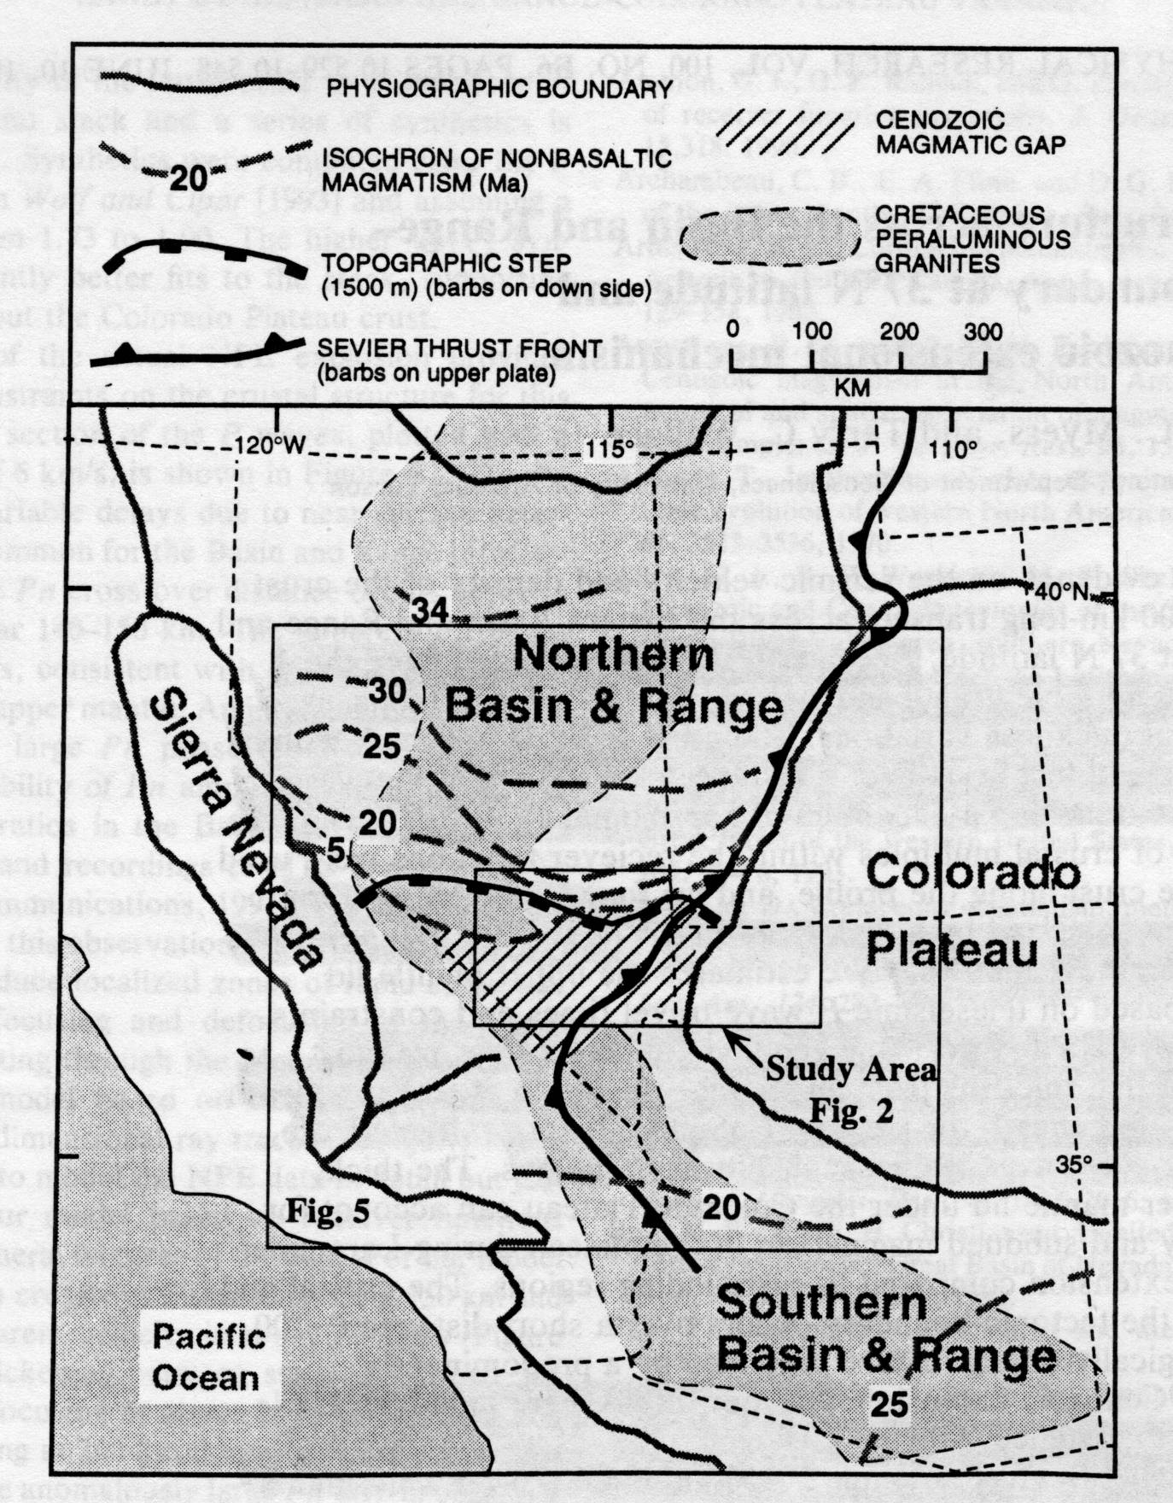
Generalized
physiographic
and tectonic
map of the
southwestern
United States

Slide 11
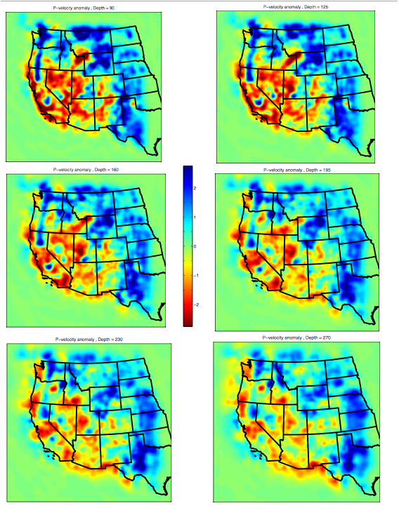
90 km
125 km
Tomographic images
(Schmandt et al, EPSL
2010)
160 km
195 km
230 km
270 km

Slide 12
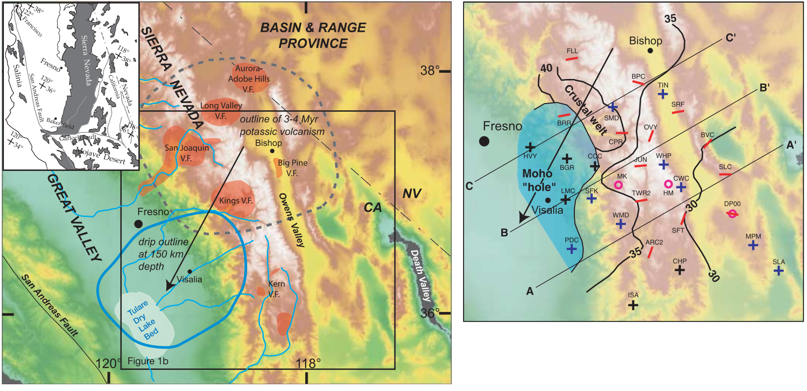
Zandt et al., Science, 2004
Unusual potassic volcanism (3-4 Ma) connects to a “finger”
of (seismically high-velocity →) “cold” mantle dipping to SW;
this also connects to thickened crust (> 40 km) and a zone
where the Moho cannot be imaged seismically (?)

Slide 13
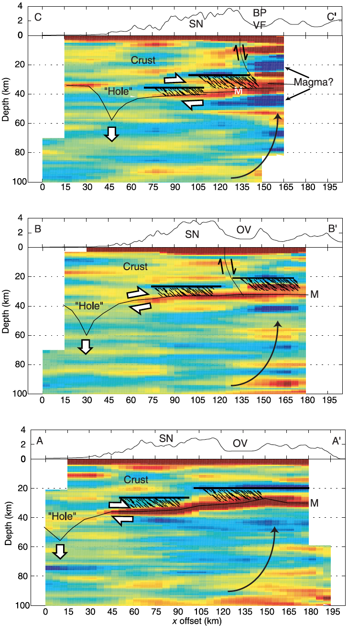
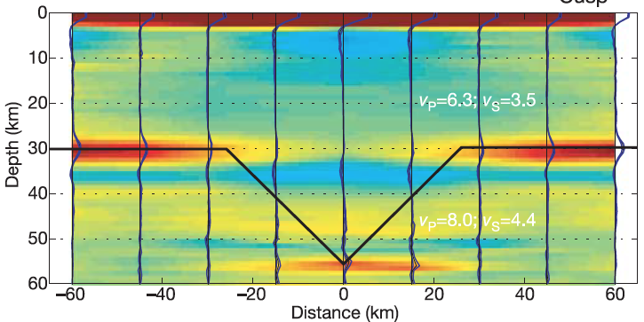
Possible explanations
for a lack of imaged Moho:
Localized zone of low S wave velocity in uppermost mantle
Moho topography scatters Ps conversion
Synthetic modeling supports 2nd explanation (but either would work!)

Slide 14
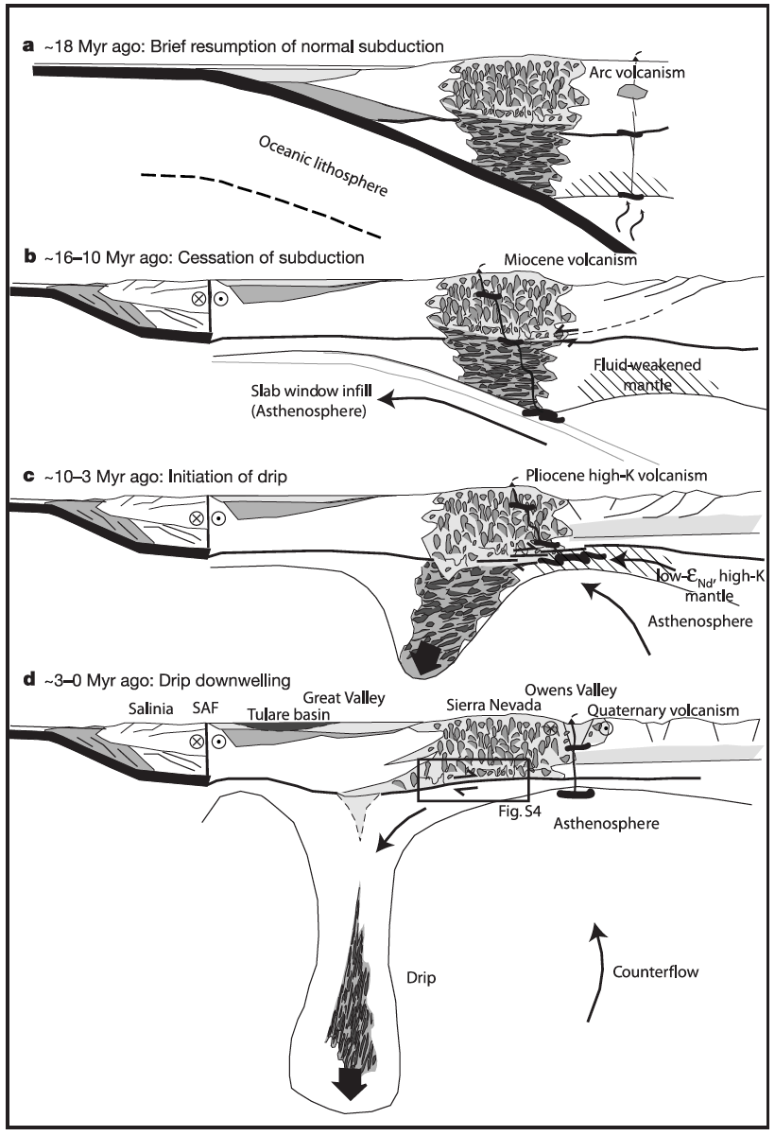
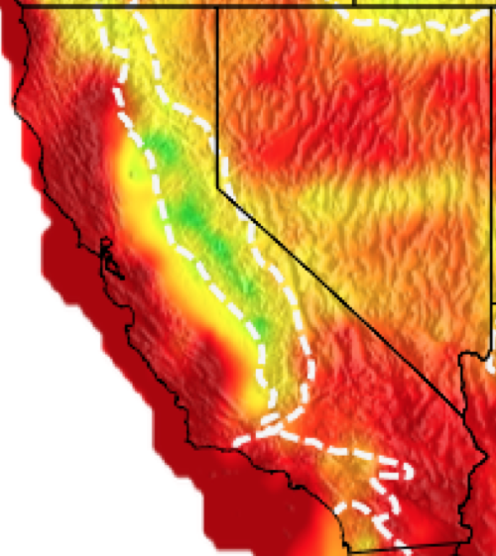
But… Why are the Moho
perturbation and deeper
seismic velocity anomaly
displaced to the west?
Zandt et al. 2004

