Slide 1
GEO 5/6690 Geodynamics
17 Mar 2023
Last Time: Yield Strength Envelopes
Yield Strength Envelopes approximate maximum
deviatoric stress difference supported by the
lithosphere; assume a pressure-dependent brittle-field rheology
(friction coefficient, pore fluid pressure) plus ductile flow…
Flow Rheology depends on mineral-type (i.e. lithology),
temperature, pressure, & volatile state (especially hydration!)
Diffusion also depends on grain size, but dominates for very
small (<50 μm) grain size or very low stress (asthenosphere)
Temperature can be estimated from seismic velocity plus
mineral physics (often with large uncertainties)!
Read for Mon 20 Mar: T&S §8.1-8.7
© A.R. Lowry 2023

Slide 2
Next Journal Article Reading:
For Wednesday Mar 22: Liu & Hasterok
(2016) Science, 353(6307), 1515-1519.

Slide 3
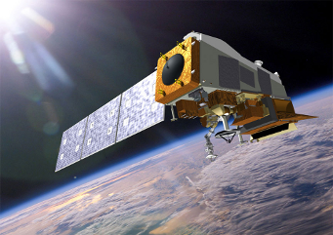
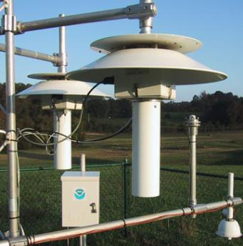
Integrative Dynamics: Weather Forecasting
Temperature
Pressure
Water
⬇
Flow of Energy
& Matter

Slide 4
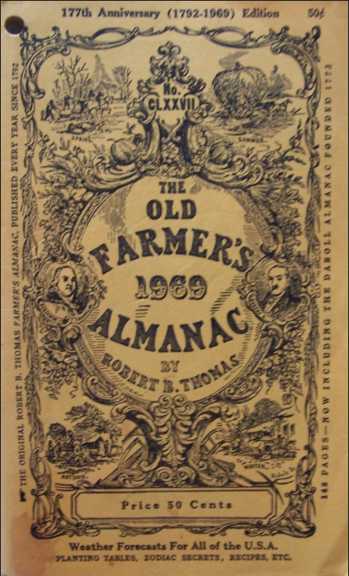
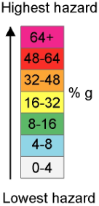
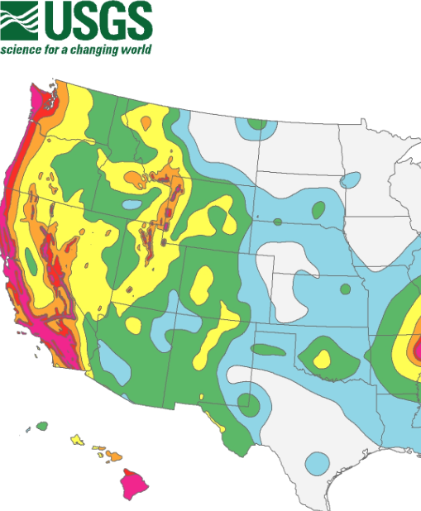
Seismological Forecasting?

Slide 5
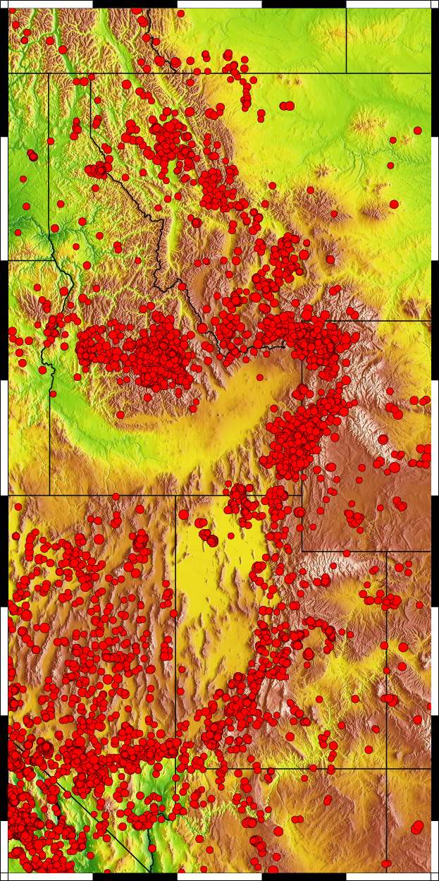
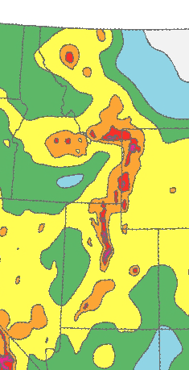
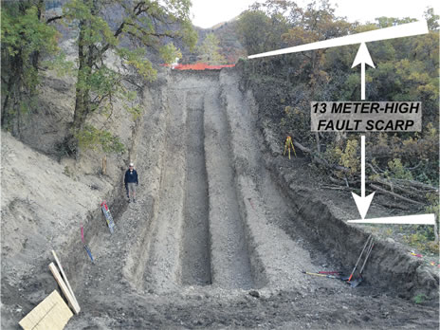
Seismological Forecasting?
Using past earthquakes to
predict future hazard is
challenging because
earthquakes often recur
on timescales much longer
than the historical record!

Slide 6
Seismological Forecasting?
?
?
?
M_{w} 6.9 Borah Peak earthquake

Slide 7
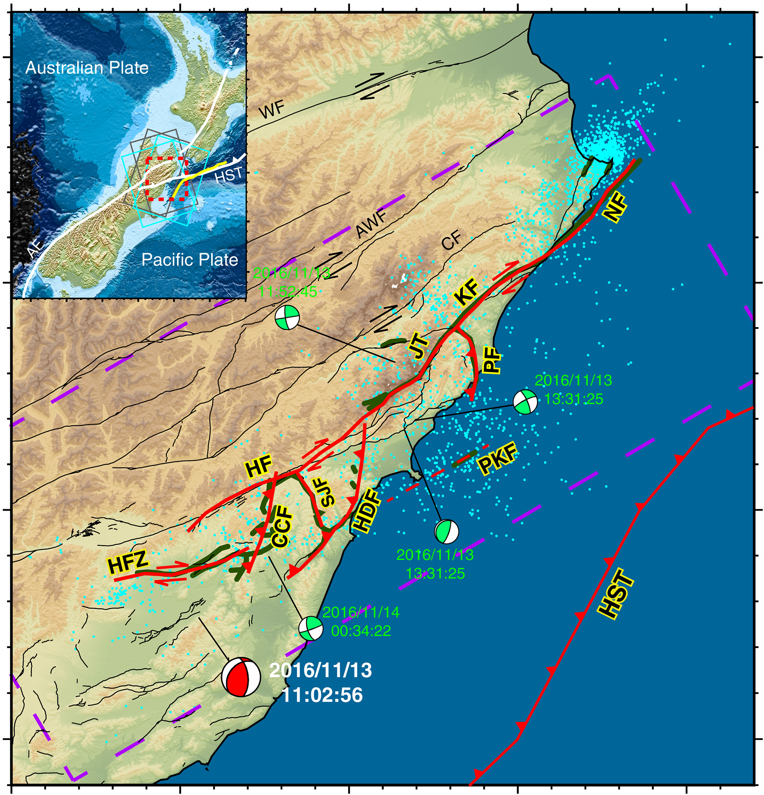
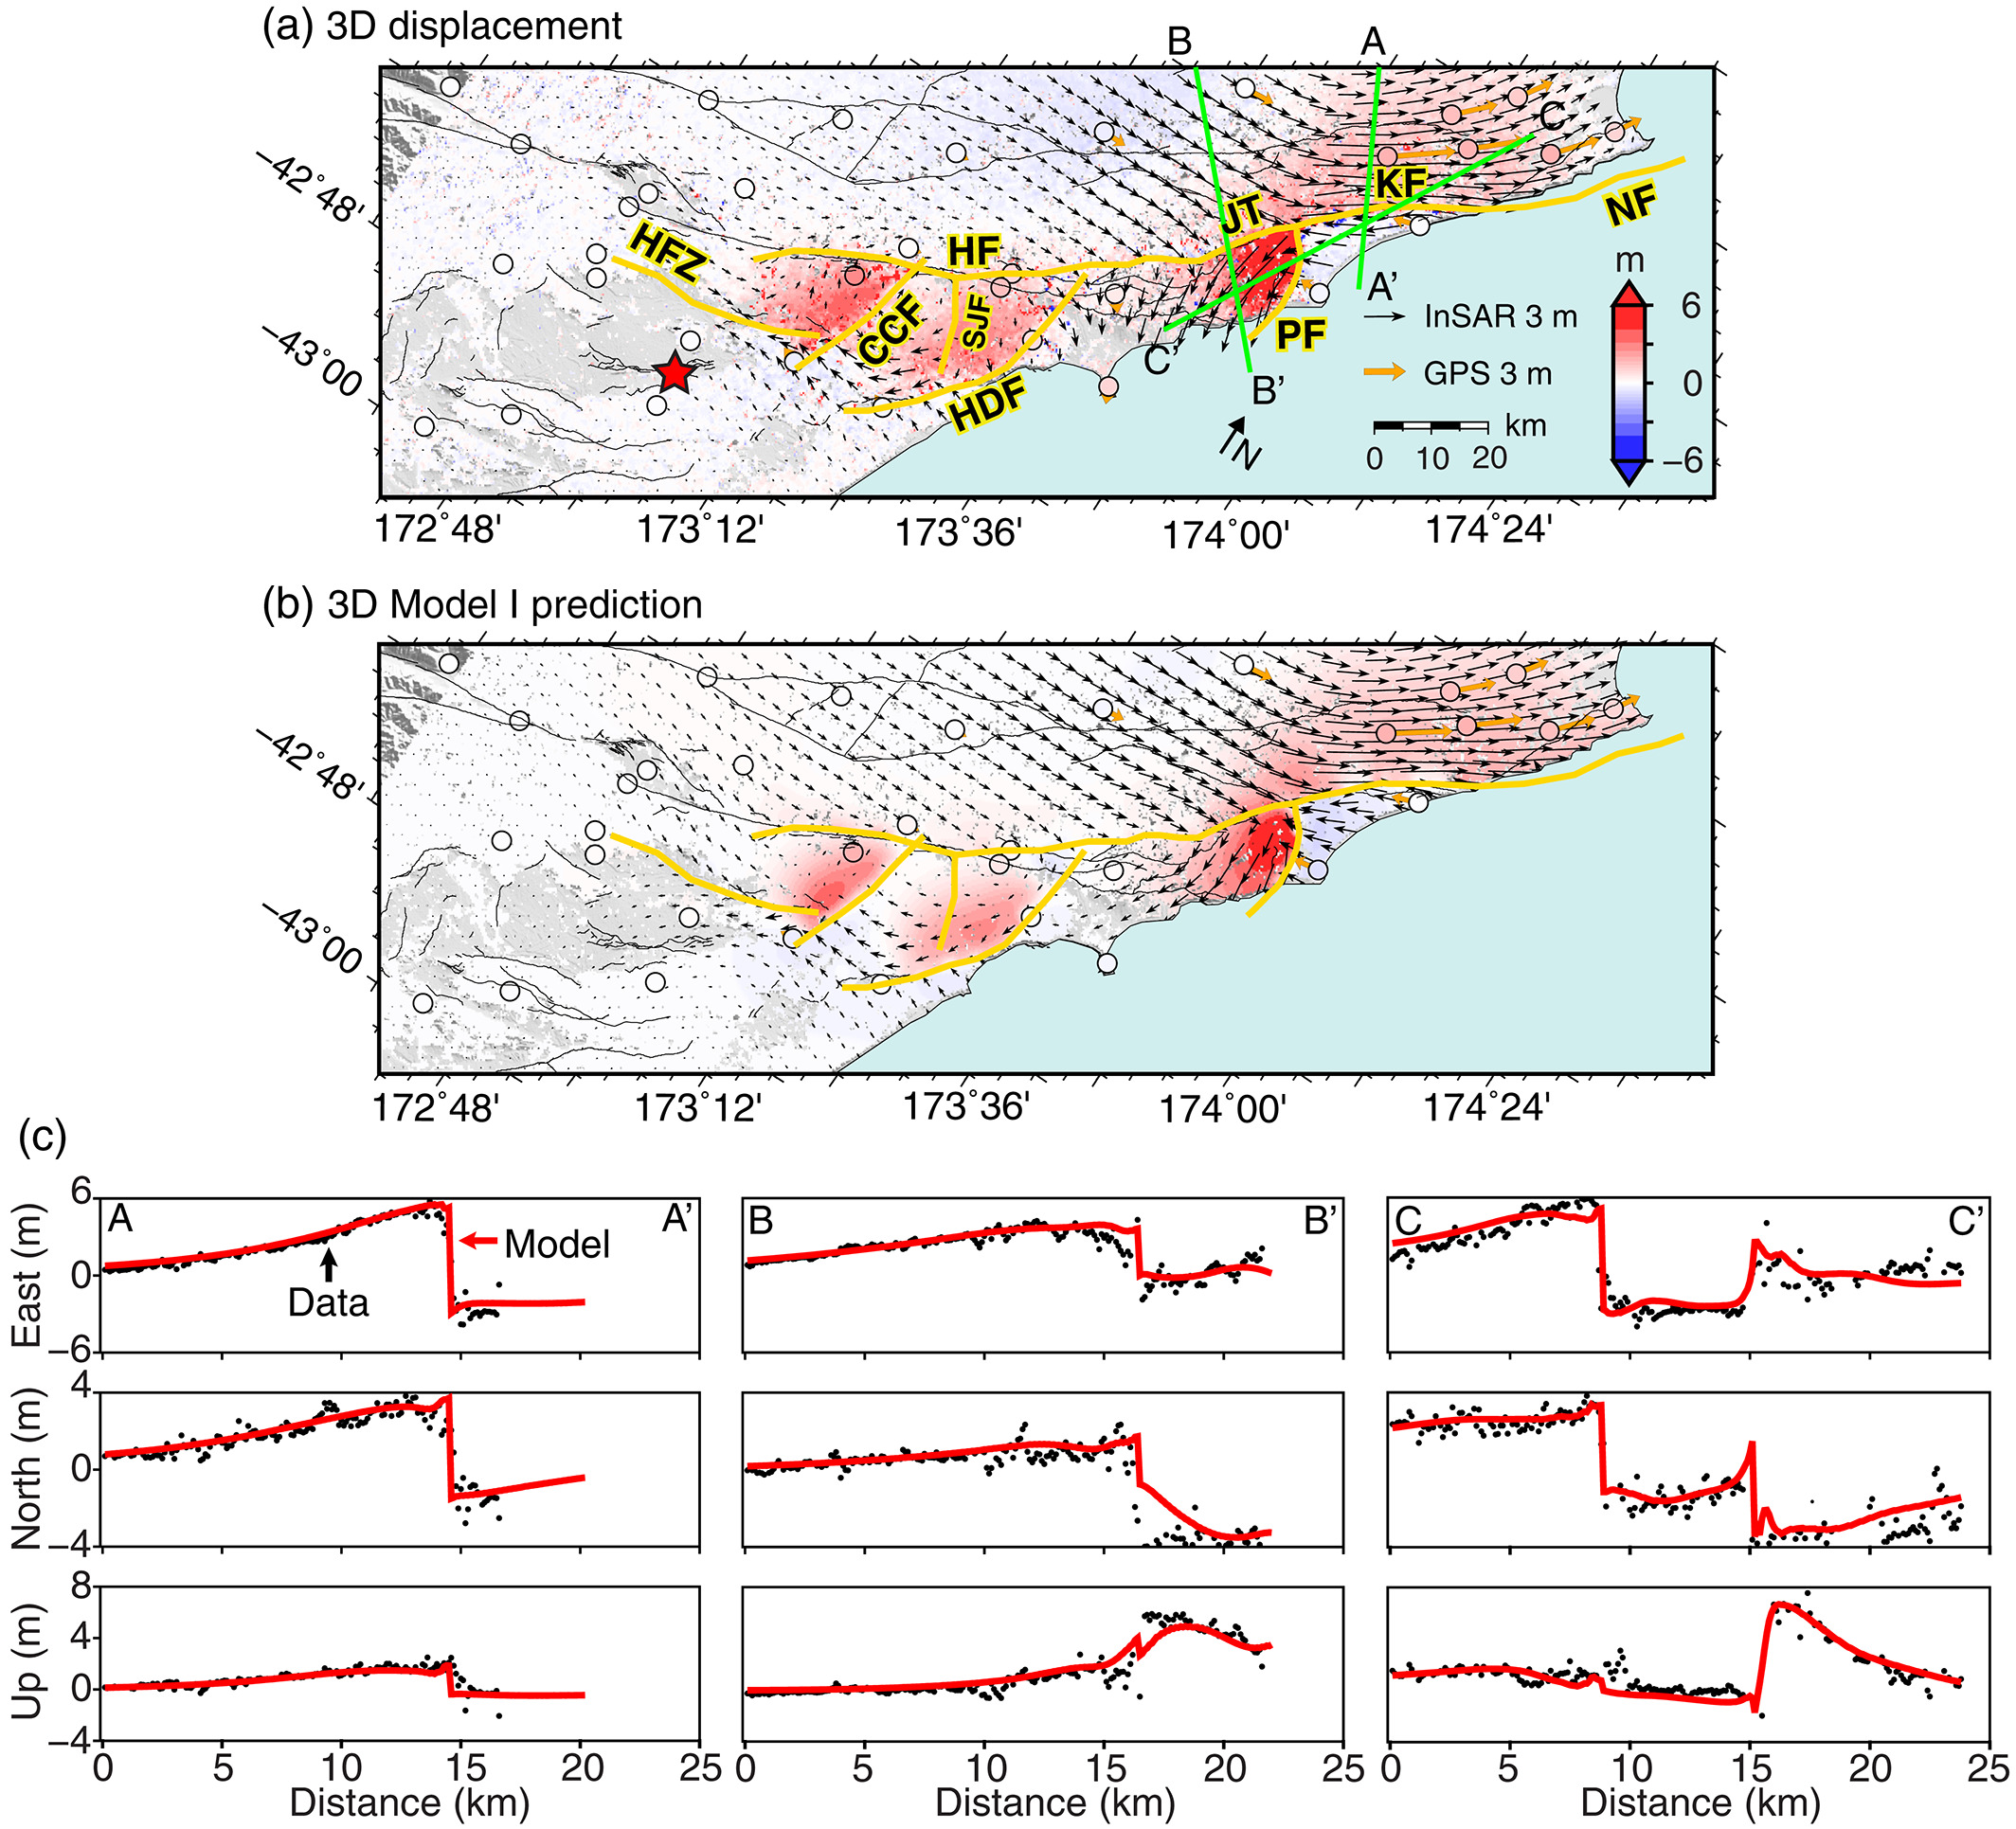
And paleoseismology may miss if fault slip is just one fault
in a much larger, complex event!

Slide 8
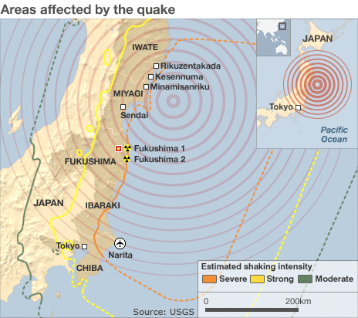
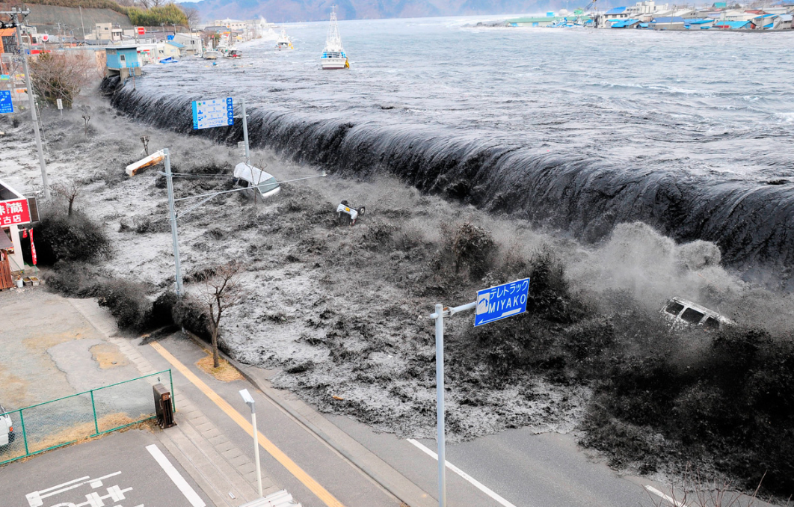
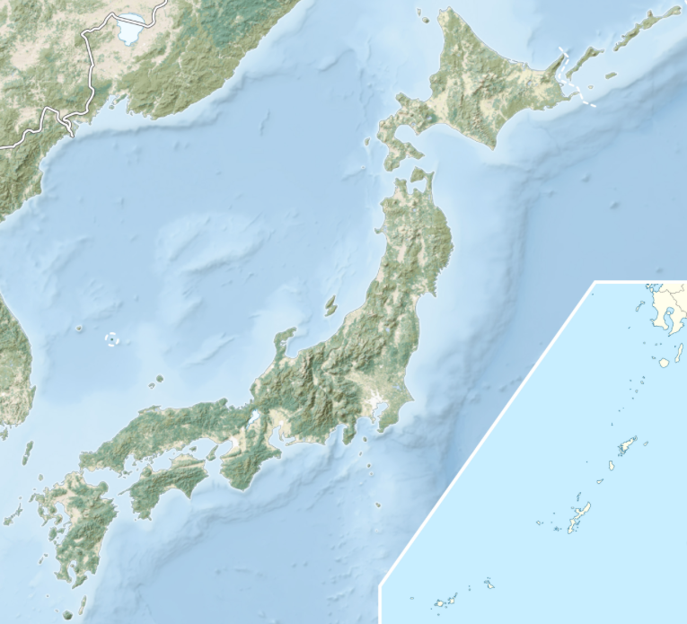
Seismological Forecasting?

Slide 9
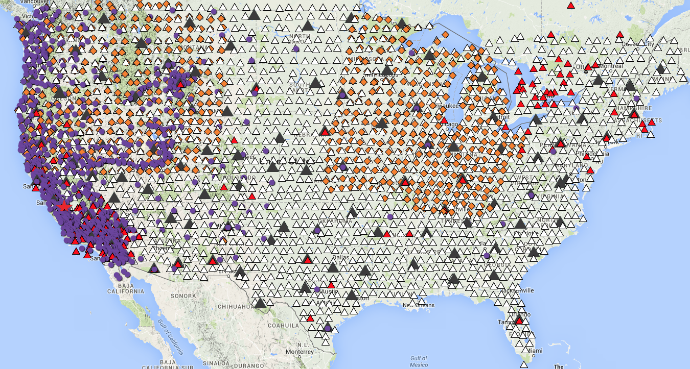
EarthScope
Electrical (MT)
Permanent GPS
Active TA Seismic
Past TA Seismic
Permanent Seismic

Slide 10
Hot?
Wet?
Higher H₂O | Property | Higher Temp.
⬇ | Seismic Velocity | ⬇
⬆ | Electrical Conductivity | ⬆
⬇ | Mass Density | ⬇
⬇ | Flow Strength | ⬇
⬆ | Partial Melt | ⬆
Cold?
Dry?
Slow
Fast
High
Low
!
These are
important
for the
dynamics…
!
!
Notes:
We can animate this so that Seismic velocity, electrical conductivity, mass density, etc are presented one at a time as you talk about them. Then add a slide after this restating that water and temp have similar outcomes.

Slide 11
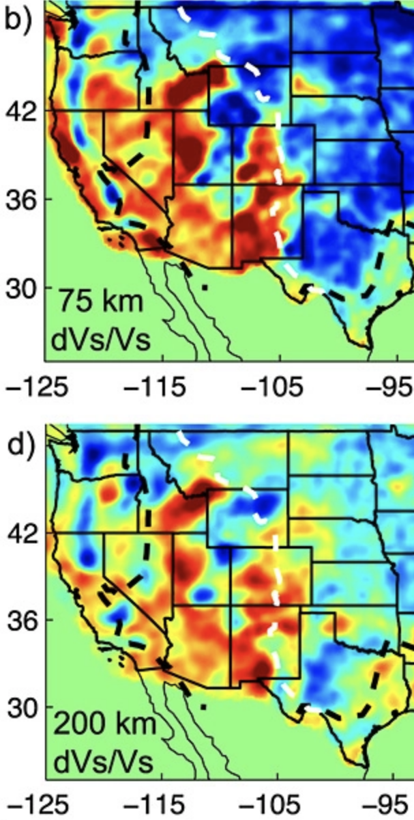
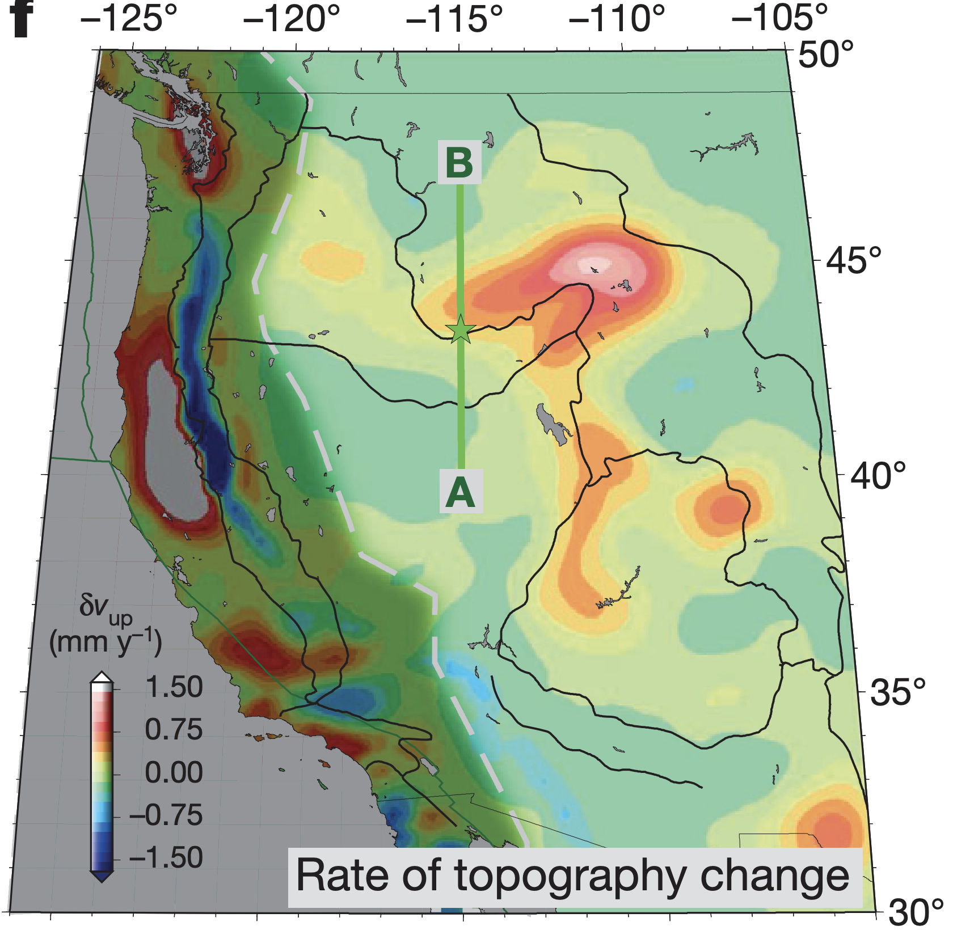
Seismological Forecasting?
Temperature
(Flow Modeling)
T
ρ
Schmandt & Lin, GRL 2014
Mass
Density
Becker et al., Nature 2015
Seismic Velocity
Rate-Change Vertical Stress

Slide 12
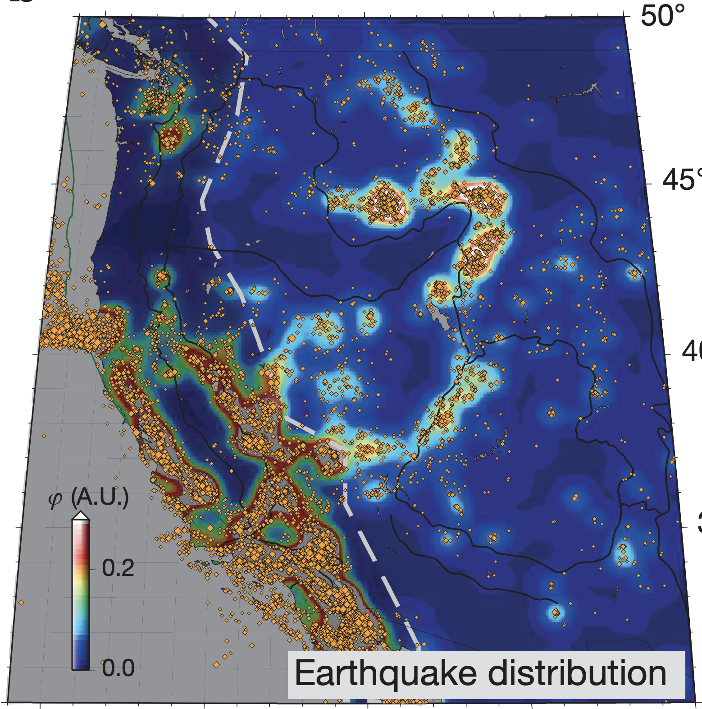
Seismological Forecasting?
Becker et al., Nature 2015
Seismicity (M ≥ 3.5)
Rate-Change Vertical Stress

Slide 13
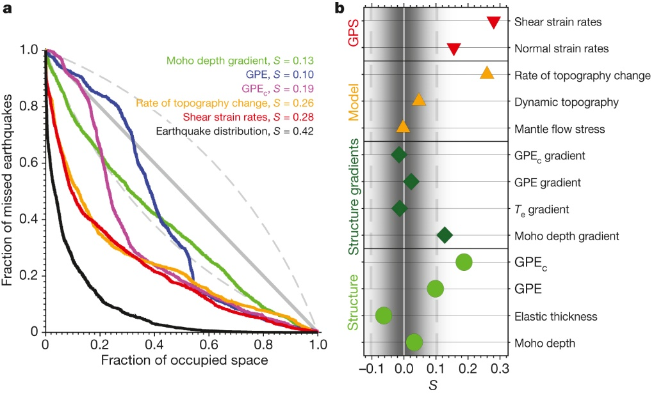
Seismological Forecasting?

Slide 14
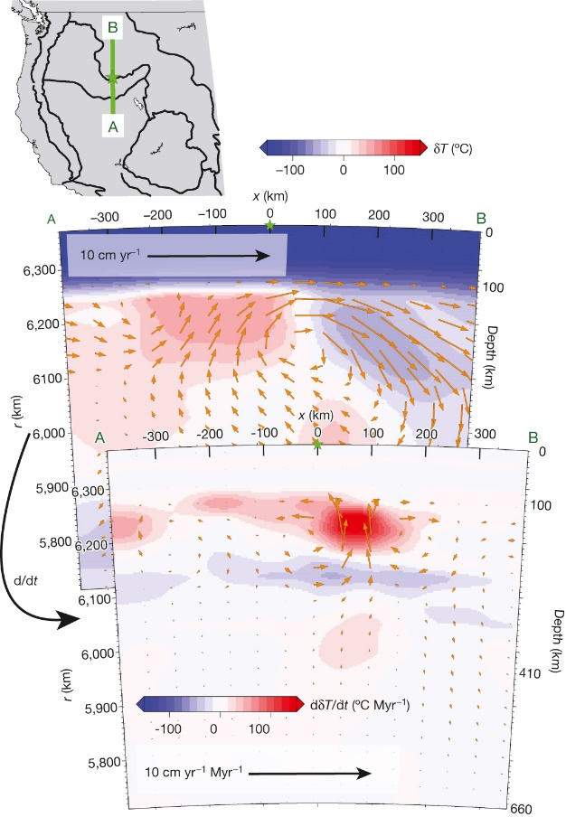
Seismological Forecasting?
Becker et al.,
Nature 2015
MECHANISM:
• Buoyancy increases lithospheric
extensional stress
• Buoyancy change is greatest at
the juxtaposition of
upwelling and downwelling flow!

Slide 15
Lithospheric Stress from a Sinking Blob…
Viscous flow model
No free surface!
With free surface!
Elastic lithosphere!

Slide 16
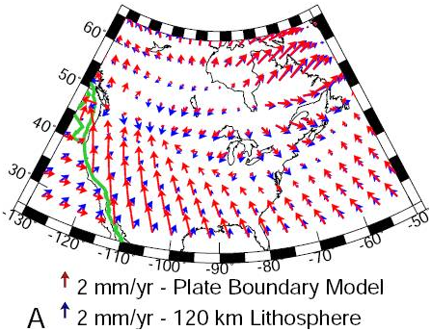
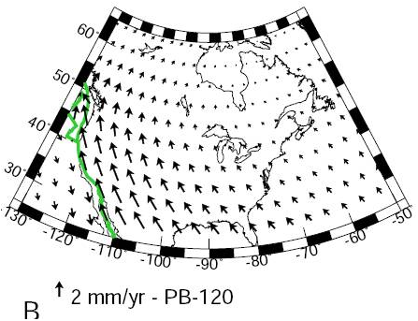
Strain response can depend heavily on assumptions
about rheology of the lithosphere!
Expect to see significant focusing of strain in zones of
rheological weakness, even if those zones are far from
the edges of the ice sheet. Note plate-like behavior and
strain focusing along San Andreas for this model…

