Slide 1
Geology 5690/6690
Geodynamics
18 Jan 2023
Last Time: The Geotherm
Four Modes of Heat Transfer:
• Conduction (Molecular collisions = slow & inefficient)
• Convection (Thermal buoyancy-driven flow in general
circulation = very efficient, relatively rapid)
• Advection (Heat carried by material flux other than
thermally-driven general-circulation flow)
• Radiation (At quantum level, thermal kinetics can
convert to a photon or photons can be absorbed &
converted to thermal energy)
Convection dominates in the mantle > 1300°C;
conduction dominates “Thermal Boundary Layer”
(but advection can be significant!)
Read for Fri 20 Jan: T&S §4.1-4.12
© A.R. Lowry 2023

Slide 2
First Journal Article Reading:
For Monday Jan 23: Furlong & Chapman,
Ann. Rev. Earth Planet. Sci. 41, 385-410
(2013).

Slide 3
The Geotherm:
0
Temperature
1200-1400 ºC
0
Conductive
50-300
km
Adiabat: Temperature
increases with pressure
but energy doesn’t
change
Depth
Convective

Slide 4
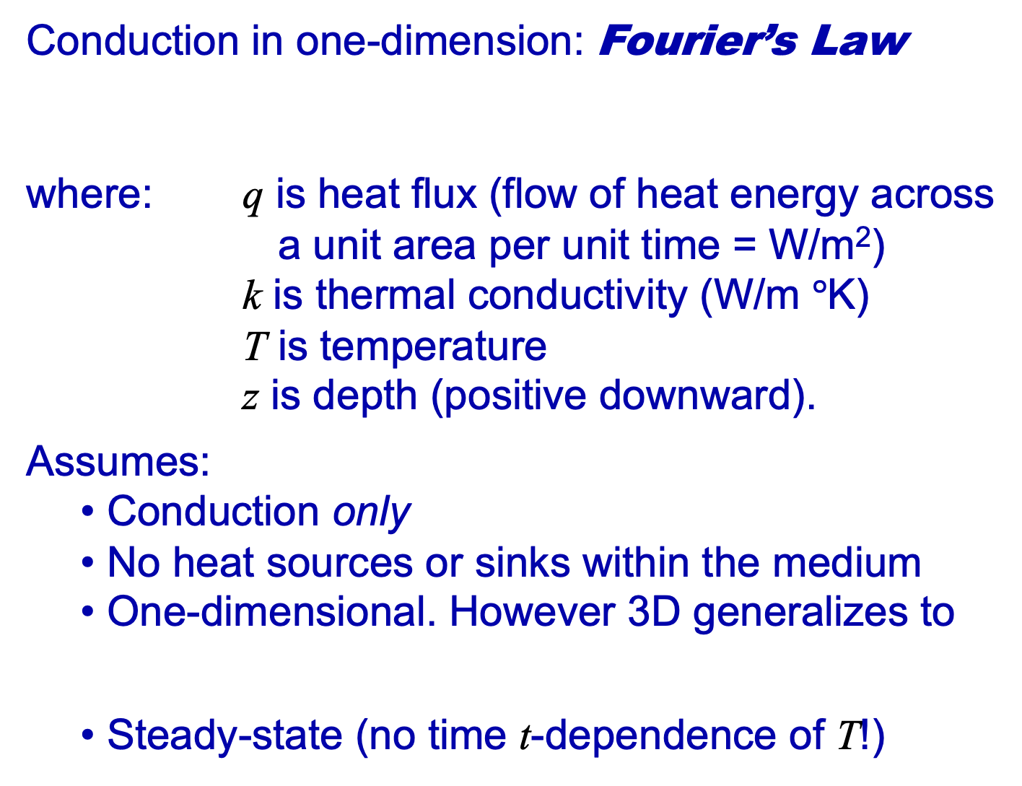
Conduction in one-dimension: Fourier’s Law
where: q is heat flux (flow of heat energy across
a unit area per unit time = W/m²)
k is thermal conductivity (W/m $°$K)
T is temperature
z is depth (positive downward).
Assumes:
  Conduction only
  No heat sources or sinks within the medium
  One-dimensional. However 3D generalizes to
  Steady-state (no time t-dependence of T!)

Slide 5
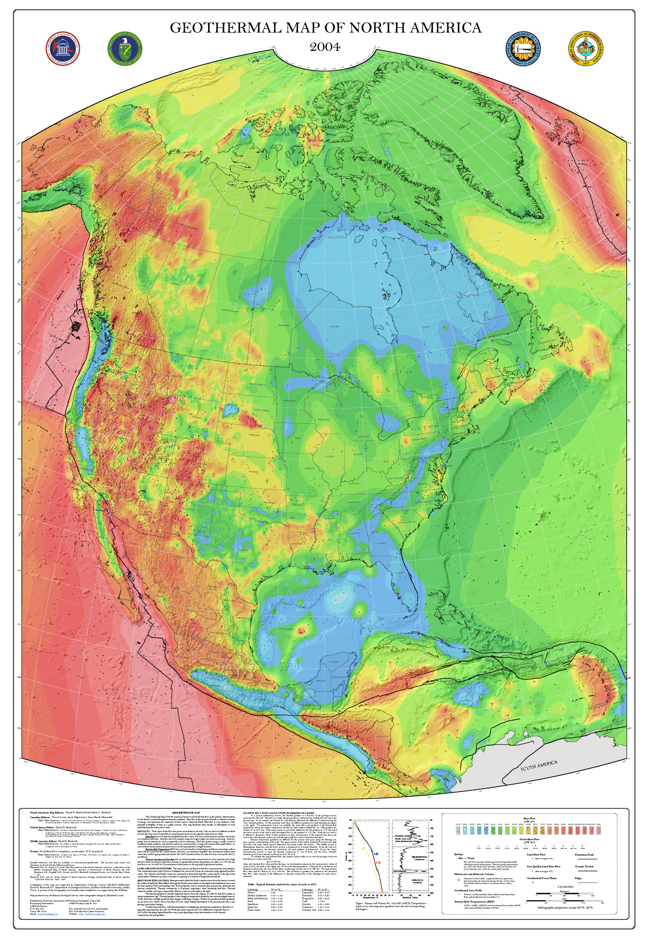
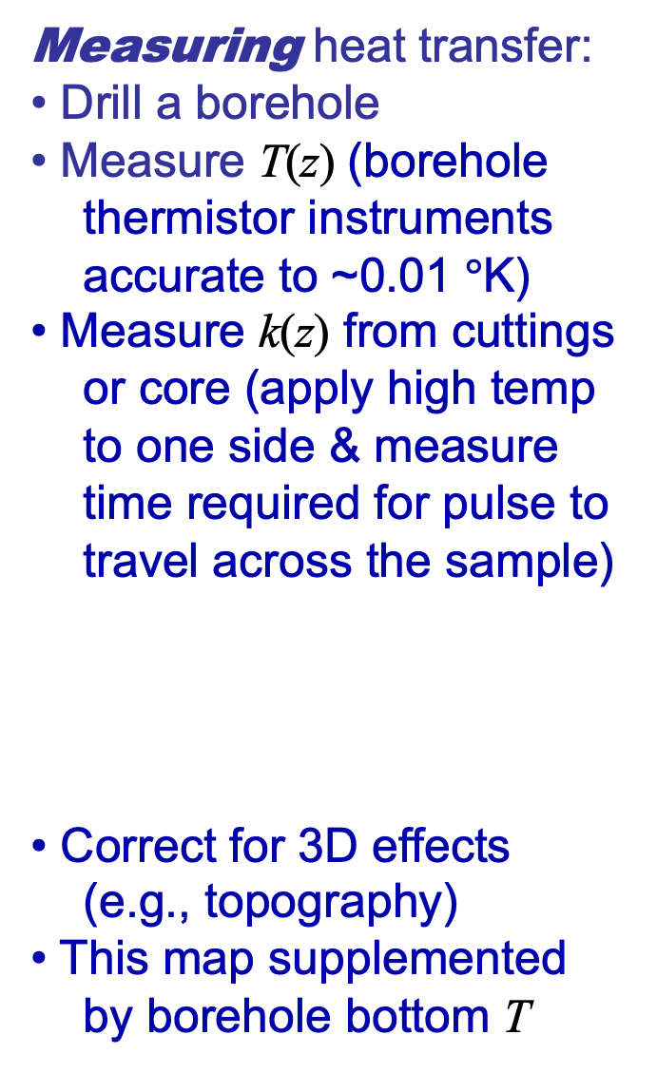
Measuring heat transfer:
• Drill a borehole
• Measure T(z) (borehole
thermistor instruments
accurate to ~0.01 $°$K)
• Measure k(z) from cuttings
or core (apply high temp
to one side & measure
time required for pulse to
travel across the sample)
• Correct for 3D effects
(e.g., topography)
• This map supplemented
by borehole bottom T
Blackwell and Richards (2004)
map of surface heat flow q_{S}

Slide 6
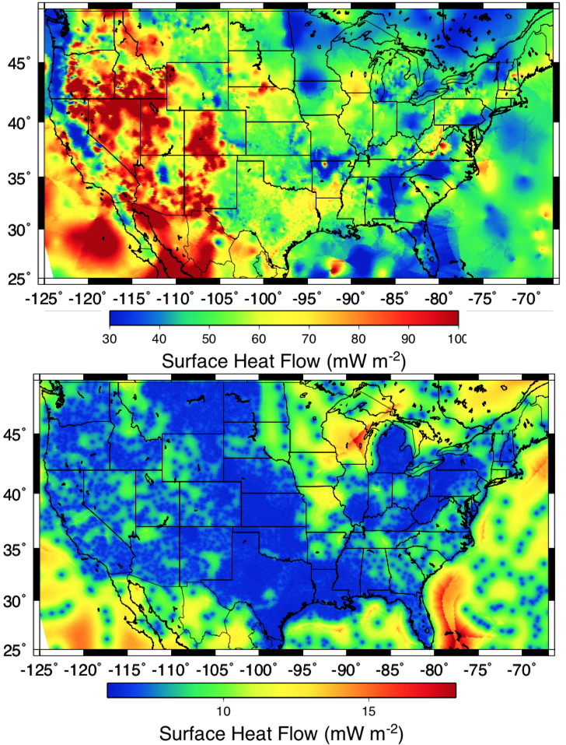
Here’s a slightly different
version just for the
conterminous United
States. The top is surface
heat flow; the bottom is
one-sigma uncertainty
(predominantly related
to sampling limitations)

Slide 7
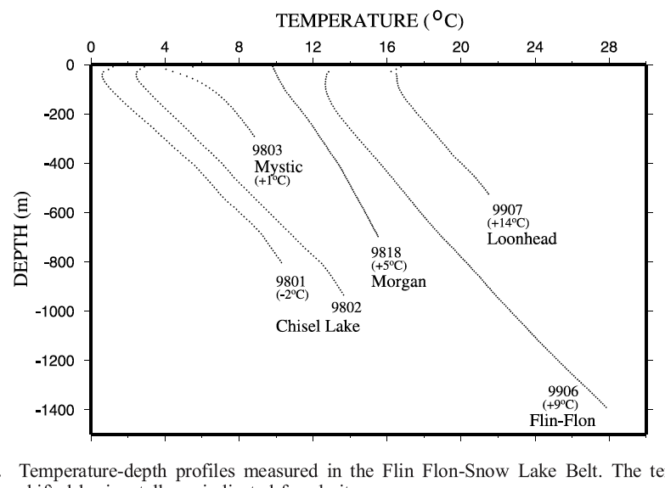
Measurements of surface heat flow:
• Measure temperature T versus depth z in
a borehole
• Measure thermal conductivity k of rock
versus depth (from cuttings or core)
• Calculate q
using
Rolandone et al., JGR 2002

