Slide 1
Dehydration Melting at the Top of the Lower Mantle
Presentation made by Jacob Cooley

Slide 2
What is this paper about?

Slide 3
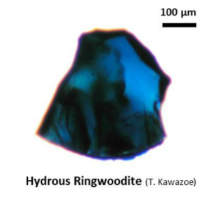
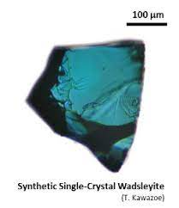
Ringwoodite and Wadsleyite & The Mantle Transition Zone
Ringwoodite & Wadsleyite – High-pressure olivine polymorphs found in the mantle transition zone (410 to 660 km depth)
High Water Storage Capacity

Slide 4
Fig. 1 Laboratory experiments on hydrous ringwoodite.
(A) Single-crystal of hydrous ringwoodite (blue crystal) containing 1 wt % H2O inside a DAC at 30 GPa. The sample was laser heated to 1600°C in several spots (orange circles) to perform direct transformation to perovskite and (Mg,Fe)O. (B) Synchrotron-FTIR spectra of the recovered sample in three locations: an unheated part of the crystal (spectrum 1) and two locations within laser-heated spots (spectra 2 and 3). FTIR spectra were collected with a 10 μm by 10 μm aperture, illustrated and numbered by white boxes in (A). (C) TEM within a laser-heated spot (position 2) shows crystals of perovskite and intergranular amorphous quench (melt).

Slide 5
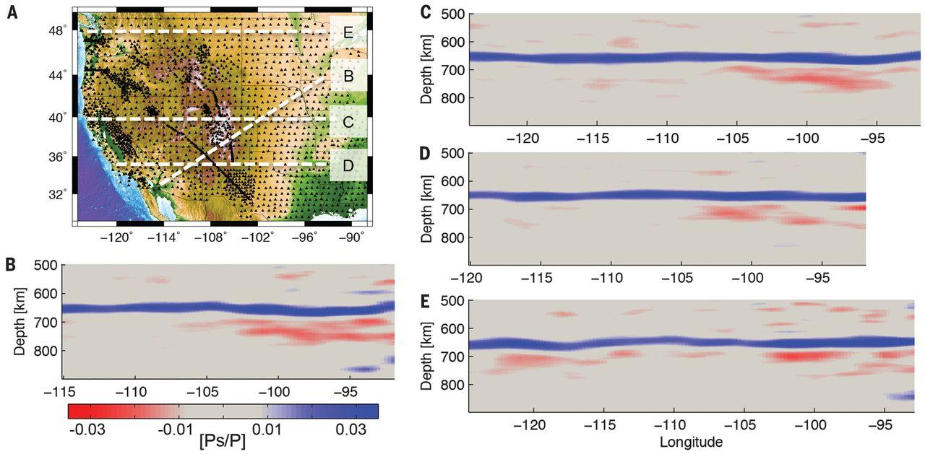
Fig. 2 Vertical cross-sections through the CCP image.
(A) Map of the study region with broadband seismometers denoted by black triangles and the locations of vertical cross-sections shown in (B) to (E) denoted by white dashed lines. (B) Vertical cross-section through the CCP image. The location of the eastern end of the cross-section is shown as Bʹ in (A). The 660, which separates the transition zone and lower mantle, is clearly imaged by 2.5 to 4% amplitude positive Ps/P arrivals in all cross-sections. Negative arrivals beneath the 660 have amplitudes ≤2.2%. (C to E) Vertical cross-sections through the CCP image beneath the three other lines labeled in (A).

Slide 6
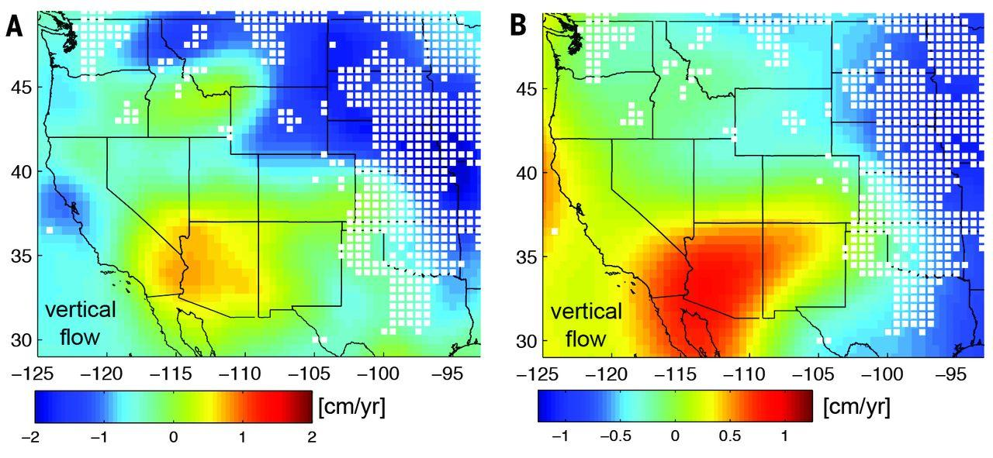
Fig. 3 Vertical flow between the transition zone and lower mantle.
(A) The background color shows the vertical flow velocity at the boundary between the transition zone and lower mantle predicted by a mantle circulation model using density structure inferred from the SH11-TX tomography model. White squares denote locations where the seismic CCP image detects velocity decreases with depth in the depth range of 670 to 800 km. (B) The background color shows the vertical flow velocity predicted using the S40RTS tomography model. In both models, velocity decreases near the top of the lower mantle are absent beneath the southwestern United States where upward flow is predicted and prevalent in areas where downward flow into the lower mantle is predicted.

Slide 7
Fig. 4 Distributions of vertical flow and seismic velocity variations at 660 km.
(A) Probability density functions (PDFs) of vertical flow velocity at 660-km depth from the convection model using SH11-TX tomography. The PDF in red represents the subset of the CCP image where negative velocity gradients are detected beneath the 660 (sub-660 NVG), and the PDF in black represents the cumulative area from the CCP image. The cumulative area of the CCP image includes the area within 200 km of the seismometers shown in Fig. 2A. (B) PDFs of vertical flow velocity from the convection model using S40RTS tomography. (C) PDFs of mantle shear velocity variations near the 660 from the tomography model SH11-TX. (D) PDFs of mantle shear velocity variations from the tomography model S40RTS.

Slide 9
Supplementary Materials

Slide 10
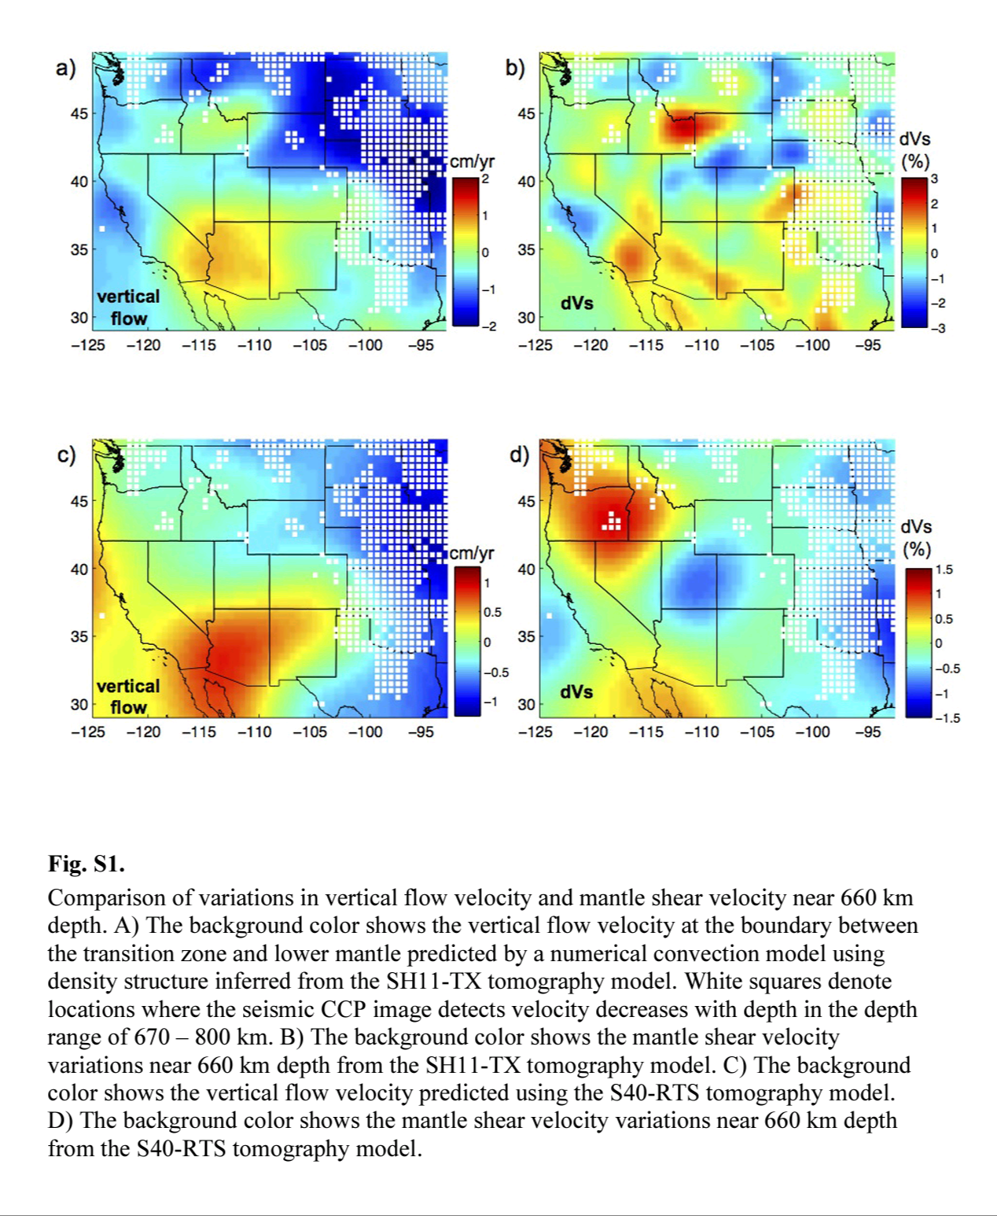
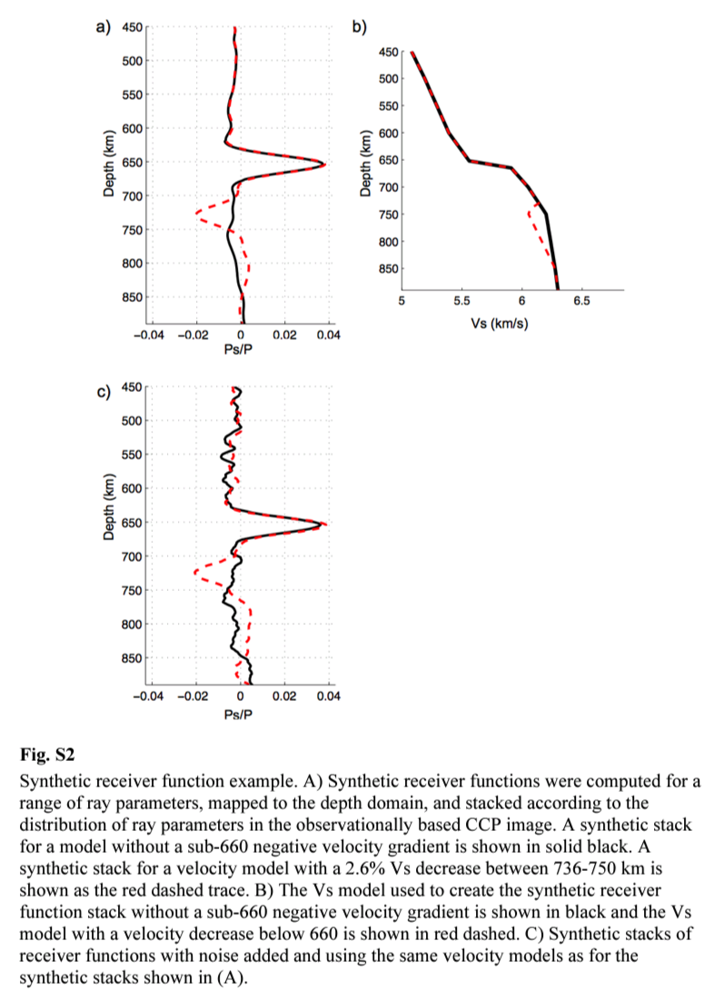

Slide 11
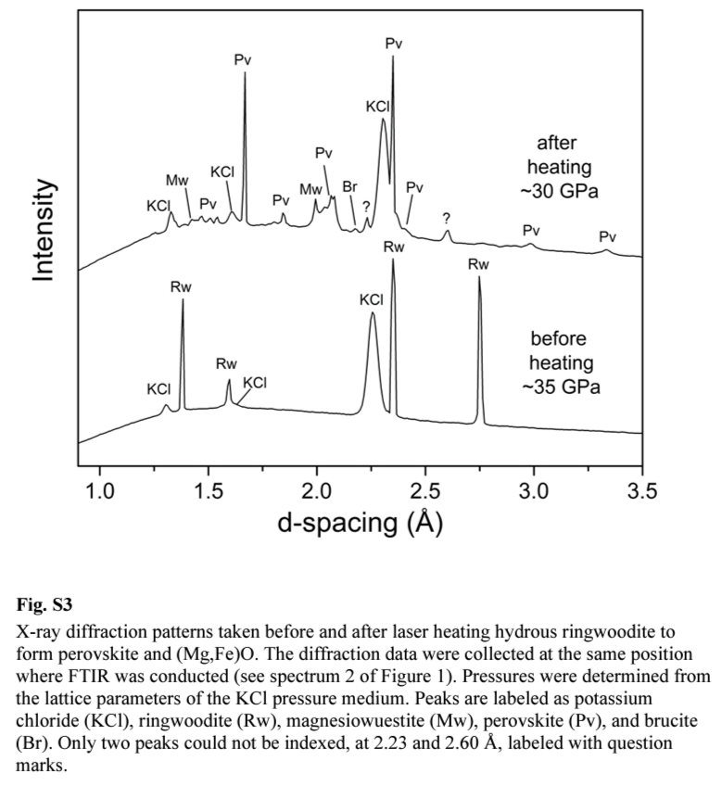
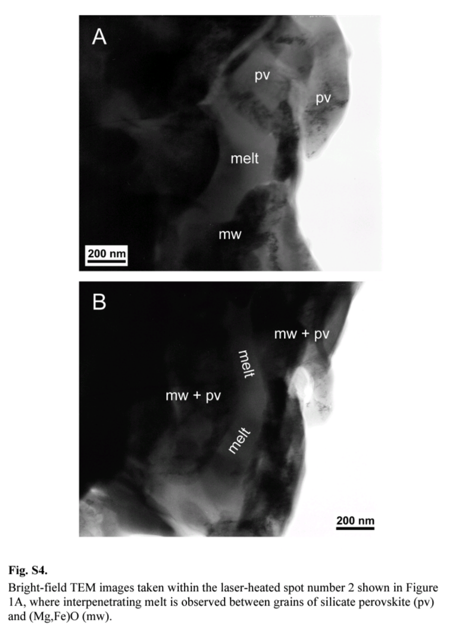

Slide 12
Additional
Excel Data File

Slide 13
