Slide 1
GEO 5/6690 Geodynamics
20 Mar 2023
Last Time: Earthquake System Science… (a thought
exercise)
• Among the greatest scientific achievements of the 20th
century was the development of models with predictive
power to describe future outcomes of highly nonlinear
fluid dynamics (i.e., weather forecasting; climate science)
• This achievement required a confluence of advances in
other fields (computing; sensor technologies; two new
branches of mathematics!)
• Earthquake system science is a grand challenge for the
21st century and will likely require similar advances…
As well as examining our assumptions &
preconceptions, and letting go of existing paradigms
about how the solid Earth behaves
Read for Fri 24 Mar: T&S §8.1-8.7
© A.R. Lowry 2023

Slide 2
Next Journal Article Reading:
For Wednesday Mar 22: Liu & Hasterok
(2016) Science, 353(6307), 1515-1519.

Slide 3
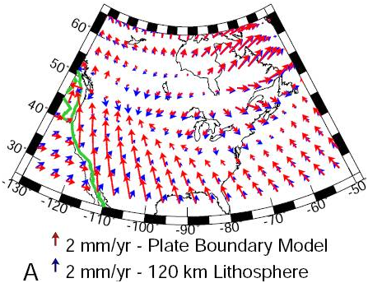
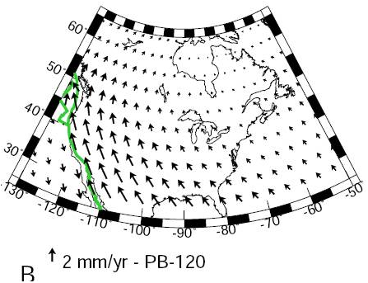
Strain response can depend heavily on assumptions
about rheology of the lithosphere!
Expect to see significant focusing of strain in zones of
rheological weakness, even if those zones are far from
the edges of the ice sheet. Note plate-like behavior and
strain focusing along San Andreas for this model…

Slide 4
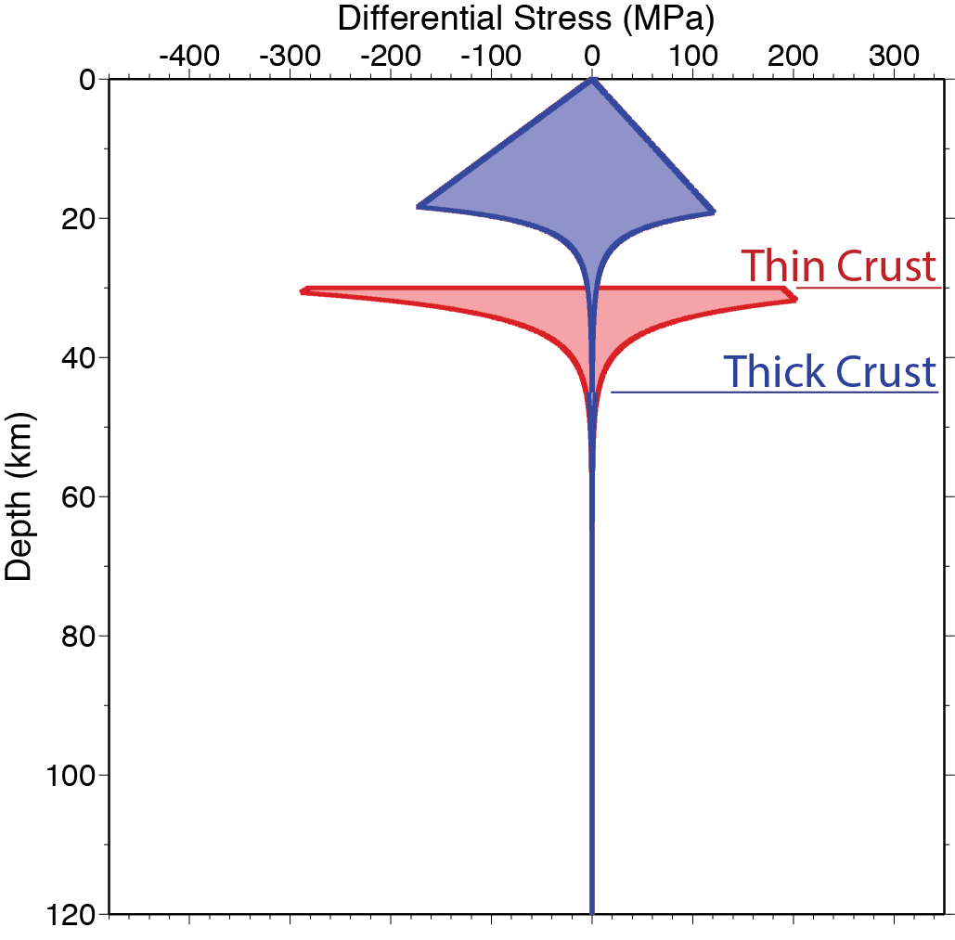
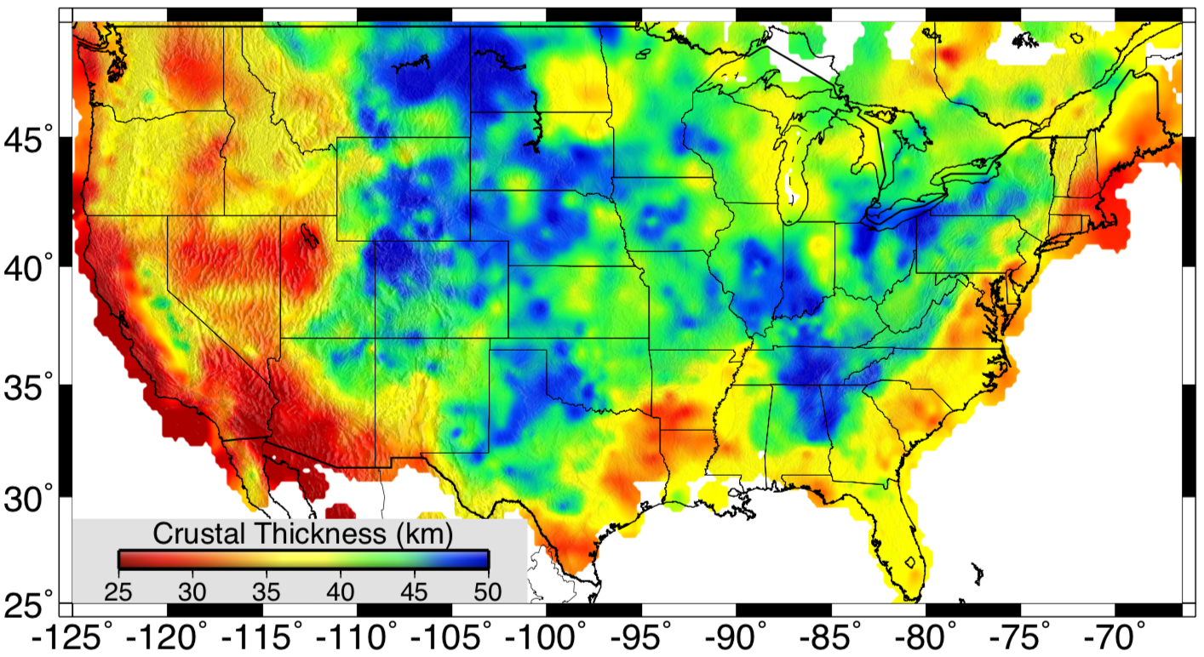
Flow Strength…
depends mostly on:
• Mineralogy
(crust thickness)
• Temperature
• Hydration
Notes:
Too complex

Slide 5
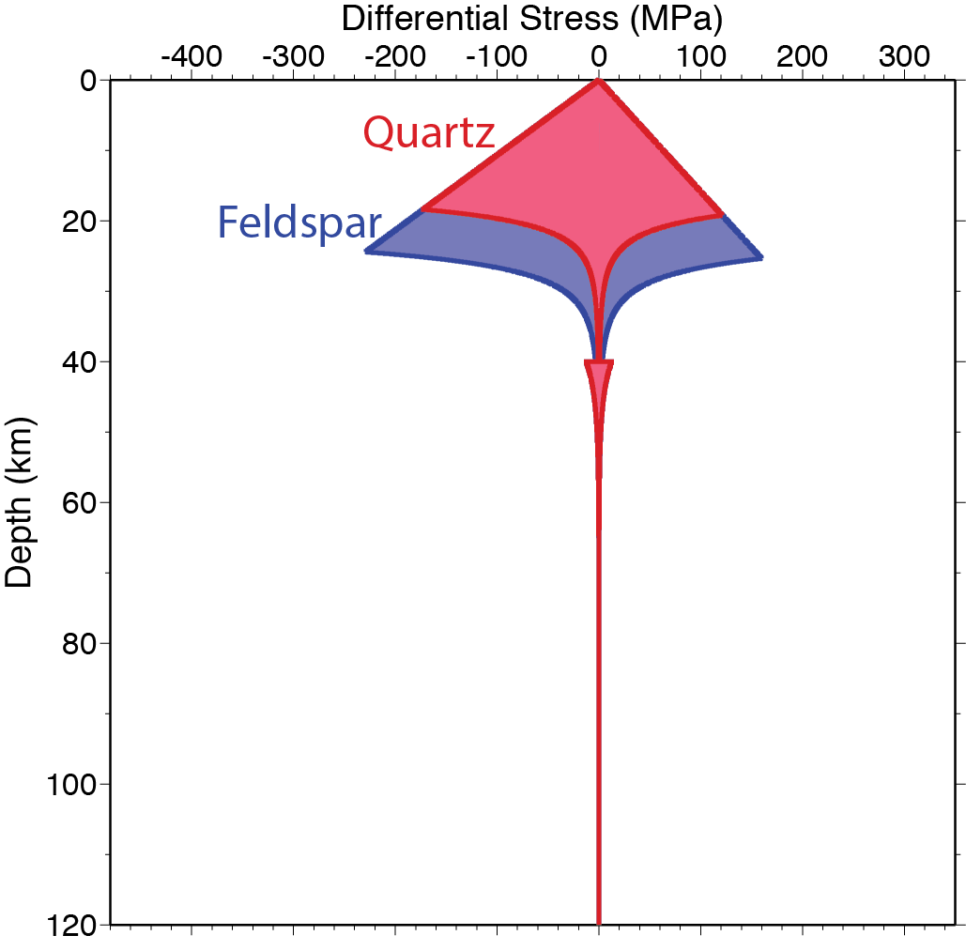
Flow Strength…
depends mostly on:
• Mineralogy
(Qtz or Fsp?)
• Temperature
• Hydration
Notes:
Too complex

Slide 6
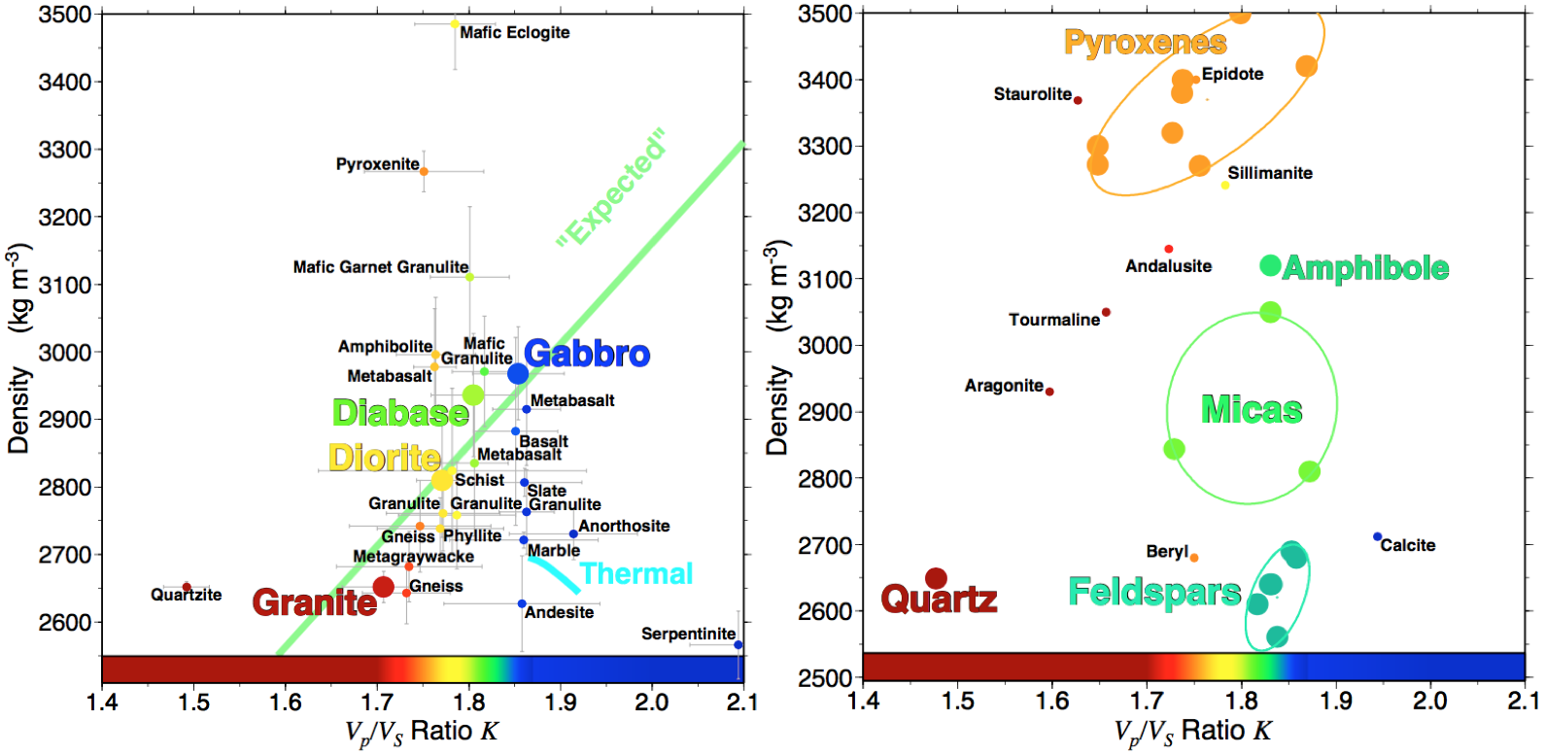

Slide 7
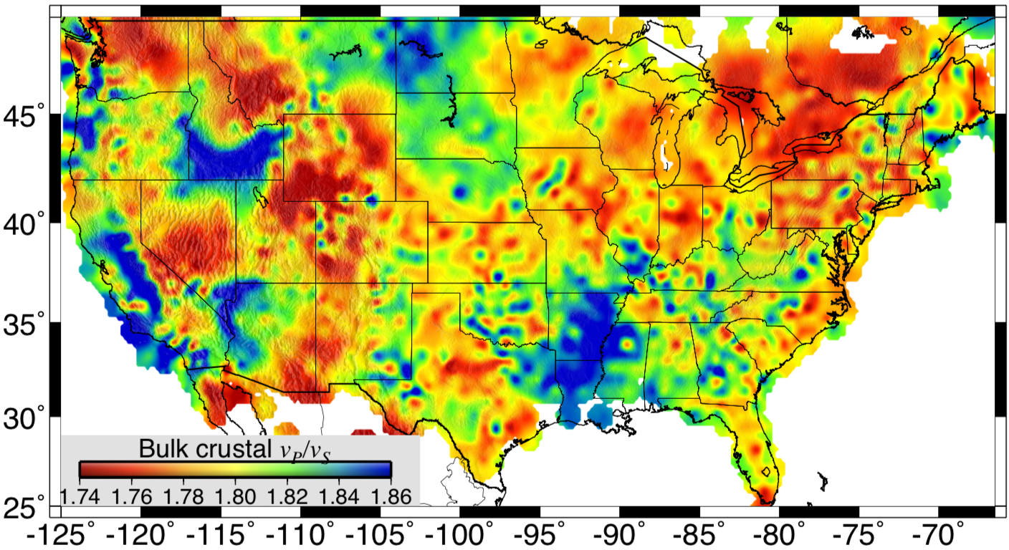
Flow Strength…
depends mostly on:
• Mineralogy
(Qtz or Fsp?)
• Temperature
• Hydration
Notes:
Too complex

Slide 8
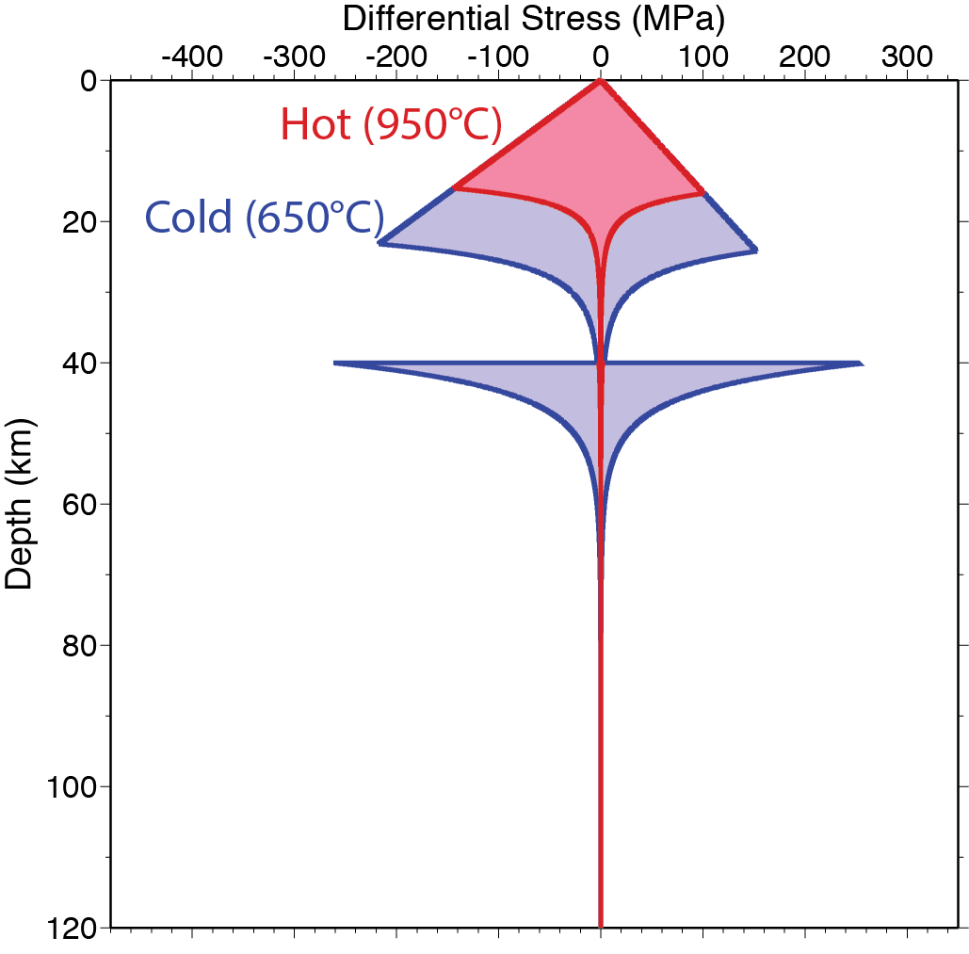
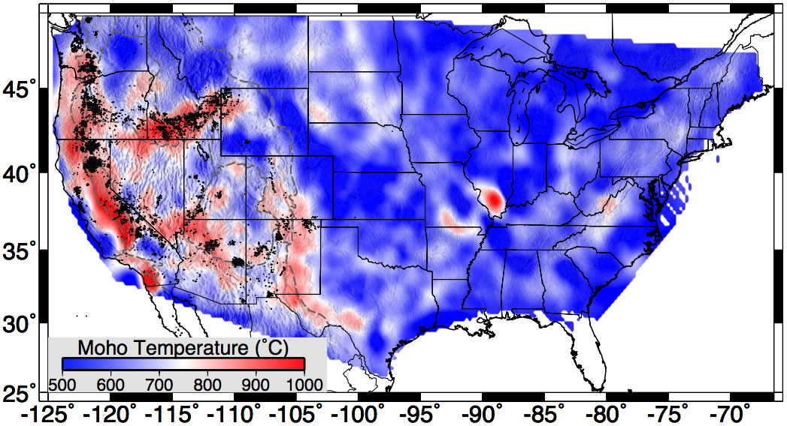
The Details…
Flow Strength…
depends mostly on:
• Mineralogy
• Temperature
• Hydration

Slide 9
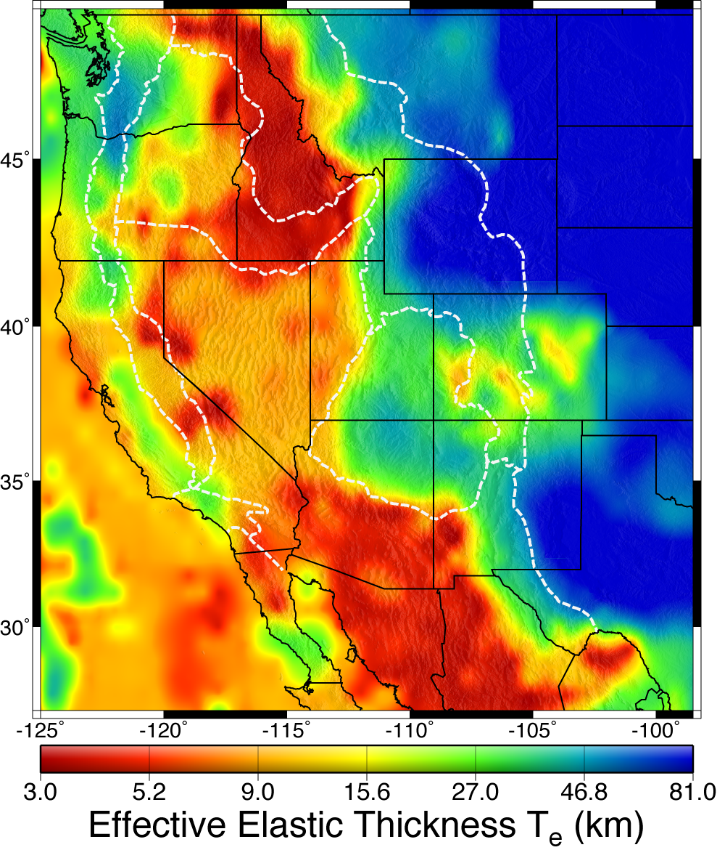
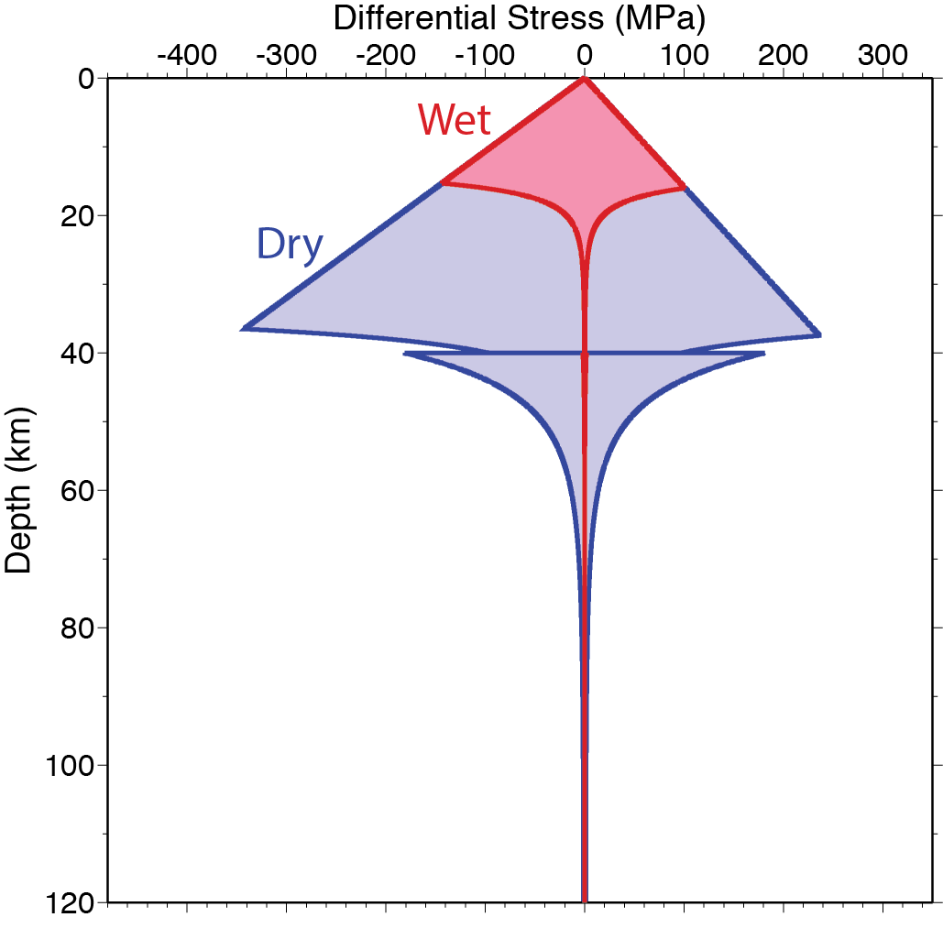
Flow Strength…
depends mostly on:
• Mineralogy
• Temperature
• Water Content

