Slide 1
GEO 5/6690 Geodynamics
22 Feb 2023
Last time: More on compositional layering
• Newer seismic data confirms low velocity, high density,
steep edges of “LLSVPs”
• Plumes arise from edges (not center) of anomalies
• Still don’t know why it’s there!
Geophysical expressions of R-T instabilities
Delamination or “drips” should have some expression in:
• Gravity
• Surface elevation
• Lithospheric stress
• Crustal thickness
All of which should evolve through time…
Mantle tomographic images suggest “drips” under southern
Sierra Nevada, southern Nevada?, Colorado Plateau?
Read for Fri 24 Feb: T&S §7.1–7.4
© A.R. Lowry 2023

Slide 2
First Assignment:
Posted on course website!
Due Mar 3 at 1:30 pm
Next reading Assignment:
(Monday Feb 27)
Castellanos et al. (2020) Science
Advances 6(28) #eabb0476

Slide 3
Things to think about for Monday’s reading:
• Seismic anisotropy is velocity that is different
in different directions (in the paper, due to mineral
foliation by shear strain that systematically
relates to the flow direction)…
• Because the crust is compositionally different
(and weaker) than the mantle, it flows
differently than the mantle!

Slide 4
Some useful things to think about:
What should a drip “look like”?
• In gravity?
• In surface elevation?
• In resulting lithospheric stress?
• In crustal thickness?
• In surface heat flow?

Slide 5
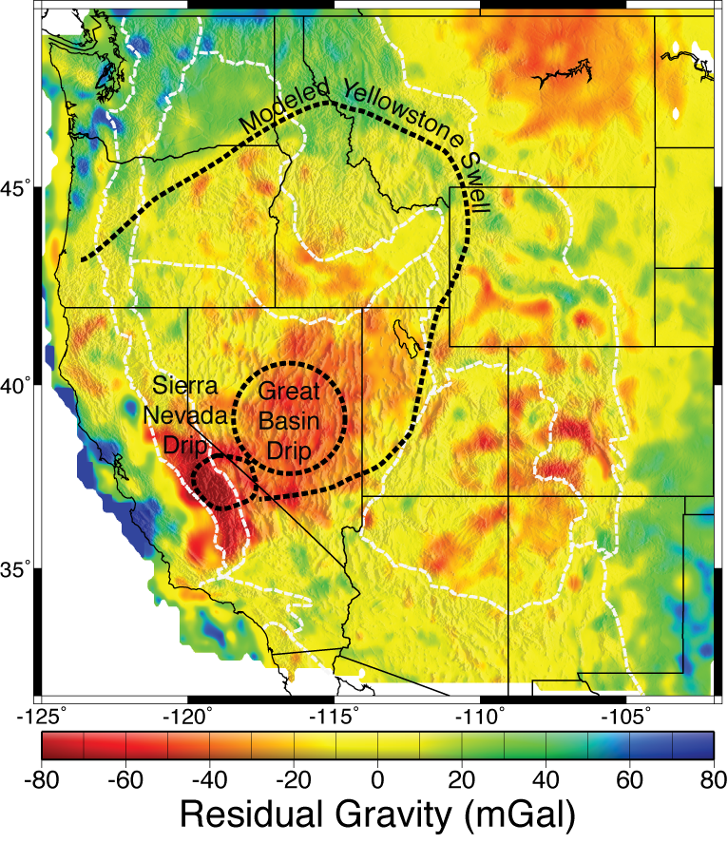
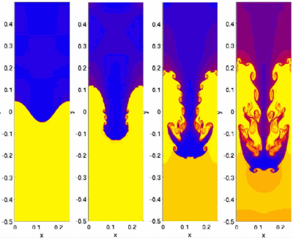
In Gravity:
The surface gravity anomaly
depends on mass anomaly
Δm, spatial wavelength λ, &
depth z as:
Here G is the universal
gravitational constant.
CP
Drip?
Gravity residual after removing effects
of crustal thickness, composition, & T

Slide 6
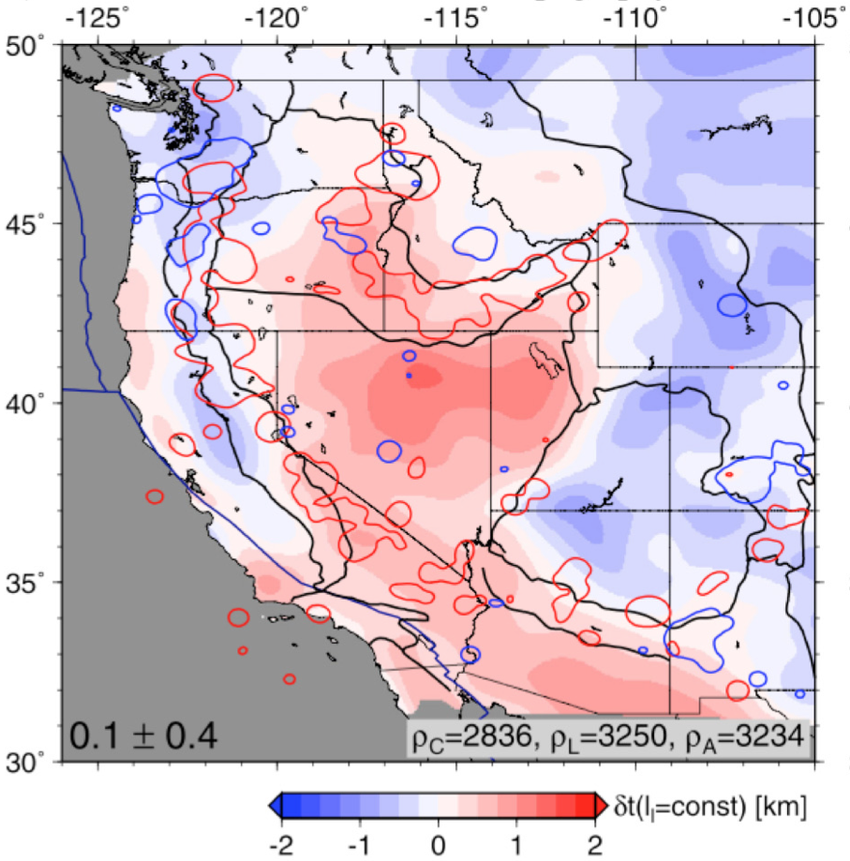
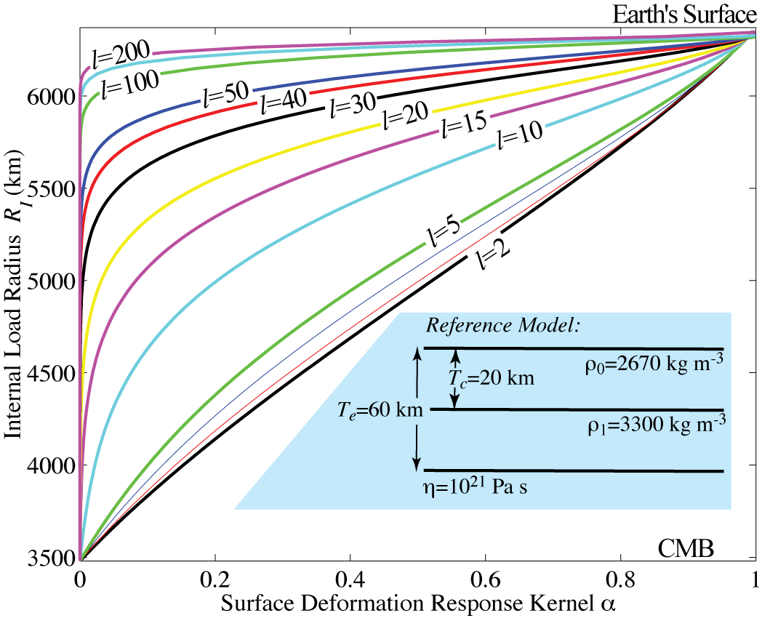
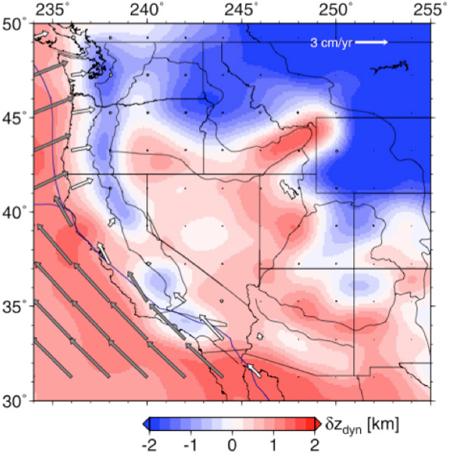
Elevation
residual,
crust
removed
Becker et al.,
EPSL, 2014
In Elevation:
“Dynamic
elevation”,
using
Schmandt
et al.
seismic
anomalies
Surface elevation also
depends on mass anomaly
Δm, spatial wavelength λ,
& depth z. Here l is the
spherical harmonic degree:

Slide 7
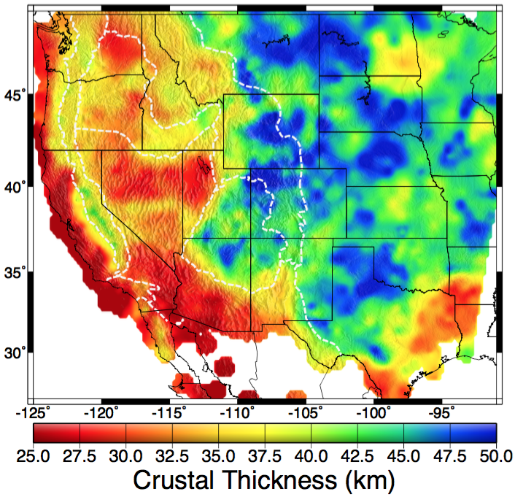
Lithospheric stress
and crustal thickness
are most sensitive
to vertical stress
applied ~ mid-
lithosphere (which
can be easily inferred
from the elevation
kernel). Elevation
kernels producing
subsidence will
favor compressional
stress and thicker
crust; uplift will favor
extension and crustal
thinning.
Drip observations…

Slide 8
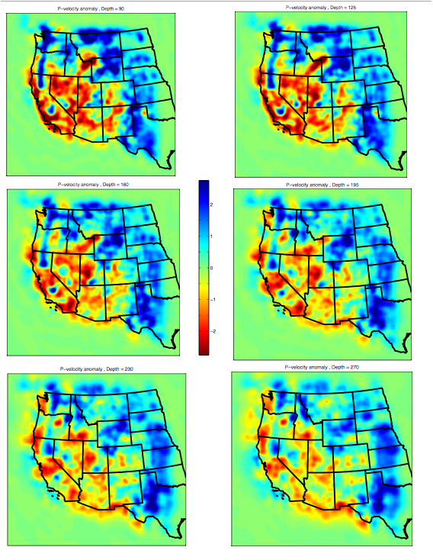
Drip observations…
90 km
125 km
(Schmandt et al, EPSL 2010)
160 km
195 km
230 km
270 km

Slide 9
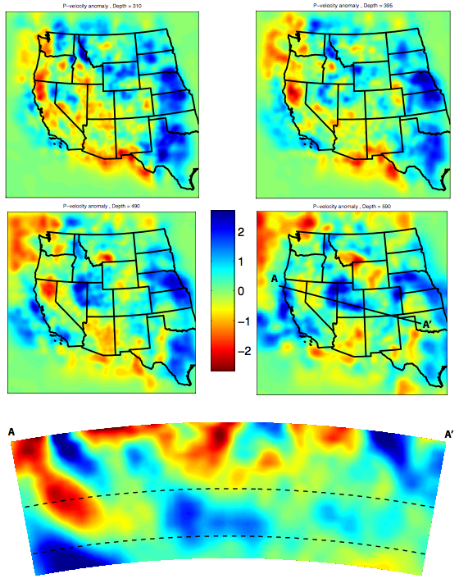
310
395
It also helps to
examine images in
three-dimensional
space…
Tomographic images
(Schmandt et al,
EPSL 2010)
490
590
410
670

Slide 10
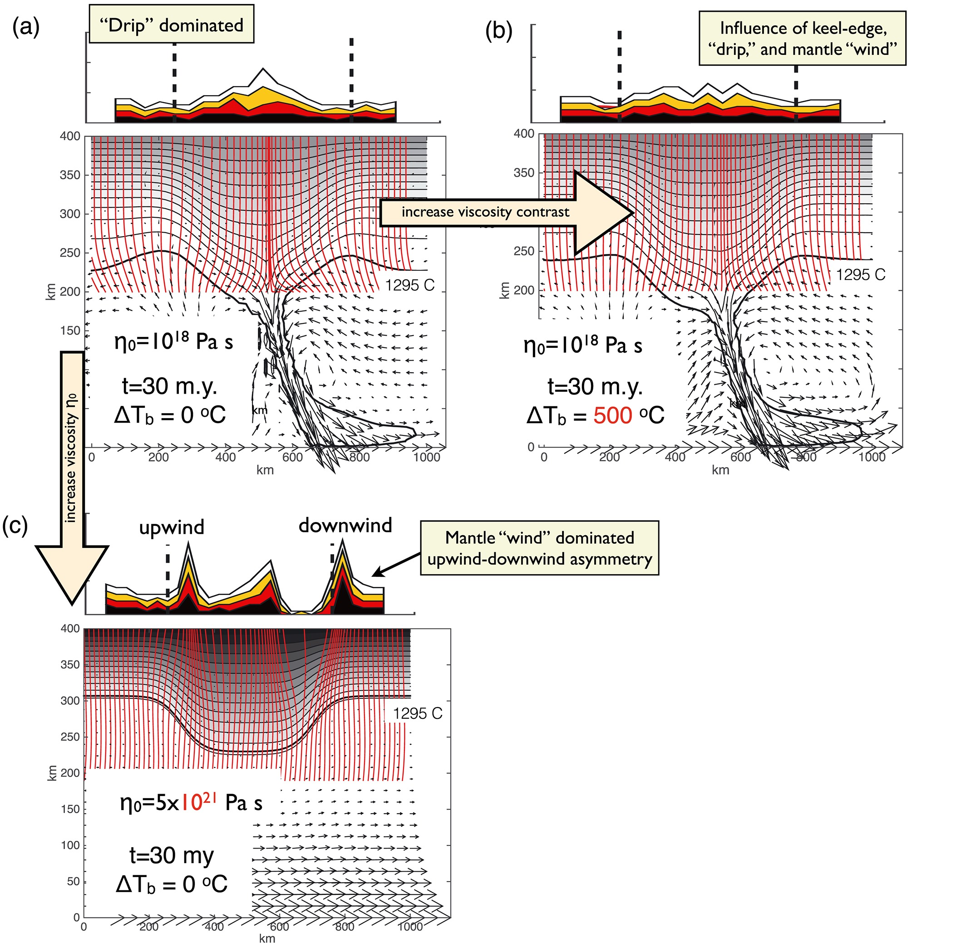
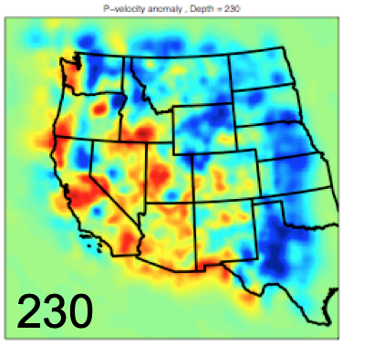
Roy et al., JGR
(2016)…
An update of
the 2009 paper
we read
earlier that
addresses
melting and
viscous flow...
Schmandt et al, EPSL 2010

Slide 11
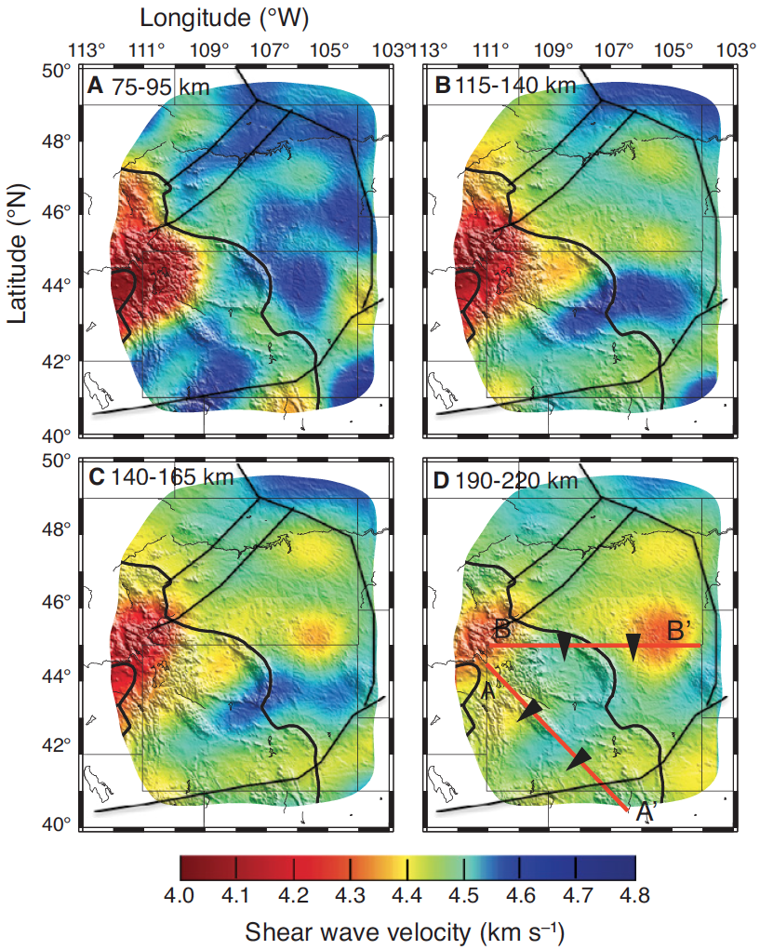
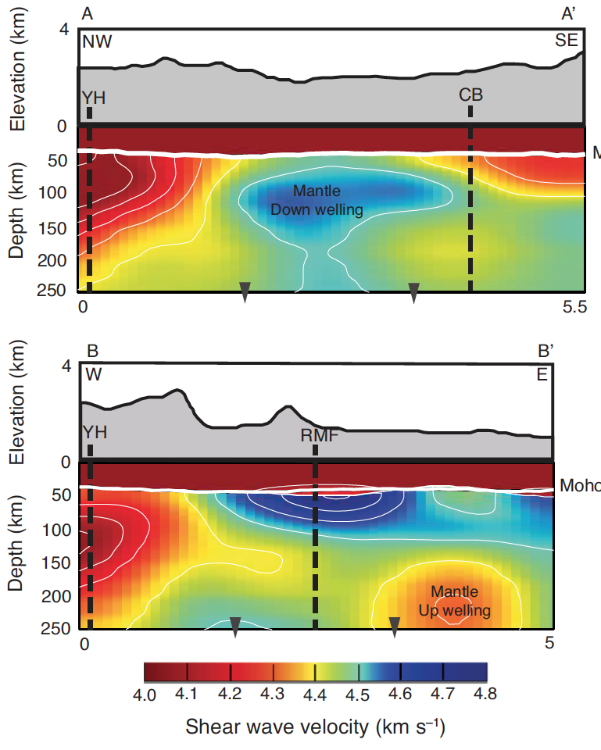
Dave & Li Geology (2016)…
So how do we test?

