Slide 1
GEO 5/6690 Geodynamics
23 Jan 2023
Today: Journal Article Discussion
Furlong & Chapman (2013) Annual
Reviews of Earth and Planetary
Science, 41, 385-410.

Slide 2
Main points of the paper?

Slide 3
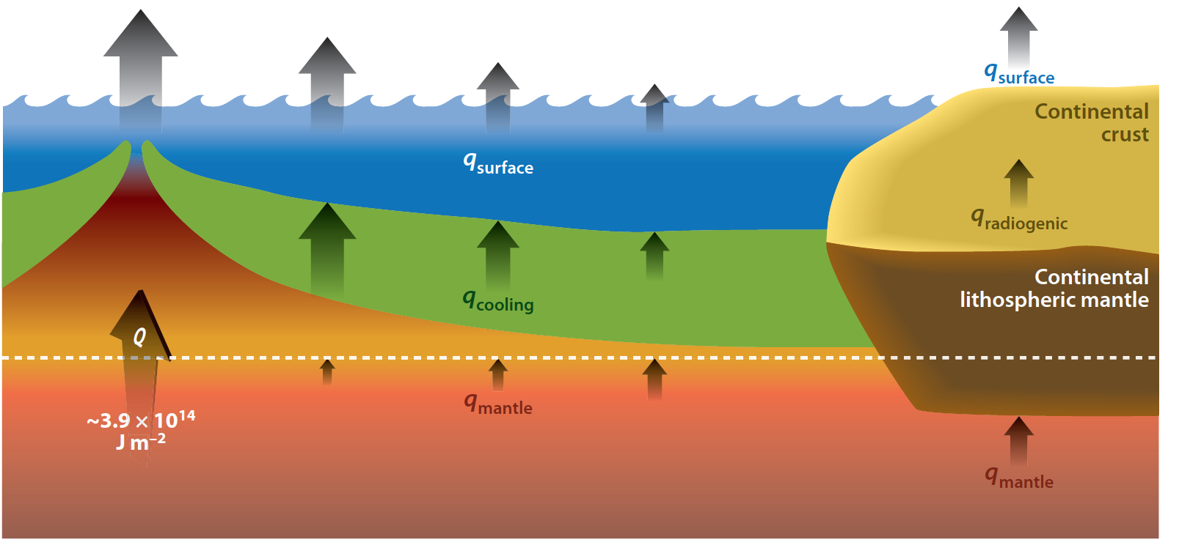
Recent estimates: total global heat flux is 46–47 TW
(92 mW/m²)
~32 TW from oceans
~15 TW continents
(105 mW/m²)
(71 mW/m²)
~8 TW
~10 TW
~7–8 TW
~20–25 TW
Attributes 10 TW to lower mantle radioactive heating (based on?);
5–15 TW to Core; remainder to continental heat production and
mantle secular cooling…

Slide 4
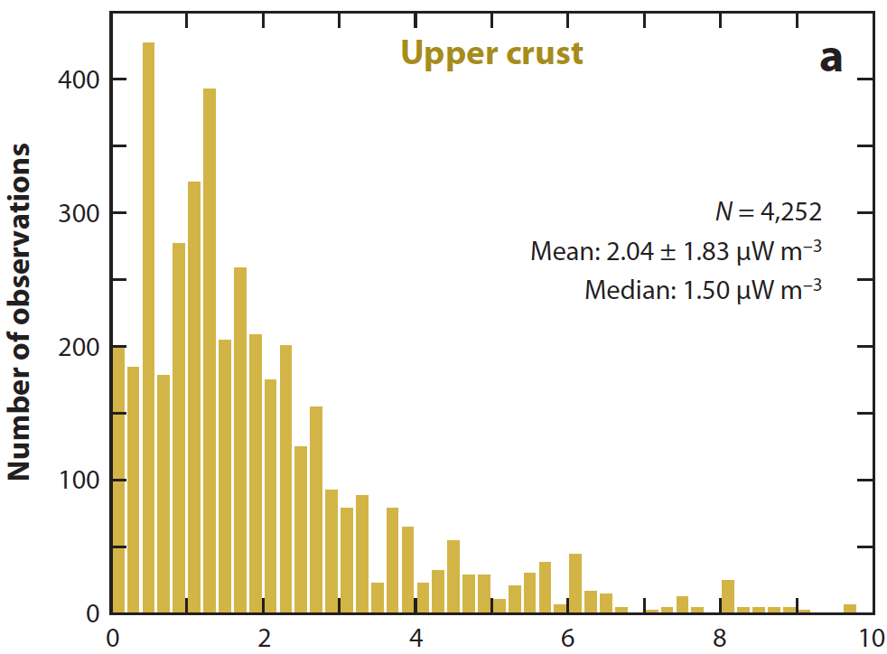
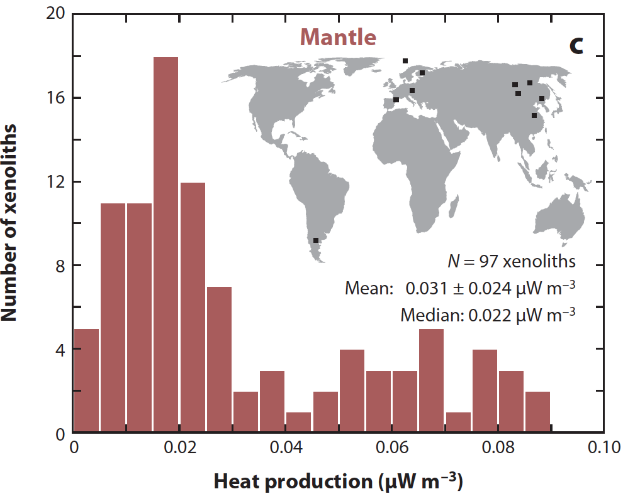
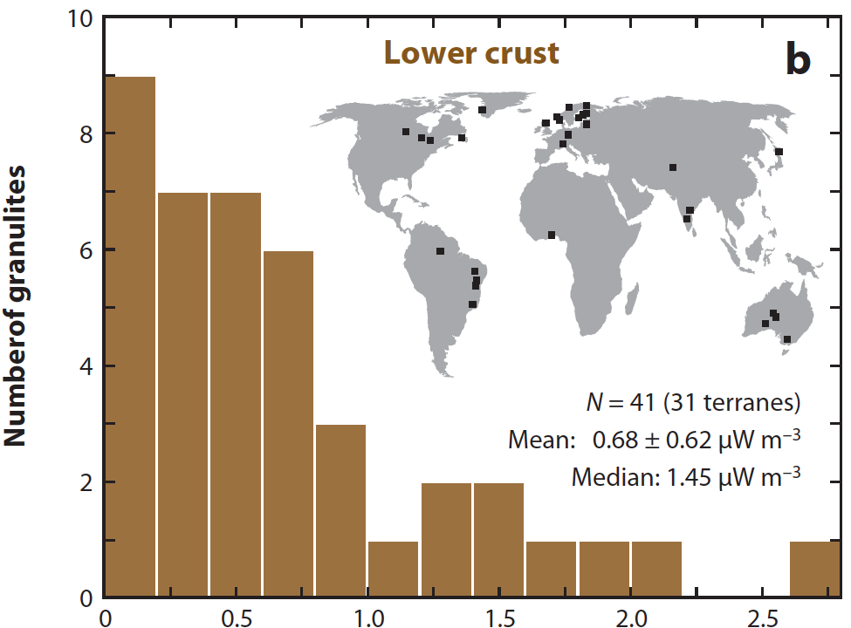
Suggest depth distribution of A
might best be approximated as
constant within layers...
“ ”
Systematic difference between
xenoliths and exposed lower
crustal rocks?

Slide 5
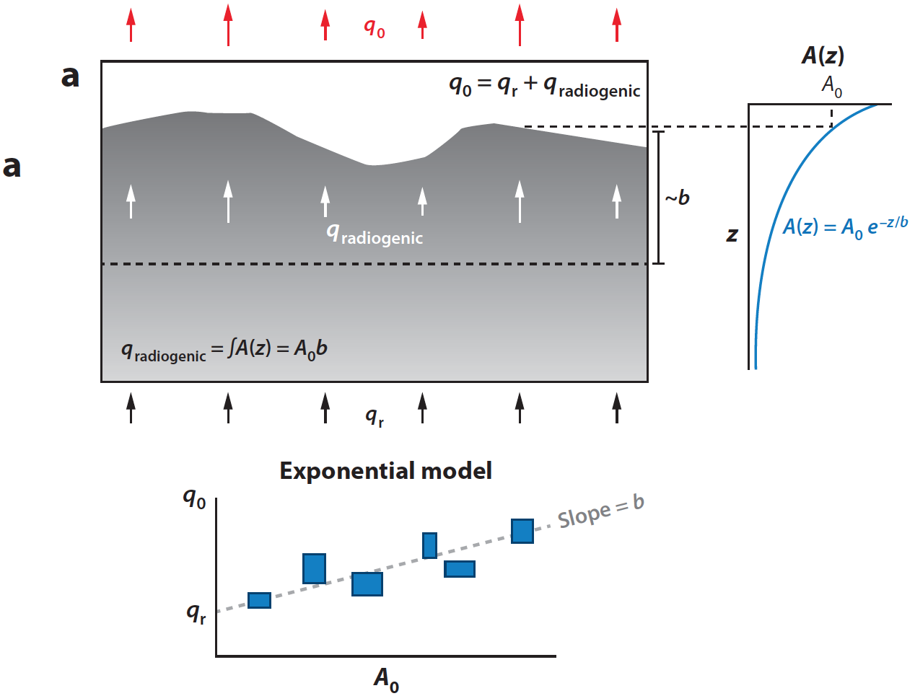
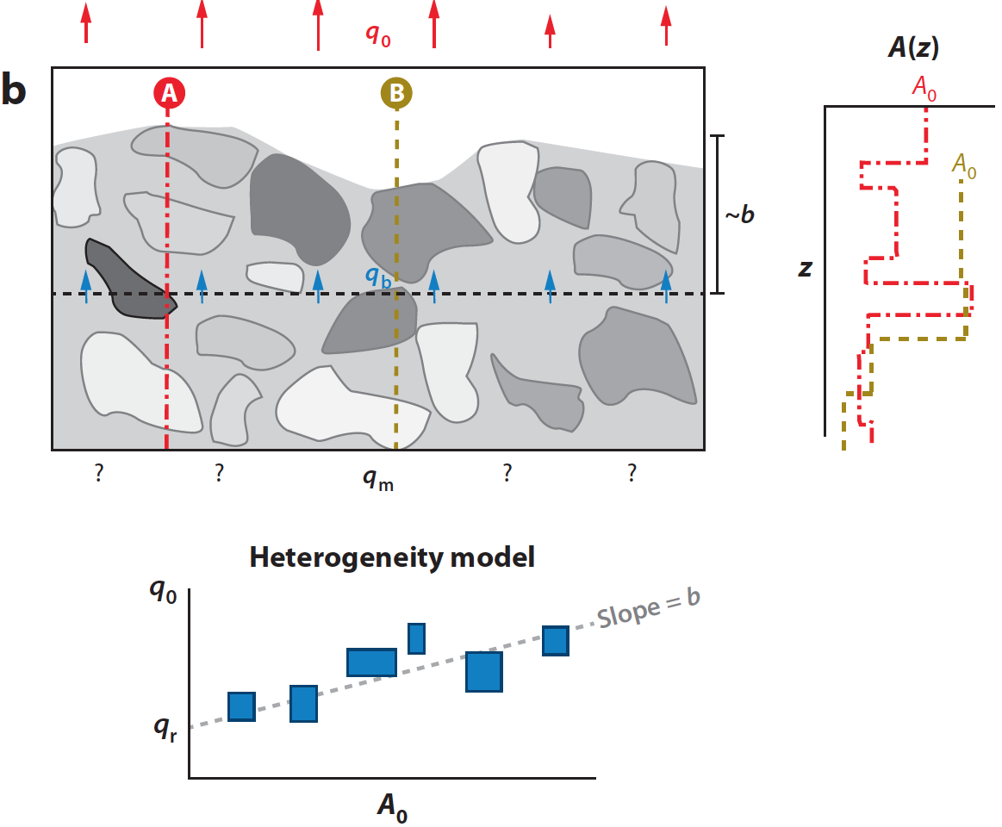
Observations of a
“linear” relationship
of surface heat flow
to surface heat
production can be
fit by many different
possible models…
Exponential
decrease, linear
decrease, or even
just random!

Slide 6
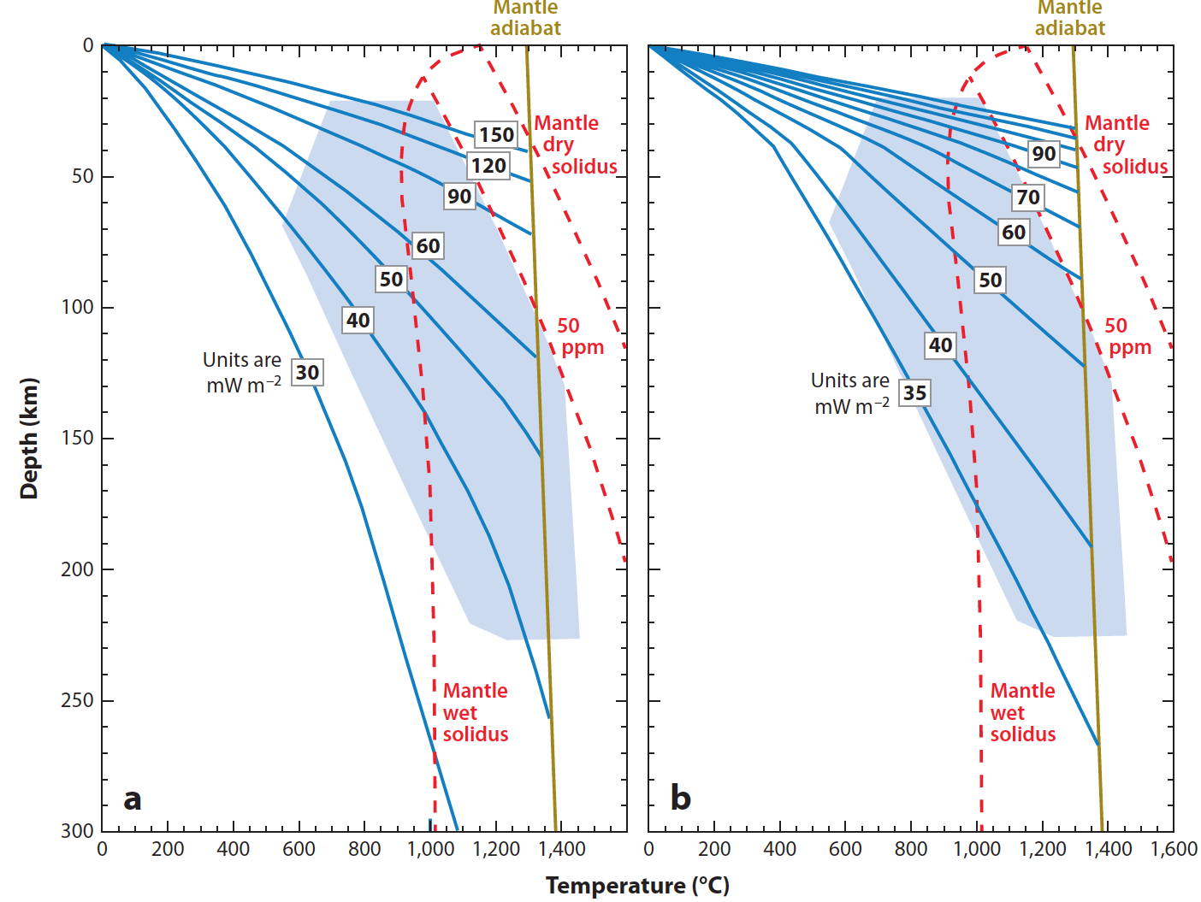
Note this
assumes a
constant
ratio of
radioactive
to total
heat flow!
A = 0.4q_{s}
A = 0.26q_{s}
Differences in
these two sets
of geotherms
are how much of
total heat flow is
from crustal
heat production
Melting
depends on
temperature,
pressure &
hydration state

Slide 7
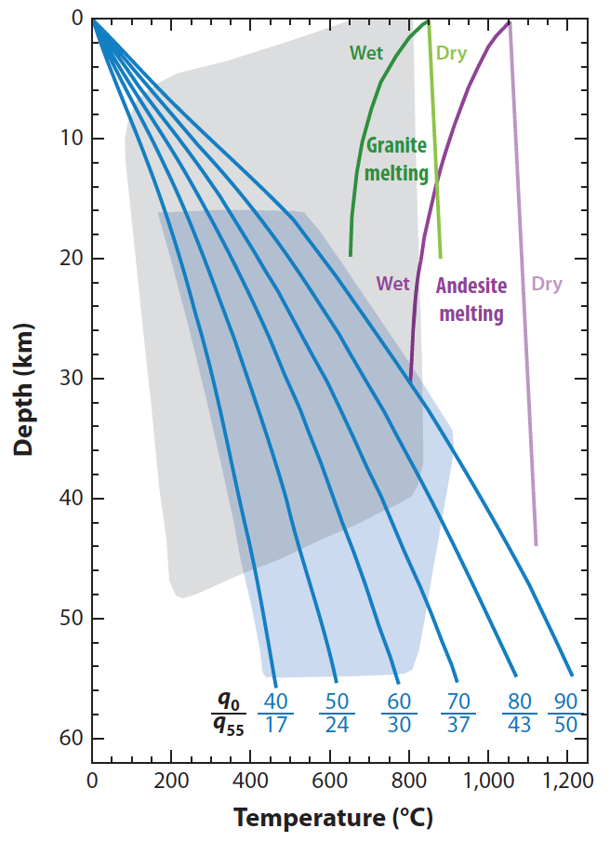
This instead
allows for a
variable ratio
of basal (or
crustal)
contribution to
total heat
flux…
Metamorphism
Grey is
range of
metamorphic
grade found
in rocks
Stable lower crust
Blue is
steady-state
conditions in
stable
continental
lithosphere

Slide 8
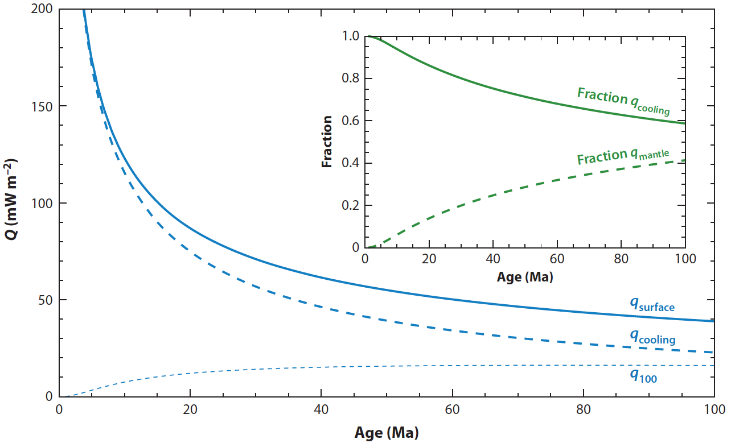
Cooling versus basal heat flow from oceans

Slide 9
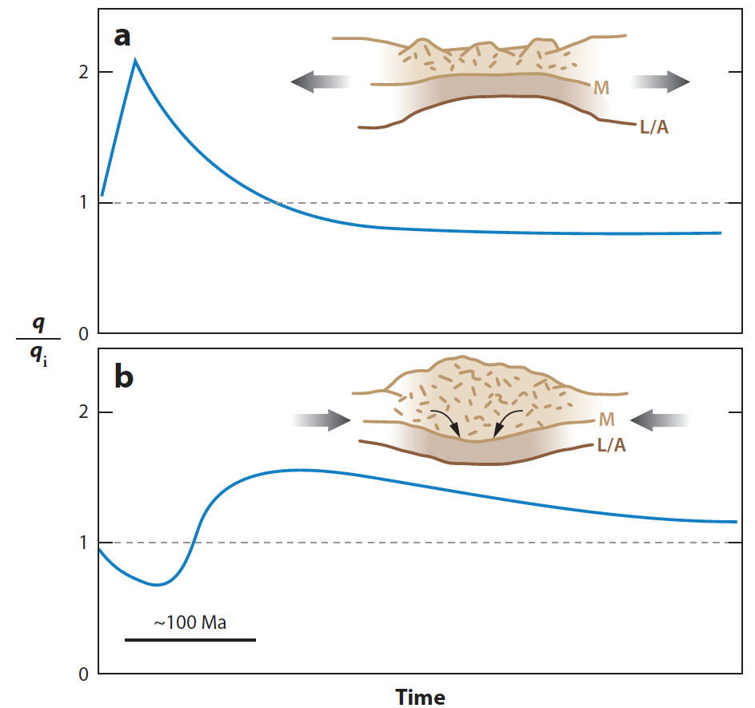
Time-dependence
of surface heat
flow following
lithospheric strain
events…

Slide 10
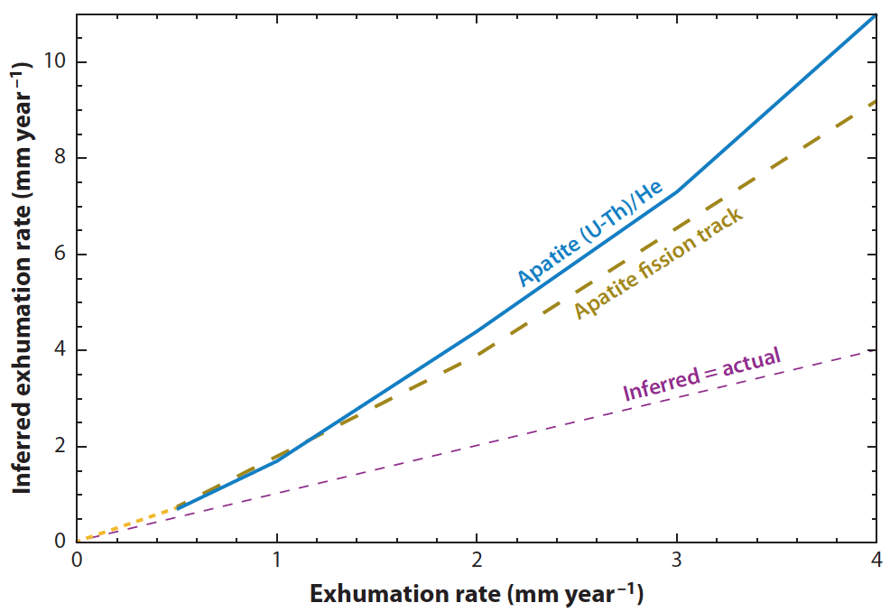
Both exhumation and cooling increase
surface heat flow and contribute to
curvature of the geotherm, so
must be corrected for in
thermochronology

Slide 11
