Slide 1
GEO 5/6690 Geodynamics
24 Feb 2023
Last Time: Geophysical expressions of “drips”
Delamination or “drips” should be expressed in:
• Seismic velocity tomography (but complicated!)
• Seismic anisotropy (?)
• Gravity
(→ Mid/Late stages will emphasize low-density return flow!)
• Crustal thickness
(→ Initial thickening, then thinning, then more thinning)
• Lithospheric stress and deformation
(→ Initial contraction, then extension!)
• Surface elevation
(→ Initial subsidence, then uplift, then subsidence)
Mantle tomographic images suggest “drips” under southern
Sierra Nevada, maybe NE Oregon, maybe Colorado
Plateau… And Wyoming?
Read for Wed 1 Mar: T&S §7.1–7.4
© A.R. Lowry 2023

Slide 2
First Assignment:
Posted on course website!
Due Mar 3 at 1:30 pm
Next reading Assignment:
(Monday Feb 27)
Castellanos et al. (2020) Science
Advances 6(28) #eabb0476
Kitri will lead!

Slide 3
Rheology:
Rheology denotes the study of deformation and flow;
specifically the relationship of stress to strain and its
derivatives
These are generally expressed as
Constitutive Laws
(I.e., operators relating stress and strain):
that are neither purely elastic strain nor classical
Newtonian flow, but have some combination of
viscous flow and elasticity.
(Note here R is a linear operator which may invoke
derivatives and/or integrands!)

Slide 4
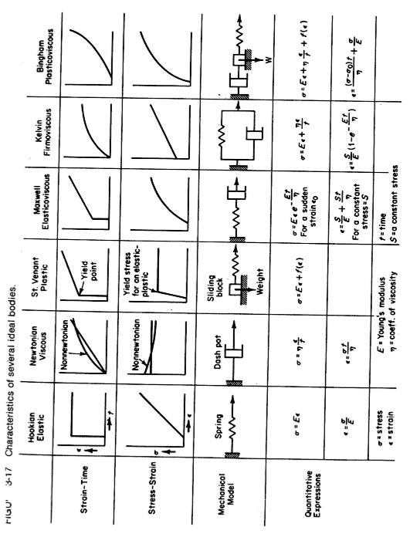
(From Twiss & Moores, Structural Geology)

Slide 5
But practically, there are four types that
are important in Earth dynamics…
Hooke’s Law (Elastic)
Byerlee’s Law (Friction)
σ = Cε
τ = μσ_{n} + C
τ is (failure) shear stress;
σ_{n} is normal stress;
μ is frictional coefficient;
C is cohesion
σ is stress;
ε is strain;
C are elastic constant(s)
Viscous (linear creep)
Viscous (power-law creep)
.
.
σ = η_{diff} ε
σ ^{n} = η_{disl}ε
σ is stress;
ε is strain-rate;
η_{diff} is viscosity
of diffusion creep
n is power-law exponent;
η_{disl} is viscosity
of dislocation creep
.

Slide 6
We denote the stress components acting on a plane with
normal (i.e. a plane on which x = constant) as:

Slide 7
Generally, we can denote:
σ_{ij}
index i denotes
direction of normal
to the plane acted
on by the force
index j denotes
direction of the
force
Hence σ_{xx} is a normal stress and σ_{xy} and σ_{xz} are stresses in
the yz-plane (called “shear stresses”). We can do the same
with the y direction: σ_{yx}, σ_{yy}, σ_{yz} act on the plane parallel to
xz-plane. For the z-direction, σ_{zx}, σ_{zy}, σ_{zz} act on the plane
parallel to the xy-plane. Thus we can use all nine σ_{ij} to
represent the internal force distribution at point P for any
plane passing through P.

Slide 8
We combine our nine components of stress defined in these
coordinate planes to represent the stress on any surface
through the medium. The 9 σ_{ij} define the state of stress
at a point P. The full stress tensor is given by :
Recall that strain is the deformation that results from a
given stress. A common PhD exam question is to
derive stress and strain & explain their difference,
particularly in relation to your specific discipline…

Slide 9
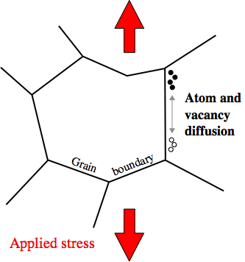
Laboratory studies & mineral physics suggest two dominant
“flavors” of non-recoverable ductile (flow) strain:
(1) Linear Viscoelastic Creep: “Diffusion creep”
where viscosity
Here:
R = gas constant E_{a} = activation energy
T = temperature V_{a} = activation volume
P = pressure D₀ = frequency factor
d = grain diameter (rock mat’l properties)
m = 2 in crystal interiors; σ_{ij} is deviatoric stress
3 on crystal boundaries

Slide 10
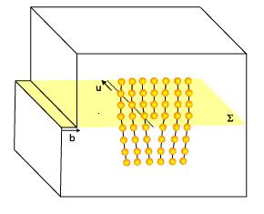
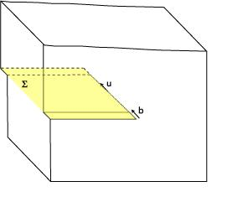
Laboratory studies & mineral physics suggest two dominant
“flavors” of non-recoverable ductile (flow) strain:
(2) Nonlinear Viscoelastic:
“Dislocation creep”
where effective viscosity
Here:
R = gas constant
T = temperature
P = pressure E_{a} = activation energy
b = dislocation density V_{a} = activation volume
n ~ 3 D₀ = frequency factor
μ = shear modulus (rock mat’l properties)
Edge dislocation
Screw dislocation

