Slide 1
GEO 5/6690 Geodynamics
24 Mar 2023
Last Time: RHEOLOGY
Flow Rheology depends on mineral-type (i.e. lithology),
temperature, pressure, & volatile state (especially hydration!)
Diffusion also depends on grain size, but only dominates for
very small (<50 μm) grain size &/or low differential stress
Temperature is often inferred from surface heat flow, which
is a poor predictor of temperature at depth… Frontier
methods use mantle seismic velocity + mineral physics
Lithology can be inferred from crustal seismic imaging
(thickness for depth to olivine; v_{P}/v_{S} for quartz vs feldspar)
Yield Strength Envelopes approximate deviatoric stress
supported by the lithosphere; assume a brittle field rheology
(friction coefficient, pore fluid pressure) plus strain rate
Read for Wed 29 Mar: T&S §8.1-8.7
© A.R. Lowry 2023

Slide 2
Next Journal Article Reading:
For Wednesday Mar 29: Berry et al. (2022)
EPSL, 584, #117483.

Slide 3
About this fingering… Is Rayleigh-Taylor a drip, or a peel?

Slide 4
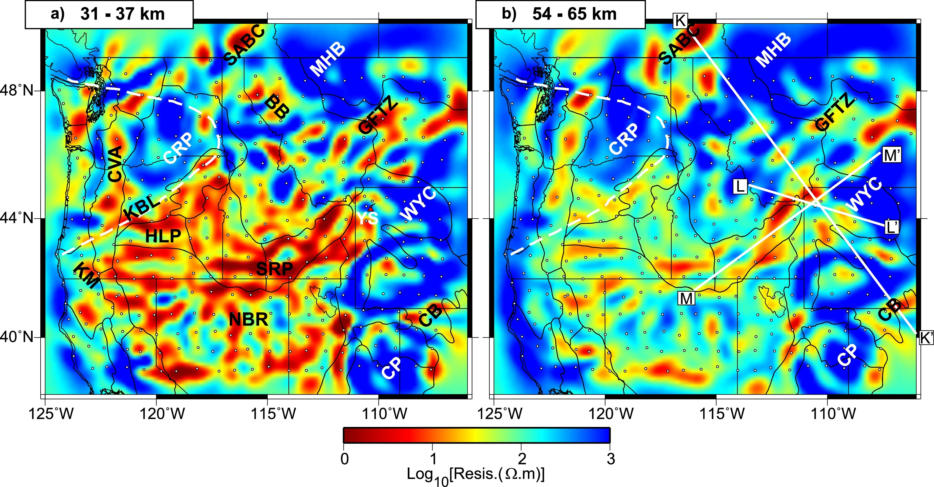
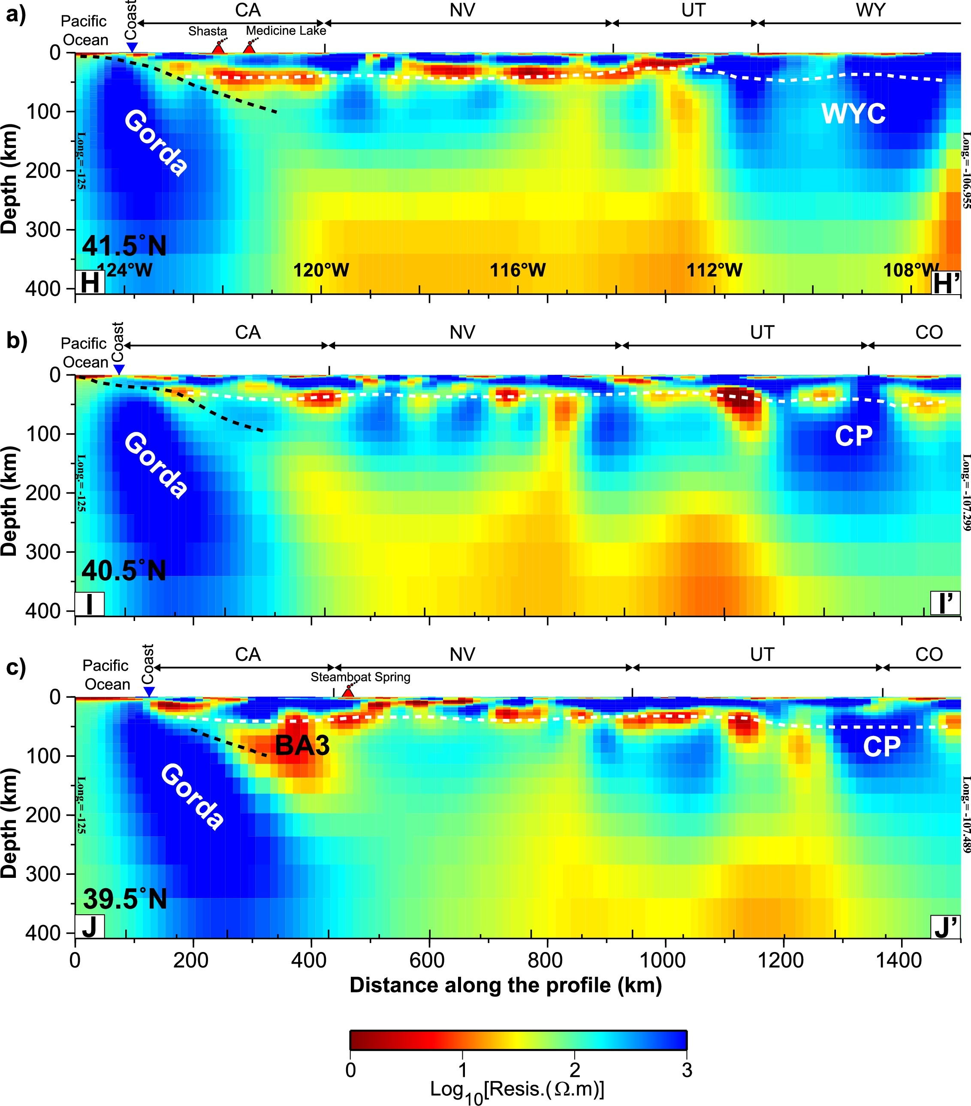
Liu & Hasterok
observation
that resistivity
ρ ~ viscosity η…
Meqbel et al., EPSL 2014
Meqbel et al., EPSL 2014
This will be critical especially for imaging
melt distributions (<10 Ω−m almost
certainly means partial melt or graphite;
widespread in B&R lower crust!) and
hydration (away from slabs, variations
below ~200 km depth are insensitive to
temperature so must be f_{H2O}…)

Slide 5
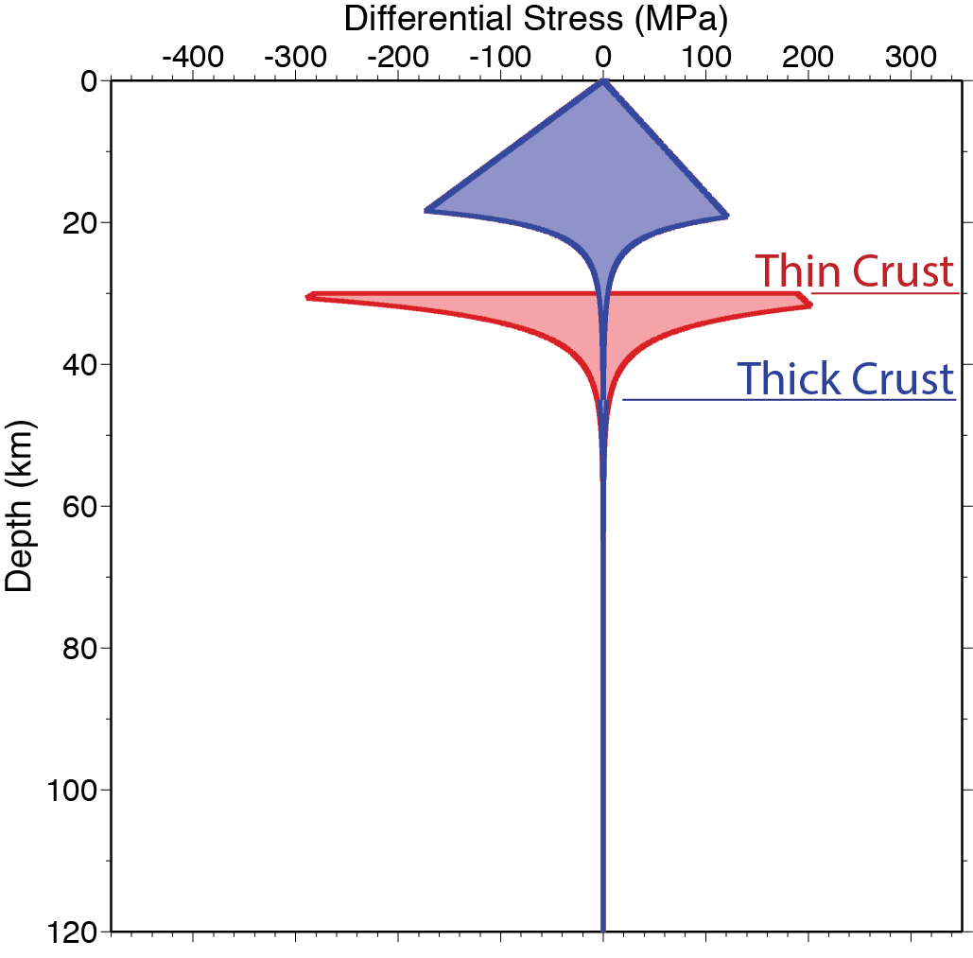
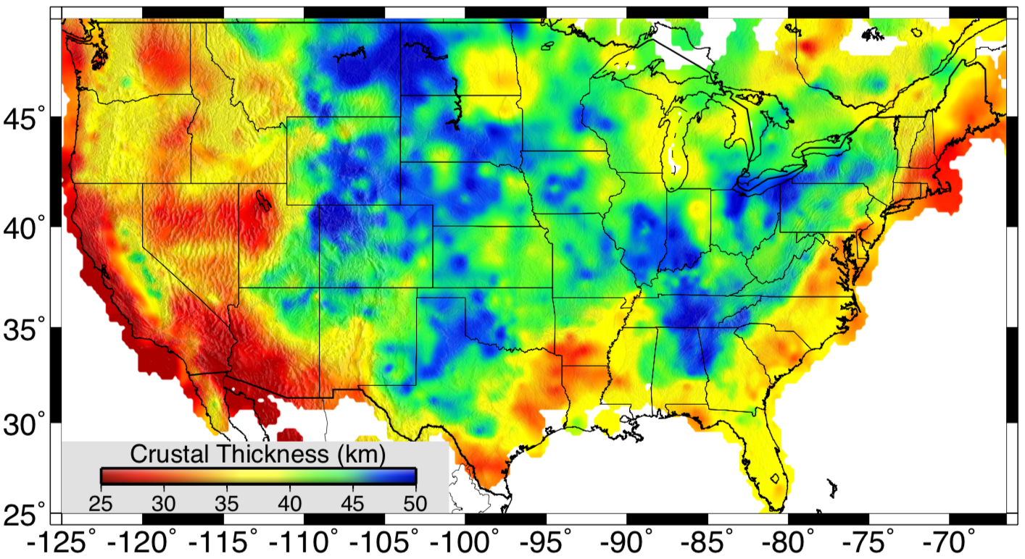
Flow Strength…
depends mostly on:
• Mineralogy
(crust thickness)
• Temperature
• Hydration
Notes:
Too complex

Slide 6
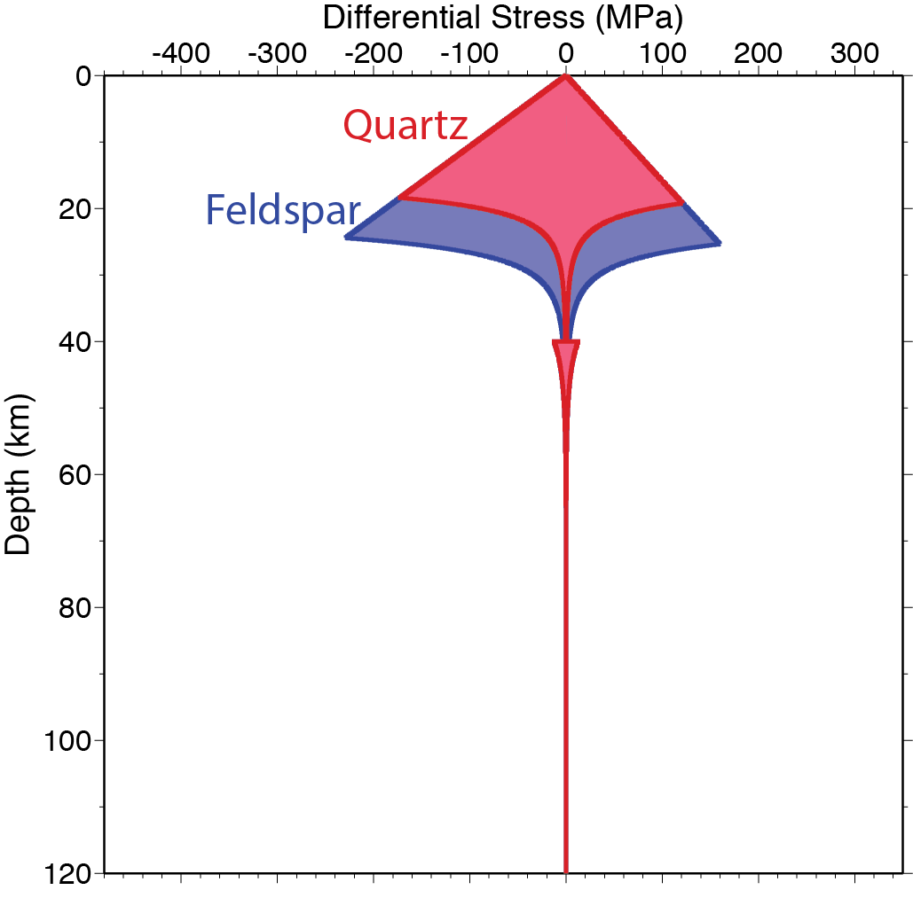
Flow Strength…
depends mostly on:
• Mineralogy
(Qtz or Fsp?)
• Temperature
• Hydration
Notes:
Too complex

Slide 7
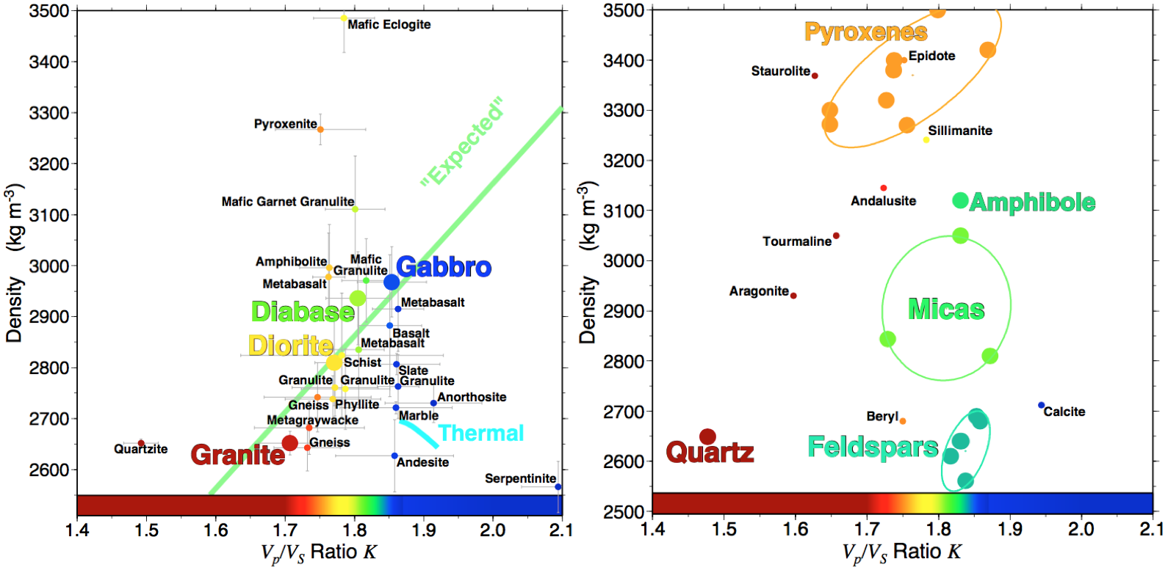

Slide 8
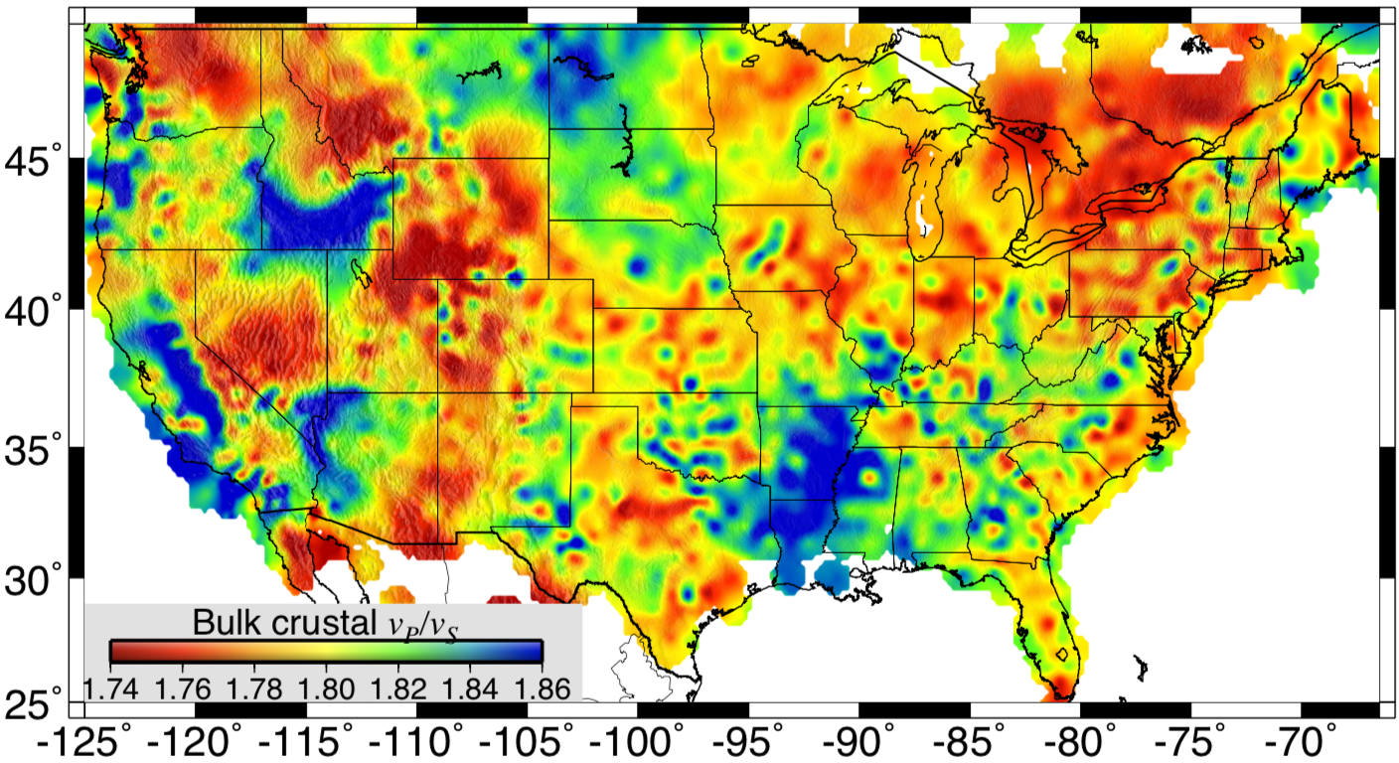
Flow Strength…
depends mostly on:
• Mineralogy
(Qtz or Fsp?)
• Temperature
• Hydration
Notes:
Too complex

Slide 9
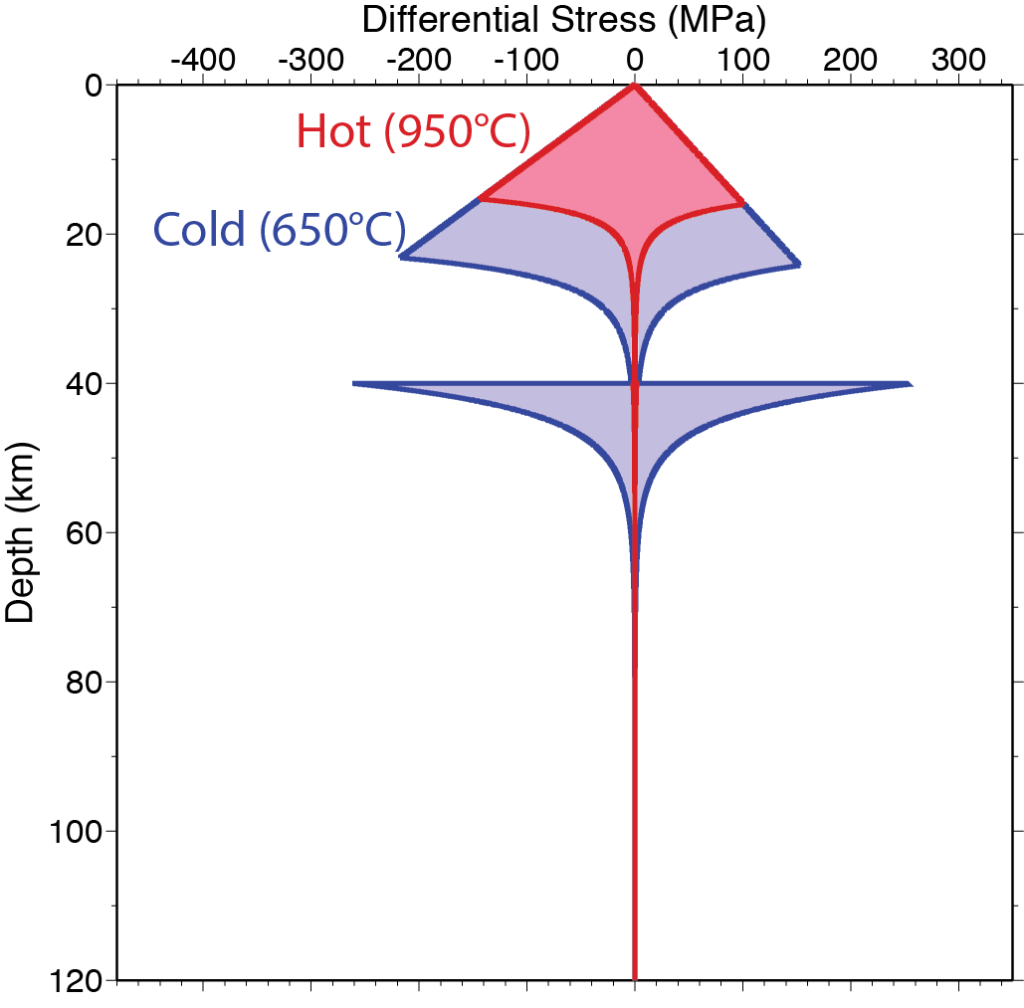
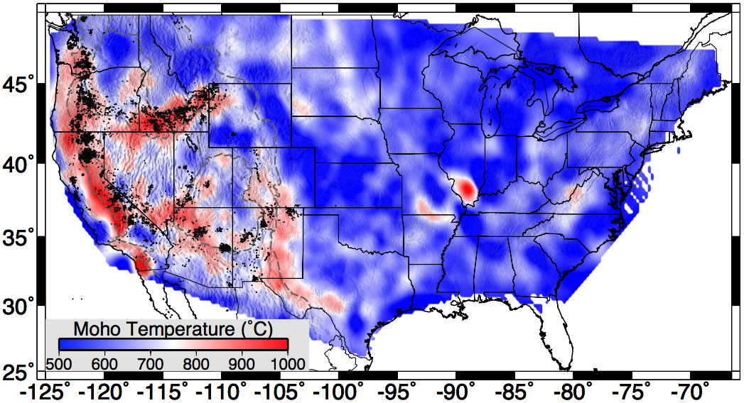
Flow Strength…
depends mostly on:
• Mineralogy
• Temperature
• Hydration

Slide 10
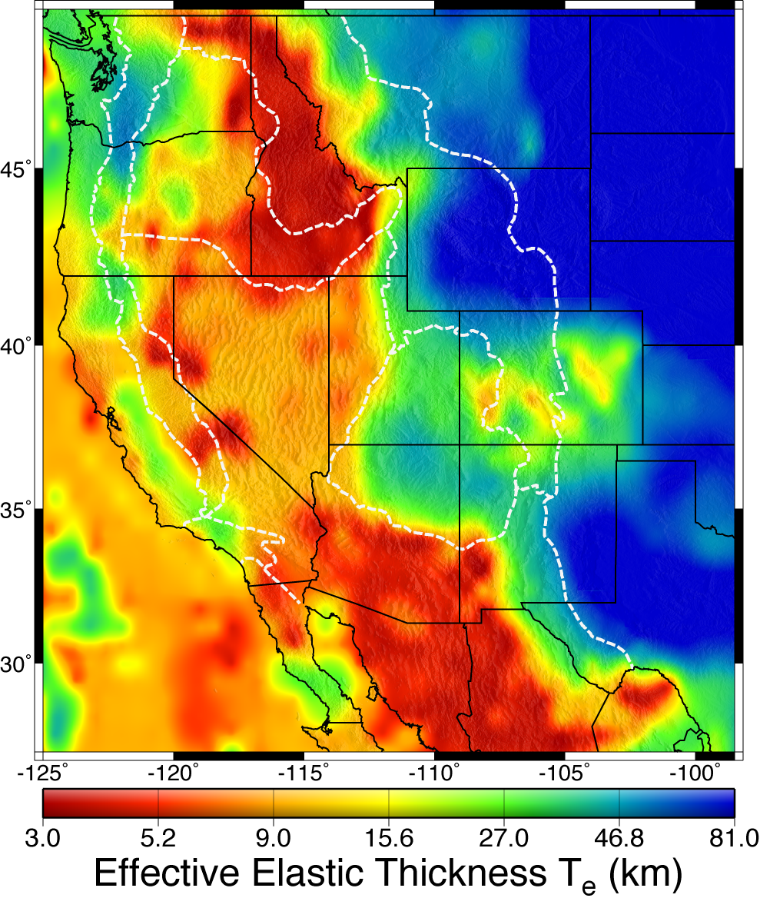
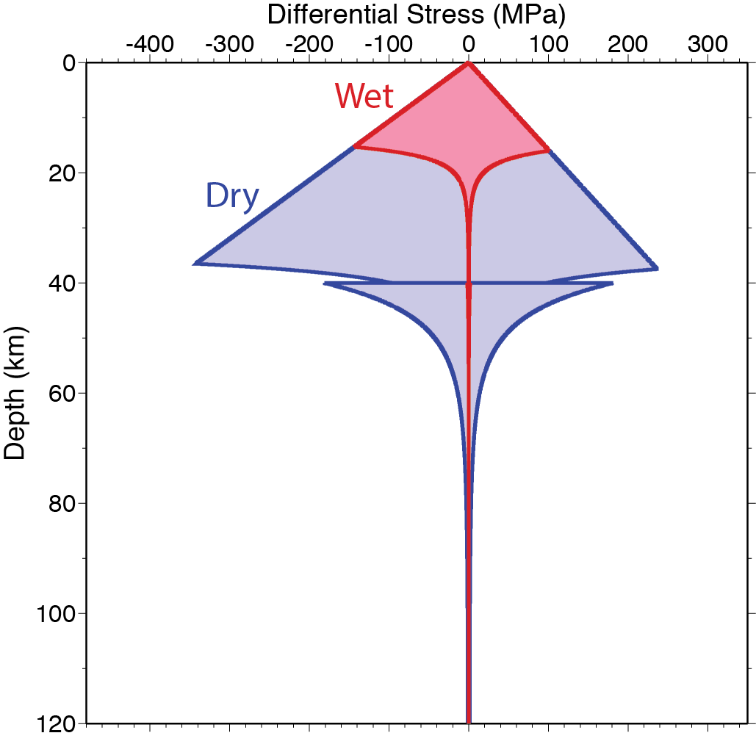
Flow Strength…
depends mostly on:
• Mineralogy
• Temperature
• Water Content

Slide 11
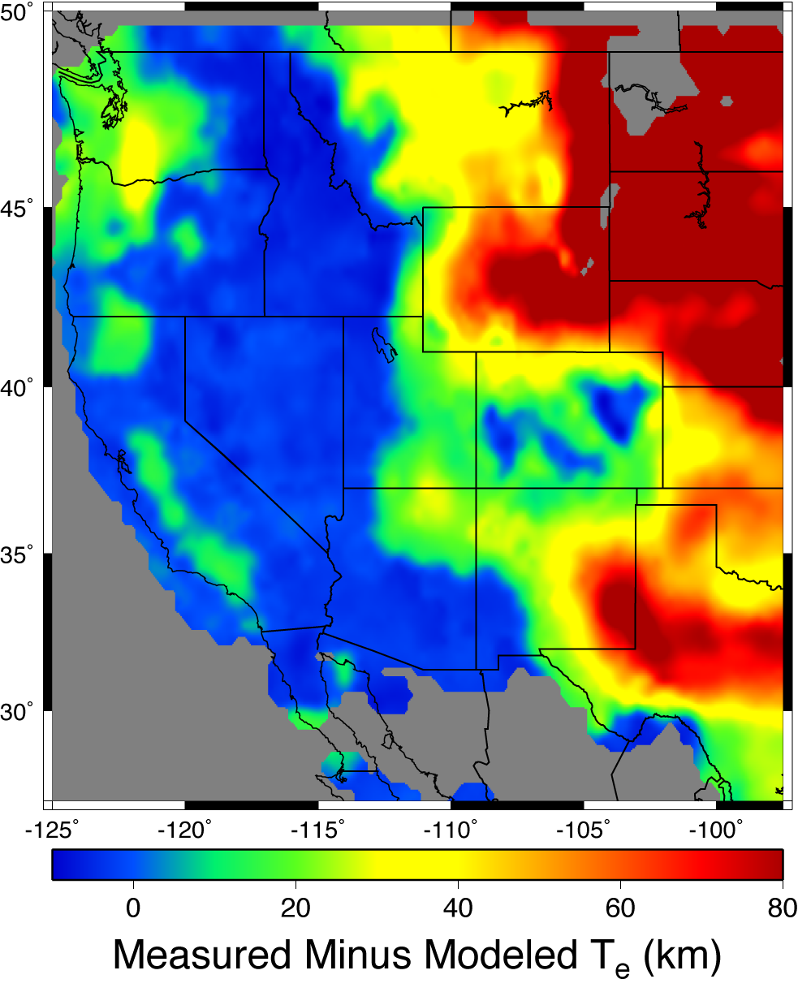
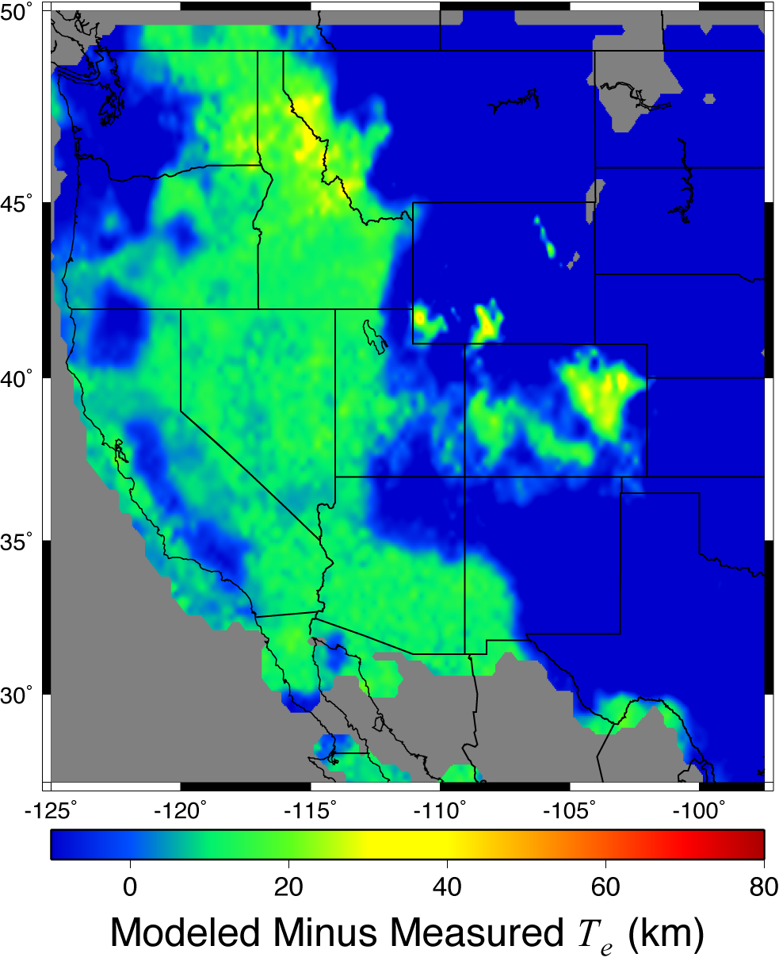
Wet (saturated) end-member
Dry end-member

Slide 12
