Slide 1
GEO 5/6690 Geodynamics
25 Jan 2023
Last Time (Fri): Conduction; Radiogenic Heating
Material Properties of Rocks:
• Thermal Conductivity k:
- Temperature sensitive; composition-dependent (esp qtz!)
- Mafic rocks have lower k at low T but higher k at
high T than granitic rocks
• Heat Production H: (In Furlong & Chapman, A)
- Radioactive decay of crustal K, Th, U adds to lithospheric
heat flow; heat production H (W/m³) is a heat source
- Only composition-dependent
- H(granite) >> H(gabbro) >> H(mantle rocks)
- Normal melt fractionation processes ⇒ decrease of H
with depth
Read for Fri 27 Jan: T&S §4.1-4.12
© A.R. Lowry 2023

Slide 2
Last Time: Furlong & Chapman
• Total heat flow from the Earth ~48 TW (T = 10¹²) (compare
with insolation at ~17,400 TW!)
• ~32 TW from oceans (much of it cooling); 15 TW from
continents (half mantle heat flow, half crustal radioactivity)
• A significant challenge in assessing thermal processes and
energy budget comes from contribution of unknown
radioactive heat production on the geotherm and heat flow
• Important distinction between steady-state (secular)
& time-dependent thermal transfer!
• Both exhumation and cooling perturb the geotherm and
introduce a time-dependence, so are important to correct
for in thermochronological studies…

Slide 3
Next Journal Article Reading
Friday Feb 3: Roy et al. (2009) Nature
459, 978-982…
Terminology: for the next reading you will need
to know:
• Rock Uplift is the change of elevation of a unit of
rock;
• Surface Uplift is the change in elevation of the
topographic surface;
• Erosion is the thickness of material that has been
removed from above a unit of rock that is now at
the surface;
• Ergo:
Rock Uplift = Surface Uplift + Erosion

Slide 4
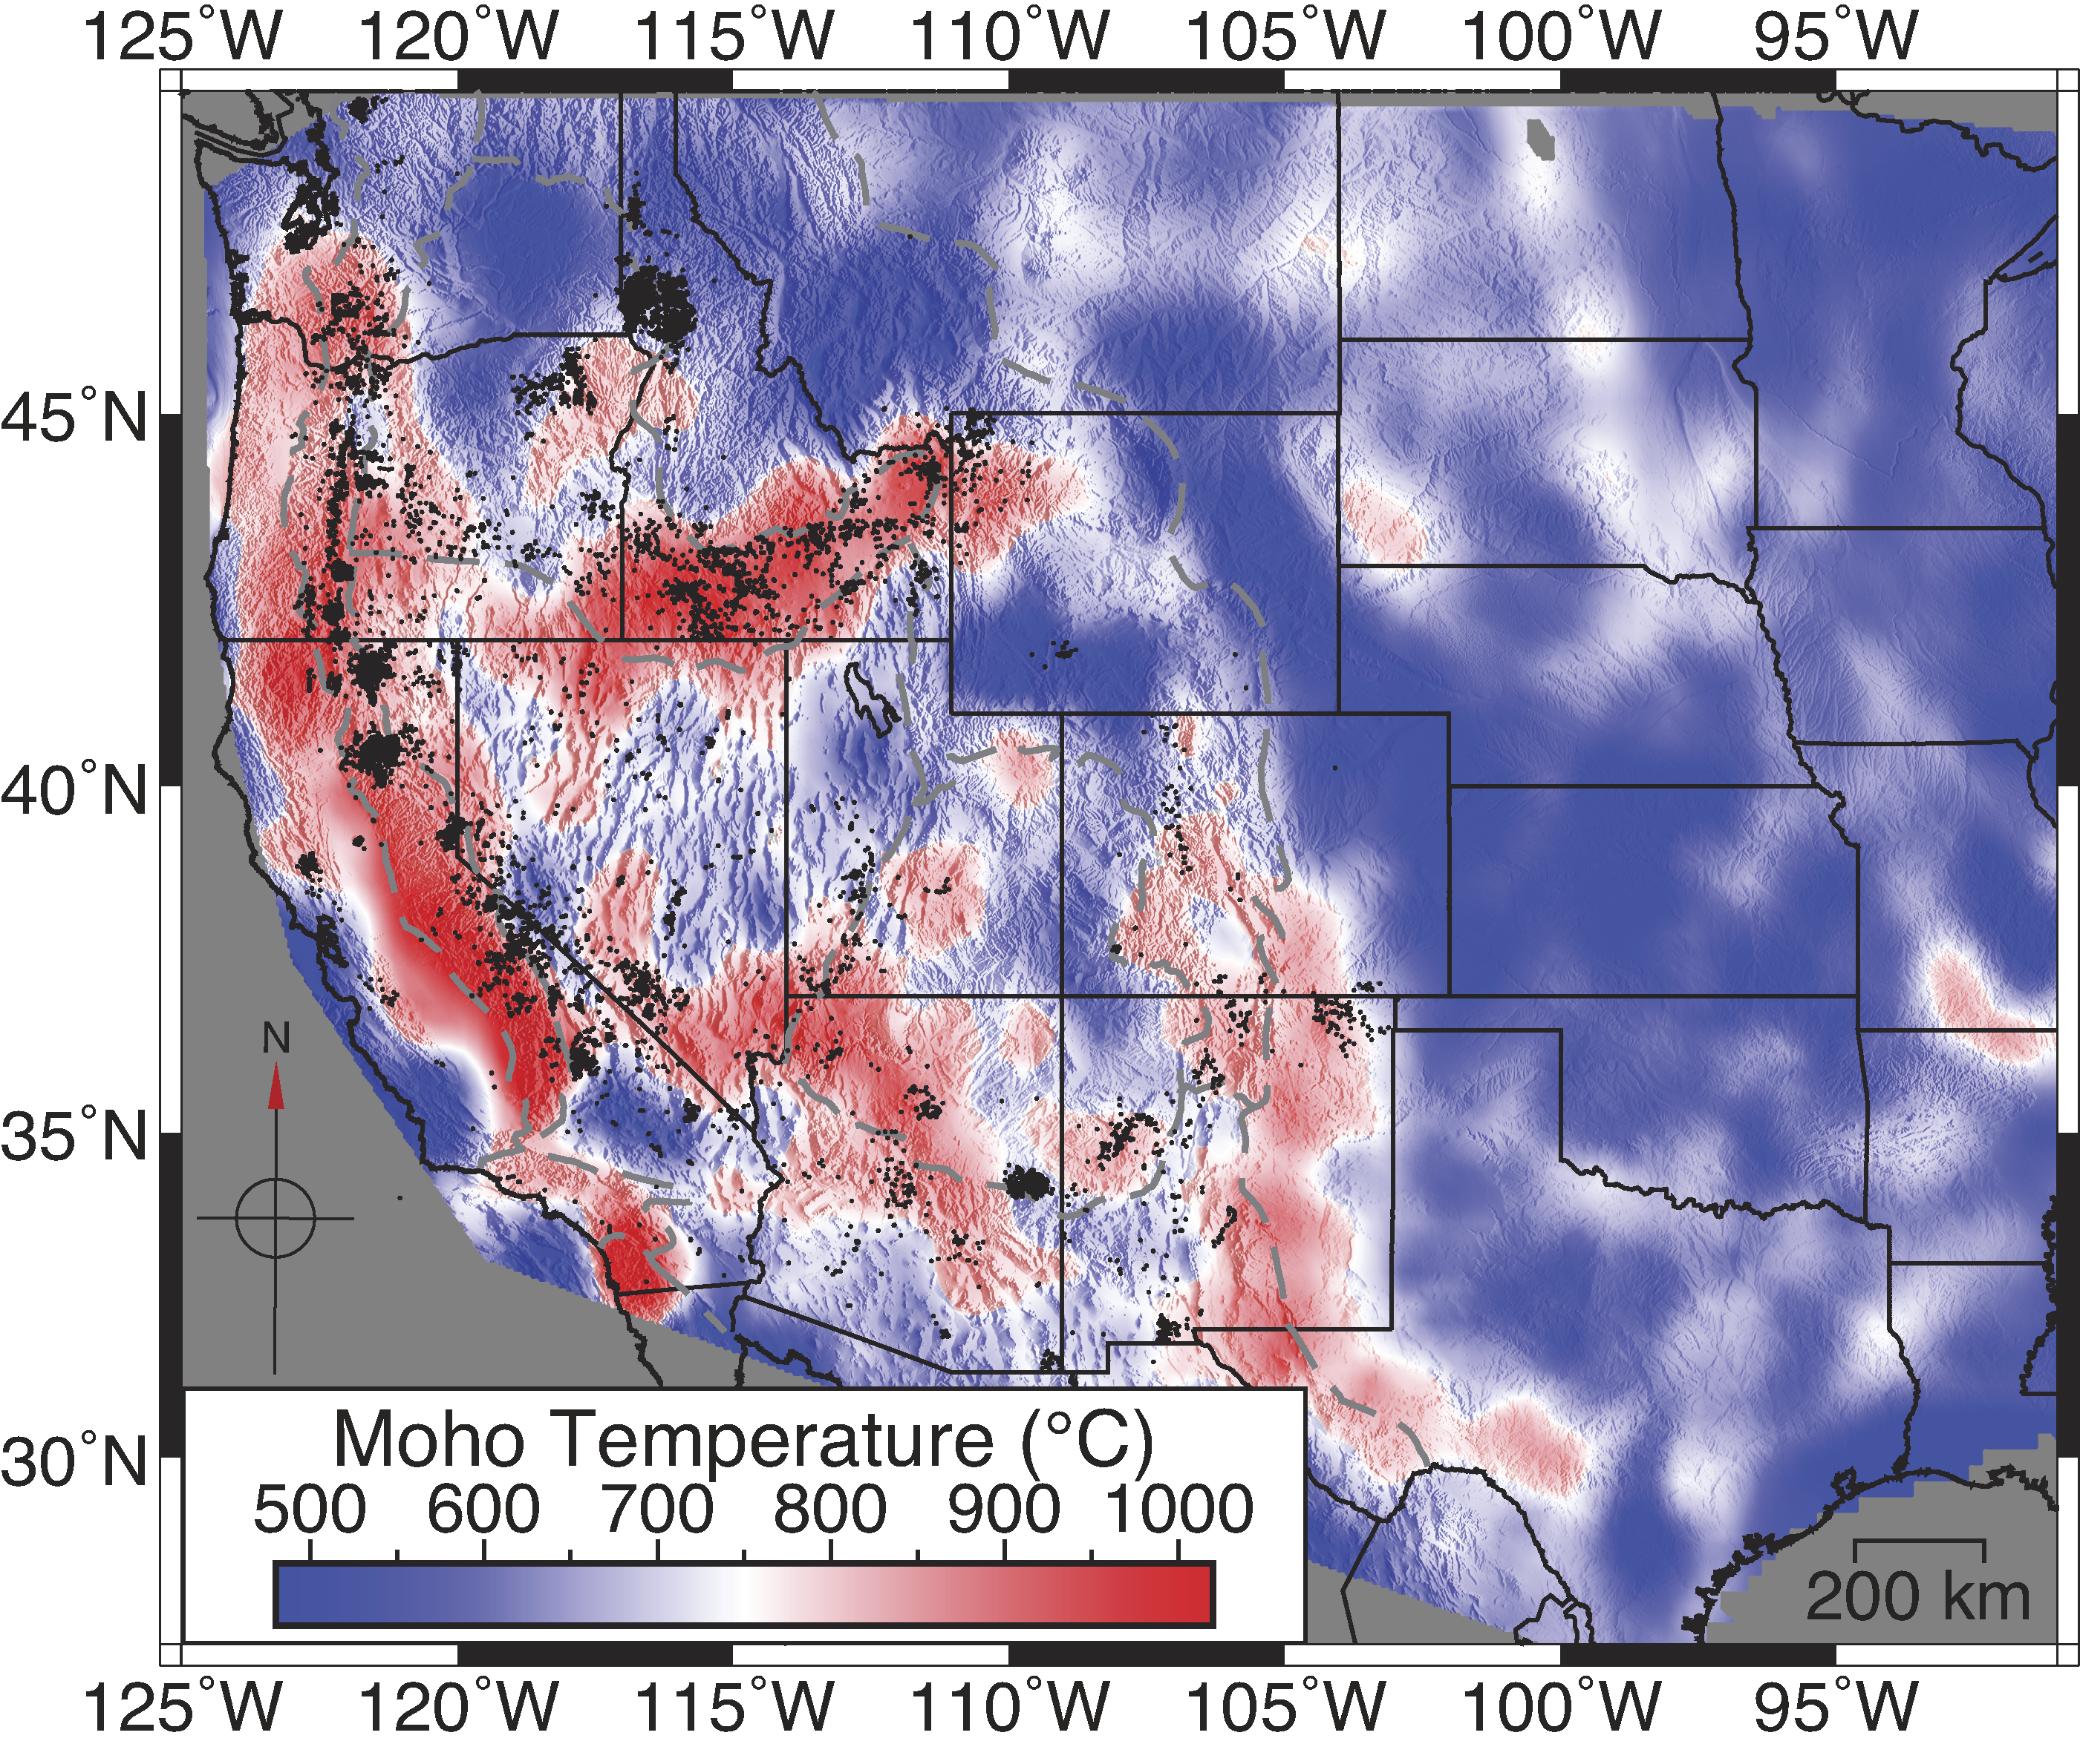
Important to note an aside in Furlong & Chapman:
Important new
information will
come from deep
seismic and
electrical imaging
combined with
mineral physics…
Here, using
Moho refracted
phase Pn.
Schutt et al., Geology 2018

Slide 5
Critical Thinking Skills (I):
When reading ANY paper, it’s important to make sure you
understand the terminology and the algebraic notation
being used.
For example, for Monday’s reading you needed to know:
• The Geotherm is the change in temperature with
depth within the Earth;
• Most of the algebraic notation used is the same as that we
use in class (q is surface heat flow; k is thermal
conductivity) but sometimes different (for example, we
used A for heat production per unit volume; F&C used
H. Note that the text uses H for heat production per unit
mass, so H_{notes} = ρH_{T&S}).

Slide 6
Critical Thinking Skills (II):
Always Look Carefully at the Observations:
• What is the core kernel of observational constraint?
• Is there a better way to describe observations?
• Is there a potential for multiple signal sources?
• Is there an approach to analysis that might remove
signals that aren’t relevant for processes you wish
to understand?

Slide 7
Science is a process of discovery by which
we increase knowledge…
Inductive Reasoning
Deductive Reasoning
begins with
begins with a
Observations
Hypothesis
used to generate a
predicts testable
Hypothesis
Observations
The
Scientific
Method
Additional observations/
experiments
If well supported, may become
Theory

