Slide 1
GEO 5/6690 Geodynamics
27 Jan 2023
Last Time: Follow-up to Furlong & Chapman;
Critical thinking skills to bear in mind for our
next reading
• Post F&C:
- Furlong & Chapman note potential for geophysics +
mineral physics to further illuminate heat transport
processes
- Mineral physics has advanced a lot in past ten years!
- Pn (Moho refracted phase) suggests discrepancies with
heat flow, implying complicating advective transfer
processes & perhaps reaction thermodynamics!
Read for Mon 30 Jan: T&S §4.13-4.17
© A.R. Lowry 2023

Slide 2
Next Journal Article Reading
Friday Feb 3: Roy et al. (2009) Nature
459, 978-982…
Shelby will lead!

Slide 3
Critical Thinking Skills (I):
When reading ANY paper, it’s important to make sure you
understand the terminology and the algebraic notation
being used.
For example, for Monday’s reading you needed to know:
• The Geotherm is the change in temperature with
depth within the Earth;
• Most of the algebraic notation used is the same as that we
use in class (q is surface heat flow; k is thermal
conductivity) but sometimes different (for example, we
used A for heat production per unit volume; F&C used
H. Note that the text uses H for heat production per unit
mass, so H_{notes} = ρH_{T&S}).

Slide 4
Critical Thinking Skills (II):
Always Look Carefully at the Observations:
• What is the core kernel of observational constraint?
• Is there a better way to describe observations?
• Is there a potential for multiple signal sources?
• Is there an approach to analysis that might remove
signals that aren’t relevant for processes you wish
to understand?

Slide 5
Science is a process of discovery by which
we increase knowledge…
Inductive Reasoning
Deductive Reasoning
begins with
begins with a
Observations
Hypothesis
used to generate a
predicts testable
Hypothesis
Observations
The
Scientific
Method
Additional observations/
experiments
If well supported, may become
Theory

Slide 6
All hypotheses (& theories)
are models…
Some models involve numbers.

Slide 7
Critical Thinking Skills (III):
When reading a paper that involves dynamical modeling,
it’s always helpful to think about:
• What are the assumptions of boundary conditions
(and do they matter?)
• What are the assumptions of initial conditions
(and do they matter?)
• What physical processes are being modeled
(and are there neglected physical processes that
could conceivably be important?)
• What observations are being modeled
(and how are they related? Qualitative or quantitative?
Comparison or inversion? What is the criterion for a
“Good Match” to the observations? Are there other
observations that might be relevant?)
• Does the model make testable predictions? How might
you test it?

Slide 8
Critical Thinking Skills (IV):
Numbers matter!
• What are the assumptions of rock material properties?
Do they gibe with laboratory measurements?
Do they gibe with geophysical measurements of
in-situ properties?
• What are the numerical values of other physical
properties?
Are they reasonable?
Is there observational support?

Slide 9
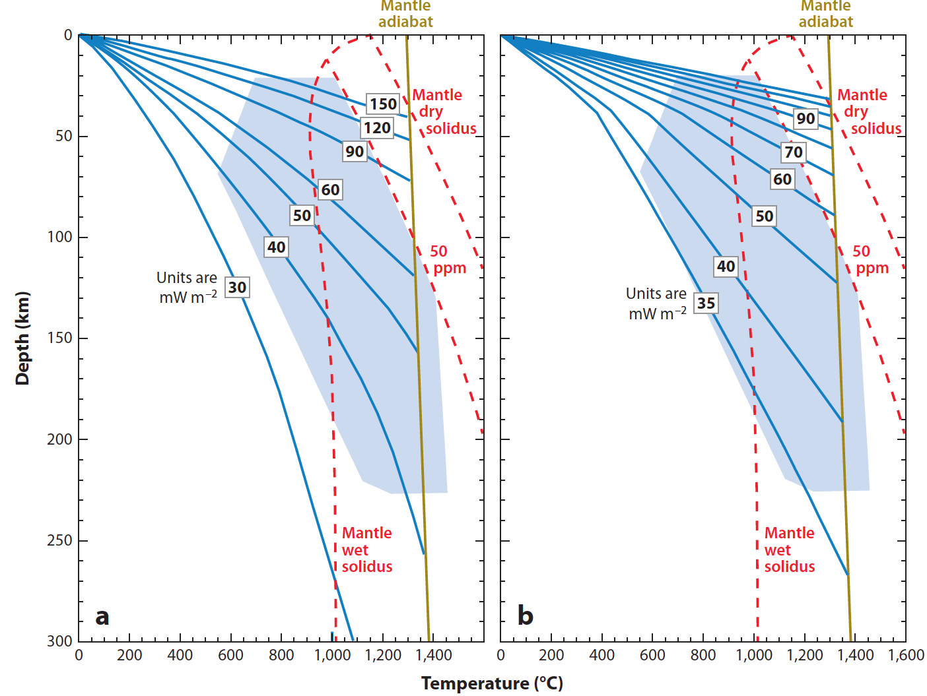
Also
important:
Melting!
A = 0.4q_{s}
A = 0.26q_{s}
Differences in
these two sets
of geotherms
are how much of
total heat flow is
from crustal
heat production
Melting
depends on
temperature,
pressure &
hydration state

