Slide 1
GEO 5/6690 Geodynamics
27 Mar 2023
Last Time: RHEOLOGY
Flow Rheology depends on mineral-type (i.e. lithology),
temperature, pressure, & volatile state (especially hydration!)
Diffusion also depends on grain size, but only dominates for
very small (<50 μm) grain size &/or low differential stress
Temperature is often inferred from surface heat flow, which
is a poor predictor of temperature at depth… Frontier
methods use mantle seismic velocity + mineral physics
Lithology can be inferred from crustal seismic imaging
(thickness for depth to olivine; v_{P}/v_{S} for quartz vs feldspar)
Yield Strength Envelopes approximate deviatoric stress
supported by the lithosphere; assume a brittle field rheology
(friction coefficient, pore fluid pressure) plus strain rate
YSE modeling of flexural rigidity plus other info can be used to
infer effects of water!
Read for Fri 31 Mar: T&S §8.1-8.7
© A.R. Lowry 2023

Slide 2
Next Journal Article Reading:
For Wednesday Mar 29: Berry et al. (2022)
EPSL, 584, #117483.

Slide 3
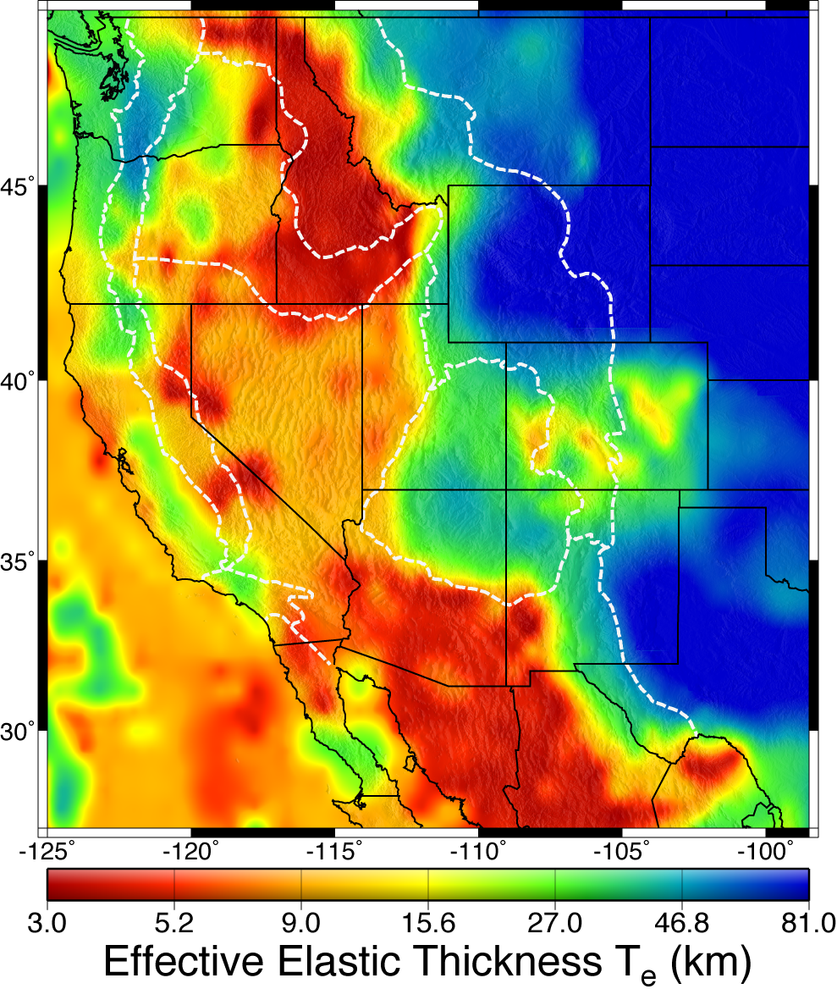
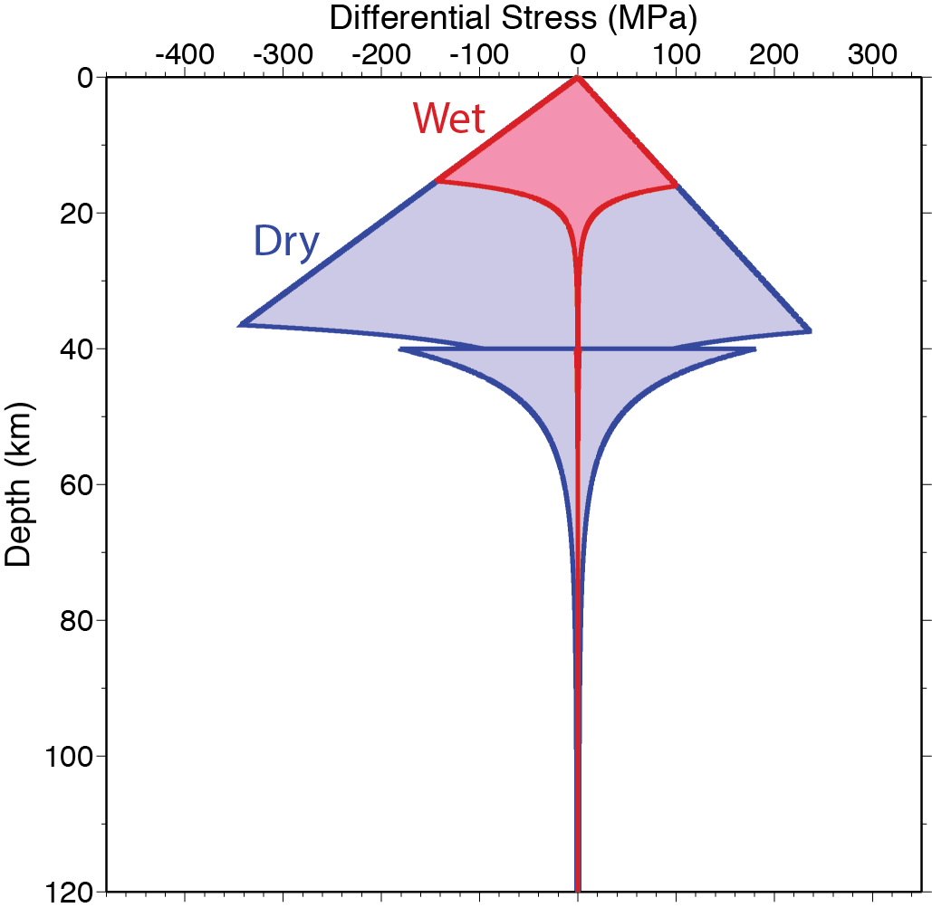

Flow Strength…
depends mostly on:
• Mineralogy
• Temperature
• Water Content

Slide 4
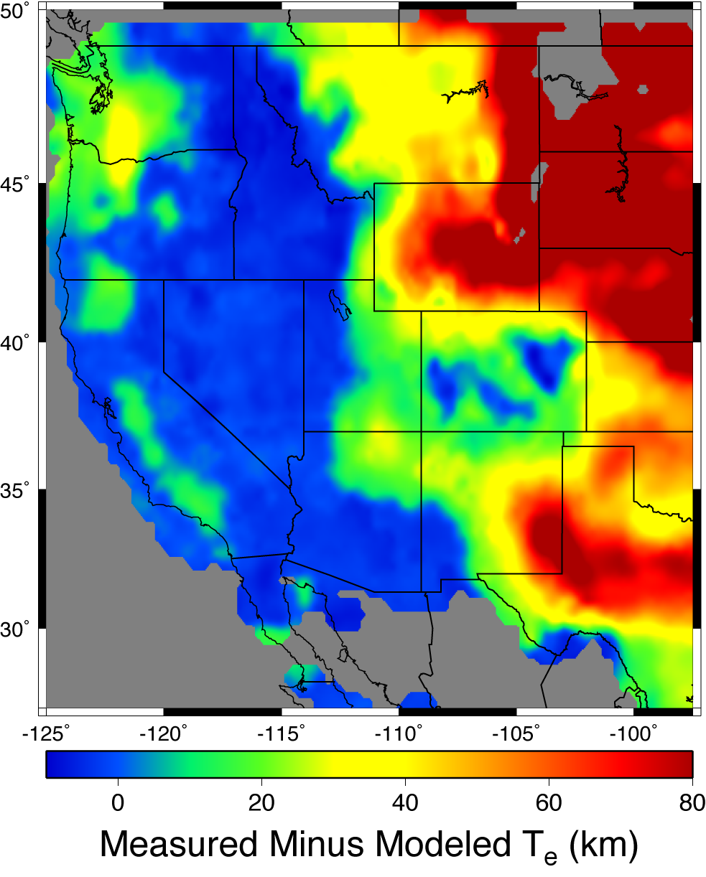
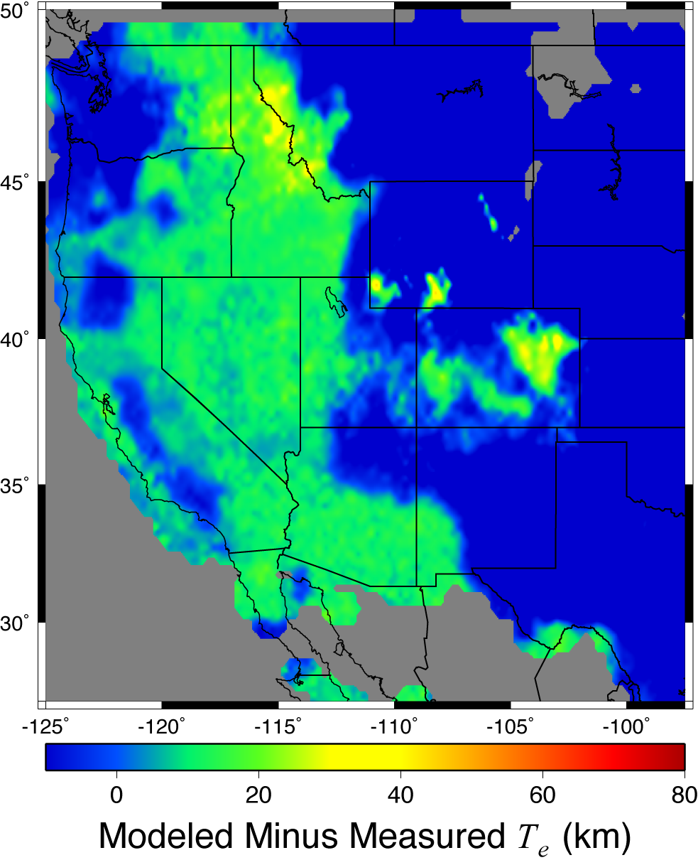
Wet (saturated) end-member
Dry end-member

Slide 5
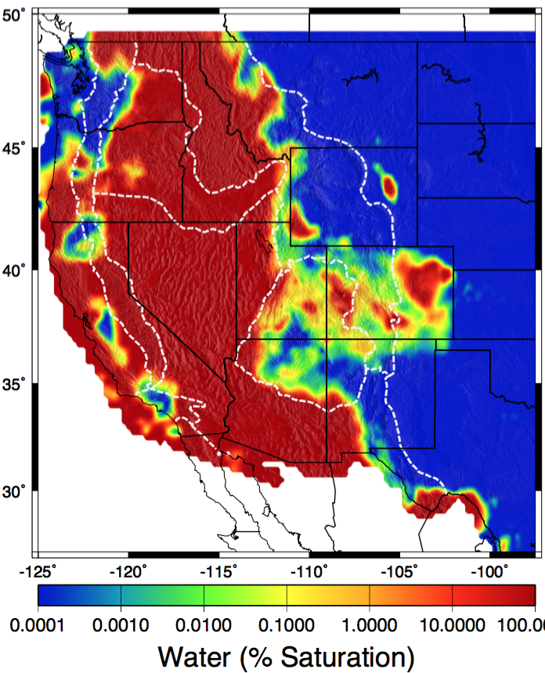

Slide 6
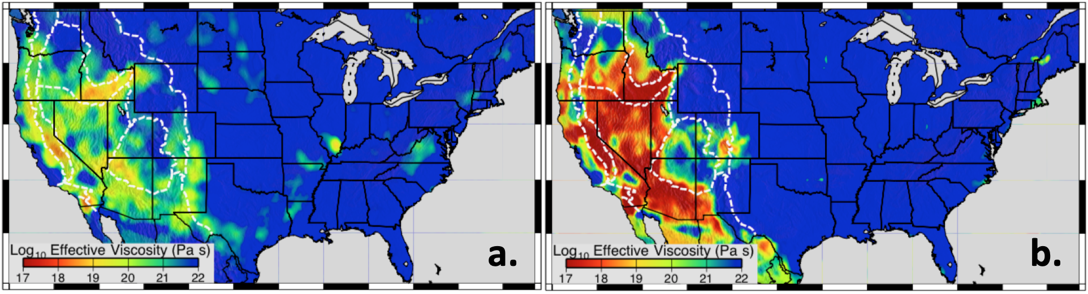
Flow viscosity at
80 km depth using
geotherms based
on Schutt et al.
(2018) Pn
temperature & 10⁻¹⁵
s⁻¹ strain rate…
Flow viscosity after
hydration state is
varied to match T_{e}.
Note the scale is
logarithmic, so
range is ~1000x
greater...

Slide 7
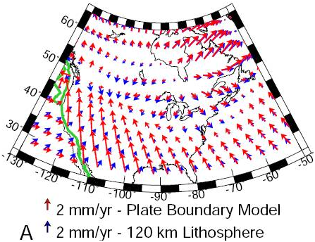
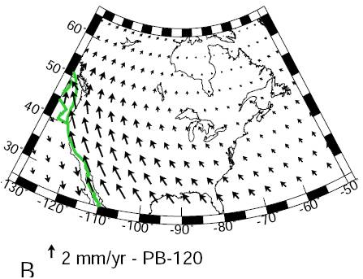
Implications?

Slide 8
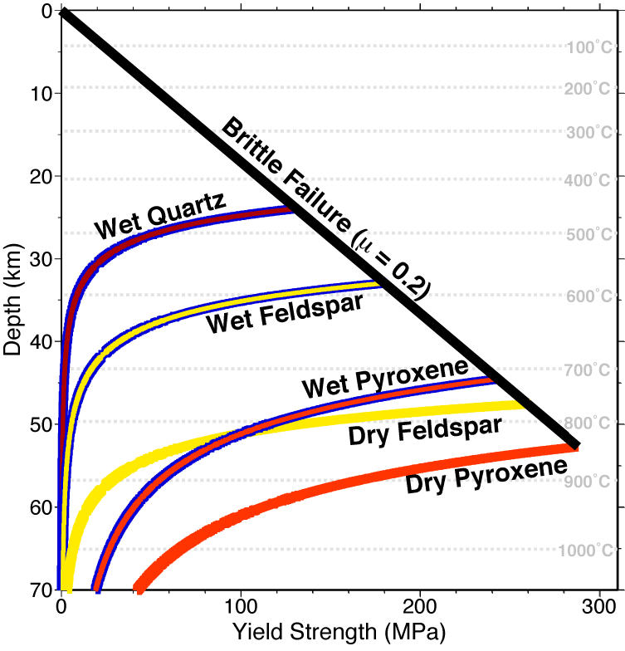
Brittle-field failure & the
“Seismogenic Zone”
So what about that top part of the
Yield Strength Envelope?
For large-scale deformation in the real
Earth, other important rheologies
include brittle (frictional) failure in
rock fracture & fault slip, described by Byerlee’s Law:
Place a rock sample with an existing fracture in a lab
apparatus, apply a stress normal to the fracture
plane σ_{N}, then determine how much shear stress τ is
required to get it to slip; frictional strength is
defined by a friction coefficient μ:

Slide 9
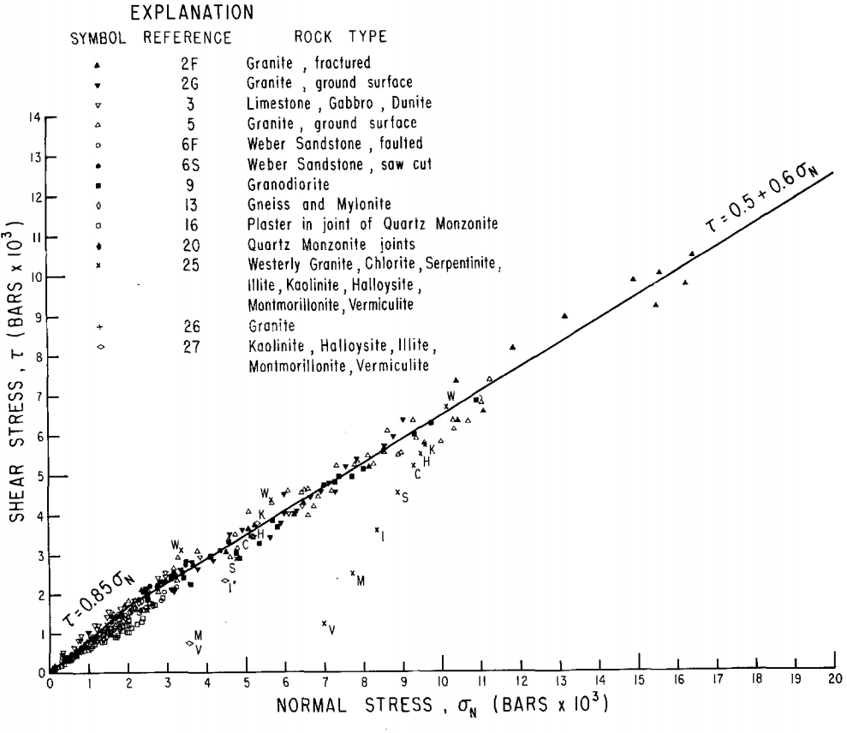
Byerlee’s Law
For dry rock, no clay(!),
low temperature…
this is insensitive to
rock type!
Lab experiments & borehole stress tests suggest μ ~ 0.6…
But dynamical models indicate long-term μ nearer 0.1-0.2!

Slide 10
Using Byerlee’s law (and assuming ubiquity of fractures),
we can define a depth-dependent failure law with frictional
yield strength Δσ as (e.g., Sibson, Nature 1974):
where λ = P/ρgz and P is pore fluid pressure,
ρ is mass density of rock,
g is gravitational acceleration,
z is depth
This is where the asymmetry in the
brittle-field part of the YSE
arises!
in compression (Δσ < 0);
in extension (Δσ > 0)
Δσ
0
z

Slide 11
Of course the bottom part of the Yield Strength Envelope
reflects a creep flow law, so it requires assumptions about
lithology, geothermal gradient, water fugacity & grain size:
Note however this also requires some assumption about
the strain rate !
Typically we assume a constant strain rate of ~10⁻¹⁴–10⁻¹⁶ s⁻¹.
But in reality, strain rate is determined by the stress forcing
via the constitutive law (so if we know, everywhere in 3D,
the density structure and the
rheology, we could calculate or
model based on that).
The YSE was first described
and used by Goetze &
Evans (GJRAS 1979).
Δσ
0
z

Slide 12
To first order, the distribution of earthquakes with depth
depends on the YSE, and
the “seismogenic depth”
will correspond (approximately)
to the brittle-ductile transition.
Δσ
0
brittle =
seismogenic
ductile
z
BUT as we will soon discuss,
frictional dynamics
predicts earthquakes only
where friction is velocity-
weakening (excluding the
upper and lower few km of
the frictional slip regime!)
Δσ
(shallowest
earthquakes)
brittle =
seismogenic(?)
ductile
(max EQ
focal depth)
z

Slide 13
max EQ
focal depths
And in addition…(!)
Earthquake focal
depths will map to the
brittle-ductile transition
ONLY if ambient stress
exceeds the yield
strength at that depth!!!
Δσ
brittle =
seismogenic(?)
ductile
z

