Slide 1
Geology 5690/6690
Geodynamics
28 Aug 2024
Last Time: Course Overview; What is Geodynamics?
Course Overview:
• Grading will emphasize HWs, leading/participating in
discussions of journal articles
• Grads have an additional semester research project
Geodynamics couples multiphysics simulation (modeling)
to observations that include topo, gravity, structure,
geophysical images, geochemistry, …
Example: Isostasy thought exercise: Surface elevation
must be balanced by some kind of buoyancy at depth.
But what is that buoyancy?
Read for Fri 30 August: T&S 73-80 (§2.1-2.2)
© A.R. Lowry 2007-2024

Slide 2
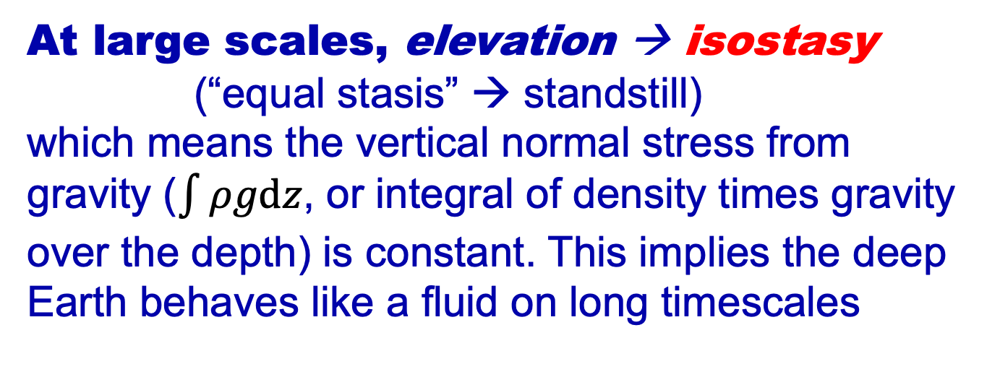
Δρ₁h₁
=
Δρ₂h₂
If the Earth is
an inviscid
fluid at depth,
(i.e., can’t
support any
deviatoric
stress), that
requires
uniform
pressure!
At large scales, elevation → isostasy
(“equal stasis” → standstill)
which means the vertical normal stress from
gravity ($\int{ρgdz}$, or integral of density times gravity
over the depth) is constant. This implies the deep
Earth behaves like a fluid on long timescales

Slide 3
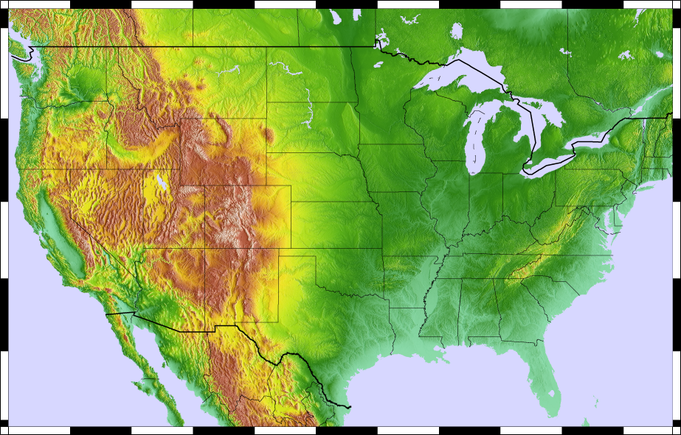

Slide 4
Other Observations:
• We can image crustal
thickness from seismic
data (ρ_{crust} ~ 2800 kg/m³;
ρ_{mantle} ~ 3350 kg/m³!)
• We can infer
temperatures from
mantle seismic V
(density change ~
1 kg/m³ for every
10°C!)
• We can infer crustal
composition from
V_{P}/V_{S} (low is granitic;
high is mafic; varies by
up to ~ 300 kg/m³!);
reflects hydration!

Slide 5
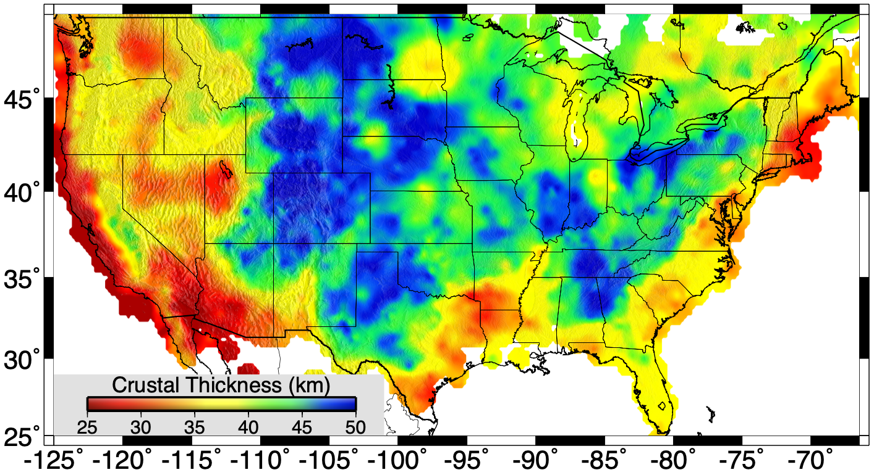
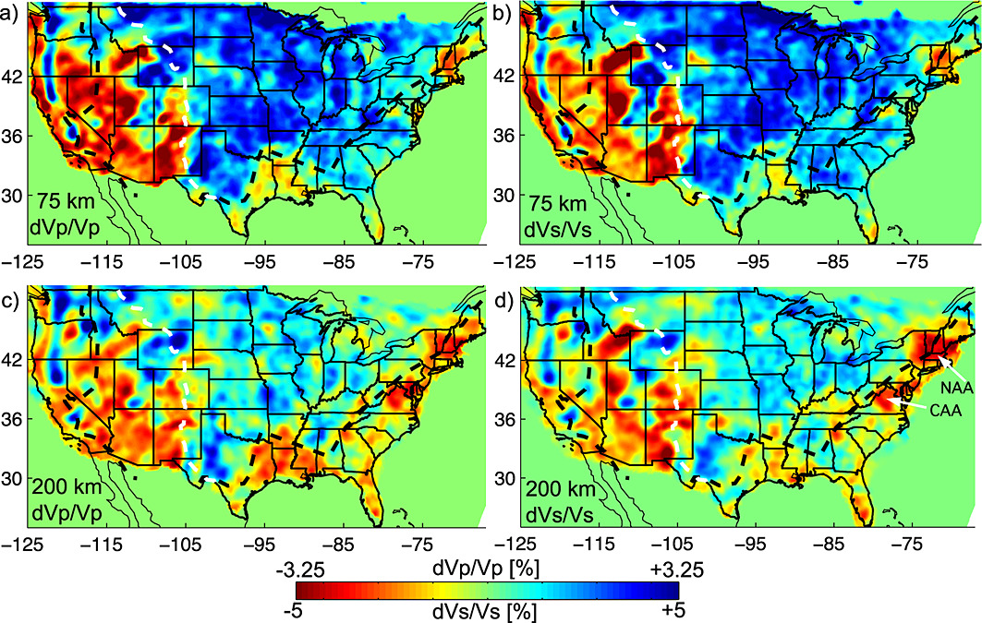
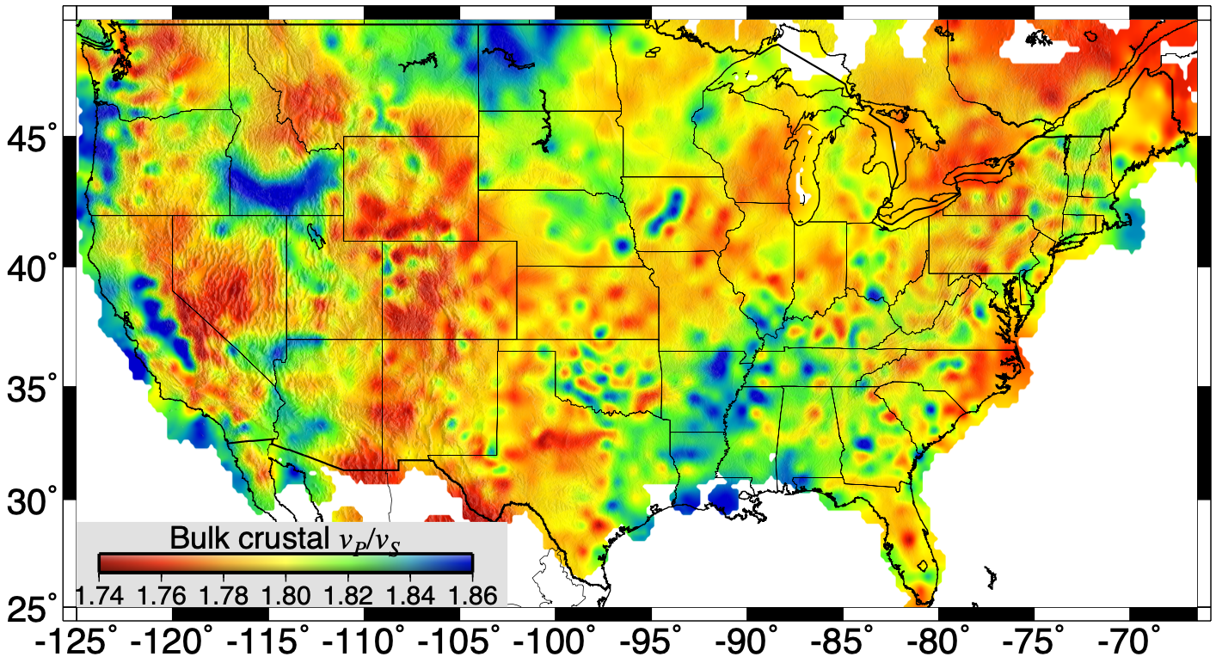
Schmandt & Lin 2014
Lowry & Pérez-Gussinyé 2011; Ma & Lowry 2017

