Slide 1
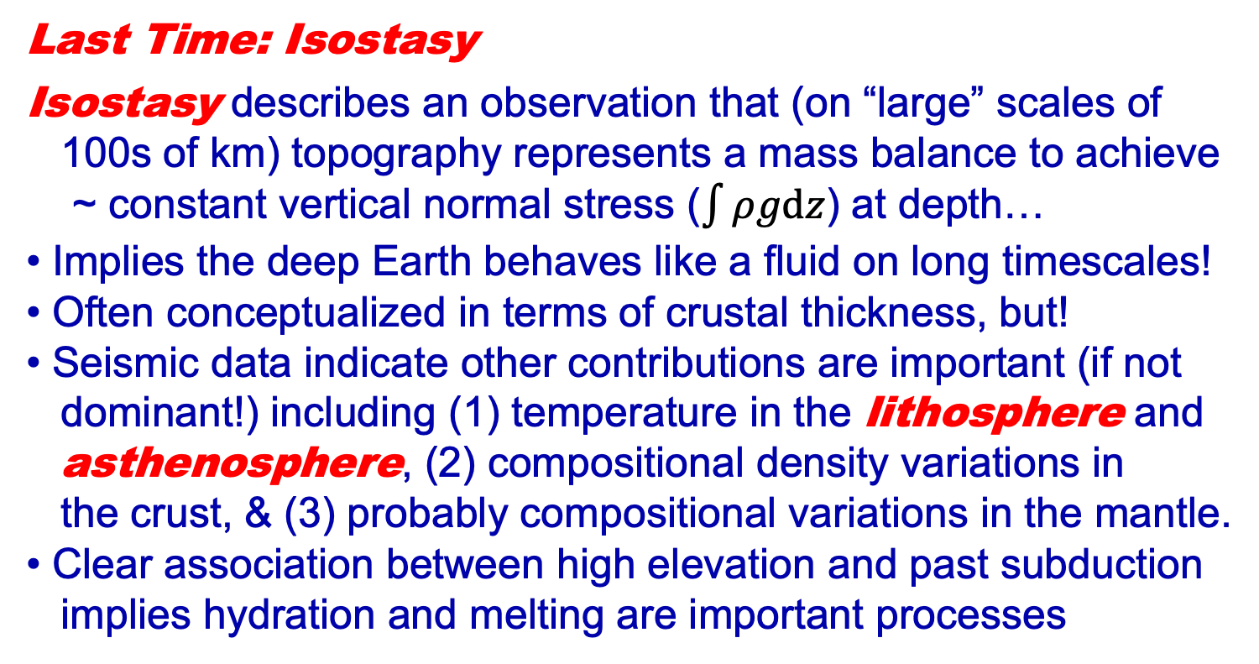
Geology 5690/6690
Geodynamics
30 Aug 2024
Last Time: Isostasy
Isostasy describes an observation that (on “large” scales of
100s of km) topography represents a mass balance to achieve
~ constant vertical normal stress ($\int{ρgdz}$) at depth…
• Implies the deep Earth behaves like a fluid on long timescales!
• Often conceptualized in terms of crustal thickness, but!
• Seismic data indicate other contributions are important (if not
dominant!) including (1) temperature in the lithosphere and
asthenosphere, (2) compositional density variations in
the crust, & (3) probably compositional variations in the mantle.
• Clear association between high elevation and past subduction
implies hydration and melting are important processes
Read for Wed 4 September: T&S 73-80 (§2.1-2.2)
© A.R. Lowry 2007-2024

Slide 2
So, what do you think of when someone
says lithosphere?

Slide 3
Plate Tectonics?
Rigid Plate
Velocity
Assume “no-slip”
boundary conditions
(fluid velocity at the
boundary with the
plate = plate velocity
u₀; fluid velocity at
mesosphere boundary
= 0) and constant
viscosity, then
u = u₀
z = 0
constant
viscosity
η
h
z = h
~Rigid Mesosphere
u = 0

Slide 4
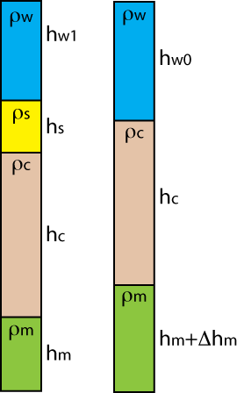
An elastic beam that bends
to isostatically balance applied
mass loads?
(G. K. Gilbert, ~1880)
(J. Barrell, ~1911)
(Probably not… But that’s the context in which the term
was introduced!)

Slide 5
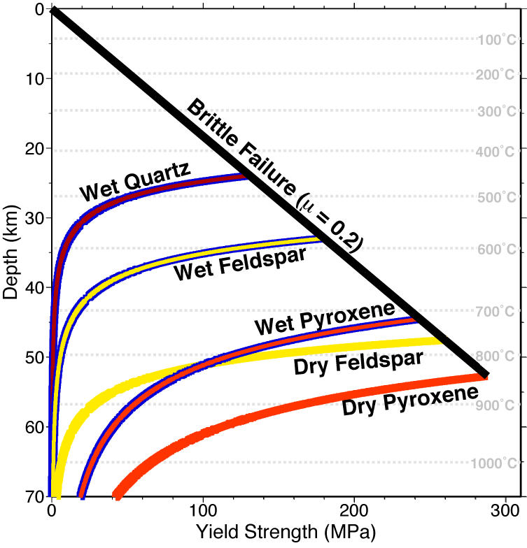
A rheologically strong layer?

Slide 6
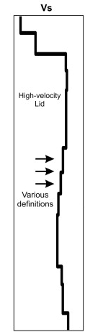
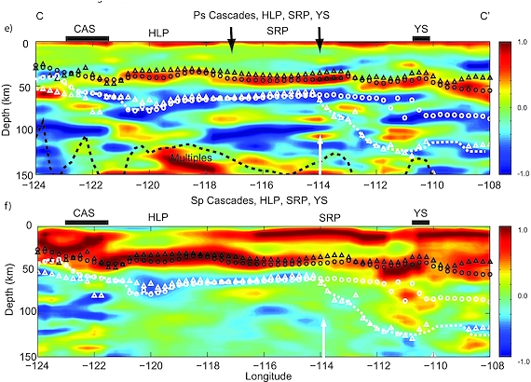
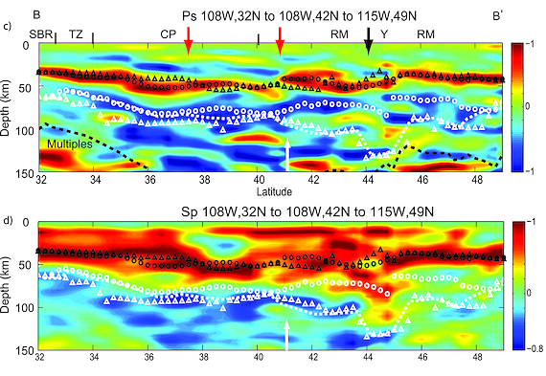
Upper Crust
Higher Seismic
Velocity in the
Uppermost
Mantle?
Lower Crust
Here, an increase in velocity
with depth creates a positive
(red) amplitude in a seismic
receiver function image… A
decrease in velocity creates
a negative (blue) amplitude
Upper
Mantle
High-
Velocity
“Lid”
(Levander & Miller, G³, 2012)

Slide 7
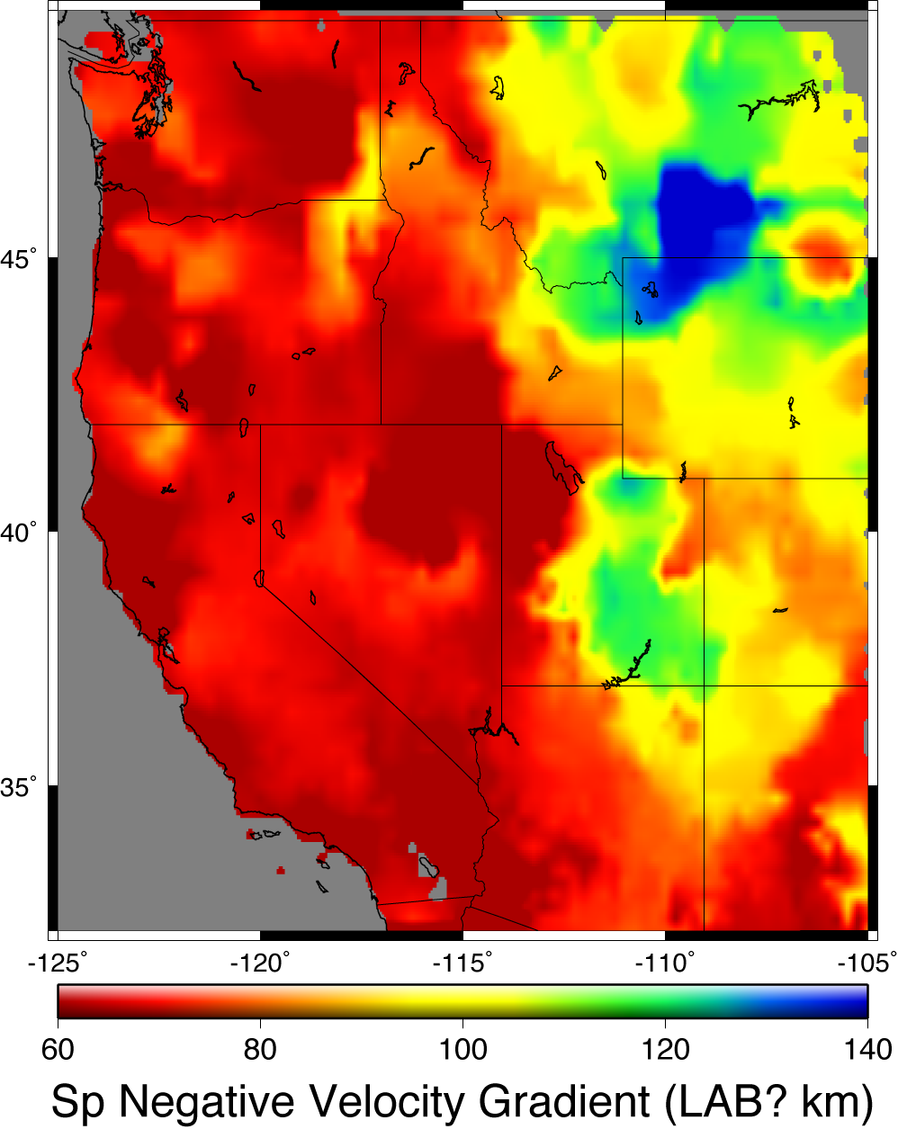
(Levander & Miller, G³ 2012)

Slide 8
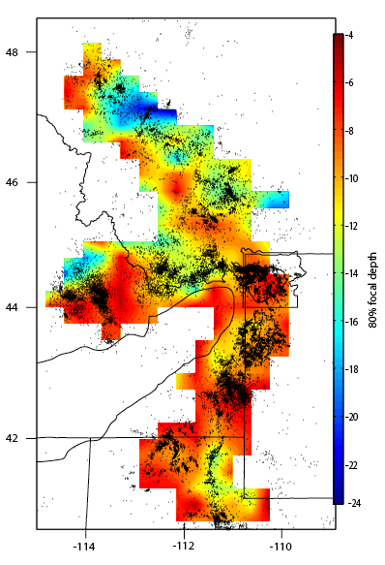
The
Seismogenic
Layer?

Slide 9
Mode of Thermal Transfer?
0
Temperature
1200-1400 ºC
0
Conductive
50-300
km
Adiabat: Temperature
increases with pressure
but energy doesn’t
change
Depth
Convective

Slide 10
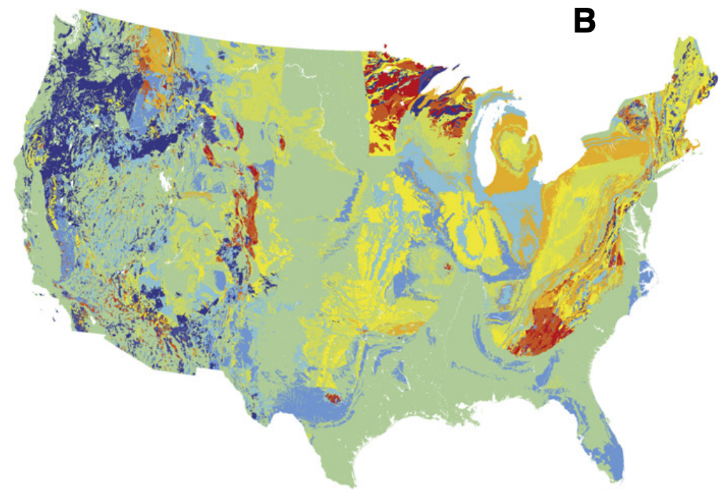
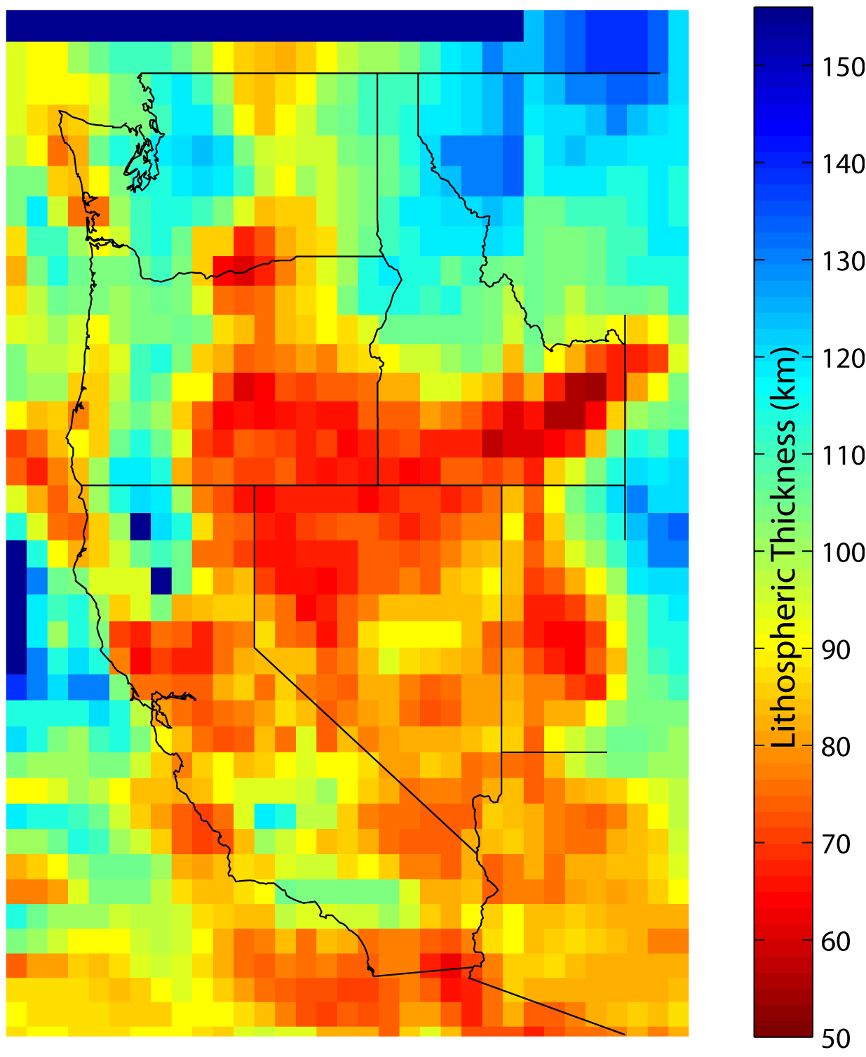
Isotopic Geochemistry?
“That can’t be
right… It should
be thinner at the
west coast!”
–J. Shervais

