Slide 1
GEO 5/6690 Geodynamics
30 Jan 2023
Last Time: Critical thinking skills;
Temperature & melting
• To understand an article, it’s often helpful to start by reading
the abstract, figures/captions, & conclusions; then the rest
of the paper!
• Helpful items to think about (in order of importance):
- Terminology
- The core kernel of observational constraints
- Assumptions/predictions implicit in the “model”
- Consistency of numerical values with other information
• The solidus (temperature of first partial melting) of mantle
rocks depends on hydration state; rarely intersects the
geotherm unless water is present &/or there is rifting
Read for Wed 1 Feb: T&S §4.13-4.17
© A.R. Lowry 2023

Slide 2
Next Journal Article Reading
Friday Feb 3: Roy et al. (2009) Nature
459, 978-982…
Shelby will lead!

Slide 3
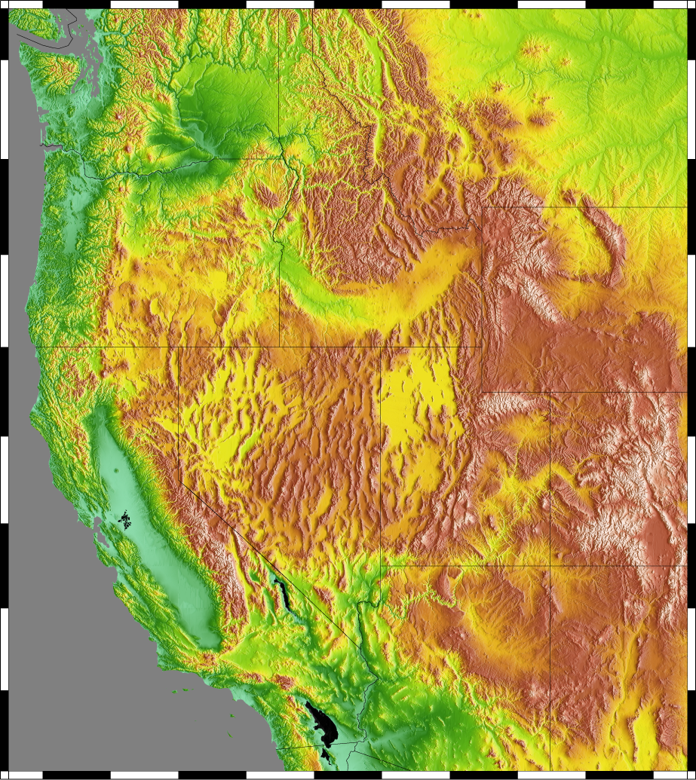
Other complications: What about topography?
ΔT
h₀
λ
Two effects:
• Temperature depends on
altitude per “lapse rate”
• Heat flow “refracts” toward
heat sinks (i.e., surface)
For a periodic boundary, first
effect is attenuated as
Second expresses in
temperature as:
H

Slide 4
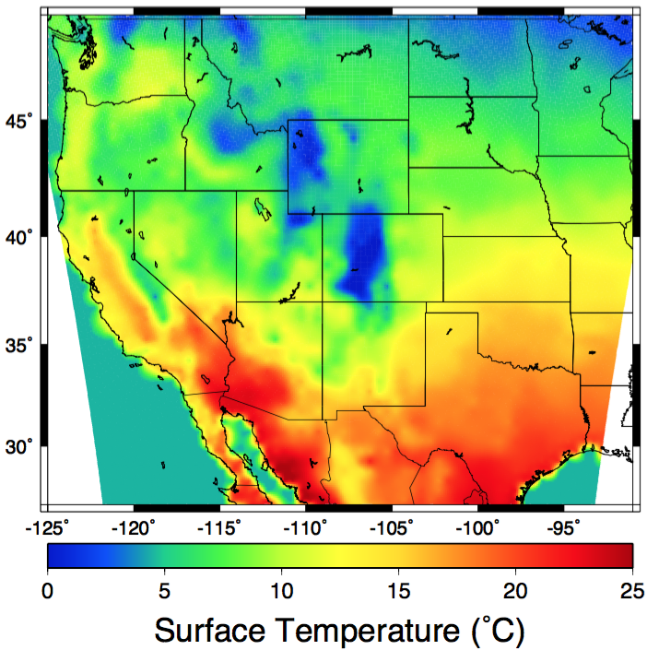
Other complications: What about topography?
So can Fourier transform observed topography and
surface T variations and solve for both effects!

Slide 5
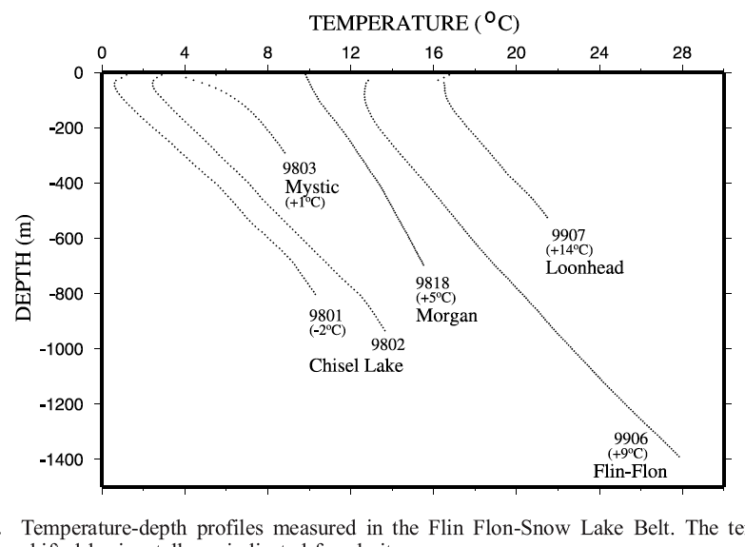
The Geotherm Cont’d:
Up to now, we’ve focused on the geotherm in
steady-state…
However temperature is not always constant!
Recall the 1D
steady-state heat
equation in the
absence of radiogenic
heating:
Does this imply negative
conductivity?

Slide 6
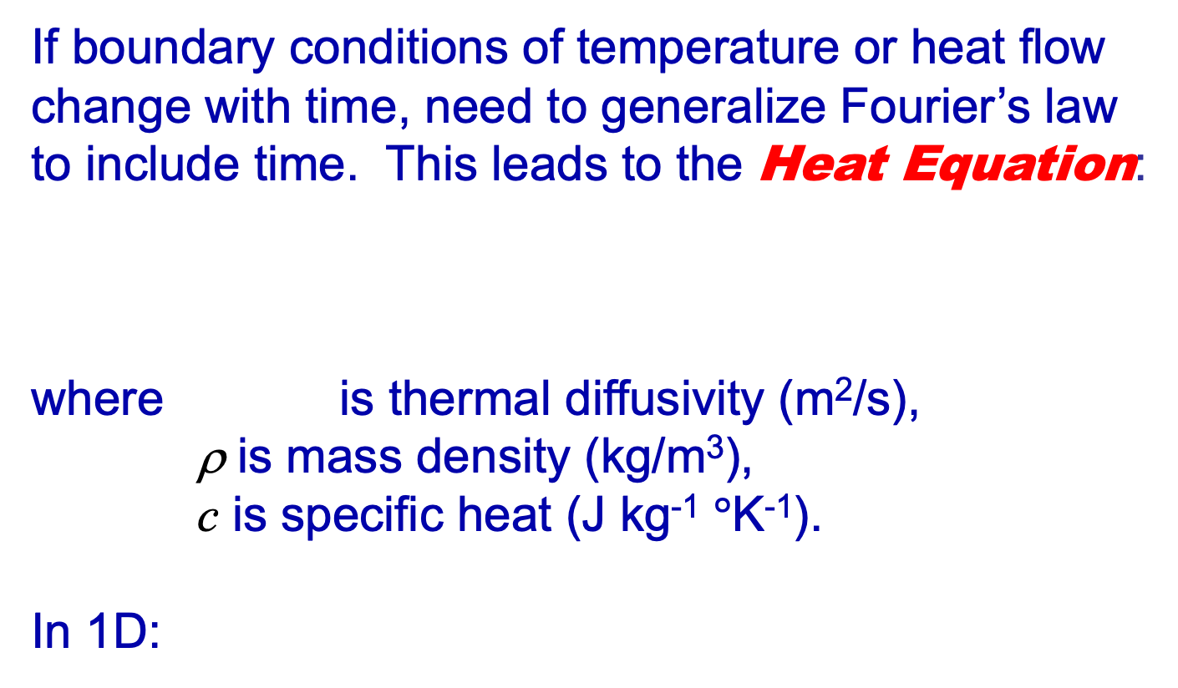
If boundary conditions of temperature or heat flow
change with time, need to generalize Fourier’s law
to include time. This leads to the Heat Equation:
where is thermal diffusivity (m²/s),
ρ is mass density (kg/m³),
c is specific heat (J kg⁻¹ $°$K⁻¹).
In 1D:
H
H

Slide 7
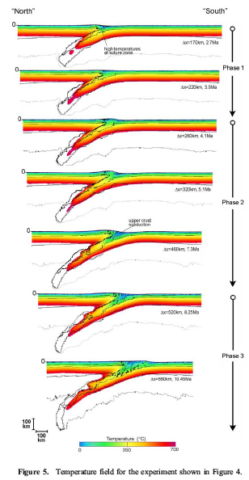
Example I: Subduction Initiation
Temperatures in the subducting slab must equilibrate with the
asthenospheric wedge…
0
1350
t = 1
t = 0
t = 2
t = 3
t = 0
Temperatures in the forearc upper-plate, above the slab, are
reduced over time by the change in lower boundary temperature

Slide 8
Example II: “Instantaneous” Rifting (McKenzie EPSL 1978)
Basically a cooling model:
crust
crust
crust
mantle
lithosphere
l
mantle
lithosphere
mantle
lithosphere
Higher temperature lower density; isostasy implies
lower density should correspond to higher elevation!
Elevation h decays ~ exponentially as
where β is stretching factor; characteristic time τ is

