Slide 1
GEO 5/6690 Geodynamics
31 Mar 2023
Last Time: Brittle-field rheology
Byerlee’s Law: Laboratory measurements of dry rock
indicate failure on a pre-existing “fracture” depends on
pressure but is (mostly) insensitive to rock lithology…
where μ is friction coefficient (0.85 shallow, 0.6 deeper)
τ is shear stress, σ_{N} is normal stress
(But the exceptions are important:
Clays are weak, with μ ∼ 0.1-0.2!!!)
Yield Strength Envelope reflects also work done (gravity),
pressure dependence on depth, pore-fluid pressure:
in compression (Δσ < 0);
in extension (Δσ > 0)
© A.R. Lowry 2023

Slide 2
Next Journal Article Reading:
For Monday Apr 3: Im et al. (2020)
Nature Geosci., 13, 705-710.

Slide 3
To first order, the distribution of earthquakes with depth
depends on the YSE, and
the “seismogenic depth”
will correspond (approximately)
to the brittle-ductile transition.
Δσ
0
brittle =
seismogenic
ductile
z
BUT as we will soon discuss,
frictional dynamics
predicts earthquakes only
where friction is velocity-
weakening (excluding the
upper and lower few km of
the frictional slip regime!)
Δσ
(shallowest
earthquakes)
brittle =
seismogenic(?)
ductile
(max EQ
focal depth)
z

Slide 4
max EQ
focal depths
And in addition…(!)
Earthquake focal
depths will map to the
brittle-ductile transition
ONLY if ambient stress
exceeds the yield
strength at that depth!!!
Δσ
brittle =
seismogenic(?)
ductile
z

Slide 5
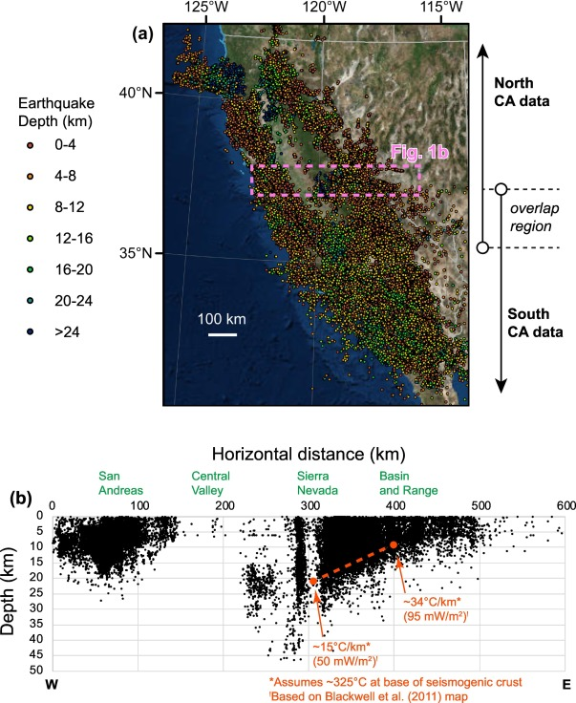
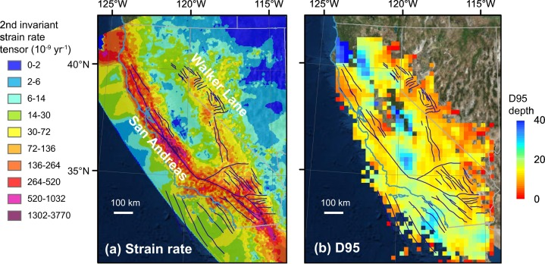
Zuza & Cao, Tectonophysics 2020
Additionally, our observations of earthquakes are a function of how long
we’ve been observing relative to a typical recurrence interval for
earthquakes, which in turn depends on strain rate, which in turn depends
on the rheological strength… And have uncertainties(!!!)

Slide 6
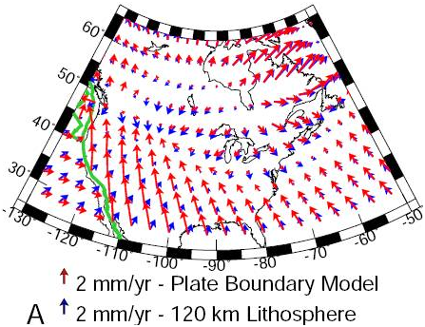
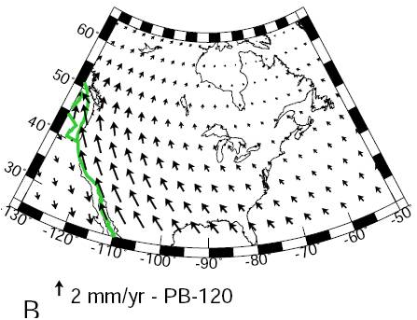
Recall that strain response depends on assumptions about
rheology of the lithosphere…
Question: What makes weak lithosphere weak? Weak faults
or weak flow rheology?

Slide 7
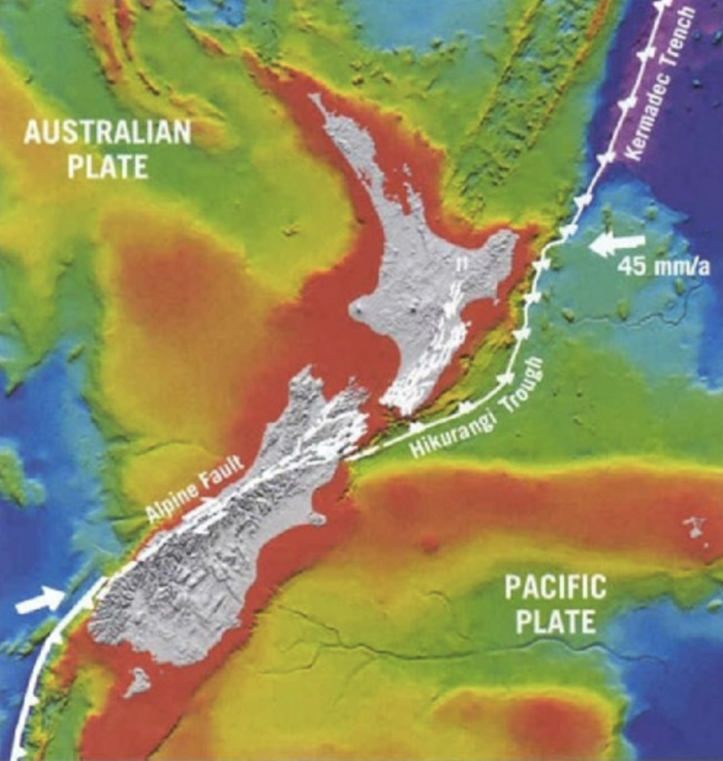
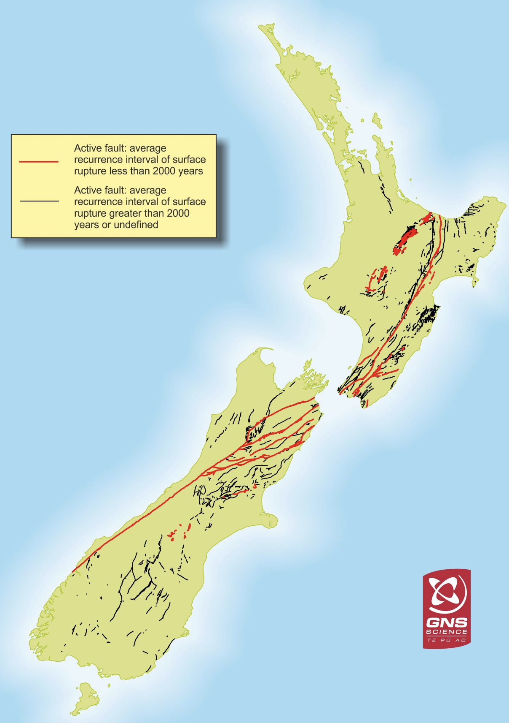
Consider faults where plate boundaries are evolving…
If the strain is there, the faults will form and coalesce!

Slide 8
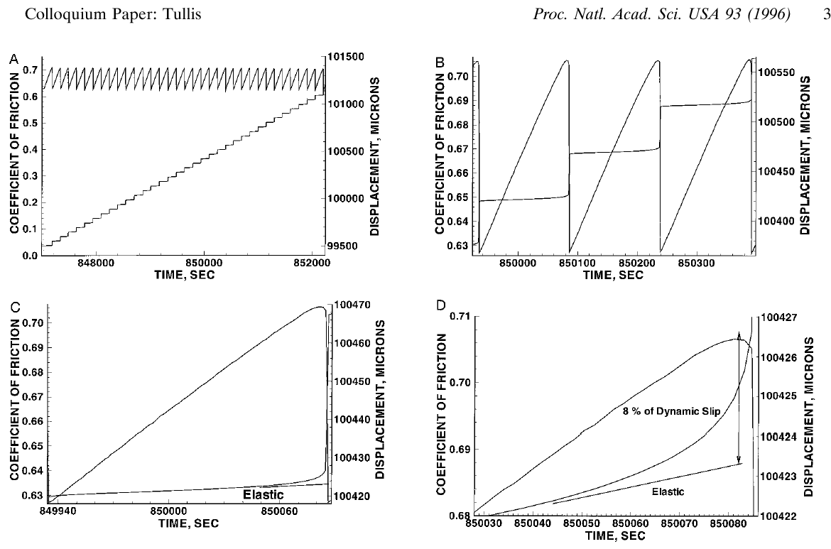


Important to note: Frictional slip is dynamical and also
depends on slip rate, and “state” of entanglement at contacts
Actual μ $⟹$ failure…
$$“μ”=\frac{τ}{σ_{N}}$$
Elastic stress
& strain are linear!

Slide 9
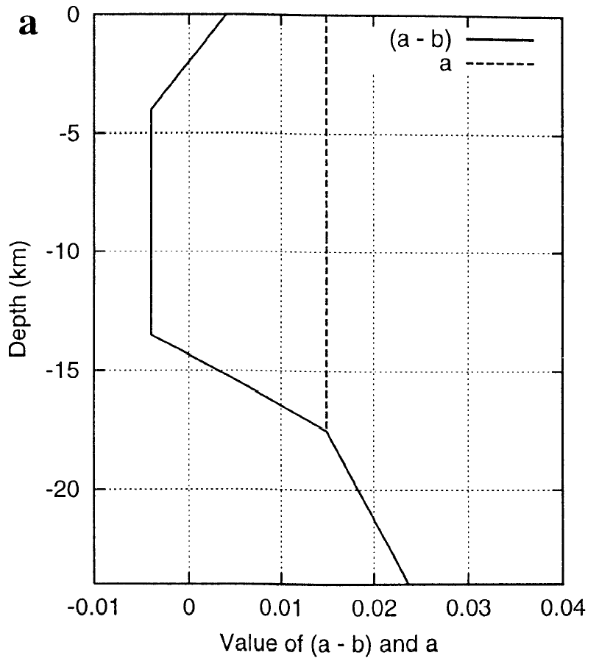
Fault friction and slip velocity:
Depend on:
• Two frictional constants a and b plus
a length scale D_{c}
• a – b < 0: friction decreases with increasing
slip velocity (→ unstable)
• a – b > 0: friction increases with increasing
slip velocity (→ stable)
• a, b, D_{c} depend on temperature, rock type,
pore fluids, gouge properties
• State variable Θ (depends on history of slip,
evolution of contact surface)
• Normal and shear stress on the fault
“Favors”
Stick-Slip
“Favors”
Stable
Sliding
(Approximation of P-T dependent
Laboratory friction measurements)
Hence friction & slip vary nonlinearly in both space and time!
Notes:
Too complex

Slide 10
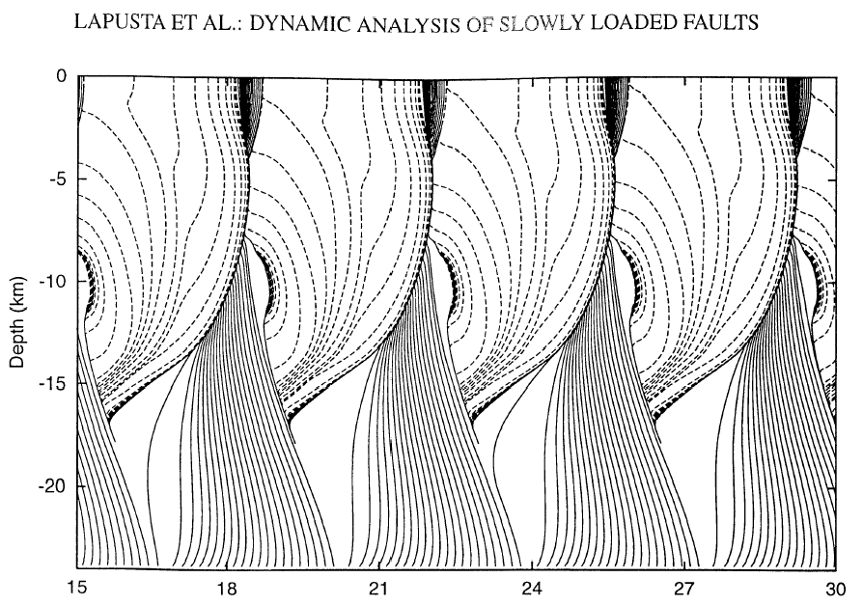
A San Andreas simulation with rate-state constitutive relations…
J. GEOPHYS. RES., 105(E10), 2000
b – a > 0
b – a = 0
Pre-Slip
b – a < 0
b – a = 0
Earthquake
b – a > 0
After-Slip
Cumulative Slip (m)
Predicts fault slip behaviors that we observe with geodesy.
(But what form does this part take?)

Slide 11
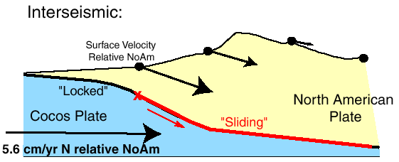
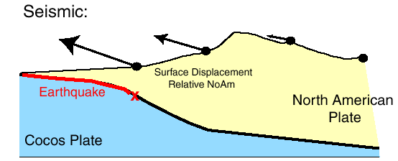
The Earthquake Cycle (With a Broad Brush)
Elastic strain
(potential
energy)
accumulates
during
interseismic
& is released
(converted to
heat and
mechanical
energy) during
earthquakes
Notes:
Too complex

Slide 12
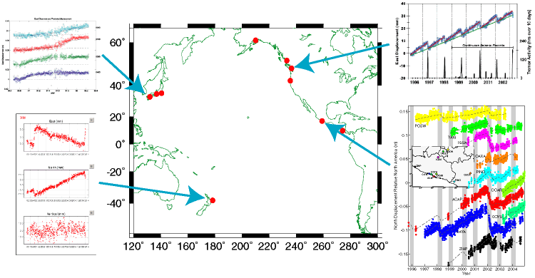
Slow fault slip events are observed
(geodetically) around the globe:
Dragert et al. 2001; Rogers & Dragert 2003
Hirose et al. 1998; Miyazaki et al. 2003
Douglas et al. 2005
Lowry et al. 2001; 2006

Slide 13
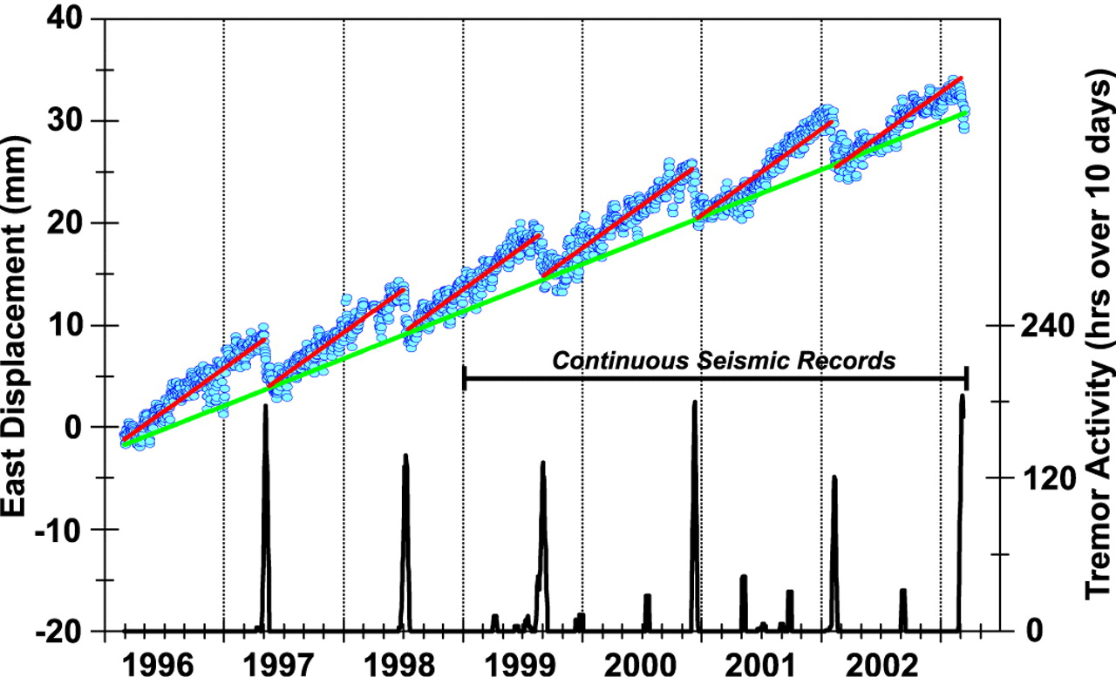
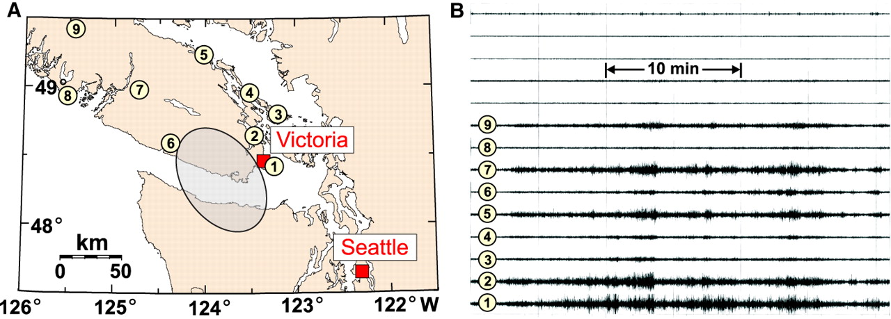
Commonly associated with tremor:
• Seismic recordings exhibit
coincident 1–5 Hz tremor
in some (but not all)
locations (Cascadia,
Japan, Mexico)
Rogers and Dragert, Science, 300, 2003

Slide 14
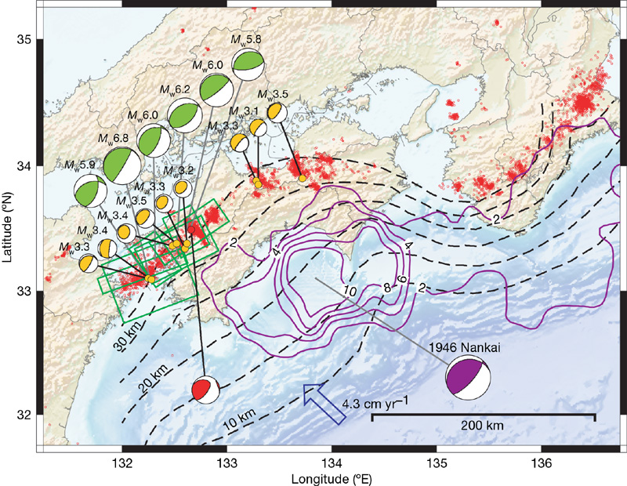
Interpretation?
Ide et al, Nature (447) 2007
Tremor has radiation pattern & location consistent with
a superposition of lots of M_{w} 1.5–3.5 “slow eq” events

Slide 15
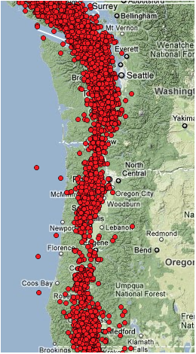
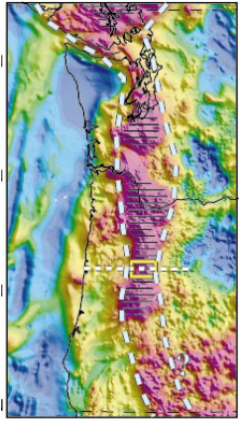
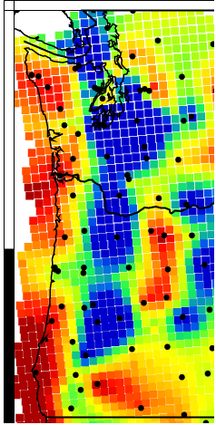
Tremor locations
2009-2011
Serpentinized
Subduction Wedge
(Blakely et al.,
Geology, 2005)
Raw EARS
“Crustal Thickness”

Slide 16
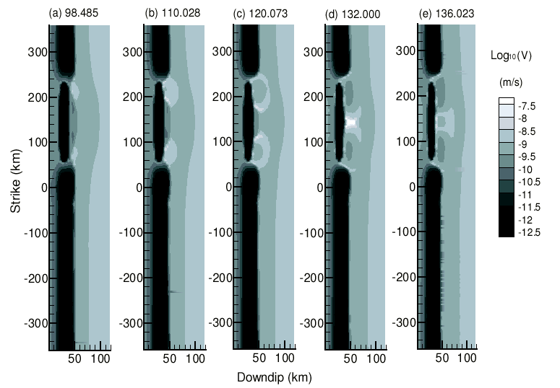
Rate & state frictional simulations of subduction zone slip…
Liu and Rice,
JGR 2006
Also predict slow slip events focus near the frictional transition!

