Slide 1
Geology 5670/6670
Inverse Theory
12 Sep 2023
Last time:
Ordinary Least Squares Parameter Error
• Parameter error relates to measurement error and the
geometry/physics of sampling as:
“Review” of Gaussian distribution (univariate):
where Mean:
Variance:
• From multivariate distribution, if measurement errors are
zero-mean, random, uncorrelated, the model
covariance matrix is:
Read for Thur 14 Sep: Menke Chapter 3 (39-68)
© A.R. Lowry 2023

Slide 2
For the ordinary least squares case,
(Note because is symmetric. Also,
, and for symmetric A).
If measurement errors are uncorrelated, constant variance:
and
*****
*****

Slide 3
So we can estimate a parameter variance for each
model parameter:
And we write

Slide 4
What should we expect to be?
Can substitute & ; after lots of algebra
and using
the identity:
(where Tr[•] = trace is the sum of the diagonal elements)
We get:
And:
If we assume measurements are
uncorrelated with constant variance:
Then:

Slide 5
Useful take-home points:
• One can always fit the data exactly if N = M.
• If your measurement errors are unknown and
N – M is “large”,
The latter is useful because often-times when σ ² is
estimated independently, we find that !
This generally indicates either (1) unanticipated “noise”
in the measurements, (2) correlated errors or (3) (& very
likely) the model under-parameterizes the true structure.
Hence we define a chi-squared parameter

Slide 6
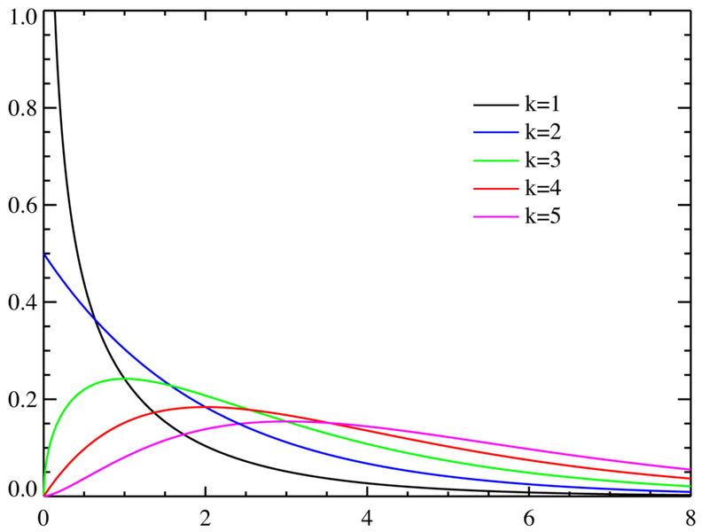
Why chi-squared (χ ²)?
DOF:
A probability density function
describes the relative likelihood
that a random variable will occur
at a given point (e.g., the “bell
curve” for a Gaussian RV).
The sum of the squares of
k zero-mean, uncorrelated, Gaussian-distributed random
variables will follow a chi-squared distribution with k (= N–M)
degrees-of-freedom:
As k gets very large, this function will peak ~k/σ ²… But we also
have a measure of the probability of getting some other
result.
has PDF:

Slide 7
Solution appraisal: What is the range of solutions?
Assume: zero-mean, Gaussian, uncorrelated errors
Estimate: Confidence intervals expressed as %: 100(1–α)%
(i.e., α is probability the true value falls outside the
confidence interval).
Case 1: Data error variance is known (= σ ²)
Desired confidence interval is ±z of the
normal (z) distribution function
Can get this from standard
statistical tables or codes
α/2
-z
1-α
+z
α/2

Slide 8
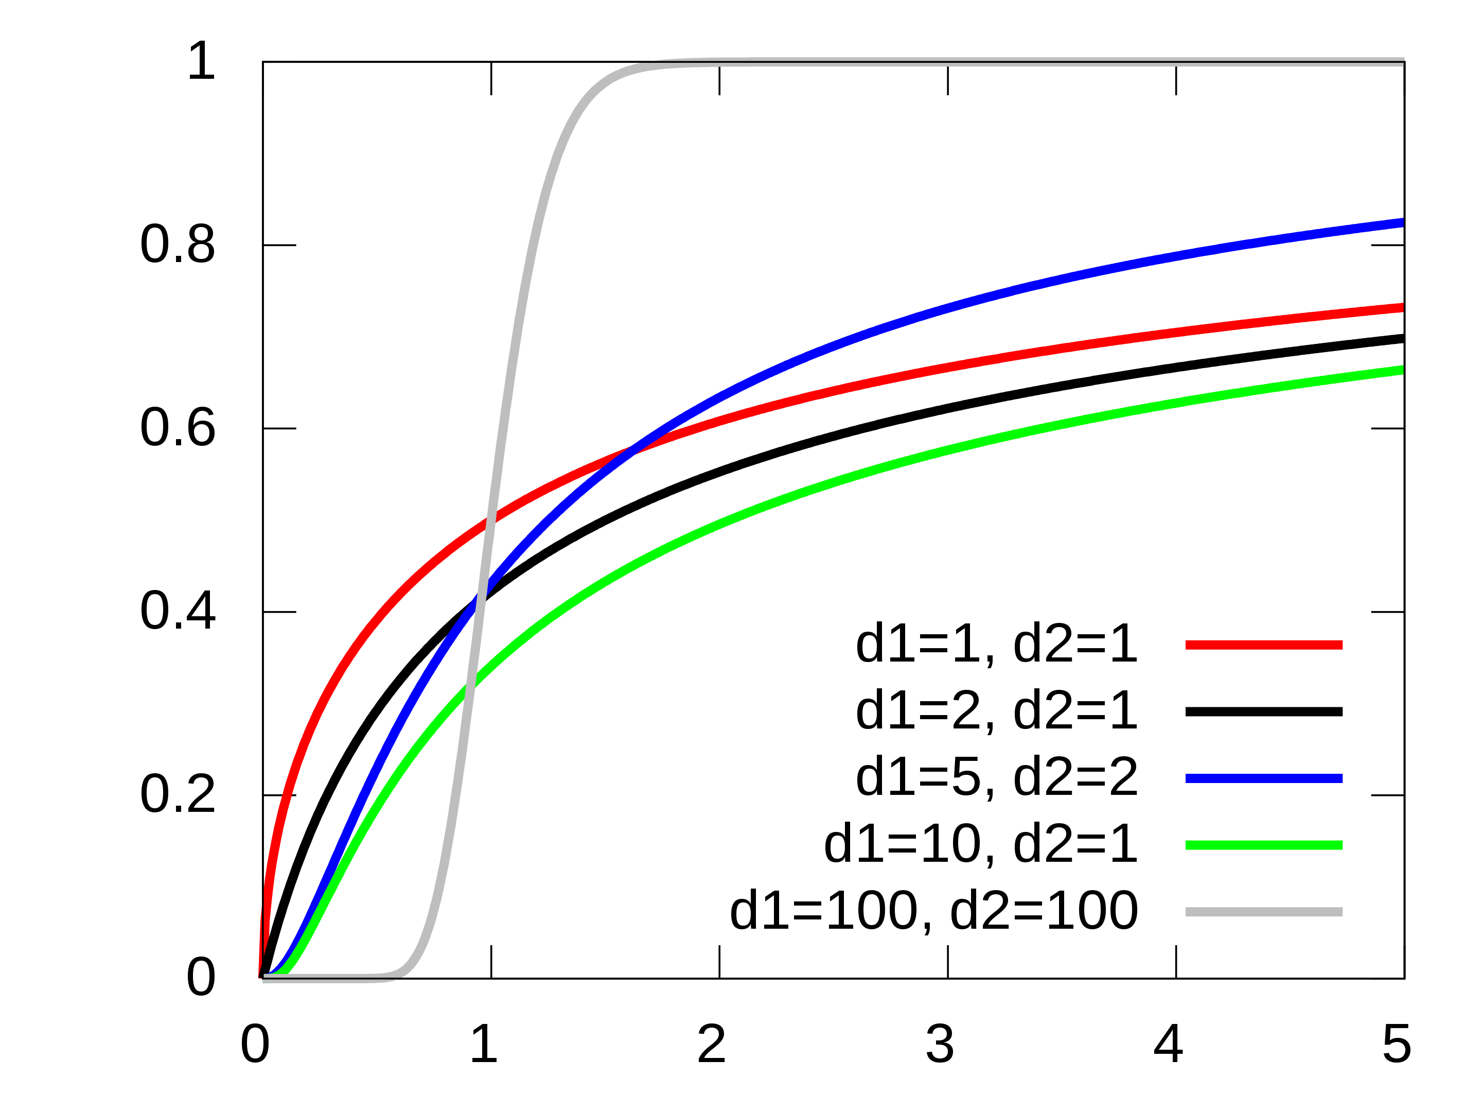
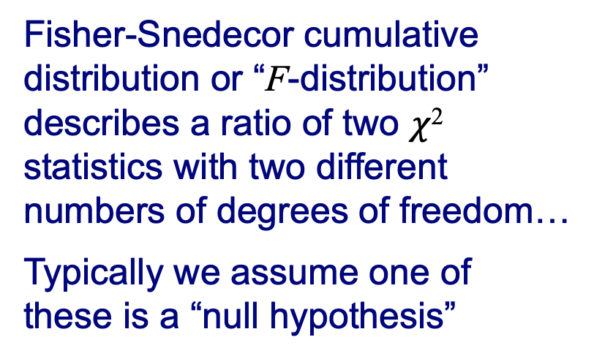
Fisher-Snedecor cumulative
distribution or “F-distribution”
describes a ratio of two $χ$²
statistics with two different
numbers of degrees of freedom…
Typically we assume one of
these is a “null hypothesis”
Suppose we want the 95% confidence interval given known
σ ² (implies ∞ DOF for the null hypothesis): Typically we use
the F- (Fisher-Snedecor) distribution for F = 1 – α/2:
95% confidence ⇒ 1 – α = 0.95
1 – α/2 = 0.975
Looking up on a standard table, find F(z) = 0.975 when
z = 1.96 (i.e. slightly less than 2σ).

Slide 9
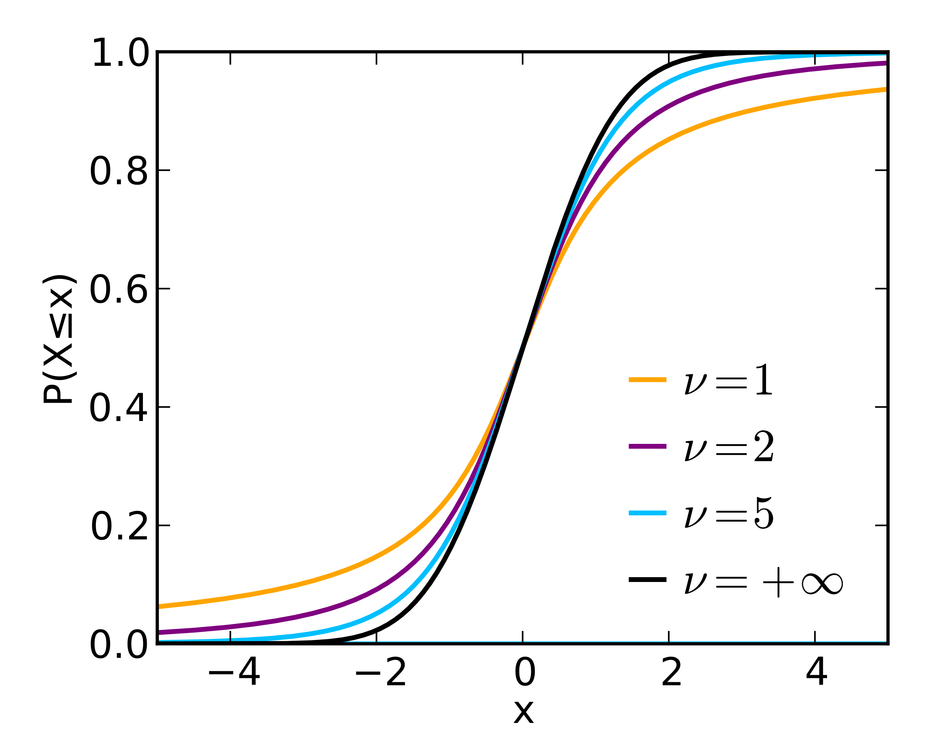
Student’s t-cumulative
distribution or “t-distribution”
also assumes a “null
hypothesis”
Here ν is the degrees-of-
freedom (= N – M in our
notation)
Case 2: Use estimated error variance from
(Look up the t-distribution as you would z-distribution
in math probability tables, or use corresponding
routines in Matlab or other stat codes).

