Slide 1
Geology 5670/6670 Inverse Theory
14 Nov 2023
Last time: Joint Inversion using Likelihoods
• Cooperative or Joint Inversion uses two different types
of model physics to invert for common parameters. However,
designing a suitable objective function when physics is imperfect
or unmodeled signals are present can be problematic
• Using probability density functions (e.g., calculate from weighted
L₂ norm via the likelihood ratio method) as “Likelihood Filters”
to maximize probability divorces the problem from dependence
on unmodeled processes & degrees of freedom, assuming only
χ² statistics
• Example joint inversion using seismic receiver functions, gravity
and spatial statistics mitigated the limitations of all three to
achieve a better model of mass density, compositional structure
and thickness of the crust!
© A.R. Lowry 2023

Slide 2
Bayesian Inference (Menke, §5.2.4)
Suppose that we would like to solve the linear problem:
d = Gm + ε
for random variables m given measurements d with
errors ε, which are also random variables.
Here we will consider parameters m as “random”, even
though they are meant to represent some nonrandom
set of true properties m_{true}, recognizing that (absent the
data) the best a-priori information we might have is a
probability distribution of these variables.
Bayesian Inversion seeks to reconstruct the most
probable m given some sort of a priori information
about the parameters.

Slide 3
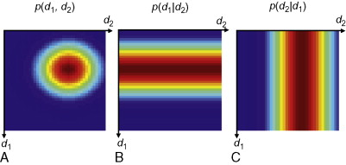
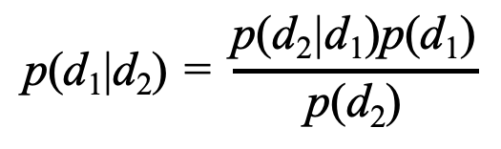
First we introduce the concept of Conditional Probability:
The text uses an example of diameter (d₁) and weight (d₂) of
a grain of sand randomly chosen from a pile…
The joint probability density
function p(d₁,d₂) varies in both
dimensions, but the conditional
probabilities depend only on one of
the parameters and therefore are
uniform across the other dimension. Moreover, the requirement
that the integral of the pdf over the dependent variable = 1
requires that p(d₁,d₂) = p(d₁|d₂)p(d₂) = p(d₂|d₁)p(d₁), resulting in
conditional probabilities p(d₁|d₂) ≠ p(d₂|d₁)…
This results in Bayes’ theorem:
$$\text{p}\text{(}\text{d}\text{1}\text{|}\text{d}\text{2}\text{)}\text{ = }\frac{\text{p}\text{(}\text{d}\text{2}\text{|}\text{d}\text{1}\text{)}\text{p}\text{(}\text{d}\text{1}\text{)}}{\text{p}\text{(}\text{d}\text{2}\text{)}}$$

Slide 4
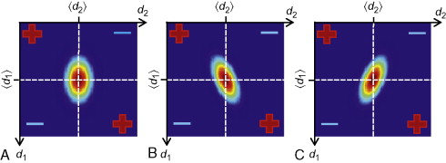
Aside: The question arises whether a joint probability density
function p(d₁,d₂) like that of the example should plot with ellipse
axes different than the variable axes:
Since the joint pdf is an expression of the relative probability
of any particular combination of (d₁,d₂), then yes, combinations
that are less likely must have smaller p (ergo, correlated
variables will have axes askew from the coordinate axes).
This from Fig 2.8: (a) uncorrelated; (b) positively correlated;
(c) negatively correlated.

Slide 5
Bayes’ Theorem for our problem states that the probability
of the model parameters m given the data d is equivalent to
The probability of d given m can represent either a likelihood
function or a measurement model. For d = Gm + ε in which
ε are zero-mean and Gaussian, the conditional probability
is:
(Here f(•) is the probability density function; more appropriate
than P for our purposes). Thus the bit inside the
exponential is our familiar measure of data misfit that we
try to minimize for Weighted Least Squares…
In which we’ve incorporated the denominator’s P(d) in the
form of the inverse data covariance matrix.

Slide 6
P(m) is the a priori distribution and contains (or should
contain) all other information about the model parameters
m.
We’ve discussed two other methods incorporating probability
density functions (or equivalently, likelihoods!) for the
model parameters: Stochastic Inversion, and
Likelihood Filtering. How does this compare?
Consider that maximizing P(m|d) is, by Bayes’ theorem,
equivalent to maximizing P(d|m)P(m), or
This is equivalent to minimizing
which is the same quantity we minimized in deriving
the stochastic inverse :
So these are actually equivalent!

Slide 7
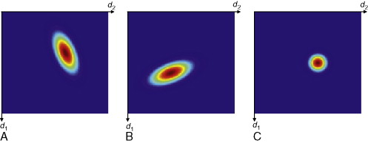
The likelihood filtering approach using likelihood ratio
probabilities presented last week is not fundamentally
different from Bayesian inversion… Because the likelihood
filters were a transformation to an expression of probability,
and probabilities are multiplicative in Bayes’ theorem!)
(Menke, Figure 2.13: (c) is the product of two joint probability
functions from (a) & (b)… An example of Bayesian inference!)
The trickiest bit for a Bayesian inversion lies in designing the
a priori probabilities for the model parameters. Priors should
• derive from truly independent information, and
• not be chosen strictly based on expectations or aesthetics!

Slide 8
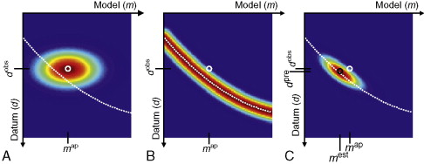
P_{A}(m,d)
P_{g}(m,d)
P(m|d)
This relationship is illustrated nicely in Menke §5.2.4 on “inexact
theories”, which addresses the fact that the model we use
may only approximate or inexactly represent the relationship
of data to model parameters. Fig A shows the a priori pdf
P_{A}(m,d) before modeling (i.e. observed data and a priori model
parameter pdf). If the model g(m) = d (the surface depicted as
dashed white line) is inexact with P_{g}(m,d) (Fig B), P(m|d) is
given by the product of the two (shown in Fig C)!

Slide 9
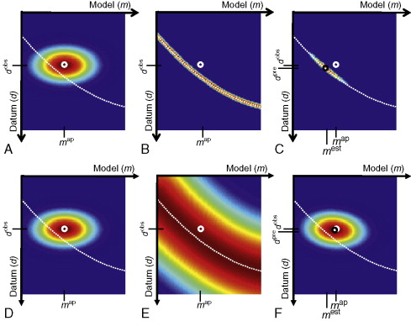
… The implication being of course that the inexactness of the
model significantly impacts the optimal parameter estimate.

Slide 10
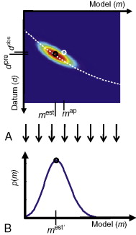
Note however that the description of
the resulting probability density
distribution of the model involved an
integration over the data dimension,
i.e.,
Important to note that the maximum
of this projection onto m may not be
the same as the model
parameterization that produced the
maximum from p(m,d)!!!

Slide 11
Menke’s representation of inexact theory, described in the
text as “assumptions”, may correspond to parameters within the
sensitivity matrix that are not known with certainty, or it may
be an approximation of an algebraically clumsier but exact theory.
What might we expect this to look like in a real problem?

