Slide 1
Geology 5670/6670
Inverse Theory
12 Sep 2023
Last time(s): OLS Parameter Error; Chi-Square Param
• From multivariate statistics, if data errors are zero-mean,
random, uncorrelated, the model covariance matrix is:
, & if data is constant variance:
• The expected value of is:
Based on this, if (N – M) is “large” we can estimate unknown
data variance as:
• If data variance is known a priori, we can calculate the
chi-squared parameter of fit as:
Read for Tues 19 Sep: Menke Chapter 3 (39-68)
© A.R. Lowry 2023

Slide 2
Last time continued: Ordinary Least Squares
Uncertainty
• The chi-squared parameter allows us to compare
a priori predictions with a posteriori realization of error
(with implications for both error and model properties):
• The chi-squared probability distribution function
describes expectations for the sum of squares of
Gaussian random variables
• Solution appraisal ⇒ confidence intervals in model
parameter space. Can use F or t distributions on σ_{m} for
linear problems (univariate uncertainty);
OR…

Slide 3
Confidence Intervals on Linear
Sol’ns… Multivariate Uncertainty
To estimate confidence regions from contours of
(i.e., neglecting how the data impact the solution):
Example 1: Given known σ ², the confidence region is
defined by
where is the inverse F-distribution with M,∞ DOF
Example: to get 95% confidence for M = 10,
Note: The F-distribution represents the null-distribution of
a test statistic… A measure of confidence!
Note: This approach to error estimation depends on data sampling via G; so is useful for experiment design or volume parameter-ization

Slide 4
Example 2: Estimated : Confidence region is defined by
For example, 95% confidence for M = 10, N = 40:

Slide 5
Another useful metric for solution appraisal is the
correlation matrix, defined as the normalized
parameter covariance matrix:
This will always have ones on the diagonal; if is large
(i.e., near one) on the off-diagonal ⇒ high correlation.
(Recall:)

Slide 6
High correlation coefficients in the correlation matrix mean
that the model will be unable to distinguish effects of one
parameter from effects of the other in the presence of
noise (i.e., it’s probably best to combine the two somehow).
Gravity example: Block mass anomaly:
x₀
(Aside: note that this is a
nonlinear model…)
d
t
Δρ
Model
m₄
E_{min}
m₂

Slide 7
Data Weighting:
When a priori uncertainties of measurements are known
and uncertainty varies with the measurement, it is
advantageous to use this information to downweight
the less certain data and upweight better data.
Example: Fitting a line with variable measurement error!
?
y
?
x

Slide 8
Data Weighting:
When a priori uncertainties of measurements are known
and uncertainty varies with the measurement, it is
advantageous to use this information to downweight
the less certain data and upweight better data.
When using the L₂-norm, the “optimal” weighting is the
inverse variance, leading us to the method of
weighted least-squares:
where
We define a weighting matrix:
Then

Slide 9
Define:
We call this “row-scaling”. Then
And the pseudo-inverse for weighted least squares
(WLS) is:

Slide 10
The pseudo-inverse for weighted least squares
(WLS) is:
Note however: Here we have assumed that the variance
of measurement error for each measurement is given by
(a priori known) σ_{i}². That implies the data covariance
matrix is:
Thus is the inverse of the data covariance
matrix, !
Ergo, weighted least squares can be generalized to the
case of full covariance by substituting for !

Slide 11
Parameter uncertainties for a weighted least squares
solution can be estimated very similarly to the OLS
case, except that now:
And the χ² parameter becomes:
We can use expectation that χ² ~ 1 to evaluate model
design and assumptions regarding error as before.
But… Now there is no longer a uniform data variance σ ²
as we assumed earlier to derive parameter confidence
intervals. How can we assess uncertainty?

Slide 12
We can also define confidence intervals from misfit function in
parameter space… but with an approach slightly different
than before, using the Likelihood Ratio Method:
We assume ε are jointly normal, zero-mean and uncorrelated:
then E follows a χ² distribution with N – M degrees of
freedom.
Probability is 1–α that
So the 100(1–α)% confidence interval is given by

Slide 13
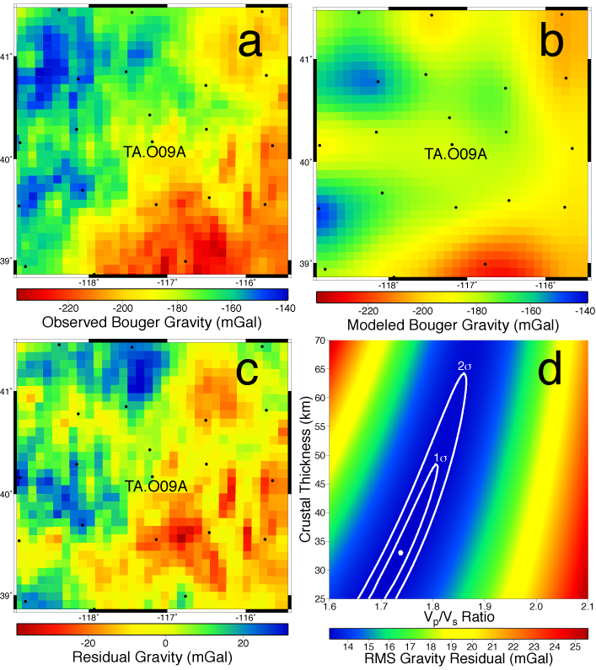
Note that this is
similar to the
(data
prediction length
from the best-fit)
described earlier:
We combine the
error-norm and
the likelihood ratio
to generate
confidence
intervals from
contours of the
error function,
such as are shown
here.

