Slide 1
Geology 5670/6670 Inverse Theory
19 Oct 2023
Last time: Simulated Annealing
• Simulated Annealing is analogous to the random,
decreasing-entropy progression that forms crystals:
1. Choose a random Δm (with some choice of pdf → μ, σ)
2. If , keep the new model!
3. If: for Poisson-distributed r ∈ [0,1],
keep the new model!
4. Temperature T decreases with increasing k
• Simulate annealing is an alternative to gradient search
that facilitates finding the global minimum in the presence
of multiple minima…
Note that here, the test criterion t is analogous to a relative probability, but scaled by temperature T instead of by the data error variance!
Read for Tues 24 Oct: Menke Chapter 8
© A.R. Lowry 2023

Slide 2
Incorporating A Priori Information:
Sometimes, we know enough about a problem before we
start to evaluate what is or is not a reasonable answer,
independent of our measurement (equality) constraints:
We can refer to this as “geological knowledge”.
Example: From knowledge of geology we might infer that
mass density in a study area will always be > 2200 kg m⁻³,
and < 3000 kg m⁻³.
Other times, we may observe outliers in our measurements
that lead us to suspect the measurement errors have a
Laplacian instead of Gaussian probability density
function (so that we want to use an L₁-norm rather than
L₂-norm to solve).
Both of these types of problems can be solved using
Linear Programming

Slide 3
Linear Programming (LP) seeks to minimize:
Subject to the constraints that:
Suppose we have K additional equality constraints: e.g.,
(Where e⁺ are errors > 0; e– are
errors < 0. Note all values in x
must be positive! Including m!)
⇒ a matrix equation Fm = h

Slide 4
Now suppose further that we have L inequality
constraints, or bounds, of the form:
We introduce “slack variables” z_{li}, z_{ui}:
and order these as:
Then:

Slide 5
Here:
Then we solve for M + 2L + 2N unknowns, minimizing
(Do this using a linear programming algorithm, e.g. in Matlab)

Slide 6
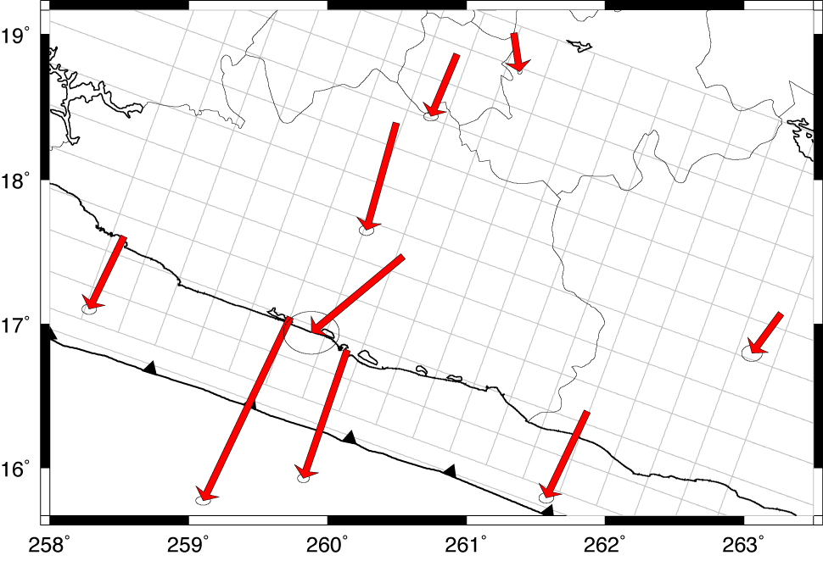
Example: Wanted to solve the slow fault slip problem discussed
last week for southern Mexico, but using a discretized fault
surface instead of one or two constant-slip patches:
Note two components of slip at each pixel ⇒ a highly
over-parameterized problem!!!

Slide 7
Useful “geological knowledge” for this problem includes:
• Expect dip-slip to be in a thrust direction (S^{ds} > 0)
• Expect dip-slip to exceed strike-slip (S^{ds} > S^{ss})
• Expect strike-slip to be left-lateral based on
relative plate motion (Cocos-North America) (S^{ss} > 0)
• Expect slip patches to connect (i.e. “smooth” rather
than “blocky”; can express as S_{i} – S_{i+1} < ε)
Also used:
• Estimates of measurement uncertainty
(used 1/σ_{i} instead of 1’s in latter part of c^{T} vector)
• Minimization of the total moment release
(used Aμ instead of 0’s in first slot of c^{T} vector)

Slide 8
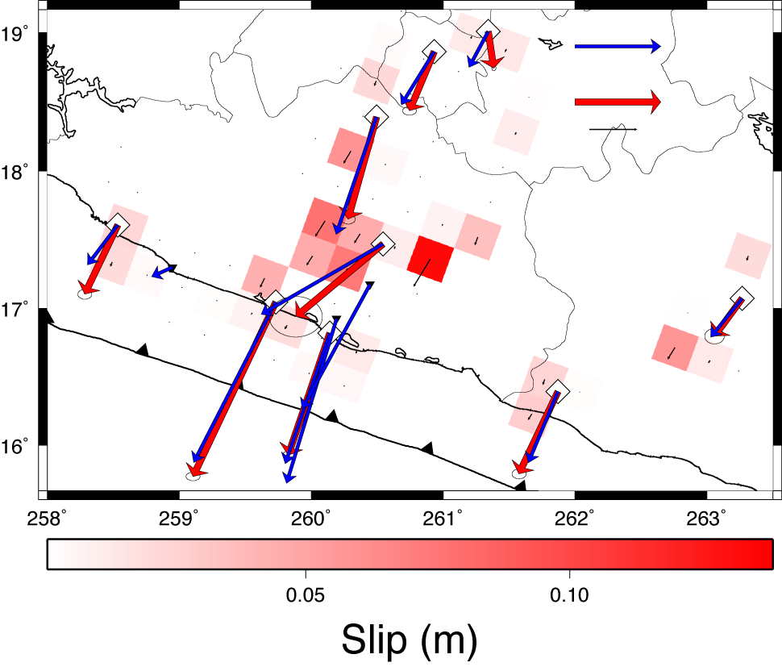

Slide 9
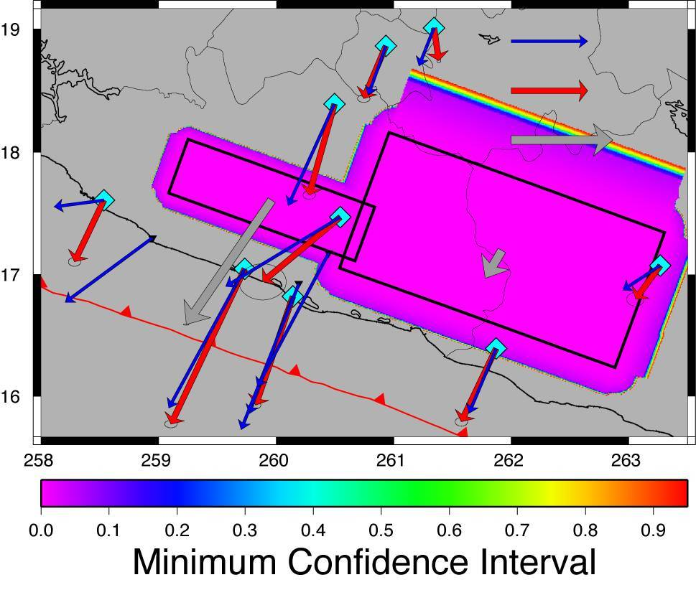
Comparison is useful just to
see what is and is not required
by the data, and what may be
artefacts of the model
parameterization…
Also very useful to look at the
difference in moment release
for the two. The minimum-
moment discretized case gives
equivalent magnitude M_{w} = 6.8
for the largest (2002) event;
the two-patch solution gives
M_{w} = 7.5! And the GPS data
sampling is clearly too sparse
to completely constrain it.

Slide 10
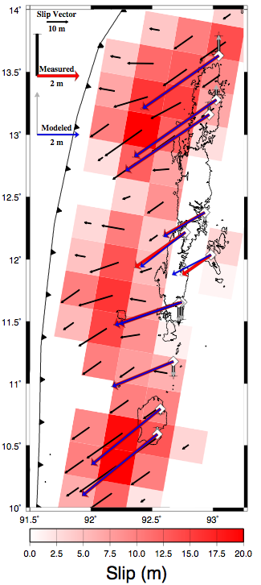
Andaman coseismic moment
release was so large, however,
that a similar constrained
solution (assuming a maximum
of 20 m of slip) gives a smooth,
well-connected solution despite
relatively sparse GPS sampling.

Slide 11
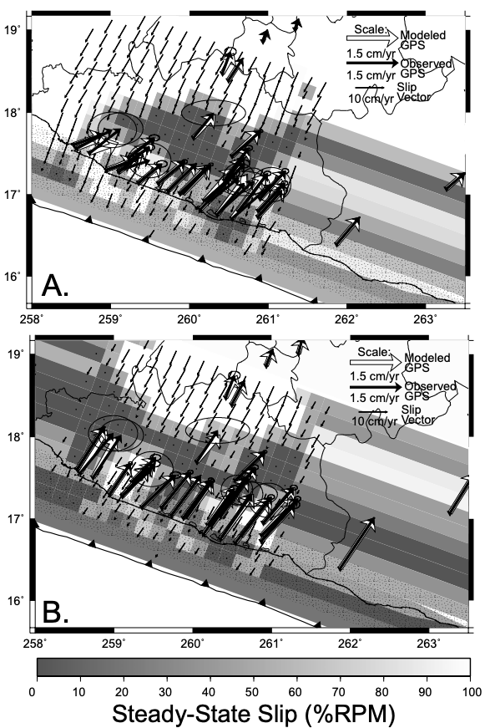
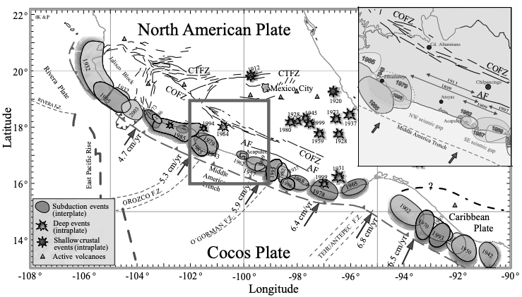
M~7.9
One potential use of this is to
hypothesis-test extremal cases
where these have some
societal relevance… E.g., how
large an earthquake might the
accumulated strain potential
energy on the Guerrero
megathrust permit?
M~8.0

