Slide 1
Geology 5670/6670 Inverse Theory
24 Oct 2023
Last time: Linear Programming for L1 & Inequality
Constraint Problems
• Linear programming
seeks to minimize an
objective function c^{T}x
subject to Bx = d, where:
• Equality constraints given by
Fm = h can be included via:
• Inequality constraints are
handled by solving for
“slack variables” z_{l}, z_{u}:
• Should only be used for minimization of the L₁-norm (i.e.,
when errors have Laplacian or outlier-prone distributions)
Read for Tues 24 Oct: Menke Chapter 8
© A.R. Lowry 2023

Slide 2
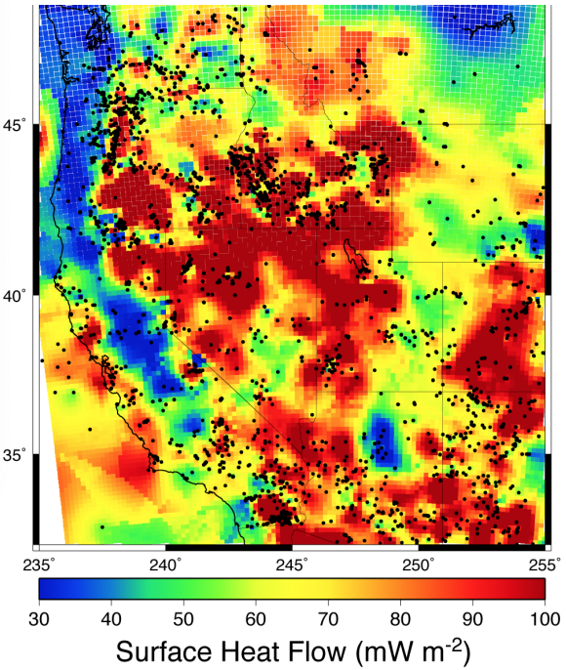
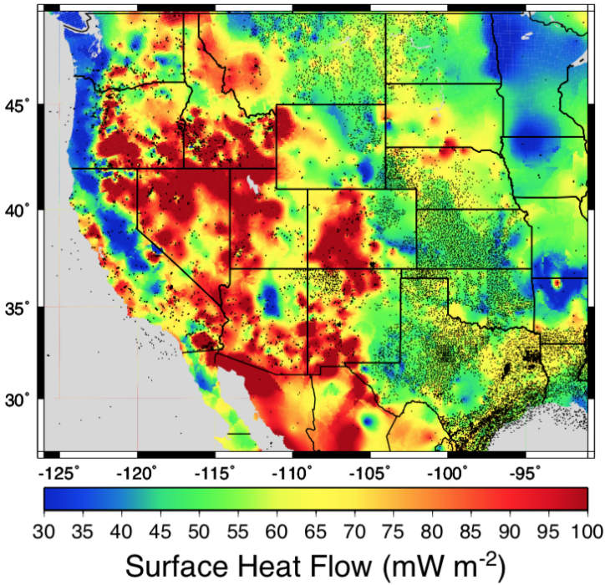
Assignment 1: Key to the assignment
(Note: In previous years, this assignment used a
different data file that gave different results!)
Without Bottom-hole
Temperature Data
With Bottom-hole
Temperature Data

Slide 3
Assignment 1: Key to the assignment
Q1: OLS inversion for mantle heat flow & radiogenic length:
1.i. Use ordinary least squares to find the model parameters for
Q_{s} = Q_{m} + A₀l_{rad}: Let
from column 2, ; ; and
If the units are correctly scaled, this gives
m₁ = Q_{m} = 45.821 mW/m² and m₂ = l_{rad} = 15.519 km. (This
changed from m₁ = 43.701 mW/m² and m₂ = 19.457 km for
the data file from earlier, before including BHT data!)
1.ii. Assume variance from mean of column 3 and estimate
formal parameter uncertainties: Note these errors are
expressed in mW/m² so must also be converted to MKS
units. But, using < σ > = 7.8 mW/m² and ,
uncertainty in Q_{m} is mW/m² and in l_{rad} is
km (compared to 0.462 and 0.399,
respectively, from the earlier data!).

Slide 4
1.iii. Assume measurement error is unknown and estimate from
the misfit: We calculate a residual and use χ²
statistics to estimate the data variance via:
This yields σ_{ε} = 19.9 mW/m² (as compared to 7.8 mW/m²
if we use the mean of variance from the inverse of values in
column 3 of the file; note that without the BHT data, these
were 21.1 and 37.1!). Using the a posteriori estimate of data
variance, model uncertainties are mW/m²
and km. (The a posteriori variance gives
uncertainties much more similar to those from the data set
without BHT data, which yielded 0.26 mW/m² and 0.23 km.)

Slide 5
1.iii. (cont’d) If we use the a priori (mean) estimate of data variance, the
χ² parameter of misfit is:
which again is very different from the χ² parameter of misfit that was
estimated for the file without BHT data (χ² = 0.323!). The a posteriori
variance from misfit changed only slightly from what it was before, so
the main difference is in the mean interpolation variance from col 3
(which was very large before because measurement sampling was
very sparse). The large χ²-parameter we get now indicates processes
not represented in our physics but present in the heat flow (resulting
in larger misfit to the data than the “measurement error” from kriging
interpolation estimates in Col 3), while the small χ² we had previously
probably reflected a “correlation” that was introduced by interpolating
heat flow to a large number of locations from a small number of
measurements (a correlation not reflected in our representation of
error).

Slide 6
1.iv. We’ve already looked at the square-root of the model
parameter variances; in addition, the model covariance matrix
exhibits a negative covariance. It is difficult to interpret what
that means (other than a negative cross-correlation) without
normalizing. The correlation matrix is:
That is, the parameter estimates are highly cross-correlated
(and so, very suspect!) An identical correlation was found in
more sparsely measured data.
From these results, (1) the parameter variances are surprisingly
small (primarily because of the very large N) but (2) that
doesn’t help much, because the parameters are so strongly
cross-correlated that the parameter variance is a conditional
uncertainty (i.e. σ of one parameter is conditioned on the
premise that the other parameter estimate is correct!)

Slide 7
Q2: WLS inversion for mantle heat flow Q_{m} & radiogenic length
l_{rad}:
2.i. Use weighted least squares to find Q_{m} & l_{rad}: Now the
pseudoinverse is given by where the
measurement covariance matrix C_{ε}⁻¹ has 1/σ_{i}² (column 3 of
the data file) along its main diagonal. (This can be done in
Matlab/Octave with smaller memory & computation using
C_eps=sparse(diag(1./(dat(:,3).^2)))*1e6;
where dat was the name of the variable the file was loaded in).
This gives m₁ = Q_{m} = 47.764 mW/m² and m₂ = l_{rad} = 13.847 km
(compared with 45.8 mW/m² and 15.5 km for OLS with the
same data, and 45.5 mW/m² and 19.0 km from the earlier
data set that did not include Bottom-Hole Temperature data!)

Slide 8
Q2: WLS inversion for mantle heat flow Q_{m} & radiogenic length
l_{rad}:
2.ii. Using , 1σ uncertainty in Q_{m} is ±0.086 mW/m²
and in l_{rad} is ±0.073 km. These uncertainties are similar to
those found for OLS but again much smaller than those
found in the earlier data set sans BHT data (±0.311 mW/m²
for Q_{m} and ±0.263 km for l_{rad}). This again reflects the lower
overall a priori variance of the interpolated data afforded by
10x greater sampling…
The χ² parameter of misfit is now 7.230 (as compared to
6.514 that we got for OLS and 0.778 for the data set that
did not include BHT data). Since this χ² is presumably
better informed than that of OLS (and this data set is
presumably more accurate than the previous one), the
higher χ² reinforces our earlier interpretation that there are
signals present in the heat flow that are not well-represented
by our physics and error estimates from interpolation.

Slide 9
Although the changes resulting from using WLS instead of OLS
were small (~1.9 mW/m² and 1.7 km for Q_{m} and l_{rad}
respectively), they were large relative to the formal
uncertainties in each estimate. This was true for the earlier
data set as well (which had larger formal errors!)
The problematic high parameter cross-correlations are about
the same for both OLS and WLS (–0.9348 for OLS;
–0.9382 for WLS) and perhaps somewhat surprisingly,
larger for the latter. Cross-correlations were also very stable
for the previous data set that did not have BHT (–0.9327 for
OLS; –0.9325 for WLS).

Slide 10
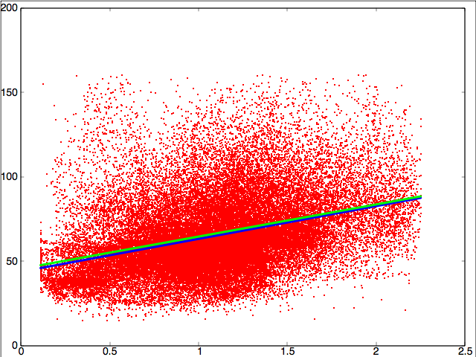
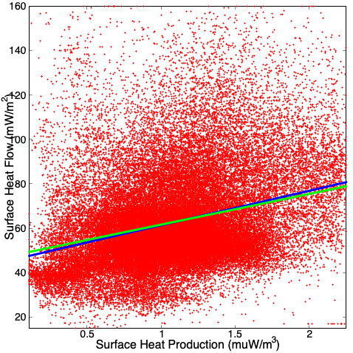
Q3: The scatter is very large
on the plot and the lines
don’t pass through the
densest part of the cloud,
suggesting model (physics)
inaccuracies and outlier
effects… But there does
appear to be a significant
relationship!
Note the current data (bottom)
WLS changes mostly in
reduction of slope (l_{rad}),
while for older data (without
BHT) WLS increases the
intercept (Q_{m}) without
changing the slope much…
(No BHT data)
WLS
OLS
(With BHT data)
OLS
WLS

Slide 11
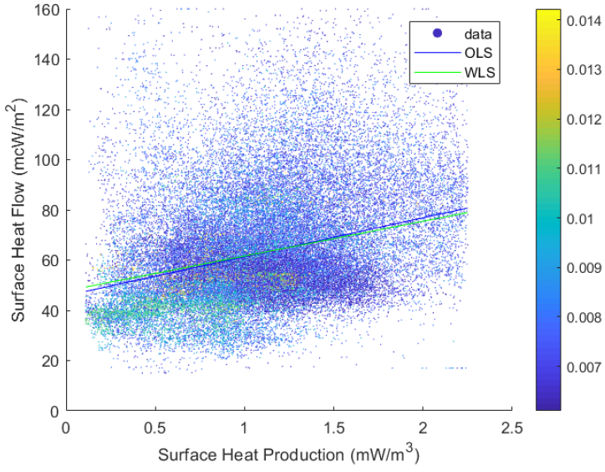
Interesting to note which data are being downweighted by WLS
and why (figure from a past student’s assignment):

Slide 12
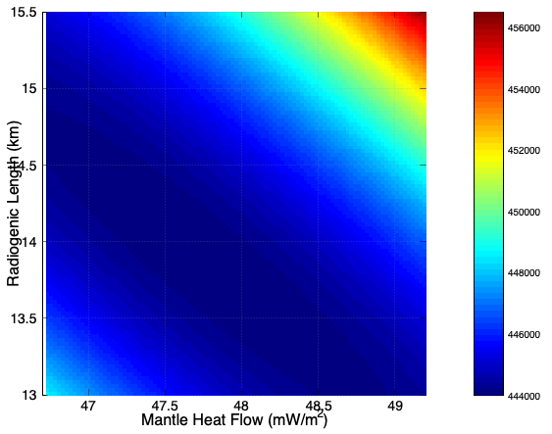
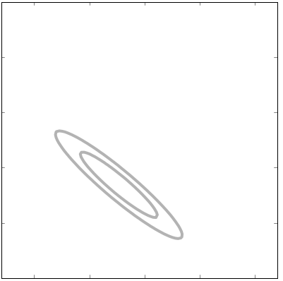
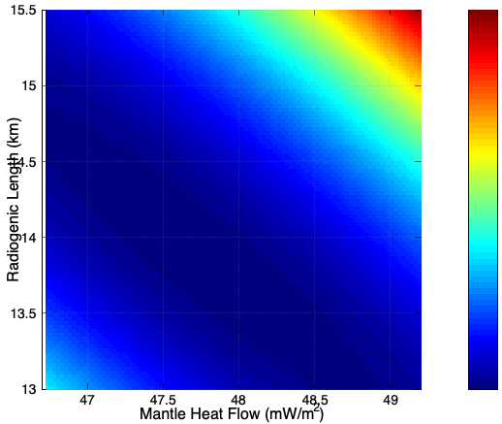
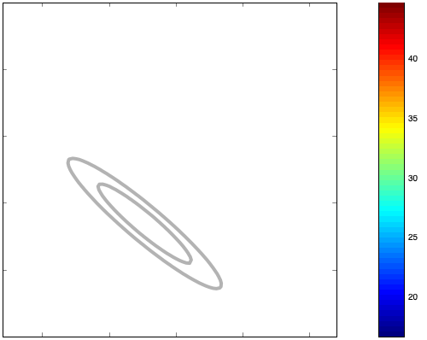
Q4: Grid-search analysis of parameter error (using WLS):
The figures at left color-contour the
WRMS misfit as a function of model
parameters near the best-fit case.
The grey contours show 1σ and 2σ
confidence intervals for (top) the
likelihood ratio method:
and (bottom) the model length:
for α = 0.6827 & 0.9545. The contours
are identical (as expected). Also
shown are the ±1σ bounds from C_{m}
as a red cross (top); interestingly
both error bars stop just short of the
contour…
Likelihood Ratio Using E
Model Length

Slide 13
Likelihood Ratio Using E
… Possibly reflecting the coordinate
transformation from the error ellipse
axes to the parameter coordinate
axes. Regardless these closely
match the expected hyperelliptical
form.
Model Length

Slide 14
Linear programming is best-suited to solve for the minimum L₁
norm solution (i.e., if measurement error statistics are Laplacian,
& prone to outliers, instead of Gaussian) and/or if a bounded
solution is desired.
We can also solve equality constraints & inequality constraints for
the L₂ norm (quadratic) case. One approach to equality constraints
uses SVD to minimize:
subject to given S equality constraints, S < M, using:
The total eigenvector matrix includes V_{o} orthogonal to the
constraints in F.
Solution using the generalized inverse is
In practice, first solve for m_{S} using SVD, then…

Slide 15
We want to minimize the objective function e^{T}e for what’s
left over:
So we solve:
And let:

