Slide 1
Geosciences 5670/6670 Inverse Theory
30 Nov 2023
Last time: Double-Difference Earthquake Location
(EQ interferometry example for inexact theory)
• Standard inversion for earthquake locations suffers from two
significant limitations:
(1) Standard (“manual”) approaches to picking arrival times
have large uncertainties, particularly if the EQ is small or
far away (=> measurement error ε!)
(2) The theory is inexact in that the velocity structure is
always imperfectly known and discretized.
• The first problem can be resolved by using cross-correlation
of signals from multiple events observed at a given site…
but in that case arrival time is relative instead of absolute
(so parameters must be framed as relative positions also).
• DD-location solves for relative position and time (which also
reduces bias effect of velocity error!)
© A.R. Lowry 2023

Slide 2
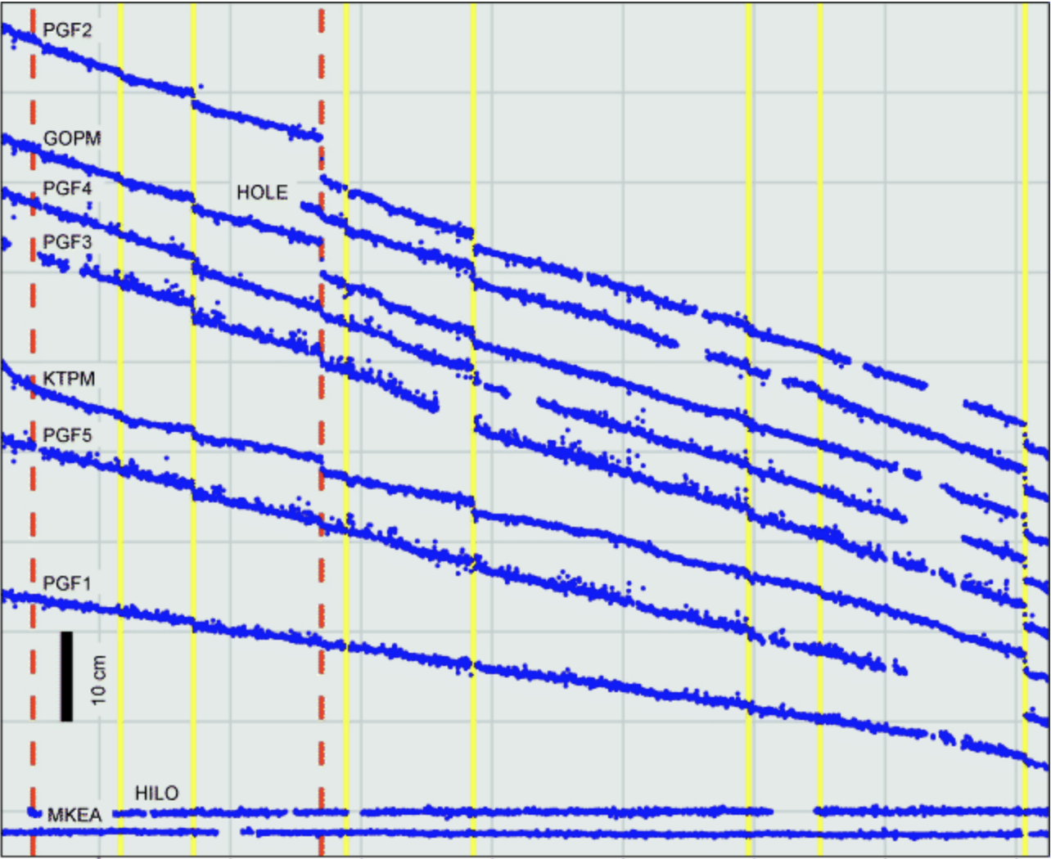
Template matching is another application of cross-correlation. Here,
GPS time series displacements during large slow slip events were
used to identify smaller (but otherwise similar) repeating events…
Brooks et al., Encyc. Complex. Sys. Sci. 2009

Slide 3
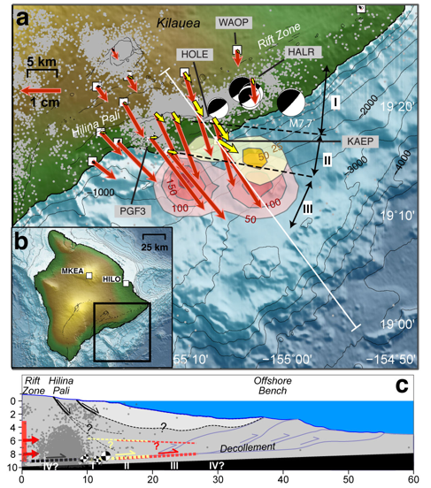
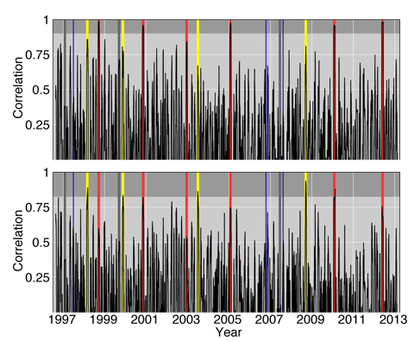
The time series observed at all sites during a large, easily-identified
event was compared via cross-correlation to the remainder of the time
series (using two differently-behaved events). High cross-correlation
coefficients were used to identify several previously unrecognized events.
Correlation to
western event
template
Correlation to
eastern event
template
Foster et al., GRL 2013

Slide 4
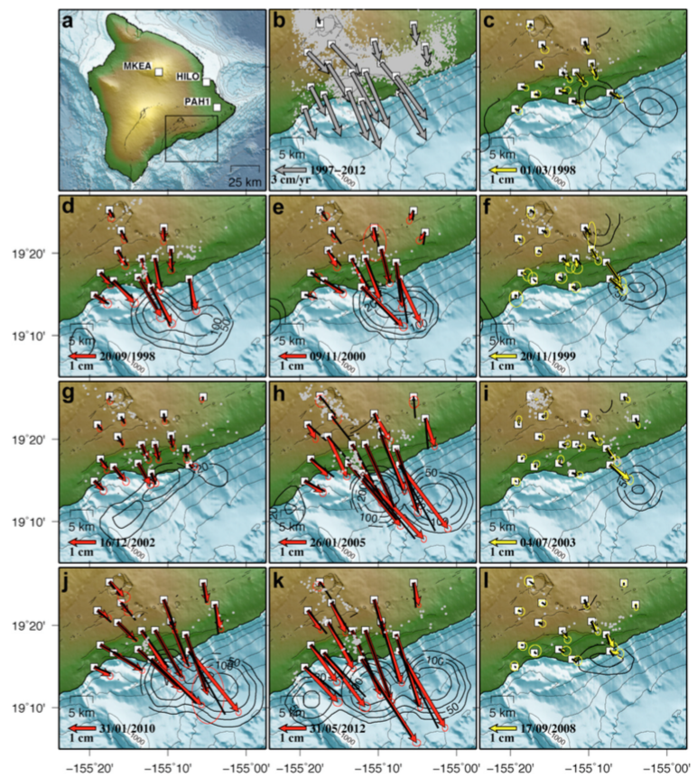
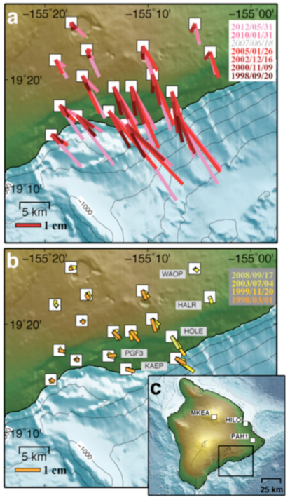
These were modeled to estimate characteristic scales for the two ruptures…
Foster et al., GRL 2013

Slide 5
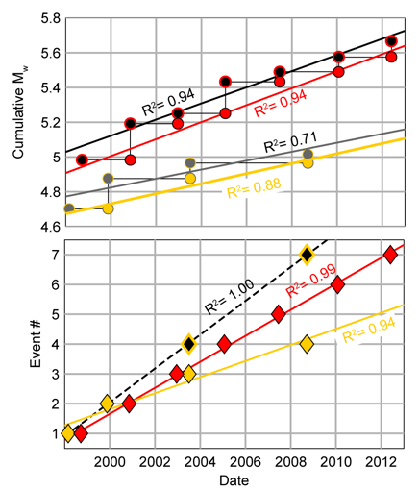
As well as characteristic
repeat times.
Some complexity: There
appear to be beat patterns
(in moment release for
western family shown in
red; recurrence for
eastern family shown in
yellow).
Recurrence rate and
patch size have
implications for rate- &
state-dependent fault
frictional parameters!

Slide 6
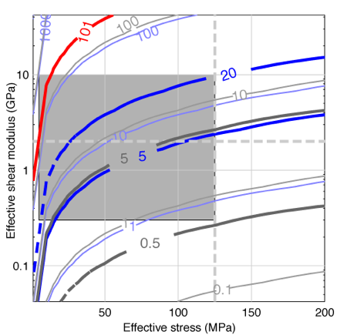
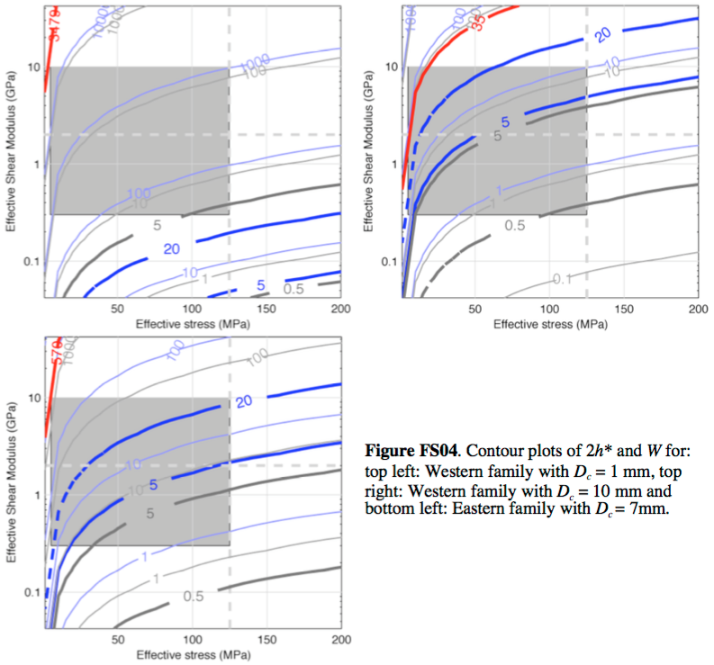
West: D_{c} = 1 mm
West: D_{c} = 7 mm;
(b – a) = 5.9x10⁻⁵
West: D_{c} = 10 mm
East: D_{c} = 7 mm
Note: “effective stress” is effective normal stress and shear
modulus is the elastic parameter μ… So the grey box is what
is physically plausible. The patch-size in length (grey) and
dip-direction width (blue) is measured at between the two thick
contours... Interestingly implies pore fluid pressure ~hydrostatic!

Slide 7
Assignment II recap:
1. Building on what we did for Asgt I, write a matlab (*.m) script to invert for mantle heat flow Q_{m} and radiogenic length parameter l_{rad} using stochastic inversion. (Be sure to think about units! Convert numbers in your file to mks for simplicity.) Use data covariance weighting as implied in column 3 of your file, and describe the model parameter expected value and covariance matrix using two different approaches:
(a) Assume the a priori expectation of mantle heat flow is 18 ± 3 mW m⁻² (loosely based on Jaupart & Mareschal, Treatises on Geophysics, 2007) and the a priori expectation of the lengthscale of radiogenic heat production is 9.4 ± 5 km (an even rougher approximation based on distributions of Sierra Nevada xenoliths in Brady et al., Lithos, 2006).
(b) Now, substitute the a posteriori parameter covariance matrix from your earlier (Assignment 1) foray into weighted least squares inversion, using the same expected values for model parameters as in part a.

Slide 8
The key for stochastic inversion is to recall that the problem must
be solved for parameters Δm for data Δd relative to an expected
model GE{m}. In (a), using the expected values [18 mW/m², 9.4 km]
and uncertainties [3 mW/m², 5 km] to create an a priori model
parameter covariance matrix gives m₁ = Q_{m} = 47.74 mW/m²
(compared to 47.764 mW/m² from WLS) and m₂ = l_{rad} = 13.866 km
(compared to 13.847 km for WLS), with χ² = 7.23 (identical to previous).
For part (b), the a posteriori uncertainties were much smaller
(Q_{m} = ±0.086 mW/m², l_{rad} = ±0.073 km) so the weighted stochastic
inverse solution was more significantly perturbed resulting in
m₁ = Q_{m} = 44.147 mW/m² and m₂ = l_{rad} = 13.307 km, with χ² = 7.556.
An important takeaway from this is that the solution can be many
standard deviations away from the expected value in a stochastic
inversion, if there are lots of data and the data demand a different
solution.

Slide 10
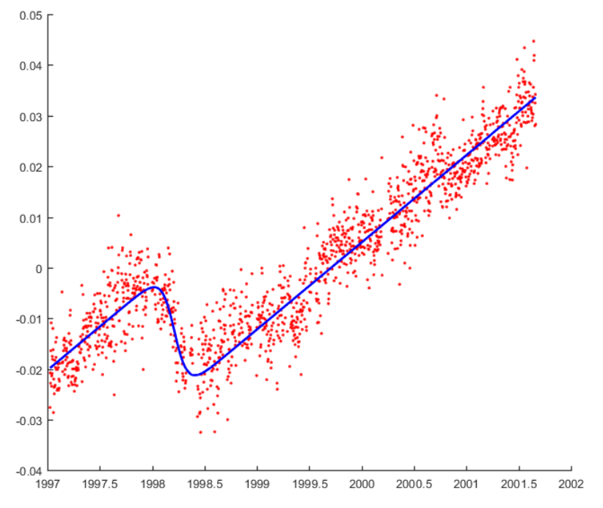

Slide 11
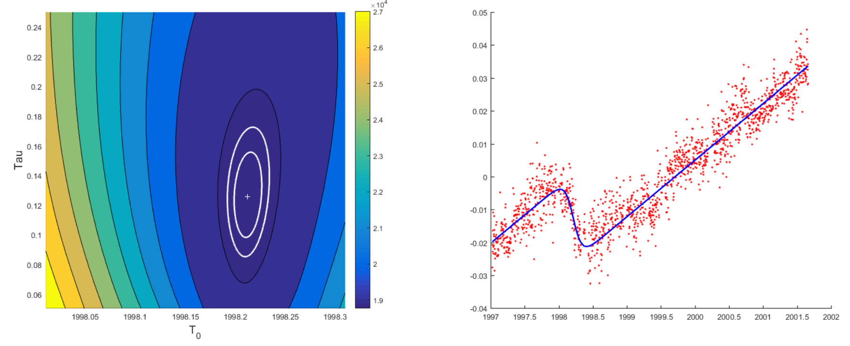

Slide 12
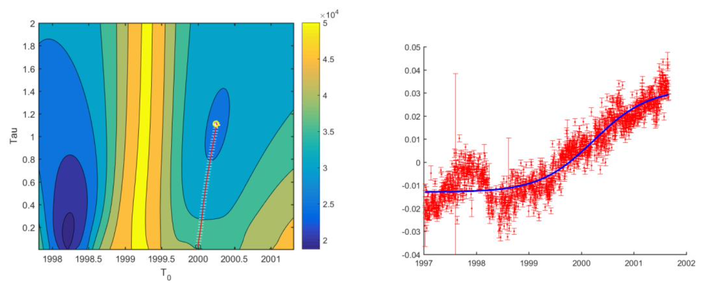
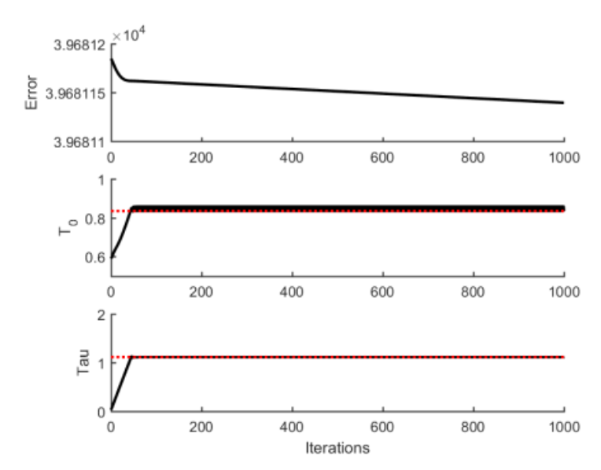

Slide 13
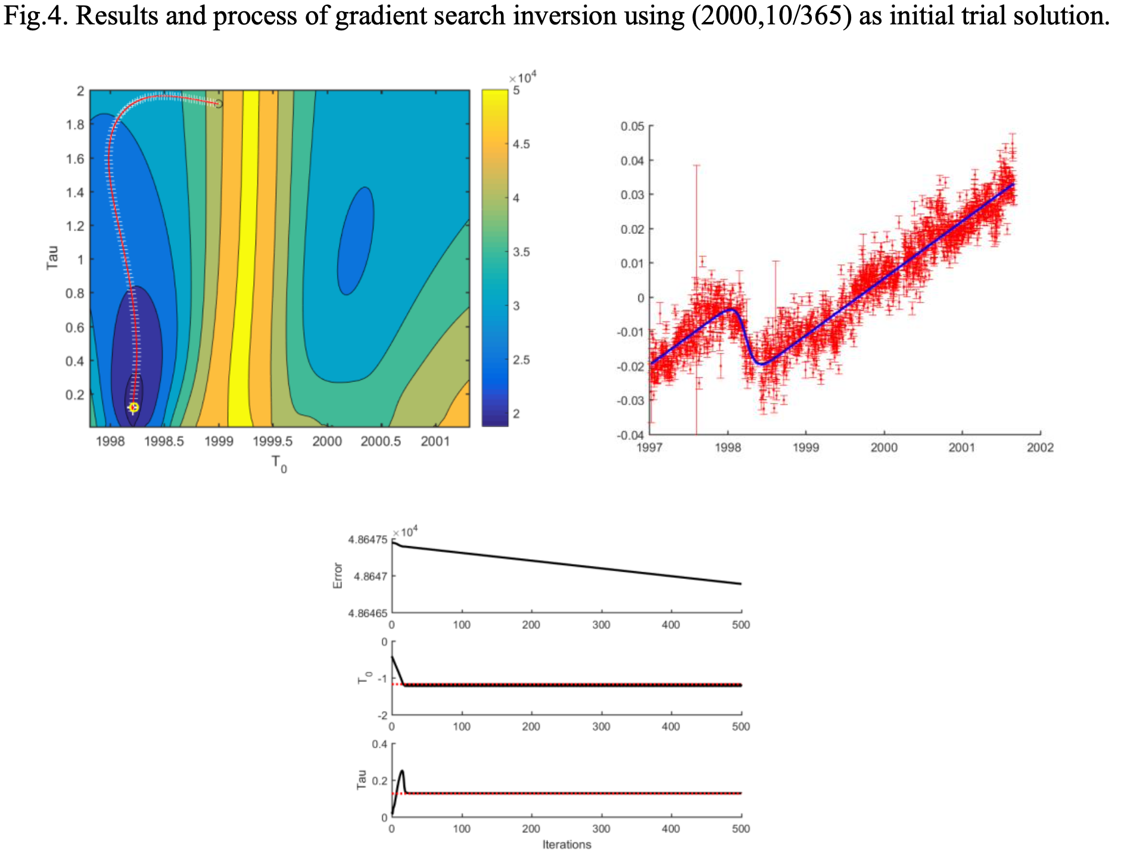

Slide 14
