Slide 1
Geology 5670/6670
Inverse Theory
31 Aug 2023
Last time: Introduction to Inverse Theory
• Syllabus, text, projects etc.
Goal is to solve for optimal model parameters from
observational data… Usually involving physics of a PDE
A linear operator (⇒ L{αf + βg} = αL{f} + βL{g}) may
include spatial or temporal derivatives and integrands.
• If desired model parameters are in the forcing function of a
PDE, inversions can be linearized easily (e.g., gravity)…
Parameters within the linear operator may require
nonlinear inversion.
• However, usefulness of inverted parameters also depends
on how accurately the model reflects the true physics!
Read for Tues 5 Sep: Menke Chapter 2 (17-38)
© A.R. Lowry 2023

Slide 2
Last time: (continued)
• We define model parameters to be “optimal” based upon
minimization of a norm (“length”) of vector misfit between
measurements and model predictions. The L₂ norm is
commonly expressed as:
or

Slide 3
Let’s return to our first example from last time: Gravity
Here G_{ij} = –4πGF_{ij} is a constant relating a density perturbation to
a gravity perturbation,
m_{j} = Δρ_{j} is the model parameter we want to find.
(L{u} = f where L = ∇²)

Slide 4
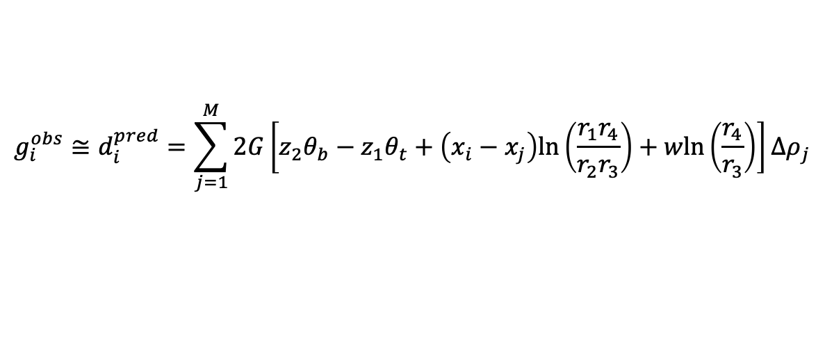

x_{i}
x_{j}
z
(measured)
(known physics)
(unknown)
$$g_{i}^{obs}≅d_{i}^{pred}=\sum_{j=1}^{M}{2G\left[z_{2}θ_{b}−z_{1}θ_{t}+\left(x_{i}−x_{j}\right)ln\left(\frac{r_{1}r_{4}}{r_{2}r_{3}}\right)+wln\left(\frac{r_{4}}{r_{3}}\right)\right]∆ρ_{j}}$$
$$θ_{1}$$
r₁
r₃
r₂
r₄
So one can “simply” solve the set of linear equations:
w
or in matrix notation,
for i = 1, …, N equations in j = 1, …, M unknowns

Slide 5

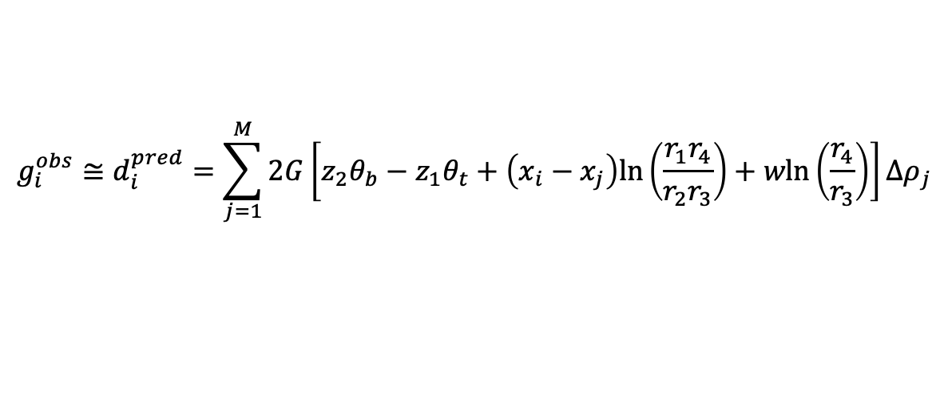
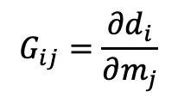
(measured)
(known physics)
(unknown)
$$g_{i}^{obs}≅d_{i}^{pred}=\sum_{j=1}^{M}{2G\left[z_{2}θ_{b}−z_{1}θ_{t}+\left(x_{i}−x_{j}\right)ln\left(\frac{r_{1}r_{4}}{r_{2}r_{3}}\right)+wln\left(\frac{r_{4}}{r_{3}}\right)\right]∆ρ_{j}}$$
$$θ_{1}$$
r₁
r₃
r₂
r₄
Note that the contribution of one particular block
with density Δρ_{j} to the i^{th} gravity observation g_{i} is given by
We call this the sensitivity of the model prediction to the
model parameter, and hence the matrix is referred to as
the sensitivity matrix.
w
$$G_{ij}=\frac{∂d_{i}}{∂m_{j}}$$

Slide 6
Note: Here we have introduced some notation that will be used
as a standard throughout the course. Throughout the course:
d denote the observational data
N be the number of observations
m denote the model parameters
M be the number of parameters
G denote scalar (sensitivity kernel) values relating m to d
Then any linear modeling problem can be written as a
set of N linear equations of the form:
or in matrix notation,
or

Slide 7
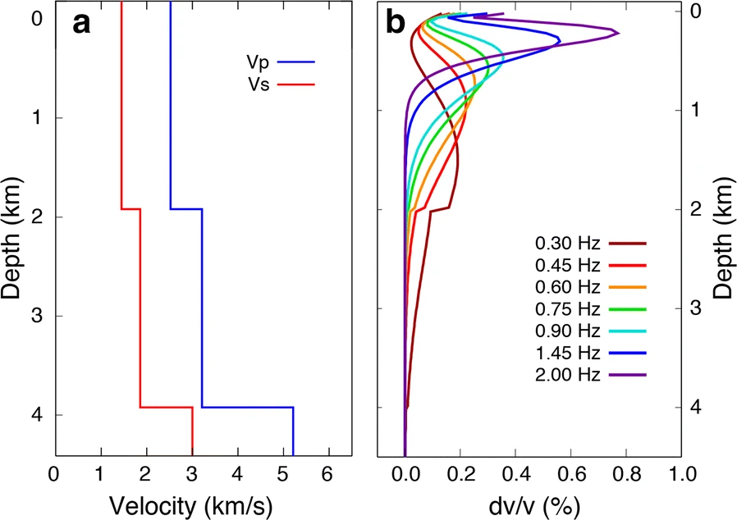
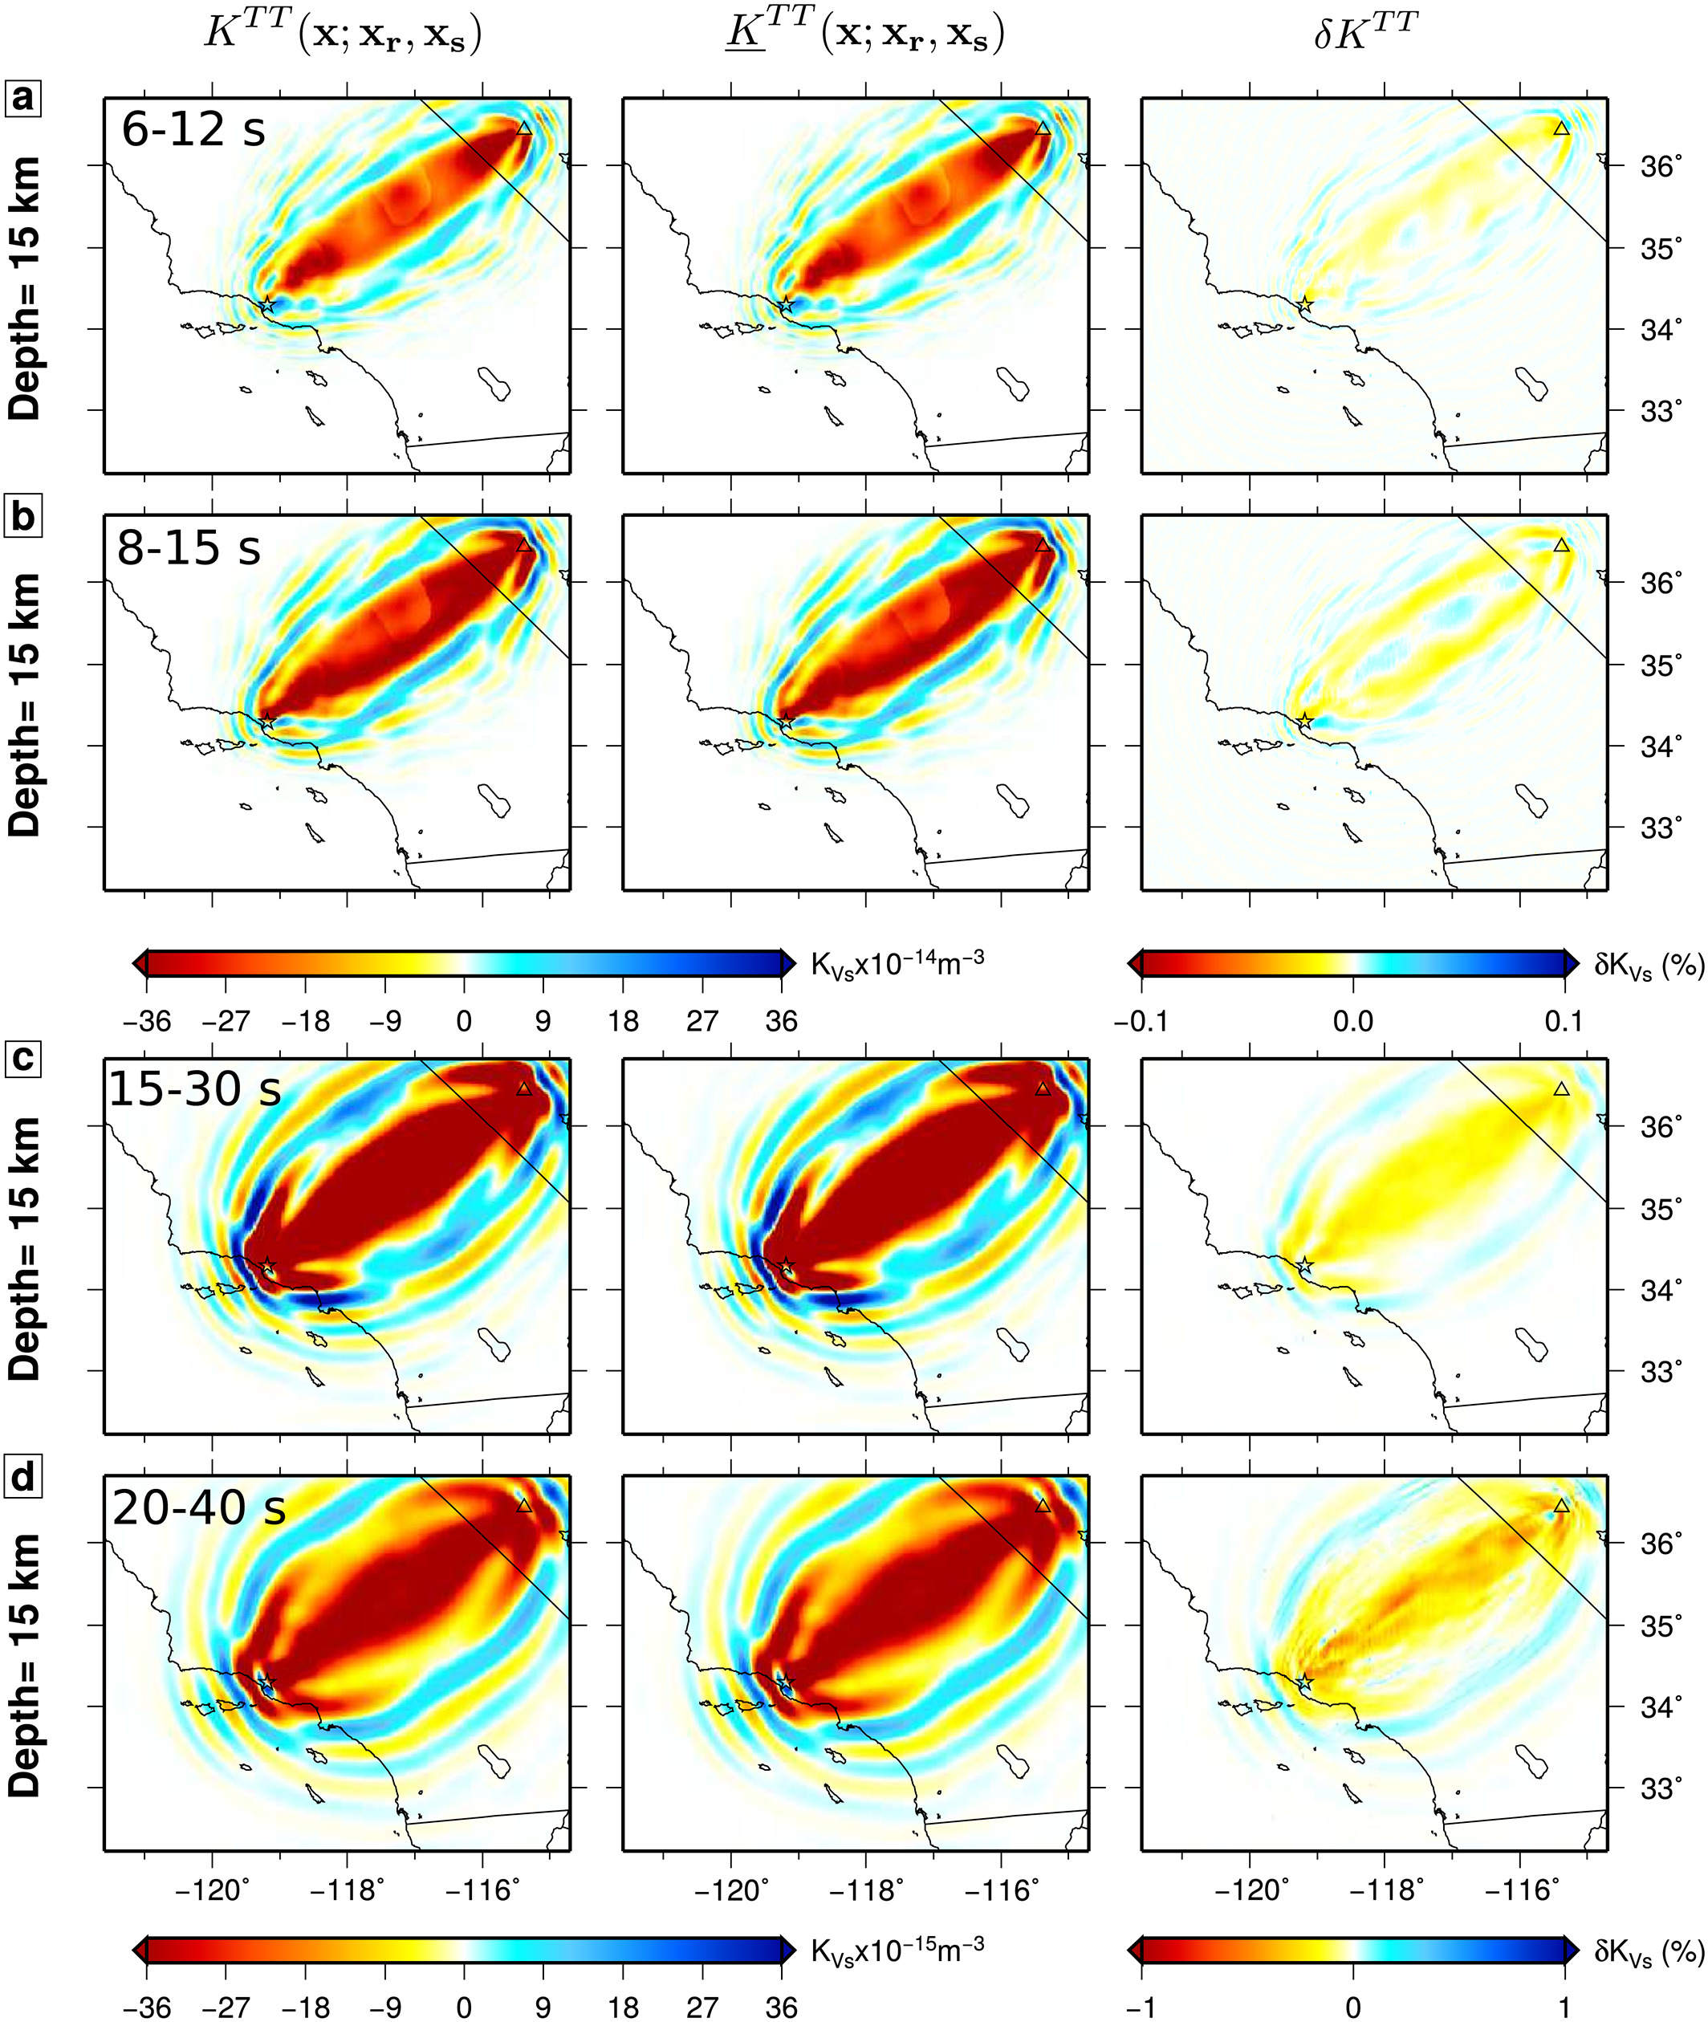
The 1D and 3D sensitivity kernels for Rayleigh phase velocities that we
showed in class last time are exactly this: Derivatives of the model
prediction of a perturbation of phase velocity to a perturbation in V_{S},
represented by their position in one-D or three-D space! An important
difference from the gravity example though is that this derivative depends
on other parameters. Nonlinear inversion is a complication saved for later!
Feng et al.,
EPS 2020
Kai et al.,
JGR 2019

Slide 8
For now let’s consider the linear problem: In practice,
where m_{t} are the “true” parameters and ε are measurement
errors. (Note this assumes physics is known and correct:
No empiricisms, no simplifying approximations). If
N = M and the inverse of G, G⁻¹, exists (defined as):
then:
So, if you know something about error in your measurements,
you can estimate error in your model parameters…

Slide 9
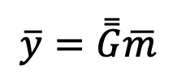
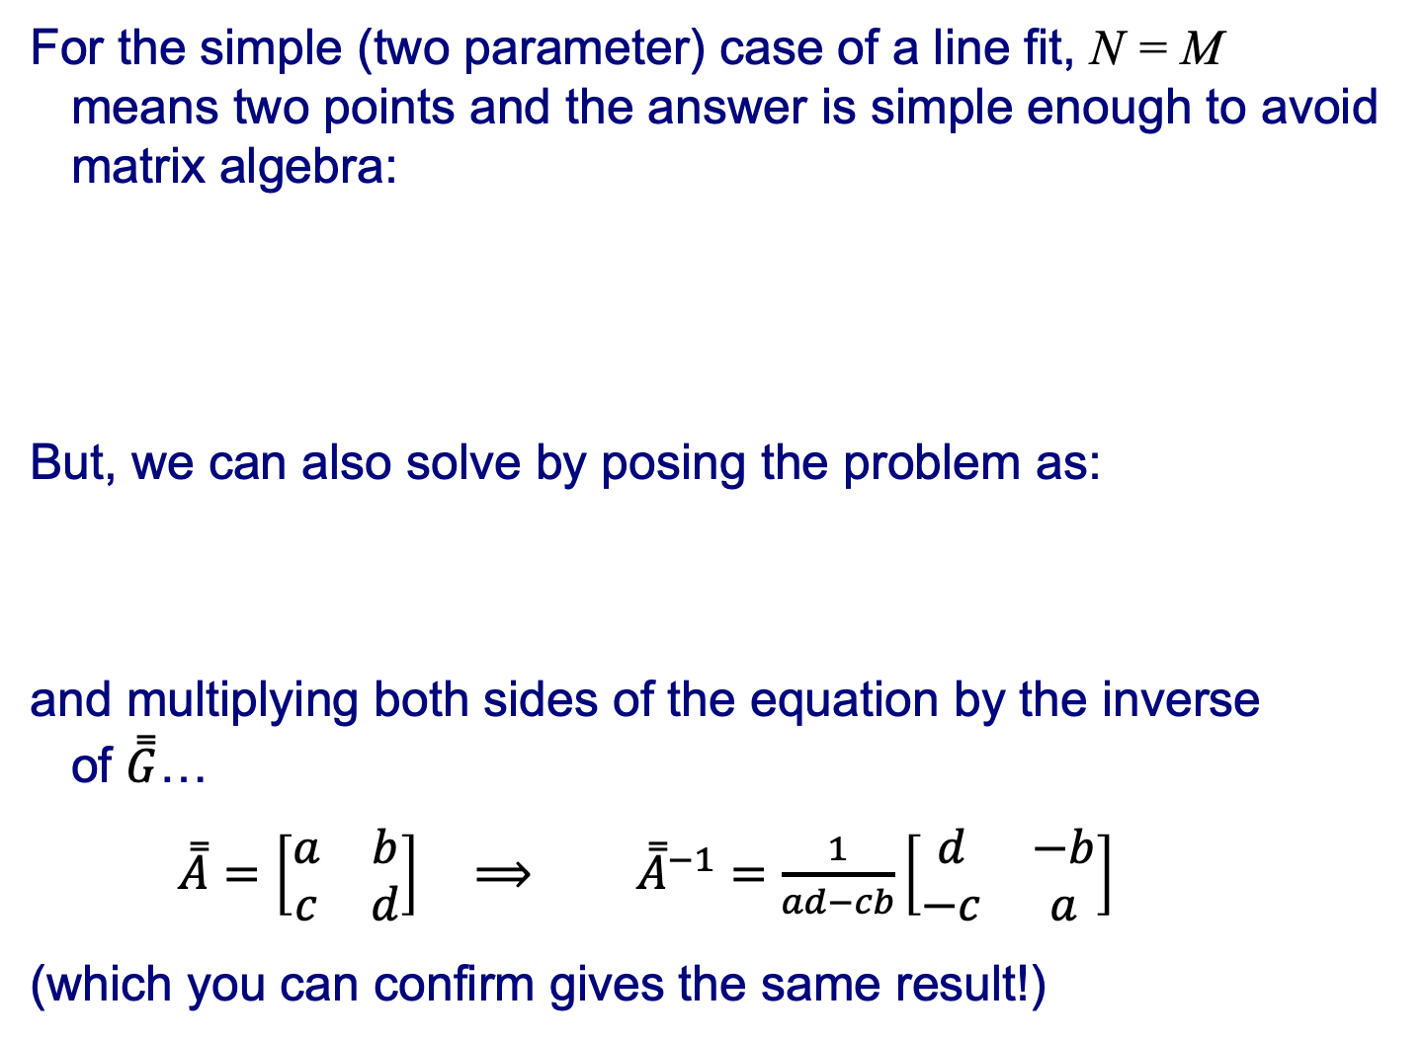
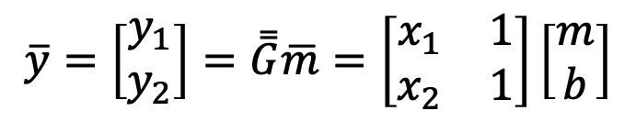
For the simple (two parameter) case of a line fit, N = M
means two points and the answer is simple enough to avoid
matrix algebra:
But, we can also solve by posing the problem as:
and multiplying both sides of the equation by the inverse
of $\overset{̿}{G}$…
$\overset{̿}{A}=\left[\begin{matrix}a & b \\ c & d\end{matrix}\right]$ $⟹$ ${\overset{̿}{A}}^{−1}=\frac{1}{ad−cb}\left[\begin{matrix}d & −b \\ −c & a\end{matrix}\right]$
(which you can confirm gives the same result!)
y₁ = mx₁ + b
y₂ = mx₂ + b
(x₂,y₂)
m = (y₂-y₁)/(x₂-x₁)
b = y₁ - mx₁
(x₁,y₁)
$$\overline{y}=\overset{̿}{G}\overline{m}$$
$$\overline{y}=\left[\begin{matrix}y_{1} \\ y_{2}\end{matrix}\right]=\overset{̿}{G}\overline{m}=\left[\begin{matrix}x_{1} & 1 \\ x_{2} & 1\end{matrix}\right]\left[\begin{matrix}m \\ b\end{matrix}\right]$$
where

Slide 10
But what should we do for the overdetermined problem,
N > M?
Here, in the presence of errors ε, no
single line will pass through all points so
we want to minimize the effects of error
in the model. An arbitrary choice of
model m predicts data:
We can define a residual vector e as

Slide 11
Recall that the measurement error is
so would like to find the m vector that minimizes e in some
sense, on the assumption that that yields e ≈ ε.
The “sense” in which we minimize e is in terms of some
measure of “length” of the residual vector, called a “norm”:
L₁ norm:
L₂ norm:
The definition of norm can be generalized to any power n:
L_{n} norm:
but in practice we generally only use L₁ & L₂…

Slide 12
Most commonly we use L₂, for two reasons:
(1) It most accurately predicts m ≈ m_{t} if errors e are
zero-mean & Gaussian (or normally distributed);
(2) It turns out to be the most computationally simple.
When we minimize L₂, we call it the method of
“least squares”. Note that outlier measurements are
emphasized more in model fits when n is larger in the
L_{n} norm being minimized.
For L₂ norm minimization (ordinary least squares), we seek
to minimize

