Slide 1
Geology 5640/6640
Introduction to Seismology
1 Oct 2024
Last time: The solution to the Wave Equation!
• The wave equations expressed in terms of displacement
potentials:
can be solved by plugging in eigenfunctions of the
form:
and solutions are:
• Note these are alternative expressions of the more familiar
v = fλ !
Read for Thursday 3 October: S&W 62–75 (§2.5)
© A.R. Lowry 2011-2024

Slide 2
Last time continued: Harmonic wave motion
• Harmonic wave motion can be described entirely by
specifying a period T (= 1/f = 2π/ω), wavelength λ (= 2π/k),
and a phase φ (= t₀ = x₀/c = tan⁻¹[a₁/a₂]) for a function
f(t) = a cos(ωt + φ) = a₁cos(ωt) + a₂sin(ωt)
• Using Euler’s identity, a₁ and a₂ can be shown to be
equivalent to the real and imaginary parts (respectively)
of a complex-valued sinusoidal amplitude!

Slide 3
Last time continued: Displacement Polarization
• Polarization of a wave describes the initial (“first-motion”)
displacement direction in a reference frame defined by the
wave propagation.
• For a P-wave, displacements are ± in the direction of
propagation (+ or “upward” for compression).
• S-wave displacements are in a plane perpendicular to
propagation.

Slide 4
Assignment 1
is now posted on the course website…
Along with other materials you’ll need.
Due Tuesday, 15 October at 9:00 am

Slide 5
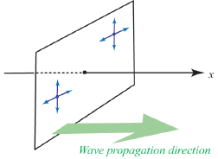
So for an S-wave propagating in the x-direction, particle
motion is only in the y- and z-directions, and not the
x-direction.
We further decompose
the wavefield using a
convention that:
SH = horizontally
polarized shear wave
SV = vertically
polarized shear wave
Both of these are always perpendicular to the propagation
direction, with SH in the horizontal plane and SV in the
direction orthogonal to both the propagation direction
and SH.

Slide 6
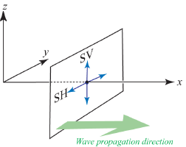
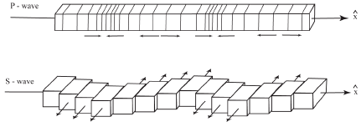
Thus for our example of
a shear wave
propagating only in
the x-direction:
Different texts illustrate
this differently; one
way is to think of a
series of blocks:
Note here that the sign of first-motion is defined by the axis system we choose: e.g., SH + is a first-motion in the direction of +y!

Slide 7
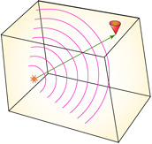
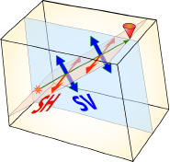
To visualize SH and SV a little better, consider a point source
deep within a constant-velocity medium:
The ray paths must be straight lines; the wavefronts are
spheres.

Slide 8
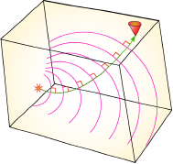
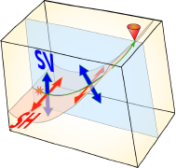
Now imagine the same source-receiver pair for a medium
in which velocity increases with depth:
The definition is the same, but now the angle between
direction of propagation & the horizontal is changing
(so angle of SV motion WRT horizontal also changes).

Slide 9
Seismic Data and Analysis:
First, a quick look at some
data and phases

Slide 10
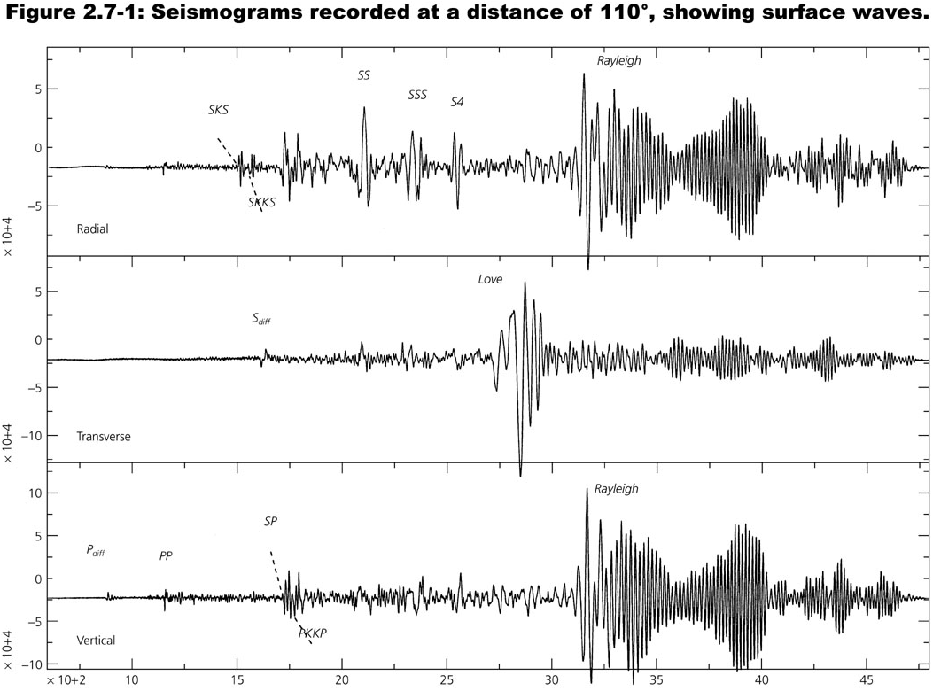
A typical seismogram: note different signals are observed
on different channels!

Slide 11
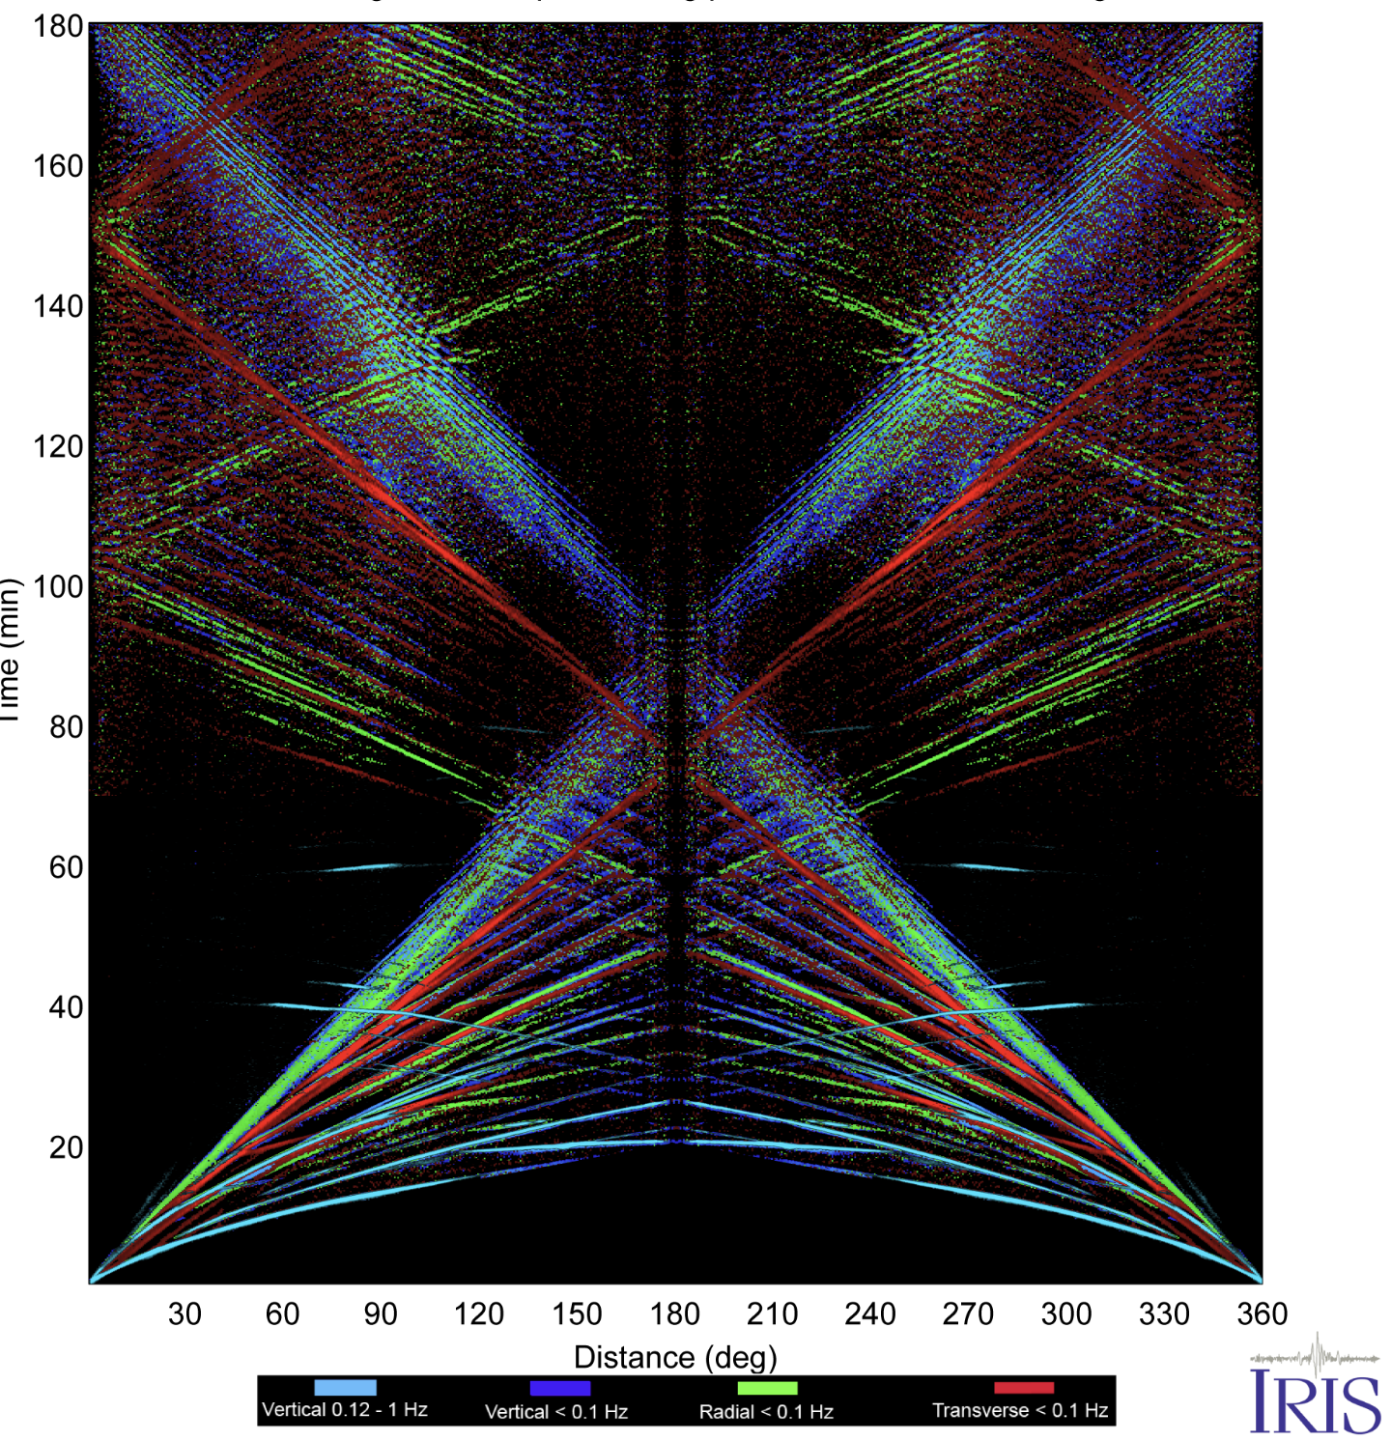
Seismic Phases are arrivals at a particular time and
distance from a source, implying a particular travel path:

Slide 12
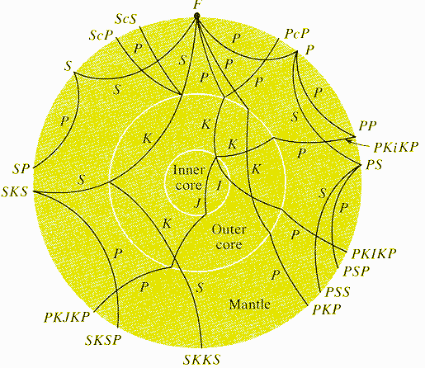
Ray Naming Conventions
P, S - P or S wave segments in the mantle
p, s - up-going energy from an earthquake
(not shown here)
K - P wave segment in the fluid outer core
I - P wave segment in the solid inner core
J - S wave segment in the solid inner core
c - a reflection off the core-mantle boundary
i - a reflection off the inner core boundary
Example: SKS—S-wave that converts to a P-wave in the outer core, then back to an S-wave when it leaves the outer core and travels up towards the seismometer.

