Slide 1
Geology 5640/6640
Introduction to Seismology
2 Dec 2020
Last time: Anisotropy
Anisotropy refers to the directional dependence of seismic
velocity, and has two main types: SPO and LPO
• Shape-preferred orientation (SPO) refers to geometrical
arrangement of bodies that have intrinsically isotropic velocity
properties. When velocity is heterogeneous on scales that
are small relative to the seismic wavelength, the wave “acts
like” a wave traveling in an intrinsically anisotropic medium
• Lattice-preferred orientation (LPO) describes
anisotropy that is intrinsic (i.e., not scale dependent) resulting
from packing/bond structure at the molecular level
• Different minerals have different fast-axis relations to crystal
axes & strain, but for dry olivine, fast v_{S} axis = flow direction!
Read for Fri 4 Dec: S&W 185-198 (§3.7)
© A.R. Lowry 2020

Slide 2
Last time: Anisotropy (continued)
Seismic anisotropy = directional dependence of velocity
• The fourth-order elasticity tensor, c_{ijkl}, can be expressed
more compactly as a 6x6 “Voight matrix” C_{mn}.
• Transverse anisotropy describes e.g. SPO in horizontally
layered media, and is characterized by one P-velocity for
x₁ & x₂ propagation, a different P-velocity for x₃ propagation,
and differing SV- & SH-velocities:
• Azimuthal anisotropy describes the (similar but rotated)
case of azimuthally-varying velocity, generalizing to e.g.:
Fluid-filled cracks reduce S-velocity as (1 – Na³/V) for
waves propagating orthogonal to the cracks

Slide 3
The Final Exam is posted on the course website…
Due 5:00 pm Fri Dec 14.
6640 Semester Project due-dates:
• Amanda’s presentation of research results will
be given xx:00 to xx:00 on Fri Dec 18;
should be max 20 minutes
• Research report is due Fri Dec 18 at 5:00 pm.
No fixed length, but it should include
‡ Intro/Context (including relevance to your thesis
topic)
‡ Description of Math/Physics of the problem
‡ Methods/Data Used
‡ Details of Analysis
‡ Results, Discussion, Future Work (if any)

Slide 4
Reminder: Please fill out your
IDEA online evaluations!
(& send me a screenshot of
the certificate for 10 pts
extra credit!)

Slide 5
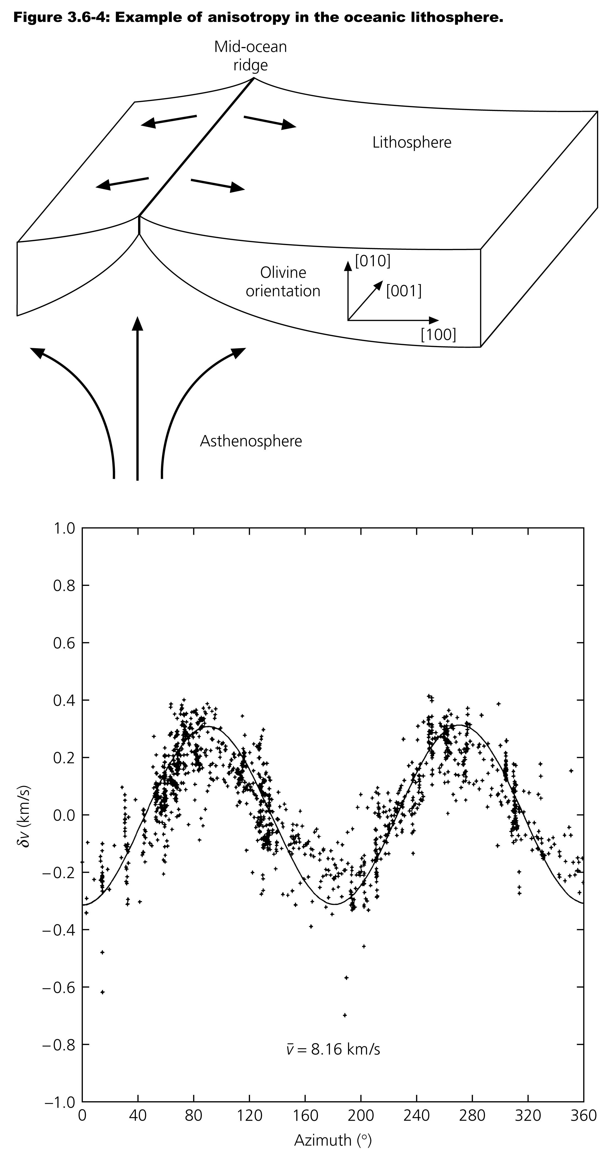
Here, marine seismic observations
of refraction travel-times near Hawaii.
Azimuth is measured relative to trend
of magnetic isochrons in the region,
so velocity peaks at 90$°$ and 270°
indicate that the fast direction is in
the direction of spreading at the time
the lithosphere was formed.
Is this more likely to represent
fluid-filled fractures or flow of mantle
olivine?

Slide 6
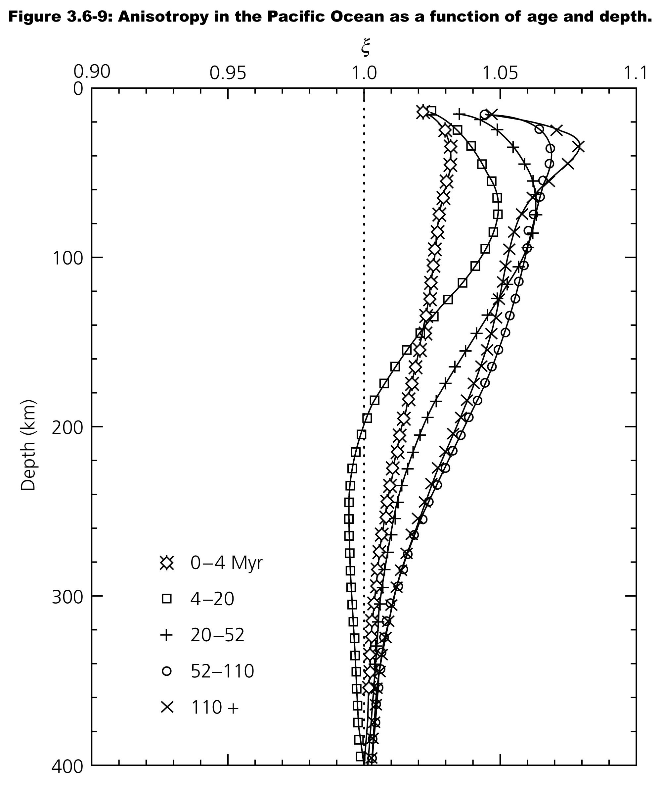
The depth and age
dependence of
anisotropy in the
oceans also lends
insight into physical
processes…
Important to note, for
interpreting this signal,
that the direction and
magnitude of
anisotropy reflects an
integral of the strain
history of the rocks!

Slide 7
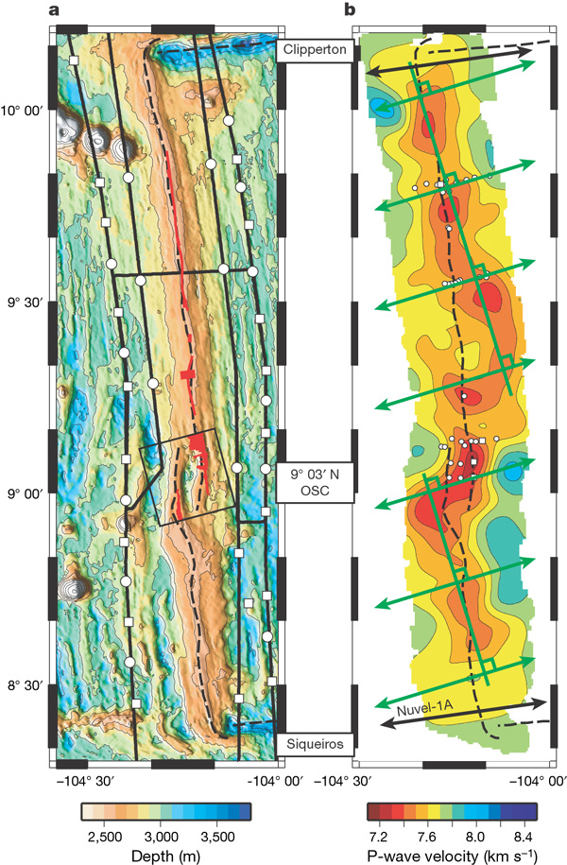
Data from the East
Pacific Rise tell a more
complicated (and more
interesting) story…
With significant implications for
active- vs passive-components
of the flow dynamics in oceanic
spreading centers (not to
mention segmentation of
ridges, and the bathymetry
and melt chemistry variations
along a mid-ocean ridge…)
Toomey et al. Nature 2007

Slide 8
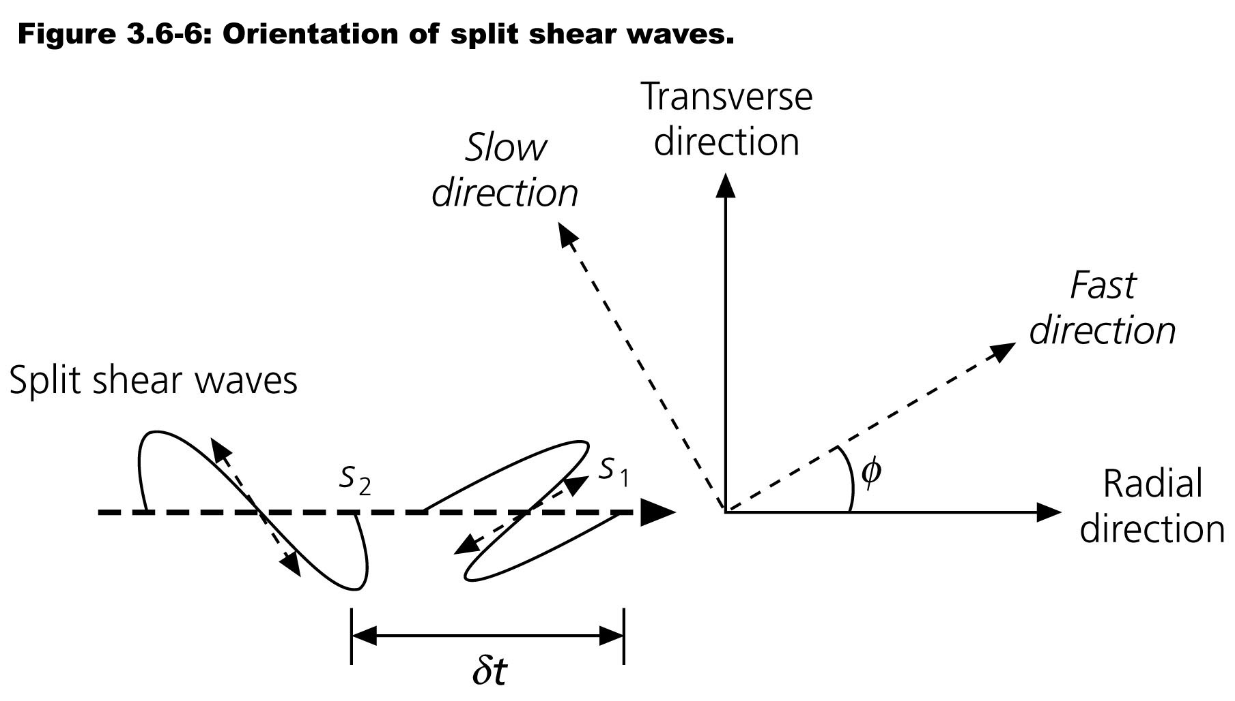
Shear Wave Splitting is commonly-used to identify
azimuthal anisotropy. Given initial signal s(t) on the radial
component only of the SKS arrival & angle φ between radial &
fast directions,
Radial:
Transverse:
Note that normally
one wouldn’t get a
transverse
component SKS
arrival; only radial!
but anisotropy “splits”
the arriving energy in
components ⊥ & || to
the anisotropy axes.

Slide 9
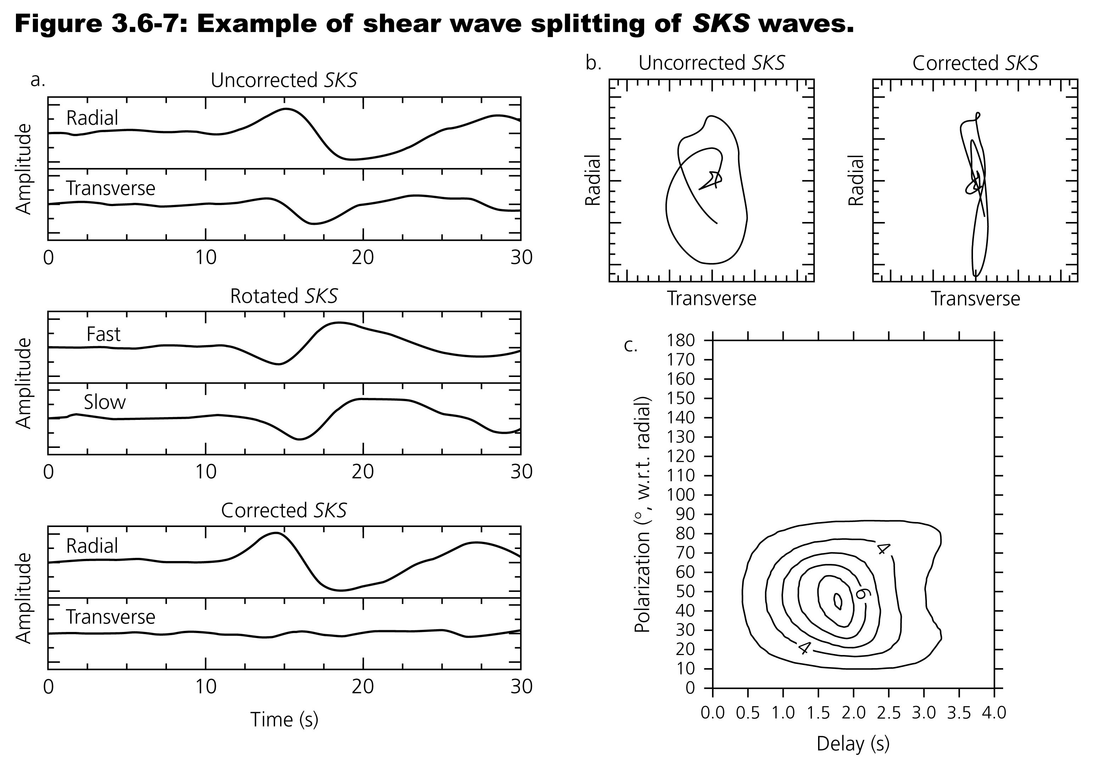
In practice, try lots of rotations and δt’s to find which maximizes
the (original, pre-splitting) radial component of amplitude.

Slide 10
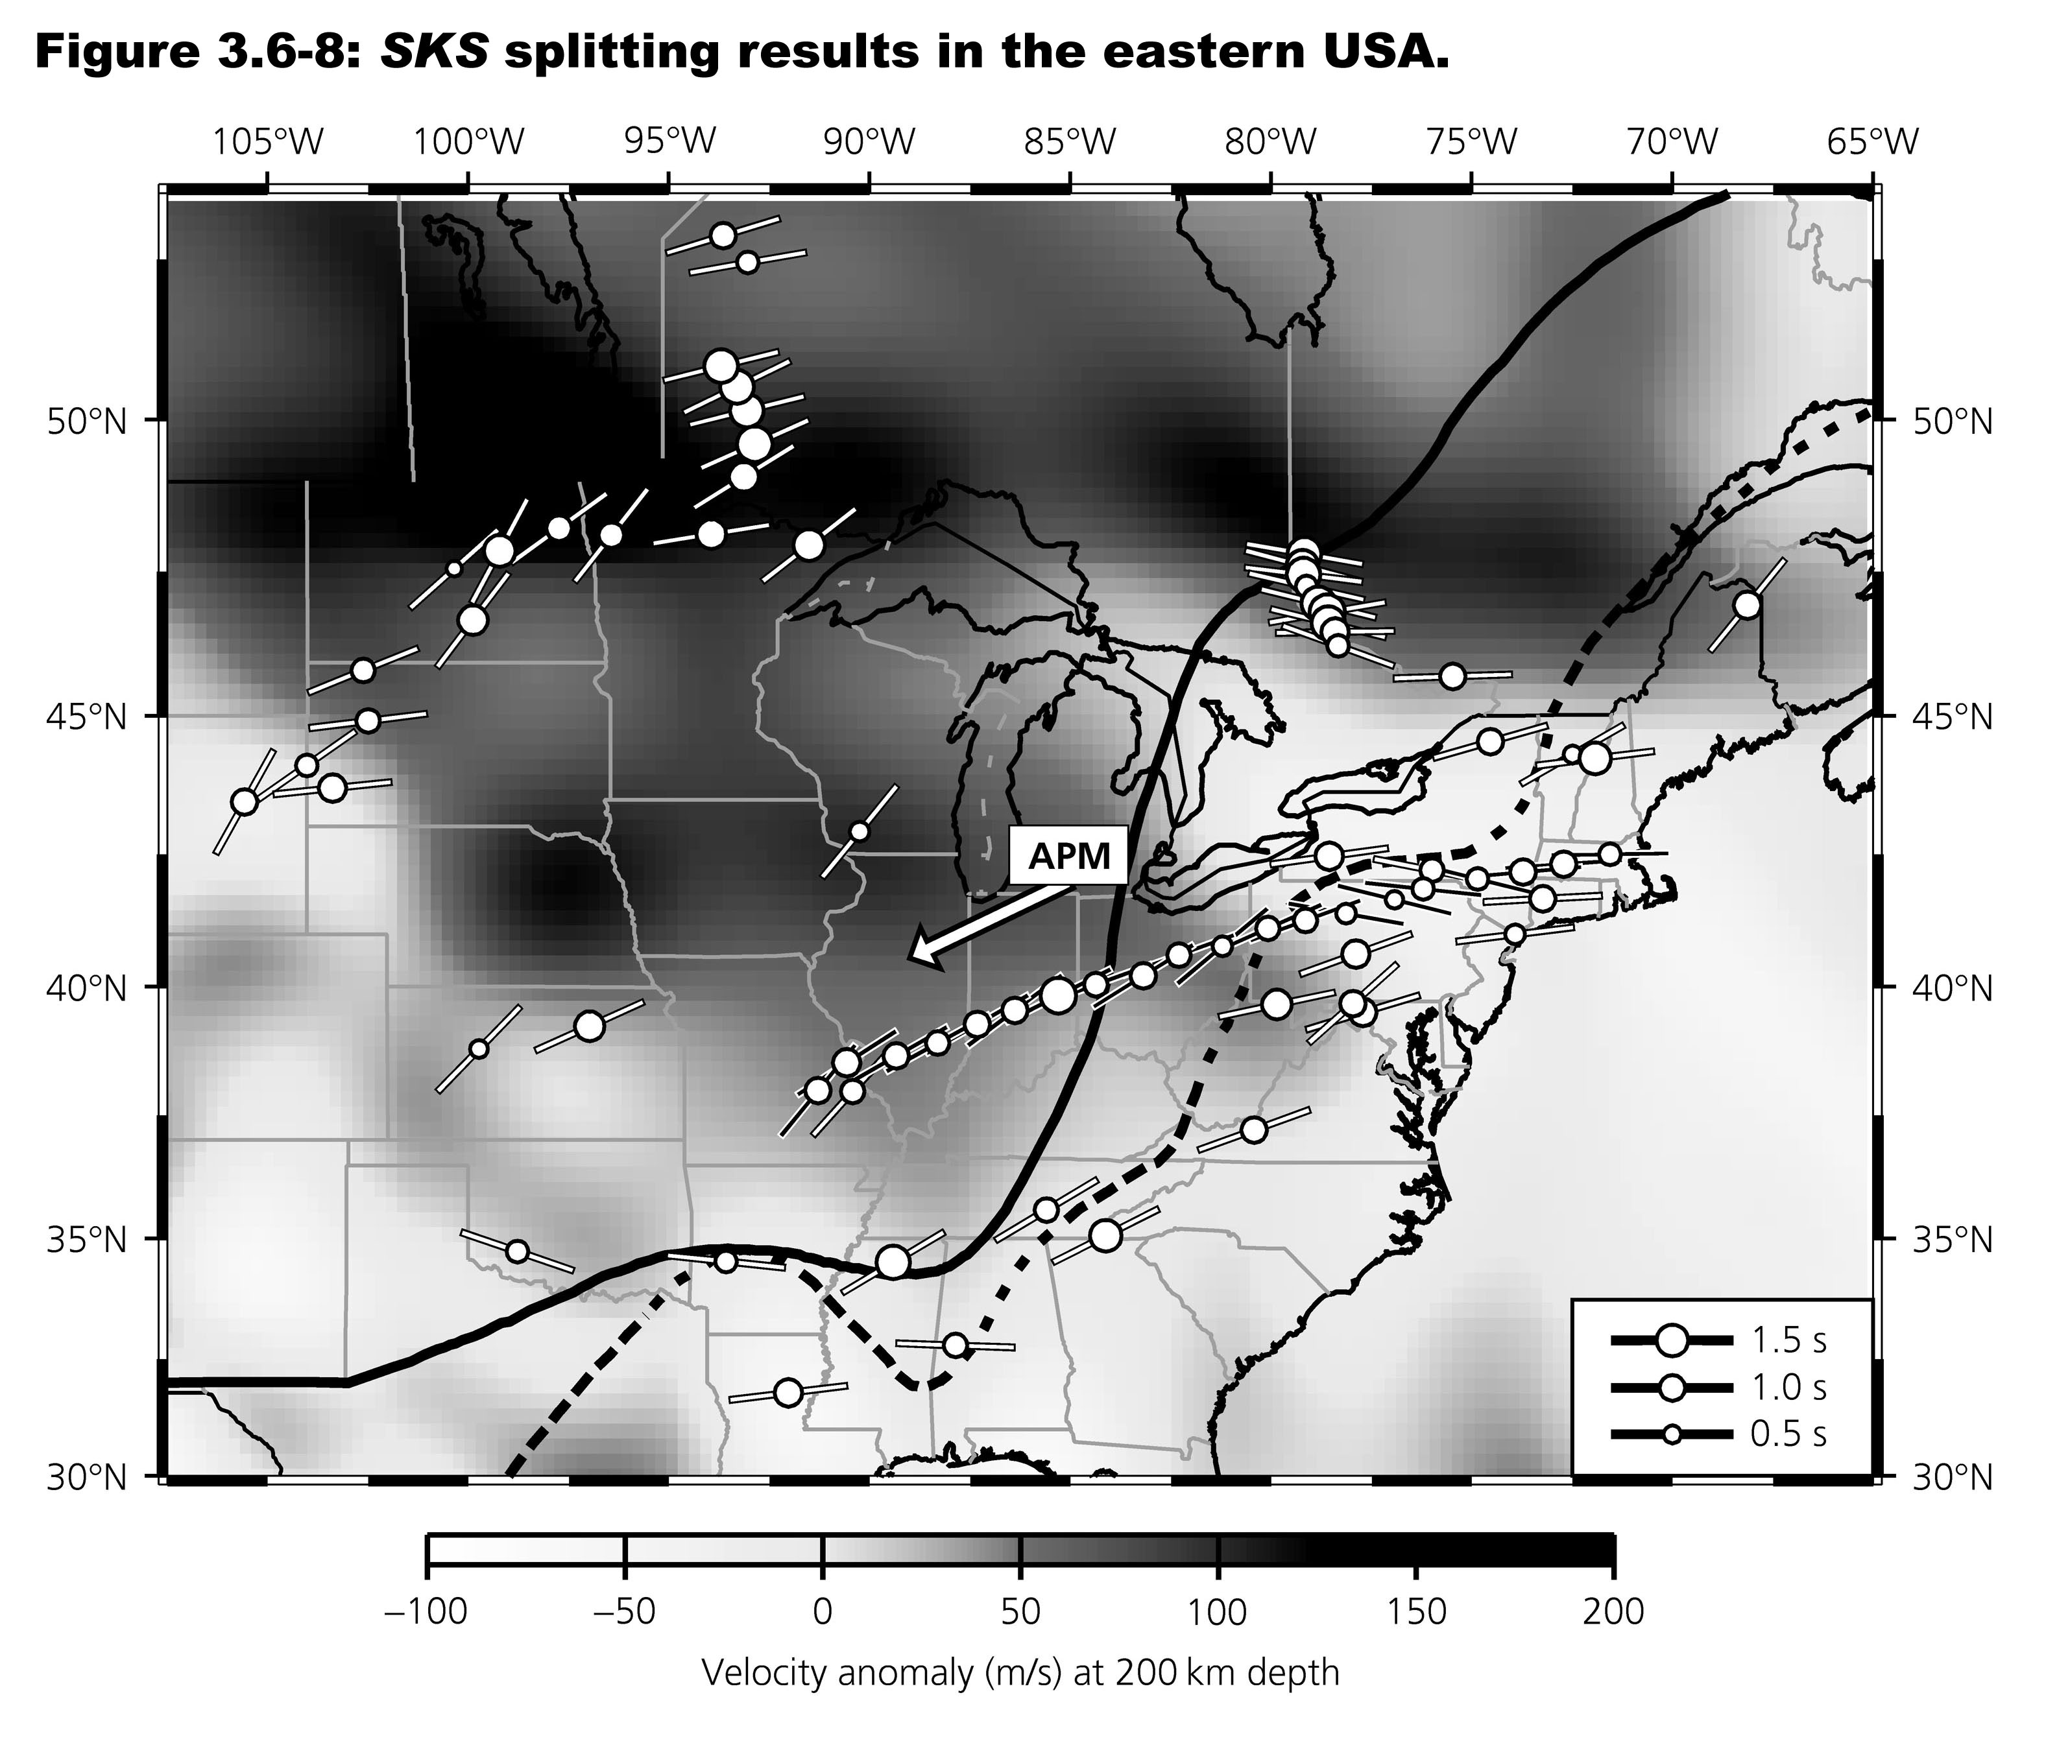
Note φ
gives you
the fast
direction;
δt
describes
thickness
times δv!

Slide 11
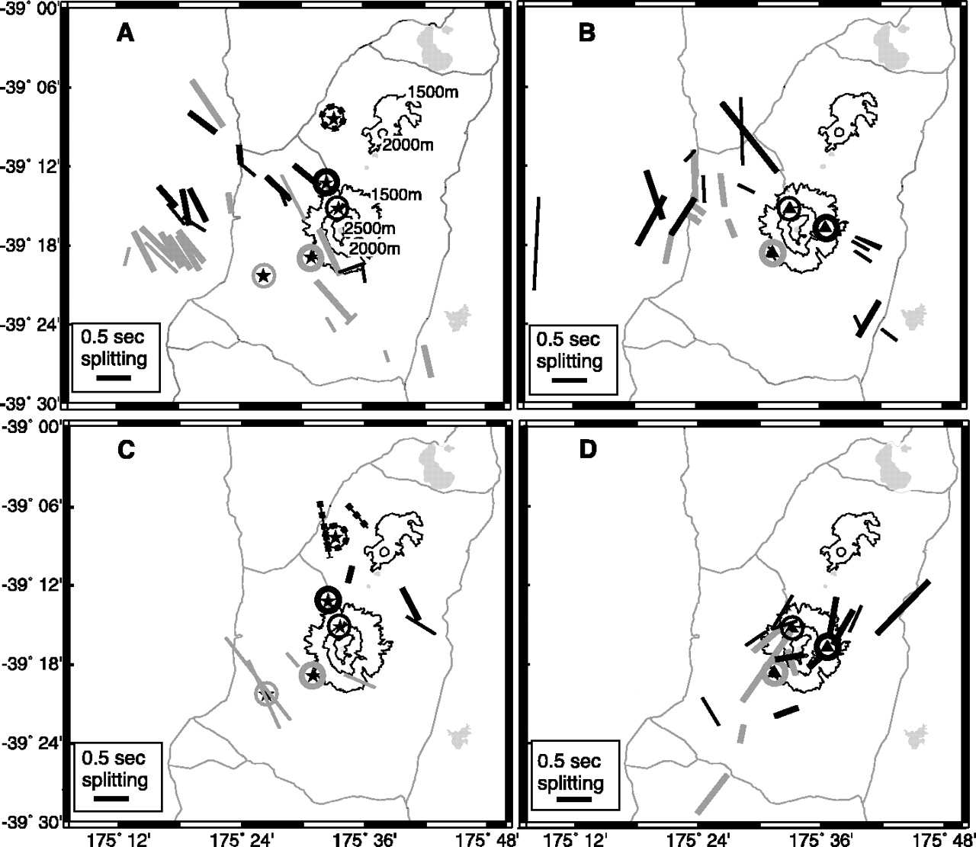
1994, <30 km
1998, <30 km
Time-
varying
anisotropy
has been
observed
e.g. before
and after
an eruption
of Mount
Ruapehu
in New
Zealand…
1994, >50 km
1998, >50 km
Miller & Savage, Science, 2001
Notes:
Map views of Ruapehu with topographic contours shown as thin black lines and roads as thin gray lines. Irregular gray areas are lakes. The measurements are indicated by a bar whose azimuth is φ and whose length is proportional to δt. They are plotted at the surface projection of the point where the ray paths intersect 10 km depth. The marking of the bar corresponds to the station recording the waveform surrounded by a circle of the same marking where the measurement was recorded [stations are shown as stars in (A) and (C) (1994) and as triangles in (B) and (D) (1998)]. (A) Shear-wave splitting from shallow (<30 km) events recorded in 1994. (B) Shear-wave splitting from shallow events recorded in 1998. (C) Shear-wave splitting from deep (>50 km) events recorded in 1994. (D) Shear-wave splitting from deep events recorded in 1998.

Slide 12
Attenuation and Anelasticity
Wave amplitudes depend on:
• Source energy
• Mode conversions or Transmissions/Reflections
at interfaces (i.e., Zoeppritz’ Equations)
• Geometric Spreading: As a wavefront propagates
from a finite source and encompasses a larger volume,
conservation of energy requires amplitude to diminish.
• Multipathing: Focusing and defocusing of waves
(analogous to mirages in the case of light).
• Scattering: Like multipathing, but this occurs when
velocity heterogeneities have wavelengths of the same
order as the propagating wave.
• Anelasticity: Elastic energy is converted to heat during
anelastic (unrecoverable) deformation.

Slide 13
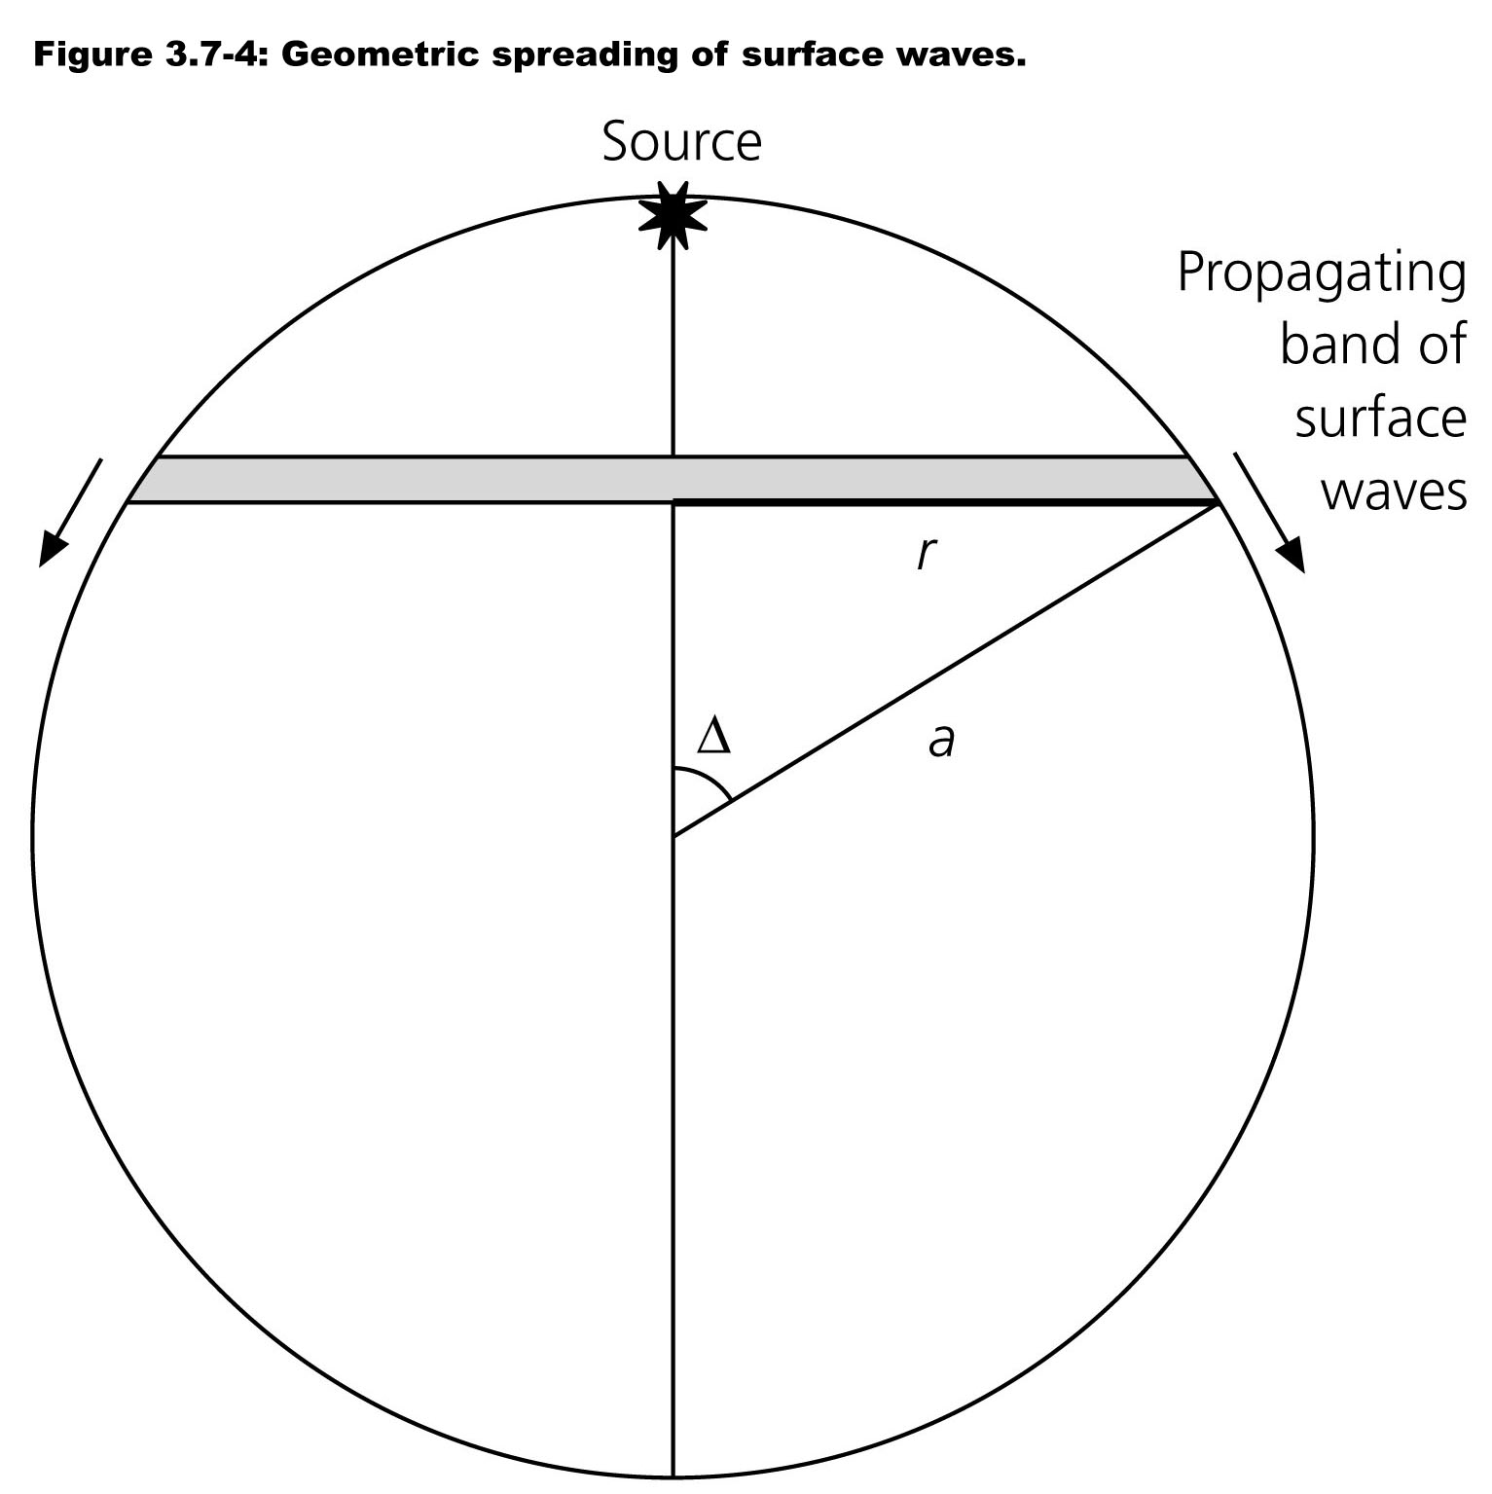
Geometrical Spreading on a Sphere:
Recall from our derivation of the wave equation in spherical
coordinates that amplitudes of a spherical (body) wavefront
decay as 1/r; we also showed that a (cylindrical) head wave
amplitude decays as 1/ (but that assumed Cartesian!).
A surface wave on a sphere
follows a ring whose circumference
equals a sinΔ. The energy per unit
wavefront decreases as
Amplitude is proportional to the
square-root of energy, so
which is a minimum at Δ = 90° and
maximum at Δ = 0$°$ & 180$°$!

Slide 14
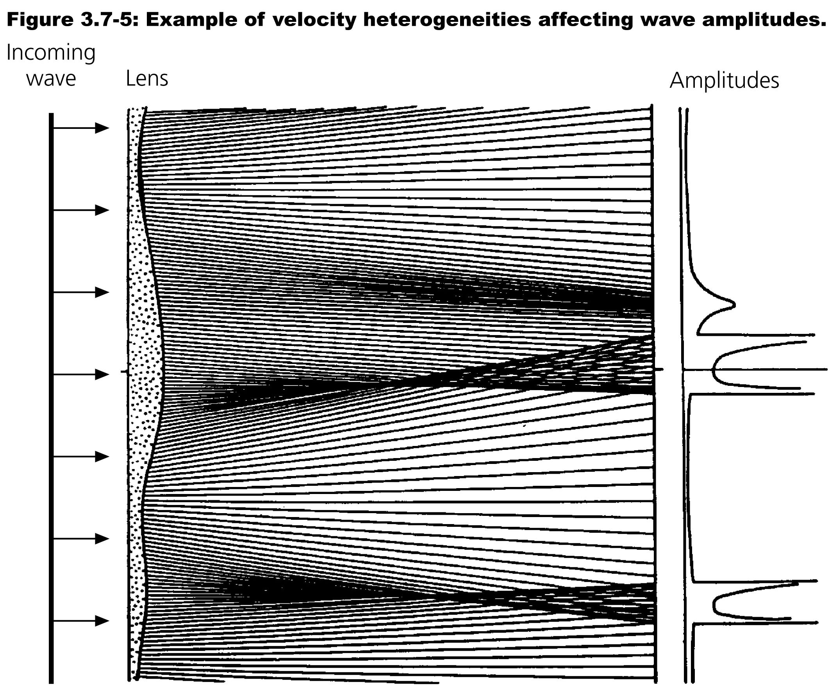
Multipathing:
Seismic
waves
also can
be
focused
and
defocused
by velocity
variations
in the
medium.

Slide 15
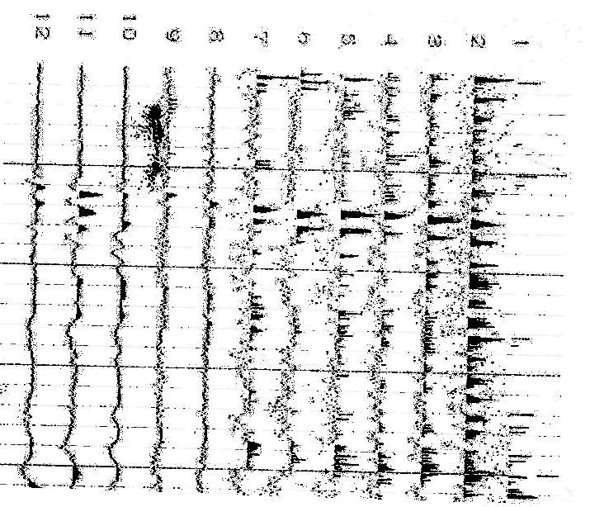
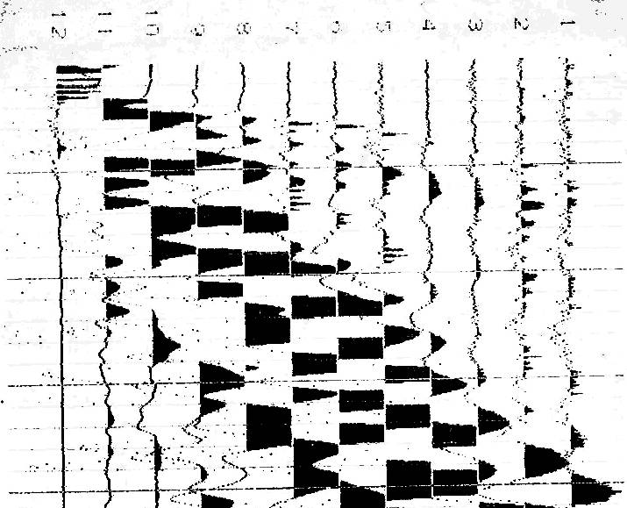
Reverse shot from a seismic refraction profile collected on a
farm near Gosport, IN.
(Note: You’ll be looking at something similar to this for your
Final Exam…)

Slide 16
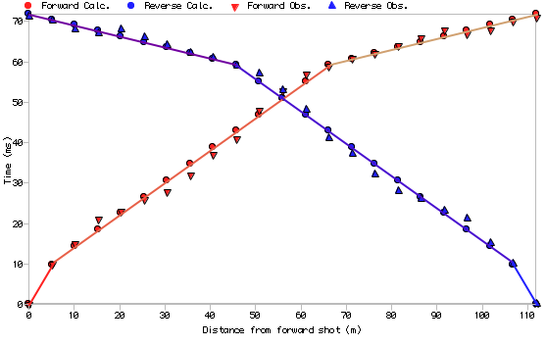
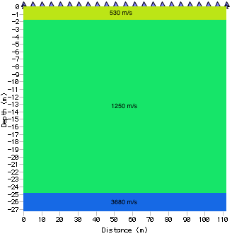
Gosport Best Fit
RMS = 1.39 ms

Slide 17
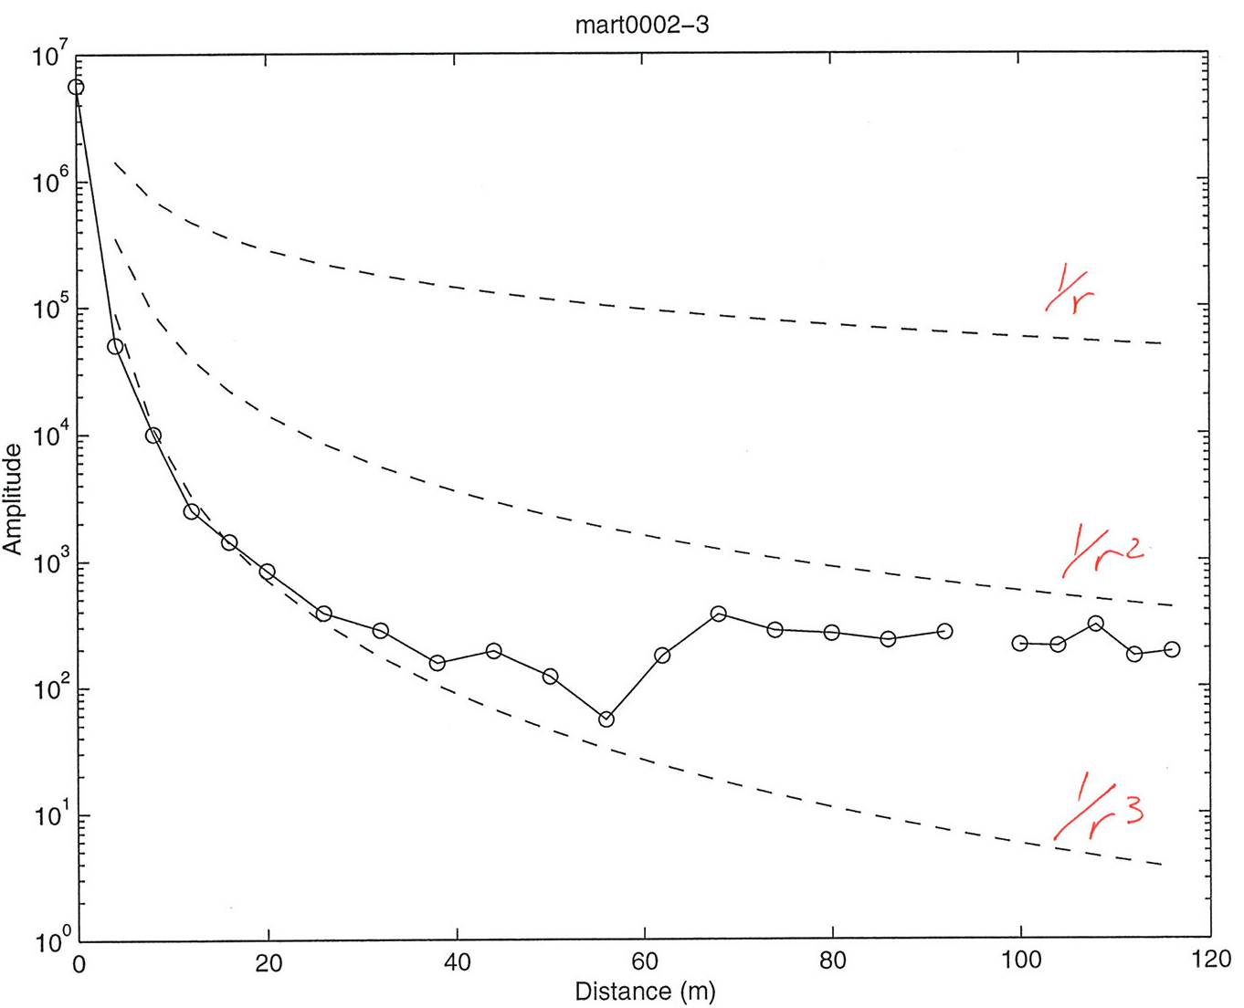
Note that the amplitudes for these first arrivals do not follow a
simple 1/r or 1/√r decay… !

Slide 18
These amplitudes decay rapidly even after correcting for
geometrical spreading (due to anelastic attenuation with low
Q: We’ll come back to that shortly). But geometric plus
anelastic decay modeling poorly fits arrivals where two waves
come in at about
the same time…
This is also an
example of
multipathing!
1
2
3
530
100
6.6
(13.3)
V = 1250 m/s
f = 250 Hz
Q = 5.1
(10.2)
V = 3680 m/s
f = 125 Hz
Q = 3.2
(6.3)
X
X

