Slide 1
Geology 5640/6640
Introduction to Seismology
2 Oct 2020
Last time: The Wave Equation!
• The seismic wave equations derive from the divergence
( dilatational strain θ) and curl ( shear strain) of
equations of motion:
P-wave equation:
S-wave equation:
in which α and β are the
propagation velocities:
• Hence, velocity is sensitive to both the isotropic elastic
properties of rocks and to their densities
• Elastic properties generally vary more than density!
Read for Mon 5 Oct: S&W 53-62 (§2.4); 458-462
© A.R. Lowry 2020

Slide 2
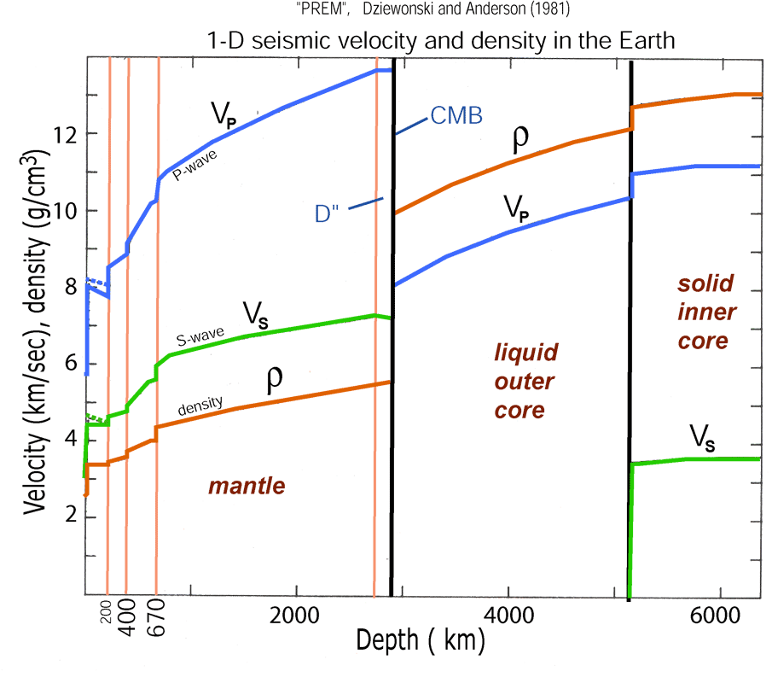
• Here and represent the
propagation velocities for the P and S waves
respectively.
• Note changes in elastic properties contribute more to
velocity variation than changes in density
• Velocity is sensitive to rock chemistry, packing structure,
porosity & fluid type, pressure and temperature. The
tricky part is distinguishing which we’re seeing…

Slide 3
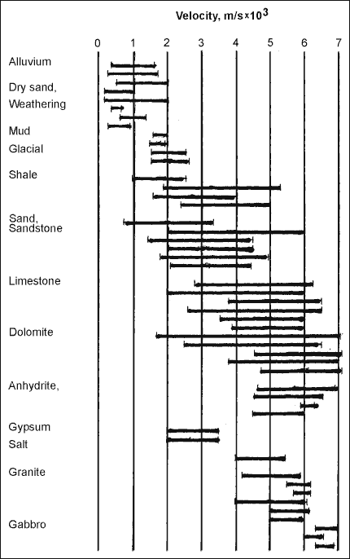
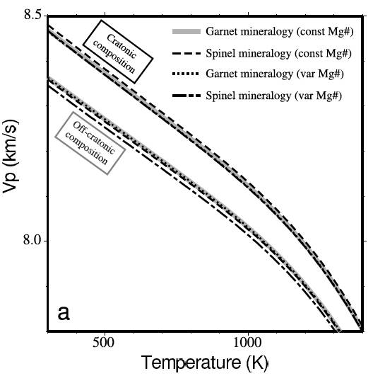
Rock properties that affect seismic
velocity include:
• Porosity
• Rock composition
• Pressure
• Temperature
• Fluid saturation
= V_{p}, β = V_{s} are much more
sensitive to λ and μ than to ρ
Crustal Rocks
Mantle
Rocks (?)

Slide 4
Seismic velocity depends on a lot of fields, but not all
are independent:
Velocity
Temperature
Composition
Partial Melt
Pressure
Porosity/Fluid
Density
And some fields can be determined to within
small uncertainty (e.g. pressure at given depth)

Slide 5
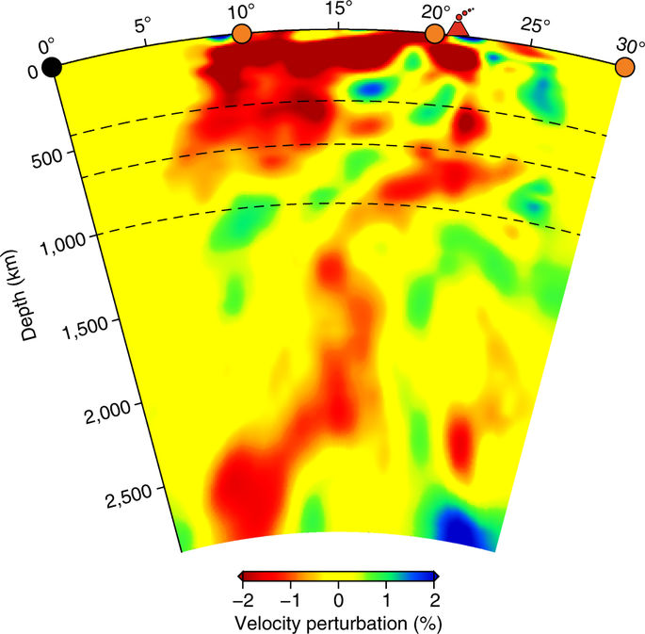
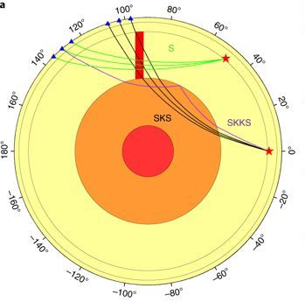
Nelson & Grand, Nat. Geosci., 2018
A shear velocity tomogram of the mantle under
Yellowstone, combining S, SKS and SKKS phases…

Slide 6
So now we have our expressions for the wave equation in
terms of displacements:
Question is, how do we solve these?
Solution is simplified by expressing displacements
in terms of displacement potentials. Helmholtz’
decomposition theorem holds that any vector field
can be expressed in terms of a vector potential and
a scalar potential φ as:
In our application, φ is a scalar displacement potential
associated with the P-wave, and is a vector
displacement potential associated with the S-wave.

Slide 7
It’s first worth noting a pair of useful vector identities:
Then, if we substitute our potentials into our P-wave
equation:
Rearranging:
And hence:

Slide 8
Similarly, substituting potentials into the S-wave equation:
Here we take advantage of another vector identity:
Rearranging:
And hence:

Slide 9
So what’s the point of this? We want to find some
solution, e.g. for P-wave displacement potential,
that allows for separation of variables:
The eigenfunctions for a partial differential equation
of this form (i.e., functions which, if plugged into the
equation, will yield solutions of similar form) are:
(called the “d’Alembert solution”). Here,
i is the imaginary number
A is amplitude
ω is angular frequency 2π/T (& T is time period)
k is spatial wavenumber 2π/λ (& λ is wavelength)

