Slide 1
Geology 5640/6640
Introduction to Seismology
2 Sep 2020
Last time: Course overview
Discussed: syllabus, resources, course objectives
The observation: A seismogram is a record of ground
motion (specifically, ground acceleration!) as a function
of time
Discussed animations of vertical movement in
EarthScope’s Transportable Array seismic network
(for the Feb 2008 Wells, NV and several Gulf of
California earthquakes)
Read for Fri 4 Sep: S&W 1-28
© A.R. Lowry 2020

Slide 2
How to use these powerpoints:
• Review them often: Before each class, for exams
and exercises, and (grads) in preparing your projects
• The most important points of each lecture (in my opinion)
are summarized on the first slide of the next lecture
• Note the notation!
→ Arial Black, italic means Important, pay
attention…
→ Arial Black, italic, red font means
Critically Important concept or terminology
that I expect you to understand intimately
for exercises and projects
→ Times New Roman, italic, black font means this is an
equation or an algebraic variable
→ A Red Box with Grey Background means this is an
especially important concept or equation

Slide 3
http://ds.iris.edu/media/product/usarraygmv-super/files/SGMV_1001F.mp4
Trabant et al. (2012) Seismol. Res. Lett.
Various Gulf of California earthquakes,
2007-2013

Slide 4
What’s the point of showing this?
Seismology provides crucial
information about the nature of
high energy seismic sources
like earthquakes!

Slide 5
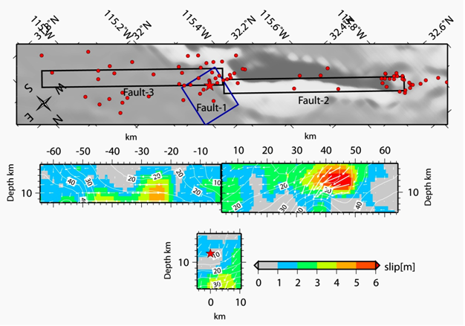
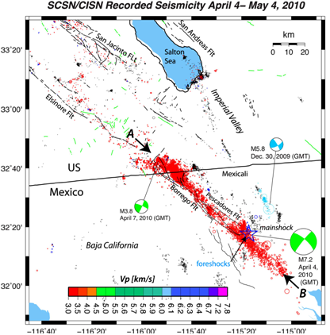
M7.2 El Mayor-
Cucapah
Event (2010)…
Finite fault model
(http://www.geerassociation.org/
GEER_Post%20EQ%20Reports/
Baja%20California_2010/
Baja10_Ch02.html)

Slide 6
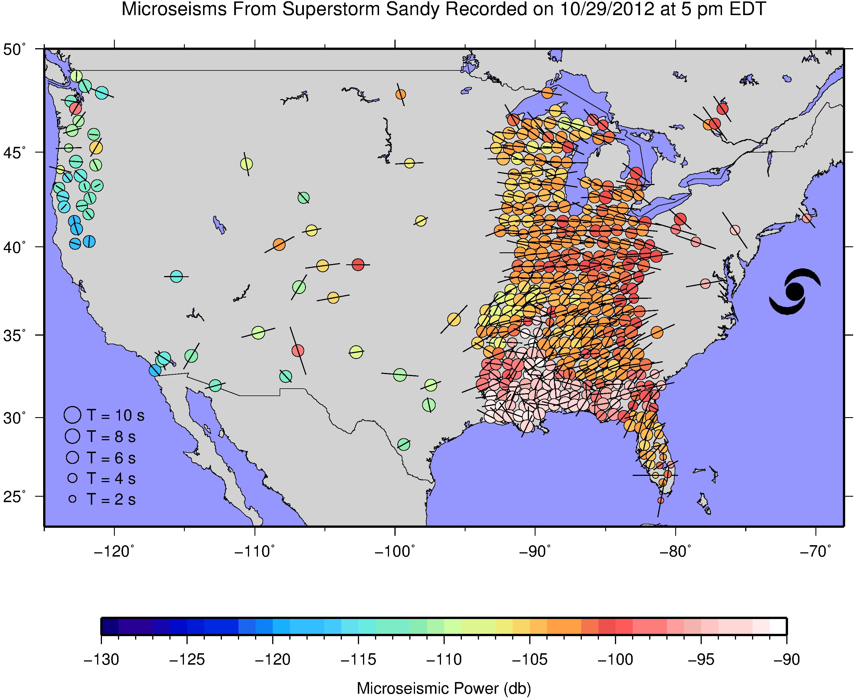
Note however that earthquakes aren’t the only significant
seismic energy source on the block!

Slide 7
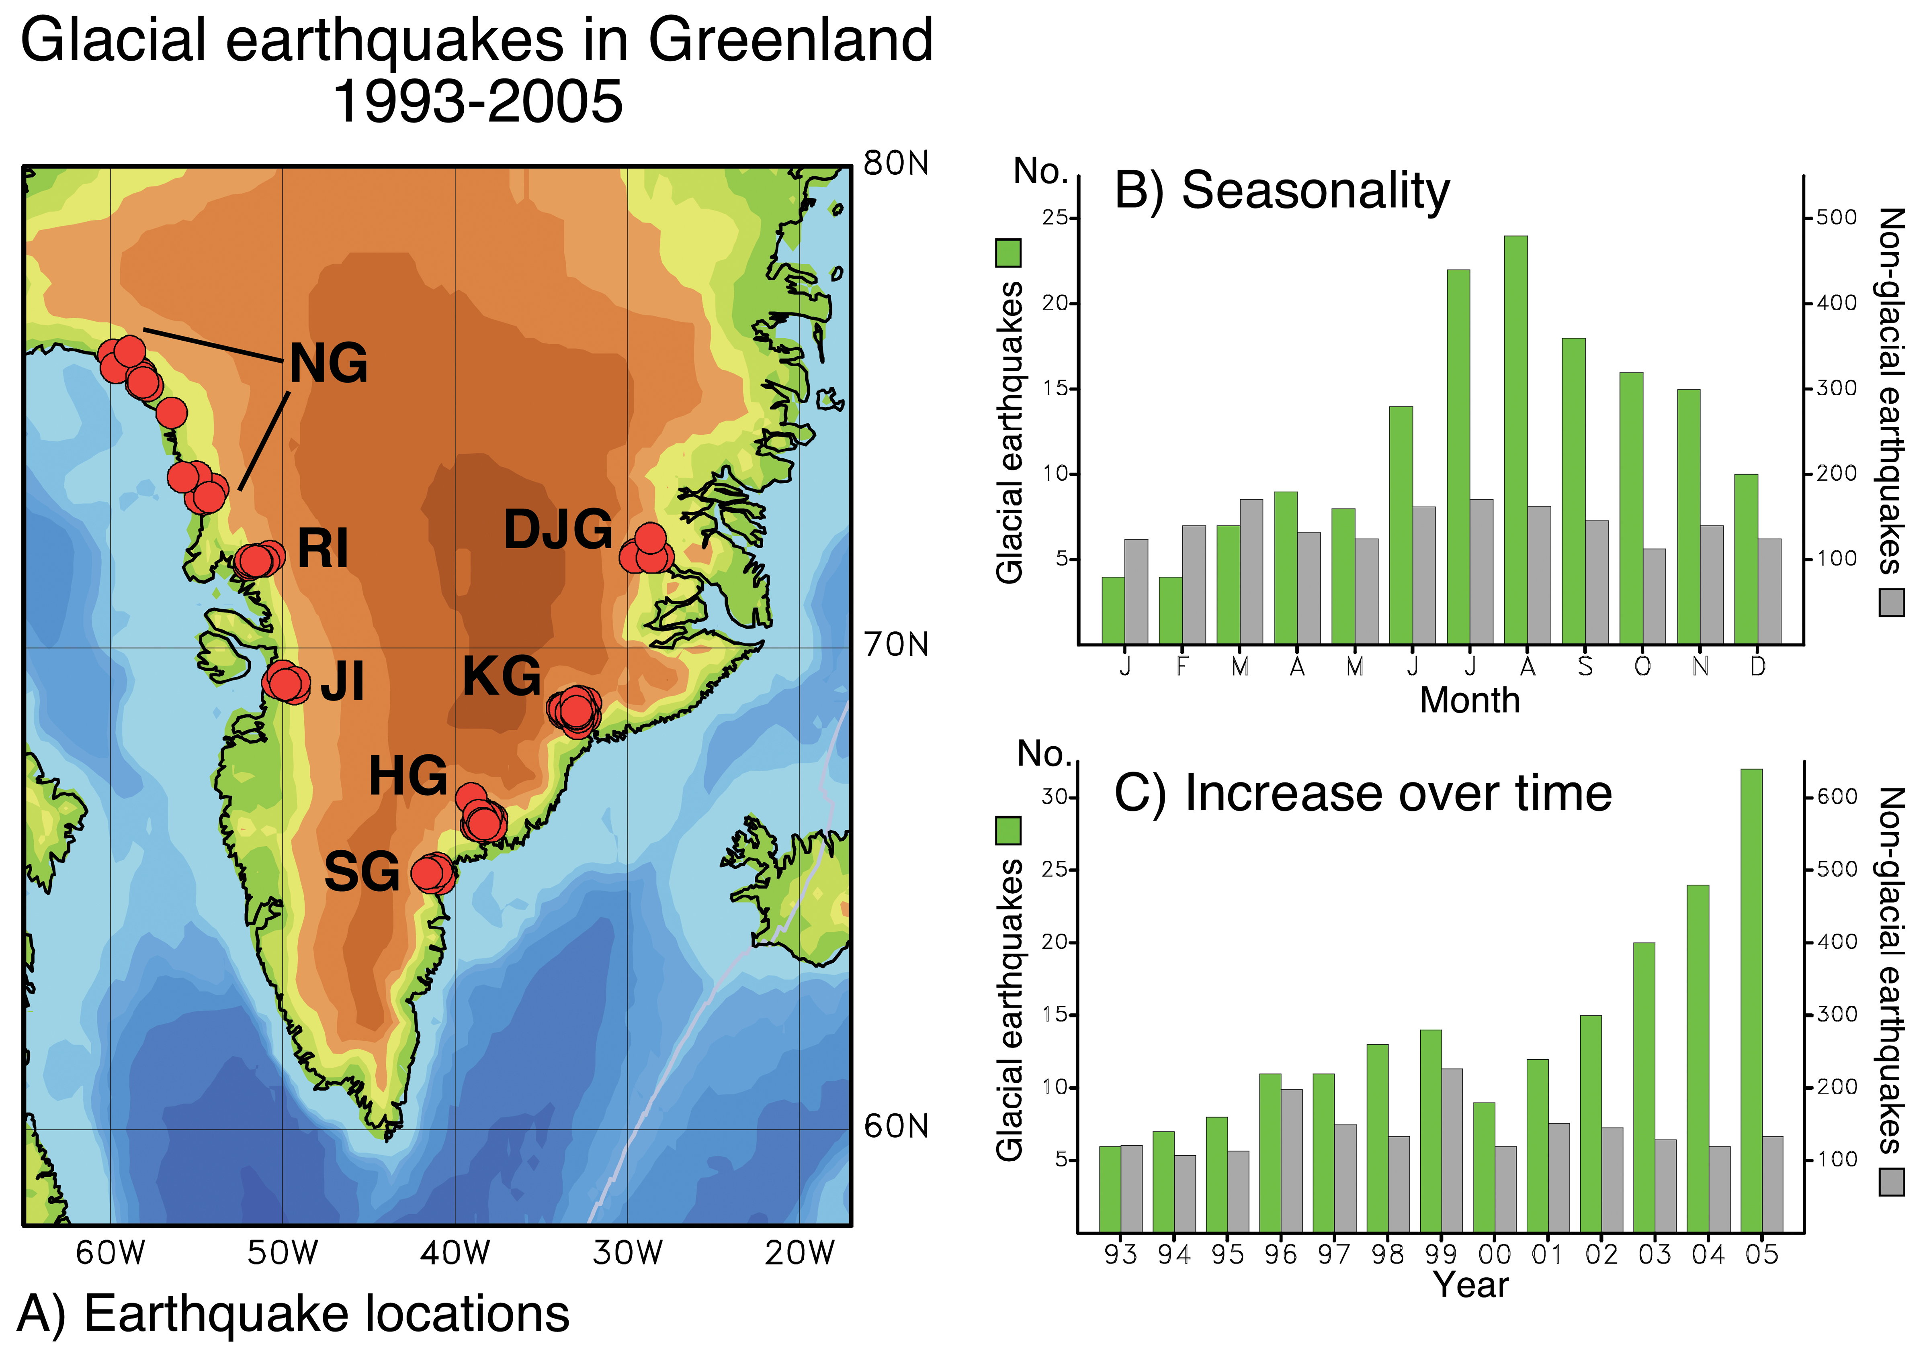
Ekström et al., Science, 2006
Icequakes? Now there’s cryoseismology!

