Slide 1
Geology 5640/6640
Introduction to Seismology
3 Dec 2024
Last time: Anisotropy
Anisotropy refers to the directional dependence of seismic
velocity, and has two main types: SPO and LPO
• Shape-preferred orientation (SPO) refers to geometrical
arrangement of bodies that have intrinsically isotropic velocity
properties. When velocity is heterogeneous on scales that
are small relative to the seismic wavelength, the wave “acts
like” a wave traveling in an intrinsically anisotropic medium
• Lattice-preferred orientation (LPO) describes
anisotropy that is intrinsic (i.e., not scale dependent) resulting
from packing/bond structure at the molecular level
• Different minerals have different fast-axis relations to crystal
axes & strain, but for dry olivine, fast v_{S} axis = flow direction!
Read for Thursday 5 December: S&W 185-198 (§3.7)
© A.R. Lowry 2011-2024

Slide 2
Last time: Anisotropy (continued)
Seismic anisotropy = directional dependence of velocity
• The fourth-order elasticity tensor, c_{ijkl}, can be expressed
more compactly as a 6x6 “Voight matrix” C_{mn}.
• Transverse anisotropy describes e.g. SPO in horizontally
layered media, and is characterized by one P-velocity for
x₁ & x₂ propagation, a different P-velocity for x₃ propagation,
and differing SV- & SH-velocities:
• Azimuthal anisotropy describes the (similar but rotated)
case of azimuthally-varying velocity, generalizing to e.g.:

Slide 3
The Final Exam is posted on the course website…
Due 5:00 pm Fri Dec 13. (This is a much-shortened
version relative to years past so you can focus on
projects.
6640 Semester Project due-dates:
• Presentations of research results will
be given 2:00 to 4:00 on Friday Dec 6;
should be max 20 minutes
• Research report is due Fri Dec 13 at 5:00 pm.
No fixed length, but it should include
‡ Intro/Context (including relevance to your thesis
topic)
‡ Description of Math/Physics of the problem
‡ Methods/Data Used
‡ Details of Analysis
‡ Results, Discussion, Future Work (if any)

Slide 4
Reminder: Please fill out your
IDEA online evaluations!
(& send me a screenshot of
the certificate for 10 pts
extra credit!)

Slide 5
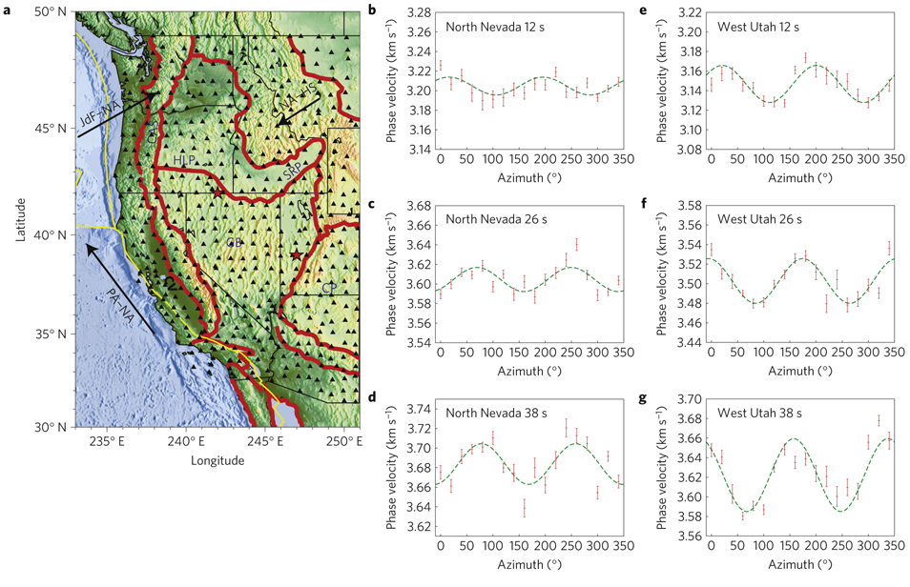
Lin et al., Nature 2010

Slide 6
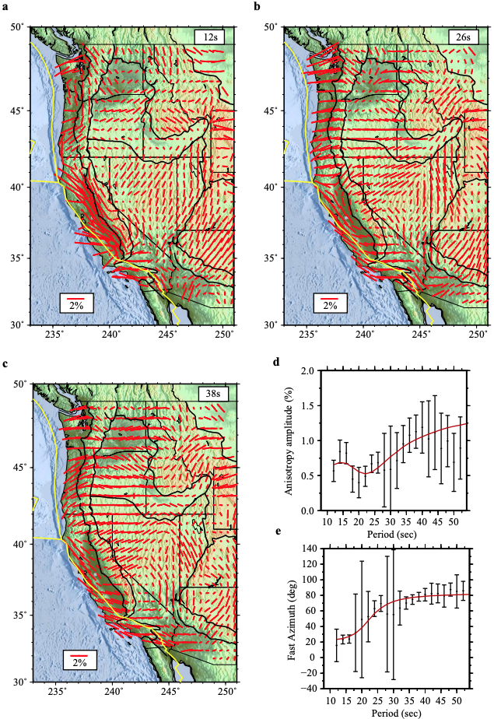
This is commonly
displayed as a fast-axis
direction and a percentage
anisotropy, by bars scaled
to the latter…
Lin et al., Nature 2010

Slide 7
Fluid-filled cracks in an isotropic medium will have
an elasticity tensor of the form:
In this example we’ve assumed that the normals to
two-dimensional cracks parallel the x₁ axis. Note how the
shear modulus is reduced by the cracks. If the fluid is
incompressible, P-wave velocity is unaffected, but
S-wave velocity is.
Here, ε = Na³/V, with N being the number of cracks per
volume V, and a is the half-width of the cracks.

Slide 8
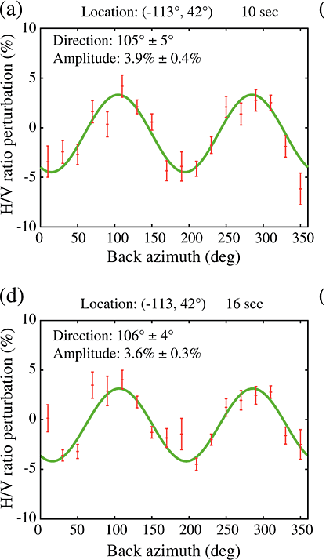
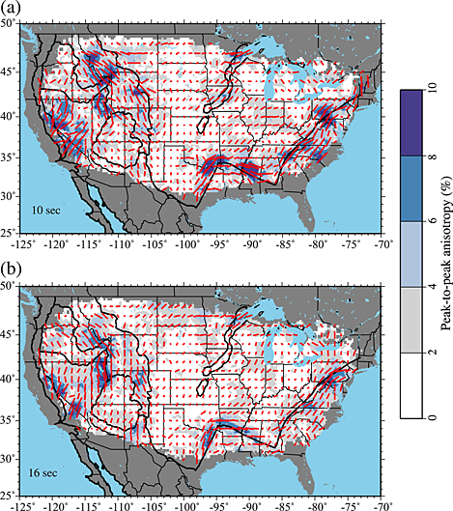
Lin & Schmandt, Geophys. Res. Lett. 2014
Example of upper
crustal (10-16 s)
Rayleigh velocity
anisotropy

Slide 9
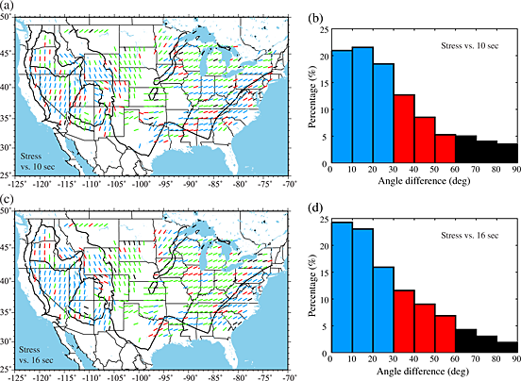
Lin & Schmandt, Geophys. Res. Lett. 2014
… Interpreted as compressional stress direction ⇒
closed fractures

Slide 10
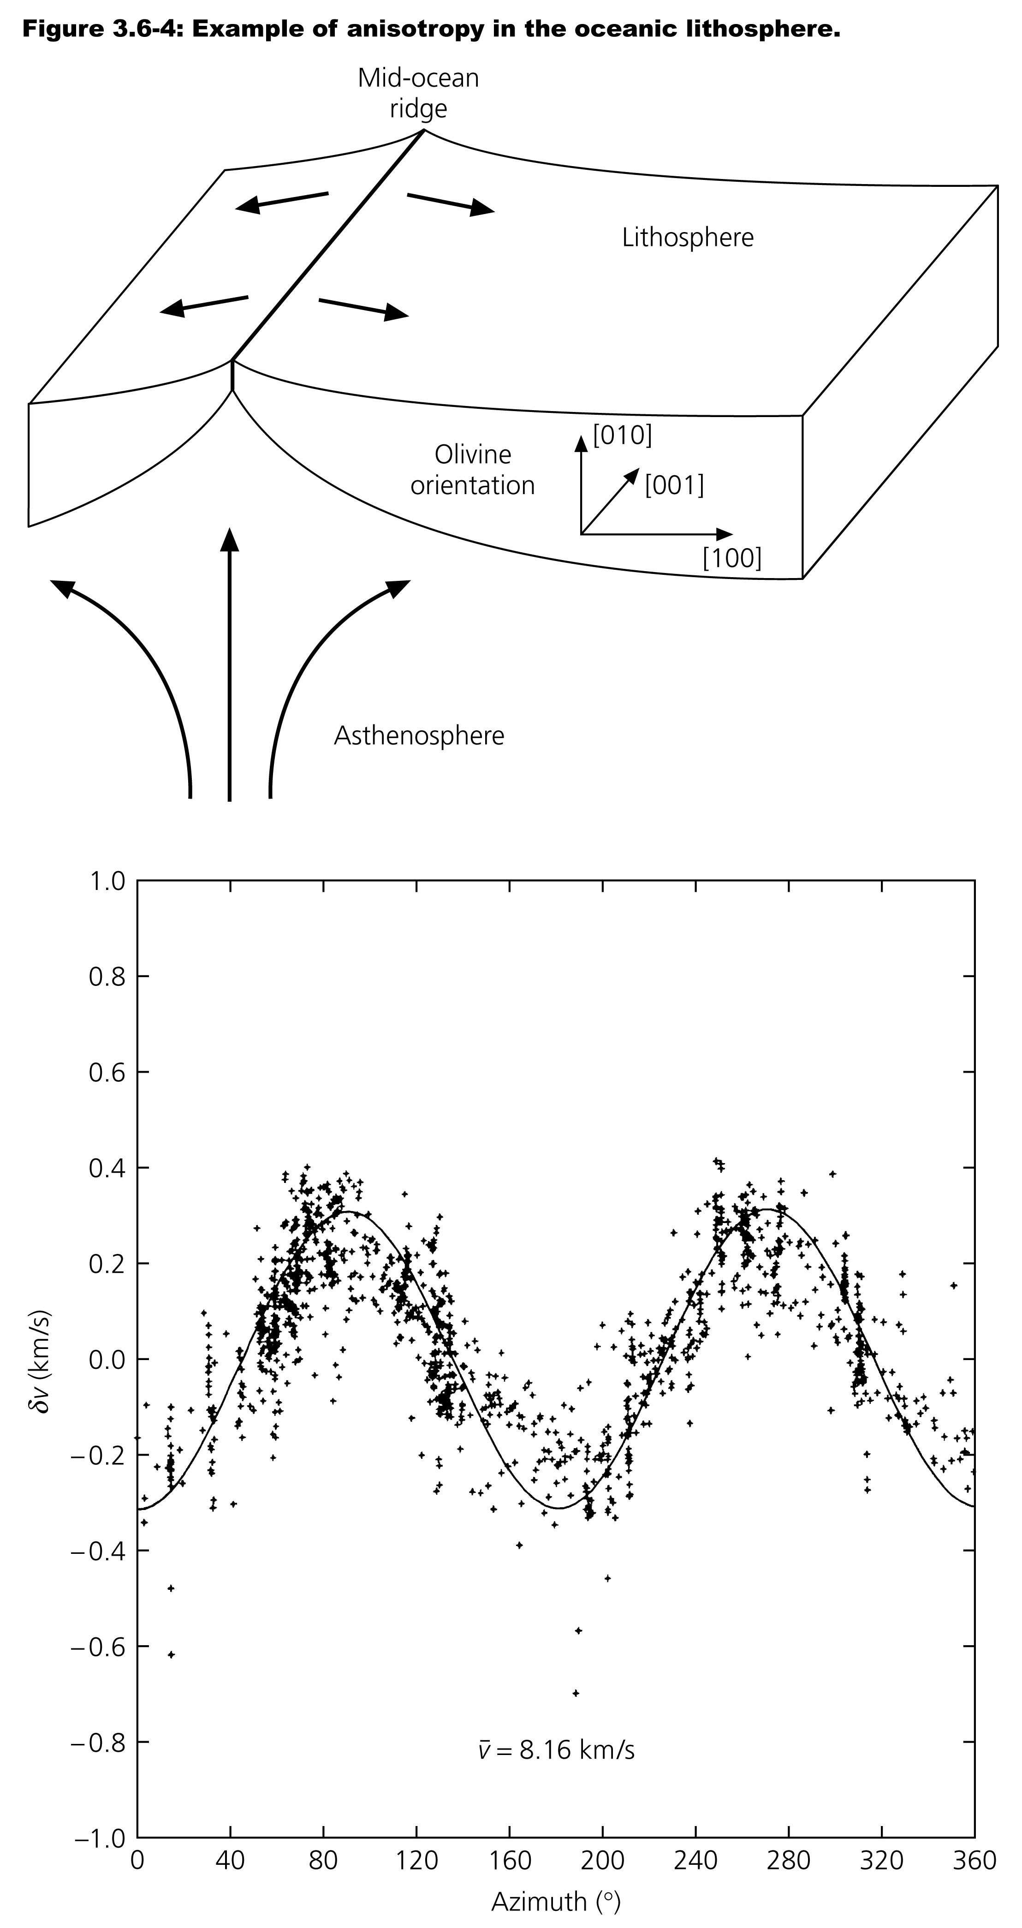
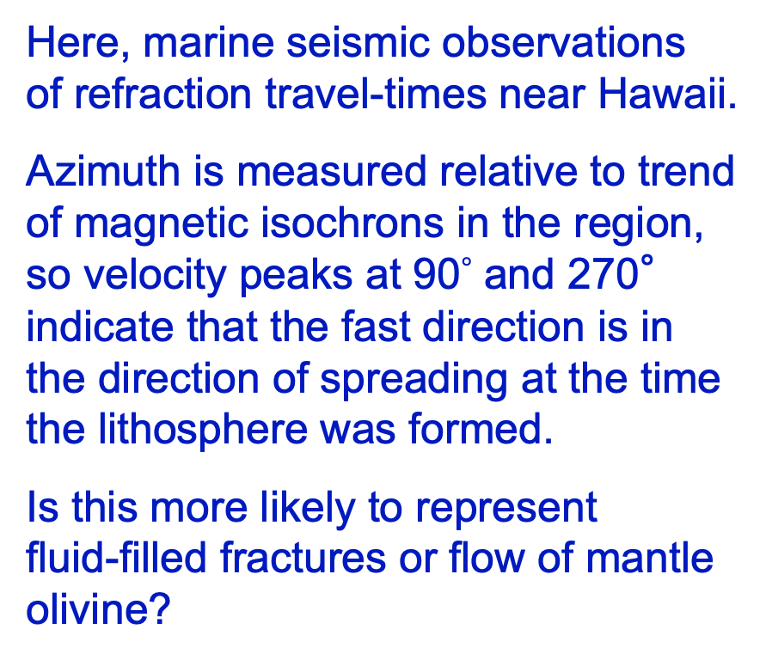
Here, marine seismic observations
of refraction travel-times near Hawaii.
Azimuth is measured relative to trend
of magnetic isochrons in the region,
so velocity peaks at 90$°$ and 270°
indicate that the fast direction is in
the direction of spreading at the time
the lithosphere was formed.
Is this more likely to represent
fluid-filled fractures or flow of mantle
olivine?

Slide 11
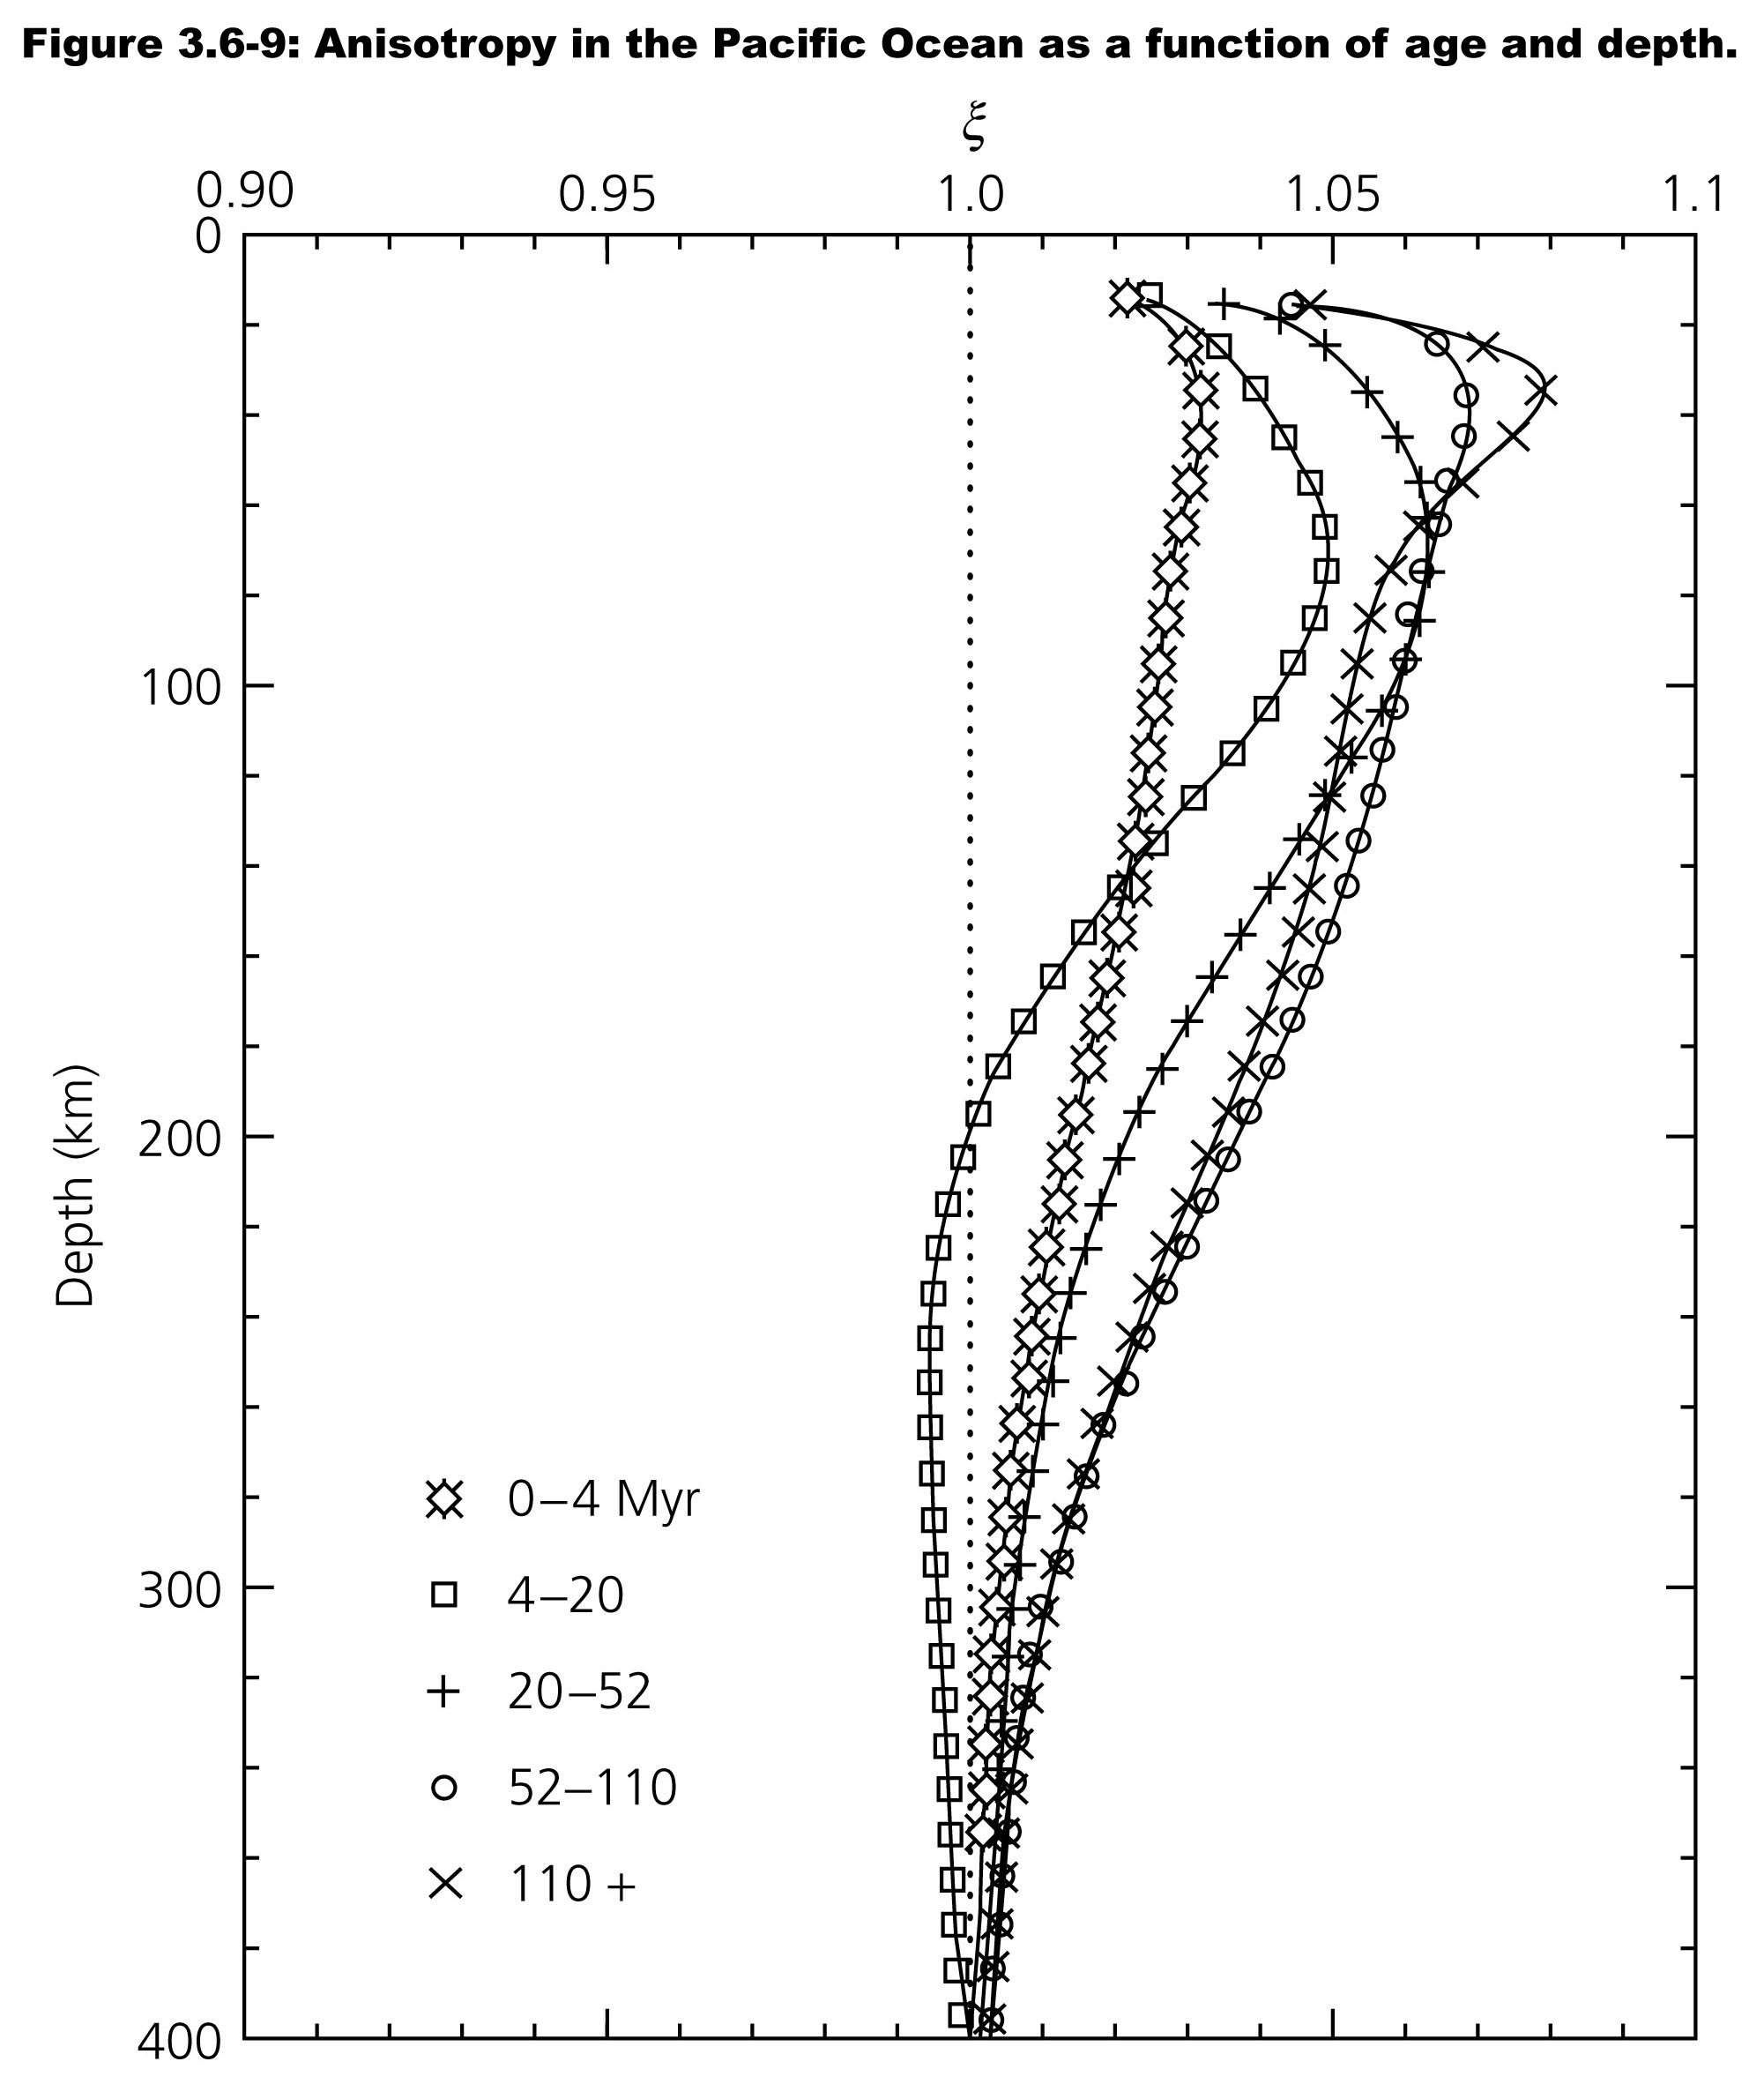
The depth and age
dependence of
anisotropy in the
oceans also lends
insight into physical
processes…
Important to note, for
interpreting this signal,
that the direction and
magnitude of
anisotropy reflects an
integral of the strain
history of the rocks!

Slide 12
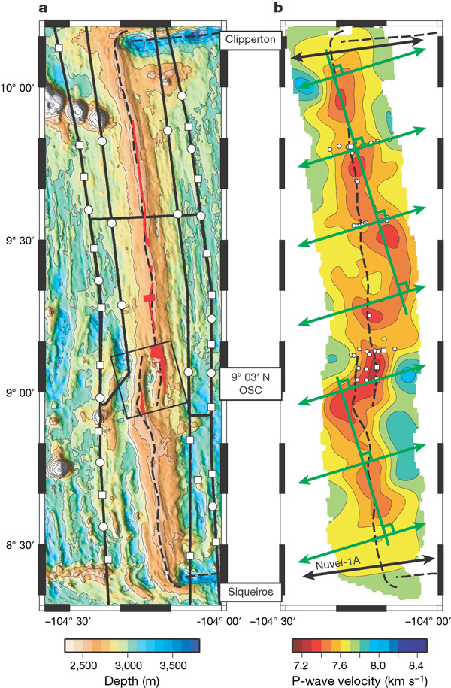
Data from the East
Pacific Rise tell a more
complicated (and more
interesting) story…
With significant implications for
active- vs passive-components
of the flow dynamics in oceanic
spreading centers (not to
mention segmentation of
ridges, and the bathymetry
and melt chemistry variations
along a mid-ocean ridge…)
Toomey et al. Nature 2007

Slide 13
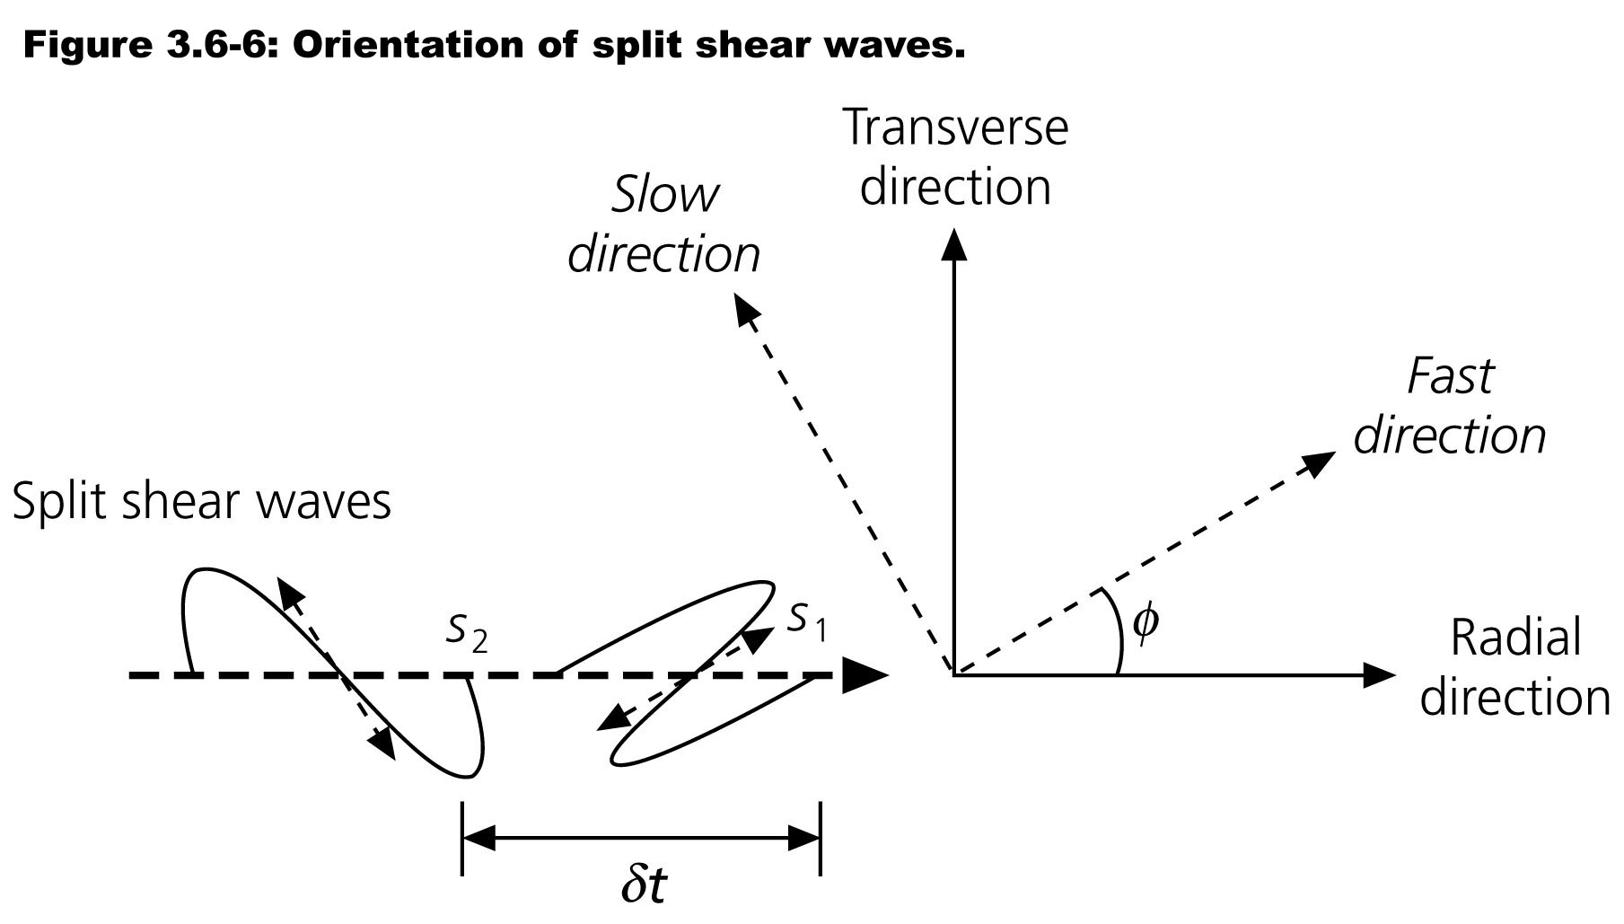
Shear Wave Splitting is commonly-used to identify
azimuthal anisotropy. Given initial signal s(t) on the radial
component only of the SKS arrival & angle φ between radial &
fast directions,
Radial:
Transverse:
Note that in an isotropic
medium one wouldn’t
get a transverse
component SKS
arrival; only radial!
but anisotropy “splits”
the arriving energy in
components ⊥ & || to
the anisotropy axes.

Slide 14
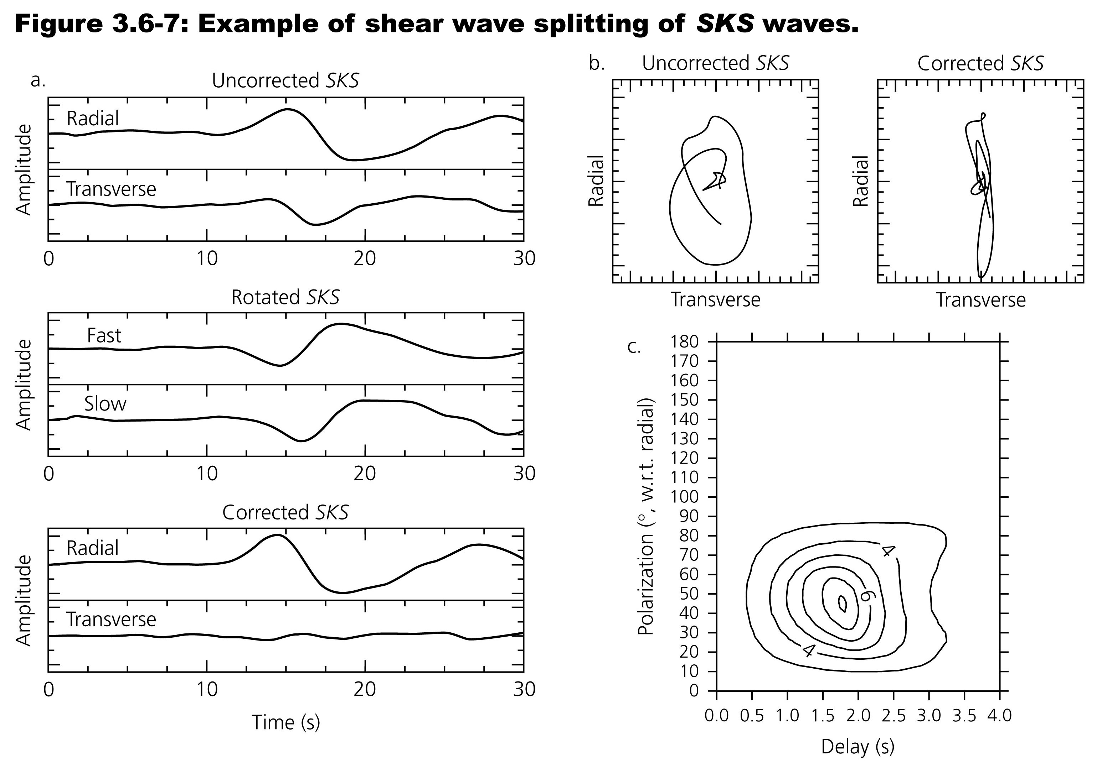
In practice, try lots of rotations and δt’s to find which maximizes
the predicted (original, pre-splitting) radial component of amplitude.

Slide 15
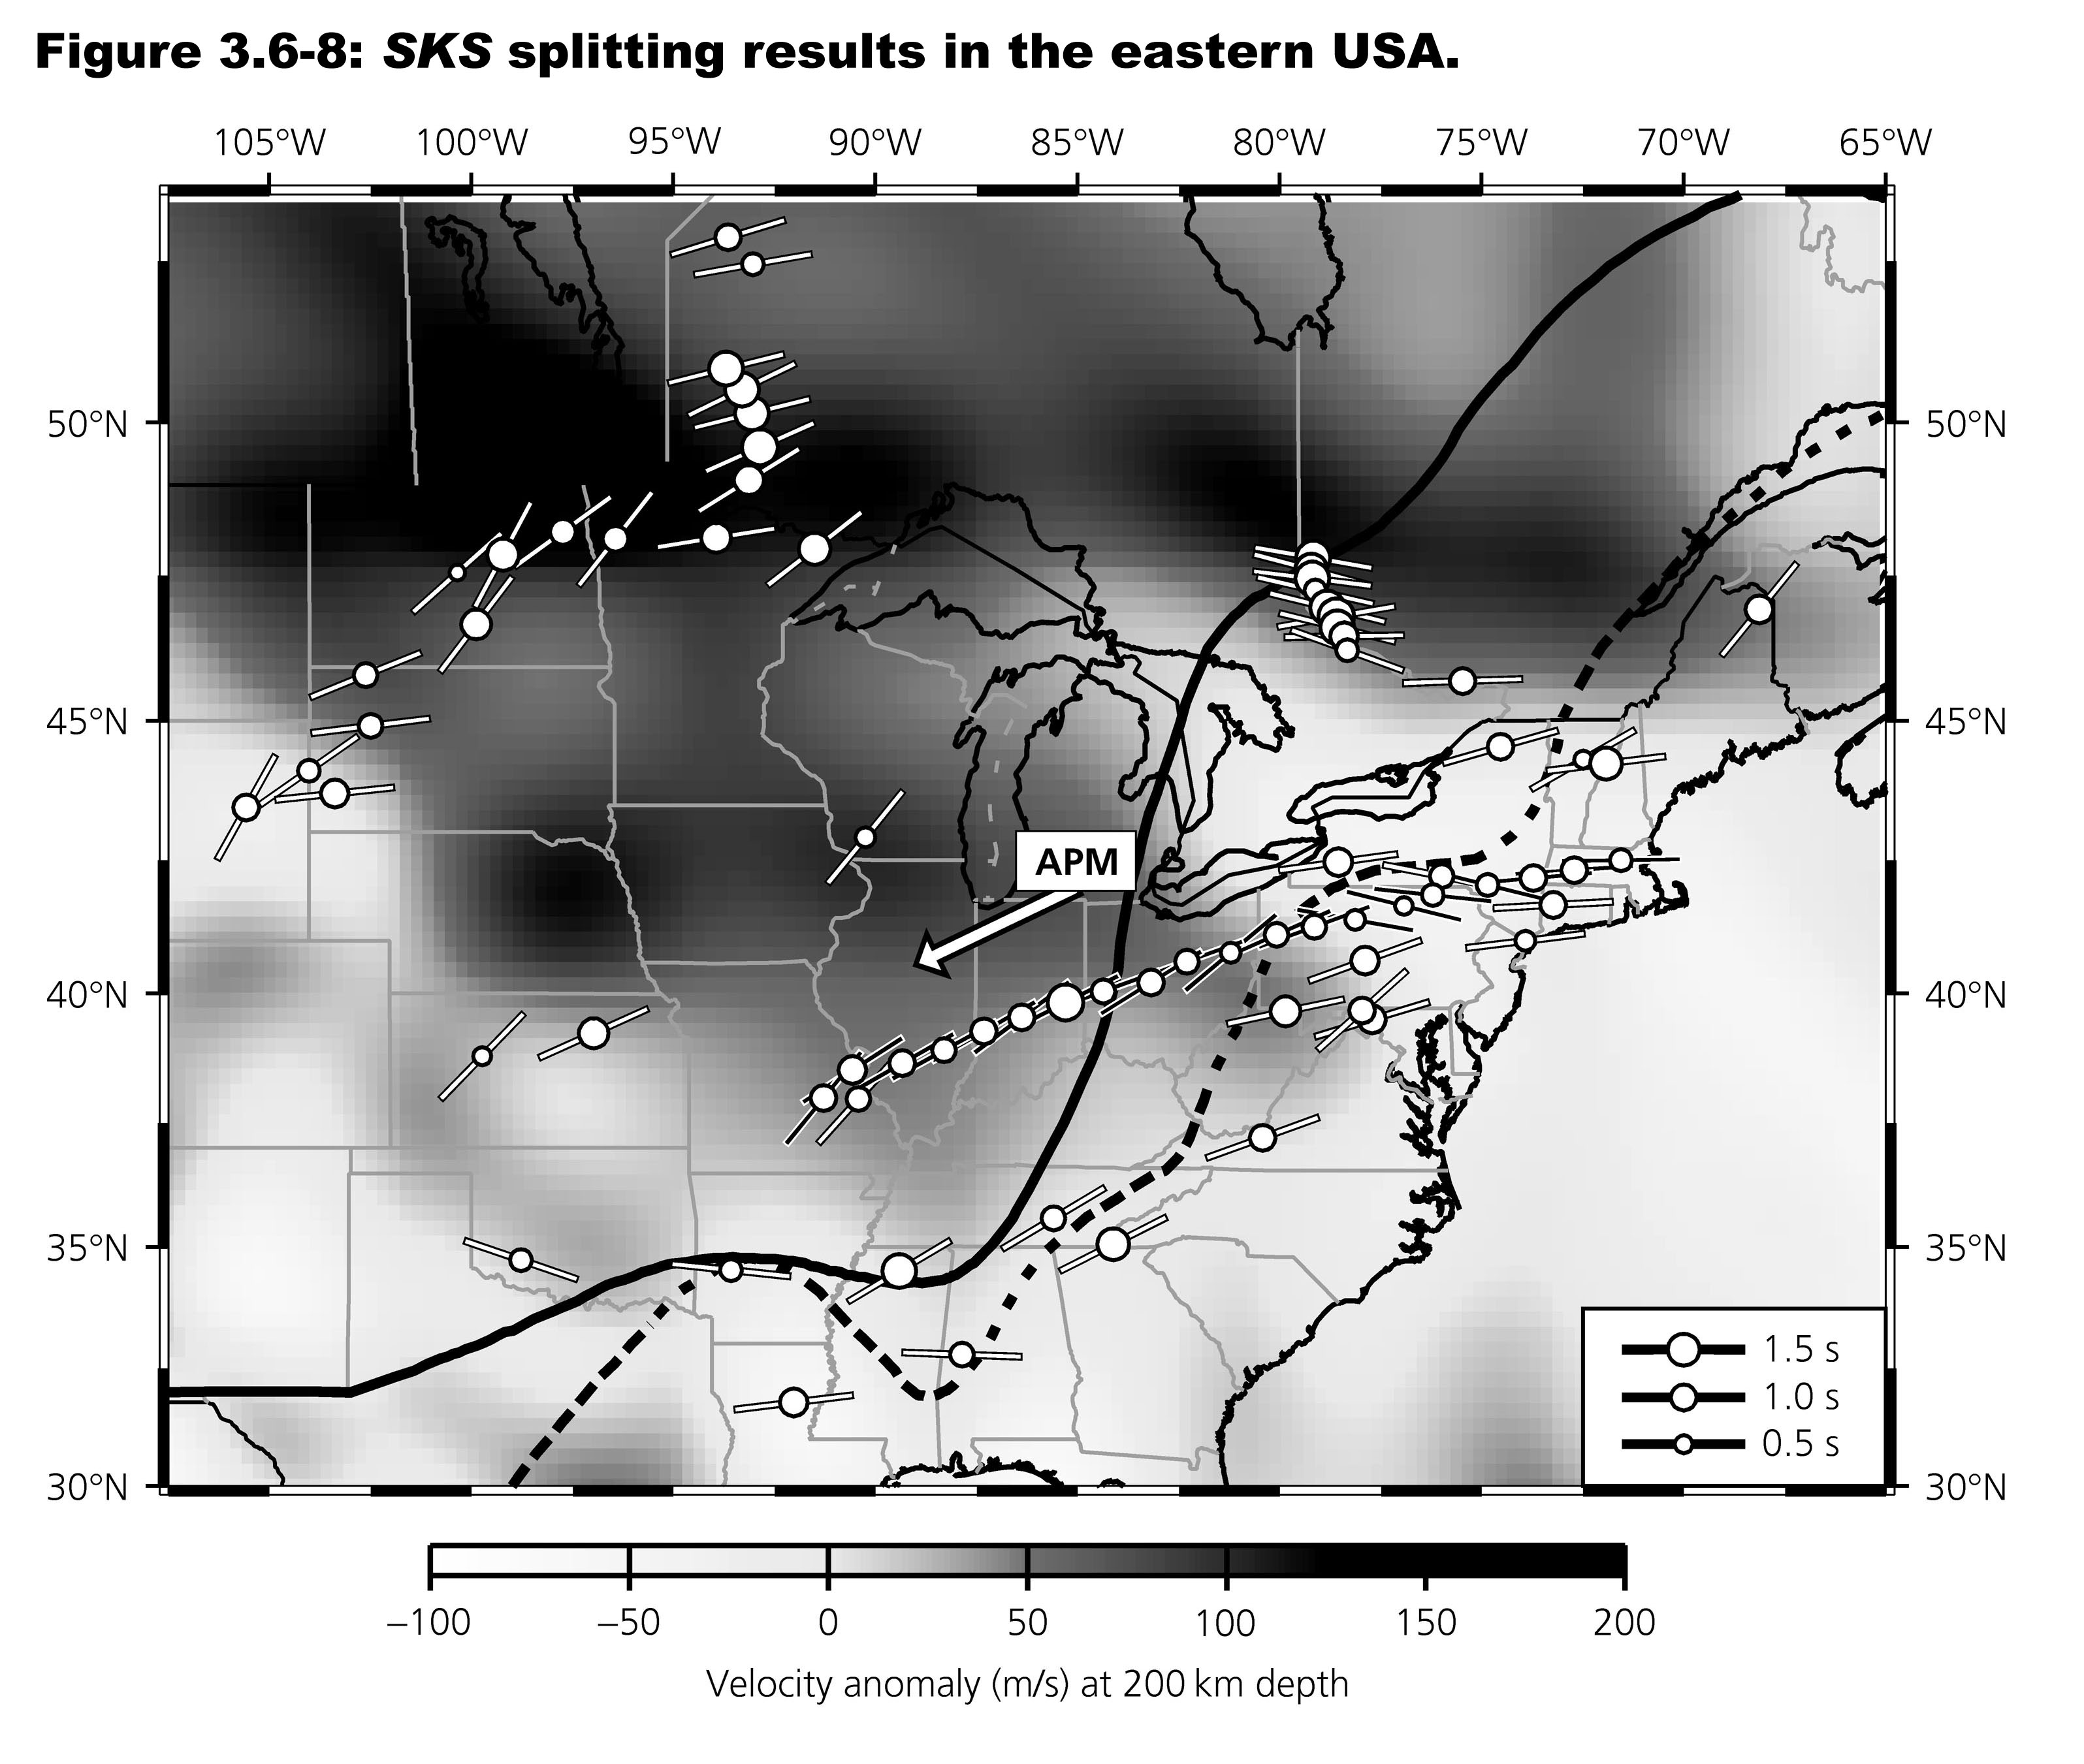
Note φ
gives you
the fast
direction;
δt
describes
thickness
times δv!

Slide 16
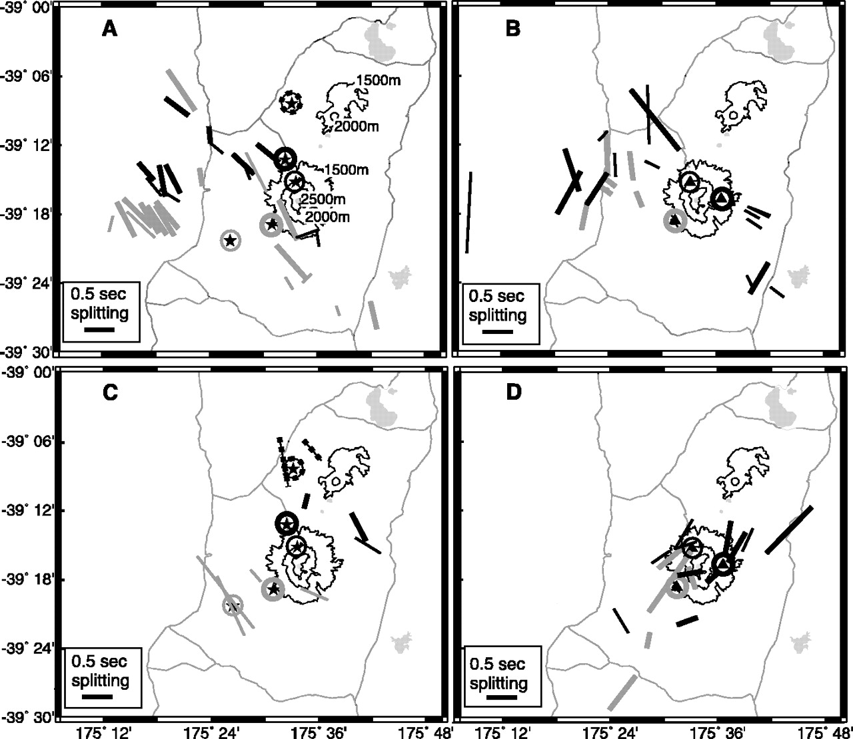

1994, <30 km
1998, <30 km
Time-
varying
anisotropy
has been
observed
e.g. before
and after
a 1996
eruption
of Mount
Ruapehu
in New
Zealand…
1994, >50 km
1998, >50 km
Miller & Savage, Science, 2001

Slide 17
Attenuation and Anelasticity
Wave amplitudes depend on:
• Source energy
• Mode conversions or Transmissions/Reflections
at interfaces (i.e., Zoeppritz’ Equations)
• Geometric Spreading: As a wavefront propagates
from a finite source and encompasses a larger volume,
conservation of energy requires amplitude to diminish.
• Multipathing: Focusing and defocusing of waves
(analogous to mirages in the case of light).
• Scattering: Like multipathing, but this occurs when
velocity heterogeneities have wavelengths of the same
order as the propagating wave.
• Anelasticity: Elastic energy is converted to heat during
anelastic (unrecoverable) deformation.

Slide 18
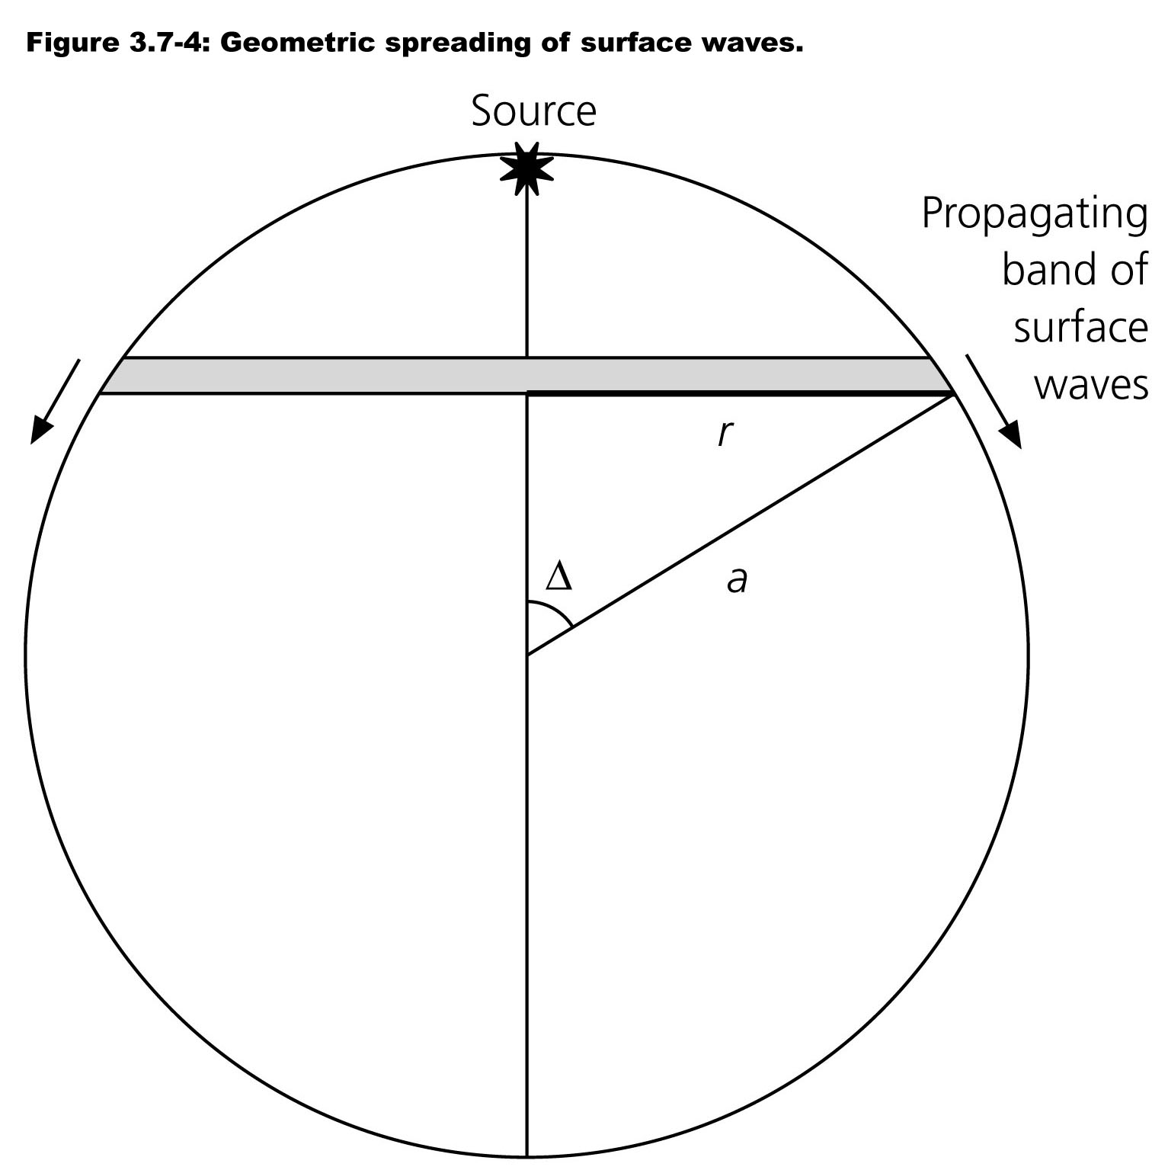
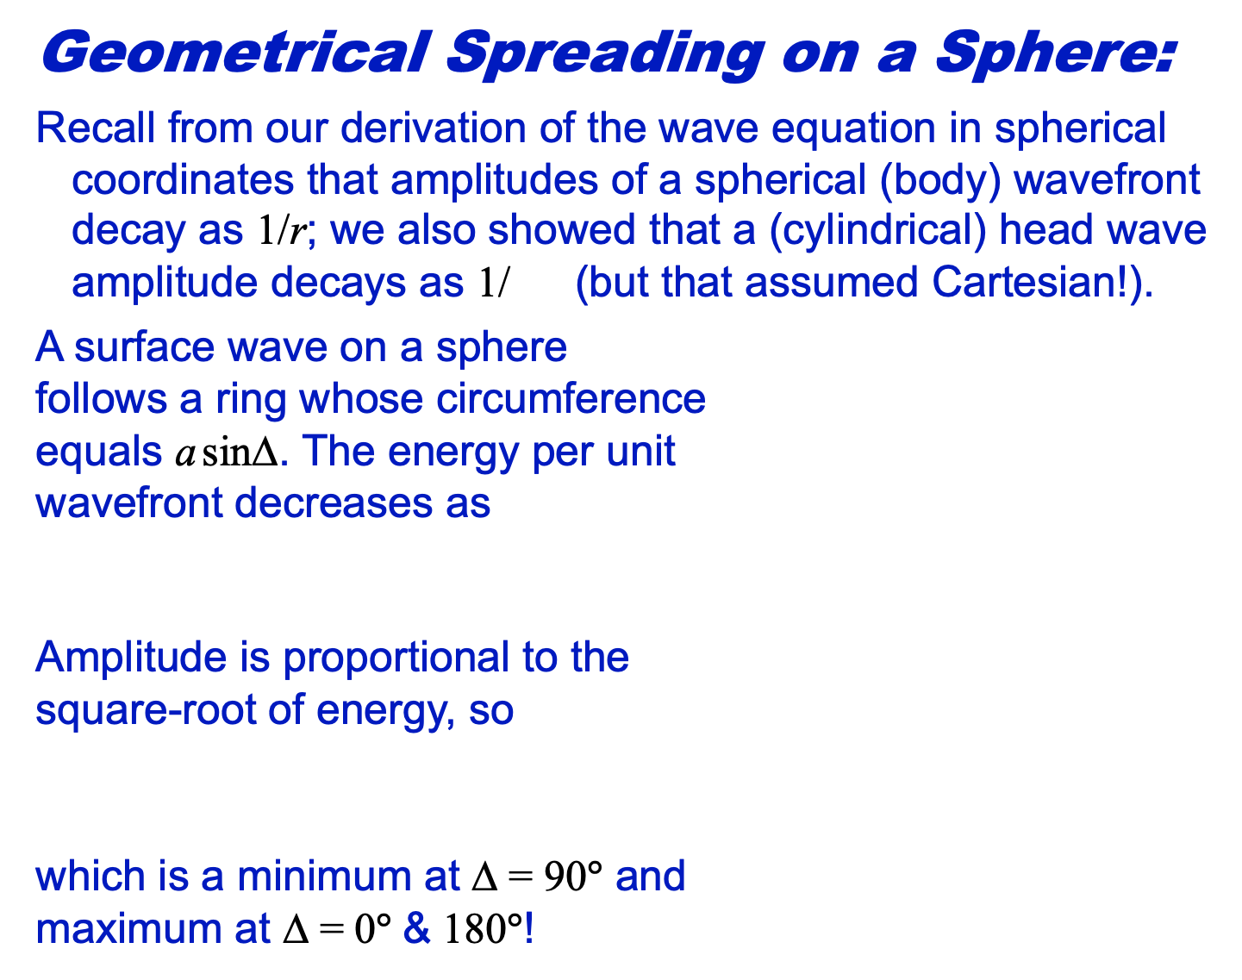
Geometrical Spreading on a Sphere:
Recall from our derivation of the wave equation in spherical
coordinates that amplitudes of a spherical (body) wavefront
decay as 1/r; we also showed that a (cylindrical) head wave
amplitude decays as 1/ (but that assumed Cartesian!).
A surface wave on a sphere
follows a ring whose circumference
equals a sinΔ. The energy per unit
wavefront decreases as
Amplitude is proportional to the
square-root of energy, so
which is a minimum at Δ = 90° and
maximum at Δ = 0$°$ & 180$°$!

