Slide 1
Geology 5640/6640
Introduction to Seismology
3 Oct 2024
Last time: Displacement Polarization
• Polarization of a wave describes the initial (“first-motion”)
displacement direction in a reference frame defined by the
wave propagation. S-wave displacements are in a plane
perpendicular to propagation.
• By convention, we separate S-wave displacements into SH
(horiz displacement ⊥ to propagation dir) and SV (“vertical”
component ⊥ SH and the propagation dir).
Read for Tuesday 8 October: S&W 62–75 (§2.5)
© A.R. Lowry 2011-2024

Slide 2
Last time continued: Seismic phases
• Seismic arrivals or phases are arrivals of seismic energy
in a seismogram that traveled by a specific travel path and
are labeled according to that path (e.g. SKS). They are
identifiable by their arrival times as a function of distance
from the source event.
• They are also distinguished by their directions and
amplitudes: e.g., the Raleigh wave has large amplitude in
radial/vertical; the Love wave only in the transverse
horizontal component; and SKS in the radial horizontal
component.

Slide 3
Assignment 1
is now posted on the course website…
Along with other materials you’ll need.
Due Tuesday, 15 October at 9:00 am

Slide 4
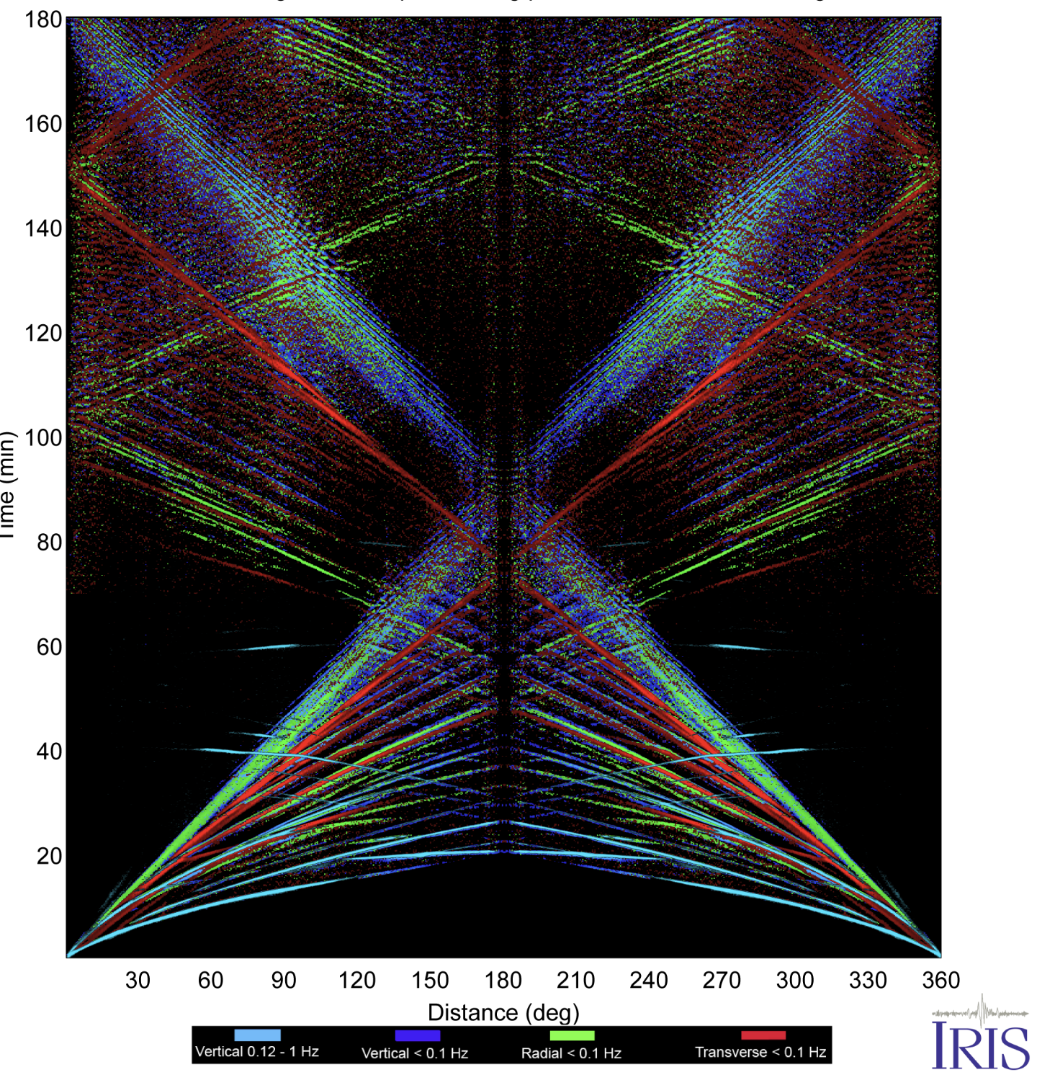
Seismic Phases are arrivals at a particular time and
distance from a source, implying a particular travel path:

Slide 5
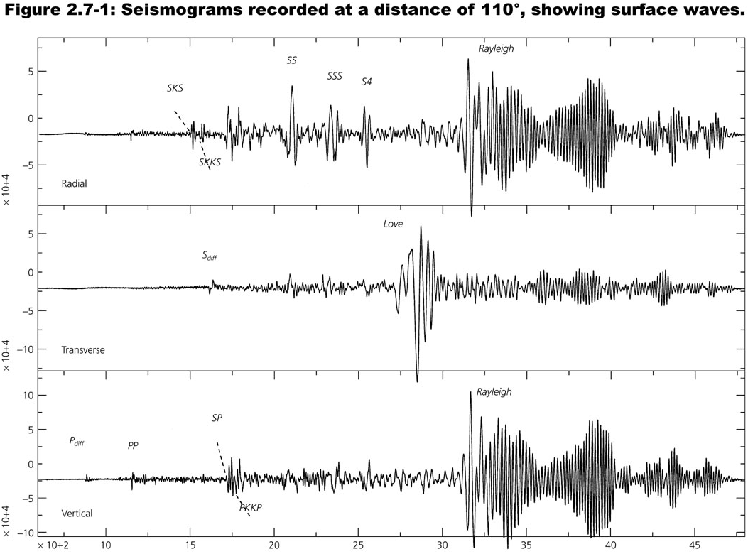
A typical seismogram: note different signals are observed
on different channels!

Slide 6
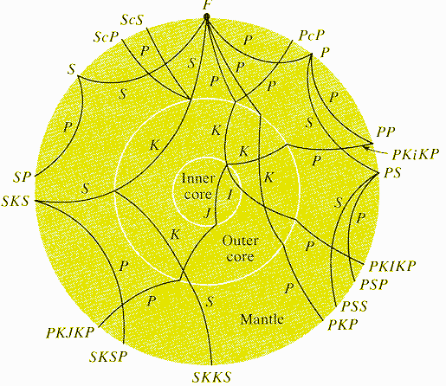
Ray Naming Conventions
P, S - P or S wave segments in the mantle
p, s - up-going energy from an earthquake
(not shown here)
K - P wave segment in the fluid outer core
I - P wave segment in the solid inner core
J - S wave segment in the solid inner core
c - a reflection off the core-mantle boundary
i - a reflection off the inner core boundary
Example: SKS—S-wave that converts to a P-wave in the outer core, then back to an S-wave when it leaves the outer core and travels up towards the seismometer.

Slide 7
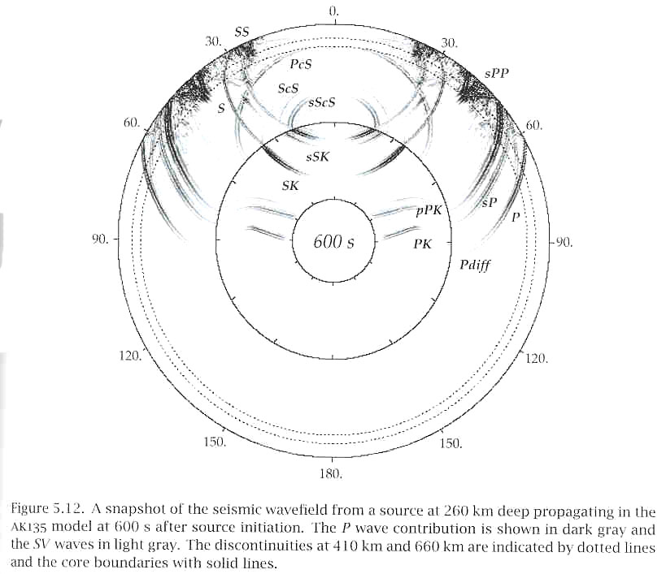
(More similar to what it really looks like:)
A ray is the normal to a propagating wavefront.

Slide 8
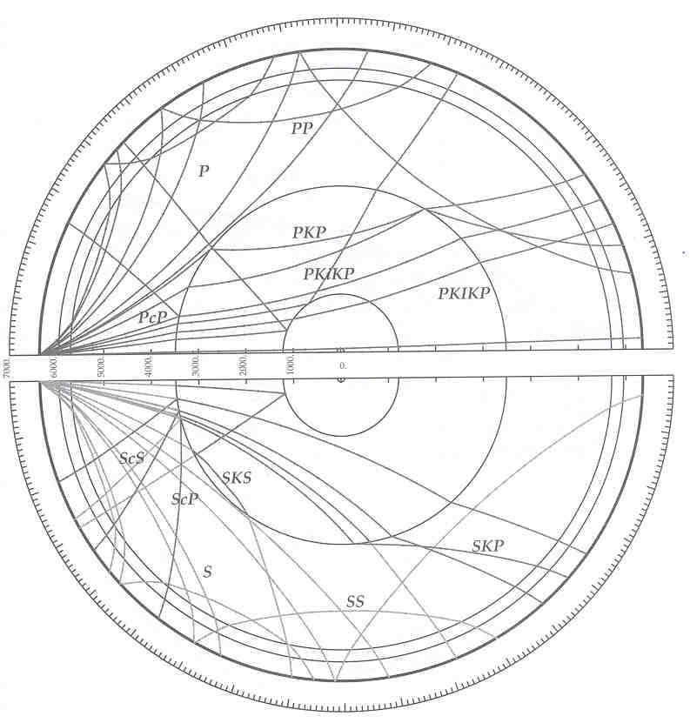
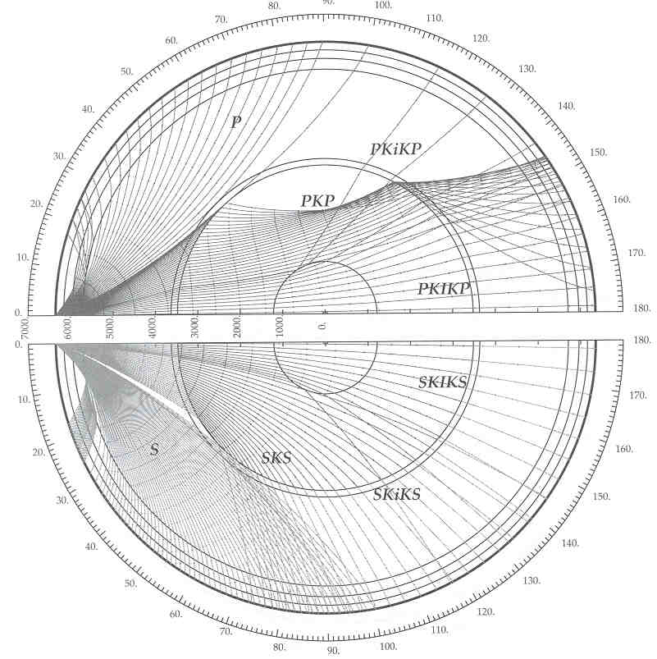
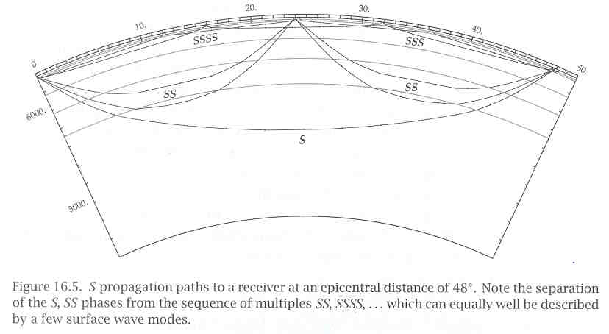
More
ray
paths…

Slide 9
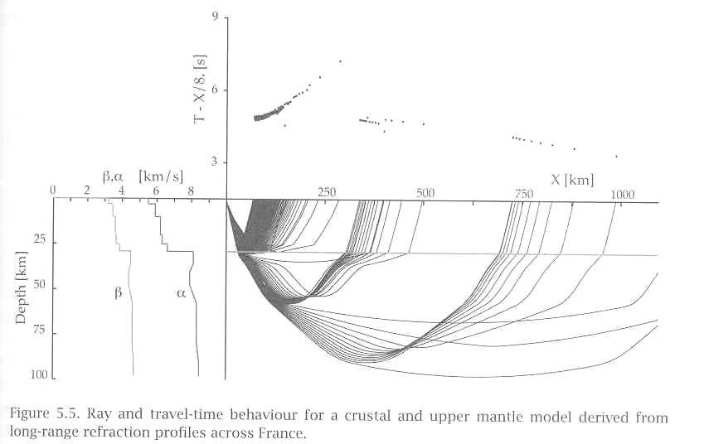
Ray paths in the upper part of the Earth (i.e. crust and upper
mantle near the “lithosphere-asthenosphere boundary”). Note
velocity decreases with depth here from ~ 35–40 km!

Slide 10
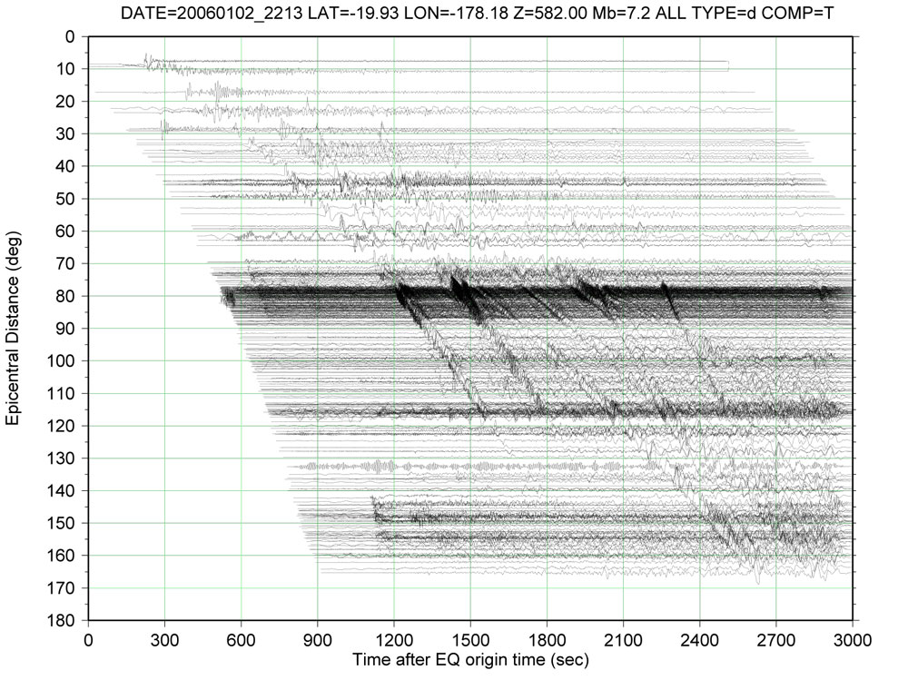
Time versus distance for seismic phases (a single event)

Slide 11
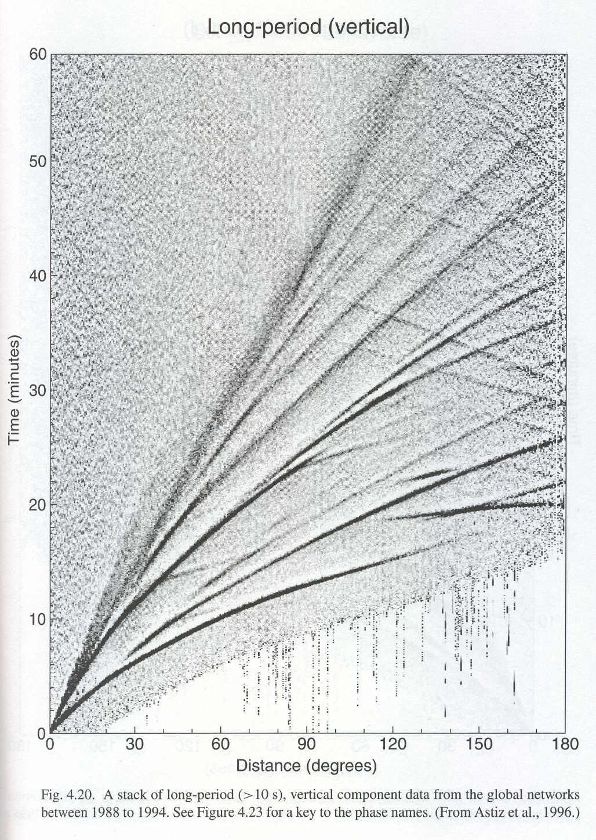
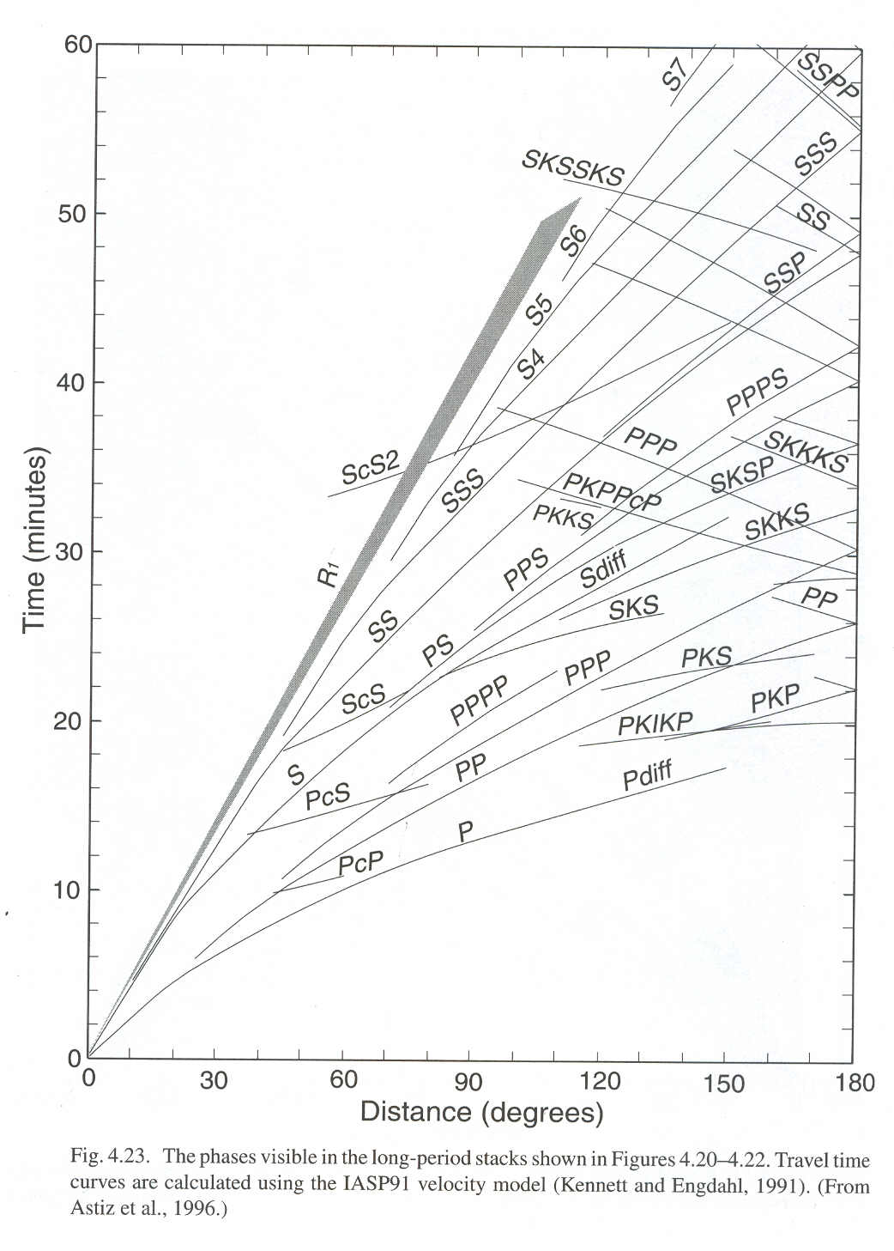

Slide 12
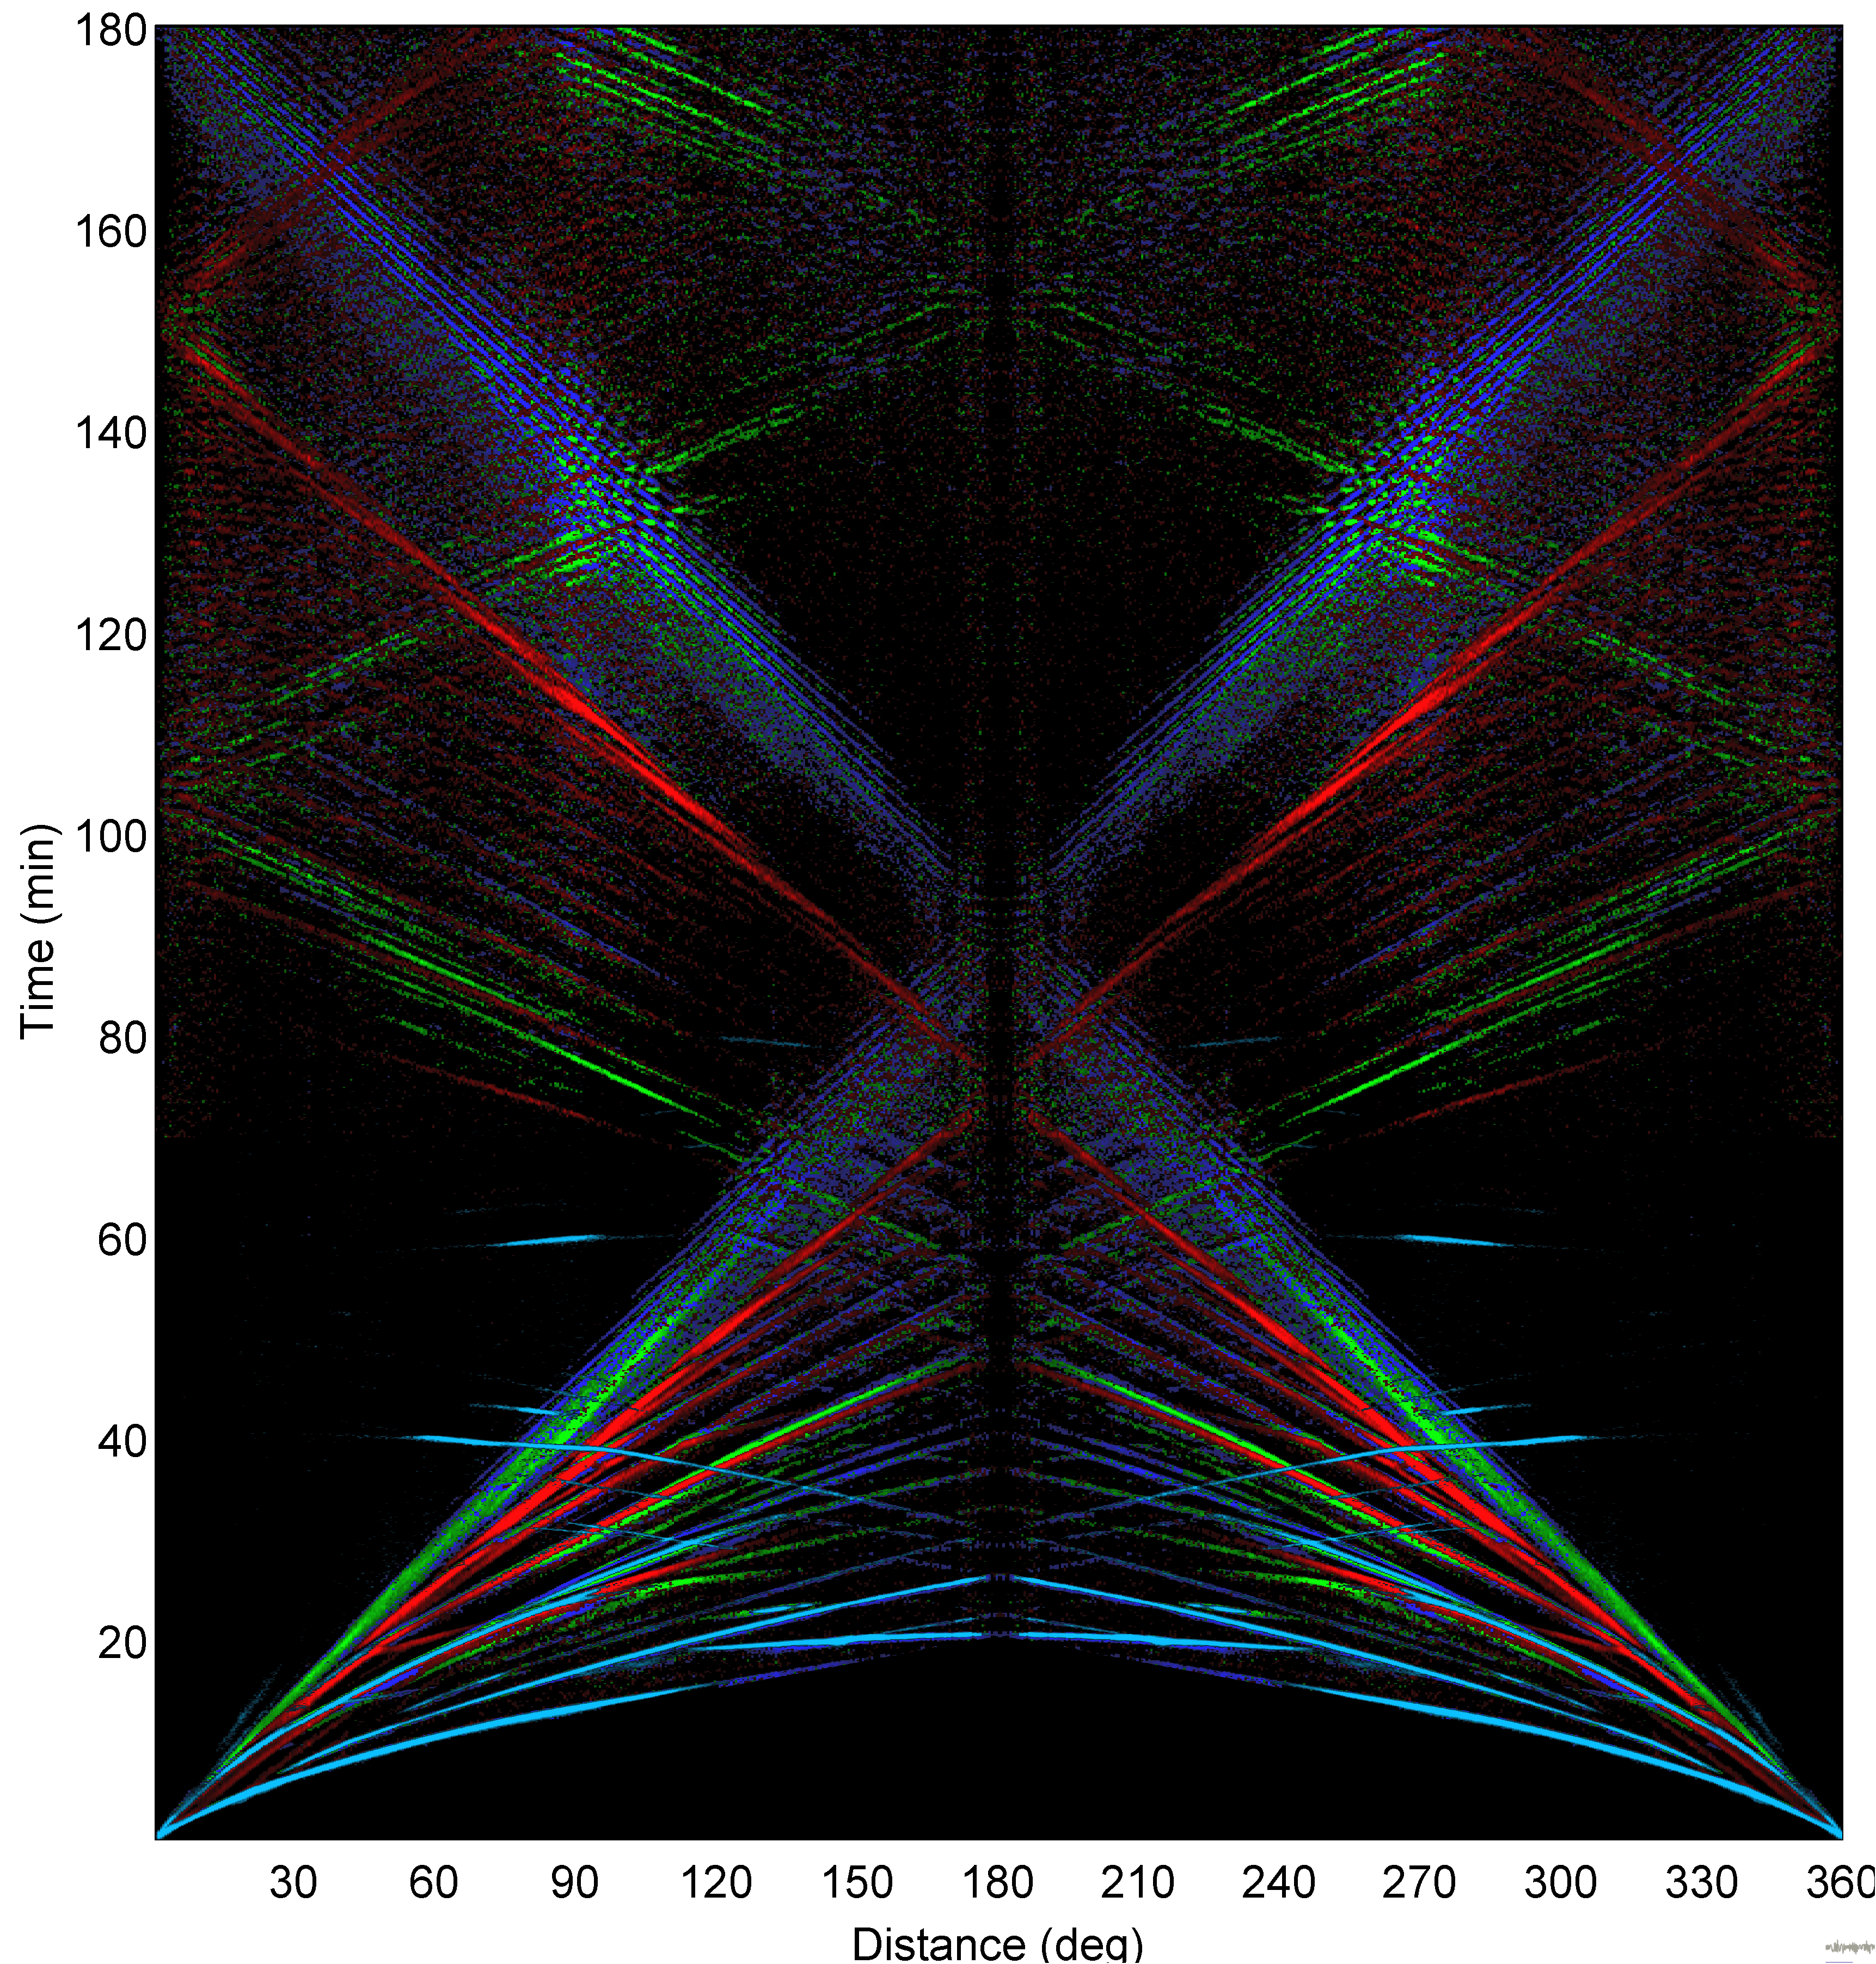

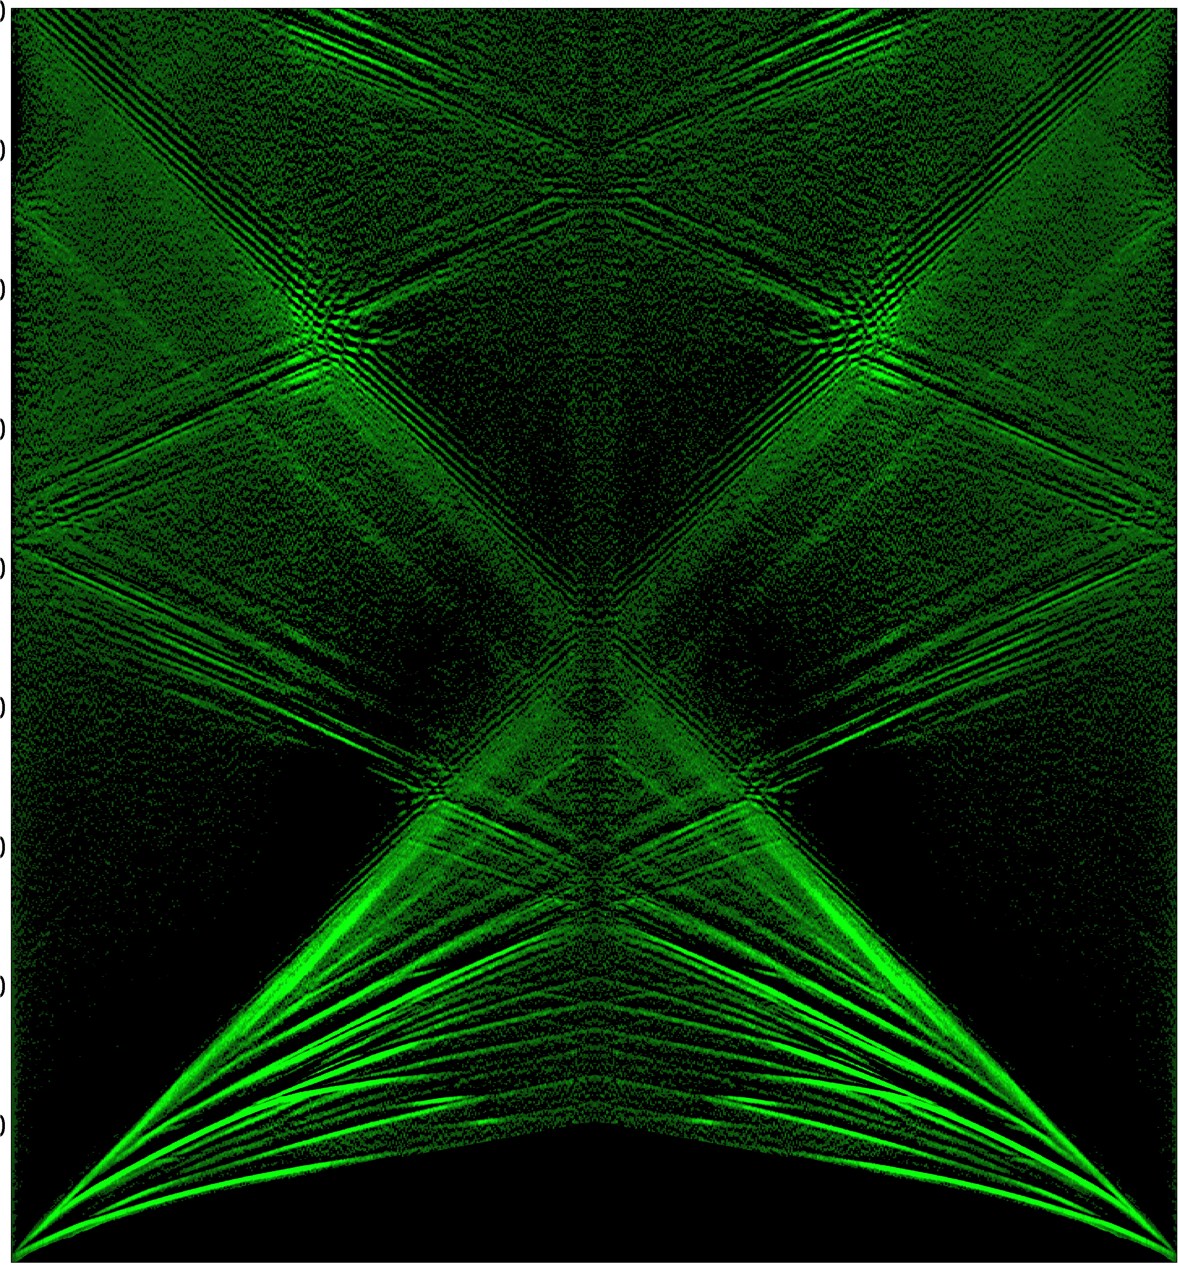
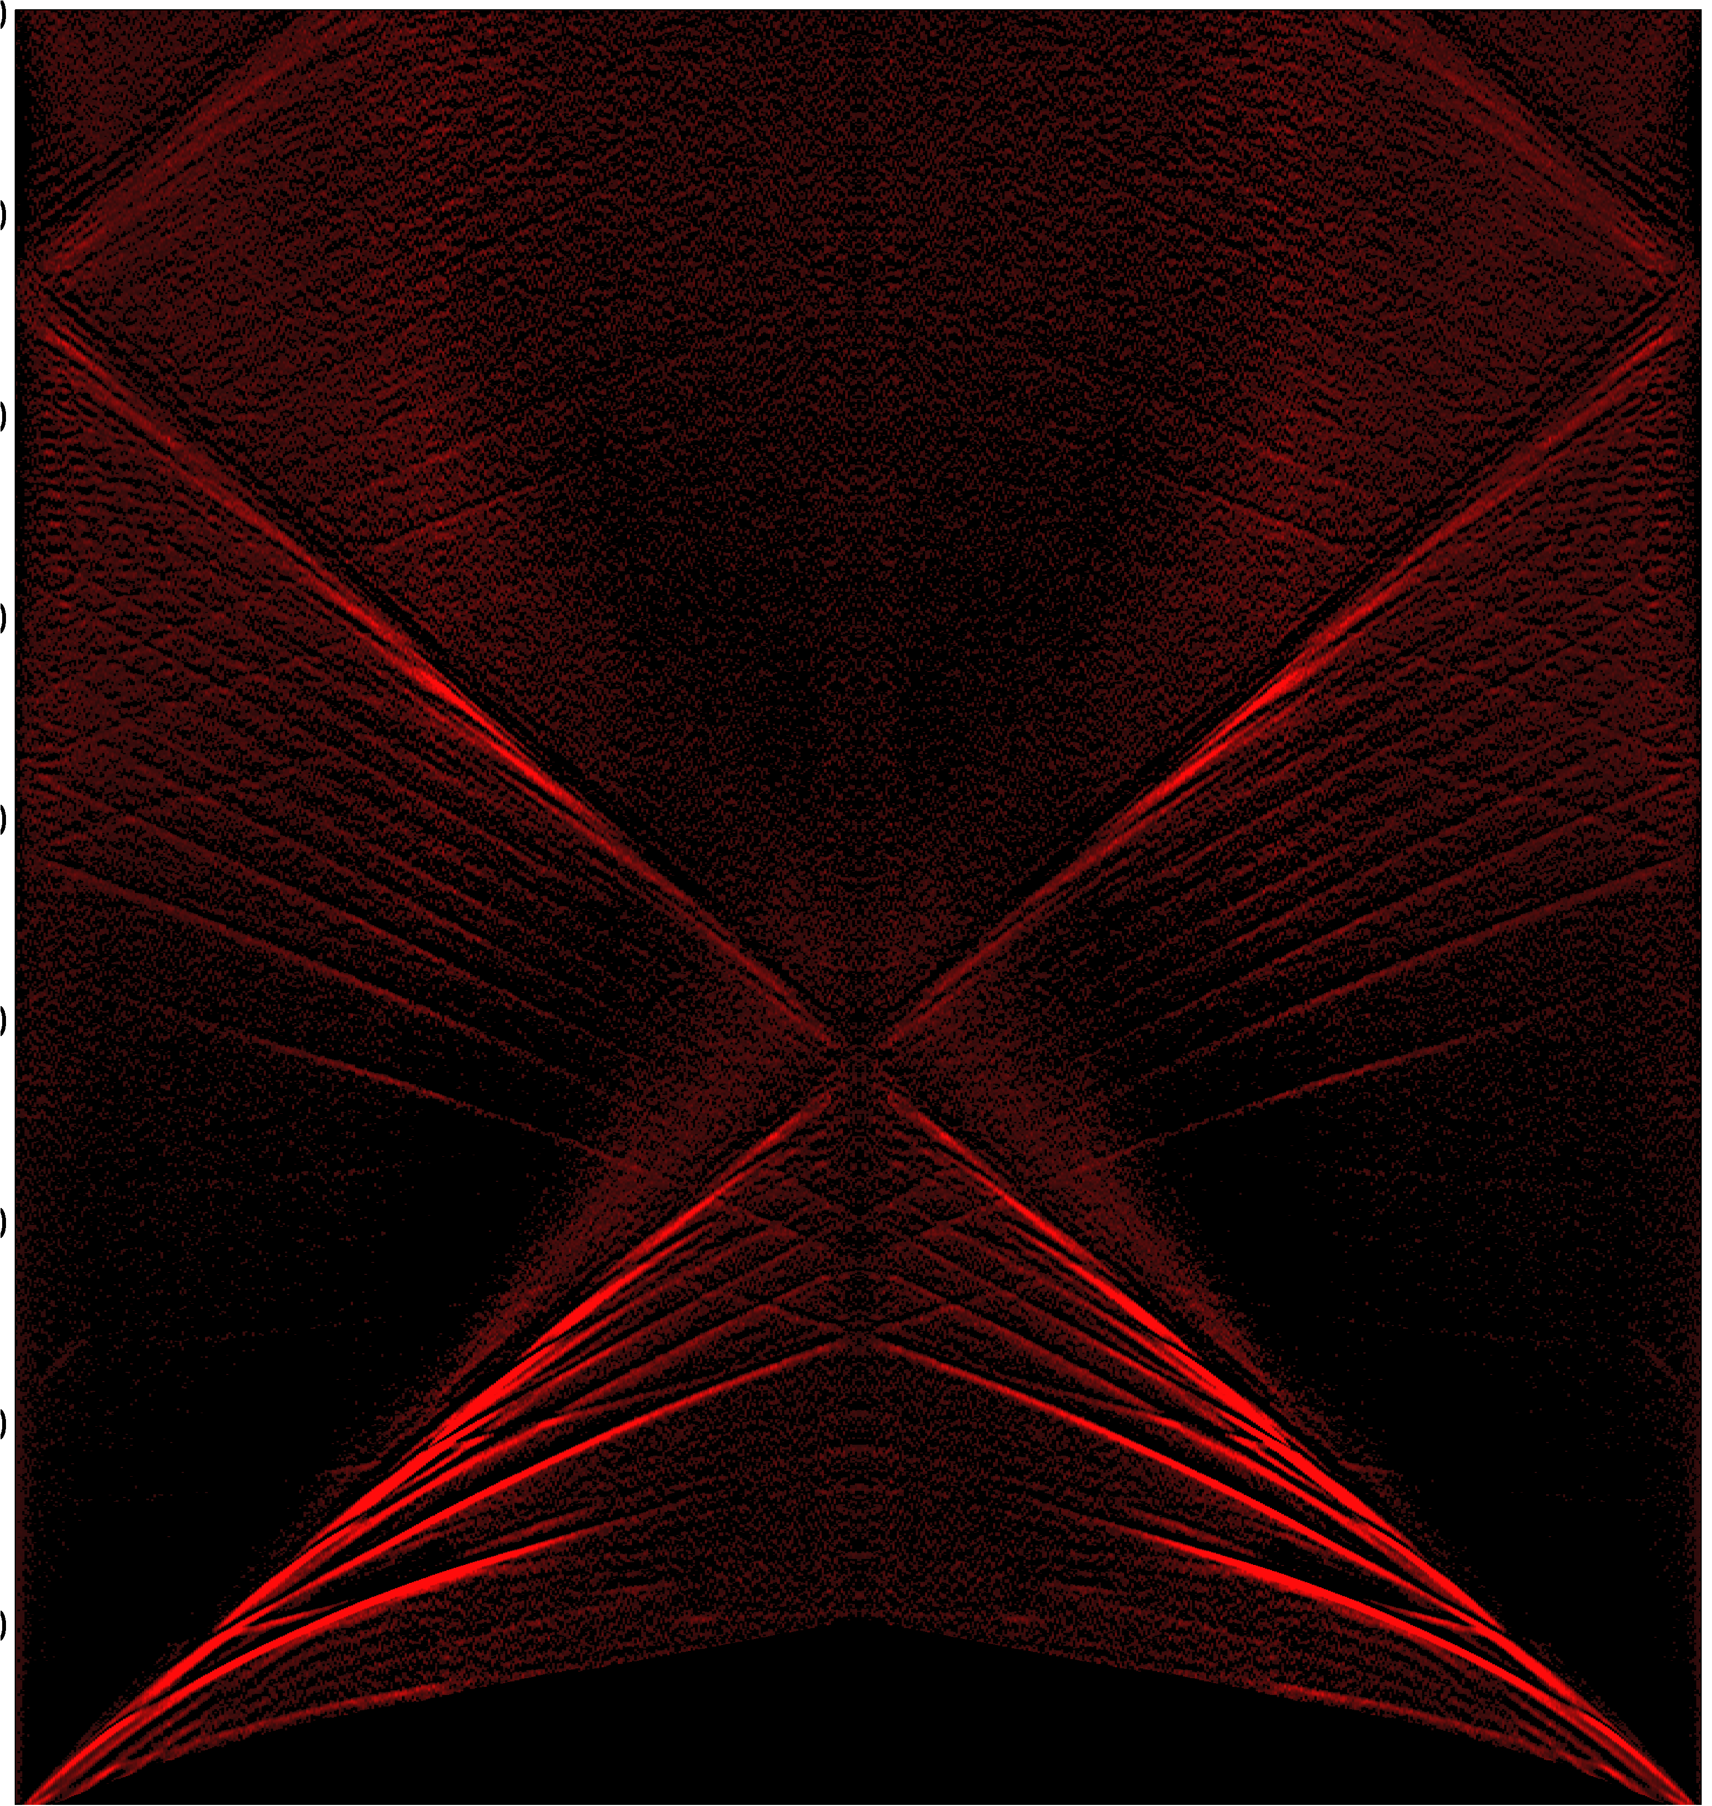
Vertical
All Events
Radial
From IRIS’ “globalstacks” data product
Transverse

Slide 13
The Ray Parameter:
is horizontal component of the
slowness vector; here θ is angle
from vertical.
Model: iasp91
Distance Depth Phase Travel Ray Param Purist Purist
(deg) (km) Name Time (s) p (s/deg) Distance Name
----------------------------------------------------------------
78.42 582.0 P 661.30 5.320 78.42 = P
78.42 582.0 PcP 667.71 4.365 78.42 = PcP
78.42 582.0 pP 783.24 5.745 78.42 = pP
78.42 582.0 sP 842.91 5.632 78.42 = sP
78.42 582.0 PP 849.12 8.184 78.42 = PP
78.42 582.0 pPP 948.77 8.533 78.42 = pPP
78.42 582.0 PPP 961.12 8.926 78.42 = PPP
78.42 582.0 PKiKP 991.08 1.538 78.42 = PKiKP
78.42 582.0 sPP 1014.64 8.428 78.42 = sPP
78.42 582.0 S 1210.59 10.354 78.42 = S
78.42 582.0 SKS 1219.66 6.936 78.42 = SKS
78.42 582.0 ScS 1228.49 8.159 78.42 = ScS
78.42 582.0 SP 1257.04 12.378 78.42 = SP
78.42 582.0 sS 1428.79 11.104 78.42 = sS
78.42 582.0 sScS 1460.15 8.064 78.42 = sScS
78.42 582.0 sSP 1461.76 13.035 78.42 = sSP
78.42 582.0 SS 1531.38 14.801 78.42 = SS
78.42 582.0 sSS 1715.18 15.253 78.42 = sSS
78.42 582.0 SSS 1740.68 15.739 78.42 = SSS
78.42 582.0 PKKP 1792.41 2.218 281.58 = PKKP
78.42 582.0 SSSS 1929.20 16.578 78.42 = SSSS
78.42 582.0 SSSS 1937.70 17.537 78.42 = SSSS
78.42 582.0 PPP 2334.08 4.560 281.58 = PPP
78.42 582.0 SSS 4296.14 8.677 281.58 = SSS
78.42 582.0 SSSS 4815.24 11.581 281.58 = SSSS
Identifying
Phases:
We can predict the
approx. arrival time of
various phases based
on a globally averaged
velocity model.
Then we can tag the
actual time in the
waveform where
amplitudes change
near the predicted
time.

Slide 14
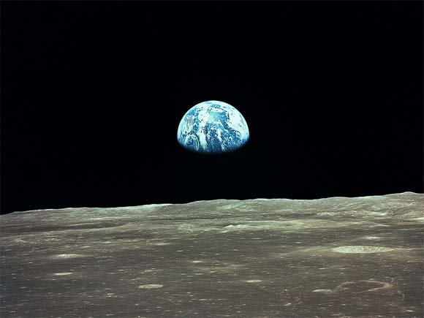

Earth as a laboratory sample…
• Compositionally complex and inhomogeneous
• Multiple phases (fluid, solid, gas!)
• Pressure and temperature are heterogeneous
• Produced by adiabatic gravitational self-compression
• Internal heat source
• Internal motion
• Largely intangible (spatially and temporally!)
Lars Stixrude

Slide 15

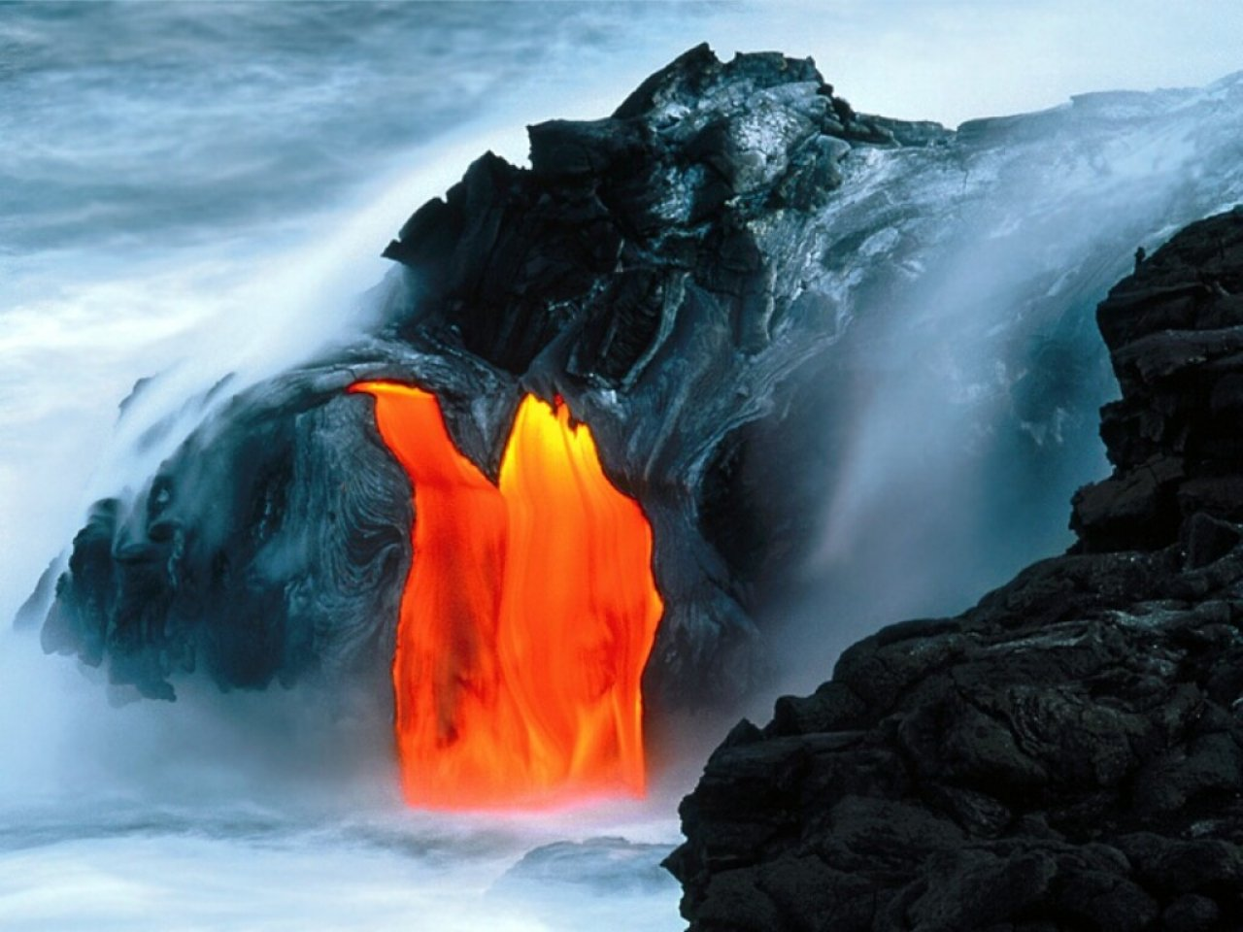
What would we like to know?
• How did it form?
• How did it evolve?
• How does it work today?
⇒ Processes
Earth is subject to various
thermal and mechanical
forcings throughout its
history
Response depends on
material properties at
extreme conditions!
Lars Stixrude

Slide 16
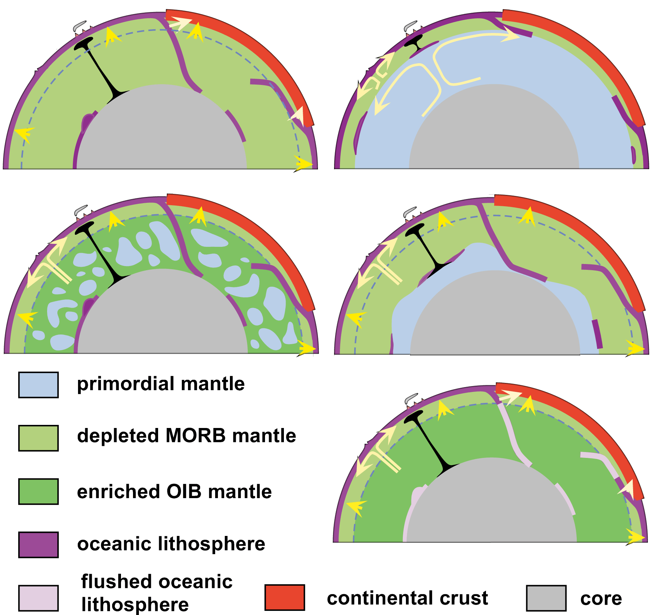
Data, models, hypotheses, and speculation from a number of geodisciplines have resulted in end-member models for flow in the mantle…
The Earth is not simply an onion made up of radially symmetric layers.
Albarede & van der Hilst (Eos, 1999)

Slide 17
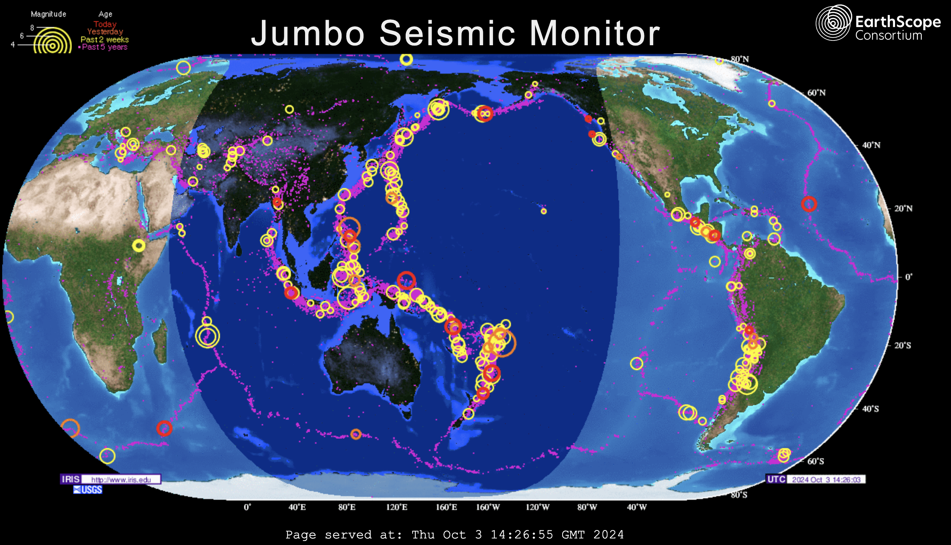
Remote Sensing using Earthquakes
Many earthquakes each year are strong enough to generate signal at antipodes:
10 major (magnitudes 7-8) 32+ megaton ~ Largest test
100 large (6-7) 1+ megaton
1000 damaging (5-6) 32+ kiloton ~ Trinity
Lars Stixrude
ds.iris.edu/seismon/index.phtml

