Slide 1
Geology 5640/6640
Introduction to Seismology
3 Sep 2024
Last time: Course overview
Seismology is a tool to investigate seismic sources:
• Earthquake physics! Recent source investigations show
that earthquakes commonly rupture multiple faults with
different orientations & focal mechanisms
• Other classical applications include nuclear test
verification & monitoring, magma transfer in volcanic
systems
• Increasingly used for investigations of environmental
processes: atmospheric storms, “icequakes”
• Also heavily used in industry applications: “rock-burst”
monitoring for mine safety, bit location in geosteering
of oil & gas well drilling…
Read for Thursday 5 September: S&W 1-28
© A.R. Lowry 2011-2024

Slide 2
Last time continued: Imaging applications
Seismology is used as a tool to investigate seismic
velocity & impedance structure:
• Seismic reflection imaging is the primary tool for
oil & gas industry subsurface exploration: images
changes in seismic impedance Z = ρV
• Also important for virtually all fundamental research
into structure and processes in the Earth’s interior
(velocity sensitive to composition, temperature, melts)
• And used for shallow site investigation (construction,
environmental, hydro resources)

Slide 3
Today: A brief review of seismology
concepts that may be familiar from
classes you’ve taken before:

Slide 4
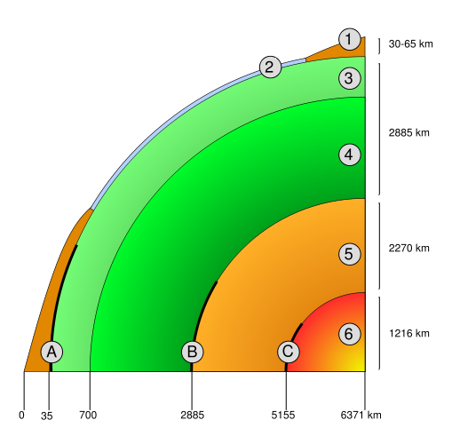
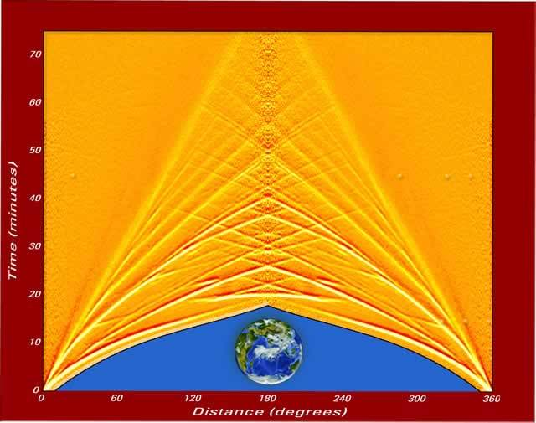
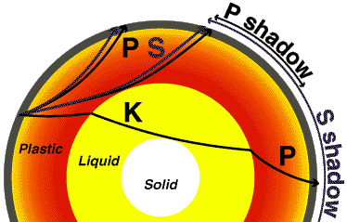
Most of what we know about the Earth’s deep
interior comes from seismology.
8-14 km/s
8-10 km/s
11 km/s

Slide 5
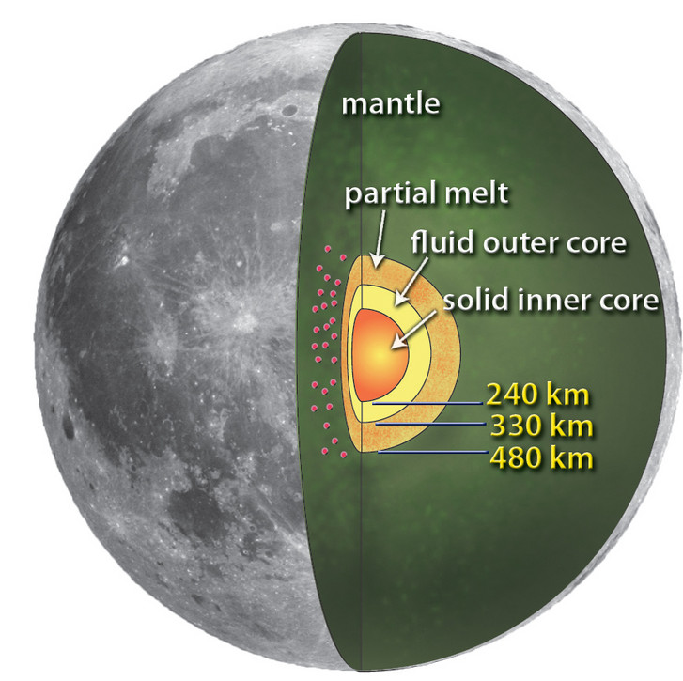
And not just
Earth!
Apollo-era
seismic data
demonstrate
the lunar
interior has
similarities
to Earth’s…

Slide 6
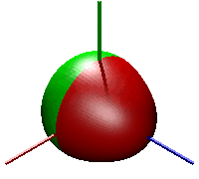
Seismology (A Brief Overview)
Four Important Types of Seismic Waves:
(1) P (primary) wave (Velocity V_{P} = 4 to 14 km/s)
(2) S (secondary) wave (V_{S} = 2/5 to 3/5 V_{P}, or 0)
(3) Surface Waves (Love, Rayleigh) V slightly < V_{S}
(4) Normal Modes (Resonant “tones”, like a bell…)
→ continue for months after largest earthquakes
→ periods of minutes to an hour
→ “standing waves”
}
Body
Waves
Animation ₀S₃ from Lucien Saviot
http://www.u-bourgogne.fr/REACTIVITE/manapi/saviot/deform/
₀S₃: (25.7 minutes)

Slide 7
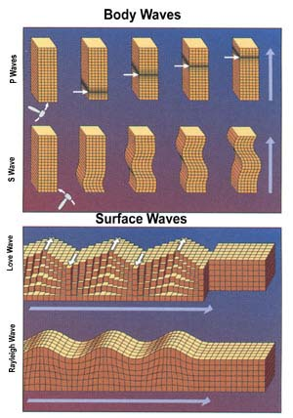
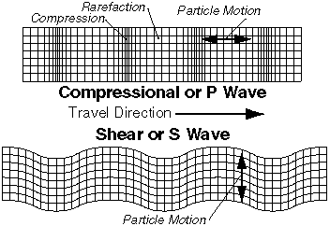
Rarefaction
Particle motion
Compression
P
Compressional or P Wave
Shear or S Wave
S
Particle motion
Surface (Love)
Surface (Rayleigh)

Slide 8

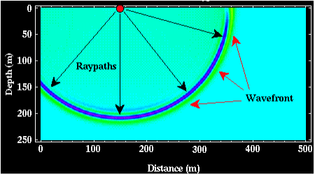
Seismic waves are strain waves
that propagate in a medium…
Common analogies use ripples in a pond, or light. There are
similarities in that all three are described by the wave equation.
Ripples & seismic waves similarly involve stress &
displacements that propagate as individual particles in the
medium oscillate between potential and kinetic energy states…
But, a major difference is rheology. Stress, displacement &
strain in a solid continuum are governed by Hooke’s Law,
a linear elastic relationship between stress and strain.

Slide 9
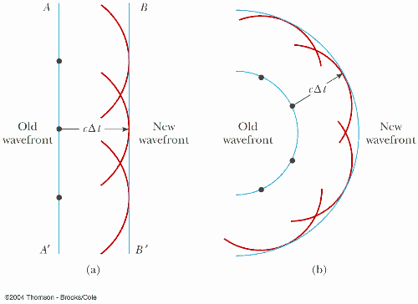
Despite the differences, similarities inherent in the
wave equation ⇒ many important principles can
be borrowed from optics.
One of these is Huygen’s Principle:
Every point on a wavefront can be treated as a point source
for the next generation of wavelets. The wavefront at a time
Δt later is a surface
tangent to the
furthest point on
each of these
wavelets. This is
because extremal
points of propagation
have the greatest
constructive
interference…

Slide 10
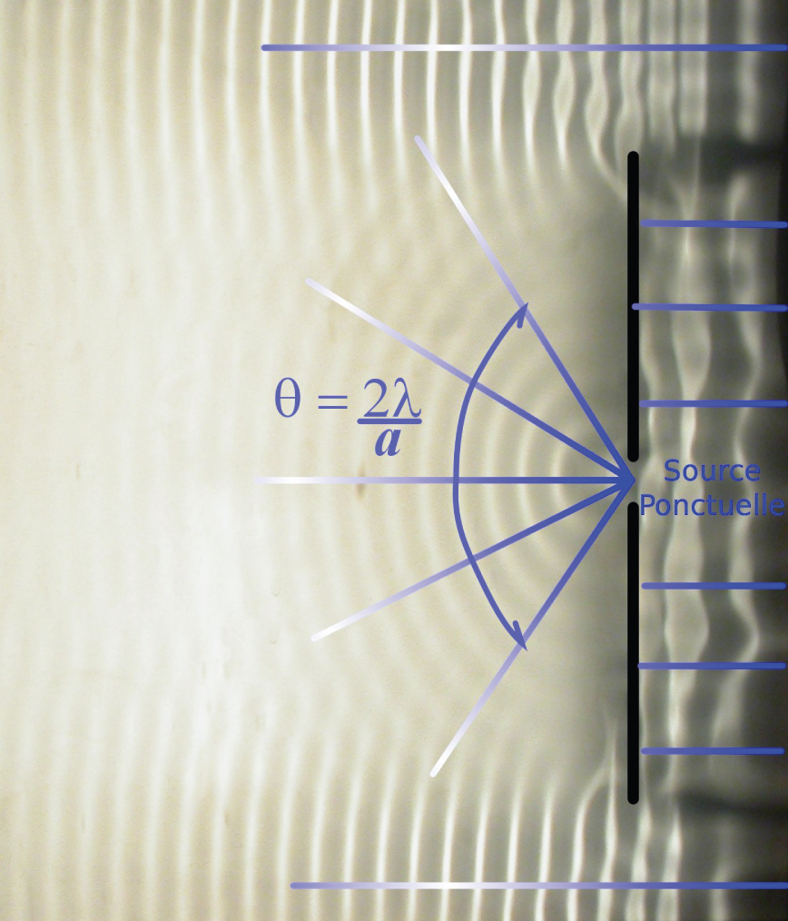
From Huygen’s Principle can also predict diffractions,
waves that don’t fit a ray-theory approximation (which
we’ll talk about, a lot,
later):
These waves are always
there but not generally
observed unless for
some reason part of
the destructively
interfering wavefield
is removed…

Slide 11
Diffractions are the energy we see continuing into
the P and S “shadows” in global phases...
8-14 km/s
8-10 km/s
11 km/s

Slide 12
Another concept from optics is Fermat’s Principle
(or the principle of least time):
The propagation path (or raypath) between any two points
is that for which travel-time is the least of all possible paths.
(Here a ray is the normal to a wavefront at any given time):
A key principle because most of our applications will involve
a localized source and observation at a point (seismometer).

Slide 13
Fermat’s principle leads to
Snell’s Law:
Travel-time is minimized when
when the ratio of sines of the
angle of incidence (angle
from the normal) to a velocity
boundary is equal to the
ratio of the velocities, i.e.,
V = fast
V = slow
•
least time in slow
θ
least time
straight line
•
least time in fast

Slide 14

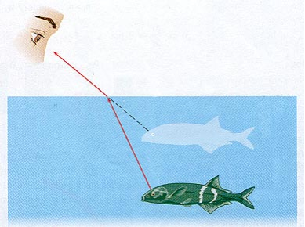
Spear-fishers understand Snell’s law intuitively, after
learning to always aim below the visual location of the
fish!
Reflection
Refraction
Important terminology: Refractions are transmitted waves
that bend at a change in medium; Reflections are bounces
off an interface that remain within the original medium.

Slide 15
Reflections & Refractions:
Consider that when a seismic wave meets a layer boundary
between solid media with different velocities V (= fλ = λ/T),
Energy E must be conserved
Stress σ must be continuous (i.e., the same on both sides)
Displacement u must be continuous
This is achieved by “partitioning” the energy between
reflections & refractions, and in most cases by converting
part of the energy from one type of wave to the other!
V₁
V₂
reflected P
refracted P
reflected S
refracted S
incoming P

Slide 16
Reflections & Refractions:
All of the reflected and refracted waves must obey
Snell’s Law. Consequently,
A reflected wave (traveling at the same velocity) will have the
same angle of incidence as the incoming wave.
A reflected or refracted wave traveling at faster velocity will
be bent toward the layer boundary.
A reflected or refracted wave traveling at slower velocity will
be bent away from the layer boundary.
reflected P
refracted P
reflected S
refracted S
incoming P

