Slide 1
Geology 5640/6640
Introduction to Seismology
4 Dec 2020
Last time: Anisotropy
• Anisotropy has added a great deal to our understanding of
mantle flow dynamics (e.g., evolution of depth and horizontal
component of ridge-related flow in oceans)
• Shear wave splitting measures polarization axis of fast
and slow directions of azimuthal S-anisotropy as well
as the time difference in polarized phases
• Deep shear-wave splitting fast directions usually align with
absolute plate motion direction; fast directions near
volcanoes are time-dependent!
Read for Mon 7 Dec: S&W 185-198 (§3.7)
© A.R. Lowry 2020

Slide 2
Last time: Amplitudes
• Amplitude effects include source, partitioning (refl/refractions),
geometrical spreading already covered…
• But geometry of a sphere results in amplitudes of surface
waves decreasing as (i.e., refocusing at
antipodes!)
• Multipathing describes the focusing and defocusing of
waves by ray-bending in a heterogeneous medium (e.g.,
basin amplification; unexpected amplitudes at the
critical distance for refractions…).

Slide 3
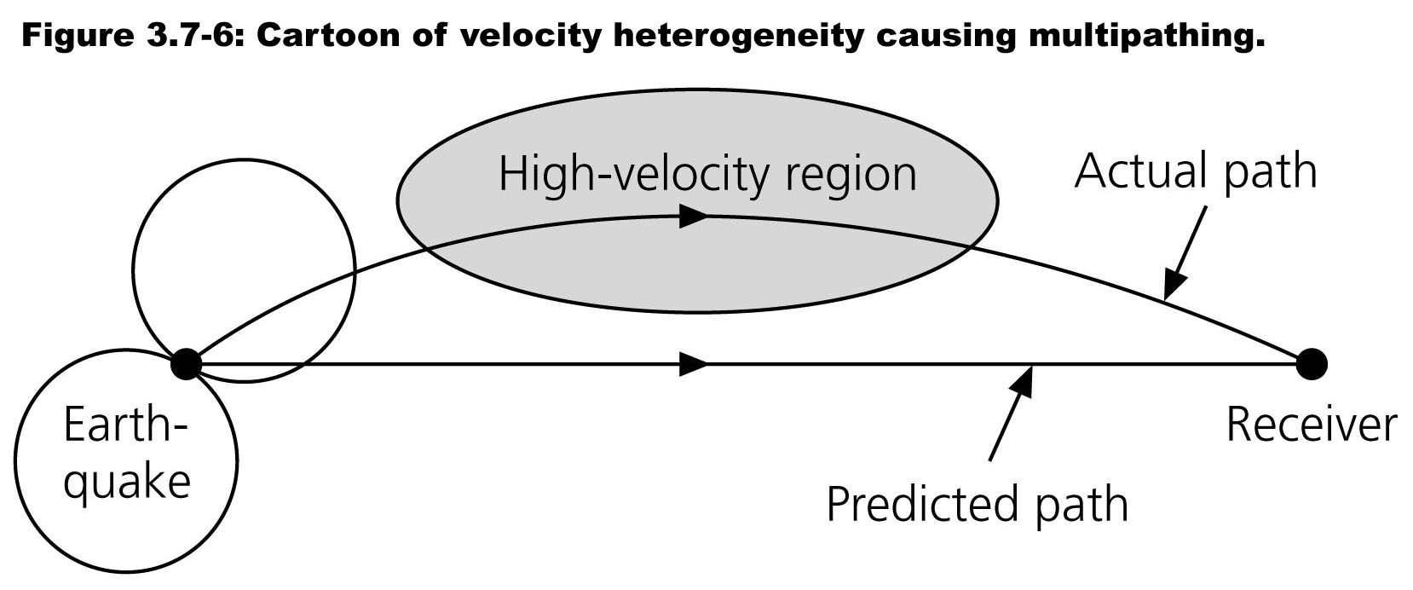
Multipathing:
Rays “prefer” high velocity regions (by Fermat’s Principle: The
fastest wins). Note also that this particular raypath was bent
back toward the receiver by the change in velocity properties.

Slide 4
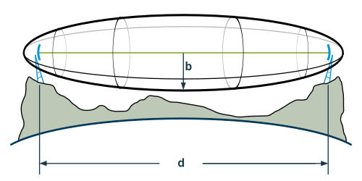
Multipathing:
Recall however that rays are idealizations of wavefront
propagation, valid only at infinite frequency.
To extend ray theory to finite frequencies, we can look at all
rays that come in within half a wave period of each other
(T/2), as these will constructively reinforce.
The volume encompassed by these raypaths is called a
Fresnel Zone.

Slide 5
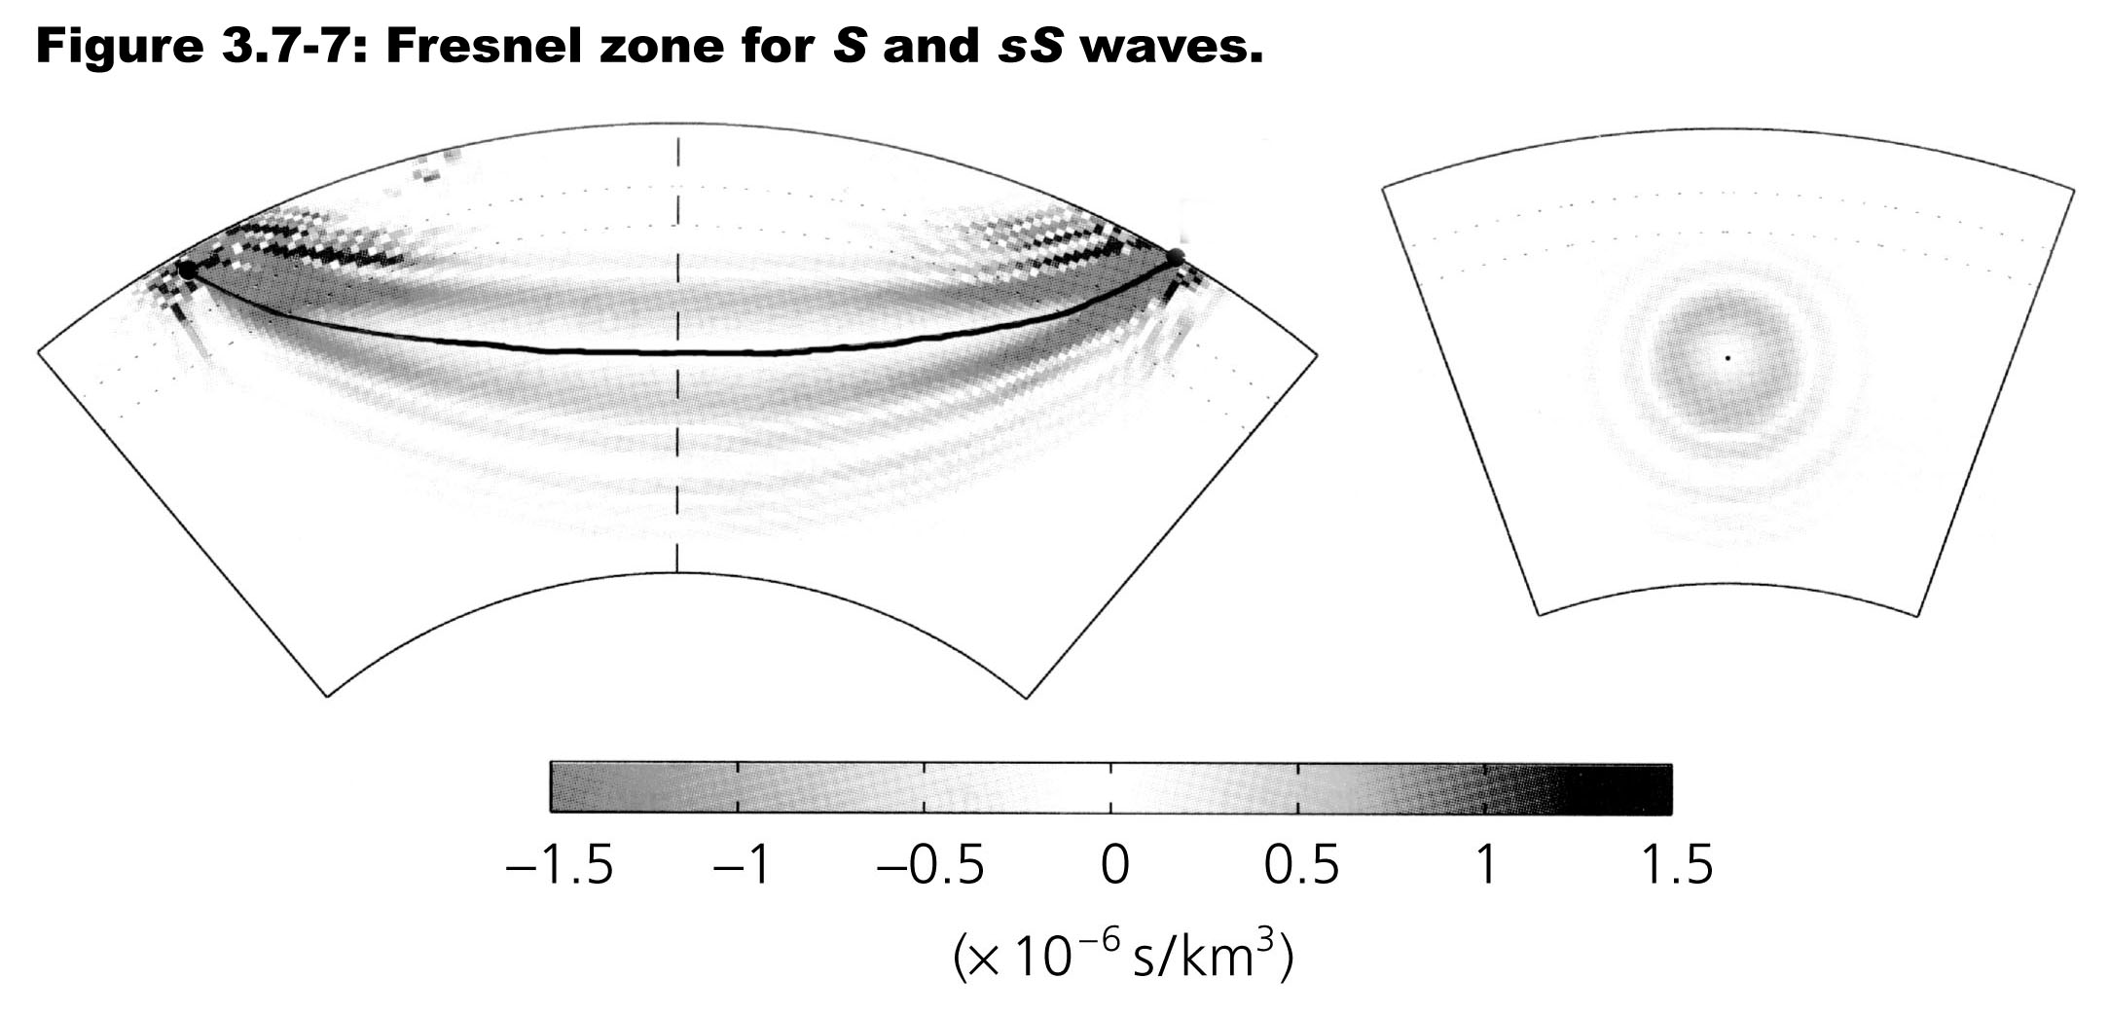
Multipathing:
For the layered Earth, where v = v(z), it gets a leetle more
complicated: We end up with annular rings of positive and
negative contributions to the total amplitude…
These are the so-called “banana-doughnut” kernels that
describe the effect of Earth structure on travel-time.

Slide 6
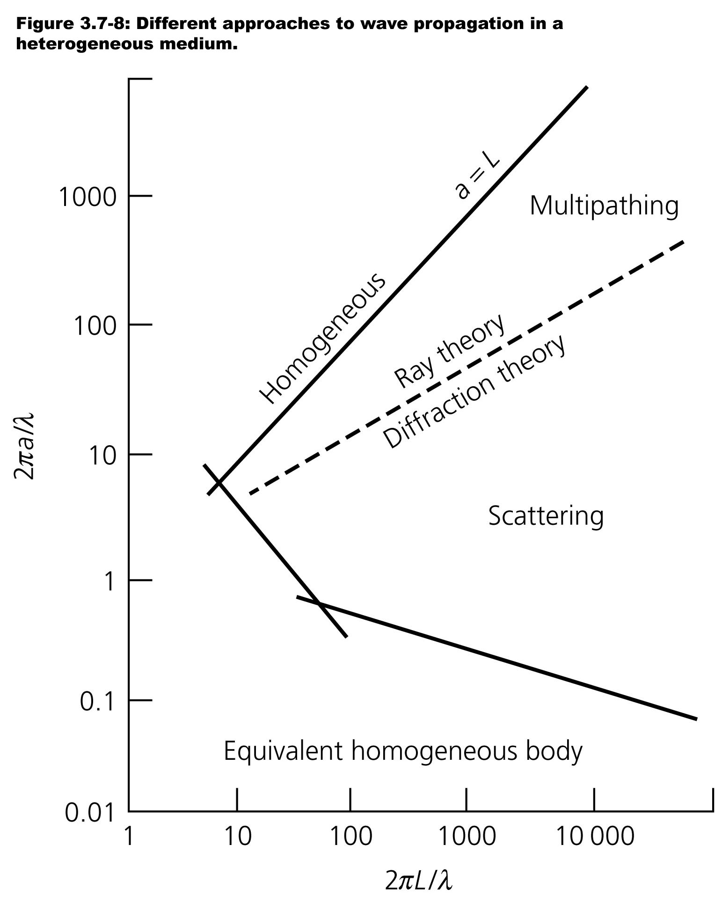
a is scale of the
heterogeneity;
L is distance
the wave
travels
Scattering:
Scattering occurs when
there are velocity
heterogeneities in the
medium with wavelengths
on the order of λ of the
wave. For seismic
propagation associated
with scatterers, ray theory
does not do very well
(much like it misses
on diffractions)….

Slide 7
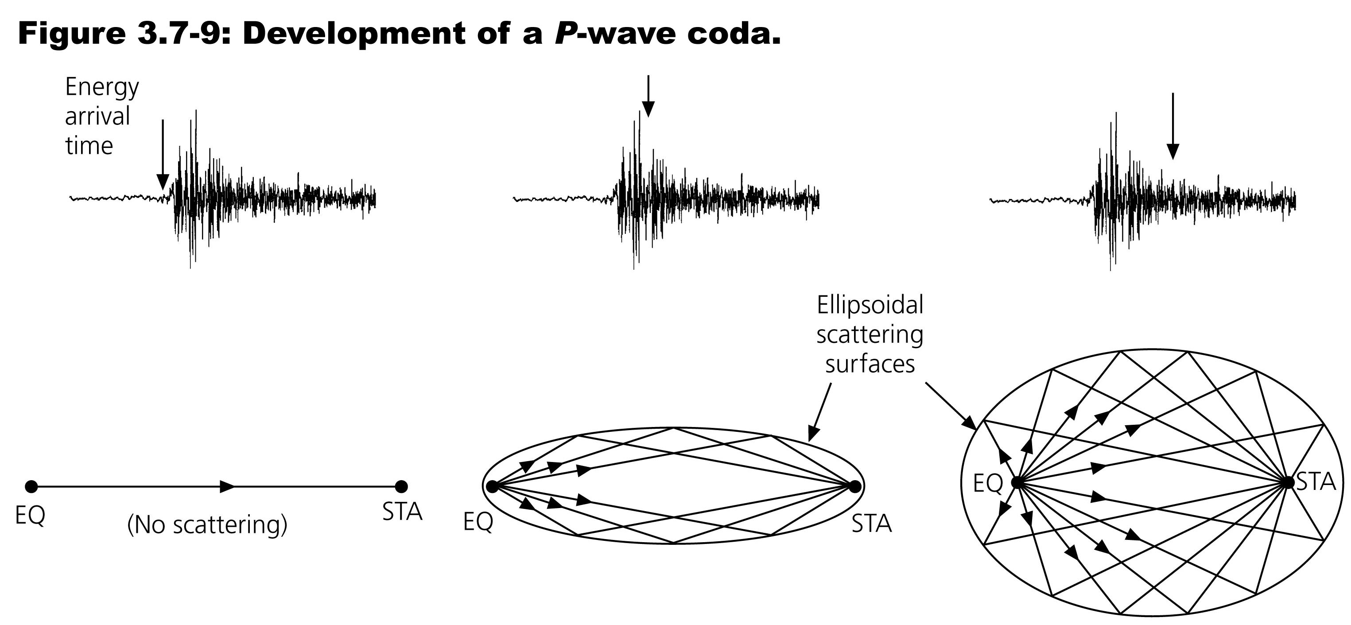
Scattering:
Scatterers can be imaged via any of several methods:
• Back-projection of coda energy (the arrivals
that form the “long tail” of a seismogram)
• Using the decay of coda amplitude to model the statistical
scattering properties (i.e. in the frequency domain)
• Coda-wave interferometry for a fixed source-receiver pair…

Slide 8
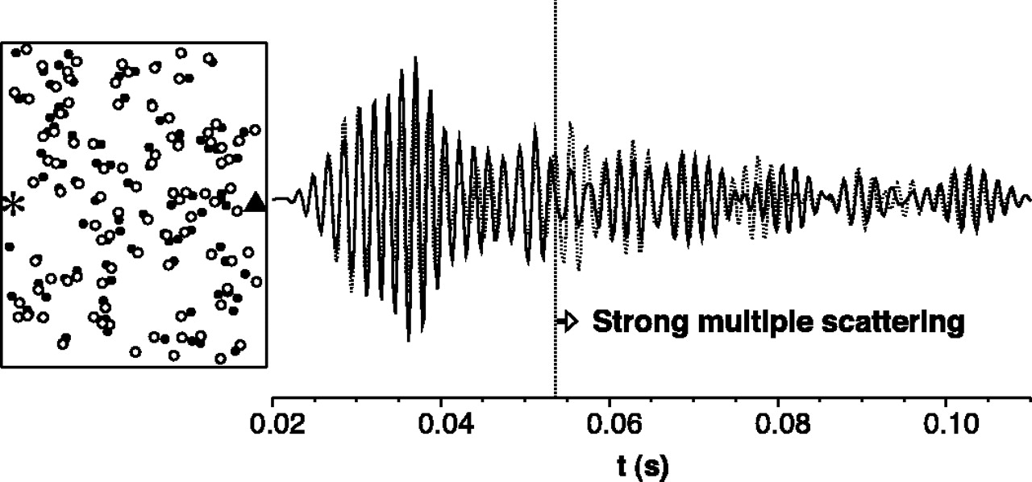
A simulation of 100 randomly-perturbed scatterers…
Snieder et al., Science, 2002
Moving the scatterers (here, 1/40th of the distance shown,
so the perturbation is visible) mostly changes the shapes
and amplitudes of the waveforms…
Notes:
Location of 100 scatterers before and after the perturbation (filled circles and open circles, respectively) with the source (asterisk) and receiver location (triangle). For the sake of clarity, the scatterer displacement is exaggerated by a factor 40. The scatterers are placed in an area of 40 m by 80 m. The waveforms recorded before and after the perturbation at the receiver are shown on the right with a solid and dashed line, respectively.

Slide 9
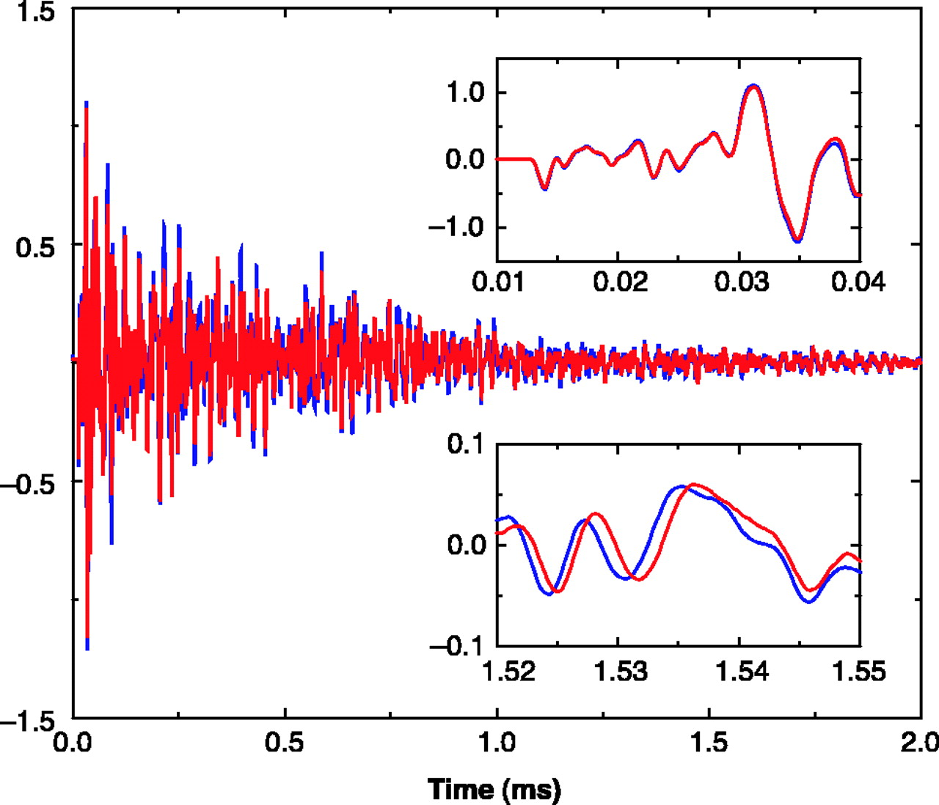
Waveforms
measured in a
granite sample
at temperatures
of 45$°$ C (blue)
and 50$°$C (red).
Snieder et al., Science, 2002
Changing the matrix velocity, by contrast, introduces a shift
(delay or advance) that increases with coda time.
Notes:
Waveforms recorded in the granite sample for temperatures of 45° and 50°C, in blue and in red, respectively. The insets show details of the waveforms around the first arrival (top inset) and in the late coda (bottom inset).

Slide 10
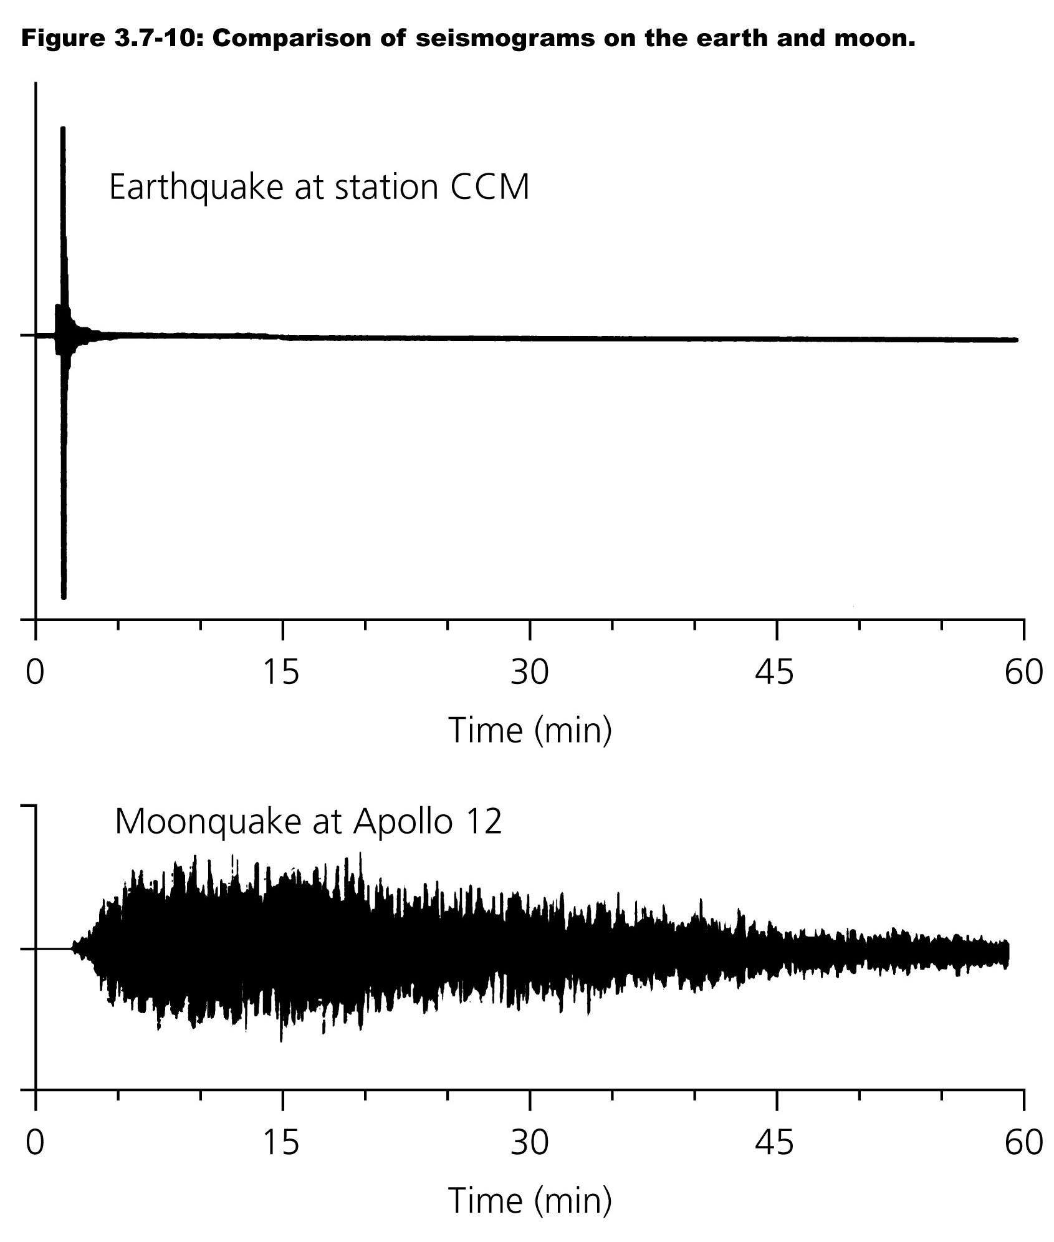
Scattering:
Interesting aside:
Coda energy in the
Earth tends to
attenuate much more
rapidly than on the
Moon!
This is partly because
lunar regolith is
highly fractured by
impacts, but mostly
because it contains
no fluids (and has
consequently much
less intrinsic
attenuation!)

Slide 11
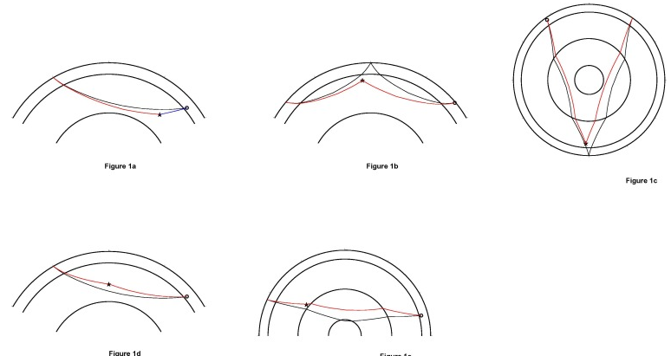
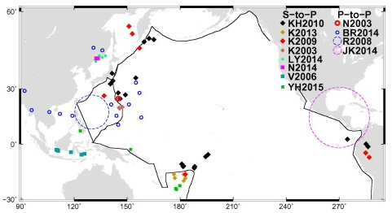
S to P in
P coda
P to P as
PP precursor
Scattering
Example:
Using scattered
energy enables us to
“see” impedance
contrasts associated
with features that are
smaller than the
theoretical limits of
resolution for
tomography...
E.g., we can pick out
small scatterers in the
(“transparent”) mid-
mantle!
P to P as
P’P’ precursor
P to P in
P coda
P to P as
PKP precursor

Slide 12
Intrinsic Attenuation:
Intrinsic attenuation, or anelasticity,
describes the process by which elastic energy
in the Earth is converted to heat when the
seismic wave induces unrecoverable
deformation.
To examine this, let’s consider a spring:
For an idealized spring,
has solution
with oscillation frequency
More realistically though, internal friction in the
spring will damp the system resulting in
where γ is a damping
factor and Q ≡ ω₀/γ
is called the quality factor.
Spring constant k
u
Mass
m

Slide 13
Intrinsic Attenuation:
This system has a solution with real and
imaginary parts; the actual displacement is the
real part and takes the form:
i.e., a harmonic oscillator with an exponential
decay of amplitude. Here, A₀ is the initial
displacement (at time t = 0) and
Important to note:
• High frequencies attenuate more than low
• Harmonic frequency is changed by attenuation
• Higher Q results in less change to frequency
and less intrinsic attenuation for given time
Spring constant k
u
Mass
m

Slide 14
Intrinsic Attenuation:
The wave equation of course is different than that for a
simple mass-spring system…
For a plane wave, the Amplitude A decreases as
where a is the absorption coefficient, a = ω₀ / 2Qc
Q is the seismic Quality factor… Low attenuation
implies high Q. For anelastic attenuation, elastic parameters
and hence velocity c are complex-valued, i.e. c = c_{R} + ic_{I},
and

