Slide 1
Geology 5640/6640
Introduction to Seismology
4 Nov 2020
Last time: Seismic Wave Energy Partitioning
• Displacement continuity for a normal-incidence seismic wave
(θ_{i} = 0) ⇒ A_{i} + A_{rfl} = A_{rfr} and 1 + R = T, where R is the
reflection coefficient and T is transmission:
• Similar requirements (conservation of energy, continuity of
stress and displacement at a boundary) yields for the SH
wave & arbitrary angle of incidence j₁:
• More generally, amplitudes of reflected, refracted and
converted waves are described by Zoeppritz’
equations (four equations in four unknown amplitudes).
Read for Fri 6 Nov: S&W 86–100 (§2.7–2.8)
© A.R. Lowry 2020

Slide 2
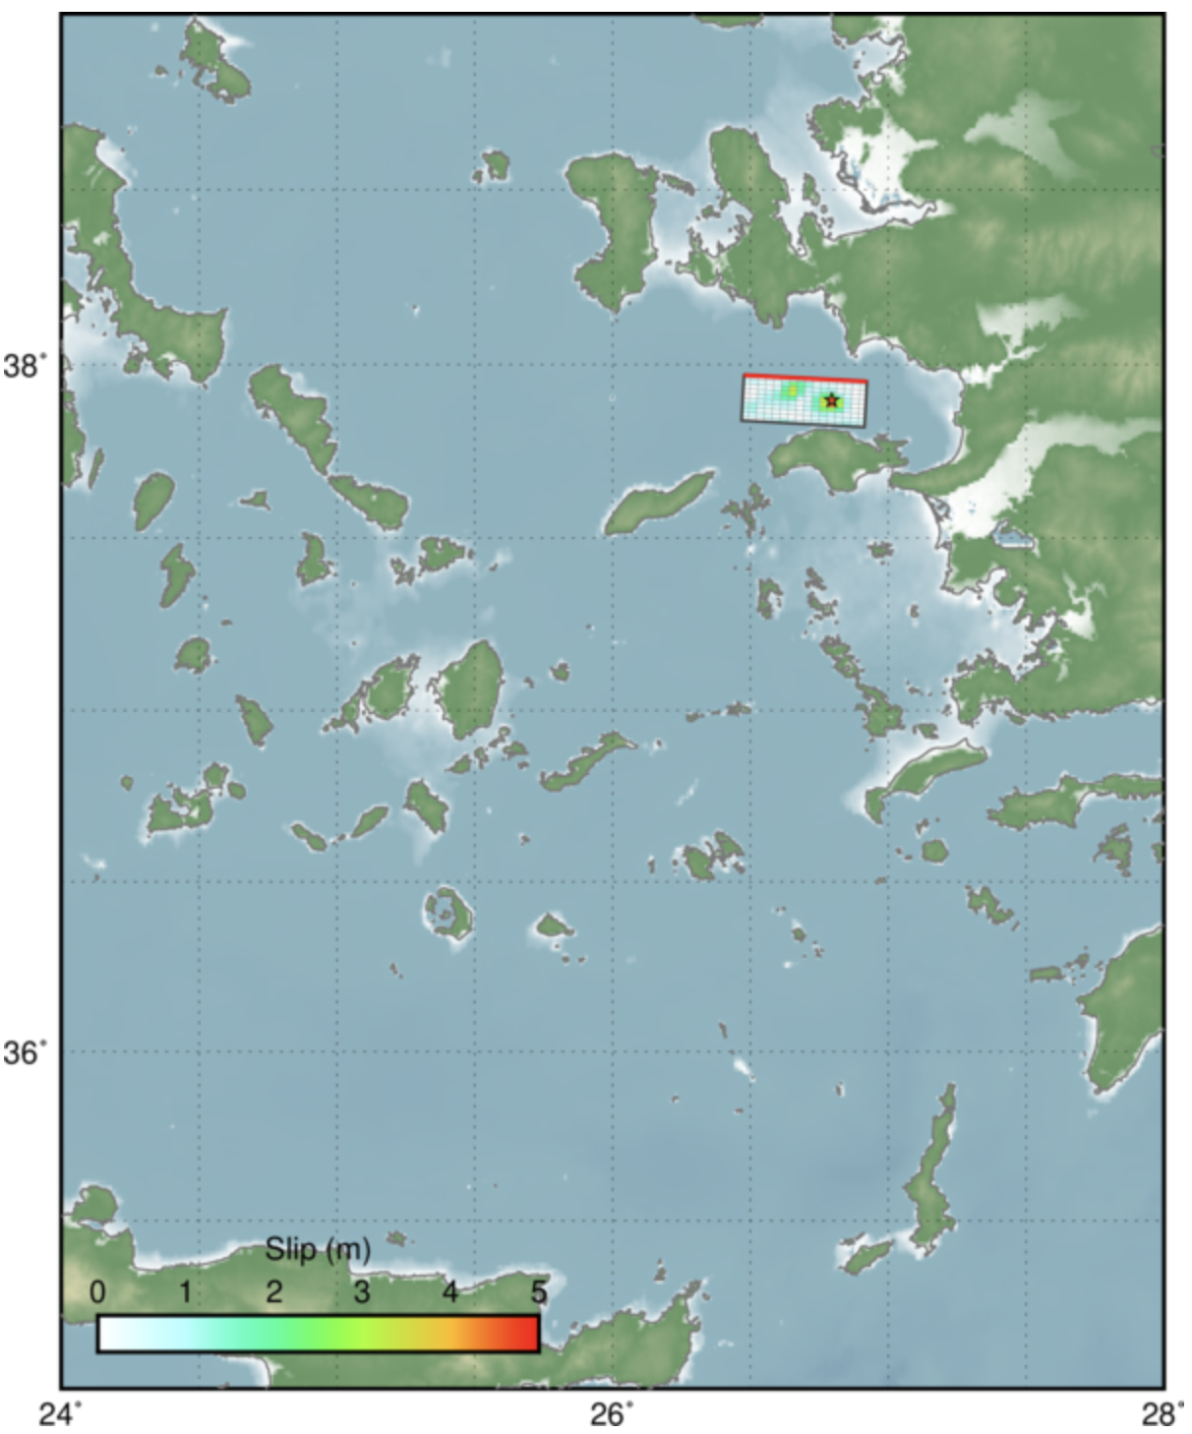
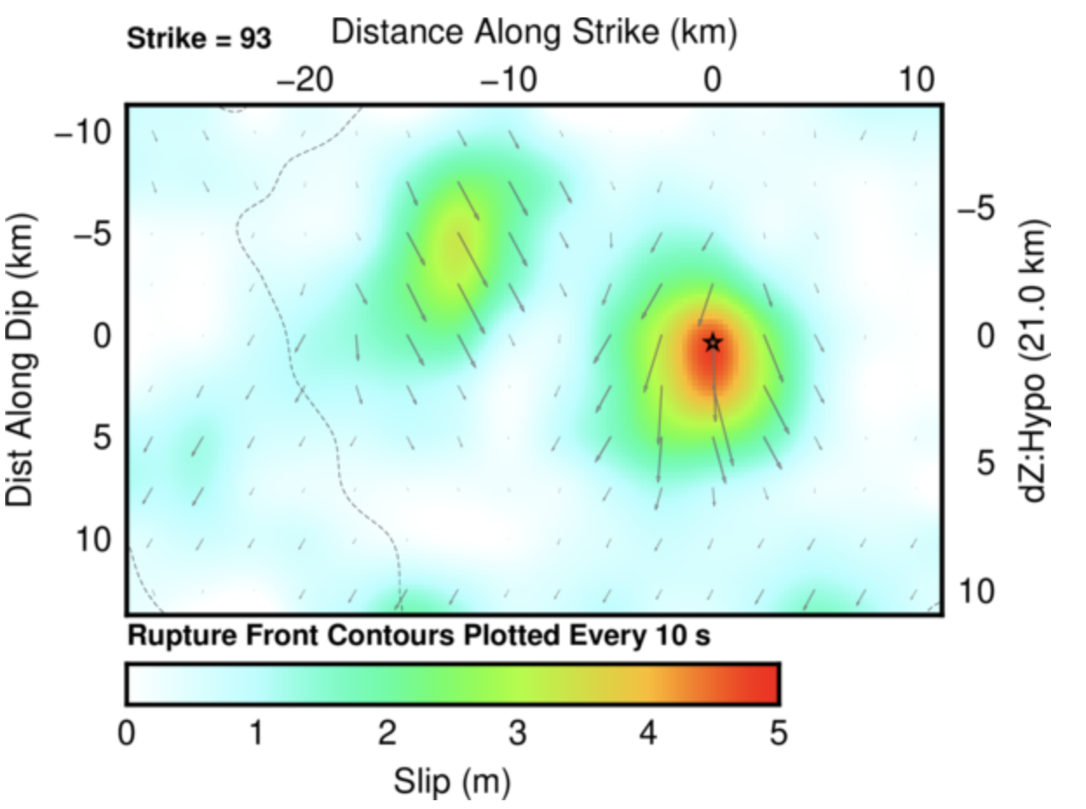
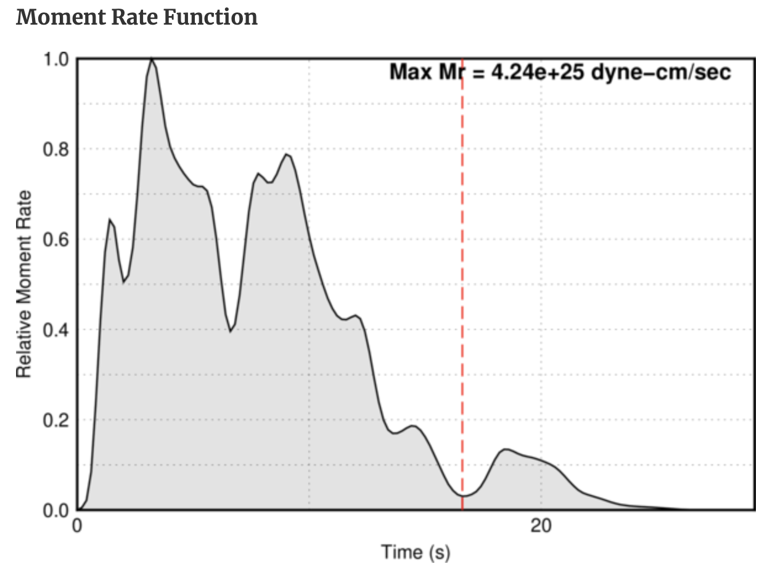
Friday’s M7 normal-faulting earthquake near Néon Karlovásion,
Greece

Slide 3
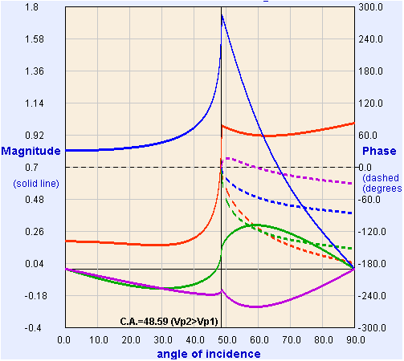
These four equations, with five unknown amplitudes, are called
Zoeppritz’ Equations.
If we fix the amplitude for the incident wave (e.g., A₀ = 1),
we can solve for the other four algebraically.
Model from:
http://www.crewes.org/
ResearchLinks/
ExplorerPrograms/ZE/
ZEcrewes2_2.html
ρ₁ = 2000, ρ₂ = 2200
kg/m³
α₁ = 3000, α₂ = 4000
m/s
β₁ = 1500, β₂ = 2000
m/s
T_{p}
R_{p}
R_{s}
T_{s}
Crewes Zoeppritz Explorer

Slide 4
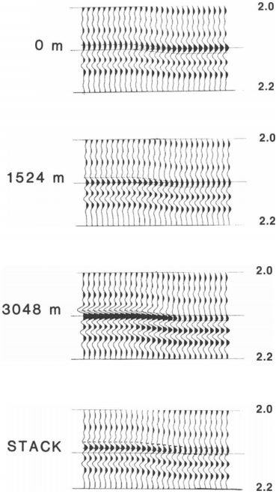
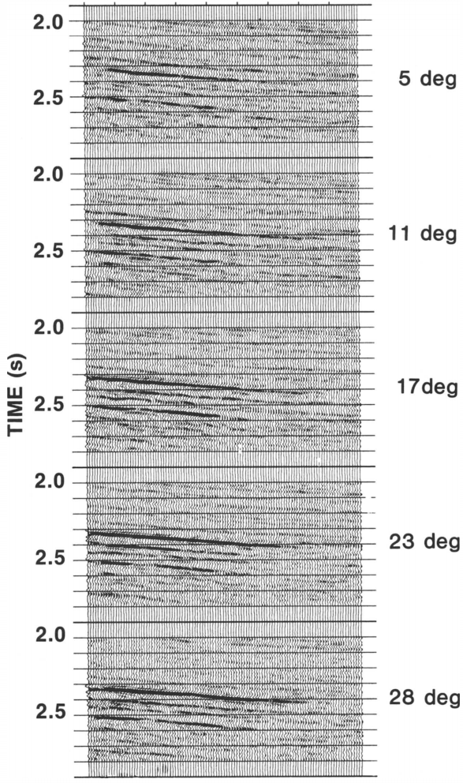
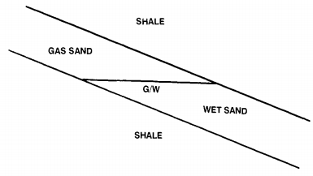
Aside: Amplitudes are the main feature used in industry seismic!
Rutherford & Williams, Geophysics 1989
Amplitude versus offset (AVO) methods give info
about deep layers that are especially useful for evaluating fluid
types & pressures…

Slide 5
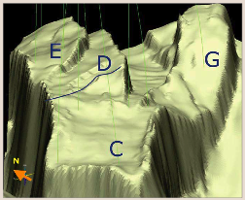
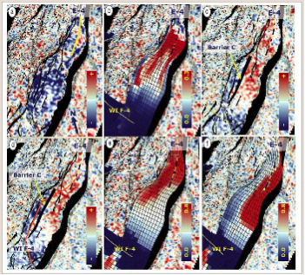
2001-2003
2001-2004
Model
w/out
seismic
Model
with
seismic
4D: imaging
changes in
impedance:
From Osdal
et al., The
Leading
Edge, 2006
Red = gas cap over oil (neutral colors); blue = water

