Slide 1
Geology 5640/6640
Introduction to Seismology
5 Dec 2024
Last time: Anisotropy
• Azimuthal anisotropy varies with azimuth θ and can
be measured from directional differences in ambient noise
phase velocities or from shear wave splitting:
Fluid-filled cracks reduce S-velocity as (1 – Na³/V) for
waves propagating orthogonal to the cracks
• Anisotropy has added a great deal to our understanding of
mantle flow dynamics (e.g., evolution of depth and horizontal
component of ridge-related flow in oceans)
• Deep shear-wave splitting fast directions usually align with
absolute plate motion direction; fast directions near
volcanoes are time-dependent!
© A.R. Lowry 2011-2024

Slide 2
Last time: Amplitude effects
• Amplitude effects include source, partitioning (refl/refractions),
geometrical spreading already covered…
• But geometry of a sphere results in amplitudes of surface
waves decreasing as (i.e., refocusing at
antipodes!)

Slide 3
The Final Exam is posted on the course website…
Due 5:00 pm Fri Dec 13. (This is a much-shortened
version relative to years past so you can focus on
projects.
6640 Semester Project due-dates:
• Presentations of research results will
be given 2:00 to 4:00 on Friday Dec 6 in Geo413;
should be max 20 minutes
• Research report is due Fri Dec 13 at 5:00 pm.
No fixed length, but it should include
‡ Intro/Context (including relevance to your thesis
topic)
‡ Description of Math/Physics of the problem
‡ Methods/Data Used
‡ Details of Analysis
‡ Results, Discussion, Future Work (if any)

Slide 4
Reminder: Please fill out your
IDEA online evaluations!
(& send me a screenshot of
the certificate for 10 pts
extra credit!)

Slide 5
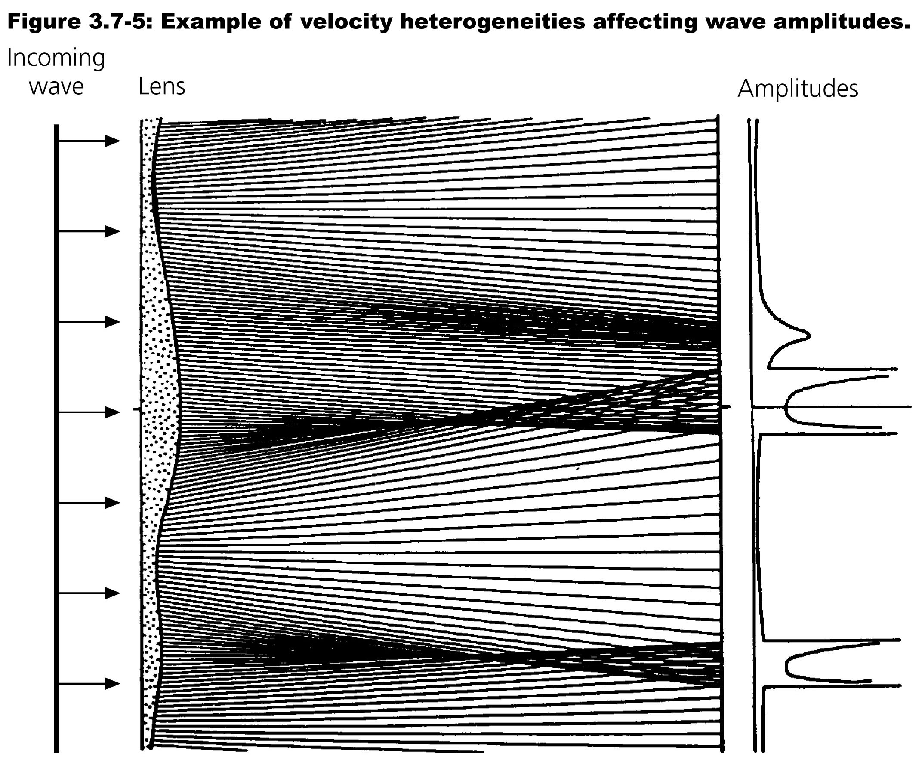
Multipathing:
Seismic
waves
also can
be
focused
and
defocused
(“lensing”)
by velocity
variations
in the
medium.

Slide 6
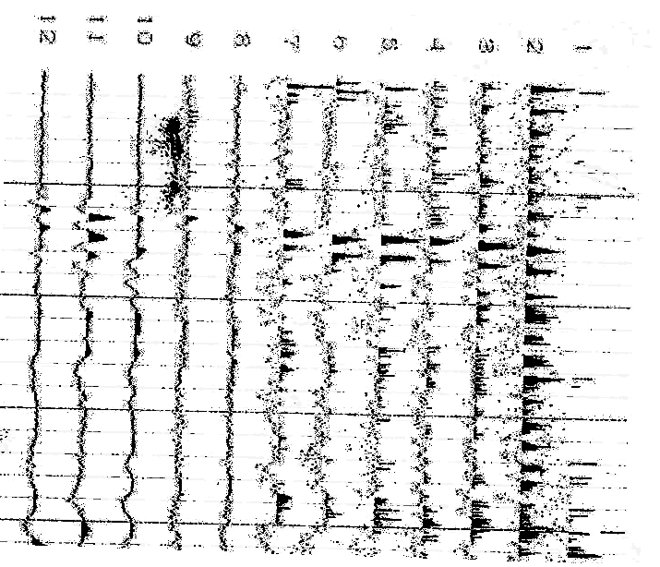
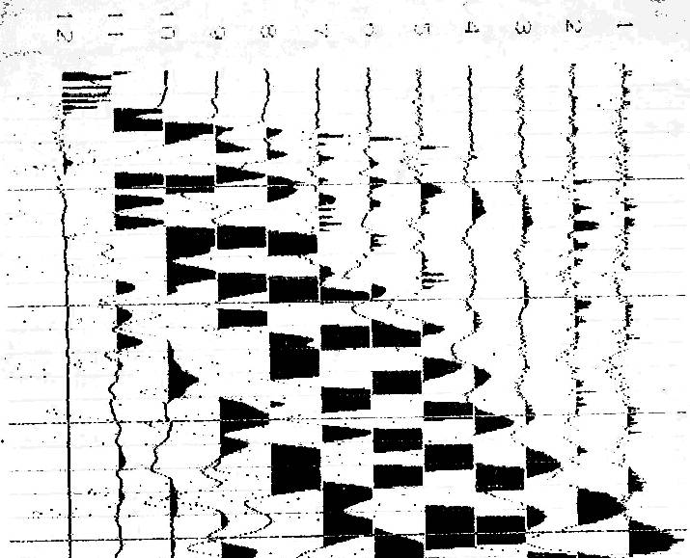
Reverse shot from a seismic refraction profile collected on a
farm near Gosport, IN.

Slide 7
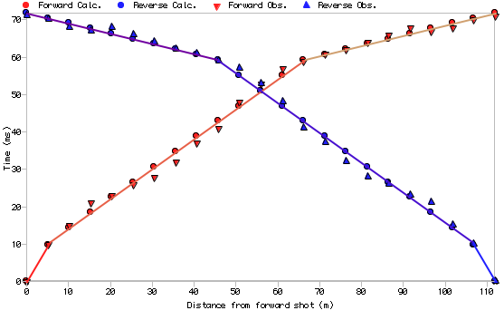
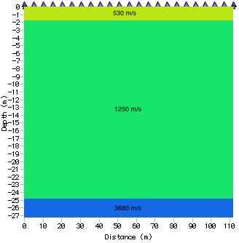
Second refraction (V = 3680 m/s)
Gosport Best Fit
RMS = 1.39 ms
First refraction (V = 1250 m/s)
Direct
1st Refraction
Direct
arrival
(V = 530)
2nd Refraction

Slide 8
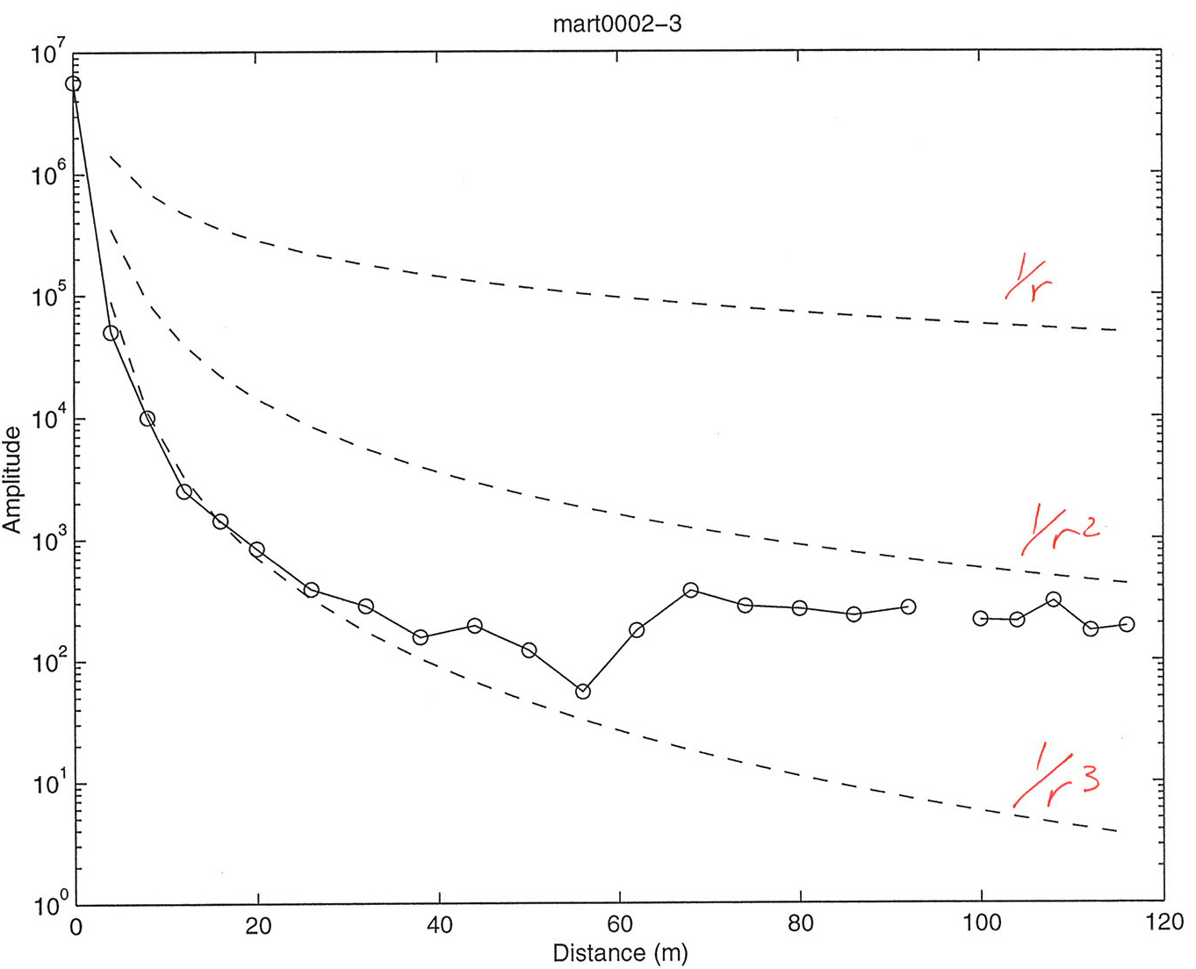
Note that the amplitudes for these first arrivals do not follow a
simple 1/r or 1/√r decay… !

Slide 9
These amplitudes decay rapidly even after correcting for
geometrical spreading (due to anelastic attenuation with low
Q: We’ll come back to that soon). But geometric plus
anelastic decay modeling poorly fits arrivals where two waves
come in at about
the same time…
This is also an
example of
multipathing!
1
2
3
530
100
6.6
V = 1250 m/s
f = 250 Hz
Q = 5.1
V = 3680 m/s
f = 125 Hz
Q = 3.2
X
X

Slide 10
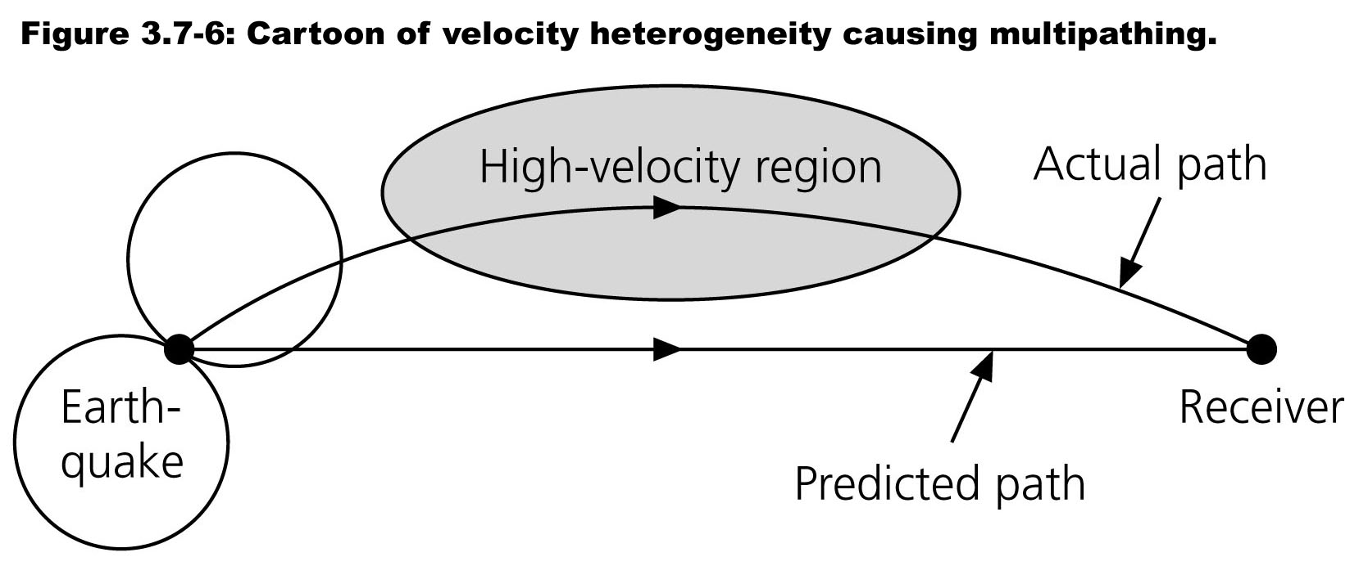
Multipathing:
Rays “prefer” high velocity regions (by Fermat’s Principle: The fastest
wins). Note also that one particular raypath in the cartoon below was
bent back toward the receiver by the change in velocity properties.

Slide 11
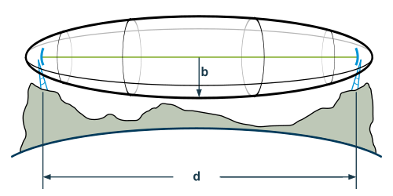
Multipathing:
Recall however that rays are idealizations of wavefront
propagation, valid only at infinite frequency.
To extend ray theory to finite frequencies, we can look at all
rays that come in within half a wave period of each other
(T/2), as these will constructively reinforce.
The volume encompassed by these raypaths is called a
Fresnel Zone.

Slide 12
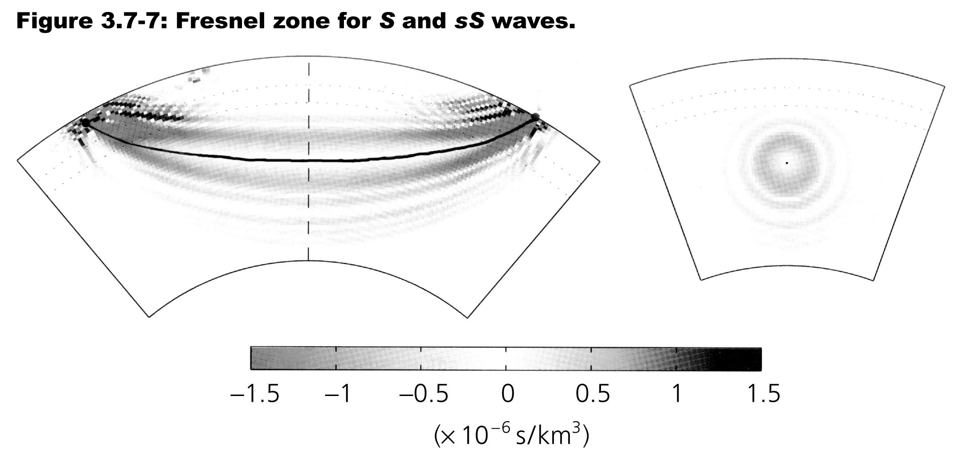
Multipathing:
For the layered Earth, where v = v(z), we also consider which
rays constructively interfere. We end up with annular rings of
positive and negative contributions to the total amplitude…
These are the so-called “banana-doughnut” kernels that
describe the effect of averaged Earth structure on travel-time.

Slide 13
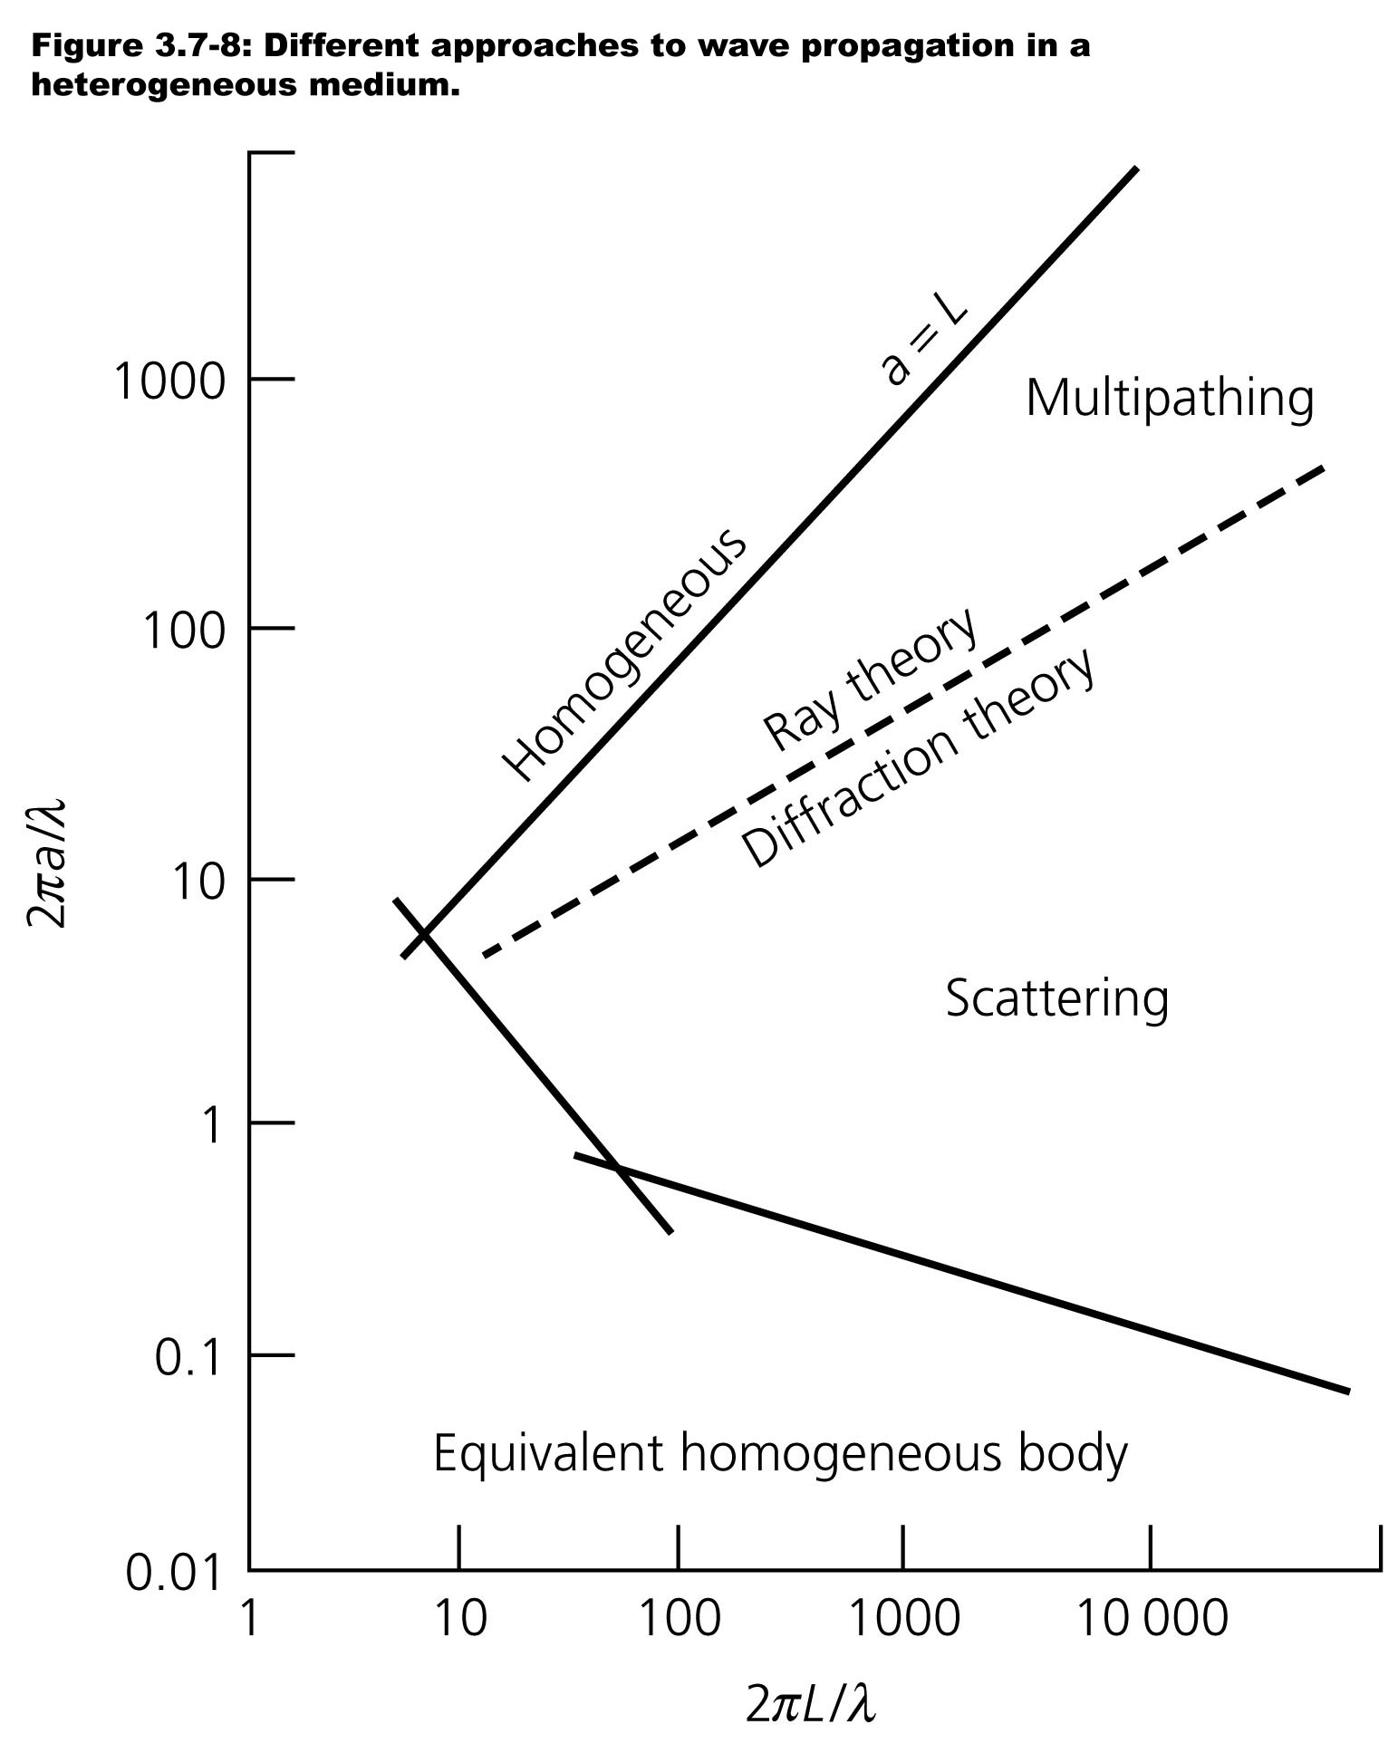
a is scale of the
heterogeneity;
L is distance
the wave
travels
Scattering:
Scattering occurs when
there are velocity
heterogeneities in the
medium with wavelengths
on the order of λ of the
wave. For seismic
propagation associated
with scatterers, ray theory
does not do very well
(much like it misses
on diffractions)….

Slide 14
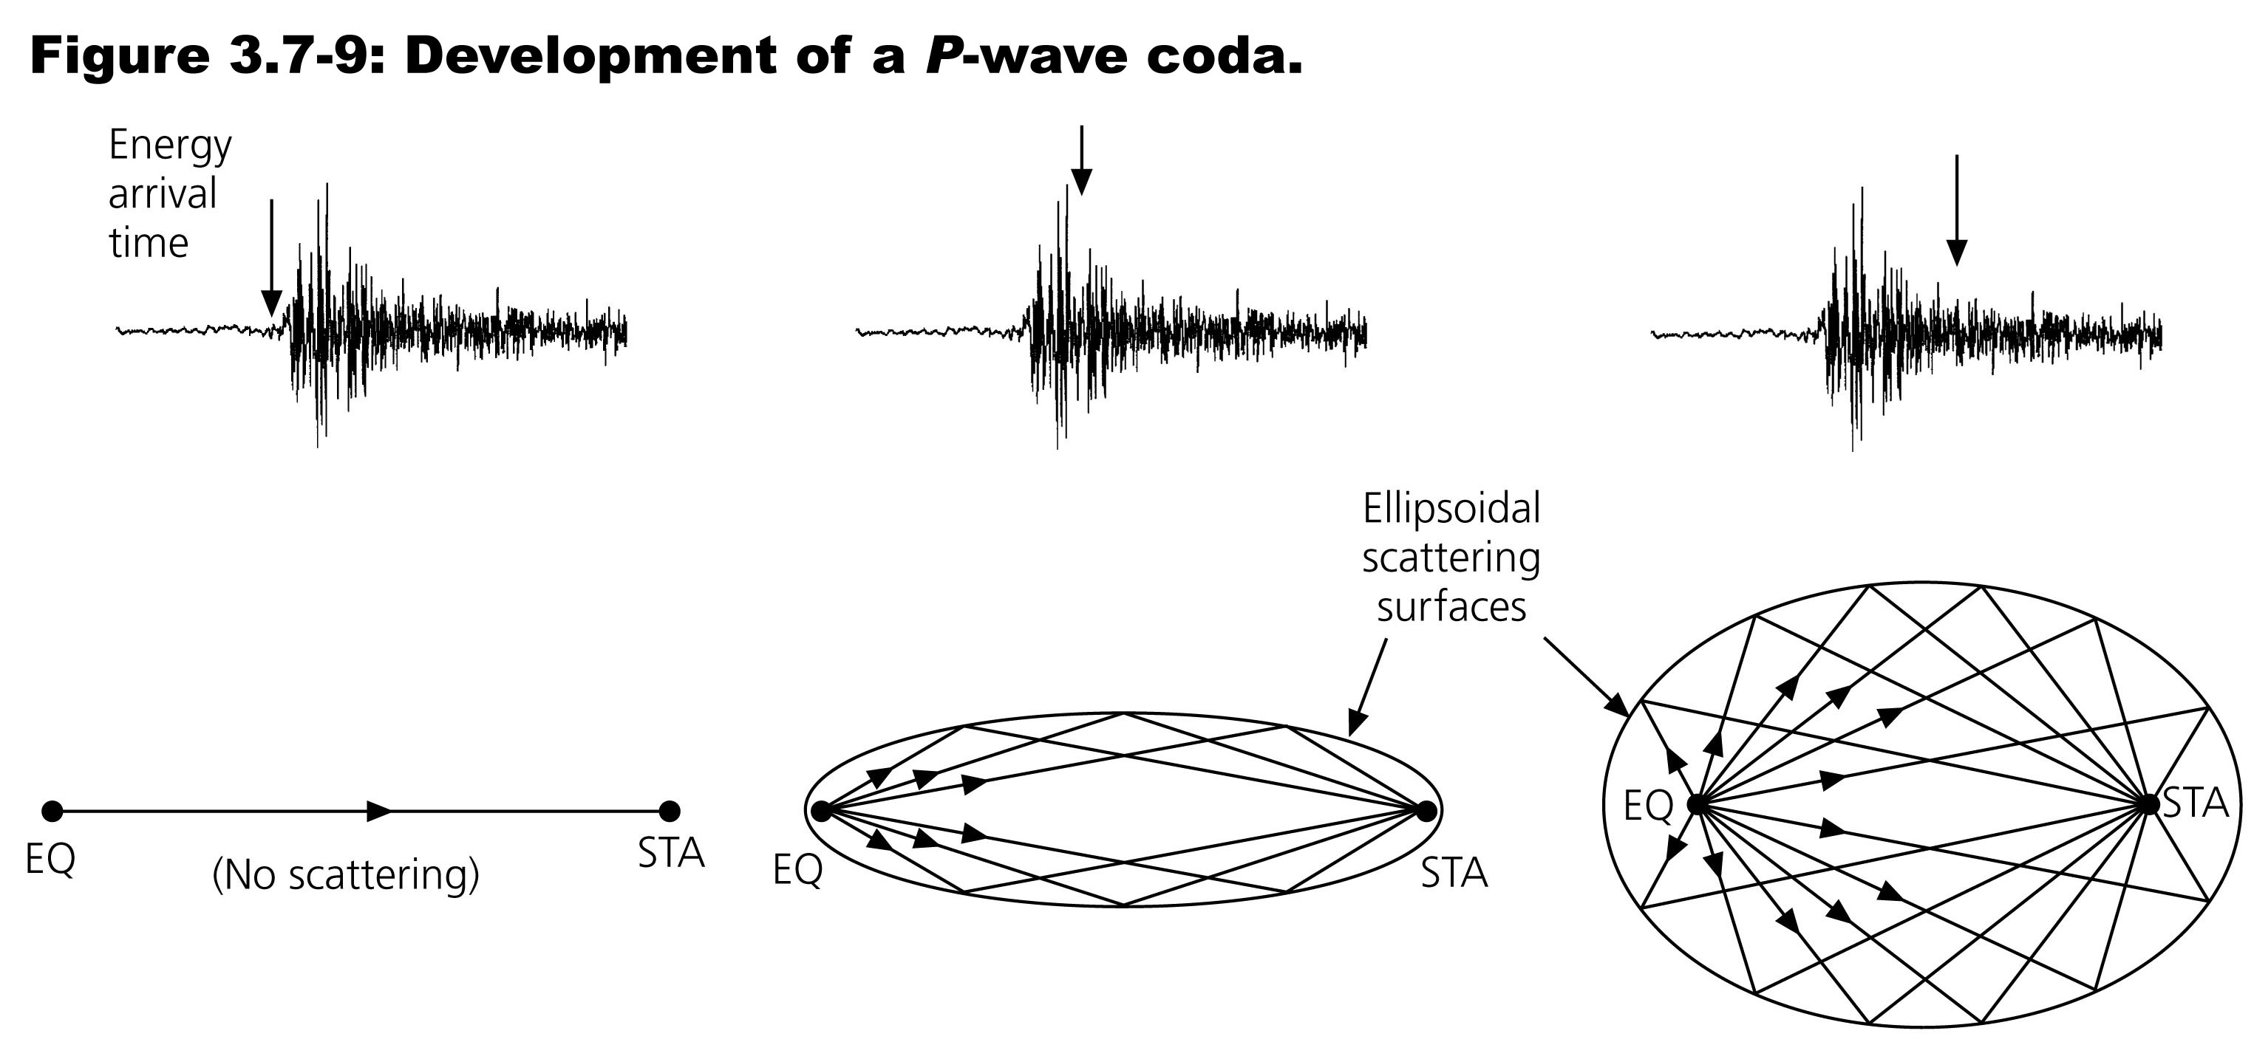
Scattering:
Scatterers can be imaged via any of several methods:
• Back-projection of coda energy (the arrivals
that form the “long tail” of a seismogram)
• Using the decay of coda amplitude to model the statistical
scattering properties (i.e. in the frequency domain)
• Coda-wave interferometry for time-dependence

Slide 15
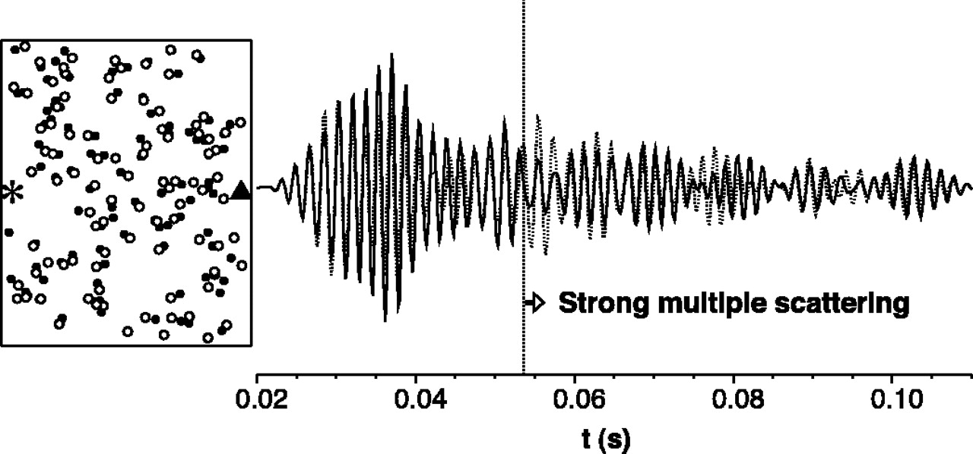

A simulation of 100 randomly-perturbed scatterers…
Snieder et al., Science, 2002
Moving the scatterers (here, 1/40th of the distance shown,
so the perturbation is visible) mostly changes the shapes
and amplitudes of the waveforms…

Slide 16
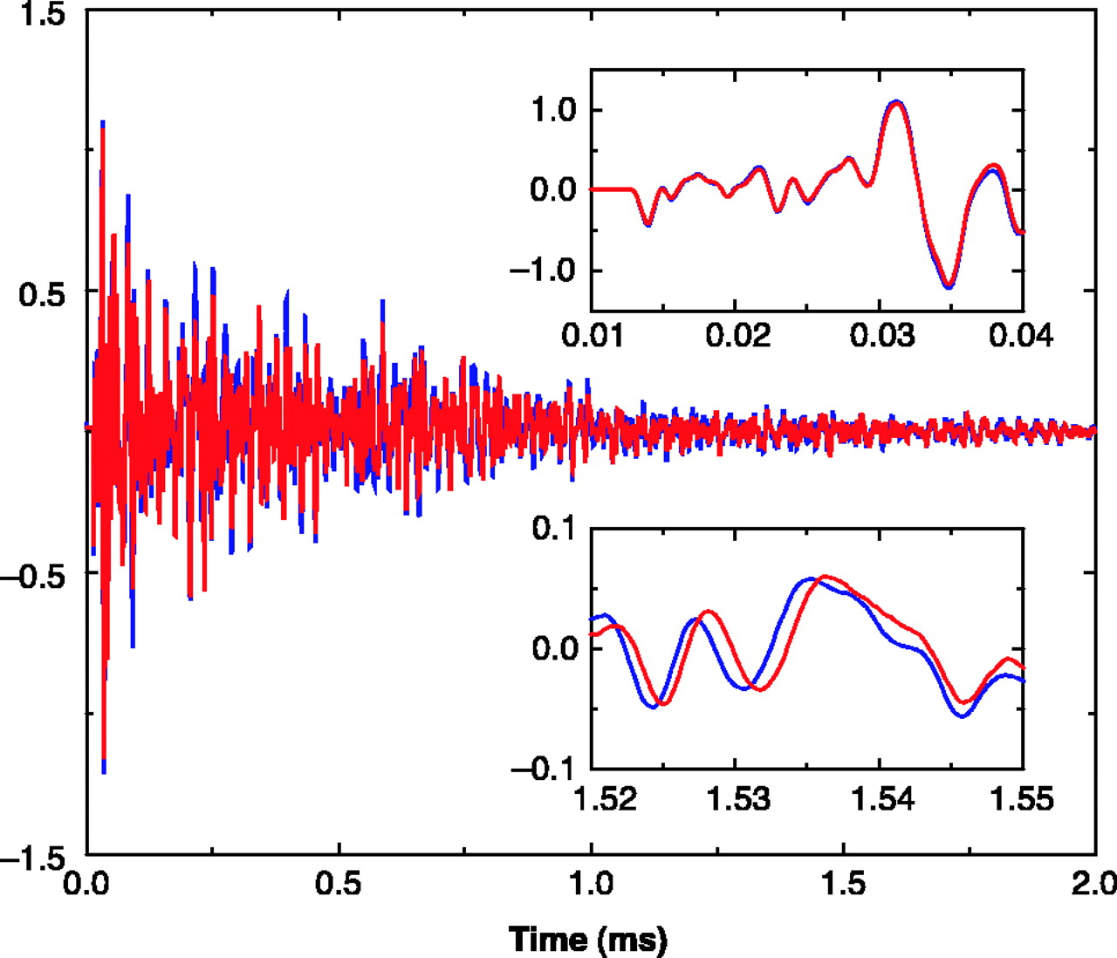
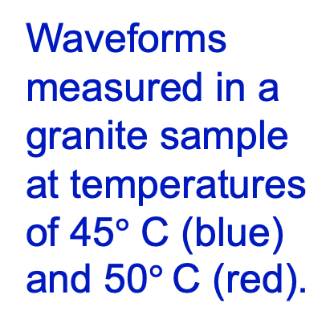
Waveforms
measured in a
granite sample
at temperatures
of 45$°$ C (blue)
and 50$°$C (red).
Snieder et al., Science, 2002
Changing the matrix velocity, by contrast, introduces a shift
(delay or advance) that increases with coda time.

Slide 17
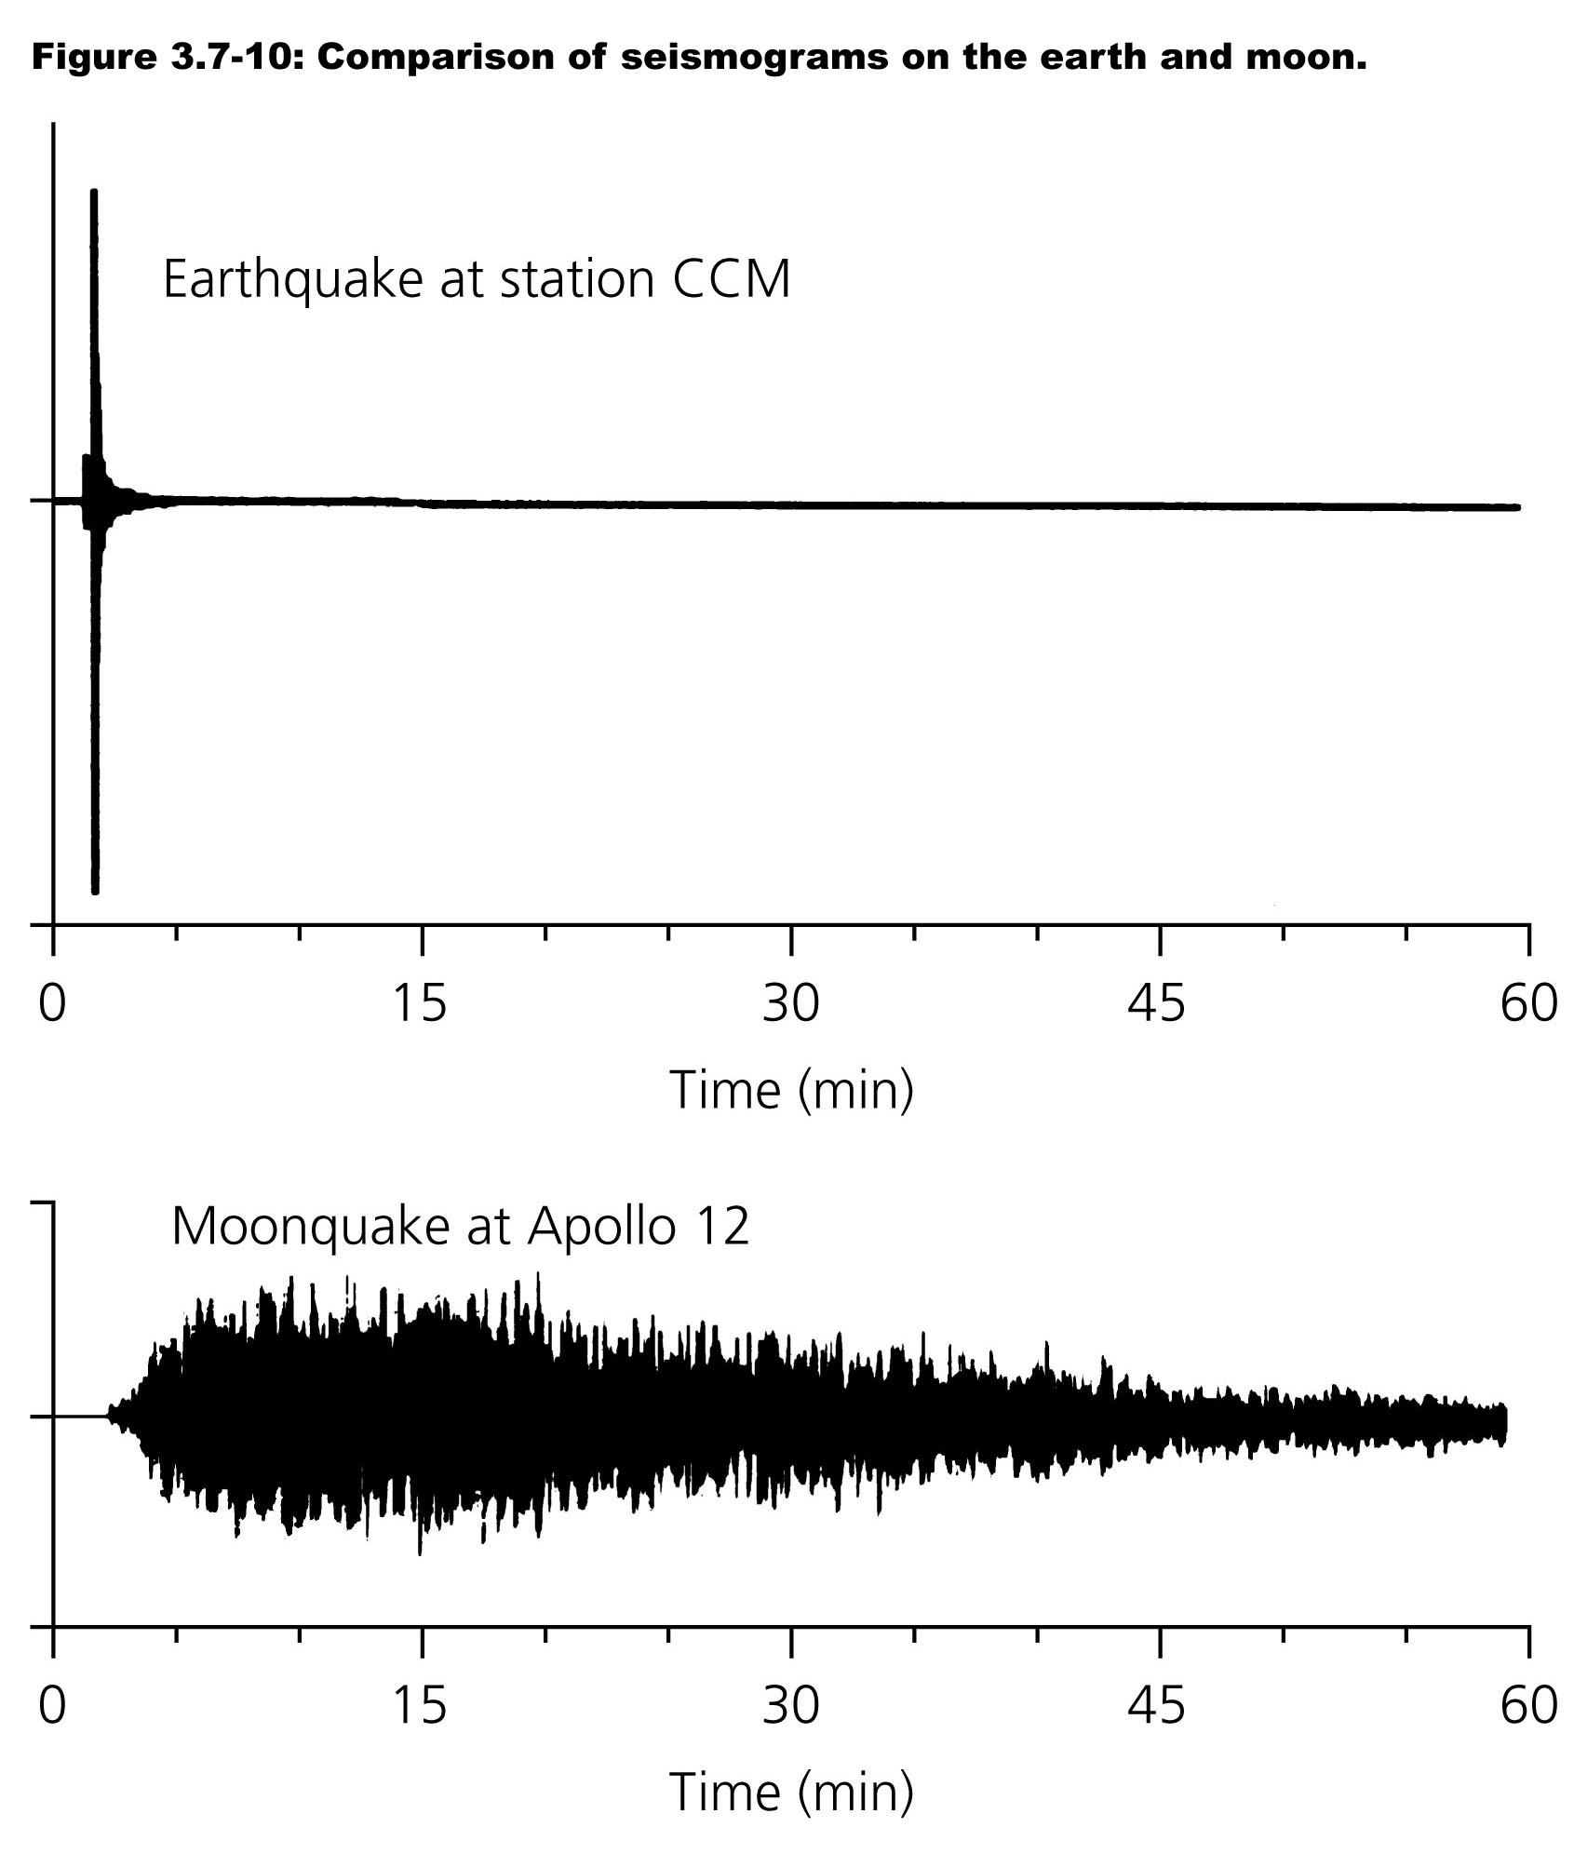
Scattering:
Interesting aside:
Coda energy in the
Earth tends to
attenuate much more
rapidly than on the
Moon!
This is partly because
lunar regolith is
highly fractured by
impacts, but mostly
because it contains
no fluids (and has
consequently much
less intrinsic
attenuation!)

Slide 18
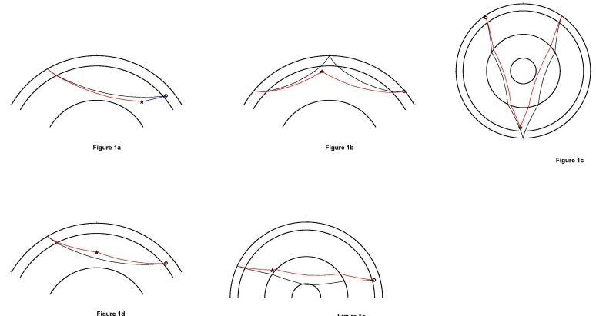
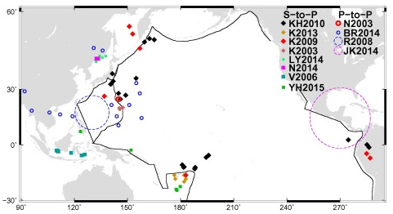
S to P in
P coda
P to P as
PP precursor
Scattering
Example:
Using scattered
energy enables us to
“see” impedance
contrasts associated
with features that are
smaller than the
theoretical limits of
resolution for
tomography...
E.g., we can pick out
small scatterers in the
(“transparent”) mid-
mantle!
P to P as
P’P’ precursor
P to P in
P coda
P to P as
PKP precursor

Slide 19
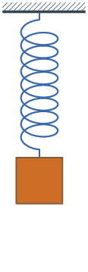
Intrinsic Attenuation:
Intrinsic attenuation, or anelasticity,
describes the process by which elastic energy
in the Earth is converted to heat when the
seismic wave induces unrecoverable
deformation.
To examine this, let’s consider a spring:
For an idealized spring,
has solution
with oscillation frequency
More realistically though, internal friction in the
spring will damp the system resulting in
where γ is a damping
factor and Q ≡ ω₀/γ
is called the quality factor.
Spring constant k
u
Mass
m

Slide 20
Intrinsic Attenuation:
This system has a solution with real and
imaginary parts; the actual displacement is the
real part and takes the form:
i.e., a harmonic oscillator with an exponential
decay of amplitude. Here, A₀ is the initial
displacement (at time t = 0) and
Important to note:
• High frequencies attenuate more than low
• Harmonic frequency is changed by attenuation
• Higher Q results in less change to frequency
and less intrinsic attenuation for given time
Spring constant k
u
Mass
m

Slide 21
Intrinsic Attenuation:
The wave equation of course is different than that for a
simple mass-spring system…
For a plane wave, the Amplitude A decreases as
where a is the absorption coefficient, a = ω₀ / 2Qc
Q is the seismic Quality factor… Low attenuation
implies high Q. For anelastic attenuation, elastic parameters
and hence velocity c are complex-valued, i.e. c = c_{R} + ic_{I},
and

Slide 22
So amplitude decay is greater for greater distance x and
higher frequency ω₀; less with higher intrinsic quality
factor Q and velocity c.
Q differs for P-wave (Q_{p}) and S-wave (Q_{s}).
For sediments,
5 < Q_{p} < 300 (lower if porosity is high)
5 < Q_{s} < 100
For crystalline rocks at shallow depth/low temperature,
100 < Q_{p} < 800

Slide 23
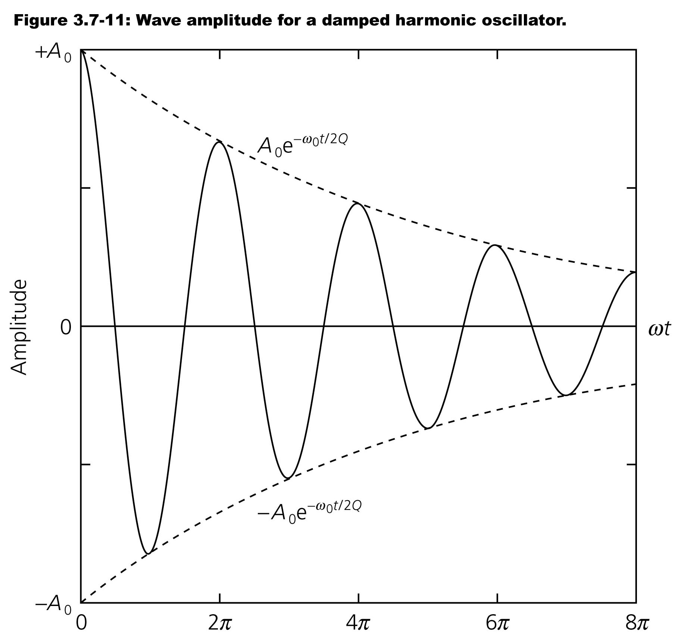
Generally in
the Earth, loss
of amplitude
due to intrinsic
attenuation is
much greater
than that due
to partitioning,
spreading and
the other
amplitude
effects we
have
discussed

Slide 24
This is the dominant reason why the amplitudes in this image
don’t follow a geometrical spreading relationship… In the
Gosport seismic example from earlier, we estimated quality
factor by first correcting for geometrical spreading and taking
log of the
amplitudes…
Amplitudes that
don’t fit attenuation
decay imply
multipathing!
1
2
3
530
100
6.6
V = 1250 m/s
f = 250 Hz
Q = 5.1
V = 3680 m/s
f = 125 Hz
Q = 3.2
X
X

Slide 25
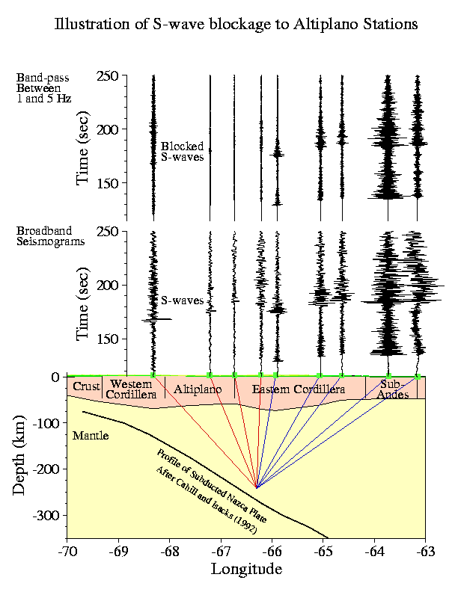
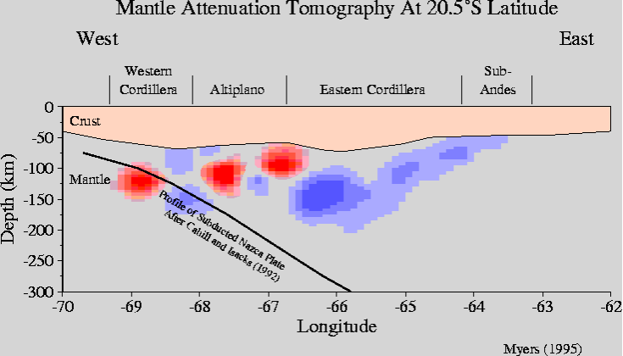
Seismic attenuation can be particularly useful for
imaging of anomalies in melt fraction and free water
content in the mantle…

Slide 26
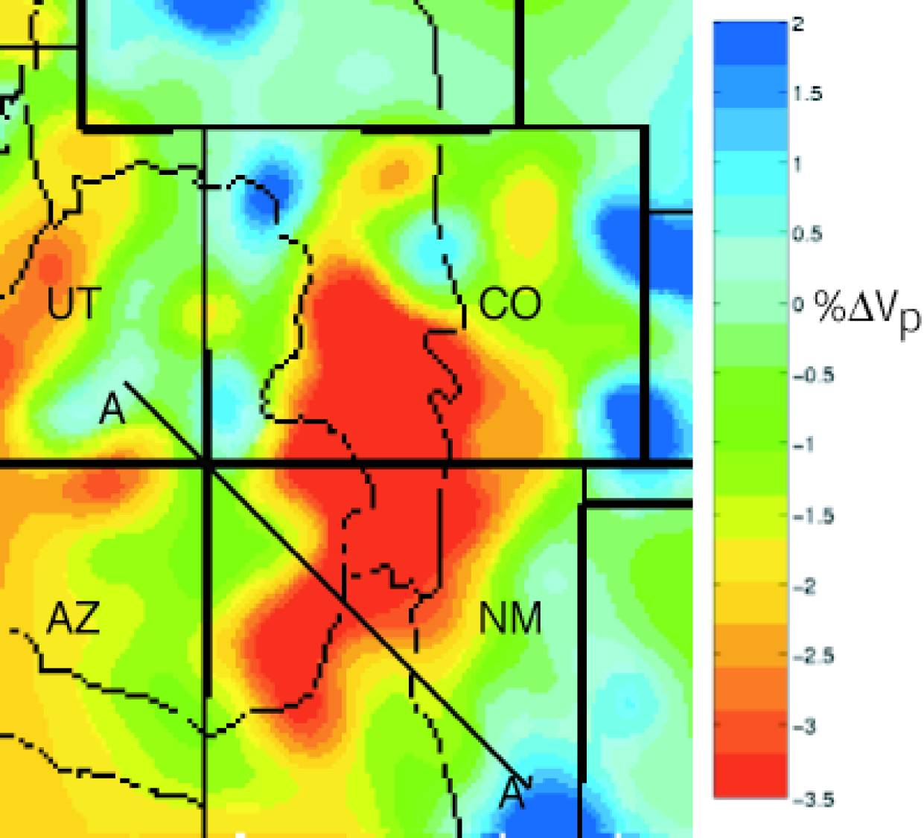
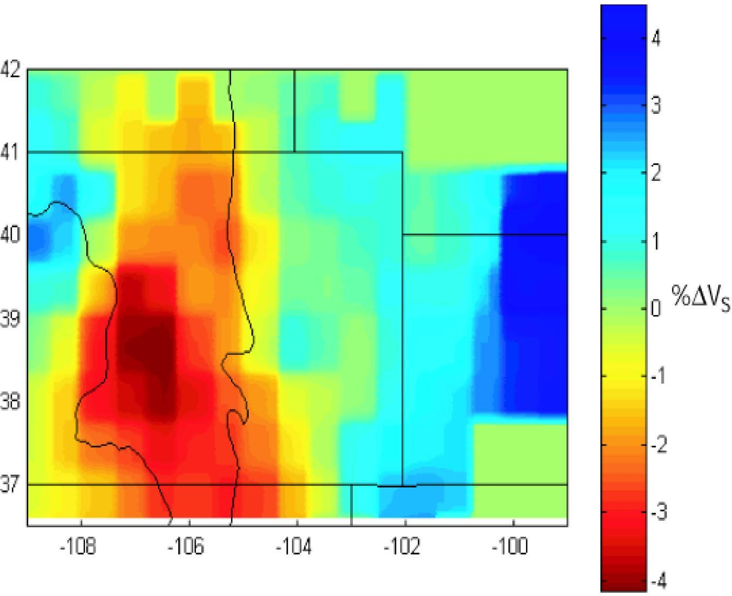
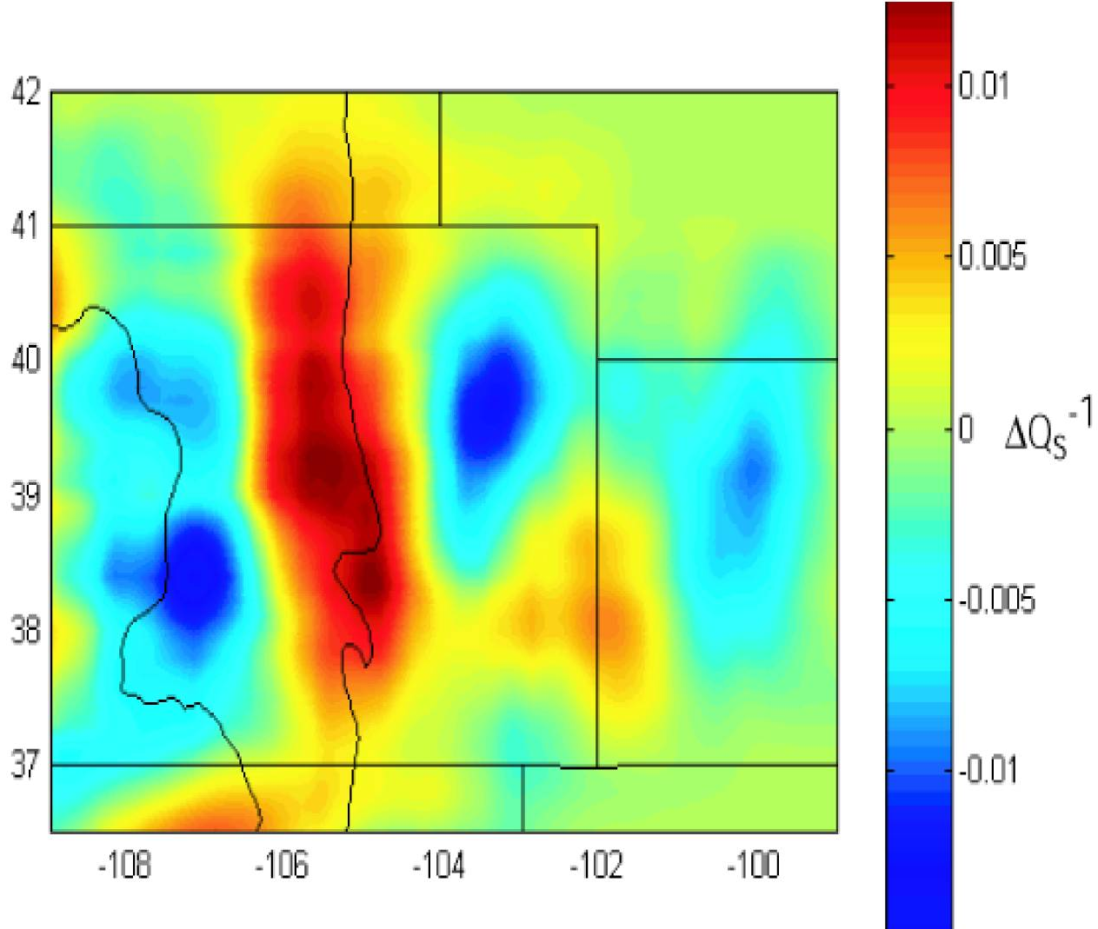
And for resolving potential
ambiguities in interpretation
of velocity images.
Example: Seismic parameters
from the Rio Grande Rift
region of Colorado (all at 100
km depth)

Slide 27
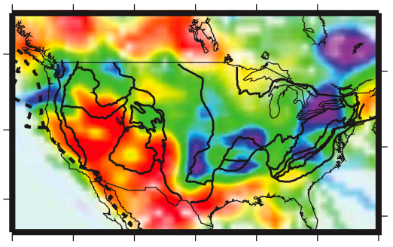
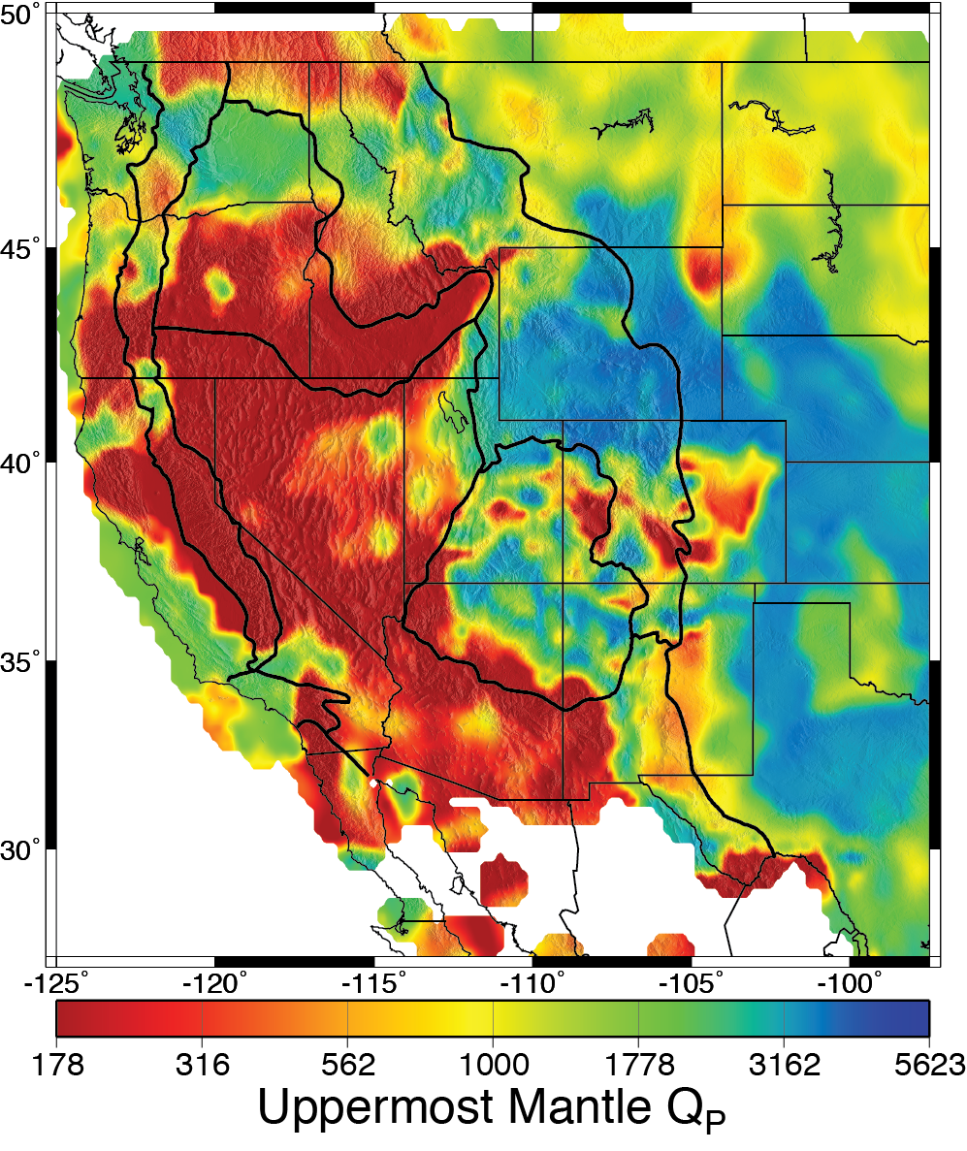
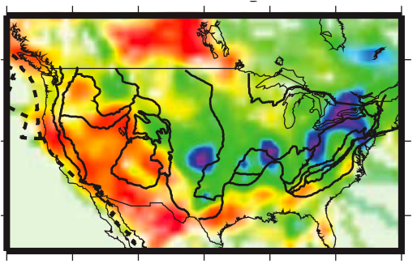
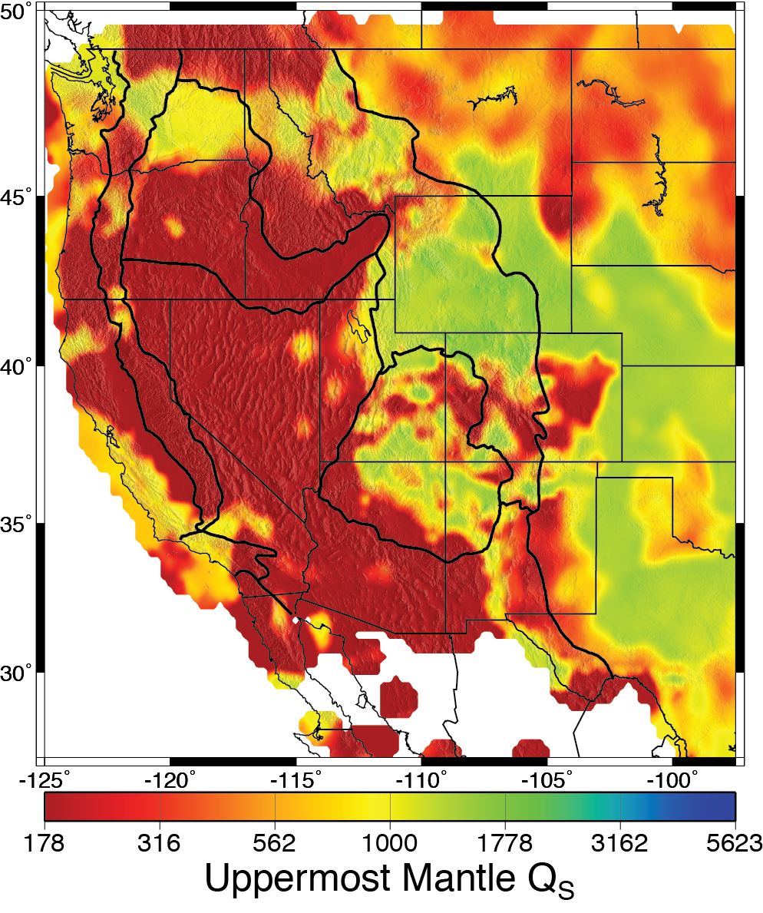

Modeled
Measured
Pn-Q_{P}
Pn-Q_{P}
Pasyanos, BSSA, 2013
Sn-Q_{S}
Sn-Q_{S}

Slide 28
Last time: Amplitude effects
• Amplitude effects include source, partitioning (refl/refractions),
geometrical spreading already covered…
• But geometry of a sphere results in amplitudes of surface
waves decreasing as (i.e., refocusing at
antipodes!)
• Multipathing describes the focusing and defocusing of
waves by ray-bending in a heterogeneous medium (e.g.,
basin amplification; unexpected amplitudes at the
critical distance for refractions…).

Slide 29
Last time: Amplitude Effects
• Multipathing describes the focusing and defocusing of
waves by ray-bending in a heterogeneous medium (e.g.,
basin amplification due to lensing effects).
• The Fresnel Zone corrects ray theory for multipathing
(arrivals within a fractional period) given a finite frequency
• Scattering effects occur when velocity varies at even smaller
scales where ray theory is no longer usable (a ~ λ)
• Scattering is responsible for some of the coda of earthquakes
(the long jumble of disturbances that arrive long after the initial
phases). Coda energy can be back-projected to the ellipse
of possible scatterer locations associated to a given arrival
time…

Slide 30
Last time: Amplitudes: Attenuation
• Anelastic deformation does work; converts some of the
potential/kinetic energy of elastic waves to heat or other
forms
• In a spring mass system with , spring damping γ
results in displacements that are complex-valued.
The quality factor Q = ω₀/γ describes how similar to true
elasticity the system behaves. Displacement and the
frequency are changed as
• In the Earth, amplitudes and velocity are reduced as
and c = c_{R} + ic_{I} where
and

