Slide 1
Geology 5640/6640
Introduction to Seismology
5 Nov 2024
Last time: Amplitudes
• Amplitudes of reflected, refracted and converted waves
are described by Zoeppritz’ equations (four equations
in four unknown amplitudes).
• Examples of practical applications (i.e., industry) include
amplitude versus offset (AVO) methods: Changes
with angle of incidence inform porosity, pore fluid type
(including bright spots, high amplitudes over gas plays)
Read for Thursday 7 November: S&W 86–100 (§2.7–2.8)
© A.R. Lowry 2011-2024

Slide 2
Last time continued: Evanescent waves
• A wave arriving with incident angle ≥ the critical angle (i.e.,
j₁ ≥ sin^{–1}(β₁/β₂)) still requires continuity of stress and
displacement. Transmission is “imaginary”, & solution is
e.g.:
These exponentially decaying “trapped” displacements
are called evanescent waves
• When an evanescent wave occurs, balancing the stress
and displacements at the boundary yields reflection and
transmission coefficients that are complex numbers; the
imaginary part of these results in a phase delay of the
reflected and converted waves!

Slide 3
Last time continued: Surface waves
• Surface waves (Love, Rayleigh) are important because:
→ Cylindrical spreading (A ∝ 1/√r) ⇒ these are the largest
arrivals outside the near-field
→ They are responsible for most of the damage in
earthquakes!

Slide 4
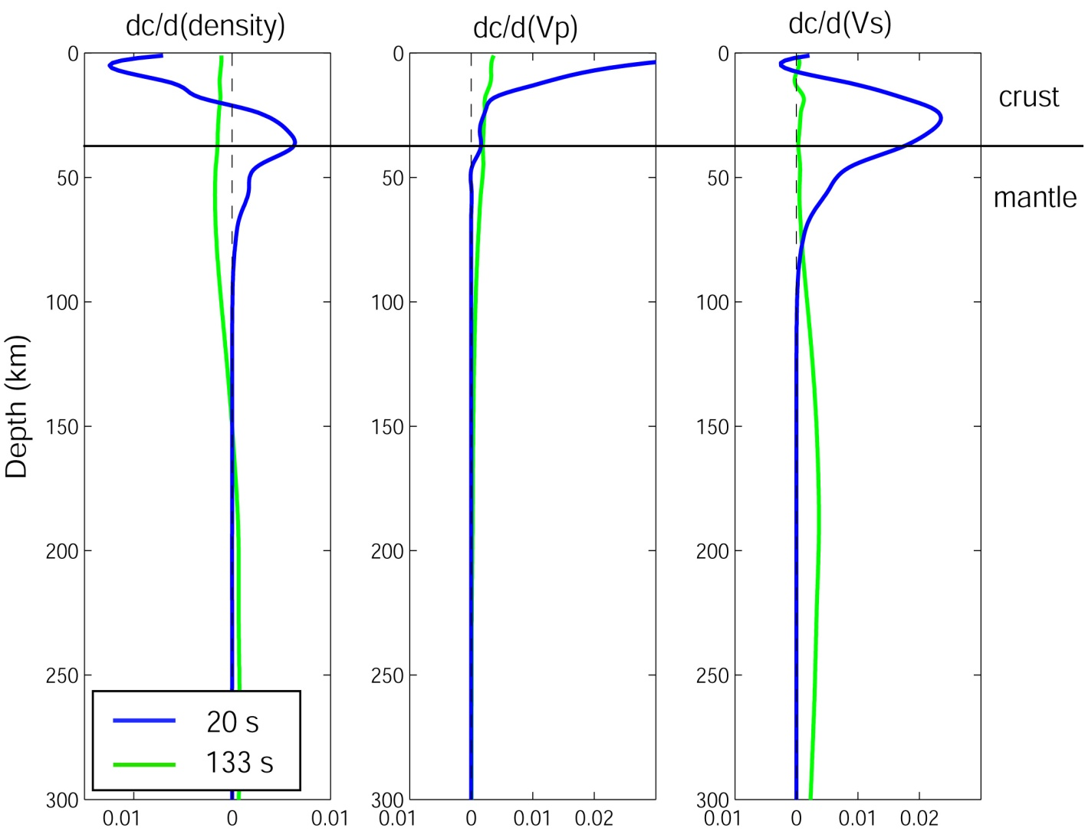
• Surface waves are dispersive: different wavelengths
travel at different velocities and sample different depth
ranges of Earth structure!

Slide 5
Types of Surface Waves:
Rayleigh waves
Lamb waves
Love waves
Stoneley waves
Basically, a surface wave describes any wave that
can only propagate along a free surface (i.e.,
when one of the media has zero shear strength).

Slide 6
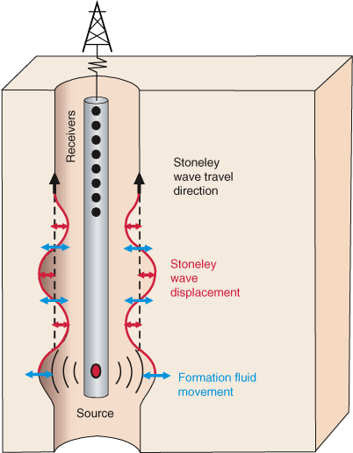
Stoneley (“tube”) waves: Occur under certain conditions
along elastic-fluid or elastic-elastic interfaces. These are a
source of noise in borehole active source seismology
(e.g. wireline logging, or vertical seismic profiling (VSP).
However, they are also
an important source of
signal in borehole
active source
seismology!
TAMU

Slide 7
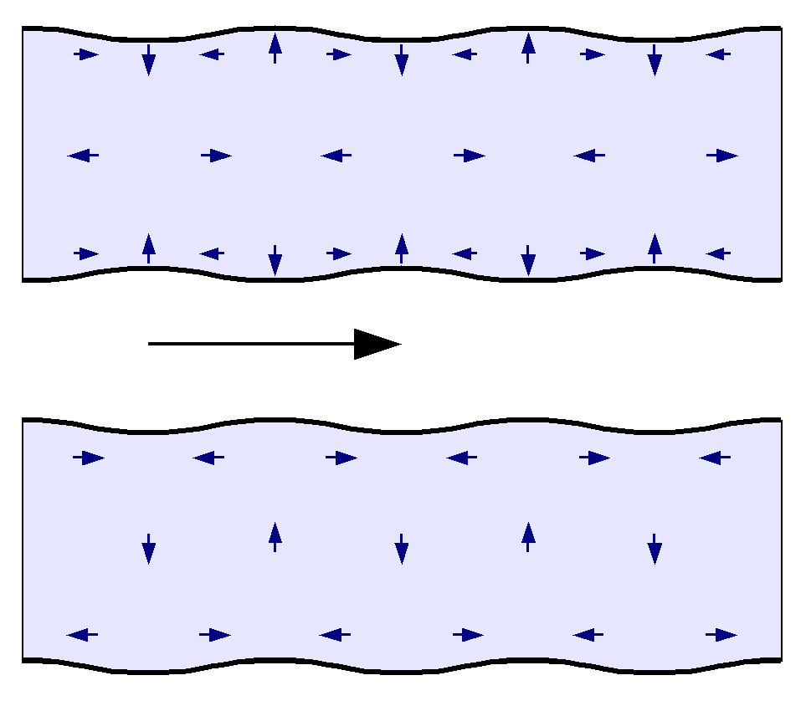
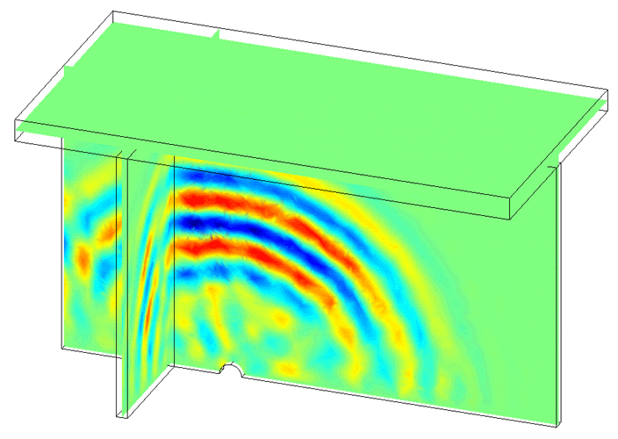
Lamb waves are waves within a plate-like object having
two free-surfaces, and are analogous to Rayleigh waves
in the Earth… Useful e.g. for engineering-related defect
detection.
Here, image of a defect
behaving like a source
disturbance.
Wikicommons
David Greve, Carnegie Mellon

Slide 8
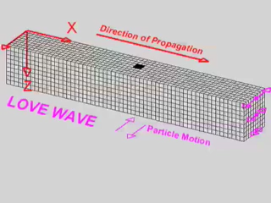
Love waves are composed of SH motion only. These do
not propagate in a uniform flat medium, but can occur in
a curved Earth, or a layered medium.
Courtesy Larry Braile via IRIS

Slide 9
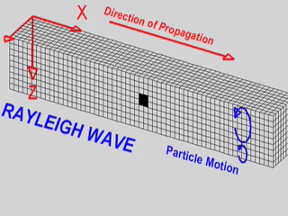
Rayleigh waves are an interference pattern composed of
P-SV motions. These require shear- and normal-stress
σ_{ij} = 0 at an interface (so could occur e.g. along a fracture
as well as at the Earth’s surface).
Courtesy Larry Braile via IRIS

Slide 10
Let’s consider Rayleigh waves first:
Rayleigh waves are a combination of “trapped” (i.e.,
evanescent) P- and SV-waves at a free-surface
interface: That is, shear and normal stress at the
interface must equal zero. To get a feeling for these, let’s
recall the P and SV solutions to the wave equation.
P-wave:
SV-wave:

Slide 11
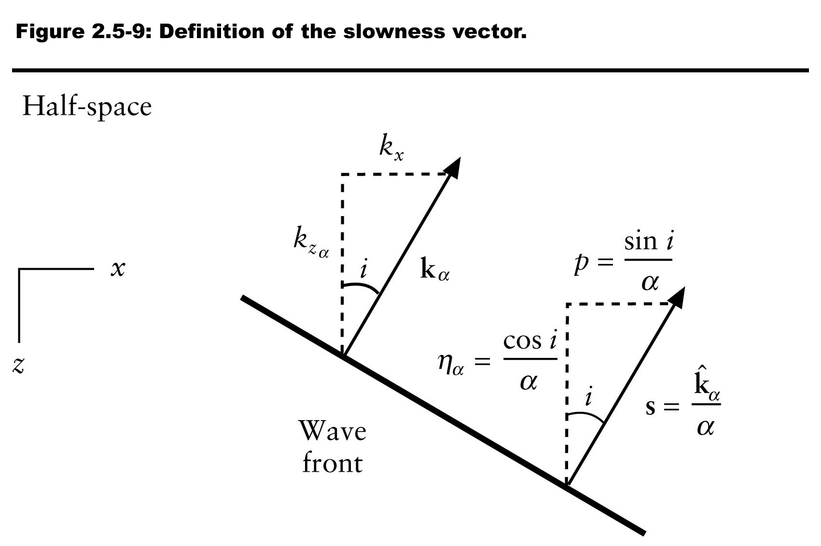
Recall that r is the ratio of the vertical to horizontal
wavenumbers, and c_{x} is the apparent horizontal velocity
of a wave.
Recall also that , and so:
(And note that for these to propagate in combination in a
surface wave, c_{x} must be the same for both!)
. Similarly,

Slide 12
We anticipate the Rayleigh waves are “trapped” waves that
decay away from the free surface, so let’s assume r_{α} and
r_{β} are purely imaginary (similar to what happened for the
evanescent wave earlier). For this condition to hold we
require (because ) that:
c_{x} < β < α
Thus
Another condition we require at a free surface (e.g., the
Earth’s surface) is that shear & normal tractions must be 0:
σ_{xz} = σ_{yz} = σ_{zz} = 0
We can calculate how stress relates to displacement from:
σ_{ij} = λθδ_{ij} + 2με_{ij}
and

Slide 13
We’ve already done this a few times so we’ll skip ahead
to the answers: Given displacement potential amplitudes
A for the P wave and B for the S wave (both unknown),
Since ρα² = λ + 2μ and μ = ρβ ², we can substitute these
into σ_{zz}. Then these equations can be written:

Slide 14
Recall from our tensor review that these have a non-trivial
(non-zero) solution only if the determinant is 0. That
means we have to solve the roots of a polynomial
equation, which we call the Rayleigh function:
This can also be written (e.g., p150 in Shearer):
To simplify this equation we can assume a Poisson’s
solid (ν = 0.25 => λ = μ), in which case:
This has three roots but only one satisfies c_{x} < β < α, so:

Slide 15
Question: Is this relation dispersive?

