Slide 1
Geology 5640/6640
Introduction to Seismology
5 Oct 2020
Last time: Velocity, displacement potentials:
• Wave propagation velocities:
depend on (shallow) porosity
& pore fluid, (deeper)
composition, pressure and temperature (leading to
ambiguities in interpretation).
• Packing structure pushes elasticity & density in different
directions; generally elasticity dominates!
• Solution of the wave equation is made easier by expressing
displacement in terms of scalar & vector displacement
potentials:
In that case:
Read for Wed 7 Oct: S&W 53-62 (§2.4); 458-462
© A.R. Lowry 2020

Slide 2
So what’s the point of this? We want to find some
solution, e.g. for P-wave displacement potential,
that allows for separation of variables:
The eigenfunctions for a partial differential equation
of this form (i.e., functions which, if plugged into the
equation, will yield solutions of similar form) are:
(called the “d’Alembert solution”). Here,
i is the imaginary number
A is amplitude
ω is angular frequency 2π/T (& T is time period)
k is spatial wavenumber 2π/λ (& λ is wavelength)

Slide 3
So let’s plug into
and see what we get after differentiating:
Similarly,

Slide 4
Dividing both sides of the equation by
we’re left with:
as a solution to the P-wave equation! Here it’s useful to
recall that wavenumber k is a vector,
so it has a magnitude and a direction:
This is called the wavenumber vector or wave vector,
and it describes the direction and (inverse) spatial
wavelength of a propagating plane wave.
Noting that ω = 2πf, you may recognize this as α = fλ!
x₃
k
k₃
x₂
k₁
k₂
x₁

Slide 5
Hence we can write our general solution to the P-wave
equation as
Note that here we’ve defined a vector property, which
we will call slowness, as:
Because the forms of the equations are very similar, we
can derive similar solutions for the S-wave equation!

Slide 6
Harmonic Wave Motion:
Let’s consider a harmonic wave with angular frequency ω,
amplitude a, and phase φ = x/c (where x is position & c is
velocity). We can
express this as:
f(t) = a cos(ωt + φ).
We can rewrite this
using a trig identity:
a cos(ωt + φ) =
a cosφ cos(ωt) +
a sinφ sin(ωt) =
a₁cos(ωt) + a₂sin(ωt)
Thus a wave with arbitrary phase can be expressed as a
weighted sum of sin & cos functions! The phase φ is given by:

Slide 7
Also note that .
We can also express a harmonic wave as f(t) = Re{Ae^{–iωt}},
where A has real and imaginary parts A = x + iy, and e
can be expressed via Euler’s identity such that
f(t) = Re{A [cos(ωt) – i sin(ωt)]}
= Re{(x + iy) (cosωt – isinωt)}
= Re{x cosωt – i²y sinωt + i (y cosωt – x sinωt)}
= x cosωt + y sinωt .
This is the same as f(t) = a₁cos(ωt) + a₂sin(ωt) if
a₁ = x = Re{A} & a₂ = y = Im{A}
so the wave equation can be satisfied using either form.
Other trig identities that are useful for translating:

Slide 8
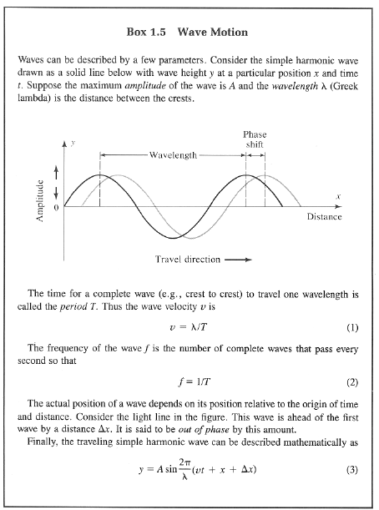
And just in case it’s been
a while since you saw
this in an intro geo class,
Here’s the “Earthquakes &
Volcanoes” (aka “Shake &
Bake”) version from Bolt’s
Earthquakes…
Check out the solution to
the wave equation!

