Slide 1
Geology 5640/6640
Introduction to Seismology
5 Sep 2024
Last time: Overview: Basic Principles of Waves
• Four types of seismic waves: P, S, surface (includes Love
and Rayleigh), normal modes.
Seismic waves are strain waves that propagate in a
continuum… Physics is governed by Hooke’s Law
• Huygen’s Principle: Every point on a wavefront can
be considered a source for the next generation of
wavelets
• Diffractions are predicted by Huygen’s Principle
• But most modeling uses Ray Theory (i.e., the normal to
the wavefront ➔ propagation direction, which defines
travel path (distance) and relates to time by way of velocity)
Read for Tuesday 10 September: S&W 29-52 (§2.1-2.3)
© A.R. Lowry 2011-2024

Slide 2
Last time continued:
• Reflections are wave energy that “bounces off” a surface
dividing media with different velocity properties, remaining
in the original medium
Refractions are energy transmitted through the boundary
into the second medium
• Conversions from P to S particle motion (or vice versa)
almost always occur at these boundaries
• All of these are subject to Fermat’s principle (the principle
of least travel time) and so must obey Snell’s Law…

Slide 3
Reflections & Refractions:
Consider that when a seismic wave meets a layer boundary
between solid media with different velocities V (= fλ = λ/T),
Energy E must be conserved
Stress σ must be continuous (i.e., the same on both sides)
Displacement u must be continuous
This is achieved by “partitioning” the energy between
reflections & refractions, and in most cases by converting
part of the energy from one type of wave to the other!
V₁
V₂
reflected P
refracted P
reflected S
refracted S
incoming P

Slide 4
Reflections & Refractions:
All of the reflected and refracted waves must obey
Snell’s Law. Consequently,
A reflected wave (traveling at the same velocity) will have the
same angle of incidence as the incoming wave.
A reflected or refracted wave traveling at faster velocity will
be bent toward the layer boundary.
A reflected or refracted wave traveling at slower velocity will
be bent away from the layer boundary.
reflected P
refracted P
reflected S
refracted S
incoming P

Slide 5
Consider a common scenario of a source at the surface
traversing the boundary between a slower upper & faster
lower layer:
There will always be some angle of incidence for which the
the angle of the refracted ray is parallel to the layer boundary.
Rays arriving at angles > the critical angle will not transmit
refracted wave energy into the lower layer (only reflections or
conversions). The critical angle, θ_{c}, is given by:
or

Slide 6
Ray representation of seismic wave propagation:
If seismic waves are (relatively) easily represented by rays
(= the direction of propagation and the normal to the
wavefront; parallel (P) or orthogonal (S) to particle motion)
But the directions are changing (by Snell’s Law) as the wave
propagates through the medium…
What are some important things we want to keep track of?
reflected P
refracted P
reflected S
refracted S
incoming P

Slide 7
Seismo-Math & Notation
(“Introduction” to Vectors)
Vectors:
z
x₃
y
x₂
x
x₁
We’ll use these notations for Cartesian coordinate systems
interchangeably…
Vectors have direction and magnitude; in these notes we may
denote as boldface u or with an overbar or arrow .
A hat-sign denotes a unit direction vector .

Slide 8
A vector v from point Q at coordinate (0, 0, 0) to point P at
coordinate (a, b, c) may be denoted by any of
z
P (a,b,c)
Q (0,0,0)
c
a
y
b
x
More generally, v between Q at (X₁,Y₁,Z₁) and P at (X₂,Y₂,Z₂)
can be expressed as any of:
Length of a vector is the square-root of the summed-squared
elements, i.e.,

Slide 9
Addition and Subtraction of vectors is performed
element-wise. If:
Then:
(You could show this graphically too).
A scalar multiplied by a vector gives:
and

Slide 10
Properties of Vector Addition and Multiplication:
Commutative:
Associative:
Distributive:
Some Special Vectors:
Null:
Unit: has length 1: Note a unit vector in any
direction can be defined as:

Slide 11
Example Unit Vectors:
Thus we can write any vector in the form, e.g.:
Part of this course will include an “introduction” to
linear algebra…
This (rows times columns) representation of
vector multiplication is standard and will crop up a
lot in this class!

Slide 12
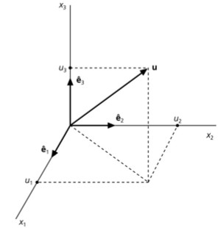
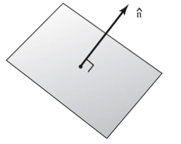
Note that other notations are common…
This is figure A.3-1 from the appendices
of Stein & Wysession. , and are
sometimes used to denote three (arbitrarily-
oriented) orthogonal directions, which
may or may not equal , and .
A normal is a unit vector that
is perpendicular to a plane or surface.
Recall that unit means !

Slide 13
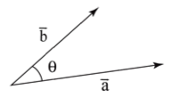
Multiplying Vectors:
A dot product represents the length of one vector multiplied
by length of its projection onto another (i.e., a measure of
how parallel
they are).
Hence, the dot product is a scalar value.
We could also write this as:
The latter, in which the repeated index implies the summation,
is called Indicial Notation (or Einstein summation
notation) & shows up a lot in seismology!
Given and ,

Slide 14
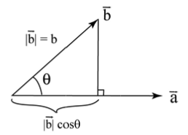
The dot product is easily shown to have associative,
commutative and distributive properties…
It is also useful for calculating the angle between two vectors:
➔
We can also use it to calculate the
projection of some vector b onto
the direction of another vector a:

Slide 15
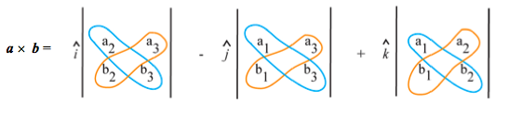
The Cross Product of two vectors is defined as:
This produces a new vector that is orthogonal (perpendicular)
to the plane spanned by a and b (with length = area of the
parallelogram described by a and b).
We can express this algebraically as the determinant of a matrix:
(Here, the straight lines surrounding the
matrix denote the determinant operation).
The determinant of a 3x3 matrix can be
derived from
2x2 matrix
determinants as
shown at left:
(a₂b₃ – b₂a₃)
(a₁b₃ – b₁a₃)
(a₁b₂ – b₁a₂)

Slide 16
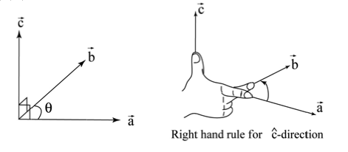
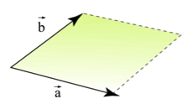
The cross product c = a×b obeys the right-hand rule:
And the length of c is defined by ||c|| = ||a×b|| = ||a|| ||b|| sinθ.
Hence, the cross-product can be thought of as a measure
of how orthogonal two vectors are.
The length ||a×b|| also equals the
area of a parallelogram defined
by a and b:
||c||

Slide 17
The cross-product is:
Anti-commutative: a×b = –b×a
Distributive: a×(b + c) = a×b + a×c
Associative: (a×b)×c = a×(b×c)

