Slide 1
Geology 5640/6640
Introduction to Seismology
7 Nov 2024
Last time: Surface waves
• Surface waves (evanescent waves trapped at a surface)
include Stoneley, Lamb as well as Rayleigh, Love waves
• Stoneley waves (“tube” waves) occur in boreholes;
used to characterize near-hole environment in industry
• Lamb waves occur in plates or low-velocity waveguides;
analogous to Rayleigh waves but not often used in Earth
science (although they have engineering applications)
• Rayleigh waves are interference patterns involving a
combination of P & SV waves at a free surface (i.e. σ_{i3} = 0),
with identical surface velocity c_{x} = 1/p
Love waves are interference patterns of two SH-waves
Read for Tuesday 12 November: S&W 101-115 (§2.9)
© A.R. Lowry 2011-2024

Slide 2
Last time continued: Rayleigh Waves
• Rayleigh waves are interference patterns involving a
combination of P & SV waves at a free surface (i.e. σ_{i3} = 0),
with identical surface velocity c_{x} = 1/p
• Imposing identical c_{x} = 1/p and stress σ_{i3} = 0 at a free surface,
we can solve for amplitudes A & B of the P-wave and
SV-wave that satisfy the constraints, leading to the
Rayleigh function (which for uniform velocity, λ = μ, is):

Slide 3
Reminder:
Exam 1 is posted on the course website;
Due at classtime Tues November 19

Slide 4
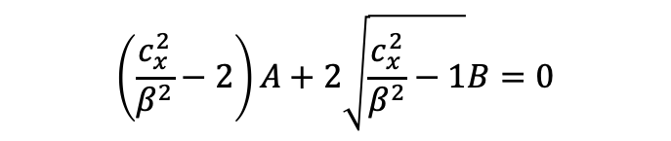
Once we know the propagation velocity c_{x}, we can solve
for the amplitudes A, B, from the system of equations:
These are amplitudes in terms of displacement potentials
φ, ψ… We’d like to know the amplitudes in terms of
displacements. For P- and SV-waves only:
If we evaluate these and take only the real component,
we get (for the uniform Poisson solid case):
$$\left(\frac{c_{x}^{2}}{β^{2}}−2\right)A+2\sqrt{\frac{c_{x}^{2}}{β^{2}}−1}B=0$$

Slide 5
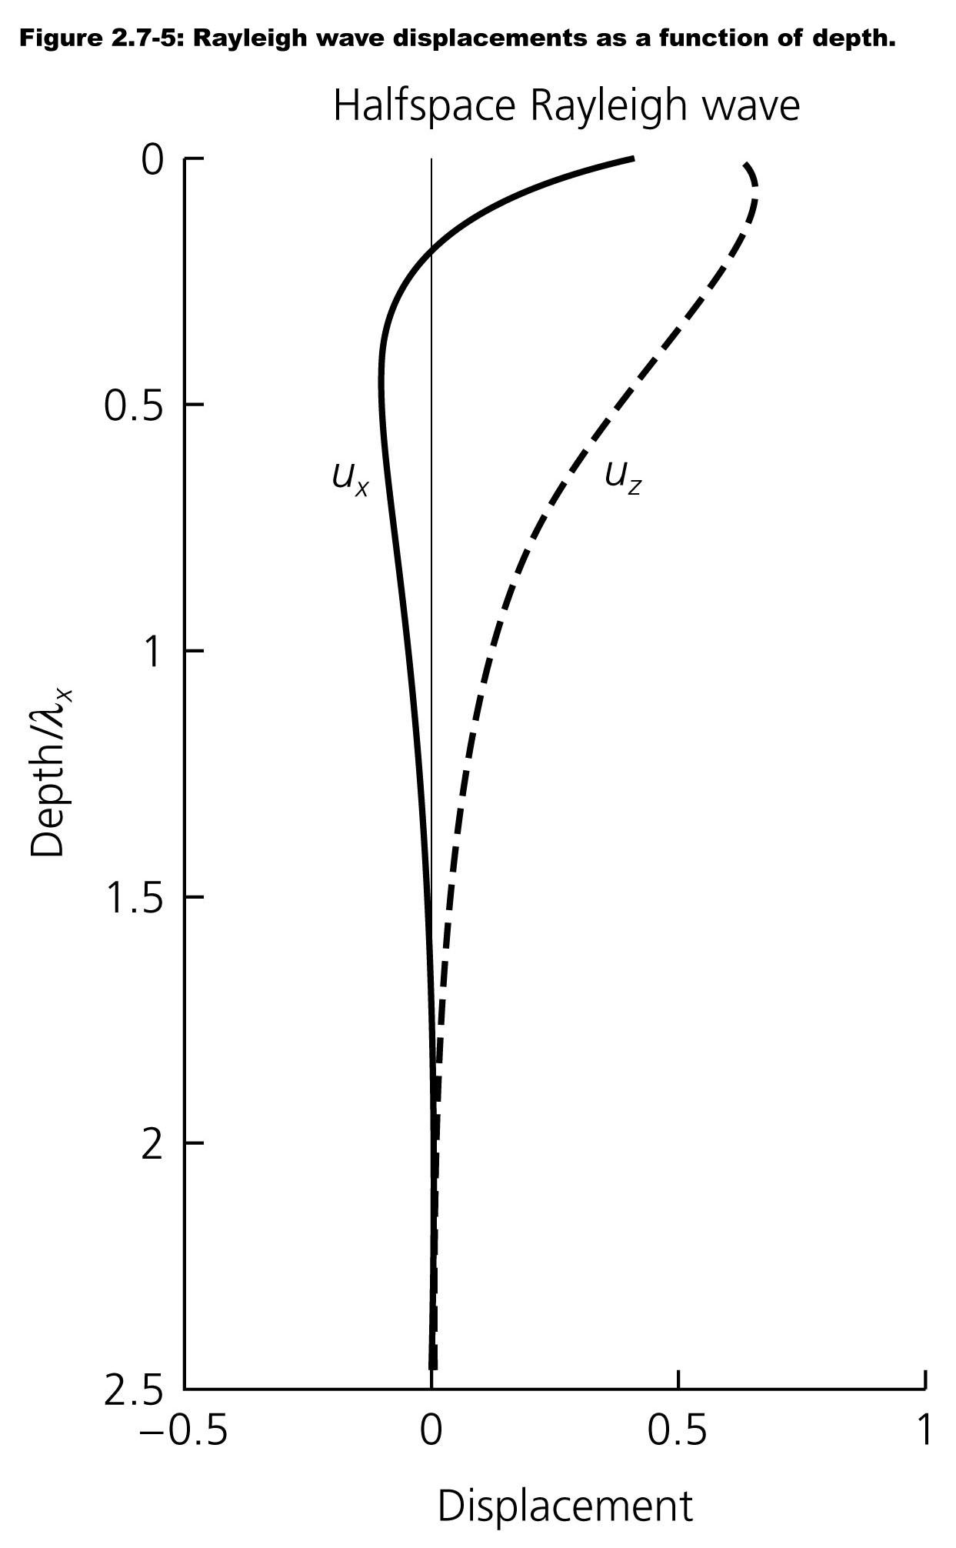
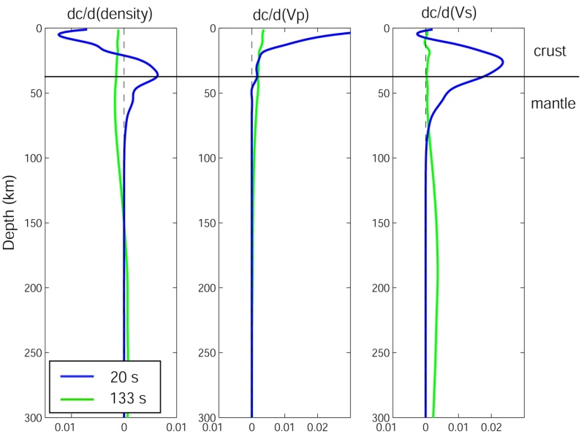
Here’s what this
looks like:
More generally velocity (and density) vary
with depth in the Earth…
But that’s for
constant velocity
& λ = μ only!
Here’s how velocity c_{x} depends on V_{P}
and V_{S} (& density ρ) for two different
periods T (= λ_{x}/c_{x}) for a PREM 1D Earth…

Slide 6
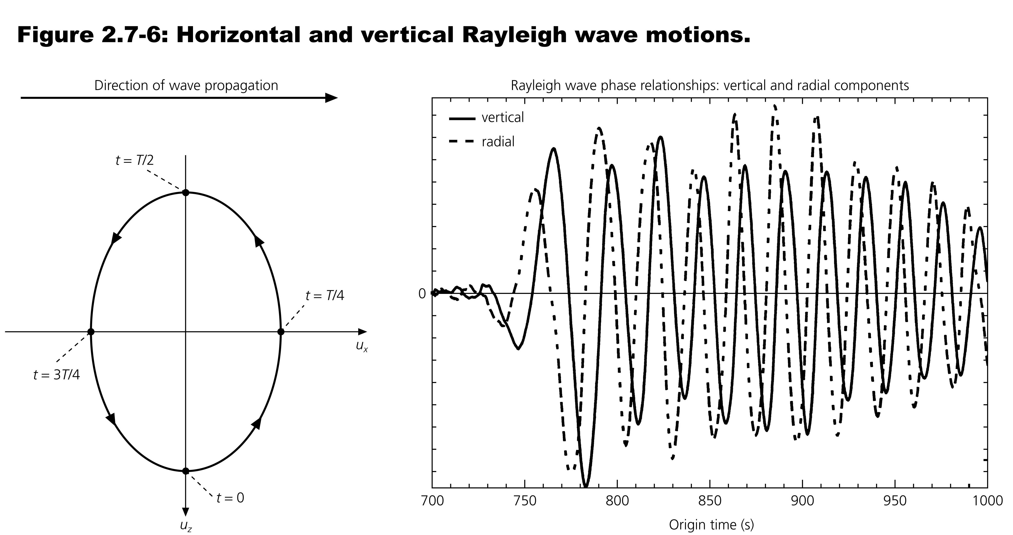
Now let’s consider particle motion in a Rayleigh wave, i.e.,
displacement of a specific point in the Earth. At z = 0:
cos and sin are 90°out of phase, so a particle on the surface
traces an elliptical motion. At depth, the sense of rotation
changes from retrograde (CCW) to prograde (clockwise).

Slide 7
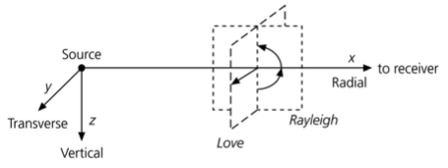
Love Waves
• Consist of SH motion only
• Need a positive velocity jump or gradient to exist
• Are inherently dispersive
(Note Rayleigh waves are also dispersive on Earth, but not
inherently: They are because different wavelengths
sample different depths, and velocity increases with depth).

Slide 8
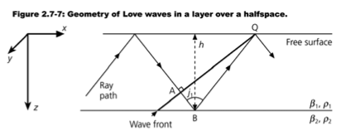
For a simple Love wave, let’s consider a (lower-velocity) layer
over a (higher-velocity) infinite half-space:
Consider a single SH wave which is a simple harmonic (sin).
As it bounces around in the layer, there are multiple places
on the wavepath where the phase is the same.
Let’s look for places where the wave might experience
constructive interference at the surface, i.e. conditions
for which the phase at point A is the same as at point Q.
(Note that for this SH
wave to generate a
Love wave, j₁ must
be post-critical.
Why?)

Slide 9
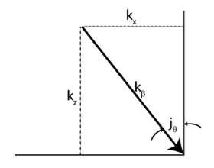
(imag)
First we need to remind ourselves what
phase is! A complex number can be
represented in the complex plane as
z = x + iy = r e^{iφ}, where φ is the
phase angle:
So for a typical SH wave represented as displacement:
the phase is φ = ωt – k_{x} x – k_{z} z. To simplify, we can rotate
our spatial axes into the propagation direction (or ray) to
get:
where k_{β} is the modulus of the
wavenumbers k_{x} & k_{z}, and d is
distance along the raypath.
r
y
φ
x
(real)

