Slide 1
Geology 5640/6640
Introduction to Seismology
8 Oct 2024
Last time: Seismic phases; the ray parameter
• Seismic arrivals or phases are identifiable by their arrival
times, which in turn imply travel path and can be labeled
(e.g. SKS)
• They are also distinguished by their directions and
amplitudes: e.g., Raleigh wave has large amplitude in
radial/vertical; Love wave only in transverse
horizontal component; and SKS in the radial horizontal
component.
• The ray parameter p also describes travel path
of a particular phase in terms of its angle from
vertical, θ, and velocity c. p is constant for a given
ray and corresponds to the inverse horizontal velocity!
(This expression for p assumes a Cartesian Earth! Spherical comes later…)
Read for Tuesday 8 October: S&W 62–75 (§2.5)
© A.R. Lowry 2011-2024

Slide 2
Last time continued: Seismology as investigative
tool
• Deep-Earth investigations use earthquakes as sources,
three-component broadband seismometers as receivers,
and are a primary tool for investigating properties and
processes in the Earth’s deep interior!

Slide 3
Assignment 1
is now posted on the course website…
Along with other materials you’ll need.
Due Tuesday, 15 October at 9:00 am

Slide 4
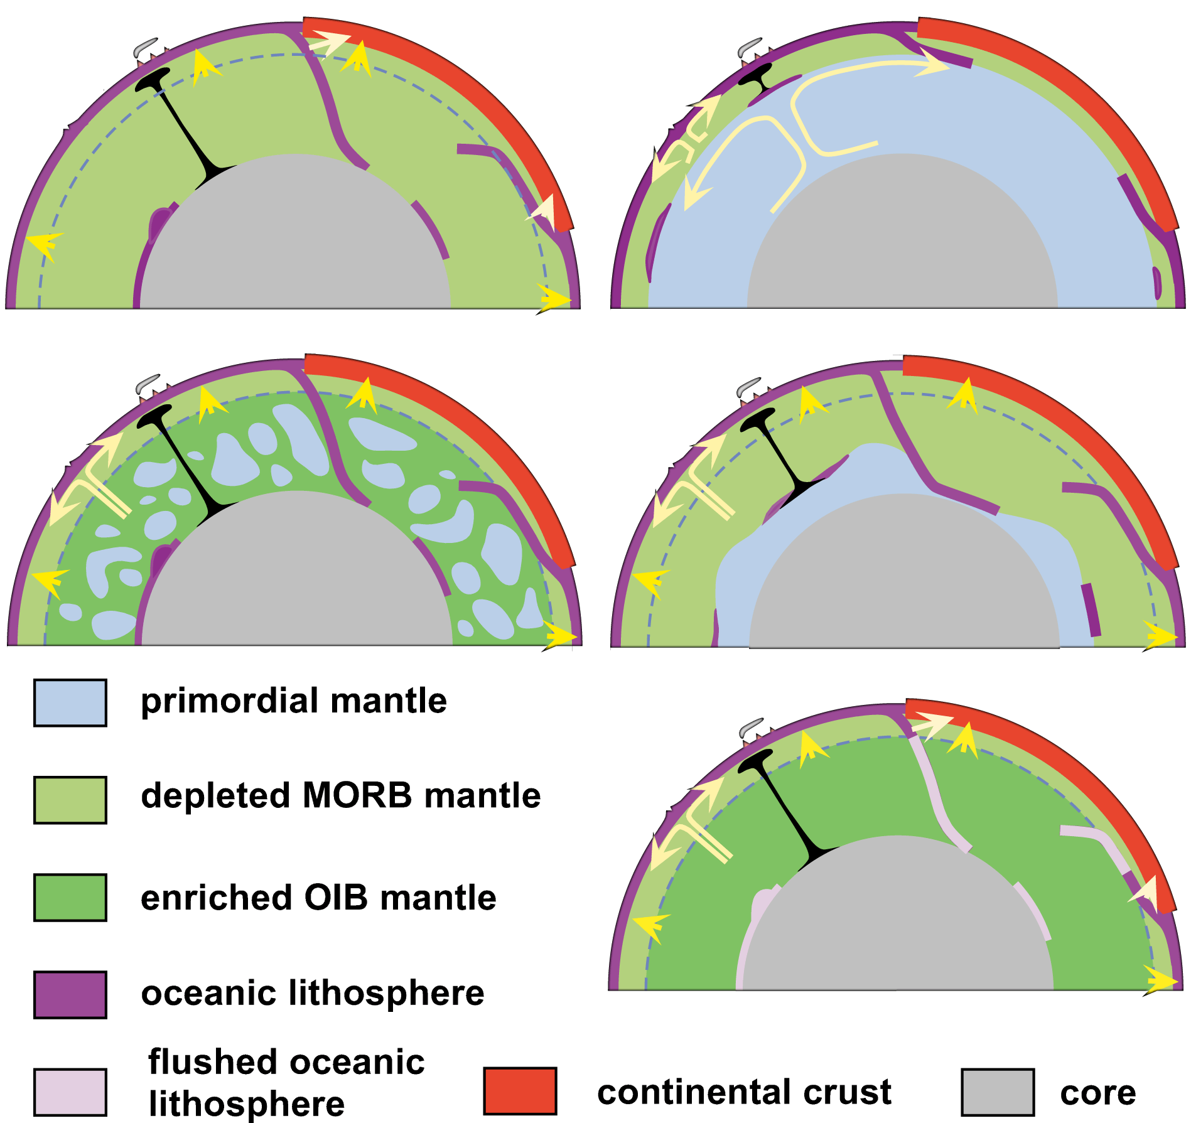
Data, models, hypotheses, and speculation from a number of geodisciplines have resulted in end-member models for flow in the mantle…
The Earth is not simply an onion made up of radially symmetric layers.
Albarede & van der Hilst (Eos, 1999)

Slide 5
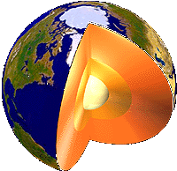
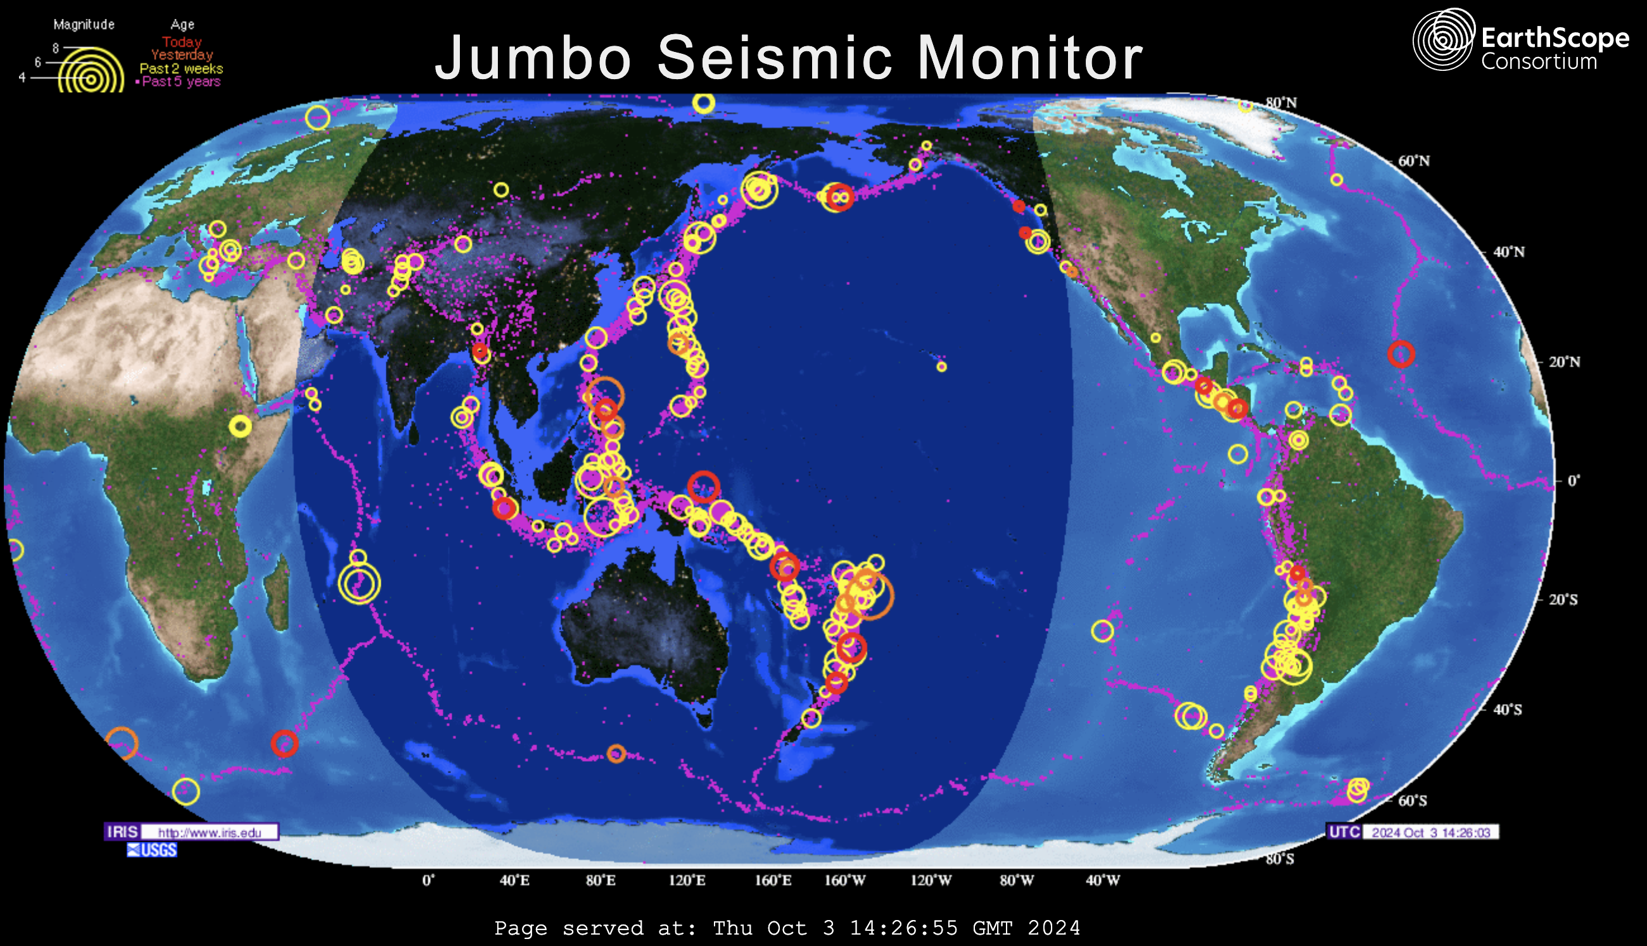
Remote Sensing using Earthquakes
Many earthquakes each year are strong enough to generate signal at antipodes:
10 major (magnitudes 7-8) 32+ megaton ~ Largest test
100 large (6-7) 1+ megaton
1000 damaging (5-6) 32+ kiloton ~ Trinity
Lars Stixrude
ds.iris.edu/seismon/index.phtml

Slide 6
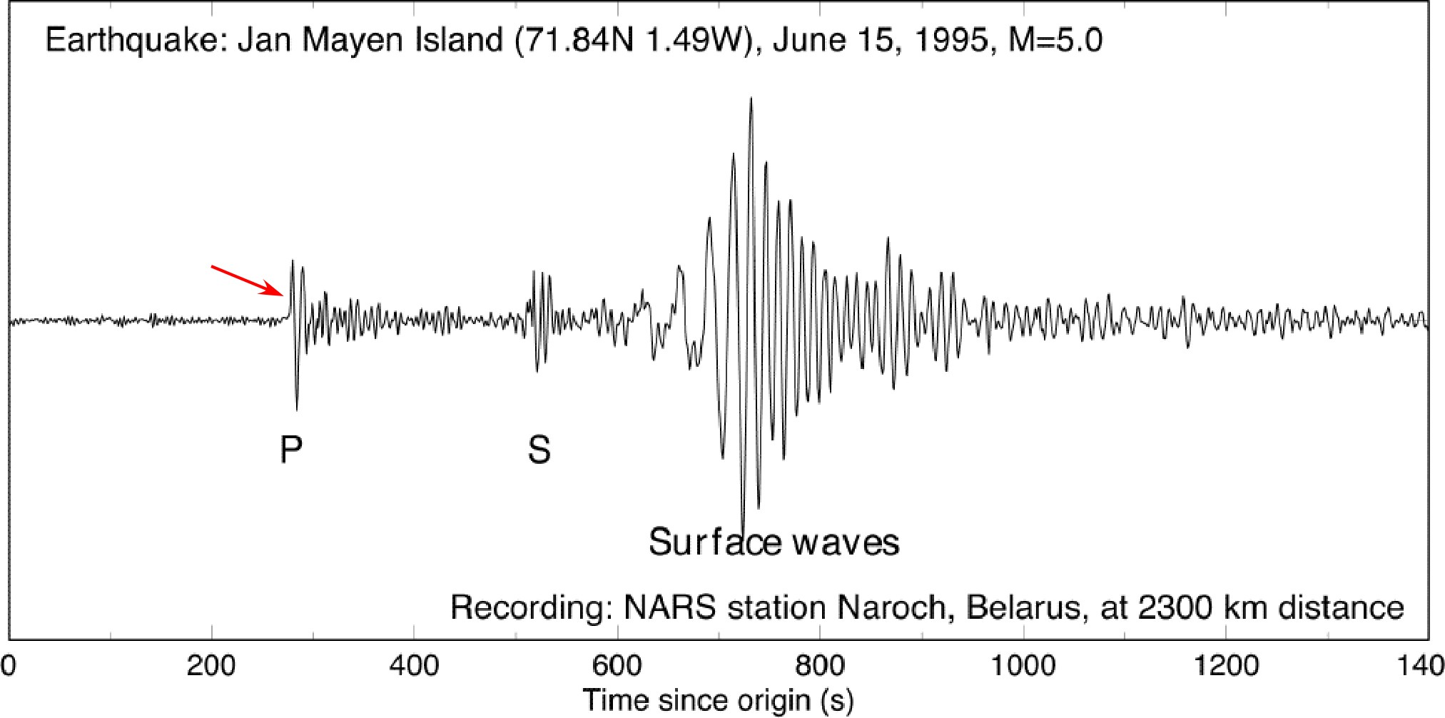
Detector: Seismograph
Lars Stixrude

Slide 7
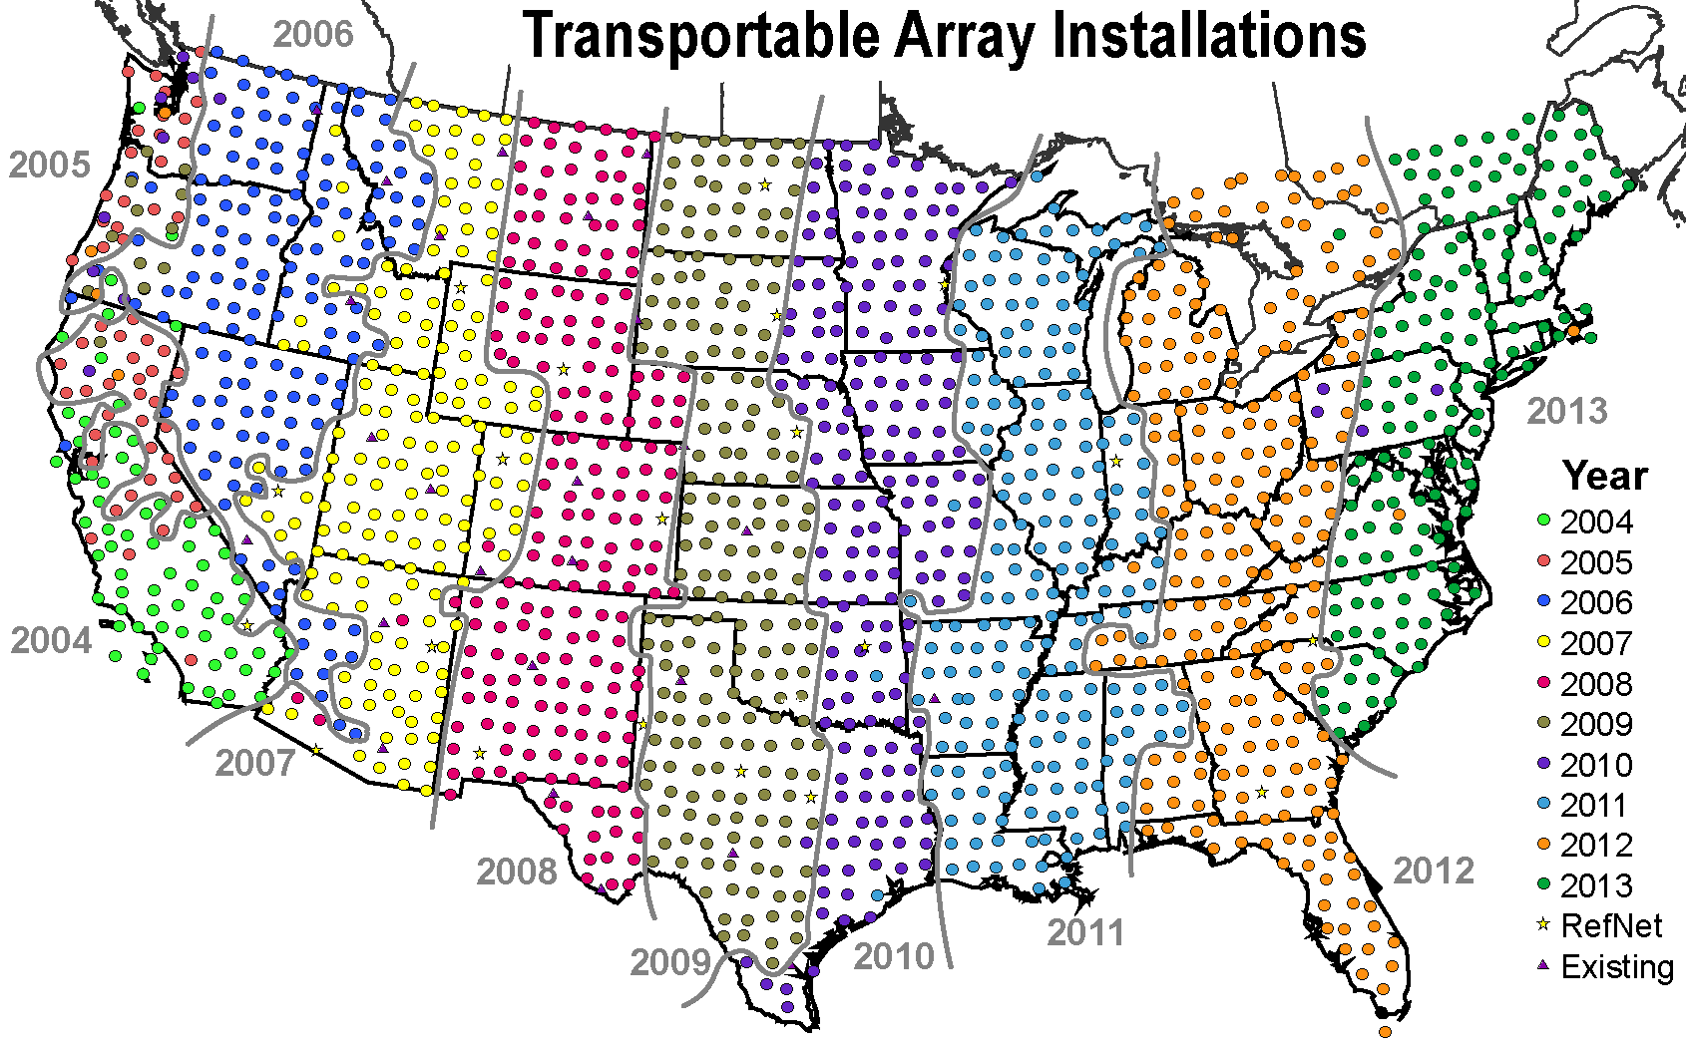
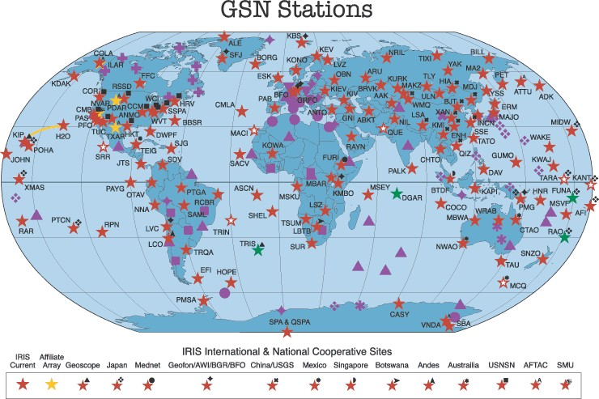
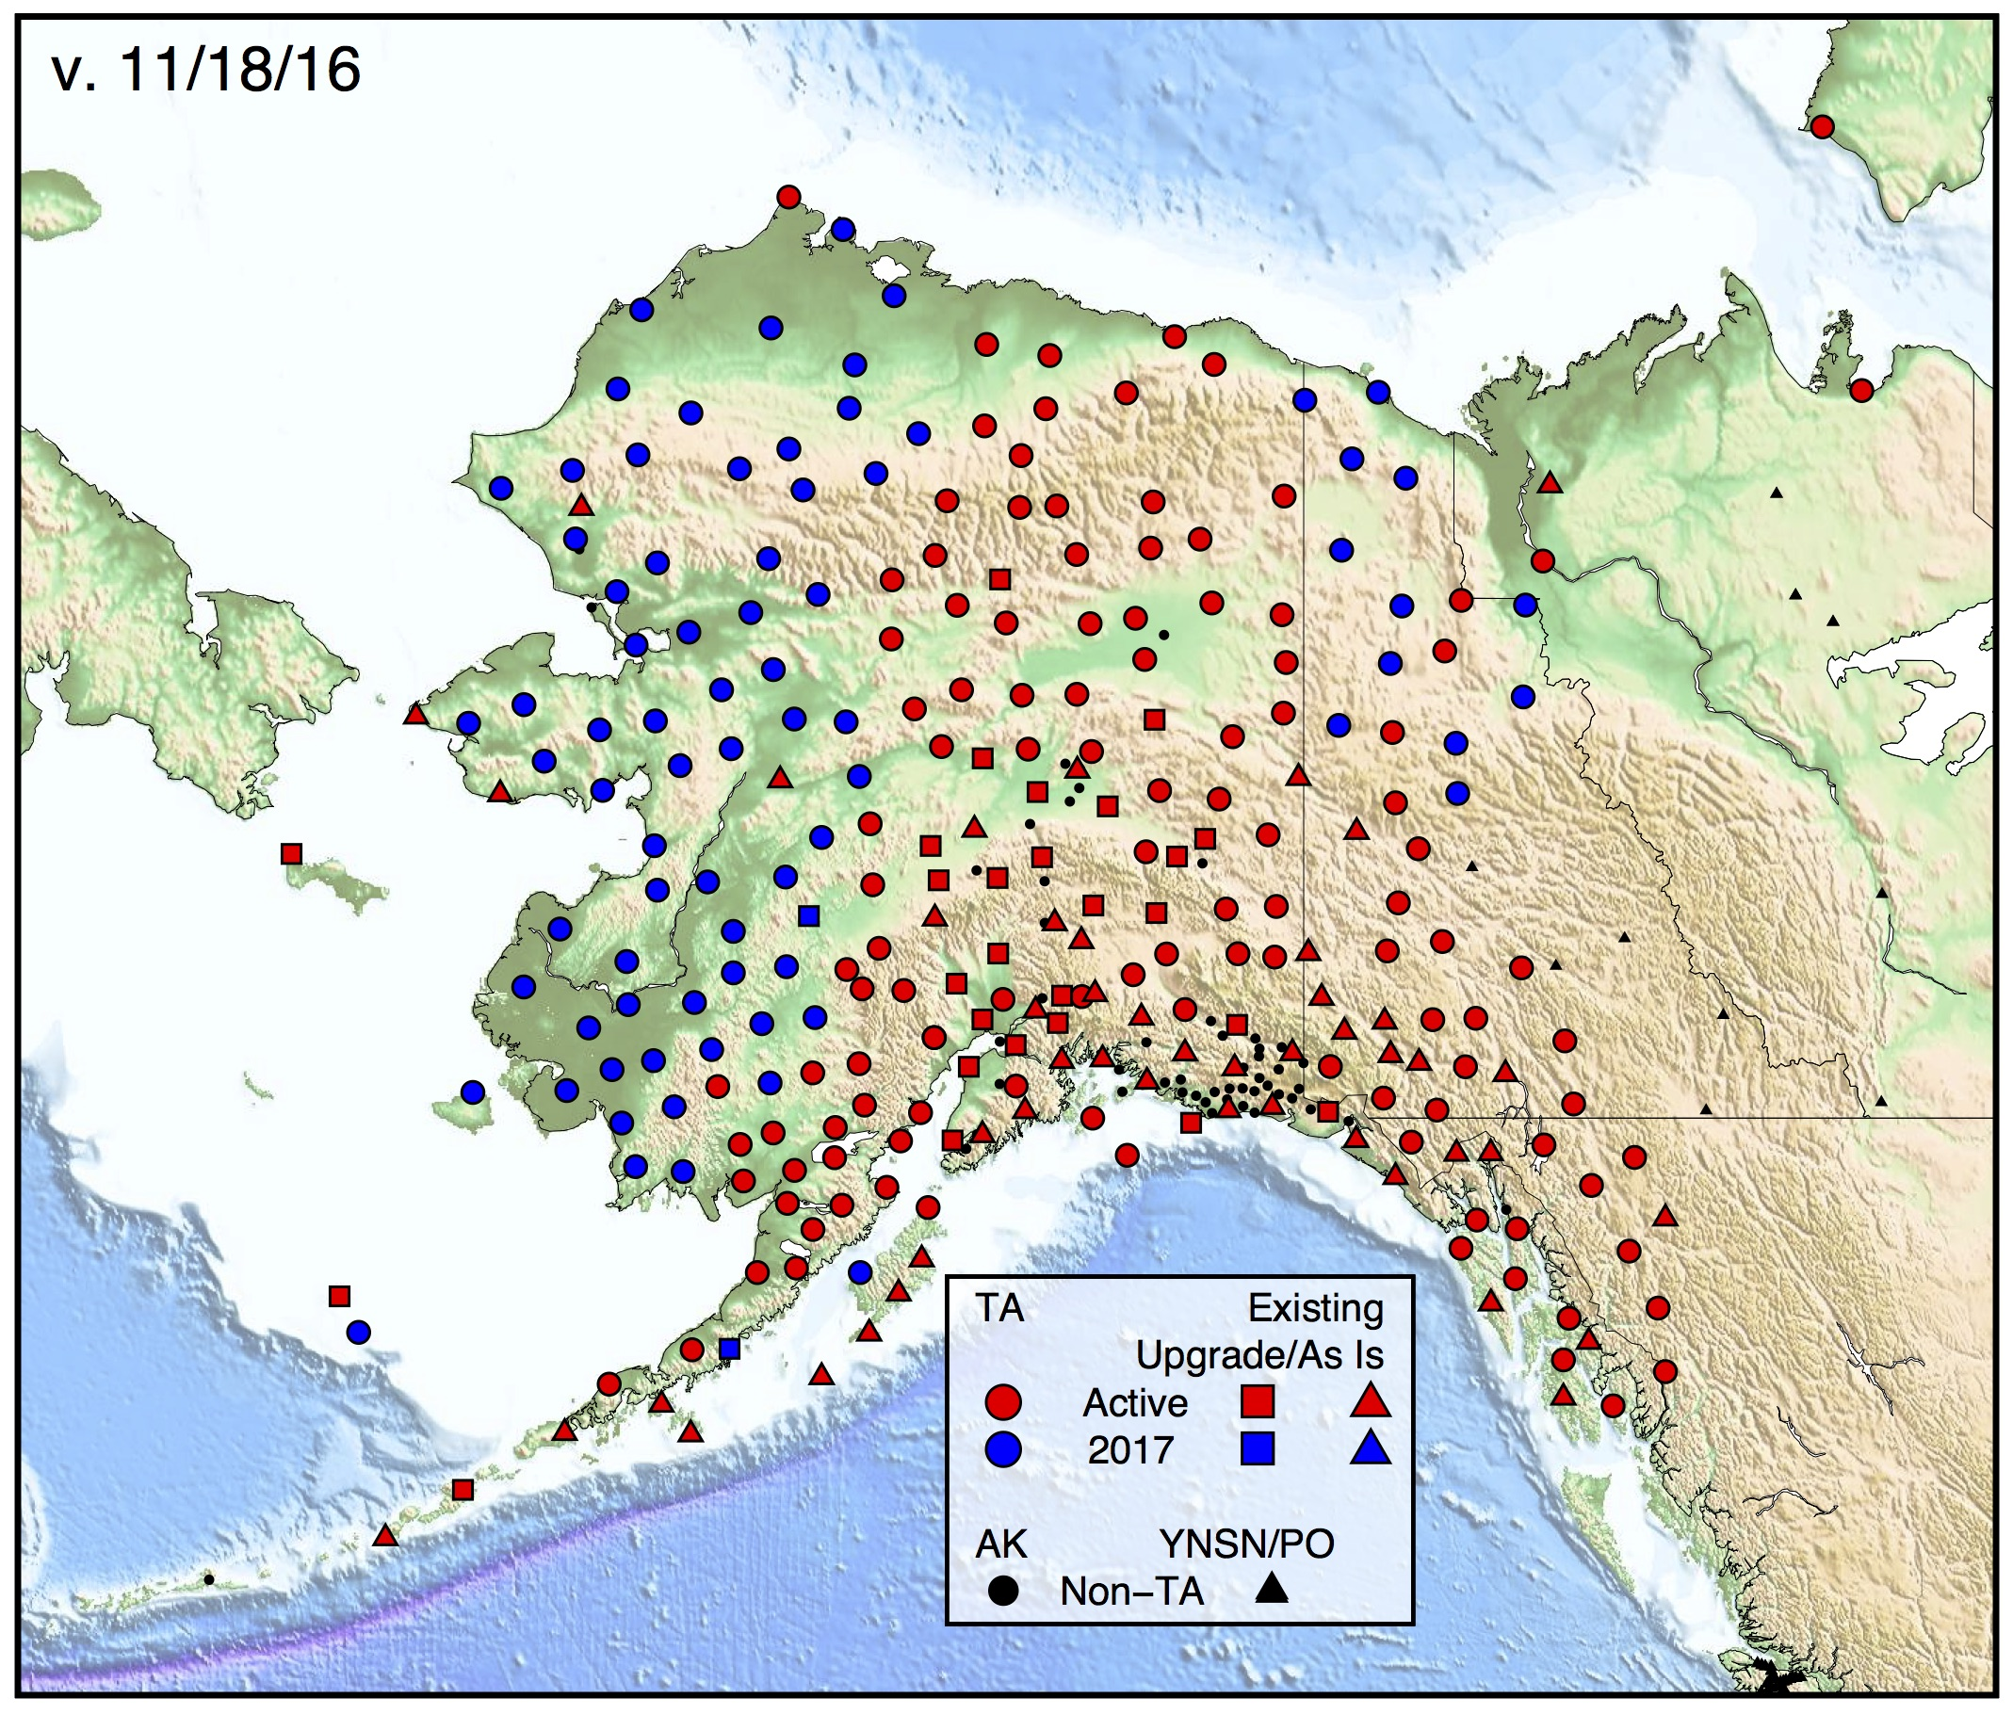
Seismic networks
USArray
Global Seismic Network
Lars Stixrude

Slide 8
Types of Seismic Analysis
(for Earth structure… Earthquake source analysis is
another topic for another day!)
• Normal modes
• Arrival times of “precursors”
• Numerical modeling of waveforms
• Deconvolve “source term” from observed waveform:
receiver functions
• Anisotropy
• Travel-time tomography
• Ambient noise (surface wave) tomography
(There are more!)

Slide 9
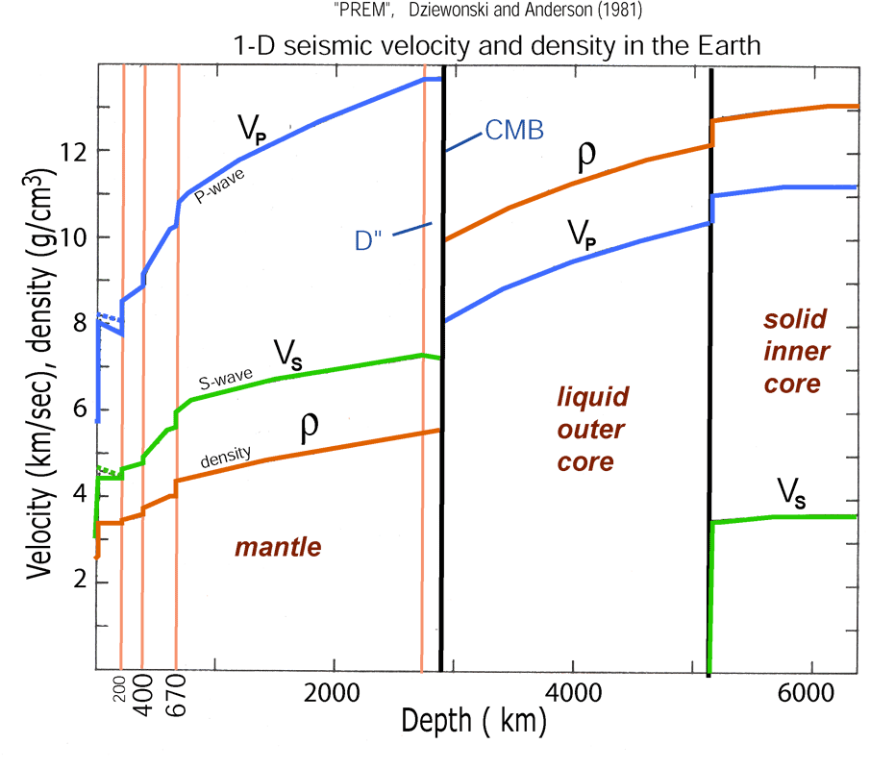
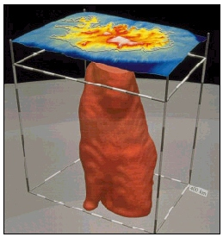
Normal Modes
Wolfe et al. Nature 1997
The first image to show a “plume”
structure in the lower mantle used
normal modes...
PREM is derived from normal modes, but they also can be used
to image three-dimensional structure (e.g. from splitting)

Slide 10
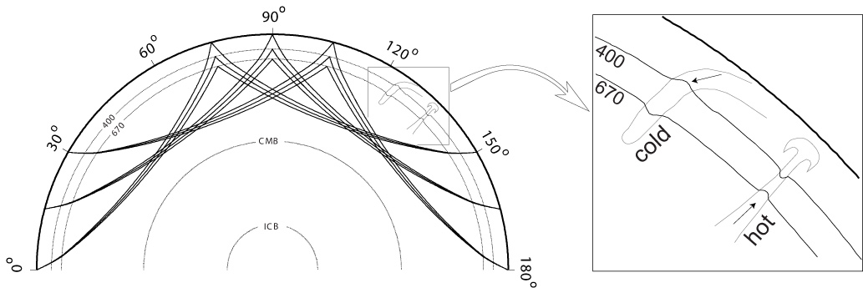
SS and SS Precursors:
Imaging upper mantle discontinuities and transition zone structure
Ed Garnero
Schmerr and Garnero [2006, JGR]

Slide 11
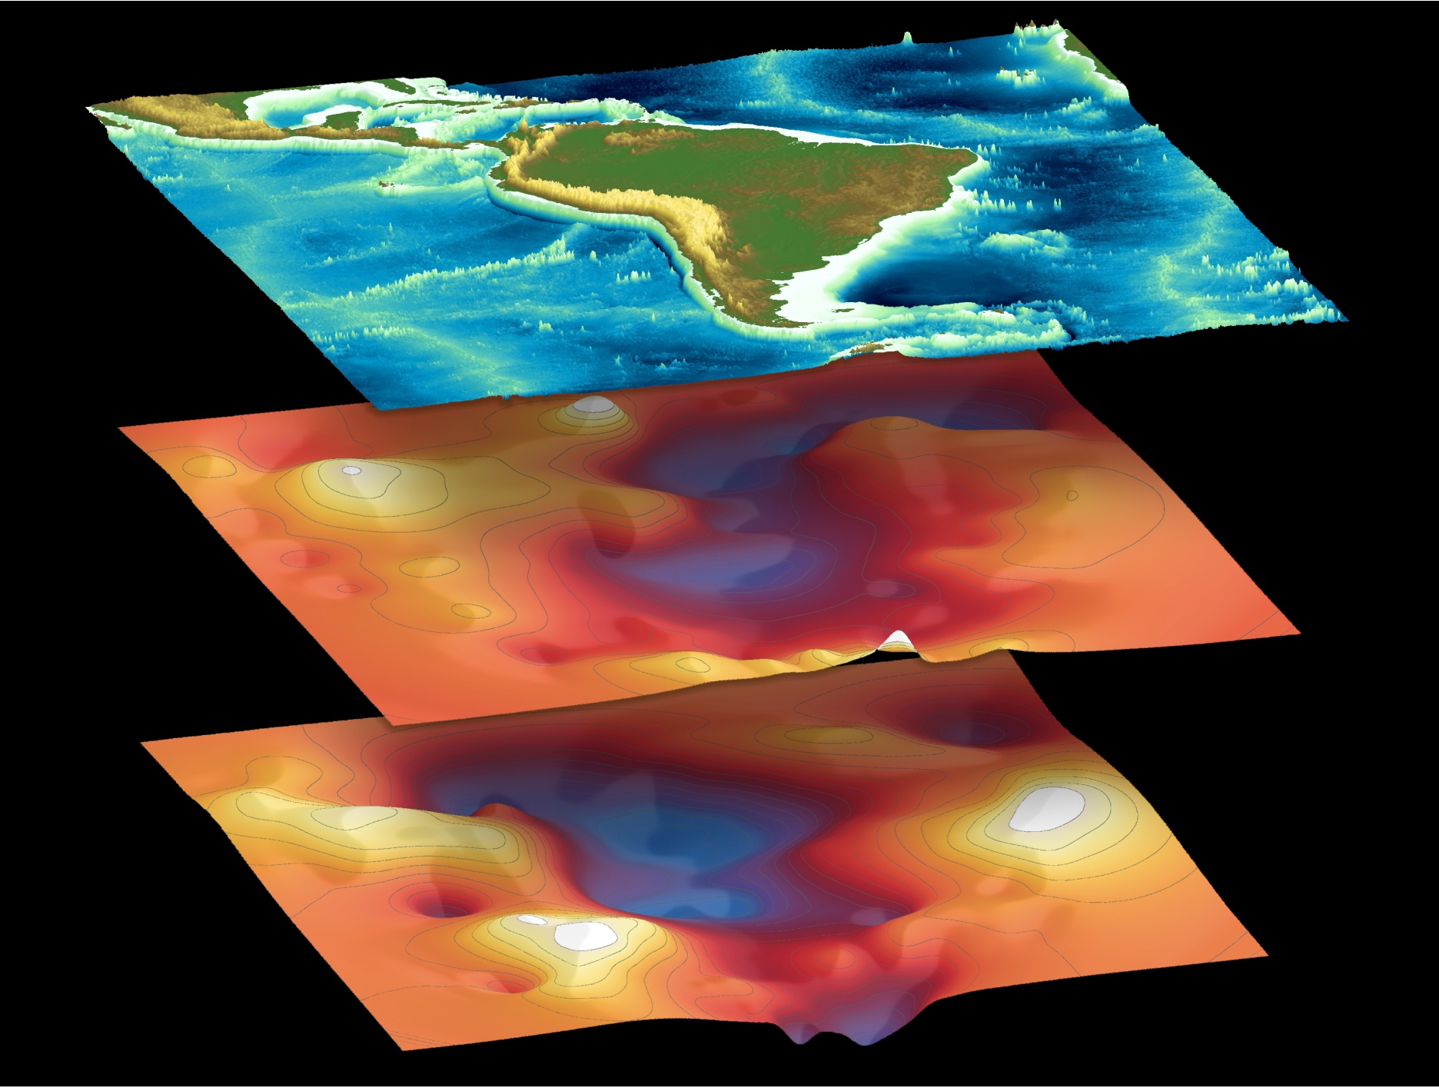
Upper mantle discontinuity topography
410
topography
660
topography
Ed Garnero
Schmerr and Garnero [2007, Science]

Slide 12
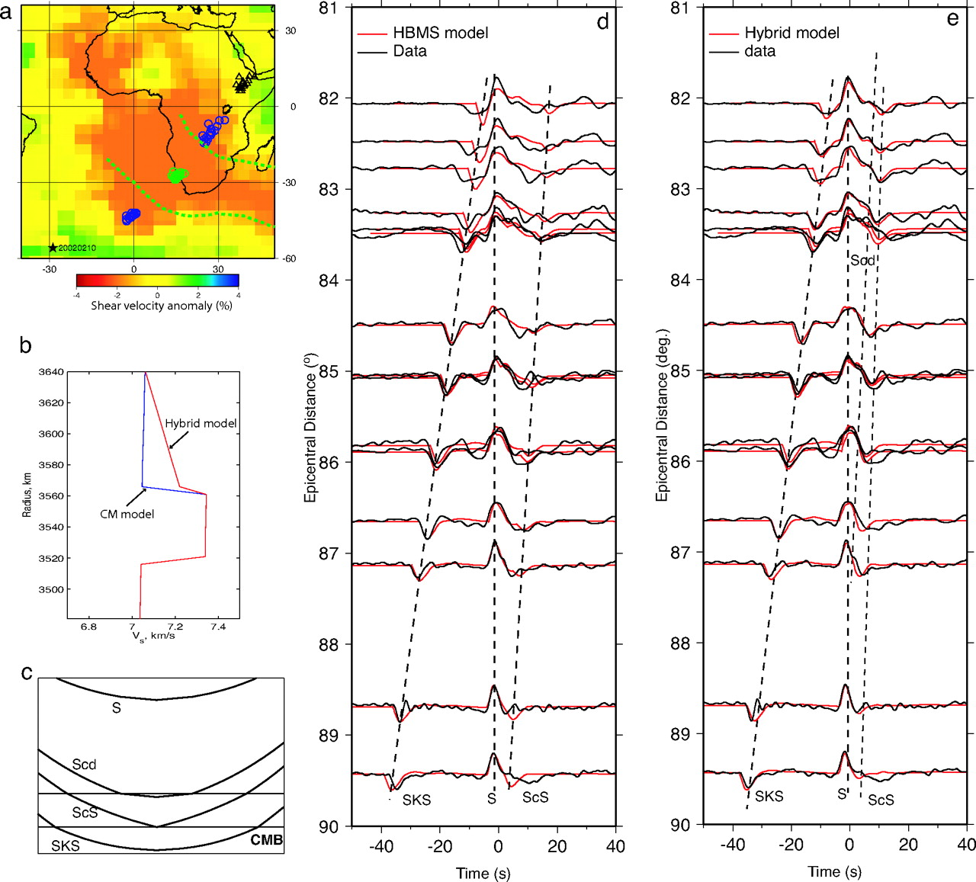
Waveform Modeling
Waveform modeling of a D” triplication from the
Ethiopia/Kenya array from a deep Sandwich Island event
HBMS = High bulk
modulus structure,
implies a lower shear
velocity, higher
temperature, higher
density chemical
layer at the core-mantle
boundary...
The inferred “fast lens”
Would be 90 km above
the CMB.
Sun D et al. PNAS 2007;104:9151-9155

Slide 13
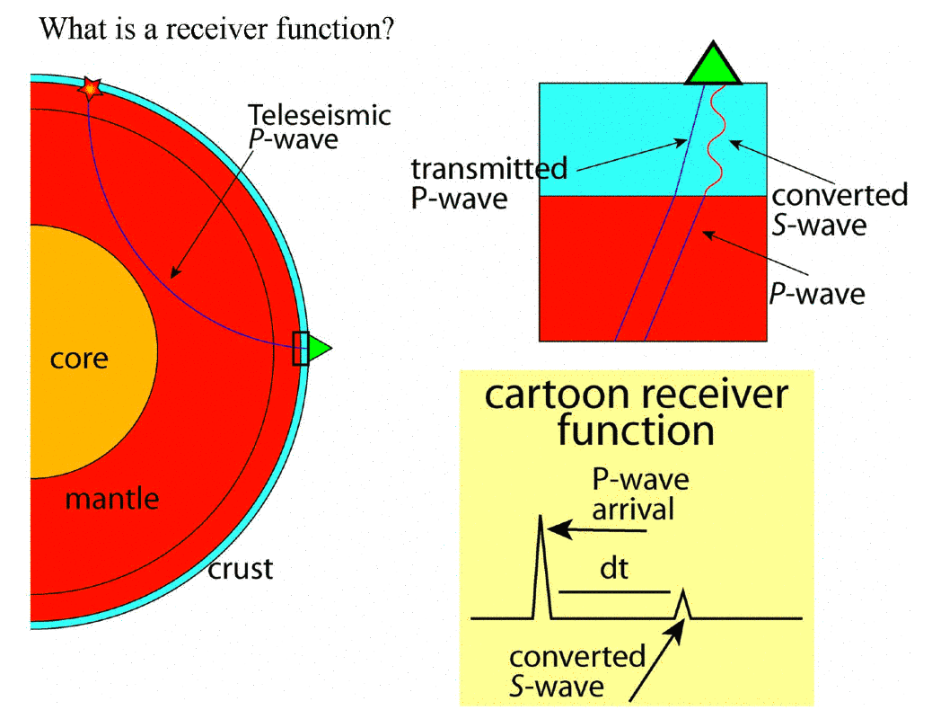
Receiver Functions
Jessie Lawrence

