Slide 1
Geology 5640/6640
Introduction to Seismology
9 Nov 2020
Last time: Evanescent waves; Surface waves
• A wave arriving with incident angle ≥ the critical angle (i.e.,
j₁ ≥ sin^{–1}(β₁/β₂)) still requires continuity of stress and
displacement. Transmission is “imaginary”, & solution is
e.g.:
These exponentially decaying “trapped” displacements
are called evanescent waves
• When an evanescent wave occurs, balancing of the stress
and displacements at the boundary yields reflection and
transmission coefficients that are complex numbers; the
imaginary part of these results in a phase delay of the
reflected and converted waves!
Read for Wed 11 Nov: S&W 86–100 (§2.7–2.8)
© A.R. Lowry 2020

Slide 2
Last time continued: Surface waves
• Surface waves (Love, Rayleigh) are important because:
→ Cylindrical spreading (A ∝ 1/√r) ⇒ these are the largest
arrivals outside the near-field
→ They are responsible for most of the damage in
earthquakes!

Slide 3
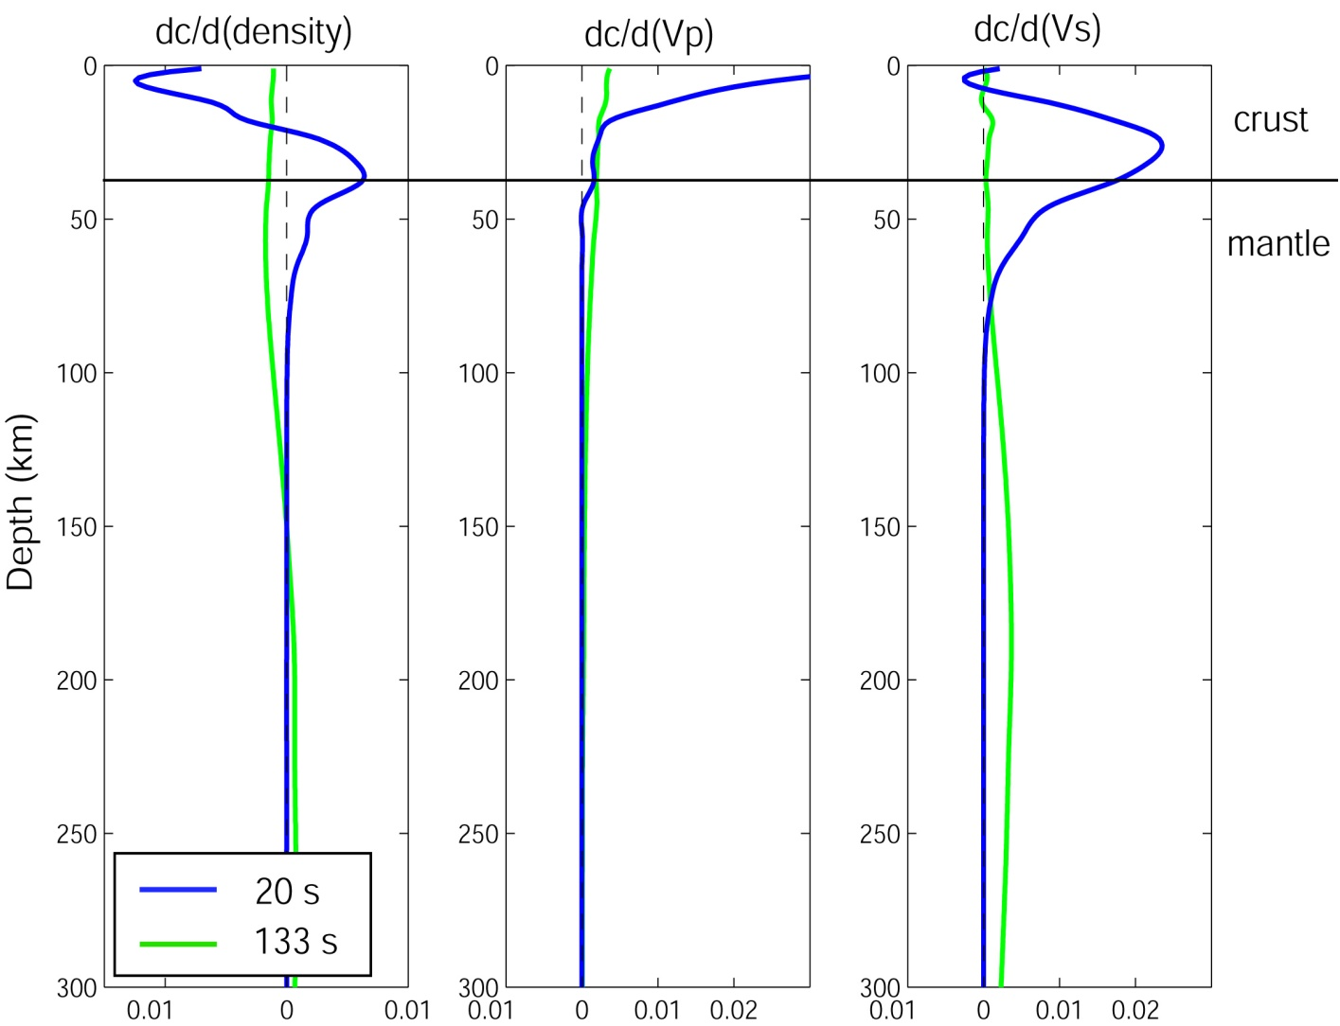
• Surface waves are dispersive: different wavelengths
travel at different velocities and sample different depth
ranges of Earth structure!

Slide 4
Types of Surface Waves:
Rayleigh waves
Lamb waves
Love waves
Stoneley waves
Basically, a surface wave describes any wave that
can only propagate along a free surface (i.e.,
when one of the media has zero shear strength).

Slide 5
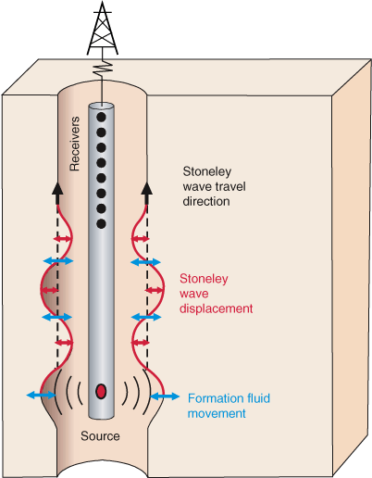
Stoneley (“tube”) waves: Occur under certain conditions
along elastic-fluid or elastic-elastic interfaces. These are a
source of noise in borehole active source seismology
(e.g. wireline logging, or vertical seismic profiling (VSP).
However, they are also
an important source of
signal in borehole
active source
seismology!
TAMU

Slide 6
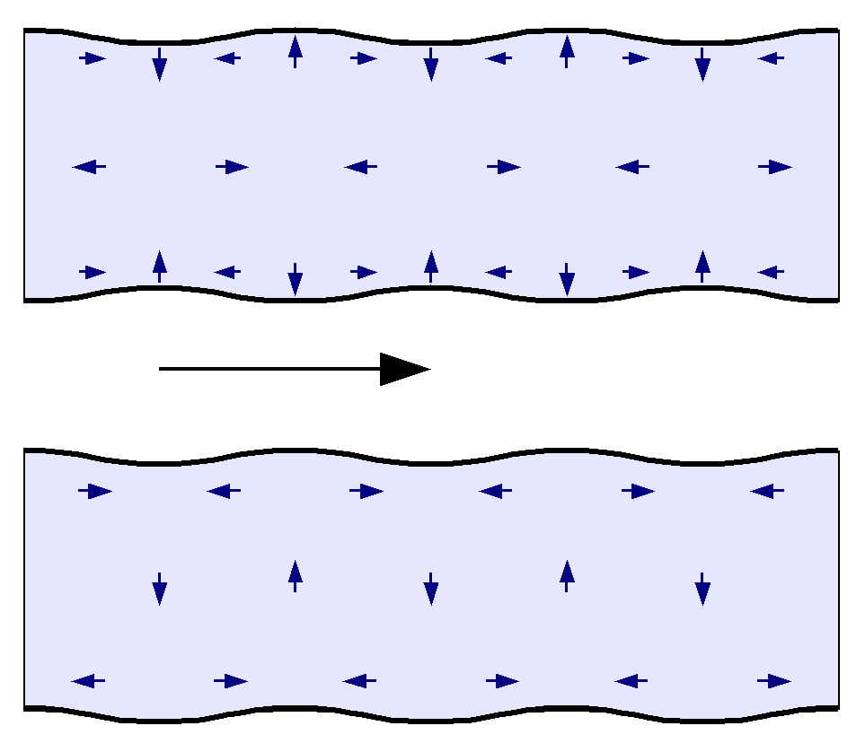
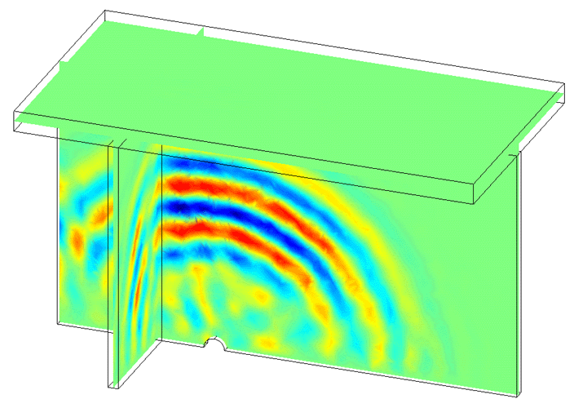
Lamb waves are waves within a plate-like object having
two free-surfaces, and are analogous to Rayleigh waves
in the Earth… Useful e.g. for engineering-related defect
detection.
Here, image of a defect
behaving like a source
disturbance.
Wikicommons
David Greve, Carnegie Mellon

Slide 7
Love waves are composed of SH motion only. These do
not propagate in a uniform flat medium, but do occur in
a curved Earth, or a layered medium.

Slide 8
Rayleigh waves are an interference pattern composed of
P-SV motions. These require shear- and normal-stress
σ_{ij} = 0 at an interface (so could occur e.g. along a fracture
as well as at the Earth’s surface).

